Slide 1
The Grand Finale: Choosing an Investment Philosophy
It ain’t over till its over…

Slide 2
A Self Assessment
To chose an investment philosophy, you first need to understand your own personal characteristics and financial characteristics, as well as as your beliefs about how markets work (or fail).
An investment philosophy that does not match your needs or your views about markets will ultimately fail.

Slide 3
Personal Characteristics
Patience: Some investment strategies require a great deal of patience, a virtue that many of us lack. If impatient by nature, you should consider adopting an investment philosophy that provides payoffs in the short term.
Risk Aversion: If you are risk averse, adopting a strategy that entails a great deal of risk – trading on earnings announcements, for instance – will not be a strategy that works for you in the long term.
Individual or Group Thinker: Some investment strategies require you to go along with the crowd and some against it. Which one will be better suited for you may well depend upon whether you are more comfortable going along with the conventional wisdom or whether you are a loner.
Time you are willing to spend on investing: Some investment strategies are much more time and resource intensive than others.
Age: As you age, you may find that your willingness to take risk, especially with your retirement savings, decreases.. It is true, though, that even as a successful investor, you will have learnt lessons from prior investment experiences that will both constrain and guide your choice of philosophy.

Slide 4
Signs of a misfit…
The sleep test: You lie awake at night thinking about your portfolio. Investors who choose investment strategies that expose them to more risk than they are comfortable taking will find themselves facing this plight. It is true that your expected returns will be lower with low-risk strategies, but the cost of taking on too much risk is even greater.
The life-change test: Day to day movements in your portfolio lead to reassessments of your future: While long term movements of your portfolio should affect your plans on when you will retire and what you will do with your future, day-to-day movements should not. It is common in every market downturn to read about older investors, on the verge or retirement, having to put off retiring because of the damage created to their portfolios.
The second-guessing test: If you find yourself second guessing your investment choices every time you read a contrary opinion, you should reconsider your strategy.

Slide 5
Financial Characteristics
Your choice of investment philosophy will also be affected by your financial characteristics – your job security, the funds you have to invest, your cash needs and your tax status.
Since these characteristics change over time, you may have to modify your investment choices to reflect these changes.
While many wealth managers tie this mix entirely to age, it is more complex and should incorporate other aspects of your financial standing including income, expenses and commitments.

Slide 6
1. Job Security
In the midst of a recession, even those with jobs worry more about their investments and demand larger risk premiums for investing in assets. The flight to quality and, at the limit, to riskless investments is exacerbated by natural and financial crises.
Your investment philosophy will also be heavily influenced by what you perceive your earning capacity to be. If you expect to earn a high income that more than covers your expenses, you have far more degrees of freedom when it comes to picking an investment philosophy. If, on the other hand, your income barely covers your expenses or worse still, falls short, your investment portfolio will have to be tailored to meet your cash needs.

Slide 7
2. Investment Funds
Your choices in terms of investment philosophy expand as the funds at your disposal increase.
When considering the investment funds at your disposal, you should look at not only your savings but also money that you have accumulated in pension funds, IRAs and insurance savings accounts.
While you are sometimes restricted in your investment choices on some of these funds, you have more choice now than you used to and odds are that your choices will continue to increase over time.

Slide 8
3. Cash Needs
One of the perils we face both as individual investors and portfolio managers is unpredictable demands for cash withdrawals. For individual investors, this may occur as the result of a personal crisis – a sickness that is not covered by health insurance or the unanticipated loss of income. For professional money managers, it arises because clients can change their minds and demand their money back.
While you may not be able to forecast when cash withdrawals may need to occur, you can still consider the probabilities when you choose your investment philosophy. The expected need for cash shortens your time horizon and may ultimately require you to adopt an investment philosophy with a shorter payoff period.

Slide 9
4. Tax Status
Investors who face high taxes on income should choose investment strategies that reduce their tax liabilities or at least defers taxes into the future.
What makes the interplay between investment philosophy and taxes complicated is the fact that different portions of the same individual’s income can be subject to different tax treatment.
  Thus, an investor, when deciding what to buy with her pension fund, where income is tax exempt, may adopt a strategy that generates large amounts of current income, but when investing her personal savings, has to be more careful about tax liabilities.

Slide 10
Market Beliefs
So much of what we believe about markets comes from anecdotal evidence – from friends, relatives and experts in the field. We also have looked at the prevailing empirical evidence and disagreements among researchers on what works and does not in financial markets.
Your views about market behavior and the performance of investment strategies will undoubtedly change over time, but all you can do is make your choices based upon what you know today.
While staying consistent to an investment philosophy and core market beliefs may be central to success in investing, it would be foolhardy to stay consistent as the evidence accumulates against the philosophy.

Slide 11
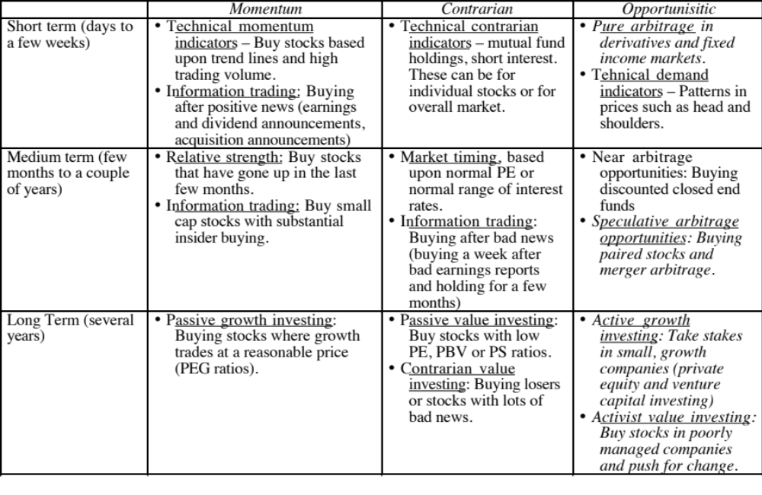
Finding an Investment Philosophy

Slide 12
The Right Investment Philosophy
One Best philosophy: You can choose the one strategy that best suits you. Thus, if you are a long-term investor who believes that markets overreact, you may adopt a passive value investing philosophy.
Combination of philosophies: You can adopt a combination of philosophies to maximize your returns. In creating this combined strategy, you should keep in mind the following caveats:
  You should not mix strategies that make contradictory assumptions about market behavior over the same periods. Thus, a strategy of buying on relative strength would not be compatible with a strategy of buying stocks after very negative earnings announcements. The first strategy is based upon the assumption that markets learn slowly whereas the latter is conditioned on market overreaction.
  When you mix strategies, you should separate the dominant strategy from the secondary strategies. Thus, if you have to make choices in terms of investments, you know which strategy will dominate.

Slide 13
In closing…
Choosing an investment philosophy is at the heart of successful investing. To make the choice, though, you need to look within before you look outside. The best strategy for you is one that matches both your personality and your needs.
Your choice of philosophy will also be affected by what you believe about markets and investors and how they work (or do not). Since your beliefs are likely to be affected by your experiences, they will evolve over time, and your investment strategies have to follow suit.

