Slide 1
VALUE AND PRICING: BASICS
Cash flows, Growth and Risk!
Notes:
It always helps to lay a philosophical foundation for what is to come. This presentation, which is usually my first session, attempts to do this. I use it not only as an opportunity to provide an overview of valuation approaches but also to link each to specific views about how markets work and what inefficiencies have to come into play for each approach to yield excess returns.

Slide 2
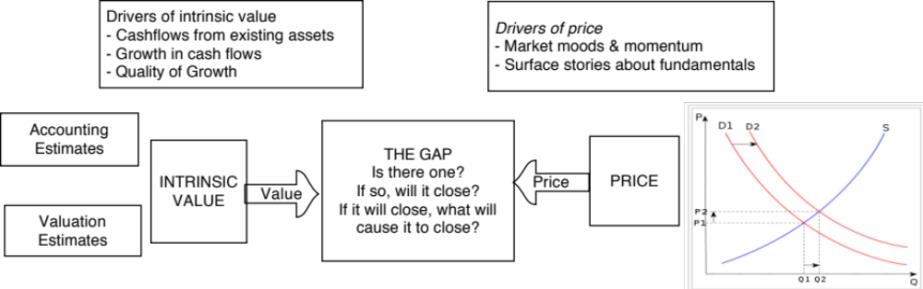
Price versus Value: The Set up

Slide 3
The essence of intrinsic value
In intrinsic valuation, you value an asset based upon its fundamentals (or intrinsic characteristics).
For cash flow generating assets, the intrinsic value will be a function of the magnitude of the expected cash flows on the asset over its lifetime and the uncertainty about receiving those cash flows.
Discounted cash flow valuation is a tool for estimating intrinsic value, where the expected value of an asset is written as the present value of the expected cash flows on the asset, with either the cash flows or the discount rate adjusted to reflect the risk.
Notes:
In the eyes of many, discounted cash flow valuation and intrinsic valuation are equivalent but that is not the case. Not all intrinsic valuations are discounted cash flow valuations. There are ways of valuing an asset based on its cash flows, risk and growth without ever using (or even knowing about present value)…. After all, DCF as a technique has been around for less than a century and people have been valuing assets and businesses for much longer. By the same token, there are DCF models that are not intrinsic valuations because much of the value is not a function of an asset’s characteristics (but of others perceptions of the asset’s value).

Slide 4

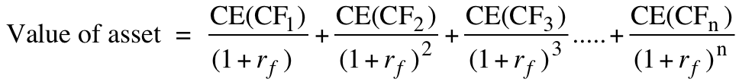
The two faces of discounted cash flow valuation
The value of a risky asset can be estimated by discounting the expected cash flows on the asset over its life at a risk-adjusted discount rate:
  where the asset has an n-year life, E(CFt) is the expected cash flow in period t and r is a discount rate that reflects the risk of the cash flows.
Alternatively, we can replace the expected cash flows with the guaranteed cash flows we would have accepted as an alternative (certainty equivalents) and discount these at the riskfree rate:
  where CE(CFt) is the certainty equivalent of E(CFt) and rf is the riskfree rate.
Notes:
Both approaches have the same objective and done right should yield the same value.
Both require the same information.
Note that taking an expected value across all scenarios is still just an expected value. To convert that into a certainty equivalent, you have to be willing to specify what you would accept as a guaranteed cash flow instead of your risky expected cash flow.
The certainty equivalent provides an answer to a puzzle posed by Buffettologists. Warren Buffett has often claimed that he does not adjust his discount rate for risk and that he uses the riskless rate.. This has led some to argue that since Buffett ignores risk in his discount rate assessment, we should all do the same. That is absurd. Buffett has also argued (implicitly most times and explicitly some times) that he considers only those cash flows that he feels secure about (cash flows from established and long term assets), which is an intuitive way of thinking about certainty equivalent cash flows.
In practice, analysts often intentionally or unintentionally use mixed approaches, adjusting both the cash flows and the discount rate for risk. In the process, they end up miscounting or double counting risk.

Slide 5

DCF Choices: Equity Valuation versus Firm Valuation
Firm Valuation: Value the entire business
Equity valuation: Value just the equity claim in the business
Notes:
A business and the equity in the business can be very different numbers…
A firm like GE in 2005 had a value of $ 500 billion for its business but its equity is worth only $ 300 billion - the difference is due to the substantial debt that GE has used to fund its expansion.
You can have valuable businesses, where the equity is worth nothing because the firm has borrowed too much….

Slide 6
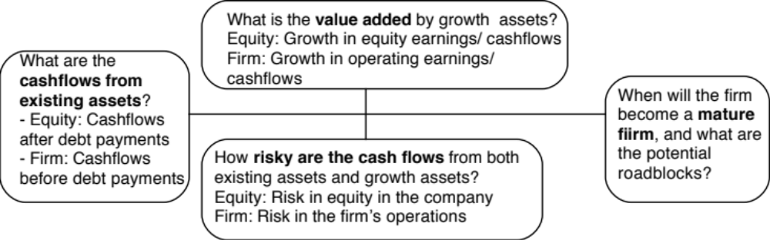
The determinants of value
Notes:
The four pillars of value:
Cashflows
Potential for high growth
Length of the high growth period (before the firm starts growing at the same rate as the economy)
Discount rate
Note the variations and the need for consistency:
With equity -> Cashflows to equity - > Growth rate in net income -> Discount at the cost of equity
With firm -> Cashflows to firm - > Growth rate in operating income -> Discount at the cost of capital

Slide 7

DCF as a tool for intrinsic valuation
Notes:
Cash is king. A firm with negative cash flows today can be a very valuable firm but only if there is reason to believe that cash flows in the future will be large enough to compensate for the negative cash flows today. The riskier a firm and the longer you have to wait for the cash flows, the greater the cashflows eventually have to be….

Slide 8
1. Cash Flows
To get to cash flow | Here is why
Operating Earnings | This is the earnings before interest & taxes you generate from your existing assets. Operating Earnings = Revenues * Operating Margin Measures the operating efficiency of your assets & can be grown either by growing revenues and/or improving margins.
(minus) Taxes | These are the taxes you would pay on your operating income and are a function of the tax code under which you operate & your fidelity to that code.
(minus) Reinvestment | Reinvestment is designed to generate future growth and can be in long term and short term assets. Higher growth usually requires more reinvestment, and the efficiency of growth is a function of how much growth you can get for your reinvestment.
Free Cash Flow to the Firm | This is a pre-debt cash flow that will be shared by lenders (as interest & principal payments) and by equity investors (as dividends & buybacks).

Slide 9
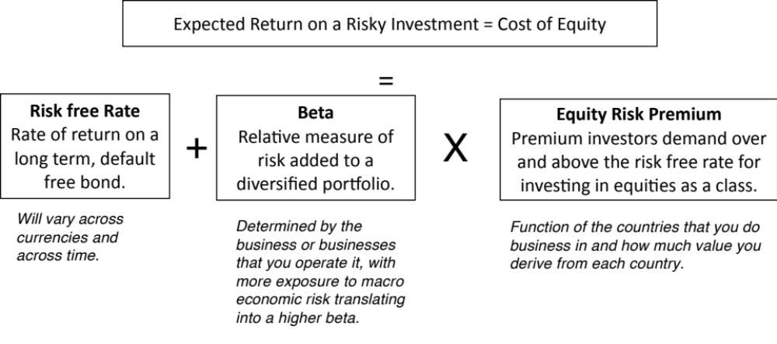
2. Discount Rates
The cost of capital is a weighted average of the cost of equity and the after-tax cost of borrowing.

Slide 10

3. Growth
Quality growth is rare requires that a firm be able to reinvest a lot and reinvest well (earnings more than your cost of capital) at the same time.
The larger you get, the more difficult it becomes to maintain quality growth.
You can grow while destroying value at the same time.

Slide 11
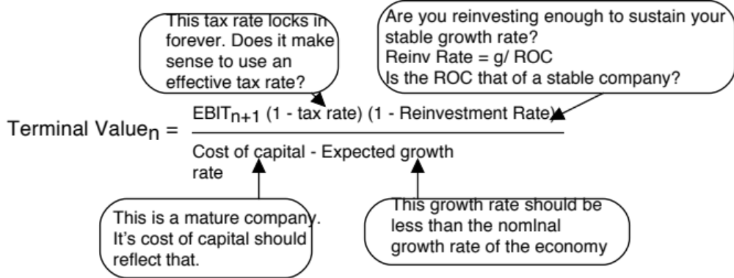
4. The Terminal Value

Slide 12
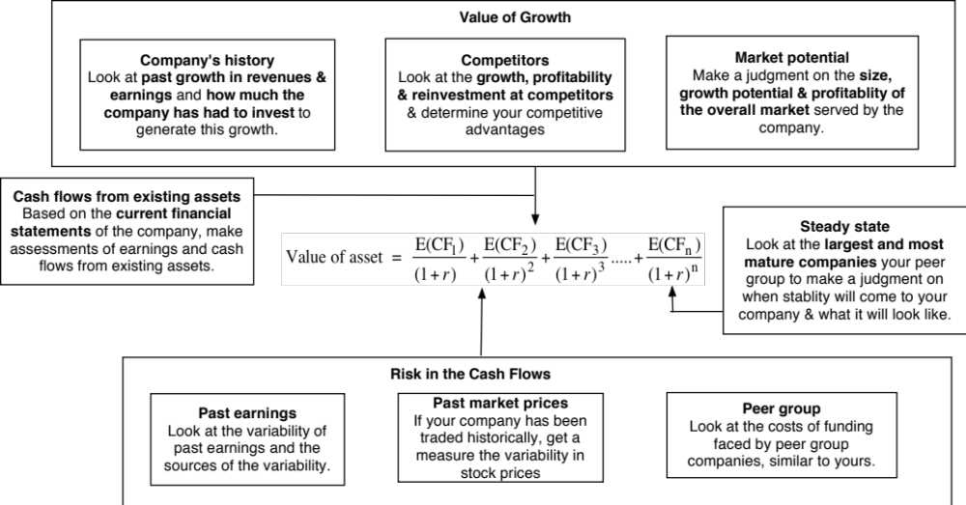
If your job is assessing value, here are youR challenges…

Slide 13
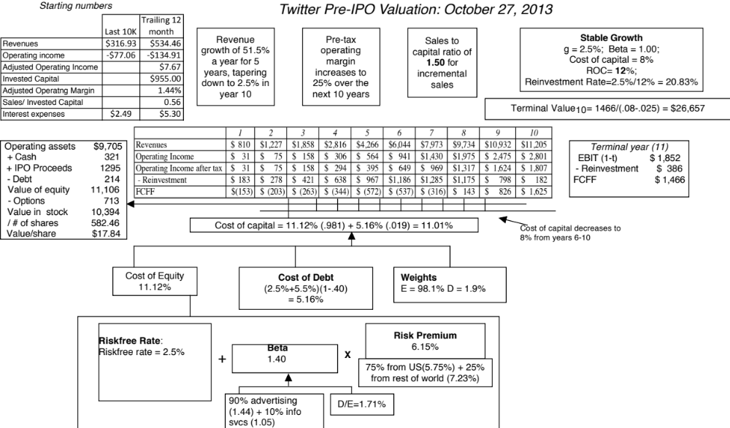

Slide 14
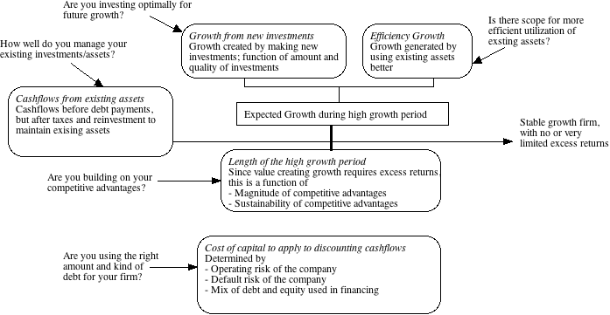
If your job is enhancing value, it has to come from changing the fundamentals

Slide 15
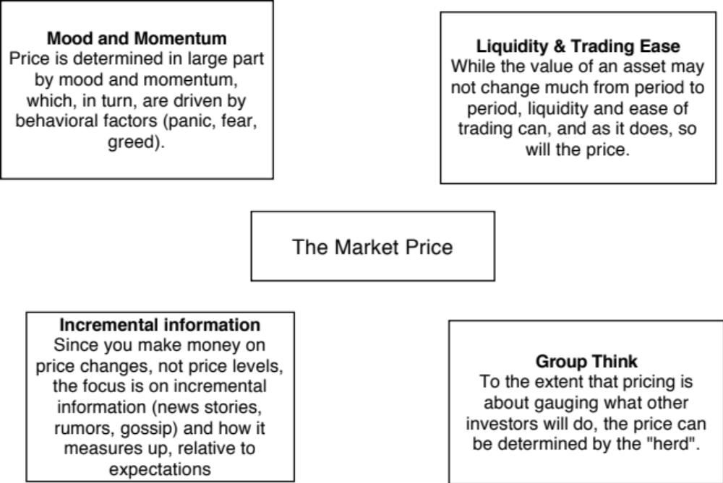
The determinants of price

Slide 16
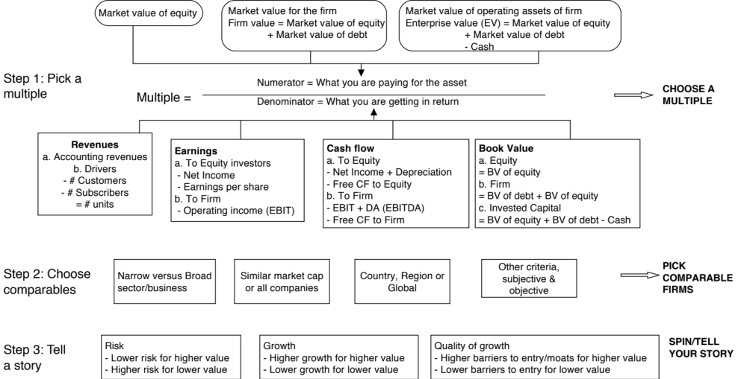
A more general tool: Multiples and Comparable Transactions

Slide 17
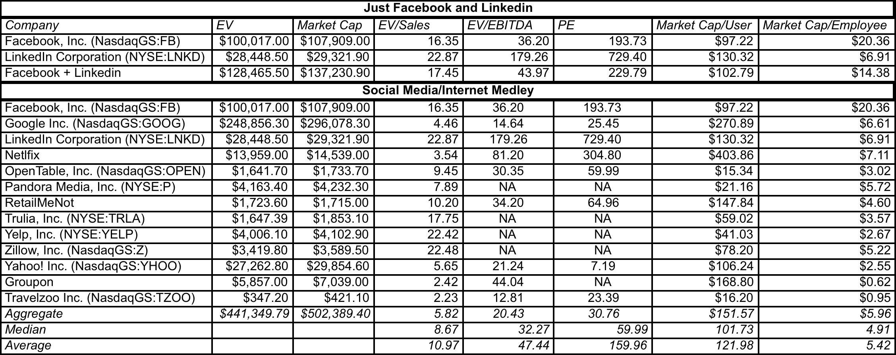
Pricing Twitter- October 2013
Twitter’s value based on revenues = $543 million * ?
Twitter’s value based on # users = 237 million * ?
Notes:
Using the multiples that other companies trade at, you can estimate a price for Twitter that the market will pay:
If you use EV/Sales, that price would be about $8.5 billion (483 *17.45).
If you use Market Cap/User, you get about $22 billion
Your job is to price Twitter, not value it. Here is my cynical assessment. To decide whether that price should be closer to $8.5 billion or $22 billion, you will call institutional investors and try to get a measure of their mood/excitement. If it looks like they think that Twitter should be priced higher, you will push your price up towards the $22 billion and market it primarily based on the number of users. You will then reverse engineer both your DCF valuation and the revenues you talk about (use forward revenues, since they will be higher) to back up your number.
Once you have priced it, you will also build in a buffer for your risk and attach a discount (15% is conventional) to that price.

Slide 18
Rules for the road: Relative valuation
  Be consistent: Both the value (the numerator) and the standardizing variable ( the denominator) should be to the same claimholders in the firm. In other words, the value of equity should be divided by equity earnings or equity book value, and firm value should be divided by firm earnings or book value.
  Play Moneyball: Look at the cross sectional distribution of a multiple and form judgments, based on the data, of what is cheap and what is expensive.
  Make your implicit assumptions explicit: Multiples are standardized values, and as a consequence are driven by exactly the same variables that determine value – cash flows, growth and risk.
  Control for differences (and go past story telling): No matter how carefully you control for differences across companies, there will still be residual differences on the fundamentals across the firms. You have to go beyond story telling and use the data to analyze how the market treats these differences.

