Slide 1
Price patterns, charts and technical analysis: The momentum studies
The Pricing Game!

Slide 2
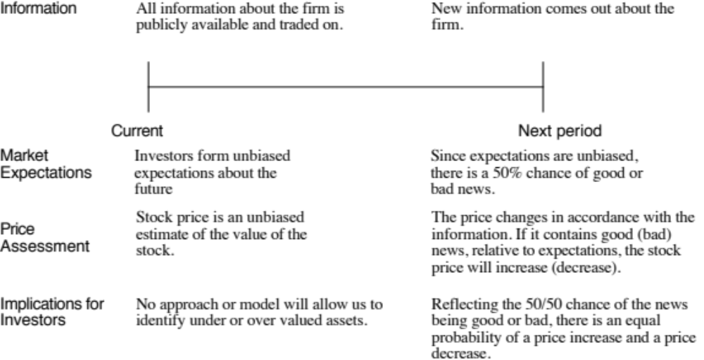
The Random Walk Hypothesis

Slide 3
The Basis for Price Patterns
Investors are not always rational in the way they set expectations.
  These irrationalities may lead to expectations being set too low for some assets at some times and too high for other assets at other times.
  Thus, the next piece of information is more likely to contain good news for the first asset and bad news for the second.
Price changes themselves may provide information to markets. Thus, the fact that a stock has gone up strongly the last four days may be viewed as good news by investors, making it more likely that the price will go up today then down.

Slide 4
The Empirical Evidence on Price Patterns
Investors have used price charts and price patterns as tools for predicting future price movements for as long as there have been financial markets.
The first studies of market efficiency focused on computing the correlation in price changes over time, to see if in fact such predictions were feasible.
  Positive correlation: Price momentum
  Negative correlation: Price reversal
Evidence on price behavior can be classified into four classes
  Studies that looks at the really short term (minutes & Hours)
  Studies that focus on short-term (Daily & Weekly price movements)
  Studies that look at medium term (many months or yearly)
  Studies that examine the long term (five-year returns)

Slide 5
1. Serial Correlation in really short-term returns (minutes & hours)
Market microstructure effect: The general consensus of studies in really short-term returns (minutes, hours) is that there is very low serial correlation, with two structural effects:
  Market liquidity effect: If markets are not liquid, you will see positive serial correlation in index returns.
  Bid-ask spread effect: The bid-ask spread creates a bias in the opposite direction, if transactions prices are used to compute returns, since prices have a equal chance of ending up at the bid or the ask price. The bounce that this induces in prices will result in negative serial correlations in returns.
Speed and Scale: To make money of these serial correlations, you have to trade fast, at low cost and in large quantities. Increasingly, computers are beating human beings at this game (high frequency trading, for instance).
Imitated quickly: That said, even these computer-based trading strategies run out of steam quickly, since there are always more powerful computers out there.

Slide 6
2. Serial correlation in the short term (days): Daily Return Predictability from 1926-2018
If there is serial correlation in daily returns, it tends to be small and not easily exploitable by investors.
There are some recent studies that find evidence of serial correlation in returns over short time periods, but the correlation is different for high-volume and low-volume stocks.
  With high-volume stocks, stock prices are more likely to reverse themselves over short periods (i.e., have negative serial correlation).
  With low-volume stocks, stock prices are more likely to continue to move in the same direction (i.e., have positive serial correlation).
  None of these studies suggest that you can make money of these correlations.

Slide 7
3. Serial correlation in the medium term: Many months or a year
Positive correlation: When time is defined as many months or a year, rather than a single month, there seems to be a tendency towards positive serial correlation.
Momentum effect: Jegadeesh and Titman present evidence of what they call “price momentum” in stock prices over time periods of several months – stocks that have gone up in the last six months tend to continue to go up whereas stocks that have gone down in the last six months tend to continue to go down.
Evidence: Between 1945 and 2010, if you classified stocks into deciles based upon price performance over the previous year, the annual return you would have generated by buying the stocks in the the top decile and held for the next year was 16.5% higher than the return you would have earned on the stocks in the bottom decile.

Slide 8
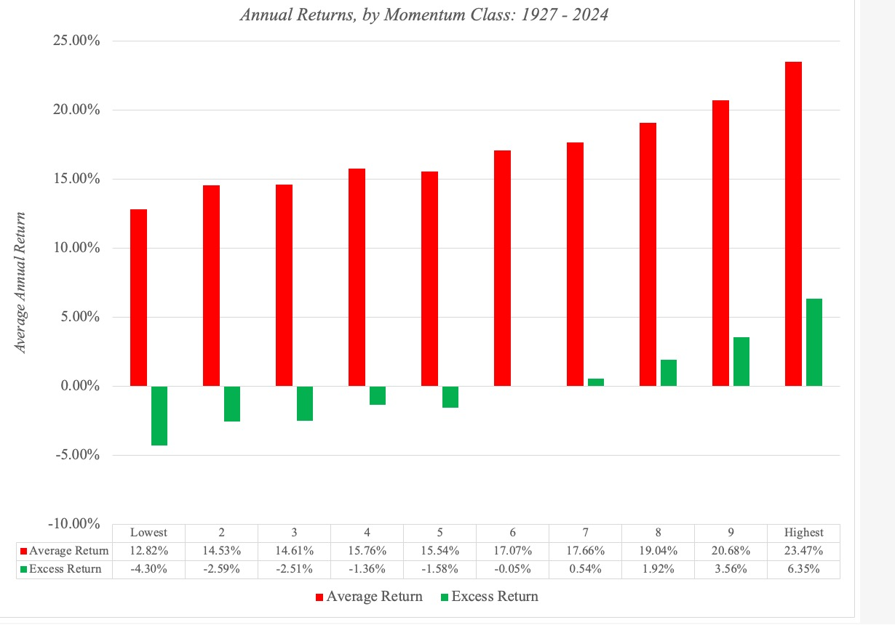
Annual returns from momentum classes

Slide 9
More “evidence” on momentum
Volume effect: Momentum accompanied by higher trading volume is stronger and more sustained than momentum with low trading volume.
Size effect: While earlier studies suggest that momentum is stronger at small market cap companies, a more recent study that looks at US stocks from 1926 to 2009 finds the relationship to be a weak one, though it does confirm that there are sub periods where momentum and firm size are correlated.
Upside vs Downside: The conclusions seem to vary, depending on the time period examined, with upside momentum dominating over very long time periods (1926-2009) and downside momentum winning out over some sub-periods (1980-1996).
Growth effect: Price momentum is more sustained and stronger for higher growth companies with higher price to book ratios than for more mature companies with lower price to book ratios.

Slide 10
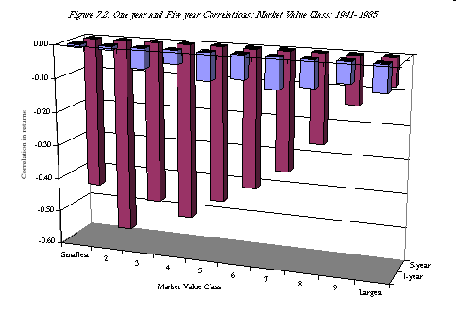
4. Long Term Serial Correlation: Over many years

Slide 11
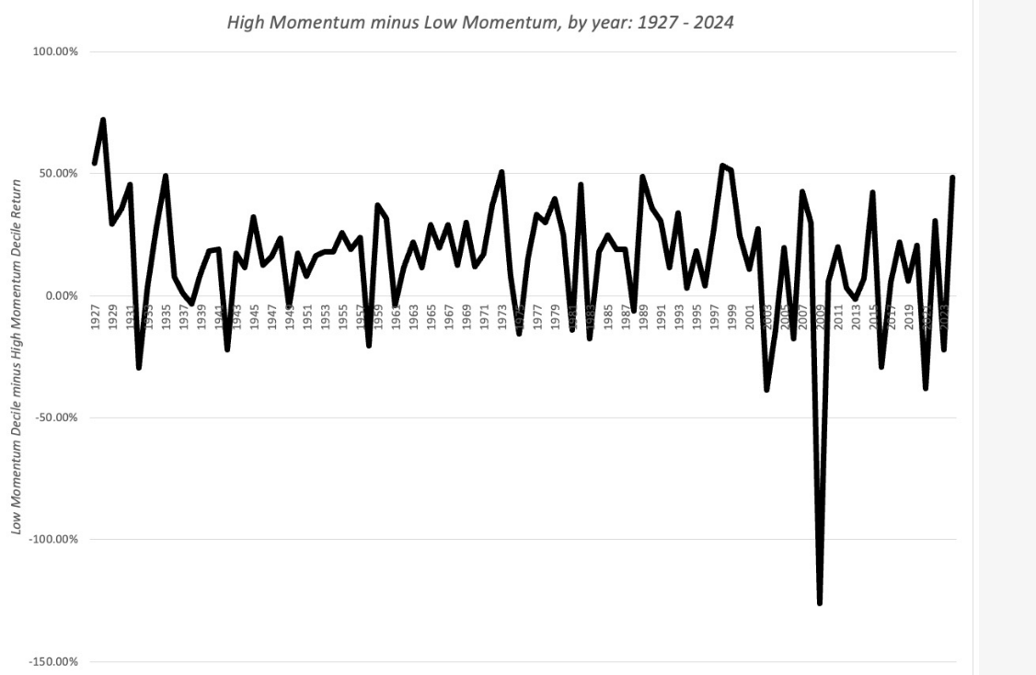
The tipping point… Momentum works, until it does not..

Slide 12
Extreme Momentum: Bubbles..
Looking at the evidence on price patterns, there is evidence of both price momentum (in the medium term) and price reversal (in the short and really long term).
Read together, you have the basis for price bubbles: the momentum creates the bubble, and the crash represents the reversal.
Through the centuries, markets have boomed and busted, and in the aftermath of every bust, irrational investors have been blamed for the crash.

Slide 13
Blooper versus Bubble
Blooper
  Rational markets can make mistakes. Assessments of value are based upon expectations, which are formed with the information that is available at the time of the assessments.You will be wrong a lot of the time and very wrong some of the time.
  It is therefore entirely possible and very likely, even in an efficient market, to see significant pricing errors.
Bubble
  A bubble is a willful error, suggestive of irrational behavior at some level.
  This irrational behavior manifests itself as an unwillingness or incapacity on the part of investors in the market to face up to reality.
Separating bloopers from bubbles is difficult. There is a tendency on the part of some to view all big price adjustments as evidence of bubbles, just as there is a tendency on the part of the others to view all big price adjustments as evidence of bloopers.

Slide 14
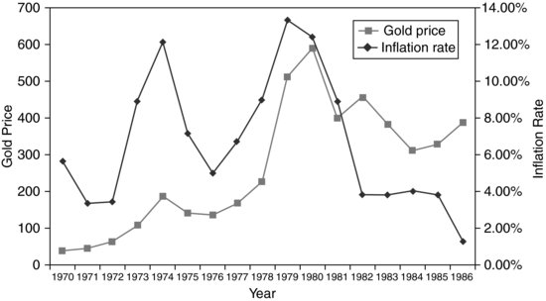
Bubble or Blooper: Gold Prices - 1970-86

Slide 15
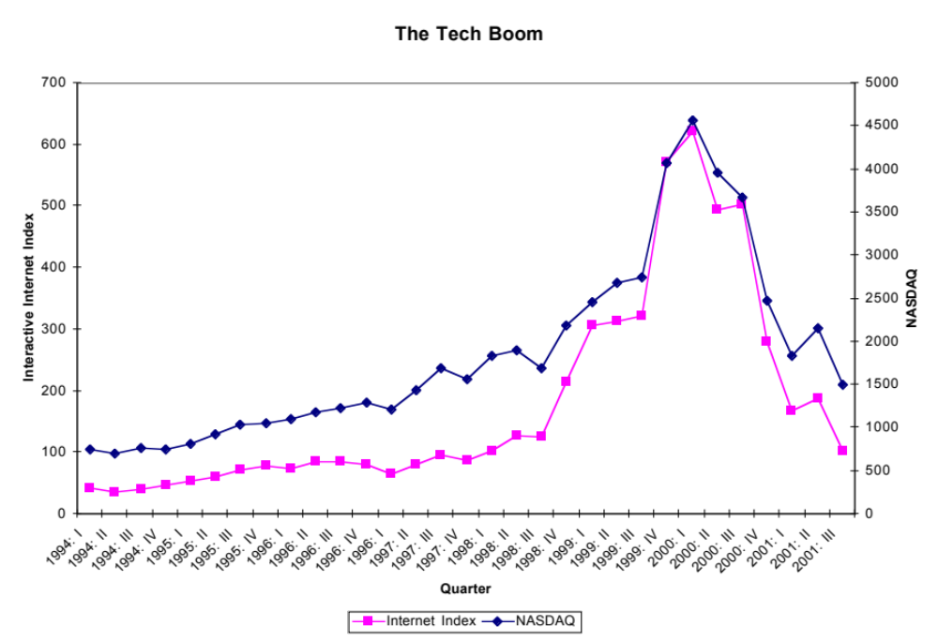
Blooper or Bubble: The NASDAQ - 1994-2001

Slide 16
Deconstructing a Bubble
There are four phases in every bubble, though the length of each phase may vary from bubble to bubble.
  The formation of the bubble
  The sustenance of the bubble
  The bursting of the bubble
  The aftermath of the bubble
That said, no two bubbles are the same, making it extraordinarily difficult to try to exploit a bubble, even if you believe there is one, for profits.

Slide 17
The Birth of a Bubble
Most bubbles have their genesis in a kernel of truth. In other words, at the heart of each bubble is a perfectly sensible story.
The bubble builds as
  Positive reinforcement is provided to irrational or ill-thought out actions on the part of some investors.
  News about the success of these investors is broadcast to the rest of the market.
  Other investors imitate the first movers and create a self-fulfilling prophecy…

Slide 18
The Sustenance of a Bubble
Institutional Parasites: Institutions, individuals and other entities make money off the bubble and develop vested interests in preserving and expanding the bubble. These include
  Investment bankers
  Brokers
  Portfolio managers
Support is provided for the bubble by academics and intellectuals(well-meaning or otherwise) who
  Proclaim that the old rules no longer apply because
  Claim new paradigms…
  Disparage those who do not buy into the bubble as being old-fashioned

Slide 19
The bursting of the bubble
All bubbles eventually burst, though there seems to be no single precipitating event that causes the reassessment. Instead, there is a confluence of factors that seem to lead to the price implosion.
  The first is that bubbles need ever more new investors (or at least new investment money) flowing in for sustenance. At some point, you run out of suckers as the investors who are the best targets for the sales pitch become fully invested.
  The second is that each new entrant into the bubble is more outrageous than the previous one.
The first hint of doubt among the true believers turns quickly to panic as reality sets in. Well-devised exit strategies break down as everyone heads for the doors at the same time. The same forces that created the bubble cause its demise, and the speed and magnitude of the crash mirror the formation of the bubble in the first place.

Slide 20
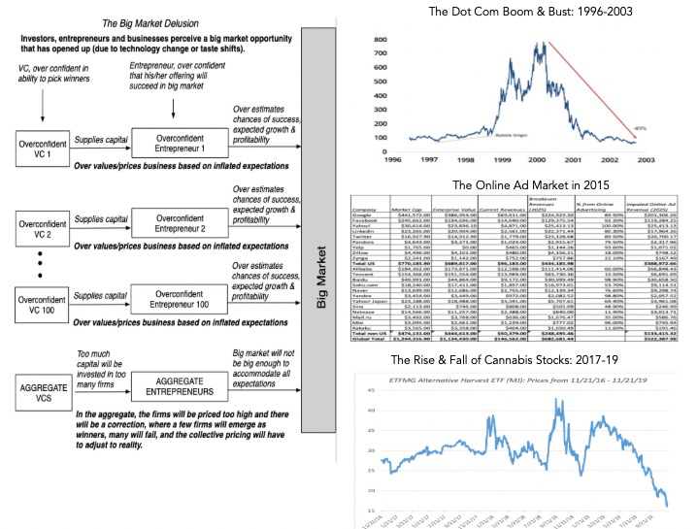
The Big Market delusion

Slide 21
The Bottom Line
Are stock prices correlated over time? Yes, but in what direction and how much depends on your time horizon and the the type of stock that you are looking at.
  With shorter time horizons (days to months), momentum strategies, where you buy past period winners and sell past period losers seems to win out.
  As the time horizon lengthens to years, reversal strategies seem to be better, where you sell past period winners and buy past losers.
  With both these strategies, the risk is that you are off on your timing.
All these strategies work better of less liquid, higher growth and smaller cap stocks than on larger cap, more liquid stocks.

