Slide 1
Value Investing: The Passive version
Aswath Damodaran

Slide 2
The Screeners
In passive value investing, you screen companies based upon either qualitative or quantitative factors to find “cheap” companies.
Qualitative screening: Investors look for “good” companies, preferably with little or no risk, and buy and hold these companies.
Quantitative screening: Tracing their lineage back to Ben Graham, the screeners try to find cheap stocks by screening stocks, using pricing multiples in conjunction with other screens

Slide 3
A. Just find good companies
There is a branch of value investing that argues that the key to success in investing is to just buy “good” companies and hold them for the long term.
There are two details on which investors even within this school disagree:
  What is a ”good” company? Some define good to mean the capacity to generate high cash flows, some in terms of stability in these cash flows and some in terms of moats (competitive advantages). Most use a combination.
  How long term is long term? The consensus seems to be that this has to be many years, not months.

Slide 4
Good and Bad Companies

Slide 5
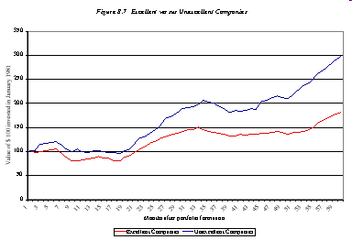
Excellent companies are not always excellent investments..
There is evidence that well managed companies do not always make great investments.
For instance, excellent companies (using the Tom Peters standard) earn poorer returns than “unexcellent companies”.

Slide 6
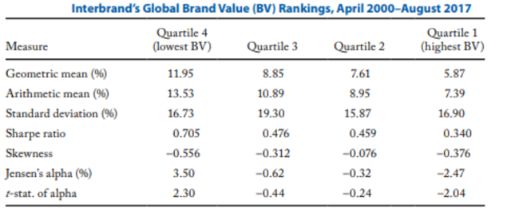
A Newer Study to back that up..

Slide 7
B. Quantitative Screens
In this approach, investors use pricing screens for cheapness to find their stocks. While there are many screens, they can be broadly classified into three groups:
  Book value screens: Buy stocks where the company trades at less than book value or at least a low multiple of the book value.
  Earnings Multiple screens: Buy assets where the asset trades at a low multiple of earnings.
  Cash Yield screens: Buy stocks with high yields. In its strictest form, the cash flow is just dividends. In more general form, it can be based upon augmented dividends (with buybacks) or even potential dividends.
In some cases, investors add other screens for fundamentals (growth, risk, cash flow) to ensure that there is no good reason for the cheapness.

Slide 8
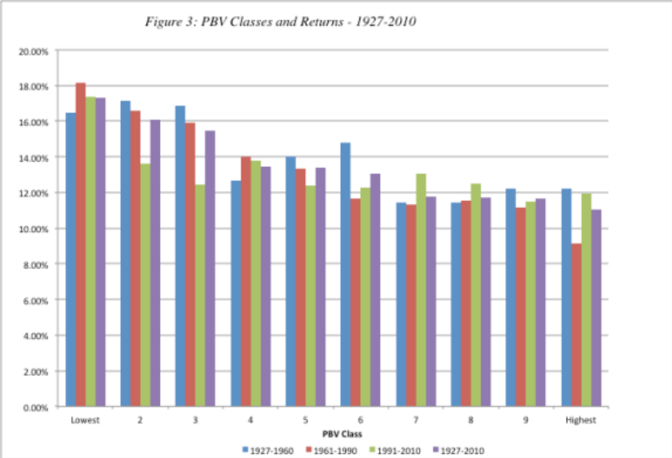
1. Price/Book Value Screens:
Low P/BV stocks are winners..

Slide 9
Patterns in time: US stocks
PBV Ratio | 1952-2018 | 1969-2018 | 1999-2018
Lowest PBV | 16.46% | 15.38% | 9.34%
2 | 16.48% | 14.91% | 10.57%
3 | 15.25% | 13.03% | 8.44%
4 | 12.52% | 11.97% | 7.36%
5 | 13.36% | 12.67% | 9.57%
6 | 12.78% | 11.81% | 9.98%
7 | 11.63% | 11.75% | 8.86%
8 | 11.85% | 12.60% | 10.46%
9 | 12.10% | 11.90% | 8.12%
Highest PBV | 11.04% | 10.43% | 7.92%
Lowest vs Highest | 5.42% | 4.96% | 1.42%

Slide 10
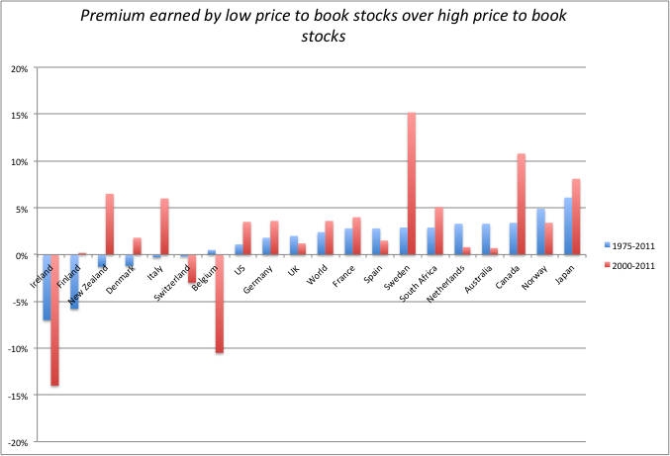
Evidence from International Markets

Slide 11
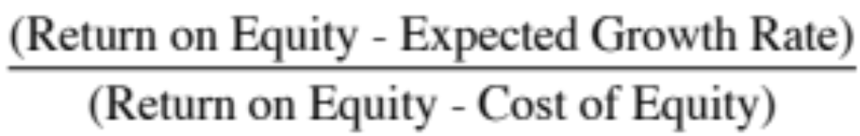
Caveat Emptor on P/BV ratios
A risk proxy: Fama and French point out that low price-book value ratios may operate as a measure of risk, since firms with prices well below book value are more likely to be in trouble and go out of business. Investors therefore have to evaluate for themselves whether the additional returns made by such firms justifies the additional risk taken on by investing in them.
Low quality returns/growth: The price to book ratio for a stable growth firm can be written as a function of its ROE, growth rate and cost of equity:
  Companies that are expected to earn low returns on equity will trade at low price to book ratios. In fact, if you expect the ROE < Cost of equity, the stock should trade at below book value of equity.

Slide 12
And a changing world has made book values less relevant
The basis for book value based investing is that book value measures capital invested in a company, albeit from an accounting standpoint.
That may be a defensible argument with manufacturing or tangible asset based companies, but it is getting increasingly difficult to sustain as the economy tilts towards service based or technology companies.
Inconsistencies in accounting can cause investments made by these companies to be either mismeasured or missed entirely, leading to book values that don’t truly measure capital invested in a business or its assets.

Slide 13
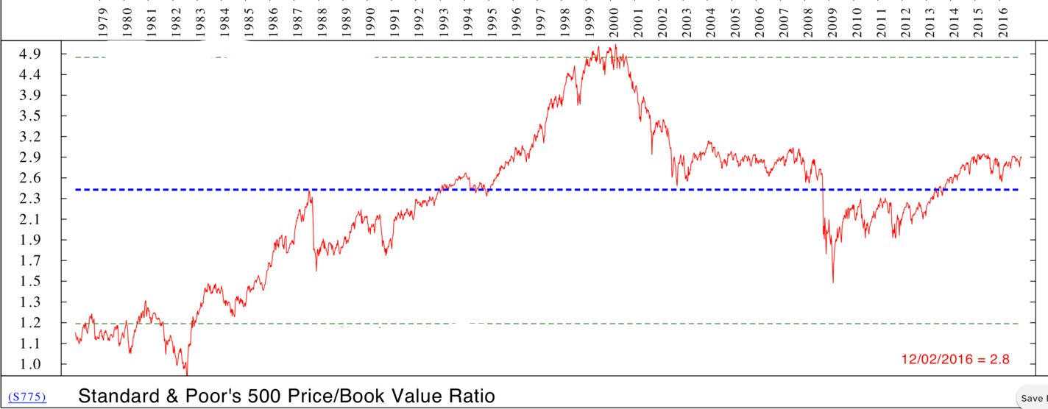
Price to Book over time: S&P 500

Slide 14
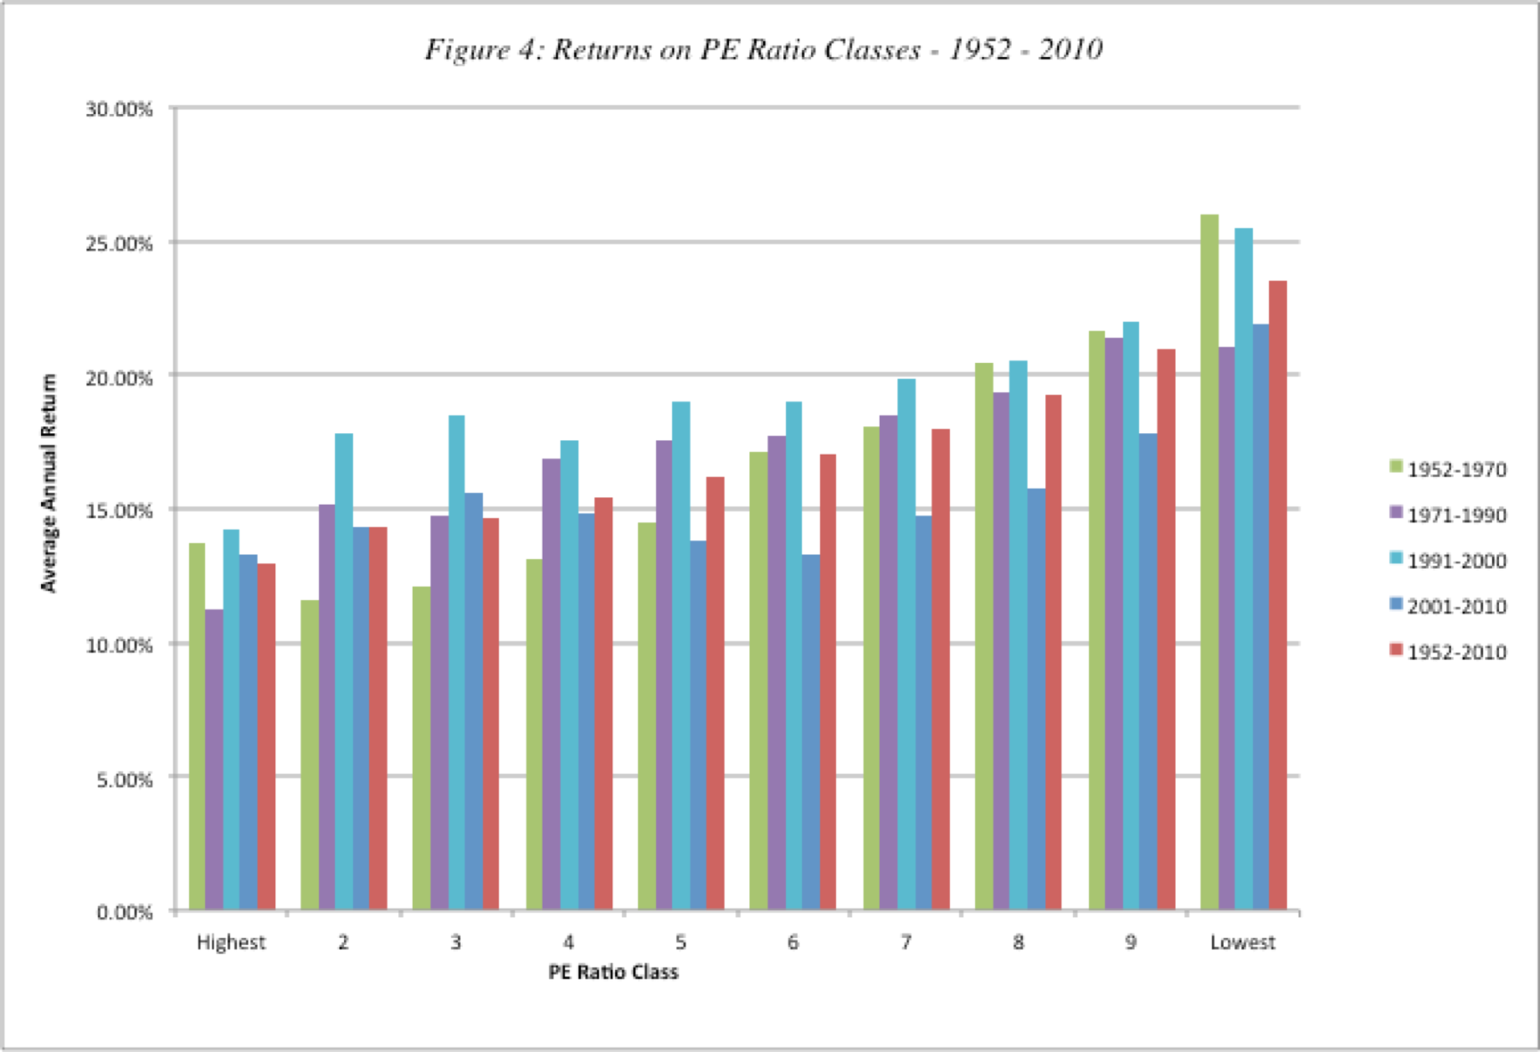
2. Price/Earnings Ratio Screens:
The Low PE story has legs…

Slide 15
But is it fading?
PE Ratio | 1952-2018 | 1969-2018 | 1999-2018
Lowest PE | 17.96% | 15.08% | 11.66%
2 | 17.21% | 14.30% | 10.91%
3 | 16.05% | 13.90% | 10.36%
4 | 14.73% | 13.85% | 8.98%
5 | 13.99% | 12.25% | 7.82%
6 | 12.27% | 11.57% | 8.34%
7 | 11.70% | 11.34% | 7.35%
8 | 12.03% | 12.04% | 9.02%
9 | 10.23% | 10.21% | 7.44%
Highest PE | 11.82% | 10.98% | 9.98%
Lowest vs Highest | 6.14% | 4.10% | 1.68%

Slide 16
What can go wrong?
Companies with high-risk earnings: The excess returns earned by low price earnings ratio stocks can be explained using a variation of the argument used for small stocks, i.e., that the risk of low PE ratios stocks is understated in the CAPM. A related explanation, especially in the aftermath of the accounting scandals of recent years, is that accounting earnings is susceptible to manipulation.
Tax Costs: A second possible explanation that can be given for this phenomenon, which is consistent with an efficient market, is that low PE ratio stocks generally have large dividend yields, which would have created a larger tax burden for investors since dividends were taxed at higher rates during much of this period.
Low Growth: A third possibility is that the price earnings ratio is low because the market expects future growth in earnings to be low or even negative. Many low PE ratio companies are in mature businesses where the potential for growth is minimal.

Slide 17
A variant on earnings multiples: EV/EBITDA
EV/EBITDA = (Market value of equity + Debt – Cash)/ EBITDA
The proponents of this multiple argue that it is better than PE, because it is less impacted by financial leverage and focused on a cash flow measure, rather than earnings.
There are two counter arguments:
  EBITDA is not a free cash flow, because you have to pay taxes and cover reinvestment needs.
  As with PE ratios, you have to be careful about checking for risk in EBITDA and low growth or low quality growth (low return on capital)

Slide 18
And a caveat about changing times..
Just as book value measurements have been skewed by the shift in economies towards service and technology companies, earnings have also been affected.
If the largest capital expenditures of companies are treated as operating expenses (as is the case with R&D at technology companies), you will understate earnings at these companies and over state PE ratios.
A pure PE approach may then find these companies to be expensive, even when they are not.

Slide 19
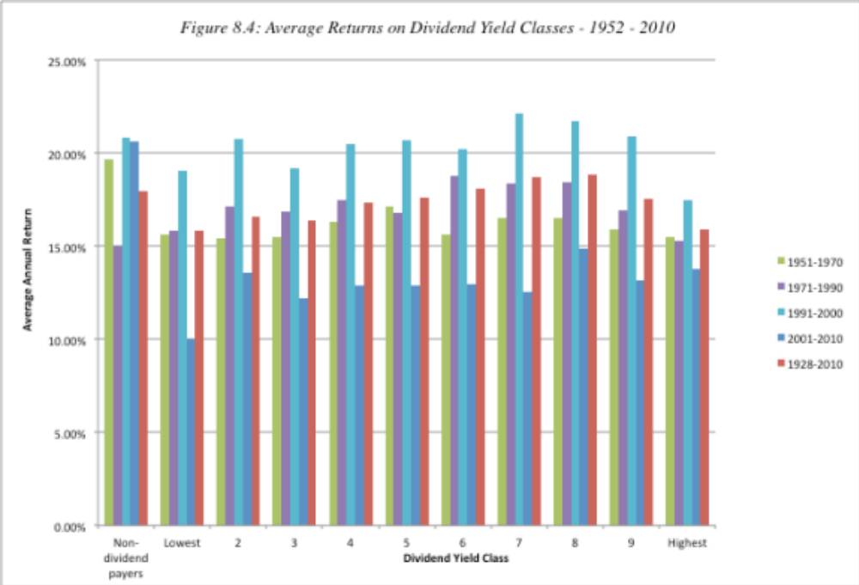
3. Dividend Yields

Slide 20
And how it has held up over time..
Dividend Yield | 1952-2018 | 1969-2018 | 1999-2018
Highest Yield | 13.09% | 12.49% | 9.64%
2 | 13.31% | 12.50% | 7.98%
3 | 13.60% | 13.32% | 8.52%
4 | 13.35% | 12.47% | 8.89%
5 | 12.33% | 12.51% | 8.97%
6 | 10.89% | 10.94% | 7.97%
7 | 12.36% | 12.10% | 9.00%
8 | 11.06% | 12.07% | 8.01%
9 | 11.55% | 10.45% | 7.12%
Lowest Yield | 10.90% | 10.50% | 4.80%
Lowest vs Highest | 2.19% | 1.99% | 4.84%

Slide 21
Dividend Screens: Specialized versions
Dogs of the Dow: In this version, investors focus on the largest dividend payers in the Dow 30, invest in that tightly concentrated group.
Dividend Aristocrats: Companies that not only pay large dividends but have a history of doing so.
In all of these models, investors are putting their faith in dividends, arguing that
  Dividends are the only tangible returns that you get from investing in stocks, since price appreciation is either just on paper or reliant on other investors paying.
  Dividends are more predictable than price appreciation, because companies are reluctant to cut them.

Slide 22
How sticky are dividends?

Slide 23
What to watch out for..
Unsustainable dividends: When you buy a stock with a high dividend yield, you are hoping that the dividends will not be cut or come under threat. While this may be a reasonable assumption across the entire market, it is also true that companies that are paying too much in dividends will be unable to sustain those dividends.
Low growth: One of the costs of returning more in dividends is that there is less to reinvest, leading to low growth.
Taxes: Investors who receive dividends have no choice on tax timing and may have to pay higher taxes on dividends.

Slide 24
And a brutal new reality… Companies are shifting away from dividends..

Slide 25
The Screener’s weakest link: Value Traps
A value trap is a company that looks cheap but rather than bounce back to what you perceive as a fair price either continues to remain cheap or becomes even cheaper.
A company becomes a value trap when forces within or without the firm cause the fundamentals to shift permanently, making assumptions that things will revert back to a norm (in terms of profits and pricing) into a pipe dream.
In a world where disruption is the norm, rather than the exception, established companies in industries that are being disrupted rapidly can look cheap, but they will become cheaper over time.

Slide 26
The Value Investors’ Protective Armour
Accounting checks: Rather than trust the current earnings, value investors often focus on three variants:
  Normalized earnings, i.e., average earnings over a period of time.
  Adjusted earnings, where investors devise their own measures of earnings that correct for what they see as shortcomings in conventional accounting earnings.
  Owner’s earnings, where depreciation, amortization and other non-cash charges are added back and capital expenditures to maintain existing assets is subtracted out.
The Moat: The “moat” is a measure of a company’s competitive advantages; the stronger and more sustainable a company’s competitive advantages, the more difficult it becomes for others to breach the moat and the safer becomes the earnings stream.
Margin of safety: The margin of safety (MOS) is the buffer that value investors build into their investment decision to protect themselves against risk. Thus, a MOS of 20% would imply that an investor would buy a stock only if its price is more than 20% below the estimated value (estimated using a multiple or a discounted cash flow model).

Slide 27
A Screening template
Screen for cheapness: You use a pricing multiple (PE, PBV, EV/EBITDA) to find cheap stocks.
Screen for low risk: You try to remove those stocks that look cheap but are risky, using your preferred proxy for risk. This proxy can be a price-based one (standard deviation, beta), an accounting measure (debt ratio) or a sector screen (no tech stocks…)
Screen for high growth: You also want to get companies that have, in not high growth, some growth in them. So, you may put in a minimum growth requirement.
Screen for high quality growth: Finally, you also want to remove companies that reinvest badly (earning low returns on investments).

Slide 28
Determinants of Success at Passive Screening
Have a long time horizon: All the studies quoted above look at returns over long time horizons. In fact, low price-book value stocks have underperformed high price-book value stocks over shorter time periods.
Choose your screens wisely: Too many screens can undercut the search for excess returns since the screens may end up eliminating just those stocks that create the positive excess returns.
Trust mean reversion: Hope that the market/companies have not changed fundamentally.
Be diversified: The excess returns from these strategies often come from a few holdings in large portfolio. Holding a small portfolio may expose you to extraordinary risk and not deliver the same excess returns.
Watch out for taxes and transactions costs: Some of the screens may end up creating a portfolio of low-priced stocks, which, in turn, create larger transactions costs.

