Slide 1
Growth Investing: Growth at a “reasonable” price
Aswath Damodaran

Slide 2
GARP Investing: The Passive Screener
In passive screening, you look for stocks that possess characteristics that you believe identify companies where growth is most likely to be under valued.
  Typical screens may include the ratio of price earnings to growth (called the PEG ratio) and earnings growth over time (called earnings momentum).
  In effect, you are looking for a mismatch, a combination of high growth potential and low pricing (multiples).
These growth screens can be adapted to enterprise value multiples, using EV multiples and operating income growth screens.

Slide 3
a. Earnings Growth Screens
Historical Growth: Strategies that focus on buying stocks with high historical earnings growth show no evidence of generating excess returns because
  Earnings growth is volatile
  There is substantial mean reversion in earnings growth rates. The growth rates of all companies tend to move towards the average.
  Revenue growth is more predictable than earnings growth.
Expected Earnings Growth: Picking stocks that have high expected growth rates in earnings does not seem to yield much in terms of high returns, because the growth often is over priced.
The simple reasons why picking stocks just based upon earnings growth in the past is unlikely to work are:
  Past growth is not a good predictor of future growth
  The pricing of the stocks already incorporates expected growth

Slide 4
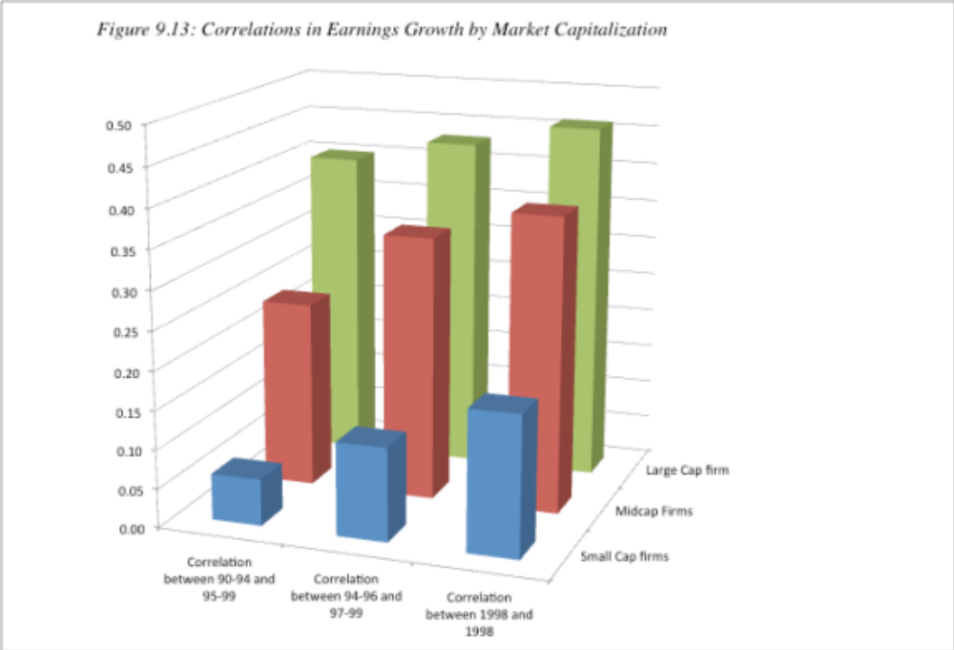
Correlation in growth…

Slide 5
b. High PE Ratio Stocks

Slide 6
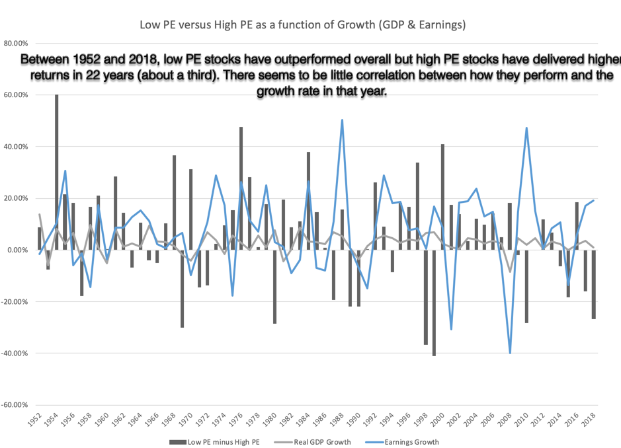
But there are periods when growth outperfoms value ..

Slide 7
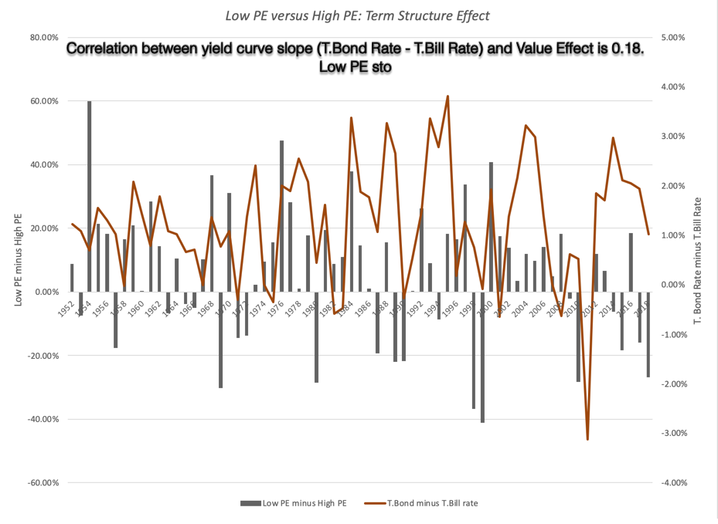
Especially when the yield curve is flat or downward sloping..

Slide 8
3. PE Ratios and Expected Growth Rates
Strategy 1: Buy stocks that trade at PE ratios that are less than their expected growth rates. While there is little evidence that buying stocks with PE ratios less than the expected growth rate earns excess returns, this strategy seems to have gained credence as a viable strategy among investors. It is intuitive and simple, but not necessarily a good strategy.
Strategy 2: Buy stocks that trade at a low ratio of PE to expected growth rate (PEG), relative to other stocks. On the PEG ratio front, the evidence is mixed. A Morgan Stanley study found that investing in stocks with low PEG ratios did earn higher returns than the S&P 500, before adjusting for risk.

Slide 9
Buy if PE < Expected Growth rate?
This strategy can be inherently dangerous. You are likely to find a lot of undervalued stocks when interest rates are high.
Even when interest rates are low, you are likely to find very risky stocks coming through this screens as undervalued.

Slide 10
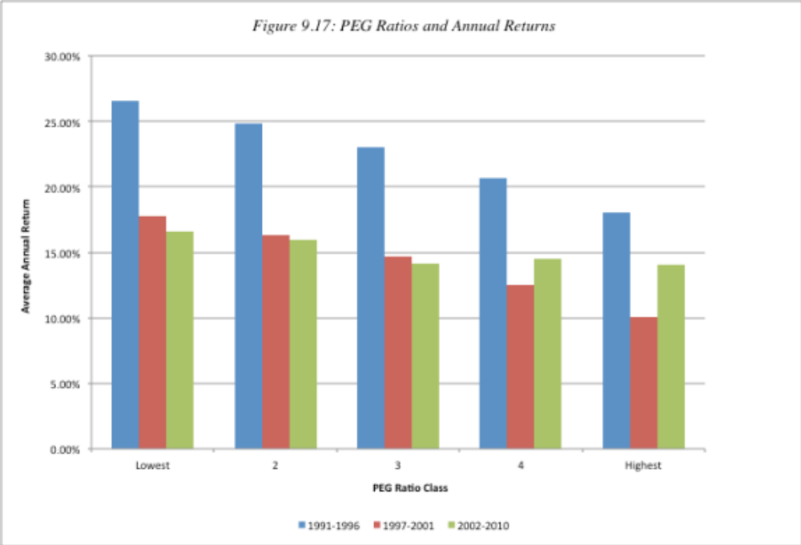
A Low PEG Ratio = undervalued?

Slide 11
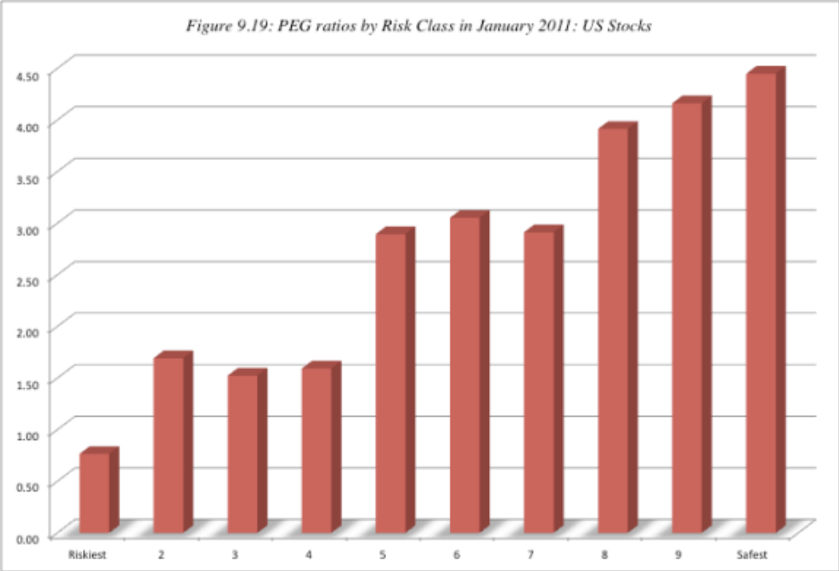
But low PEG stocks tend to be risky…

Slide 12
Determinants of Success at Passive Growth Investing
Superior judgments on growth prospects: Since growth is the key dimension of value in these companies, obtaining better estimates of expected growth and its value should improve your odds of success.
Long Time Horizon: If your underlying strategy is sound, a long time horizon increases your chances of earning excess returns.
Market Timing Skills: There are extended cycles where the growth screens work exceptionally well and other cycles where they are counter productive. If you can time these cycles, you could augment your returns substantially. Since many of these cycles are related to how the overall market is doing, this boils down to your market timing ability.

