Slide 1
Information Trading: Public Information – Earnings Reports
Aswath Damodaran

Slide 2
Trading on Public Information
There is substantial information that comes out about stocks publicly.
  Some of the information comes from the firm - earnings and dividend announcements, acquisitions and other news - and some comes from competitors.
  Prices generally react to this information.
Access to this information has widened and become more timely, removing an advantage that institutional investors and professional traders used to have, leveling the playing field.

Slide 3
Earnings Announcements
Every quarter (in the U.S) and less frequently elsewhere, firms report their earnings for the most recent period.
When firms make earnings announcements, they convey information to financial markets about their current and future prospects. The magnitude of the information, and the size of the market reaction, should depend upon how much the earnings report exceeds or falls short of investor expectations.
In an efficient market, there should be an instantaneous reaction to the earnings report, if it contains surprising information, and prices should increase following positive surprises and down following negative surprises.

Slide 4
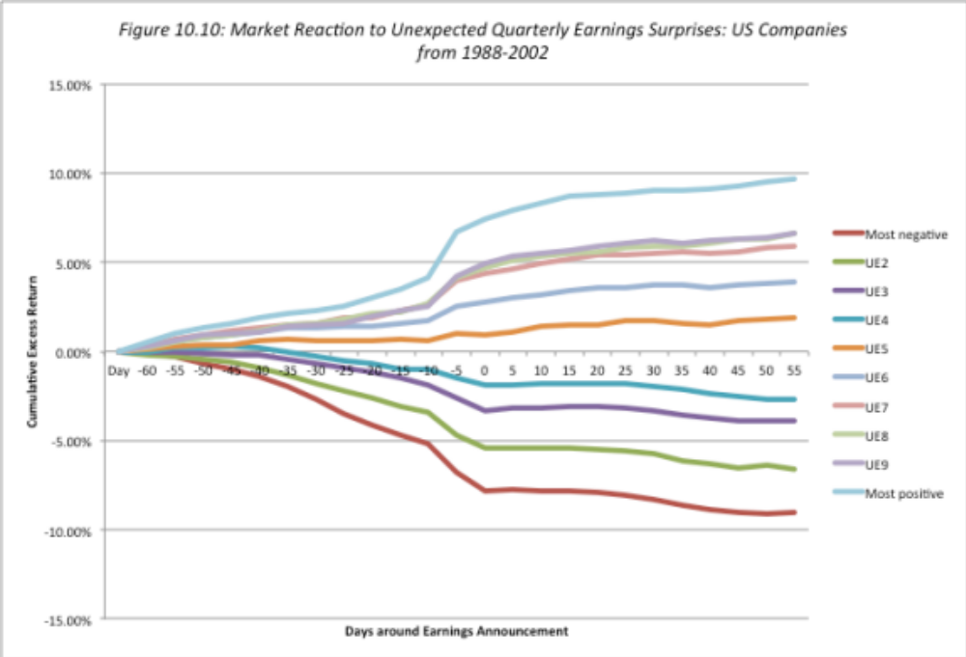
Market Reaction to Earnings Reports

Slide 5
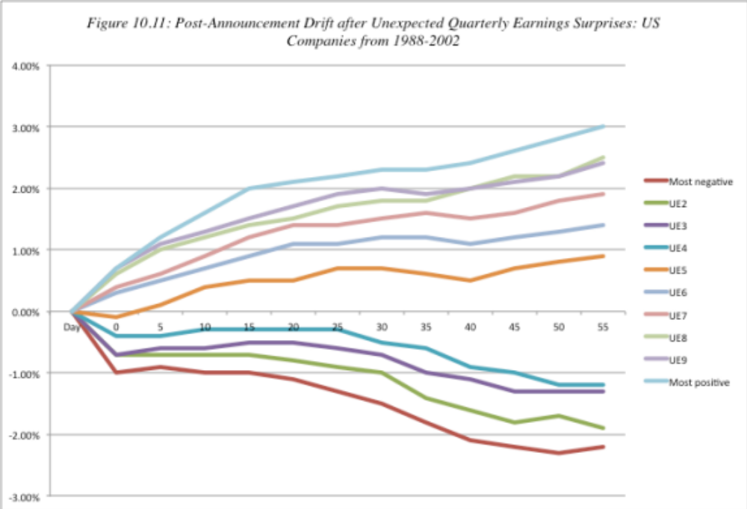
The post-announcement drift?

Slide 6
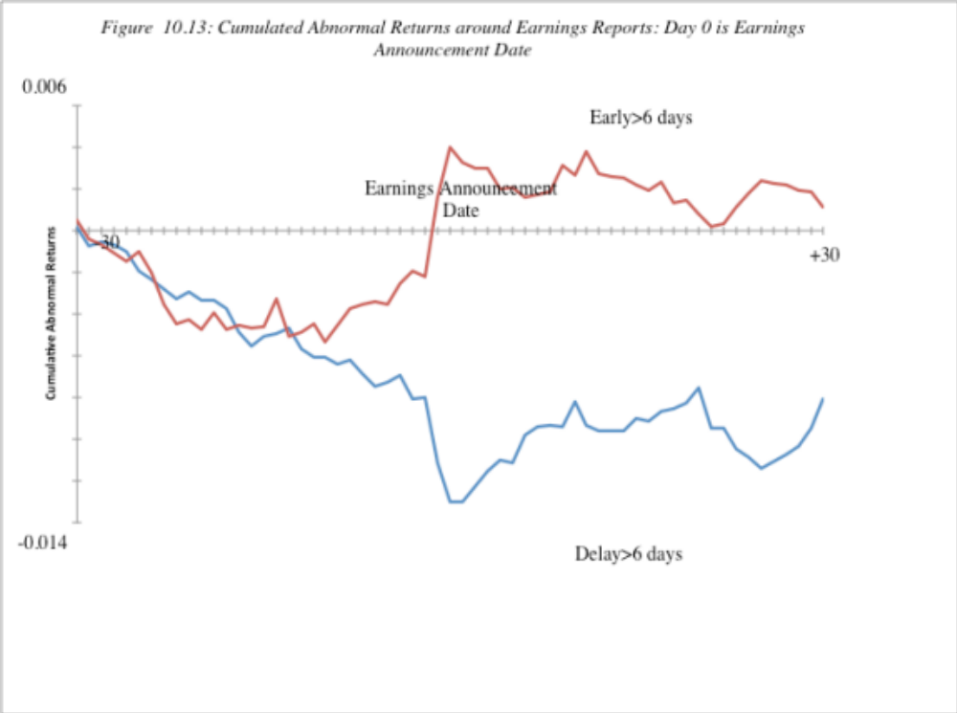
The Consequence of Delays…

Slide 7
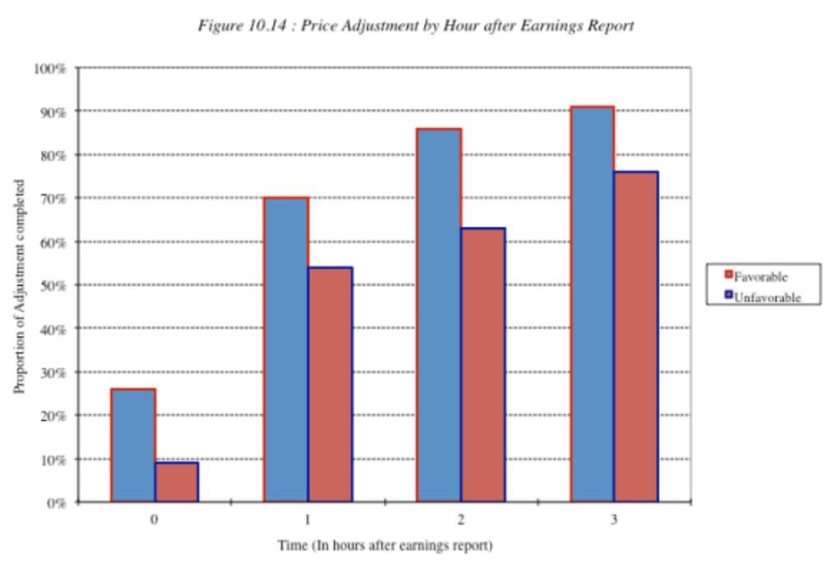
The Intraday reaction..

Slide 8
And earnings quality matters…
Quality varies across firms: As firms play the earnings game, the quality of earnings has also diverged across companies. A firm that beats earnings estimates because it has more efficient operating should be viewed more favorably than one that beats estimates because it changed the way it valued inventory.
Accrual versus cash earnings: Chan, Chan, Jegadeesh and Lakonishok examined firms that reported high accruals – i.e. the difference between accounting earnings and cash flows and argued that firms report high earnings without a matching increase in cashflow have poorer quality earnings. When they tracked a portfolio composed of these firms, they discovered that the high accrual year was usually the turning point in the fortunes of this firm, with subsequent years bring declining earnings and negative stock returns.

Slide 9
Can you make money of earnings announcements?
Play the drift: One strategy is to buy stocks that report large positive earnings surprises, hoping to benefit from the drift. The evidence indicates that across all stocks, the potential for excess returns from buying after earnings announcements is very small.
But be selective: You can concentrate only on earnings announcements made by smaller, less liquid companies where the drift is more pronounced. In addition, you can try to direct your money towards companies with higher quality earnings surprises by avoiding firms with large accruals.
And see if you can get ahead of the game: Your biggest payoff is in investing in companies before large earnings surprises. You may be able to use a combination of quantitative techniques (time series models that forecast next quarter’s earnings based upon historical earnings) and trading volume (insiders do create blips in the volume) to try to detect these firms. Even if you are right only 55% of the time, you should be able to post high excess returns.

