Slide 1
Not riskless, not even close.. Pseudo or Speculative Arbitrage
Aswath Damodaran

Slide 2
Pseudo or Speculative Arbitrage
There are a large number of strategies that are characterized as arbitrage, but actually expose investors to significant risk.
We will categorize these as pseudo or speculative arbitrage. In effect, they should not titled arbitrage in the first place, but their users continue to do so because:
  They have deluded themselves into believing that they are riskless
  They want to delude others into believing they are riskless

Slide 3
1. Paired Arbitrage
In paired arbitrage, you buy one stock (say GM) and sell another stock that you view as very similar (say Ford), and argue that you are not that exposed to risk. Clearly, this strategy is not riskless since no two equities are exactly identical, and even if they were very similar, there may be no convergence in prices.
The conventional practice among those who have used this strategy on Wall Street has been to look for two stocks whose prices have historically moved together – i.e., have high correlation over time.

Slide 4
Evidence on Paired Trading
It has worked: Screening first for only stocks that traded every day, the authors found a matching partner for each stock by looking for the stock with the minimum squared deviation in normalized price series. Once they had paired all the stocks, they studied the pairs with the smallest squared deviation separating them.
  If you use absolute prices, a stock with a higher price will always look more volatile. You can normalize the prices around 1 and use these series.
  With each pair, they tracked the normalized prices of each stock and took a position on the pair, if the difference exceeded the historical range by two standard deviations, buying the cheaper stock and selling the more expensive one.
And delivered returns: Over the 15 year period, the pairs trading strategy did significantly better than a buy-and-hold strategy. Strategies of investing in the top 20 pairs earned an excess return of about 6% over a 6-month period, and while the returns drop off for the pairs below the top 20, you continue to earn excess returns. When the pairs are constructed by industry group (rather than just based upon historical prices), the excess returns persist but they are smaller. Controlling for the bid-ask spread in the strategy reduces the excess returns by about a fifth, but the returns are still significant.

Slide 5
Two Caveats on Paired Arbitrage
It is risky: The study quoted found that the pairs trading strategy created negative returns in about one out of every six periods, and that the difference between pairs often widened before it narrowed. In other words, it is a risky investment strategy that also requires the capacity to trade instantaneously and at low cost.
And imitation has made it less profitable: By the late 1990s, the pickings for quantitative strategies (like pairs trading) had become slim because so many investment banks were adopting the strategies. As the novelty has worn off, it seems unlikely that the pairs trading will generate the kinds of profits it generated during the 1980s.

Slide 6
2. Merger Arbitrage
The stock price of a target company jumps on the announcement of a takeover. However, it trades at a discount usually to the price offered by the acquiring company.
The difference between the post-announcement price and the offer price is called the arbitrage spread, and there are investors who try to profit off this spread in a strategy called merger or risk arbitrage. If the merger succeeds, the arbitrageur captures the arbitrage spreads, but if it fails, he or she could make a substantial loss.
In a more sophisticated variant in stock mergers (where shares of the acquiring company are exchanged for shares in the target company), the arbitrageur will sell the acquiring firm’s stock in addition to buying the target firm’s stock.

Slide 7
Evidence from merger arbitrage
You can make money, with risk: Mitchell and Pulvino (2000) use a sample of 4750 mergers and acquisitions to examine this question. They conclude that there are excess returns associated with buying target companies after acquisition announcements of about 9.25% annually, but that you lost about two thirds of these excess returns if you factor in transactions costs and the price impact that you have when you trade (especially on the less liquid companies).
And failure can be costly: The strategy earns moderate positive returns much of the time, but earns large negative returns when it fails. The strategy has payoffs that resemble those you would observe if you sell puts – when the market goes up, you keep the put premium but when it goes down, you lost much more.

Slide 8
Determinants of Success at Speculative Arbitrage
Use leverage judiciously: The use of financial leverage has to be scaled to reflect the riskiness of the strategy. With pure arbitrage, you can borrow 100% of what you need to put the strategy into play. In futures arbitrage, for instance, you borrow 100% of the spot price and borrow the commodity. Since there is no risk, the leverage does not create any damage. As you move to near and speculative arbitrage, this leverage has to be reduced. How much it has to be reduced will depend upon both the degree of risk in the strategy and the speed with which you think prices will converge. The more risky a strategy and the less certain you are about convergence, the less debt you should take on.
Minimize market impact: These strategies work best if you can operate without a market impact. As you get more funds to invest and your strategy becomes more visible to others, you run the risk of driving out the very mispricing that attracted you to the market in the first place.

Slide 9
3. Long Short Strategies: Hedge Funds
While hedge funds come in all varieties, they generally share a common characteristic. They can go both buy and sell short assets.
You can have value and growth investing hedge funds, hedge funds that specialize in market timing, hedge funds that invest on information and hedge funds that do convertible arbitrage.

Slide 10
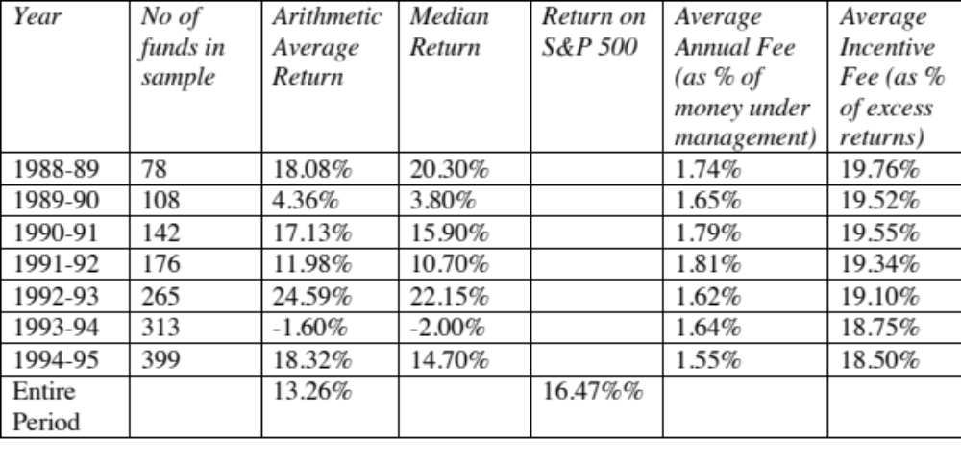
The Performance of Hedge Funds: An Early Study

Slide 11
Looking a little closer at the numbers…
The average hedge fund earned a lower return (13.26%) over the period than the S&P 500 (16.47%), but it also had a lower standard deviation in returns (9.07%) than the S & P 500 (16.32%).
  Thus, it seems to offer a better payoff to risk, if you divide the average return by the standard deviation – this is the commonly used Sharpe ratio for evaluating money managers.
These funds are much more expensive than traditional mutual funds, with much higher annual fess and annual incentive fees that take away one out of every five dollars of excess returns.

Slide 12
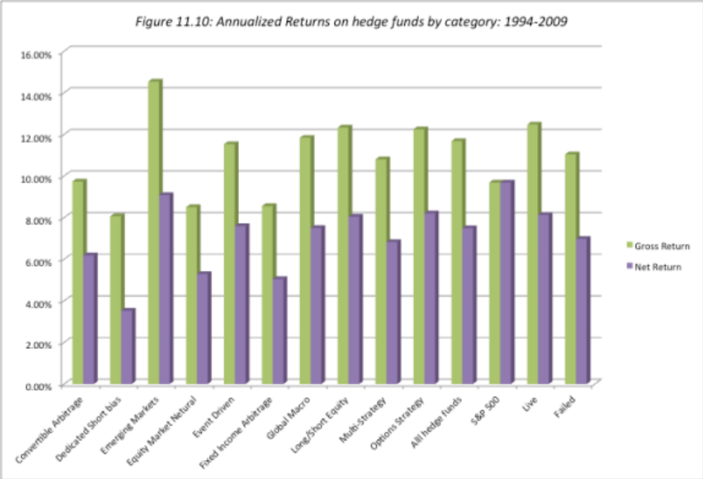
Returns vary across categories..

Slide 13
There is substantial survival risk..
Good risk/return trade off: Liang examined 2016 hedge funds from 1990 to 1999. While his overall conclusions matched those of Brown et al., i.e. that these hedge funds earned a lower return than the S&P 500 (14.2% versus 18.8%), they were less risky and had higher Sharpe ratios (0.41 for the hedge funds versus 0.27 for the S&P 500),
But many don’t make it: Liang also noted that there a large number of hedge funds die each year. Of the 2016 funds over the period for instance, only 1407 remained live at the end of the period.

Slide 14
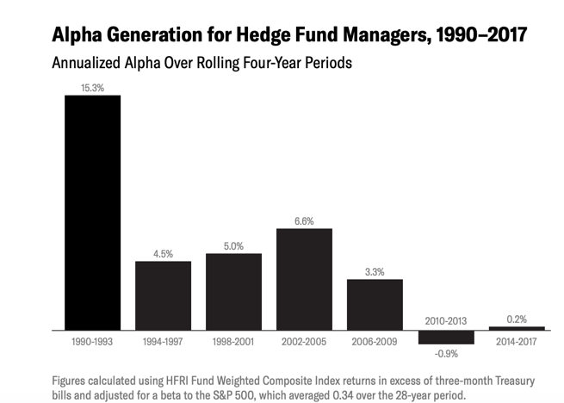
And hedge fund alphas have declined over time..

Slide 15
In closing…
In pure arbitrage, two exactly identical assets trade at different prices and price convergence is guaranteed at a point in time in the future. Pure arbitrage yields riskless profits but is difficult to find in markets and if found, difficult to sustatin.
Near arbitrage is more common but there is risk, either arising from the fact that assets are not identical or because there is no guaranteed convergence.
Pseudo arbitrage is really not arbitrage. Similar assets are mispriced, either relative to their fundamentals or relative to their historical pricing. You buy the cheaper asset and sell the more expensive one and hope to make money on convergence.

