Slide 1
Market Timing Approaches: Non-financial & Technical Indicators
Aswath Damodaran

Slide 2
I. Non-financial Indicators
Spurious indicators that may seem to be correlated with the market but have no rational basis.
Feel good indicators that measure how happy investors are feeling - presumably, happier individuals will bid up higher stock prices.
Hype indicators that measure whether there is a stock price bubble.

Slide 3
1. Spurious Indicators
There are a number of indicators that claim to predict stock market movements that have no story to tell other than the fact that they work.
There are three problems with these indicators:
  We disagree that chance cannot explain this phenomenon. When you have hundreds of potential indicators that you can use to time markets, there will be some that show an unusually high correlation purely by chance.
  A forecast of market direction (up or down) does not really qualify as market timing, since how much the market goes up clearly does make a difference.
  You should always be cautious when you can find no economic link between a market timing indicator and the market.

Slide 4
2. Feel Good Indicators
When people feel optimistic about the future, it is not just stock prices that are affected by this optimism. Often, there are social consequences as well, with styles and social mores affected by the fact that investors and consumers feel good about the economy.
It is not surprising, therefore, that people have discovered linkages between social indicators and Wall Street. You should expect to see a high correlation between demand at highly priced restaurants at New York City (or wherever young investment bankers and traders go) and the market.
The problem with feel good indicators, in general, is that they tend to be contemporaneous or lagging rather than leading indicators.

Slide 5
3. Hype Indicators
When stocks become a fad and investors are buying stocks just because of the hype, there is clearly a danger of a bubble.
Here is an example. The “cocktail party chatter” indicator tracks three measures – the time elapsed at a party before talk turns to stocks, the average age of the people discussing stocks and the fad component of the chatter. According to the indicator, the less time it takes for the talk to turn to stocks, the lower the average age of the market discussants and the greater the fad component, the more negative you should be about future stock price movements.
As investors increasingly turn to social media, researchers are probing the data that is coming from these forums to see if they can used to get a sense of market mood. A study of ten million tweets in 2008 found that a relationship between the collective mood on the tweets predicted stock price movements.
There are limitations with these indicators
  Defining what constitutes abnormal can be tricky in a world where standards and tastes are shifting.
  Even if we decide that there is an abnormally high interest in the market today and you conclude (based upon the hype indicators) that stocks are over valued, there is no guarantee that stocks will not get more overvalued before the correction occurs.

Slide 6
II. Technical Indicators
Past prices
  Price reversals or momentum
  The January Indicator
Trading Volume
Market Volatility
Other price and sentiment indicators

Slide 7
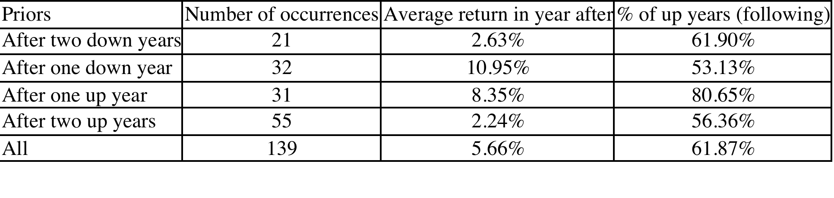
1a. Past Prices: Does the past hold signs for the future?

Slide 8
1b. The January Indicator
As January goes, so goes the year – if stocks are up, the market will be up for the year, but a bad beginning usually precedes a poor year.
According to the venerable Stock Trader’s Almanac that is compiled every year by Yale Hirsch, this indicator has worked 88% of the time.
Note, though that if you exclude January from the year’s returns and compute the returns over the remaining 11 months of the year, the signal becomes much weaker and returns are negative only 50% of the time after a bad start in January. Thus, selling your stocks after stocks have gone down in January may not protect you from poor returns.

Slide 9
2a. Trading Volume
Price increases that occur without much trading volume are viewed as less likely to carry over into the next trading period than those that are accompanied by heavy volume.
At the same time, very heavy volume can also indicate turning points in markets. For instance, a drop in the index with very heavy trading volume is called a selling climax and may be viewed as a sign that the market has hit bottom. This supposedly removes most of the bearish investors from the mix, opening the market up presumably to more optimistic investors. On the other hand, an increase in the index accompanied by heavy trading volume may be viewed as a sign that market has topped out.
Another widely used indicator looks at the trading volume on puts as a ratio of the trading volume on calls. This ratio, which is called the put-call ratio is often used as a contrarian indicator. When investors become more bearish, they buy more puts and this (as the contrarian argument goes) is a good sign for the future of the market.

Slide 10
2b. Money Flow
Money flow is the difference between uptick volume and downtick volume, as predictor of market movements. An increase in the money flow is viewed as a positive signal for future market movements whereas a decrease is viewed as a bearish signal.
Using daily money flows from July 1997 to June 1998, Bennett and Sias find that money flow is highly correlated with returns in the same period, which is not surprising. While they find no predictive ability with short period returns – five day returns are not correlated with money flow in the previous five days – they do find some predictive ability for longer periods. With 40-day returns and money flow over the prior 40 days, for instance, there is a link between high money flow and positive stock returns.
Chan, Hameed and Tong extend this analysis to global equity markets. They find that equity markets show momentum – markets that have done well in the recent past are more likely to continue doing well,, whereas markets that have done badly remain poor performers. However, they find that the momentum effect is stronger for equity markets that have high trading volume and weaker in markets with low trading volume.

Slide 11
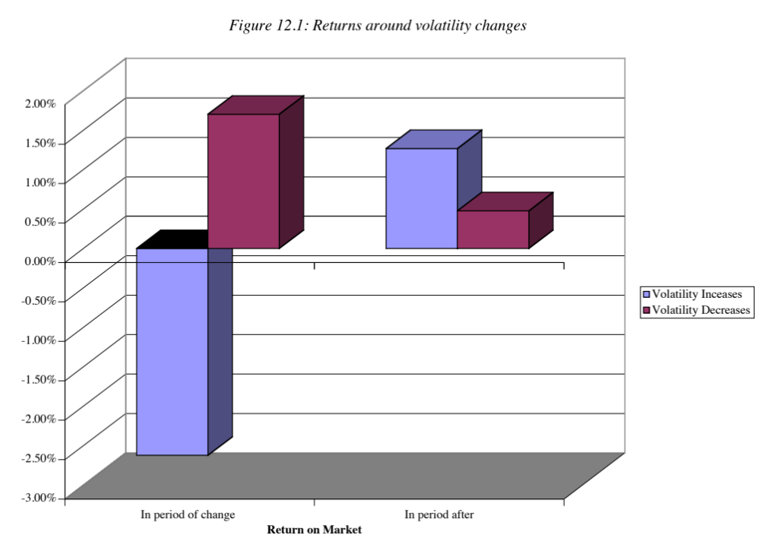
3. Volatility

Slide 12
4. Other Indicators
Chart patterns: Just as support and resistance lines and trend lines are used to determine when to move in and out of individual stocks, they are also used to decide when to move in and out of the stock market.
Sentiment indicators try to measure the mood of the market. One widely used measure is the confidence index which is defined to be the ratio of the yield on BBB rated bonds to the yield on AAA rated bonds. If this ratio increases, investors are becoming more risk averse or at least demanding a higher price for taking on risk, which is negative for stocks.
Trader sentiment: Another indicator that is viewed as bullish for stocks is aggregate insider buying of stocks. When this measure increases, according to its proponents, stocks are more likely to go up. Other sentiment indicators include mutual fund cash positions and the degree of bullishness among investment advisors/newsletters. They can be used either as momentum or contrarian indicators.

