Slide 1
Market Timing Approaches: Mean Reversion and Macro Fundamentals
Aswath Damodaran

Slide 2
I. Mean Reversion Measures
These approaches are based upon the assumption that assets have a normal range that they trade at, and that any deviation from the normal range is an indication that assets are mispriced.
  With stocks, the normal range is defined in terms of PE ratios.
  With bonds, the normal range is defined in terms of interest rates.

Slide 3
1a. A Normal Range of PE Ratios

Slide 4
1b. A Normal Range of Interest Rates

Slide 5
II. Fundamentals
The simplest way to use fundamentals is to focus on macroeconomic variables such as interest rates, inflation and GNP growth and devise investing rules based upon the levels or changes in macro economic variables.
Over time, a number of rules of thumb have been devised that relate stock returns to the level of interest rates or the strength of the economy. For instance, we are often told that it is best to buy stocks when
  Treasury bill rates are low (or the yield curve is upward sloping)
  Treasury bond rates have dropped
  GNP growth is strong

Slide 6
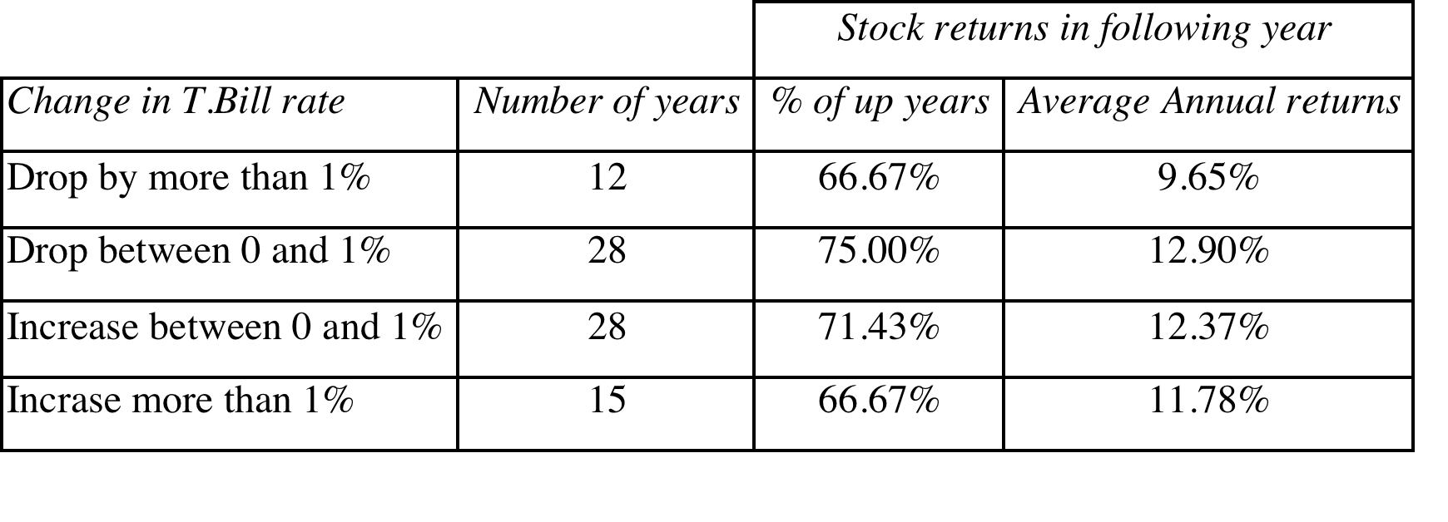
1. Treasury Bill Rates: Should you buy stocks when the T.Bill rate is low?

Slide 7
More on interest rates and stock prices…
A 1989 study by Breen, Glosten and Jagannathan evaluated a strategy of switching from stock to cash and vice versa, depending upon the level of the treasury bill rate and conclude that such a strategy would have added about 2% in excess returns to an actively managed portfolio.
In a 2002 study that does raise cautionary notes about this strategy, Abhyankar and Davies examine the correlation between treasury bill rates and stock market returns in sub-periods from 1929 to 2000.
  They find that almost all of the predictability of stock market returns comes from the 1950-1975 time period, and that short term rates have had almost no predictive power since 1975.
  They also conclude that short rates have more predictive power with the durable goods sector and with smaller companies than they do with the entire market.

Slide 8
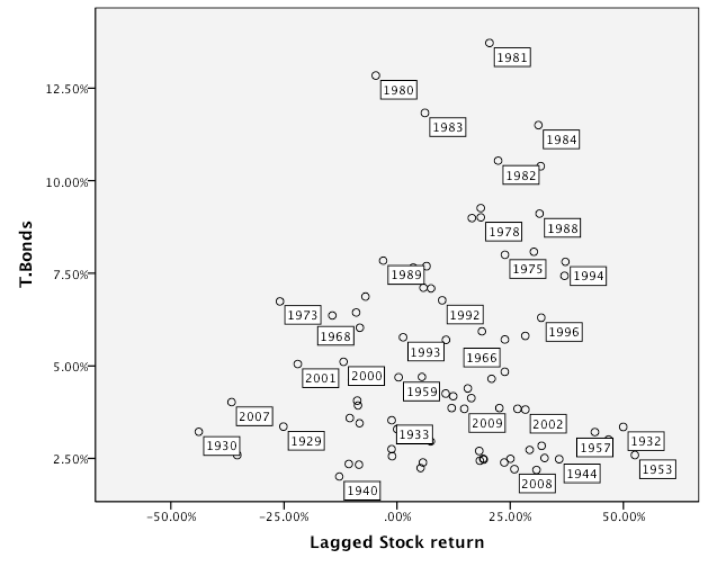
2. T. Bond Rates
By itself, the level of the T.Bond rate at the start of the period seems to provide no indication of how stocks will do during the period.

Slide 9
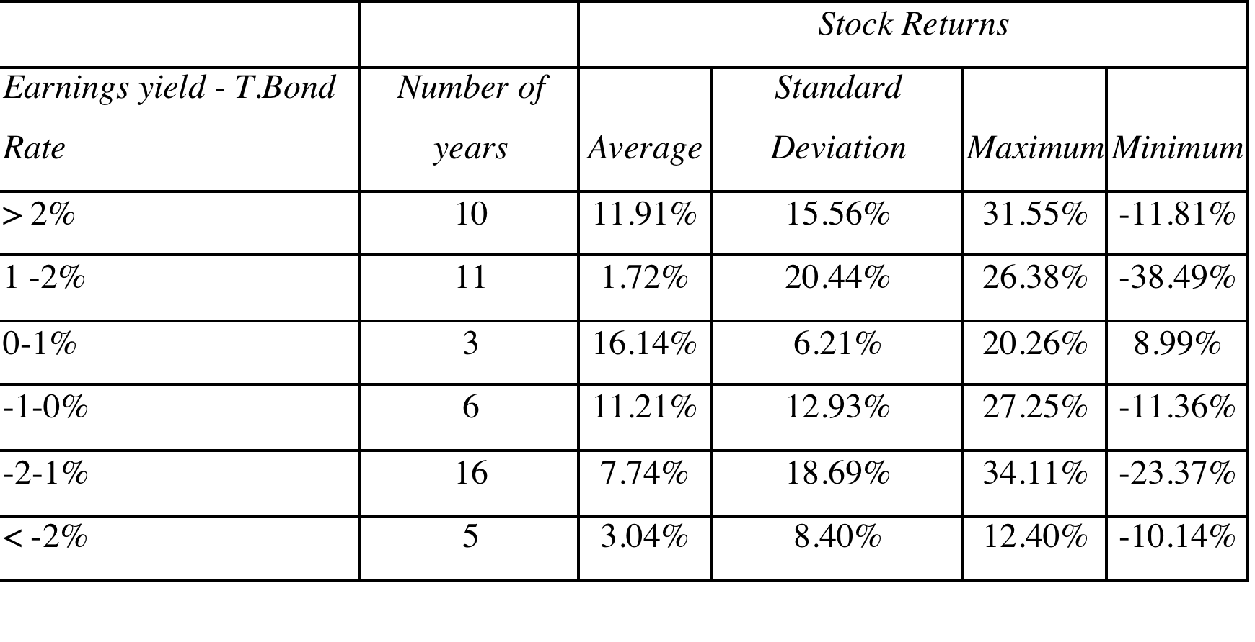
Buy when the earnings yield is high, relative to the T.Bond rate (The Fed Model)

Slide 10
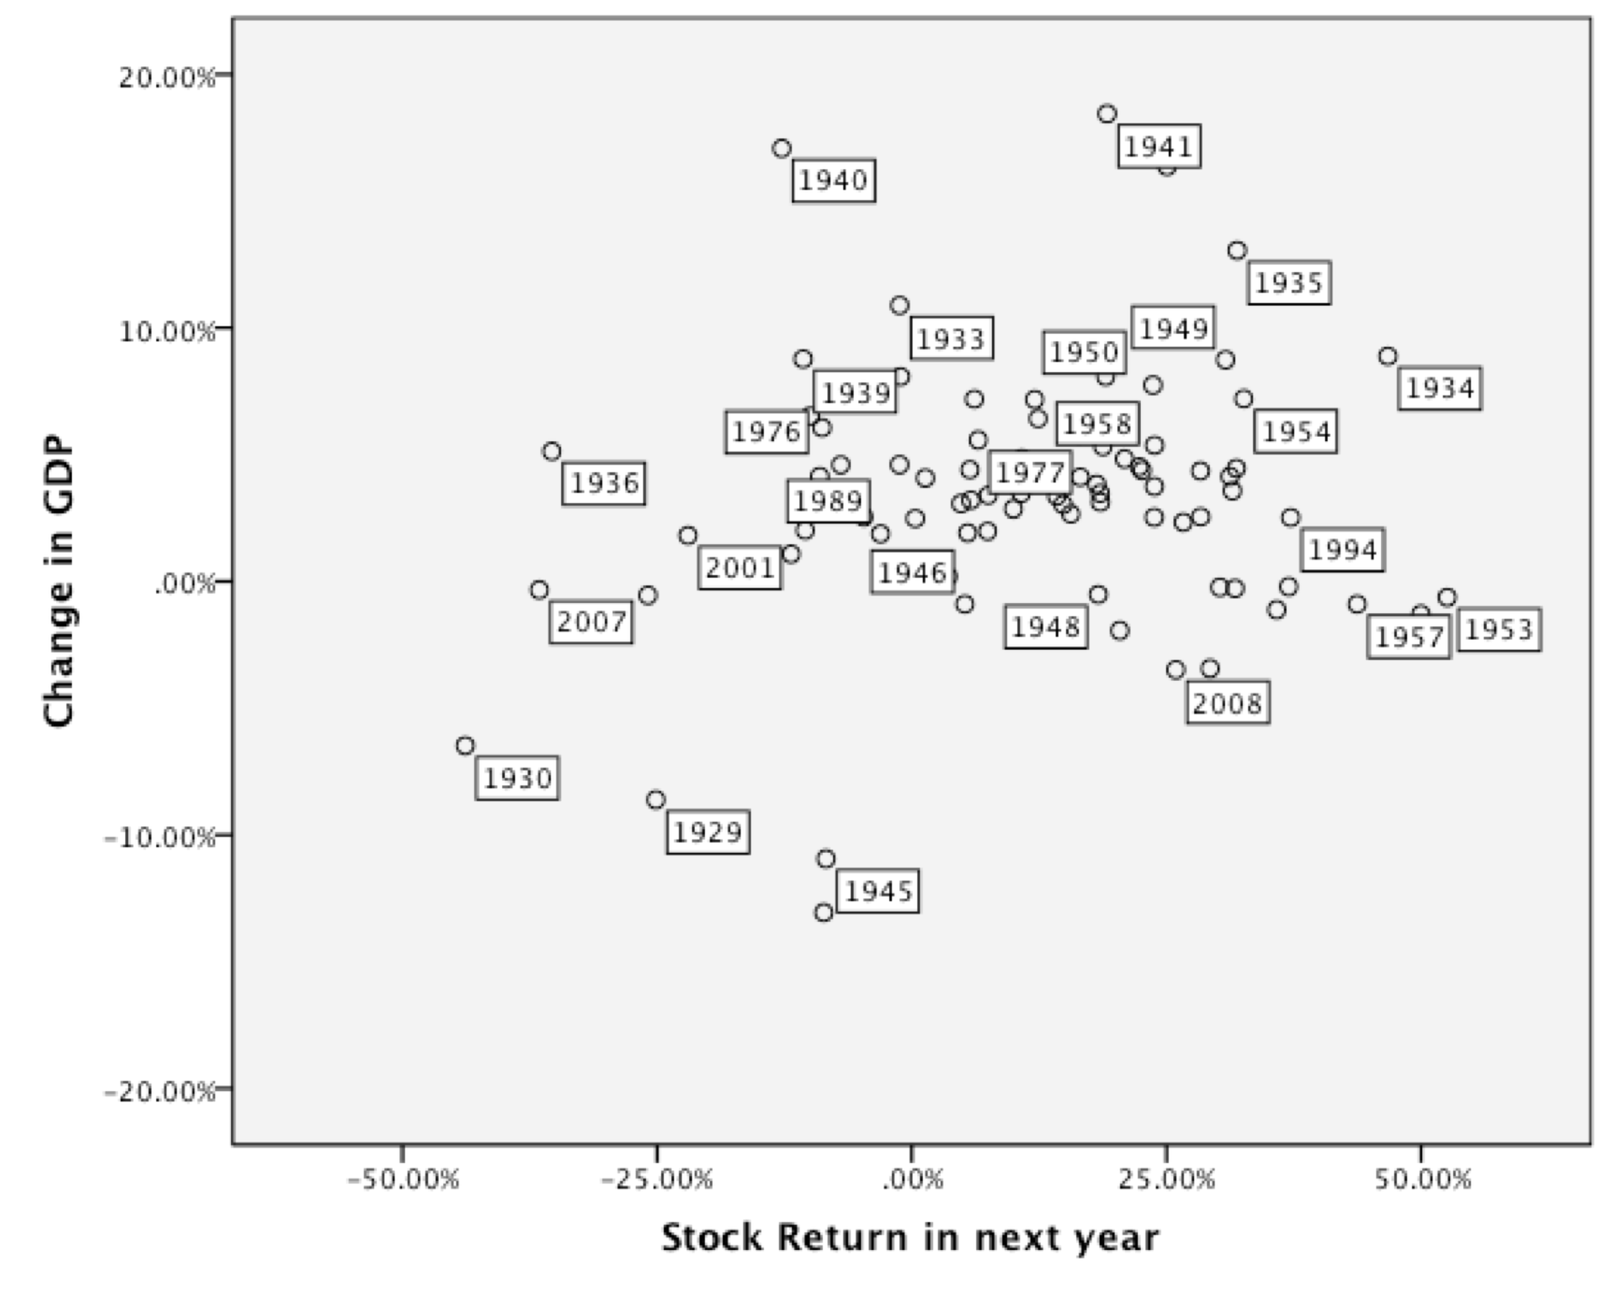
3. Business Cycles and GNP growth

Slide 11
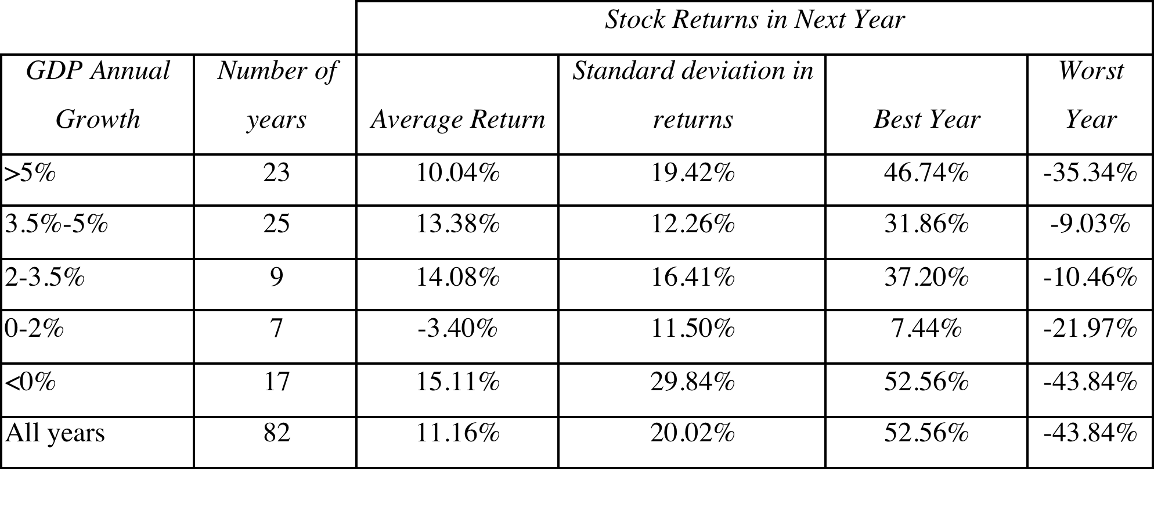
Real GDP growth and Stock Returns

Slide 12
Macro forecasting: The perils
The links are weak: While we assume that the links between macro variables and stock prices are strong, the relationship is a lot weaker than most of us realize. Put simply, the notion that stock prices go down when the economy does badly is not backed strongly in the data.
Forecasting macro variables is difficult: If you need to forecast macro variables (GDP growth, interest rates etc.) to get a forecast of the stock market, you have just replaced one problem with an even bigger one,.
And watch out for structural changes: Mean reversion works as long as the underlying fundamentals do not change significantly. If they do, mean reversion will break down and you could wait for a long time for normalization and not see it.

