Slide 1
More on investor performance: Continuity & Consistency
Aswath Damodaran

Slide 2
Performance Continuity
Fund managers argue that the average is brought down by poor money managers. They argue that good managers continue to be good managers whereas bad managers drag the average down year after year.
The evidence indicates otherwise. While there is some evidence of a hot hand phenomenon with mutual fund managers, the overwhelming evidence is that there is no continuity in performance.

Slide 3
1. Transition Probabilities

Slide 4
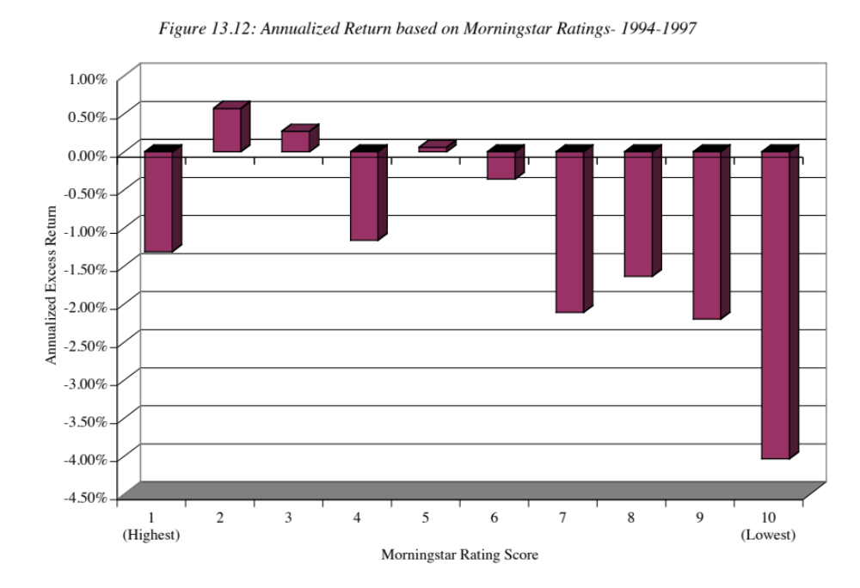
2. The Value of Rankings

Slide 5
But ratings have become more informative..
Morningstar did revamp its rating system in 2002, making three changes.
  They broke funds down into 48 smaller subgroups rather than four large groups, as was the convention prior to 2002.
  They adjusted their risk measures to more completely capture downside risk; prior to 2002, a fund was considered risky only if its returns fell below the treasury bill rate, even if the returns were extremely volatile.
  Funds with multiple share classes were consolidated into one fund rather than treated as separate funds.
A study that classified mutual funds into classes based upon these new ratings in June 2002 and looked at returns over the following three years (July 2002-June 2005) finds that they do have predictive power now, with the higher rated funds delivering significantly higher returns than the lower rated funds.

Slide 6
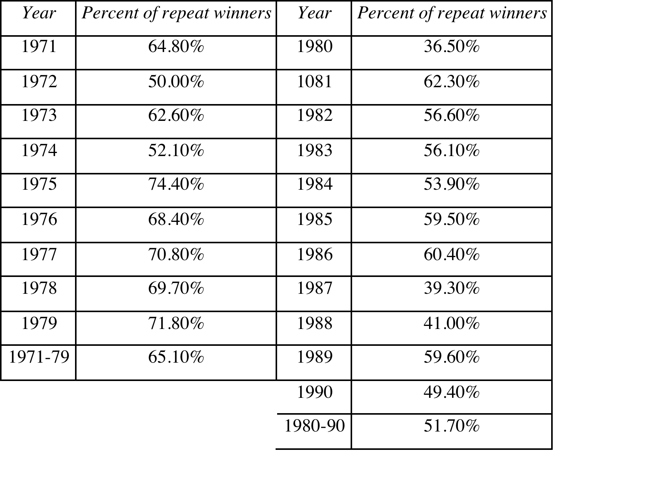
There is some evidence of hot hands..

Slide 7
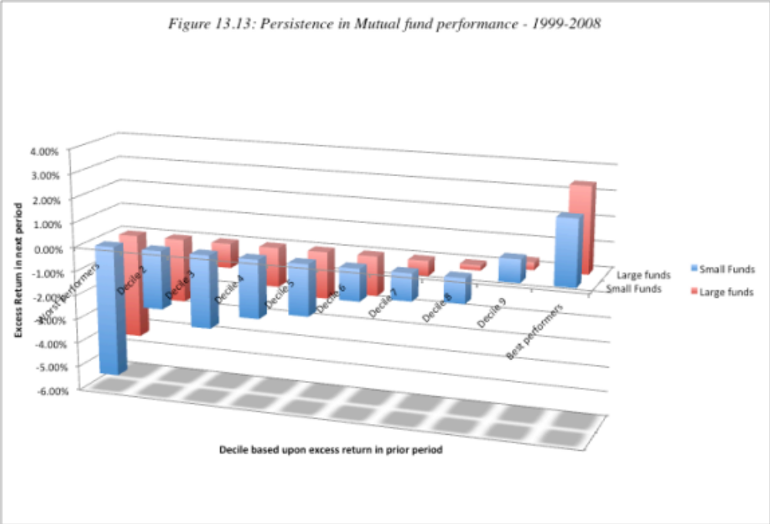
And the persistence continues.. At both small & large funds

Slide 8
Why active money managers fail…
High Transactions Costs: The costs of collecting and processing information and trading on stocks is larger than the benefits from the same.
No core philosophy: Lacking a rudder, money managers shift styles constantly, leading to high turnover, transactions costs and tax bills.
Too much activity: Activity, by itself, can be damaging as investors often sell when they should not and buy when they should not.
Failure to stay fully invested in equities: Since mutual fund managers are not great market timers, failing to stay fully invested hurts more than it helps.
Behavioral factors: All of the behavioral problems that we see with individual investors apply in spades with institutional investors.

Slide 9
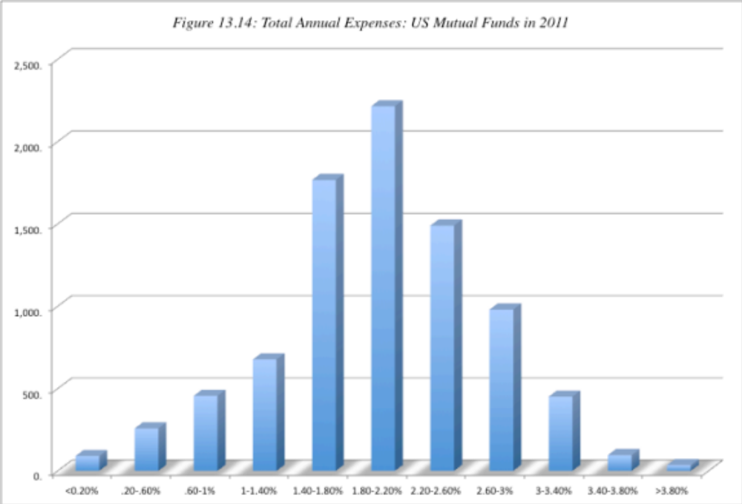
1. High Transactions Costs

Slide 10
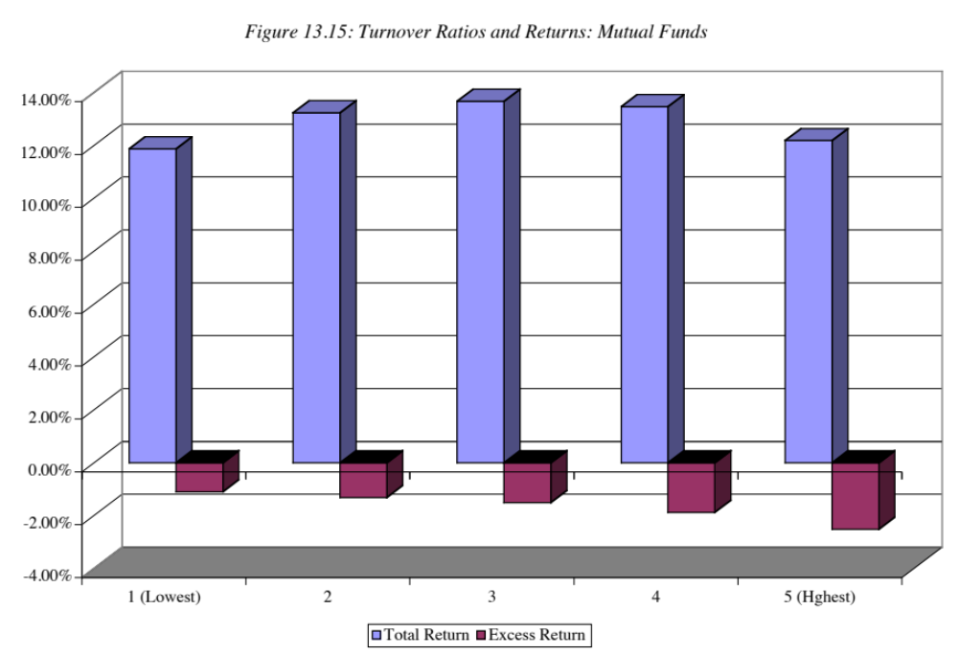
Turnover Ratios and Returns

Slide 11
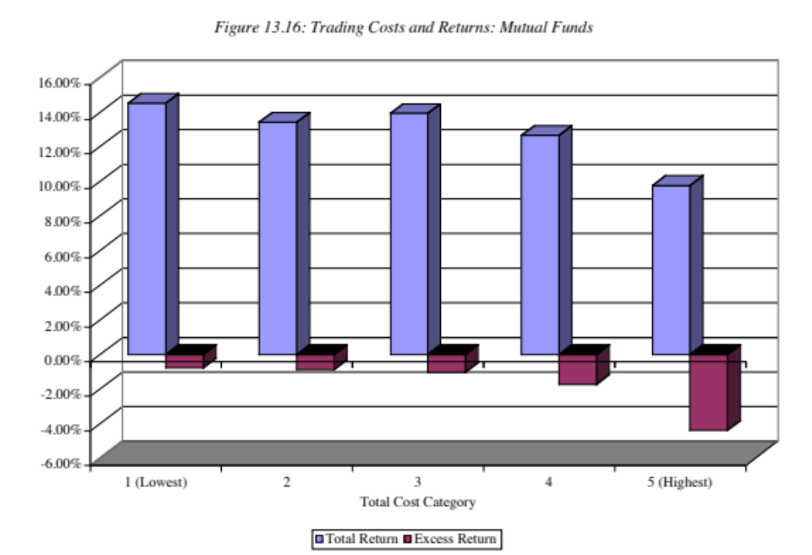
Trading Costs and Returns

Slide 12
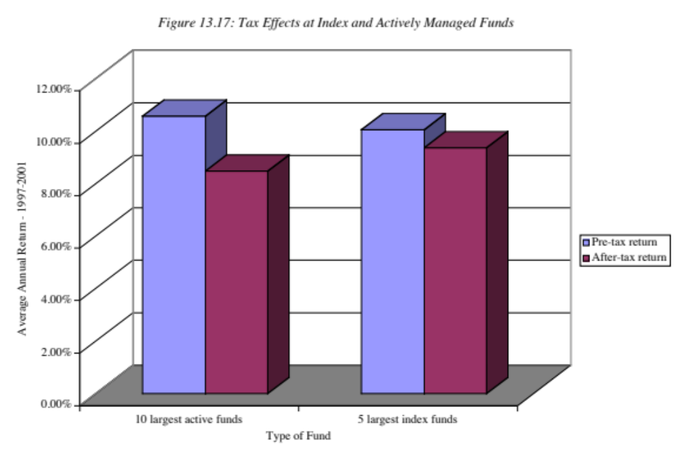
High Tax Burdens

Slide 13
2. They seem to have no core philosophy..

Slide 14
3. Too Much Activity
In an interesting study, researchers have looked at the value added by activity by comparing the returns generated by funds over a year with the returns that they would have earned over the same year, if they had left their portfolios untouched over the year.
These studies generally find that activity generates negative returns: the returns from the frozen portfolios exceed the actual returns, with the magnitude a function of how much activity the fund is involved in.

Slide 15
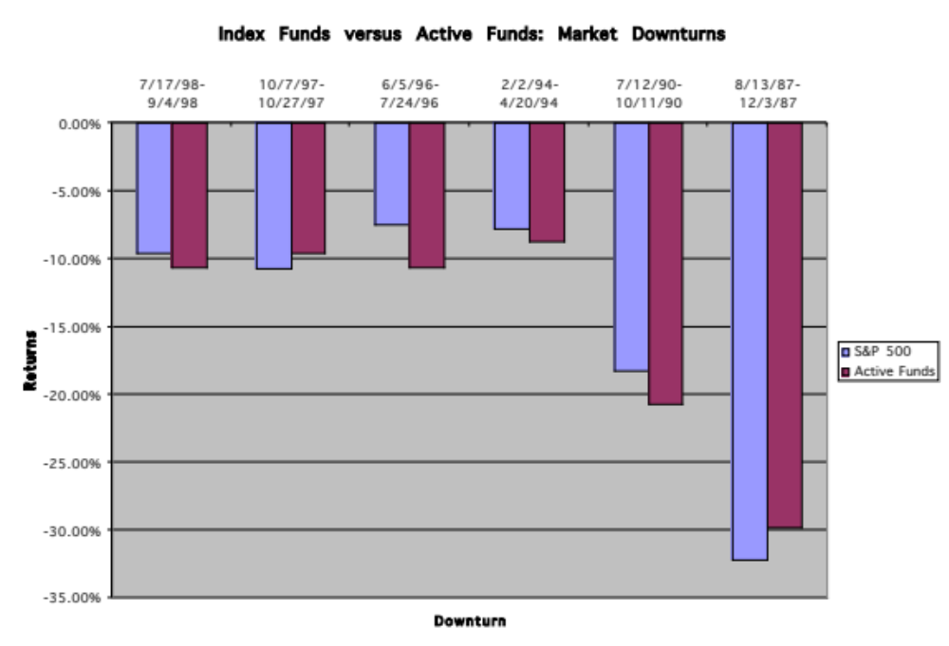
4. Failure to stay fully invested

Slide 16
5. Behavioral Factors
Lack of consistency: Brown and Van Harlow examined several thousand mutual funds from 1991 to 2000 and categorized them based upon style consistency. They noted that funds that switch styles had much higher expense ratios and much lower returns than funds that maintain more consistent styles.
Herd Behavior: One of the striking aspects of institutional investing is the degree to which institutions tend to buy or sell the same investments at the same time.
Window Dressing: It is a well documented fact that portfolio managers try to rearrange their portfolios just prior to reporting dates, selling their losers and buying winners (after the fact). O’Neal, in a paper in 2001, presents evidence that window dressing is most prevalent in December and that it does impose a significant cost on mutual funds.

Slide 17
Conclusion
There is substantial evidence of irregularities in market behavior, related to systematic factors such as size, price-earnings ratios and price book value ratios.
While these irregularities may be inefficiencies, there is also the sobering evidence that professional money managers, who are in a position to exploit these inefficiencies, have a very difficult time consistently beating financial markets.
Read together, the persistence of the irregularities and the inability of money managers to beat the market is testimony to the gap between empirical tests on paper and real world money management in some cases, and the failure of the models of risk and return in others.
The performance of active money managers provides the best evidence yet that indexing may be the best strategy for many investors.

