Slide 1
Testing “market beating” schemes and strategies

Slide 2
Testing Market Efficiency
  Tests of market efficiency look at the whether specific investment strategies earn excess returns, after adjusting for risk. Some tests also account for transactions costs and execution feasibility.
  A test of market efficiency is a joint test of market efficiency and the efficacy of the model used for expected returns. When there is evidence of excess returns in a test of market efficiency, it can indicate that markets are inefficient or that the model used to compute expected returns is wrong or both.

Slide 3
Benchmarks to assess performance
Comparison to indices: Compare to returns you would have made by investing in an index, without adjusting for risk.
Risk and Return Models: You can adjust for risk, when making your comparison:
  Mean Variance Measures
    Sharpe Ratio: Average Return / Standard deviation of Returns from Strategy
    Information Ratio: (Return on Strategy – Return on Index)/ Tracking Error versus the Index
  CAPM based measures
    Jensen’s alpha = Actual return – Expected Return (from CAPM)
    Treynor Index = (Return on Strategy – Riskfree Rate)/ Beta
  Arbitrage Pricing and Multi-factor Models
  Proxy and Composite Models

Slide 4
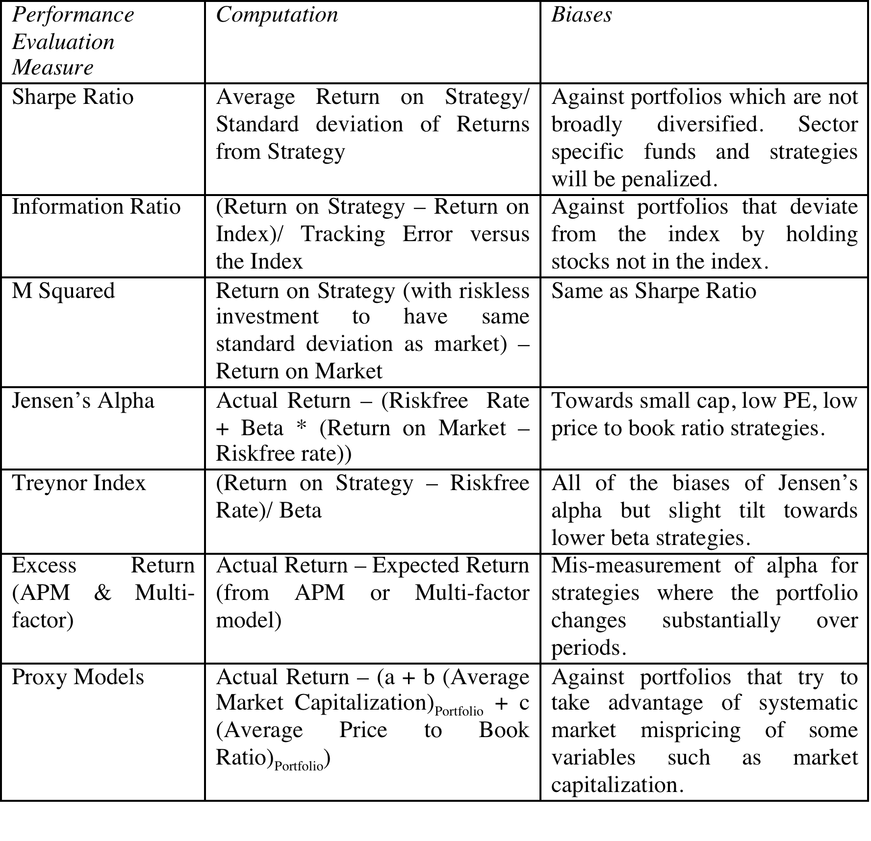
Reviewing the choices…

Slide 5
Testing Efficiency: Three forms
In an event study, we examine whether markets efficiently incorporate the ”news” in a news story (earnings announcement, acquisition or even a Federal Reserve interest rate change).
In a portfolio study, we examine whether investing in an group of assets/companies that share the same characteristic (low PE ratio, high dividend yields etc.) generates higher returns than it should, given the risk in the investments.
In an investor group study, we evaluate whether a group of investors who share the same characteristic (value investors, hedge funds, growth-oriented mutual funds) beat the market, after adjusting for risk and transactions costs.

Slide 6
1. Event Study
An event study is designed to examine market reactions to, and excess returns around specific information events.
The information events can be market-wide, such as macro-economic announcements, or firm-specific, such as earnings or dividend announcements.
The objective is to examine whether the event causes stock prices to move abnormally (up or down).

Slide 7
Steps in conducting an event study
Specify the “event” that you are testing and dentify the “time” the event occurred
Returns are collected around these dates for each of the firms in the sample.
  Decide on time intervals (hourly, daily, weekly)
  Determine how many intervals before and after event.
Adjust the returns for market performance and risk, i.e., estimate excess or abnormal returns.
Estimate the average and standard error in these returns.
  Check for statistical significance (T statistics, for example)
  Check for economic significance (Are excess returns large enough to cover execution difficulties and costs?)

Slide 8
An Example: The Effects of Option Listing on Stock Prices
Step 1: The date on which the announcement that options would be listed on the CBOE on a particular stock was collected.
Step 2: The returns of the underlying stock(j) were computed for the ten days prior, the day of, and each of the ten days after announcement
Step 3a: The beta for the stock (bj) was estimated using 100 trading days from before the event and 100 trading days after the event. The returns on the market index (Rmt) were computed for each of the 21 trading days.
Step 3b: Excess returns were computed for each of the trading days:
  Er_{j,t} = R_{j,t} - β_{j} R_{m,t} .......... t = -10,-9,-8,....,+8,+9,+10
Step 4: The average and standard error of excess returns across all stocks with option listings were computed for each

Slide 9
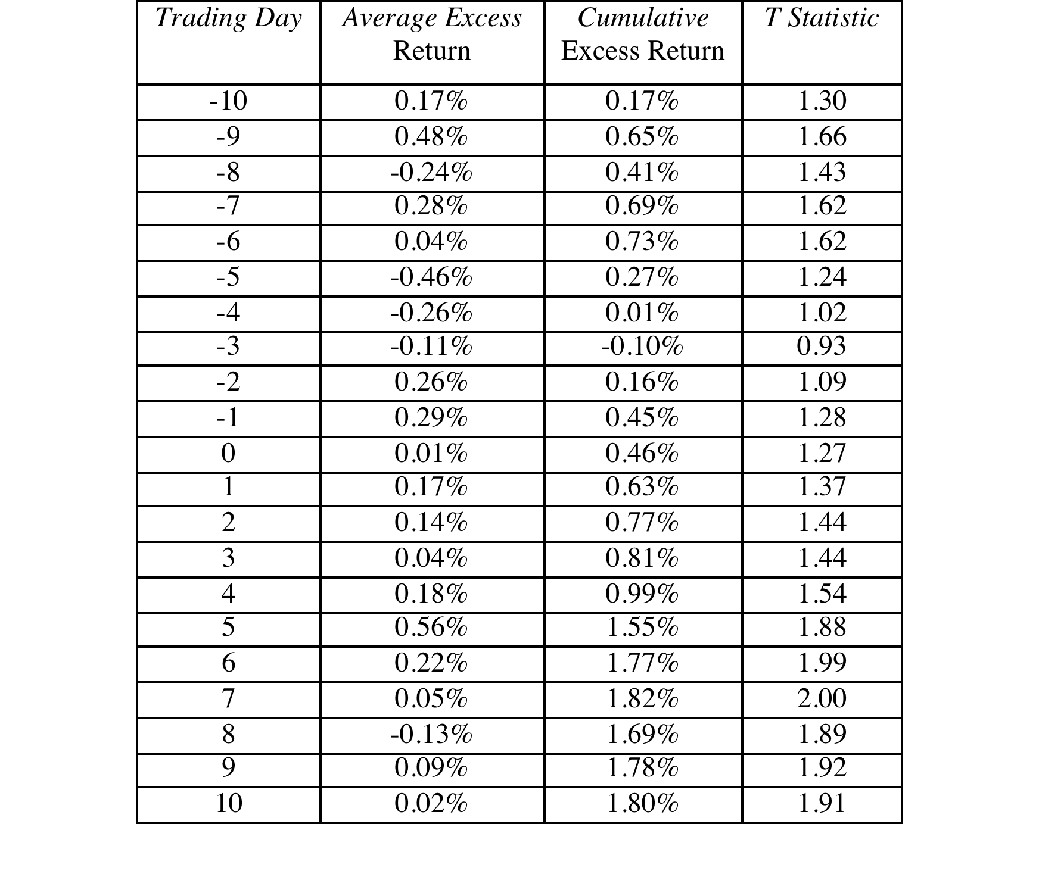
The Results of the Study

Slide 10
2. Portfolio Study
In some investment strategies, firms with specific characteristics are viewed as more likely to be undervalued or overvalued, and therefore have excess returns, than firms without these characteristics.
  In these cases, the strategies can be tested by creating portfolios of firms possessing these characteristics at the beginning of a time period, and examining returns over the time period.
  To ensure that these results are not colored by the idiosyncratic behavior of any one time period, this is repeated for a number of periods.
Finally, to make sure that your results are not the result of data mining, you try your strategy on a hold out period.

Slide 11
Steps in Doing a Portfolio Study
The variable on which firms will be classified is defined, using the investment strategy as a guide. The data on the variable is collected for every firm in the defined universe at the start of the testing period, and firms are classified into portfolios based upon the variable.
The returns are collected for each firm in each portfolio for the testing period, and the returns for each portfolio are computed.
The “risk” of each portfolio is estimated, using one of the risk and return models.
The excess returns and standard errors earned by each portfolio are computed.
Use statistical tests to see if the excess returns are different from zero. The extreme portfolios can be matched against each other to see whether they are statistically different.

Slide 12
Testing a low PE strategy
Using data on PE ratios from the end of 1987, firms on the New York Stock Exchange were classified into five groups, the first group consisting of stocks with the lowest PE ratios and the fifth group consisting of stocks with the highest PE ratios. Firms with negative price-earnings ratios were ignored.
Returns on each portfolio were computed annually from 1988 to 1992. Stocks that went bankrupt or were delisted were assigned a return of -100%.
The betas for each stock in each portfolio were computed using monthly returns from 1983 to 1987, and the average beta for each portfolio was estimated. The portfolios were assumed to be equally weighted.The returns on the market index was computed from 1988 to 1992.
The excess returns on each portfolio were computed using the betas from step 3 and market returns from step 4.

Slide 13
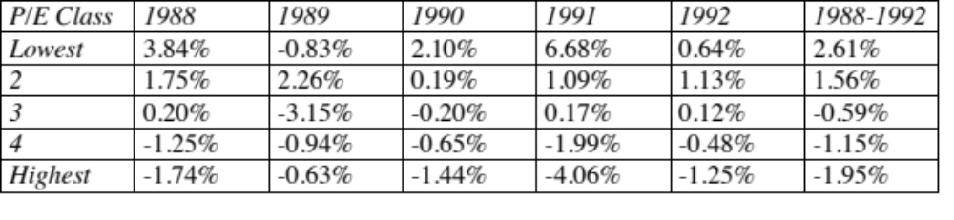
Low PE Strategy: Excess Returns
Extreme portfolio test
The lowest PE portfolio earned 4.56% more than the highest PE portfolio. (2.61% - (-1.95%)) = 4.56%
Don’t forget your statistics. Every one of these numbers has a standard error attached to them and you can compute statistics (t, F) that will tell you whether these numbers are statistically significant.

Slide 14
Regressions
One of the limitations of portfolio studies is that they become increasing unwieldy, as the number of variables that you use in your strategy increases.
The other problem with portfolio studies is that you group firms into classes and ignore differences across firms within each class. Thus, the stocks in the lowest PE ratio class may have PE ratios that range from the 4 to 12.
If you believe that these differences may affect the expected returns on your strategy, you could get a better measure of the relationship by running a multiple regression. Your dependent variable would be the returns on stocks and the independent variables would include the variables that form your strategy.

Slide 15
Running a regression
Independent variable: This is the variable that you are trying to explain. In most investment schemes, it will be a measure of the return you would make on the investment but you have to decide how you are going to measure returns (total or excess) and how often (daily, weekly, quarterly).
Dependent variables: These are the variables that you think will help you find “better” investments. If they are quantitative (PE ratios), you are set. If they are qualitative (good management), you have to come up with a quantitative measure of the variable at the beginning of each period that you are computing returns.
Linearity check: Run scatter plots for each variable against independent variable to see if relationship is linear or not.
Run the regression: You can either run cross sectional regressions (across firms) or time series regressions (across time)
Check for statistical significance: Check the R-squared for the regression and the t statistics for the coefficients.

Slide 16
3. Investor Group Studies
In these studies, you focus on an investor group that shares a common characteristic and examine whether the returns delivered by that group are higher than what they should have earned on a risk-adjusted basis to break even.
Since the returns reflect execution difficulties and transactions costs, this is a more difficult test for markets to pass to be deemed “efficient”.
In effect, you are examining whether statistical proof of market inefficiency translates into economic inefficiency.

Slide 17
Steps in investor group studies
Identify the group: Specify the common characteristics of the group. In some cases, this will be easier than others.
Avoid survivor bias: Since the worst of the investors in your specified group may fail, you should look at all investors in the group during the period of your assessment, not just survivors.
Measure actual returns: If the investments are in market-traded assets, this will be easier. If not, be wary of self-reported returns.
Evaluate risk: Look at both the risk of the underlying investments, as well as the variability in total returns reported for portfolios.
Calculate excess returns: Convert risk measure into expected returns, and compute excess return as actual return minus expected return.

Slide 18
Example: Hedge funds
Identify the group: Hedge funds.
Avoid survivor bias: Look at all hedge funds that were open for investment on January 1, 2014
Measure actual returns: Compute returns on these funds every year from 2014-2018. If a fund fails, compute the returns to investors in that fund during the failed year.
Evaluate risk: Measure the variability in hedge fund returns over time. If you are using the CAPM or a market-based model, compute the correlation (and beta) of these returns, relative to a market index.
Calculate excess returns: Convert risk measure into expected returns each year and compute excess returns for each fund, each year. Compute statistics to see if the average excess return across funds is different from zero.

Slide 19
The Cardinal Sins in Testing Strategies
Using 'anecdotal evidence’: Anecdotes can be tailored to come to any conclusion.
No holdout periods: An investment scheme should always be tested out on a time period different from the one it is extracted from or on a universe different from the one used to derive the scheme.
Sampling Biases: If your sampling is biased, it can provide results that are not true in the larger universe.
Failure to control for market performance: When the overall market is doing well (badly), all strategies look good (bad).
Failure to control for risk: A failure to control for risk leads to a bias towards accepting high-risk investment schemes and rejecting low-risk investment schemes.
Mistaking correlation for causation: Statistical tests often present evidence of correlation, rather than causation.

Slide 20
Other Sins
1. Data Mining: The easy access to huge amounts of data is a double-edged sword. When you relate stock returns to hundreds of variables, you are bound to find some that seem to predict returns, simply by chance.
2. Survivor or Survival Bias: If you start with a existing universe of publicly traded companies and work back through time, you create a bias since you eliminate firms that failed during the period. If the tested strategy is susceptible to picking firms with high bankruptcy risk, this may lead to an overstatement of returns on the scheme.
3. Not allowing for Transactions Costs: Some investment schemes are more expensive than others because of transactions costs - execution fees, bid-ask spreads and price impact.
4. Not allowing for difficulties in execution: Some strategies look good on paper but are difficult to execute in practice, either because of impediments to trading or because trading creates a price impact.

Slide 21
A skeptic’s guide to investment strategies
Can the investment strategy be tested? Can it be implemented?
If the strategy can be tested, is the test that has been devised a fair one of the strategy?
Does it pass the economic significance tests?
Has it been tried before?
There is truth to the saying that almost everything that is marketed as new and different in investing has been tried before, sometimes successfully, and sometimes not.

