Slide 1
Understanding Risk III: The risk in stocks
Aswath Damodaran

Slide 2
The Risk in Equity
An equity investment in a business (private or public) entitles you to residual earnings and cash flows. In other words, you are not promised an interest rate but earn whatever is left over after you pay off other investors.
Investing in equity in a business therefore exposes you to more risk than lending money or buying bonds in that same business.
If you are investing in equity, you should demand a higher expected return to compensate you for that risk. That higher expected return can be, at its most general level, broken down into two parts:
  An equity risk premium that you would demand for investing in equities as an asset class, over and above something riskless.
  A relative risk measure for individual equities that will allow you to differentiate between safer and riskier businesses to invest in.

Slide 3
1. The Price of Equity Risk
Since equities are collectively more risky than bonds, you should expect them to earn a premium over bonds over long periods and you should price in that premium, when you value stocks.
That premium, over and above what you can earn on a risk free investment, is called the equity risk premium.
There are two ways in which investors measure this risk premium:
  Historical premiums look at what stocks have earned over very long time periods in the past, relative to risk free investments.
  Implied premiums back out the premium by looking at what people are paying today for stocks.

Slide 4
The ubiquitous historical risk premium
The historical premium is the premium that stocks have historically earned over riskless securities.
While the users of historical risk premiums act as if it is a fact (rather than an estimate), it is sensitive to
  How far back you go in history…
  Whether you use T.bill rates or T.Bond rates
  Whether you use geometric or arithmetic averages.
For instance, looking at the US:
 | Arithmetic Average |  | Geometric Average
 | Stocks - T. Bills | Stocks - T. Bonds | Stocks - T. Bills | Stocks - T. Bonds
1928-2018 | 7.93% | 6.26% | 6.11% | 4.66%
Std Error | 2.09% | 2.22%
1969-2018 | 6.34% | 4.00% | 5.01% | 3.04%
Std Error | 2.38% | 2.71%
2009-2018 | 13.00% | 11.21% | 12.48% | 11.00%
Std Error | 3.71% | 5.50%
Notes:
While everyone uses historical risk premiums, the actual premium in use can vary depending upon
How far back you go in time
Whether you T.Bills or T.Bonds
Whether you use arithmetic or geometric averages
This table was developed using data that is publicly accessible on the S&P 500, treasury bills and 10-year treasury bonds on the Federal Reserve of St. Louis web site.
Dataset: histretSP.xls
Note how much the historical risk premium varies in this table. In fact, any of these numbers, which range from very low or negative values to very high values could be called a historical risk premium.

Slide 5
An Implied Equity Risk Premium
Notes:
The key lesson I would take away is that equity risk premiums are unstable and that globalization has made them more unstable. The other is that there seems to be mean reversion in the process – implied premiums, when abnormally high or low, move back towards a longer term average.

Slide 6
The ERP: A Composite Measure

Slide 7
II. Relative Risk
Once you have a price for equity risk in the aggregate, you still have to decide how risky an individual stock or group of stocks is, in order to determine what return you need to make on that stock.
Models that try to measure equity risk vary across investors. Broadly speaking, these risk and return models can be categorized as:
  Theory based models that begin with an economic (and quantitative) definition of risk and derive risk measures based on that definition.
  Alternative models that are based upon either intuitive or qualitative measures of risk.

Slide 8
I. Theory Based Models
Most theory based models begin by defining risk in terms of variance in actual returns around expected returns.
They usually measure risk through the eyes of the marginal investor in equity (rather than the average investor).
The marginal investor is an investor who owns a large portion of the equity and trades frequently.

Slide 9
a. The Capital Asset Pricing Model
Building Blocks
We live in a mean variance world, trading expected returns (good) for standard deviation (bad).
There are no transactions costs. You can trade freely, without brokerage costs or bid-ask spreads.
There is no private information, i.e., we all share the same information set.
All the non-diversifiable risk in the market can be captured with one market risk factor.
Implications
There is no reason to stop diversifying. We all hold every traded asset in the market (market portfolio) and vary only in how much we put into it.
The risk of an asset becomes the risk it adds to the market portfolio.
That risk can be measured by how it moves with the market (its covariance) and can be measured standardized by dividing by the variance of the market:
  Beta = Covariance_{Asset, Market}/ σ_{Market}²
The expected return for an asset is a function of it’s beta:
Beta = Riskfree Rate + Beta (ERP)

Slide 10
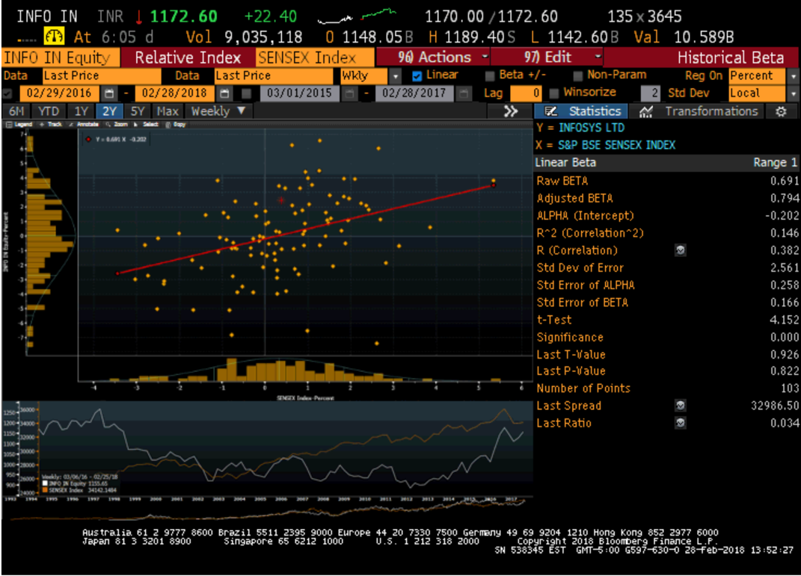
The beta for a company: The standard regression

Slide 11
The Beta for a company: A bottom up estimate
Based on its business breakdown into software and services.
Infosys provides a breakdown of its clients, by business type.
Business | Revenues | EV/Sales | Estimated Value | Value Weight | Unlevered Beta
Computer Software | ₹ 2,101 | 6.3640 | ₹ 13,371 | 13.51% | 1.1114
Computer Services | ₹ 66,383 | 1.2899 | ₹ 85,630 | 86.49% | 1.0136
Company | ₹ 68,484 |  | ₹ 99,001 |  | 1.0268
Levered Beta = 1.03 (1+ (1-.30)(0)) = 1.03
Business | Revenues | Weight | Unlevered Beta
Financial Services | ₹ 18,555 | 28.00% | 1.0703
Manufacturing | ₹ 7,507 | 11.33% | 1.0377
Energy | ₹ 15,430 | 23.28% | 0.9133
Retail | ₹ 11,225 | 16.94% | 0.6958
Healthcare | ₹ 8,437 | 12.73% | 0.7202
Hi-tech | ₹ 5,122 | 7.73% | 0.8837
Company | ₹ 66,276 |  | 0.9076

Slide 12
Myths about beta
Beta is a measure of overall risk: It is not. It measures only exposure to macro or market risk. Thus, volatile investments can have low betas, if the bulk of their risk is specific to the investment.
Beta is a statistical measure: While betas might be estimated from regressions, they are determined by three fundamental decisions that a firm makes: the business it is in, its fixed cost structure and its financial leverage.
Beta is a fact: It is not. It is an estimate and a single regression beta can have a very high standard error.
Beta measures investment quality: It does not. It measures investment risk. Thus, you can have a great investment with a low beta, an average beta or a high beta.

Slide 13
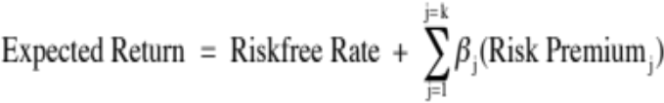
b. The Arbitrage Pricing Model
Building Blocks
We live in a mean variance world, trading expected returns (good) for standard deviation (bad).
There are no transactions costs. You can trade freely, without brokerage costs or bid-ask spreads.
There is no private information, i.e., we all share the same information set.
There are multiple market risk factors, with individual stock exposures varying against each one.
Implications
The risk of an asset comes from its exposure to different market risk factors.
Analyzing past stock returns (factor analysis) should tell us how many market risk factors there are in those returns and individual stock exposures against each one..
The expected return on an asset then can be written as a function of its betas against each market risk factor and the risk premiums associated with each:

Slide 14
c. The Multi-factor Model
Building Blocks
We live in a mean variance world, trading expected returns (good) for standard deviation (bad).
There are no transactions costs. You can trade freely, without brokerage costs or bid-ask spreads.
There is no private information, i.e., we all share the same information set.
There are multiple macroeconomic risk factors that are the source of market risk.
Implications
The risk of an asset comes from its exposure to macroeconomic risk factors.
Looking at past returns for individual stocks against macro economic variables should yield estimates of betas against each one.
The expected return on an asset then can be written as a function of its betas against each macroeconomic risk factor and the risk premiums associated with each:

Slide 15
II. Alternative models of Equity Risk
There are many who find theory based models of equity risk lacking because
  They look at both upside and downside volatility (it is only the latter that investors don’t like)
  They are based upon market prices rather than fundamentals
  They break risk down into diversifiable and non-diversifiable components, a break down that may have no relevance if you are only minimally diversified.
The alternative models for equity risk can broadly be classified as
  Models that are based upon accounting statements
  Proxy models (where something else stands in for risk)
  Market implied measures of risk
  Risk adjusted earnings/ cash flows
  Margin of Safety

Slide 16
a. Accounting based risk measures
Accounting Ratio: You can use an accounting ratio as your measure of risk. Here are some choices:
  Debt risk: If you start with the presumption that companies that are more indebted are riskier than firms that are not, you can use the debt ratio (debt as a percent of overall capital or as a percent of equity) as your risk measure.
  Earnings risk: If you assume that companies with higher earnings are safer than companies with lower earnings, you can use an accounting measure of earnings (earnings as a percent of market capitalization or as a percent of book value of equity) as your risk measure.
Compute an accounting beta: Look at changes in accounting earnings at a firm, relative to accounting earnings for the entire market. Firms that have more stable earnings than the rest of the market or whose earnings movements have nothing to do with the rest of the market will have low accounting betas.

Slide 17
b. Proxy Models
Look at returns on individual stocks over long periods and search for characteristics shared by companies that earn high returns.
This approach was kicked off by Fama and French, who found that low price to book and small market cap stocks earned higher returns than the rest of the market.
In the years since, there have been additional three additional variables that seem to be correlated with returns:
  Earnings momentum: Companies that have reported stronger than expected earnings growth in the past earn higher returns than the rest of the market.
  Price momentum: Returns are higher for stocks that have outperformed markets in recent time periods and lower for stocks that have lagged.
  Liquidity: Stocks that are less liquid (lower trading volume, higher bid-ask spreads) earn higher returns than more liquid stocks.

Slide 18
c. Market Implied risk measures
If you can observe the price of a risky asset, and you can estimate the expected cash flows on that asset, you can back out the market’s implied “required return” for that asset.
With stocks, with we can used expected dividends or cash flows together with the stock price to get an expected return on the stock.
Here is a simple example. Assume that you have a stable dividend paying stock that is trading at $20/share, is expected to pay a dividend of $1/share next year and grow at 3% in perpetuity. You can back out the cost of equity for this company:
Value per share = 20 = 1/ (r - .03)
Implied expected return = r = .08 = 8%
This process becomes more complicated if you use cash flow based models and if there is growth, but the process remains the same.

Slide 19
d. Risk adjusted cash flows
Risk adjusting the cash flows requires more than taking the expected cash flow across all scenarios, good and bad. You have to convert these expected cash flows into certainty equivalent cash flows.
There are two practical approaches to computing certainty equivalent cash flows. .
  In the first, you consider only those cash flows from a business that are "safe" and that you can count on, when you do valuation. If you do so, and you are correct in your assessment, you don't have to risk adjust the cash flows.
  The second variant is an interesting twist on dividends and a throw back to Ben Graham. To the extent that companies are reluctant to cut dividends, once they initiate them, it can be argued that the dividends paid by a company reflects its view of how much of its earnings are certain.

Slide 20
e. Margin of Safety
The "margin of safety" has a long history in value investing. While the term may have been in use prior to 1934, Graham and Dodd argued that investors should buy stocks that trade at significant discounts on value and developed screens that would yield these stocks.
To put into practice the margin of safety (MOS), investors have to
  Screen for companies that meets good company criteria: solid management, good product and sustainable competitive advantages.
  Estimate intrinsic value. Value investors use a variety of approaches in this endeavor: some use discounted cash flow, some use relative valuation and some look at book value.
  The third step in the process is to compare the price to the intrinsic value and that is where the MOS comes in: with a margin of safety of 40%, you would only buy an asset if its price was more than 40% below its intrinsic value.

Slide 21
Final thoughts about equity risk
Explicit versus implicit: There are plenty of analysts who steer away from discounted cash flow valuation and use relative valuation (multiples and comparable firms) because they are uncomfortable with measuring risk explicitly. The danger with implicit assumptions is that you can be lulled into a false sense of complacency, even as circumstances change.
Quantitative versus qualitative: Analysts who use conventional risk and return models are accused of being too number oriented and not looking at qualitative factors enough. Perhaps, but the true test of whether you can do valuation is whether you can take stories that you hear about companies and convert them into numbers for the future.
Simple versus complicated: Sometimes, less is more and you get your best assessments when you keep things simple.

