Slide 1
AI’s Winners, Losers and wannabes: Beyond buzz words!
ChatGPT did this!

Slide 2
AI: Buzz Word, World Changer or Something in the Middle?
It is undeniable that AI is the buzzword of the moment, showing up in almost every aspect of our lives and in markets.
  Nvidia has become the hottest company to invest in, seeing its market cap surge in the last two years, hitting $ 3 trillion in 2024.
  Every company seems to be latching on to the AI revolution, sprinkling into earnings reports and mentioning products that are built around AI.
  A surge of venture capital is invested in AI-related businesses.
The question, as with other big buzzwords that capture our imagination, is whether the buzz is merited or just a passing fad.

Slide 3
Change coming? Revolutionary or Incremental?
Revolutionary Changes not only affected wide swathes of businesses, some positively and some adversely, but they also changed the ways that we live, work and interact.
In parallel, we have also seen changes that are more incremental, and while significant in their capacity to create new businesses and disruption, don't quite qualify as revolutionary.
The question of whether a change is revolutionary or incremental depends in large part on:
  It’s staying power
  It’s reach across businesses
  It’s capacity to change how we live and work

Slide 4
Revolutionary Changes (in my lifetime)
Revolutionary Change | Business Effects | Personal Effects
Personal Computers (1980s) | New companies built around these new businesses Disrupt companies in businesses that are displaced by change Show up as a cost component for companies that buy its products or services | New workforce that is skilled in the new businesses Job losses in businesses that are disrupted by these new businesses Changes how we live and work
Internet (1990s)
Smartphones (2000s)
Social Media (2010s)

Slide 5
Revolutionary Change: Disruption’s Dark Side
The market is littered with the carcasses of what used to be successful businesses that have been disrupted by technological change.
Investors in these disrupted companies not only lose money, as they get disrupted, but worse, invest even more in them, drawn by their "cheapness".
If AI succeeds in its promise, will there be businesses that are upended and disrupted? Of course, but we are in the hype phase, where much more will be promised than can be delivered, but the biggest targets will come into focus sooner rather than later.

Slide 6
The Big Market Delusion!

Slide 7
1. Big Markets
There is nothing more exciting for a nascent business than the perceived presence of a big market for its products and services, and the attraction is easy to understand.
In the minds of entrepreneurs in these markets, big markets offer the promise of easily scalable revenues, which if coupled with profitability, can translate into large profits and high valuations.
The logic of impending change is impeccable, but the extrapolation that the change would lead create huge and profitable markets was made casually.

Slide 8
2. Overconfidence
Daniel Kahneman, whose pioneering work with Amos Tversky, gave rise to behavioral finance as a disciple described overconfidence as the mother of all behavioral biases, for three reasons.
  First, it is ubiquitous, since it seems to be present in an overwhelming proportion of human beings.
  Second, overconfidence gives teeth to, and augments, all other biases, such as anchoring and framing.
  Finally, there is reason believe that overconfidence is rooted in evolutionary biology and thus cannot be easily countered.
The problem gets worse with big markets, because of a selection bias, since these markets attract entrepreneurs and venture capitalists, who tend to be among the most overconfident amongst us.

Slide 9
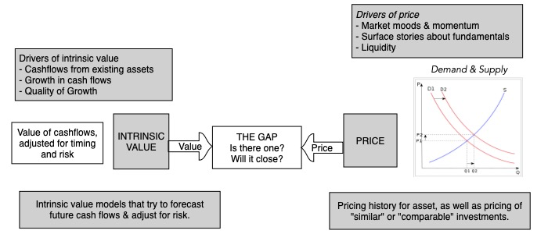
3. The Pricing Game

Slide 10
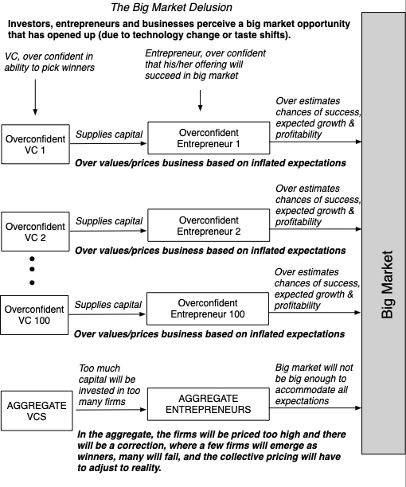
The Big Market Delusion

Slide 11
Common Elements in Big Market Delusions
Big Market stories: When asked to justify the pricing of a company in the market, especially young companies with little to show in terms of fundamentals, entrepreneurs, managers and investors almost always point to macro potential.
Blindness to competition: Entrepreneurs, managers and investors generally downplay existing competition, thus failing to factor in the reality that growth will have to be shared with both existing and potential new entrants.
All about growth: When enthusiasm about growth is at its peak, companies focus on growth, often putting business models to the side or even ignoring them completely.
Disconnect from fundamentals: If you combine a focus on growth as the basis for pricing with an absence of concern at these companies about business models, you get pricing that is disconnected from the fundamentals.

Slide 12
The Bottom Line
In the aftermath of every correction, there are many who look back at the bubble as an example of irrational exuberance. A few have gone further and argued that such episodes are bad for markets, and suggested fixes, some disclosure-related and some putting restrictions on investors and companies.
Not only are bubbles part and parcel of markets, they are not necessarily a negative. They change the way we live and work. We would choose the chaos of bubbles, and the change that they create, over a world run by actuaries, where we would still be living in caves, weighing the probabilities of whether fire is a good invention or not.
Our policy advice to politicians, regulators and investors then is to stop trying to make bubbles go away. In our view, requiring more disclosure, regulating trading and legislating moderation are never going to stop human beings from overreaching.

Slide 13
The AI Effect: Revolutionary or Incremental?

Slide 14
AI: Revolutionary or Incremental Change
In many ways, AI is the culmination of two forces that have been building up over time:
  Big data: Over the last two decades, not only have we seen data consolidated and accessible as never before, but we have also traded away personal data for convenience.
  Computing power: We have a multiple of the power that only a few with access to super computers had a few decades ago.
It is ironic that what brought AI into the public consciousness was not a AI breakthrough, but Chat GPT, a lower-level AI innovation, which brought AI into public consciousness.
In the short time since, AI has not only driven markets, but also altered company strategies and has started affecting how we do our jobs/ live our lives.

Slide 15
AI: Business Potential
Hardware and Infrastructure The AI effect on NVIDIA comes from the increased demand for AI-optimized computer chips, and as that market is expected to grow exponentially, the companies that can grab a large share of this market will benefit. | Data Big data, used more as a buzzword than a business proposition, over the last decade may finally find its place in the value chain, when twinned with AI, but that pathway will not be linear or predictable
Software This software can take multiple forms, from AI platforms, chatbots, deep learning algorithms (including image and voice recognition, as well as natural language processing) and machine learning. | AI Products/Services AI may allow companies to target customers better (increasing revenues) or reduce costs (replacing manual labor with AI-driven applications) and make them more efficient, and by extension, more profitable.

Slide 16
On the AI hardware front..
While Nvidia has had the lion’s share of the AI chip glory, there are signs that the other chip makers are throwing resources into catching up.
  To the extent that you believe that one or more of these companies will be the one to take share away from Nvidia in a growing market, you have a winner.
  Of course, you could always bet on a maker of chips like TSMC as a winner, no matter who dominates the market.
There is more to AI architecture that AI chips. As the business evolves, you are likely to see the rest of the AI hardware business developing, and winners in that market.
The question, from a value perspective, is whether the AI business will be commoditized.

Slide 17
On the AI software & data front…
To the extent that AI is the real payoff from “big data”, and that its requirements in big data are specific, there may be big data providers who have an advantage.
Among companies that already collect data, the payoff to using AI will be directly proportional to how exclusive their data is, and how well they can use what they learn to modify products and services.
If everyone has it, no one has it.

Slide 18
The AI business customers…
For some companies that are built around providing services that are mechanical (or easily replicated), AI will be an existential threat.
For most companies, AI will become an expense that they will have to incur, since not spending money on it may put them at a disadvantage, reducing margins and profitability.
For some companies, the payoff to using AI will come from having exclusive data, that they can turn the AI machine on, and how well they can use what they learn to modify products and services.

Slide 19
AI: Social Effects
I know that there are some advocates of AI who paint a picture of goodness, where AI takes over the menial tasks that presumably cause us boredom and brings an unbiased eye to data analysis that lead to better decisions.
I know that there are others who see AI as an instrument that big companies will use to control minds and acquire power.
There are some who believe that AI can be held in check and made to serve its more noble impulses, by restricting or regulating its development, but I am not as optimistic for many reasons.
  Regulators and legislators are woefully incapable of understanding the mechanics of AI, let alone pass sensible restrictions on its usage.
  Any regulation or law that is aimed at preventing AI's excesses will almost certainly set in motion unintended consequences, that at least in some cases will be worse than the problems.

Slide 20
AI: Bottom Line
Even if you buy into the argument that AI will change the ways that we work and play, it does not necessarily follow that investing in AI-related companies will yield returns. You can get the macro story right, but you need to also consider how that story plays out across companies to be able to generate returns.
Refusing to make estimates or judgments about how AI will affect the fundamentals (cash flows, growth and risk) in a business, just because you face significant uncertainty, will not make that uncertainty go away, and instead will create a vacuum that will be filled by arbitrary AI premiums.
As a society, it is unclear whether adding AI to the mix will make us better or worse off, since every big technological change seems to bring with it unintended consequences.

Slide 21
Nvidia: An AI winner

Slide 22
My Nvidia Interests..
Market buzz: Nvidia has clearly caught a market wave, and generated media buzz, as its market cap has exploded. Just as Amazon and Cisco became the poster children for the dot.com boom, Nvidia is at the center of the AI buzz.
Jensen Huang, genius CEO: As Nvidia has risen, Huang has gone from a CEO whose name most people (including institutional investors) would have had a hard time recalling to the “greatest CEO” of all time.
Personal: I was lucky enough to buy Nvidia after it was beaten up by markets in 2018, at $29/share, and if I truly believe in value investing, I had to take a look when the stock price hit $450/share.

Slide 23
Nvidia: The Ai chip story
First mover: Nvidia was the first large semiconductor company to see the potential for AI to be a large market, and channel its energies to designing chips for that market.
Software bundling: Nvidia has software that it bundles with its chips, making them more efficient in delivering results (with less energy being consumed).
Design, not manufacturing: Nvidia does not make its own chips. It designs the chips for TSMC to manufacture. That does expose them to outsourcing risk, but it does allow them to move faster.

Slide 24
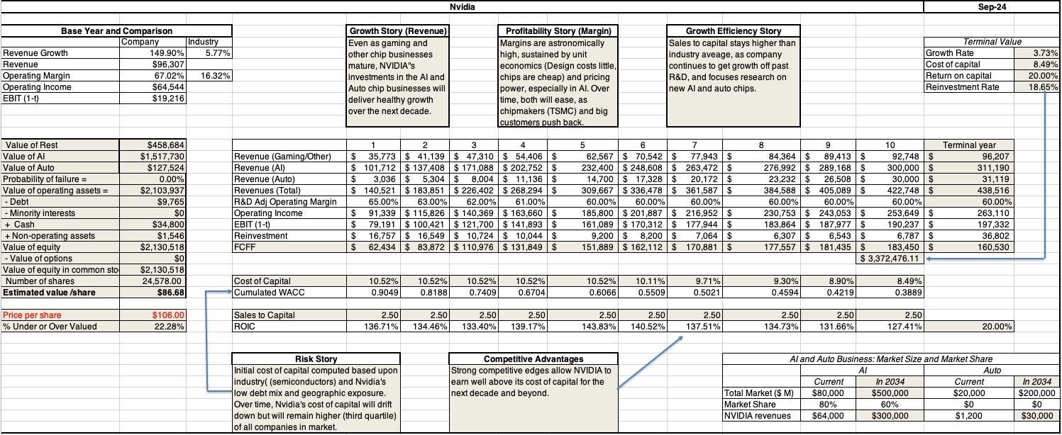

Slide 25
And an AI breakeven analysis!
If it is the AI story that is carrying Nvidia to new highs, it is worth asking how big the AI chip market will have to be to sustain Nvidia’s current pricing (close to $3 trillion).
The answer is, holding margins at their stratospheric levels and the market share at the dominant 60%, is about a trillion dollars.
Even if you buy into the highest end estimates of what the overall AI market will be, which is $2-$3 trillion, this would require that AI chips alone would be more than a third to a half of the market.

Slide 26
Judgment Day: Investing
I love NVIDIA as a company and have nothing but praise for Jensen Huang's leadership of the company. My valuation story for NVIDIA reflects all of the positive features in the company will continue into the next decade, but that upbeat narrative still yields a value well below the current price.
I would be lying if I said that selling one of my biggest winners is easy, especially since there is a plausible pathway, albeit a low-probability one, that the company will be able to deliver solid returns, at current prices.
  I chose a path that splits the difference, selling half of my holdings and cashing in on my profits, and holding on to the other half, more for the optionality (that the company will find other new markets to enter in the next decade).
  The value purists can argue, with justification, that I am acting inconsistently, given my value philosophy, but I am pragmatist, not a purist, and this works for me.
It does open up an interesting question of whether you should continue to hold a stock in your portfolio that you would not buy at today's stock prices, and it is one that I will return to in a future post.

Slide 27
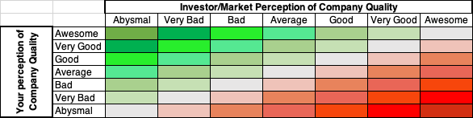
But it is an awesome company!

Slide 28
AI: The Personal Threat

Slide 29
The Damodaran Bot
I was in the eleventh week of teaching my 2024 spring semester classes at Stern, when my good friend, Vasant Dhar, who teaches a range of classes from machine learning to data science at Stern and has forgotten more about AI than I will ever know, called me.
He mentioned that he had developed a Damodaran Bot, and explained that it was an AI creation, which had read every blog post that I had ever written and every valuation that I had made public.
He also went on to tell me that he was ready to take the Bot on a trial run, and when I asked him what he meant, he said that he would like the Bot to value companies and see how those valuations measured up against valuations done by the best students in my class.

Slide 30
Gauging the threat!
In the months since I was made aware of the Damodaran Bot, I have thought in general terms about what AI will be able to do as well or better than I can, and the areas where it might have trouble.
Ultimately, AI is the culmination of two forces that have become more powerful over the last few decades.
  The first is increasing (and cheaper) computing power, often coming into smaller and smaller packages; our phones are now computationally more powerful than the very first personal computers.
  The second is the cumulation of data, both quantitative and qualitative, especially with social media accelerating personal data sharing.
As an AI novice, it is entirely possible that I am not gauging the threat correctly, but there are four dimensions on which I see the AI playing out (well or badly).

Slide 31
1. Mechanical versus Intuitive/Adaptable
Well before ChatGPT broke into the public consciousness, IBM's Deep Blue was making a splash playing chess, and beating some of the world's greatest chess players.
  Deep Blue's strength at chess came from the fact that it had access, in its memory, to every chess game ever played (data) and the computing power to evaluate 200 million chess positions per second, putting even the most brilliant human chess player to shame.
In contrast, AI has struggled more with automated driving, not because driving is mechanically complicated, but because there are human drivers on the surface roads, behaving in unpredictable ways.
While AI is making progress on making intuitive leaps, and being adaptable, it will always struggle more on those tasks than on the purely mechanical ones.

Slide 32
2. Rules-based versus Principles-based
Expanding the mechanical/intuitive divide, AI will be better positioned to work smoothly in rules-based disciplines and will be at a disadvantage in principle-positioned disciplines.
  Using valuation to illustrate my point, accounting and legal valuations are mostly rule-based, with the rules sometimes coming from logic, and sometimes from arbitrary rule writers. AI can not only replicate those valuations but can do so at no cost and with a much closer adherence to the rules.
  In contrast, financial valuations done right, is built around principles, requires judgment calls and analysis on the part of appraisers, on how these principles get applied, and should be more difficult to replace with AI.

Slide 33
3. Subjective versus Objective
When valuing companies, I am often accused by those who disagree with my numbers of being “subjective”, with the subtext being that estimating something (and being wrong) is a sign of weakness.
  The alternative that they are looking for is something objective, by which they usually mean an equation or data.
  The bottom line is that the future is subjective, and using objectivity as a shield against making estimates is delusional.
If your entire process is build around this version of objectivity, a machine can do it better than you can.

Slide 34
4. Biased versus Open minded
If you are biased, your analysis will lead you to the outcome that your biases direct you towards. The more biased you become, the more predictable your outcomes will be as well.
It is human nature to claim, even in the face of obvious bias, that you are being open minded.
The bottom line is that if you become biased enough that your outcomes become predictable, a machine will replicate you (at least in terms of outcome) though it may not be able to match your hypocrisy.

Slide 35
Responding to AI
While AI, at least in its current form, may be unable to replace you at your job, the truth is that AI will get better over time, as it learns more from watching what you do.
So, what can we do to make it more difficult to be outsourced by machines or replaced by AI?
  It is a question that I have thought about for three decades, as machines have become more powerful, and data more ubiquitous, and while I don't have all of the answers, here are some thoughts.
  The answers I have are those that work for me, reflecting what I think are my strengths and weaknesses, and what I do.
  You have to come with your own answers.

Slide 36
1. Generalist versus Specialist
In the last century, we have seen a push towards specialization in almost every discipline.
  In medicine, the general practitioner has become the oddity, as specialists abound to treat individual organs and diseases.
  In finance, there are specialists in sub-areas that are so esoteric that no one outside those areas can even comprehend the intricacies.
In the process, there are fewer and fewer people who are comfortable operating outside their domains, and humanity has lost something of value.
In a great book on forecasting, Phil Tetlock argues that foxes (people who know a little bit a lot of things) do better are forecasting than hedgehogs (people who know a great deal about their domain)

Slide 37
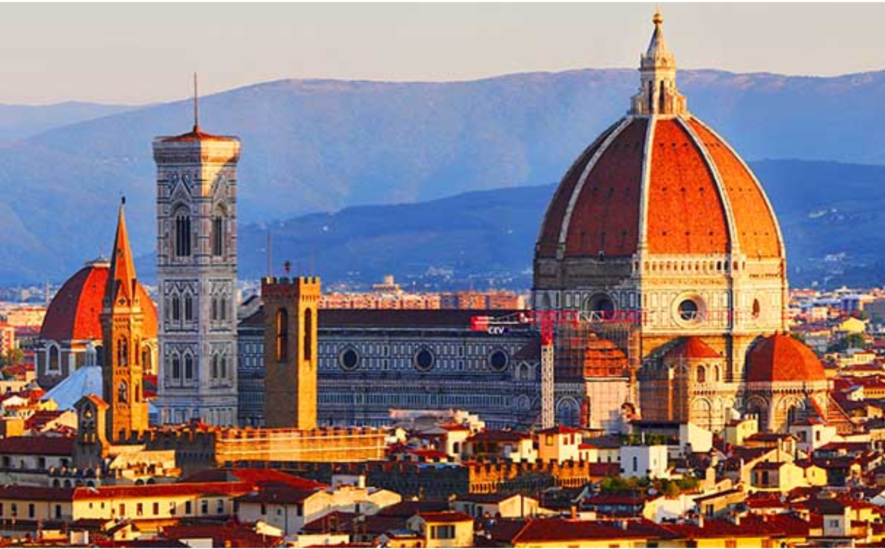
The answer is in the Duomo!

Slide 38
2. Bounded Storytelling
Starting about a decade ago, I drew attention to a contradiction at the heart of valuation practice, where as access to data and more powerful models has increased, in the last few decades, the quality of valuations has actually become worse.
I argued that one reason for that depletion in quality is that valuations have become much too mechanical, exercises in financial modeling, rather than assessments of business quality and value.
If, as legend had it, you have a right brain (controlling your story side) and a left brain (controlling the numbers), most of us as acting as if we are half brained.

Slide 39
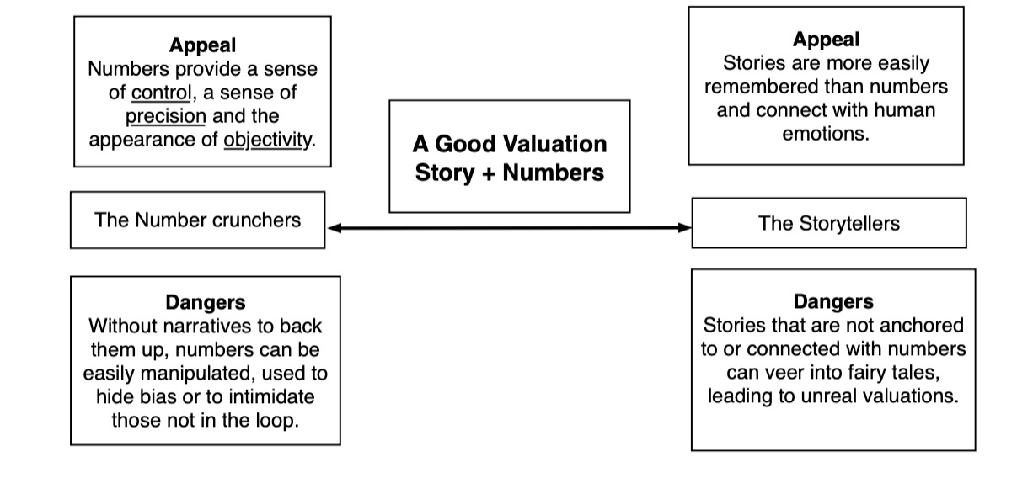
The answer: Stories plus Numbers

Slide 40
3. Exercise your reasoning muscle…
I have never been good at reading physical maps, and I must confess that I have completely lost even my rudimentary map reading skills, having become dependent on GPS to get to where I need to go.
While that may not make or break me, there are other skills that we have has human beings, where letting machines step in and help us, because of convenience and speed, may have much worse long term consequences.
In an interview I did on teaching a few years, I called this the "Google Search" curse, where when faced with a question, we often are quick to look up the answer online, rather than try to work out the answer.

Slide 41
The answer: Reason it out…
While looking up answers to questions is benign, if you are looking up answers to trivia, it can be malignant, when used to answer questions that we should be reasoning out answers to, on our own.
That reasoning may take longer, and sometimes even lead you to the wrong answer, but it is a learned skill, and one that I am afraid that we risk losing, if we let it languish.
You may think that I am overreacting, but evolution has removed skill sets and organs that we used to use as human beings, when we stopped using or needing them, and reasoning may be next on the list.

Slide 42
4. Let your mind wander…
An empty mind may the devil's workshop, at least according to puritans, but it is also the birthplace for creativity.
I have always marveled at the capacity that we have as human beings to connect unrelated thoughts and occurrences, to come up with marvelous insights.
Like Archimedes in his bath and Newton under the apple tree, we too can make discoveries, albeit much weighty ones, from our own ruminations.

Slide 43
Two personal examples…
The first one, Snowmen and Shovels, emerged while I was shoveling snow after a blizzard on the East coast, and as I and my adult neighbors struggled with the heavy snow, our kids were out building snowmen, and I thought of a market analogy, where the same shock (snowstorm) evokes both misery (from some investors) and joy (on the part of others) .
The second, written more recently, was formed while I walked my dog, and pondered how earthquakes in Iceland, a data leak at a genetics company and climate change affected value, and became a more general discourse on how human beings respond (not well) to the possibility of catastrophes.

Slide 44
Are we disarming ahead of the threat?
It is disconcerting that on every one of these four fronts, progress has made it more difficult rather than less so, to practice.
In fact, if you were a conspiracy theorist, you could spin a theory of technologists conspiring to deliver us products, often free and usually convenient, that make us more specialized, more one dimensional, less reasoning and that consume our free time.
This may be delusional on my part, but if want to keep my bot at bay, and I take these lessons to heart, I should continue to be a dabbler in all that interests me, work on my weak side (which is story telling), try reasoning my way to answers before looking them up online and take my dog for more walks.

Slide 45
Prepping for your Bot Threat
The degree to which AI is a threat to you will vary across disciplines and jobs, but there are some jobs where it will be less of a threat than others.
  White collar jobs are more at threat than blue collar jobs (The ”learn to code” advice meted out rather thoughtlessly to factory workers may become “learn to plumb” being dished out to software engineers and financi
  Hard skills are more at threat than soft skills
The question each of you has to answer is how big the threat is to you, and what (if anything) you can do to get ahead of it.

Slide 46
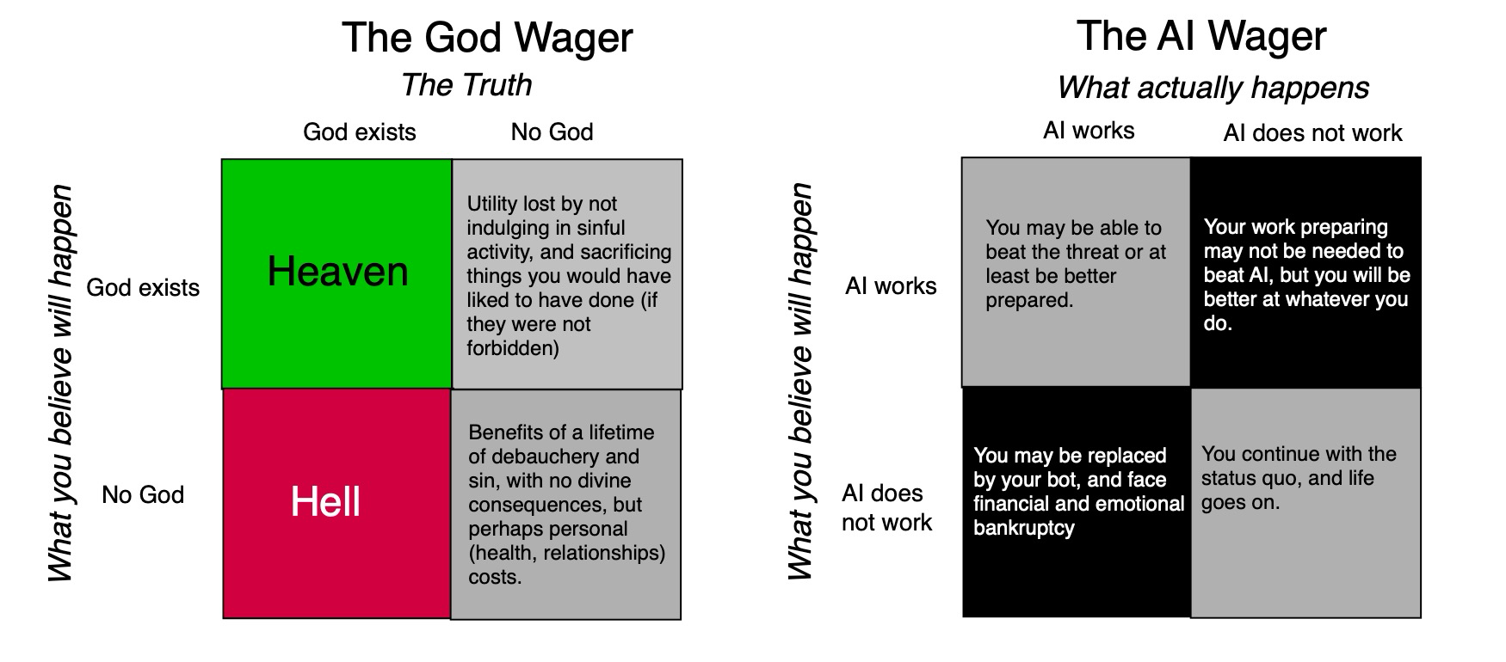
Passcal’s Wager (applied to AI)

Slide 47
Beat your bot!
I am in an unusual position. My life’s work is in the public domain, and I have a bot with my name on it not only tracking all of that work, but also shadowing me on any new work that I do.
  On the minus side, my AI threat is here, and I don’t have the choice of denying its existence or downplaying what it can do.
  On the plus side, I am old enough to not face financial catastrophe, if outsources
Your work may not be public, and you may not have a bot with your name on it, but it behooves you to act like there is one that tracks you at your job.

Slide 48
1. The Secrecy Strategy
My bot has learned how I think and what I do because everything I do is public - on my blog, on YouTube and in my recorded classes.
I know that some of you may argue that I have facilitative my own disruption, and that being more secretive would have kept my bot at bay.
As a teacher, I neither want that secrecy, nor do I think it is feasible, but your work may lend itself better to this strategy. There are two reasons to be wary, though.
  The first is that if others do what you do, an AI entity can still imitate you, making it unlikely that you will escape unscathed.
  The second is that your actions may give away your methods and work process, and AI can thus reverse engineer what you do.

Slide 49
2. The “System Protection” Strategy
I have bought and sold houses multiple times in my lifetime, and it is not only a process that is filled with intermediaries (lawyers, realtors, title deed checkers), all of whom get a slice from the deal, but one where you wonder what they all do in return for their fees. The answer often is not rooted in logic, but in the process, where the system (legal, real estate) requires them to be there for the house ownership to transfer.
This system protection for incumbents is not just restricted to real estate, and cuts across almost every aspect of our lives, and it creates barriers to disruption.
Thus, even if AI can replicate what appraisers do, at close to no cost, I will wager that courts and accounting rule writers will be persuaded by the appraisal ecosystem that the only acceptable appraisals can come from human appraisers.

Slide 50
3. Build your moat!
In business, companies with large, sustainable competitive advantages are viewed as having moats that are difficult to competitors to breach and are thus more valuable.
That same idea applies at the personal level, especially as you look at the possibility of AI replacing you.
It is your job, and mine, to think of the moats that we can erect (or already have) that will make it more difficult for our bots to replace us.
As to what those moats might be, I cannot answer for you, but the last section lays out my thinking on what I need to do to stay a step ahead.

Slide 51
The Bottom Line
I am a work in progress, even at this stage of my life, and rather than complain or worry about my bot replacing me, I will work on staying ahead.
It is entirely possible that I am embarking on an impossible mission, but I will keep you posted on my progress (or absence of it).
Of course, my bot can get so much better at what I do than I am, in which case, this blog may very well be written and maintained by it, and you will never know!

