Slide 1
Acquirers Anonymous: Seven Steps to Business Sobriety…
Aswath Damodaran
Notes:
The original title I had was “Acquirer’s Anonymous: Seven Steps to Sobriety” but I decided that it showed my biases a little too strongly.

Slide 2

Acquisitions are great for target companies but not always for acquiring company stockholders…
Notes:
Easy to tell who the winners in this game are…

Slide 3
And the long-term follow up is not positive either..
Managers often argue that the market is unable to see the long term benefits of mergers that they can see at the time of the deal. If they are right, mergers should create long term benefits to acquiring firms.
The evidence does not support this hypothesis:
  McKinsey and Co. has examined acquisition programs at companies on whether acquirers earn more than the cost of capital and whether they outperform their peers and find most wanting.
  Synergy is elusive. KPMG in a study of global acquisitions concludes that most mergers (>80%) fail - the merged companies do worse than their peer group.
  A large number of acquisitions that are reversed within fairly short time periods. About 20% of the acquisitions made between 1982 and 1986 were divested by 1988. In studies that have tracked acquisitions for longer time periods (ten years or more) the divestiture rate of acquisitions rises to almost 50%.
Notes:
And for those who argue that markets don’t quite understand or see all the good stuff (synergy…) that can come from mergers, there is little evidence that it does show up in these long term follow up studies.

Slide 4

Payoff on Growth Strategies
Notes:
This is from a study by McKinsey, looking at the odds of succeeding with different growth strategies, extracted by looking at their proprietary data base over time. They are ranked in terms of their history in delivering value.
Best strategy in terms of value creation: Develop a new product (Think of Apple during the 2001-2010 time period). The downside is that it is tough to do (Think of Microsoft trying and failing repeatedly over that same period)
Next best: Either find new uses for an existing product (aspirin as heart medicine) or new markets for existing product (Coca Cola going global in the 1980s…)
Maintaining/Growing share of a growing market: If the overall market is growing, maintaining market shares can still be lucrative.
Competing for share in a stable market: Biggest likelihood of losing money, partly because you have to cut prices to get market share..
Acquisitions offer you the least upside and also require much larger investments to deliver the same growth…

Slide 5

The disease is spreading… Indian firms acquiring US targets – 1999 - 2005
Months around takeover
Notes:
Emerging market companies used to be targets. Now that they have become more powerful, they are proud to be the acquirers. But is that a good thing?

Slide 6
Growing through acquisitions seems to be a “loser’s game”
Firms that grow through acquisitions have generally had far more trouble creating value than firms that grow through internal investments.
In general, acquiring firms tend to
  Pay too much for target firms
  Over estimate the value of “synergy” and “control”
  Have a difficult time delivering the promised benefits
Worse still, there seems to be very little learning built into the process. The same mistakes are made over and over again, often by the same firms with the same advisors.
Conclusion: There is something structurally wrong with the process for acquisitions which is feeding into the mistakes.
Notes:
To understand why acquisitions fail, we have to break the process apart to see what part of it is not working…

Slide 7
Acquisition Sins

Slide 8
The seven sins in acquisitions…
Risk Transference: Attributing acquiring company risk characteristics to the target firm.
Debt subsidies: Subsiding target firm stockholders for the strengths of the acquiring firm.
Auto-pilot Control: The “20% control premium” and other myths…
Elusive Synergy: Misidentifying and mis-valuing synergy.
Its all relative: Transaction multiples, exit multiples…
Verdict first, trial afterwards: Deal first, valuation to follow
Not my fault: Holding no one responsible for delivering results.
Notes:
These are seven parts of the acquisition process where errors proliferate. In this presentation, we will focus on each one…

Slide 9
Your Testing Sheet
Test | Passed/Failed | Rationalization
Risk transference
Debt subsidies
Control premium
The value of synergy
Comparables and Exit Multiples
Bias
A successful acquisition strategy
Notes:
Keep a running tab…

Slide 10
Lets start with a target firm
The target firm has the following income statement:
Assume that this firm will generate this operating income forever (with no growth) and that the cost of equity for this firm is 20%. The firm has no debt outstanding. What is the value of this firm?
 | Next Year
Revenues | $ 100.00
Operating Expenses (includes depreciation of $20 million) | $ 80.00
Pre-tax Operating Income | $ 20.00
Taxes | $ 8.00
After-tax Operating Income | $ 12.00
Notes:
Could not be simpler:
Value of the firm = 12/.20 = 60 million

Slide 11
Test 1: Risk Transference…
Assume that as an acquiring firm, you are in a much safer business and have a cost of equity of 10%. What is the value of the target firm to you?
$60 million
$90 million
$120 million
Other
Notes:
Does not change. You cannot make the argument (though many do) that since it is your equity that is being used to fund the acquisition, you can use your cost of equity (which would lead you to double the value of the target firm).

Slide 12
Lesson 1: Don’t transfer your risk characteristics to the target firm
Let’s start with a basic capital budgeting principle, which is often ignored: The discount rate used for an investment should reflect the risk of the investment and not the risk characteristics of the investor who raised the funds.
  Risky businesses cannot become safe just because the buyer of these businesses is in a safe business.
  The right cost of equity to use in valuation is the one that reflects the risk in equity in the target firm.
Notes:
The reason lies in a basic principle in capital budgeting - that a project’s discount rate should reflect the risk of the project and not of the entity taking the project. (Of course, this would also imply that you would use project specific costs of equity and capital….)
If you fail on this principle, safe companies will end up overvaluing and overpaying for risky companies (as many did in the late 1990s)

Slide 13
If you fail this test..
Risky firms will look cheap to you: If you use your (acquirer’s) cost of equity and capital in valuing a target firm, you will find that risky firms look under valued.
You will pay too much for these risky firms: It follows then that you will pay a premium over what you should pay (even though it looks like a bargain relative to your assessed value.
You will become a risky (and bad) firm: Over time, you (the acquiring firm) will become not just a much riskier firm, but one that has been built up through over investing in risky projects.

Slide 14
Test 2: Cheap debt?
Assume as an acquirer that you have both excess debt capacity (because you have not chosen to borrow as much as you could have, given your assets) and access to cheap debt.
You plan to borrow money at 4% (in after-tax terms) and that you plan to fund half the acquisition with debt. How much would you be willing to pay for the target firm?
Notes:
This is a tougher one and you may be tempted to argue that the new cost of capital for the target firm will be:
Cost of capital = 20% (.5) + 4% (.5) = 12%
This would lead you to value the target firm at 100.
What is the problem with doing this? Remember that the reason you are able to borrow money is because you as the acquiring firm have excess debt capacity and you are able to borrow at low rates because you have no default risk. If you use this lower cost of capital, you are in effect subsidizing the target firm stockholders with your excess debt capacity.
How about if the target firm could have afforded to have a 50% debt ratio and a 4% cost of debt? That is a different question and can be considered a value for control. If you pay 100, though, you do all the work of bringing them to their optimal debt ratio and the target firm stockholders walk away with all of the benefits.

Slide 15
Lesson 2: Render unto the target firm owners that which is theirs, not a penny more..
As an acquiring firm, it is entirely possible that you can borrow much more than the target firm can on its own and at a much lower rate.
If you build these characteristics into the valuation of the target firm, you are essentially transferring wealth from your firm’s stockholder to the target firm’s stockholders.
When valuing a target firm, use a cost of capital that reflects the debt capacity and the cost of debt that would apply to the firm.
Notes:
The minute you start building into the valuation strengths that flow from you (as the acquiring firm), you start giving target firm stockholders premiums that they do not deserve.

Slide 16
If you fail this test…
You will subsidize target firms: If you use your (acquirer’s) cost of debt and debt capacity to compute a cost of capital to value a target firm, you will be subsidizing the target firm shareholders for something (your debt capacity + low cost of debt) that they had no role in creating. That is investing malpractice.
The subsidy gets worse, if you are not adjusting your cost of debt for the higher debt that you will have, post-acquisition, and the changed riskiness of the combined firm, after the deal.

Slide 17
Test 3: Control Premiums
Assume that you are now told that it is conventional to pay a 20% premium for control in acquisitions.
That premium is justified by pointing to historical studies that show that this is what acquirers pay for control, i.e., pay roughly a 20% premium over the market price.
  How much would you be willing to pay for the target firm?
  Assuming that you are paying a control premium, how would you justify it?
Notes:
Wrong on both counts. Control can be worth nothing (or 50%) and rules of thumb are useless.

Slide 18
The Shaky Origins of the 20% Control Premium!
Me-tooism is not great rationale: Just because everyone does it does not make it right.
Price premium also covers other motives: Even if this is the right premium, on average, it is a premium for everything in a merger, not just control.
And if it is on a publicly traded firm, it is a pricing premium: The premium is the premium over the market price, not intrinsic value.

Slide 19
The Expected Value of Control
The value of the control premium that will be paid to acquire a block of equity will depend upon two factors -
  Probability that control of firm will change: This refers to the probability that incumbent management will be replaced. This can be either through acquisition or through existing stockholders exercising their muscle.
  Value of Gaining Control of the Company: The value of gaining control of a company arises from two sources - the increase in value that can be wrought by changes in the way the company is managed and run, and the side benefits and perquisites of being in control
  Value of Gaining Control = Present Value (Value of Company with change in control - Value of company without change in control)
Notes:
Contrary to conventional wisdom, the value of control is not 20%… (That is a common rule of thumb used in acquisitions, and really reflects the average premium paid in acquisitions..) Even if bidders do not overpay, the premium on an acquisition can reflect lots of other motivations besides control (synergy, for example).

Slide 20
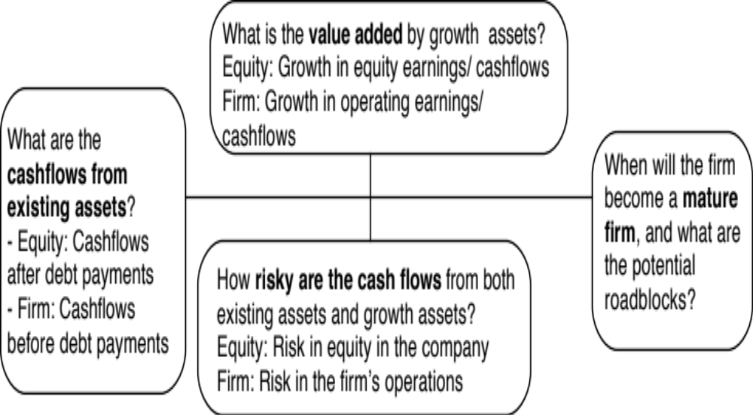
The Drivers of Value
Notes:
To create value, you have to change one or more of the above inputs…

Slide 21
Value Enhancement 101
Notes:
The key is that there is a trade off between current cashflows and future growth. If you increase current cashflows at the expense of future growth, you may destroy value rather than add to it.

Slide 22
Myth 1: Higher growth = Higher Value

Slide 23
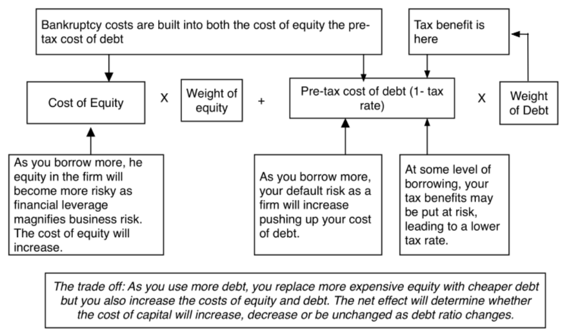
Myth 2: Borrowing money always lowers your cost of capital
Notes:
Reducing the cost of capital, holding cashflows constant, increases firm value. Note that while people tend to focus on changing the mix of debt and equity to reduce cost of capital, you can reduce cost of capital by reducing fixed costs and by making your product/service less discretionary to your customers…

Slide 24
Myth 3: The cheapest debt is the most value enhancing…
Projects/assets | Debt Design
Duration of projects | If projects are long term (short term), debt should be long term (short term) as well.
Cash flow profile | If cash flows are even over time, straight debt is better. If cash flows are low in early years, but expected to grow over time, convertible debt fits.
Currency | Currency mix of debt should be reflective of currency mix of cashflows (especially inflows).
Pricing power | With pricing power, as inflation rises, cash flows will rise as well and floating rate debt makes sense. Without pricing power, as inflation rises, profits can be squeezed, cash flows can drop and fixed rate debt is a better fit.

Slide 25
Lesson 3: Control is not worth 20%.. It could be worth nothing or 100%
The value of control is target-specific: The value of control will depend upon how well or badly managed the target firm is, and how easily the mismanagement can be fixed by a new management (presumably you).
Without a plan, that value will not delivered: Control does not happen by accident. To enhance value, you need to know what (in the target firm) needs changing and what should be left alone and.
And if you pay it all as a premium, why bother? If you pay the entire value of control as a premium, you are putting in the hard work and target shareholders are reaping the benefits.
Notes:
Rules of thumb in billion dollar valuations are signs of laziness and indicate an unwillingness to actually estimate the value of control or what a reasonable value to EBITDA multiple is for a firm.

Slide 26
If you fail this test
Pointless Premiums: If control is always worth 20%, you will find a way to pay a premium for any company, even if you have no good reason for doing acquisitions.
Control ≠ Change: If you do not do your homework on what you plan to change after you acquire a firm you will either change nothing or use cookbook solutions (borrow money & buy back stock).
Leave all value on table: If you do not value control explicitly, you will leave it all on the table or even pay more than it is worth to target shareholders.

Slide 27
Test 4: Synergy….
Assume that you are told that the combined firm will be less risky than the two individual firms and that it should have a lower cost of capital (and a higher value). Is this likely?
  Yes
  No
Assume now that you are told that there are potential growth and cost savings synergies in the acquisition. Would that constitute value added?
  Yes
  No
Should you pay this as a premium?
  Yes
  No
Notes:
Answer to part a
Not unless I am given specifics. Buzz words are worth nothing.
Answer to part b
By the present value of the cashflows that will be generated by the synergy
Answer to part c
Since synergy requires both the acquiring firm and the target firm’s strengths to be pooled, you (as the acquirer) should demand your fair share of that synergy. If there are literally dozens of firms that have the strength you bring to the merger, odds are that you will end up with very little of the synergy.

Slide 28
The Value of Synergy
Notes:
The value of synergy has to show up in one or more of the inputs into a DCF valuation. In this picture, I look at different types of synergy (operating and financial) and where they will show up in terms of the inputs…

Slide 29
Valuing Synergy
Step 1: The firms involved in the merger are valued independently, by discounting expected cash flows to each firm at the weighted average cost of capital for that firm.
Step 2: The value of the combined firm, with no synergy, is obtained by adding the values obtained for each firm in the first step.
Step 3: The effects of synergy are built into expected growth rates and cash flows, and the combined firm is re-valued with synergy.
  Value of Synergy = Value of the combined firm, with synergy - Value of the combined firm, without synergy
Notes:
You have to do three valuations to value synergy and you have to quantify the impact of synergy into valuation inputs.

Slide 30
Synergy 1.1: Why lower risk is an illusion..
When we estimate the cost of equity for a publicly traded firm, we focus only on the risk that cannot be diversified away in that firm (which is the rationale for using beta or betas to estimate the cost of equity).
When two firms merge, it is true that the combined firm may be less risky than the two firms individually, but the risk that is reduced is ‘firm specified risk’.
By definition, market risk is risk that cannot be diversified away and the beta of the combined firm will always be a weighted average of the betas of the two firms in the merger.
When does it make sense to “merge” to reduce total risk?

Slide 31
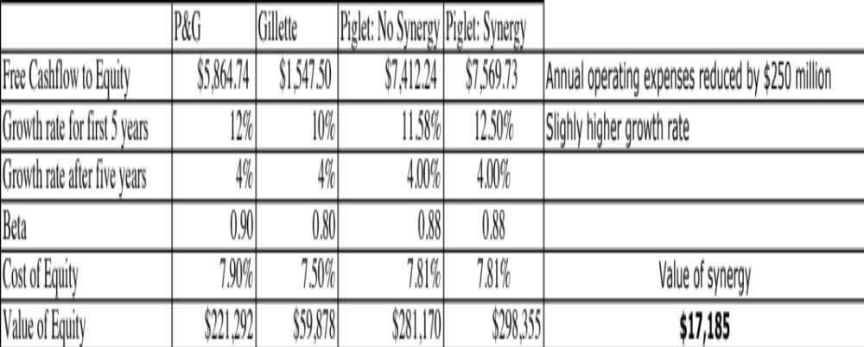
Synergy 1.2: Higher growth and cost savings can create value
Notes:
If you can cut costs and/or increase growth, synergy can be worth a lot.
In this example, P&G has synergy of almost $ 17 billion in the acquisition of Gillette.
This is probably a best case valuation, since it is based on assuming that everything managers claimed would happen actually happened and did so instantaneously.
A Follow up question
What would happen to the value of synergy if the cost savings were over estimated by $ 100 million/year? (Drop by 40%)
What if you have to wait 5 years for synergy to show up? (You would have to discount the value of synergy back 5 years, using the cost of capital of the combined firm)

Slide 32
Synergy 1.3: Tax Benefits?
Assume that you are Best Buy, the electronics retailer, and that you would like to enter the hardware component of the market. You have been approached by investment bankers for Zenith, which while still a recognized brand name, is on its last legs financially. The firm has net operating losses of $ 2 billion. If your tax rate is 36%, estimate the tax benefits from this acquisition.
If Best Buy had only $500 million in taxable income, how would you compute the tax benefits?
If the market value of Zenith is $800 million, would you pay this tax benefit as a premium on the market value?
Notes:
If you can get the tax savings immediately, it is 36% of 2000 = $720 million
If you have to save only $ 180 million a year (36% of $500 million), the value would be = PV of $ 180 million each year for 4 years at the cost of capital of Best Buys (the risk is in the operating income of Best Buys)…
And I would not necessarily pay it as a premium, since the market price may already incorporate some or much of this value.

Slide 33
Synergy 1.4: Paying that synergy as a premium on price is a mistake
Premium on value versus price: If you have valued the acquiring and target companies and derived the value of synergy by valuing the combined firm, that synergy value is over intrinsic value, not price. You have to compute the premium over price, which can be much smaller (usually) or bigger (sometimes).
Fair share? If you pay the entire synergy as a premium, you are effectively delivering the entire value to the target company stockholders and keeping none for yourself.

Slide 34
Lesson 4: Value synergy first and make sure you negotiate for your fair share.
You have to value synergy, before you decide how much to pay (not after): Synergy will be the buzzword that explains away the premium that you are paying.
To value synergy, you need specifics: Before you value synergy, you need to be specific about what synergies you see in a merger and where they will show up in a valuation.
Don’t mistake control for synergy: If the benefits can be generated by just one of the two entities in the merger, it is not synergy.
Negotiate for your fair share: As the acquiring firm, you should negotiate for your share of the synergy, not pay it all off as a premium.
Notes:
To value synergy, you would need to do the following:
Value the two firms independently
Define how synergy will show up in the combined firm. It can take the form of higher growth (with growth synergies), higher margins (with cost saving synergies), longer growth period (with strategic synergies).
Value the combined firm with the synergy built it.
Value of synergy = Value of combined firm (from step c) - Sum of the values of the independent companies from step a.

Slide 35
If you fail this test
Synergy will become a plug variable: Synergy will be your explanation for the difference between what you paid and what you should have.
No plan, no synergy: If you are not explicit about the form synergy will take, you cannot plan for it and check to see whether it is being delivered. That may explain:
  Why synergy does not manifest itself in so many mergers, after the mergers.
  Why no one seems to lose their jobs, even after the worst mergers.

Slide 36
Test 5: Comparables and Exit Multiples
Now assume that you are told that an analysis of other acquisitions reveals that acquirers have been willing to pay 5 times EBITDA.. Given that your target firm has EBITDA of $ 40 million, would you be willing to pay $ 200 million for the acquisition?
What if I estimate the terminal value using an exit multiple of 5 times EBITDA?
Notes:
Two basic problems here:
Sampling bias: Looking at transaction multiples (on other acquisitions), you are looking a sample of firms that are likely to have over paid. If you are going to do relative valuation, at least look at how other publicly traded companies in the sector are trading at. Better still, try to control for differences between your firm and these comparable firms.
If the market is, on average, wrong and overpaying for stocks in a sector, you will end up overpaying as well. This problem becomes even worse when you use the industry average to estimate terminal value in acquisition valuations. If the market is wrong, it is likely to correct well before you get to your terminal year.

Slide 37
Pricing ≠ Value

Slide 38
Four Steps to Good Pricing
Check your multiple or consistency/uniformity
  In use, the same multiple can be defined in different ways by different users. When comparing and using multiples, estimated by someone else, it is critical that we understand how the multiples have been estimated
Look at all the data, not just the key statistics
  Too many people who use a multiple have no idea what its cross sectional distribution is. If you do not know what the cross sectional distribution of a multiple is, it is difficult to look at a number and pass judgment on whether it is too high or low.
Don’t forget the fundamentals ultimately matter
  It is critical that we understand the fundamentals that drive each multiple, and the nature of the relationship between the multiple and each variable.
Don’t define comparables based only on sector
  Defining the comparable universe and controlling for differences is far more difficult in practice than it is in theory.

Slide 39
The Problems in Acquisition Pricing
Biased samples: Basing what you pay on what other acquirers have paid is a recipe for disaster. After all, we know that acquirers, on average, pay too much for acquisitions. By matching their prices, we risk replicating their mistakes.
Game Playing with Metrics: Allowing analysts (especially if they have an agenda) to pick the multiple that they will use is a recipe for backing into a bad deal.
Myopic Multipliers: One of the most distracting games in acquisitions is working out EPS accretion and dilution, and arguing that accretive mergers are good (they are not) and dilutive mergers should be avoided (again not true).
And pushing into the terminal value does not make the problem go away: Creating a front end of cash flows, when the terminal value is coming from a multiple, is not a discounted cash flow valuation.

Slide 40
Lesson 5: If you are going to price a target firm, do it right..
Pick your game: If you are acquiring other companies not for the cash flows but because you think that you can sell them to someone else at a higher price, it is perfectly okay to play the pricing game. If you are acquiring a firm for its cash flows, you have to play the value game.
Don’t get distracted: If you are playing the pricing game, dispense with the DCF and do an honest pricing. If you are playing the value game, stop looking at what other people are paying.
To do an honest pricing, you have to be unbiased in your choice of multiple and comparable firms, and control for differences between your firm & the peer group.
Notes:
The fact that everyone else in the sector is doing bad acquisitions and over paying for them is not a good reason to join the group. It is entirely possible that you are operating in a value destroying sector and it may be time for you to consider shrinking while everyone else is expanding or better still become a target of their acquisitions.

Slide 41
If you fail this test..
You will over price the target: By using a biased sample (of acquirers who are more likely to be over paying), you will end up over paying as well.
You will open the door to bias in your choice of multiples: Since you pick the multiple, you will find bias guiding your choices.
You will end up paying twice for synergy and control: Even if other acquirers are paying a “fair” price on their acquisitions, that fair price will already include a control premium and perhaps a synergy premium. Paying these premiums on top of your assessed price will be double paying.

Slide 42
Test 6: The CEO really wants to do this… Or your competitors are all in the game..
Now assume that you know that the CEO of the acquiring firm really, really wants to do this acquisition and that the investment bankers on both sides have produced fairness opinions that indicate that the firm is worth $ 150 million. Would you be willing to go along?
  Yes
  No
Now assume that you are told that your competitors are all doing acquisitions and that if you don’t do them, you will be at a disadvantage? Would you be willing to go along?
  Yes
  No
Notes:
Fairness opinions are not worth the paper they are written on. When the deal makers (investment bankers) also pass judgment on whether the deal makes sense (which is what the fairness opinion provides), you have a huge conflict of interest.

Slide 43
CEO Egos and Overconfidence: The Dirty Secret in Mergers
The Deal Rules: The premiums paid on acquisitions often have nothing to do with synergy, control or strategic considerations (though they may be provided as the reasons). They are just what you have to pay to get the deals done, because management really, really wants it done.
The Ego Problem: They may just reflect the egos of the CEOs of the acquiring firms. There is evidence that “over confident” CEOs are more likely to make acquisitions and that they leave a trail across the firms that they run.

Slide 44
Defensive Mergers: Signs of a Deeper Rot?
Me-tooism: Pre-emptive or defensive acquisitions, where you over pay, either because everyone else is overpaying or because you are afraid that you will be left behind if you don’t acquire are dangerous.
Weak businesses? If the only way you can stay competitive in a business is by making bad investments, it may be best to think about shrinking or even getting out of the business.
There is no glory in survival, for the sake of survival. Corporate sustainability, as a corporate objective, is not just a joke, but an expensive one.

Slide 45
The Deal Process is broken..
Deal makers are deal analysts: If you were going to design a process that maximizes bias, you could not do much better than the current one, especially in a friendly merger.
Spending other People’s Money: Managerial interests don’t align with shareholder interests and they can advance them using shareholder money.
Boards of directors are managerial rubber stamps, mostly incapable or unwilling to check managerial egos.
The legal system is incapable of stopping bad acquisitions. Unwittingly, it has given acquiring firms a template to evade responsibility for bad mergers, with the expensive charade called ”fairness opinions”.

Slide 46
Fairness Opinions: A waste of time and money?

Slide 47
Lesson 6: Egos and Conflicts of Interest are your biggest enemies
Winning is not everything: If you define your objective in a bidding war as winning the auction at any cost, you will win. But beware the winner’s curse!
Bankers do what’s in their best interests, not yours: If your rewards and compensation are contingent on the deal going through, you cannot be an honest advisor.
It is easy to spend other people’s money: In public companies, it is shareholder money that is being spent on acquisitions, often in the pursuit of managerial interests. Boards of directors need to do their jobs.
Notes:
This is not a macho game. CEOs are all too willing to fight out acquisitions with other people’s money. Investment bankers are all too willing to go along. In a typical acquisition, who is watching out for the stockholders of the acquiring firm?

Slide 48

To illustrate: A bad deal is made, and justified by accountants & bankers
Notes:
HP acquired Autonomy, a UK-based business software company, for $11.1 billion in 2011. At the time, almost everyone except for HP’s management thought that they were paying too much. Leo Apotheker, HP’s CEO at the time, claimed that they had done their homework and that the investment bankers had done a DCF and found the deal to be an accretive, good deal. The board of HP went along with the deal… and Meg Whitman was on the board. This is the same board that a year earlier had been caught sleeping on the job as the previous CEO, Mark Hurd, was found to have been involved in personal misconduct… And guess what…. This board met all of the Sarbanes Oxley requirements for independence.

Slide 49
The CEO steps in… and digs a hole…
Leo Apotheker was the CEO of HP at the time of the deal, brought in to replace Mark Hurd, the previous CEO who was forced to resign because of a “sex” scandal.
In the face of almost universal feeling that HP had paid too much for Autonomy, Mr. Apotheker addressing a conference at the time of the deal: “We have a pretty rigorous process inside H.P. that we follow for all our acquisitions, which is a D.C.F.-based model,” he said, in a reference to discounted cash flow, a standard valuation methodology. “And we try to take a very conservative view.”
Apotheker added, “Just to make sure everybody understands, Autonomy will be, on Day 1, accretive to H.P….. “Just take it from us. We did that analysis at great length, in great detail, and we feel that we paid a very fair price for Autonomy. And it will give a great return to our shareholders.

Slide 50

A year later… HP admits a mistake…and explains it…
Notes:
About a year later, HP announced that it was writing off almost $8.9 billion off its original deal value and claimed that Autonomy had cooked the books. This was my attempt to break down the write off, even with the presumption of accounting impropriety. The CEO of HP, Meg Whitman, claimed no responsibility…

Slide 51
Test 7: Gauging the Odds
The odds seem to be clearly weighted against success in acquisitions. If you were to create a strategy to grow, based upon acquisitions, which of the following offers your best chance of success?
This | Or this
Sole Bidder | Bidding War
Public target | Private target
Pay with cash | Pay with stock
Small target | Large target
Cost synergies | Growth synergies
Notes:
Not necessarily…

Slide 52

1. Better to lose a bidding war than to win one…
Returns in the 40 months before & after bidding war
Source: Malmendier, Moretti & Peters (2011)
Notes:
This graph looks at the stock returns a forty-month period after a bidding war to the “winner” and “loser” of the bidding war… Seems like no contest. The losing firm in the bidding war significantly outperforms the winning firm by almost 50%. The results are invariant to different measures of risk and correcting for sector performance.

Slide 53

2. Better off buying small rather than large targets…
Notes:
Note that the larger the target, the greater the negative returns…
And cash acquisitions tend to do better than stock acquisitions, at least for big acquisitions. For small acquisitions, the reverse is true.. (Perhaps, target company stockholders in big acquisitions are more likely to be suspicious about the use of stock as currency)

Slide 54

3. And focusing on private firms and subsidiaries, rather than public firms…
Notes:
Better to target private businesses and subsidiaries, where you don’t have to pay market price plus…

Slide 55


4. On cost synergies, not growth synergies
Notes:
Cost savings synergies are more likely to be realized than growth synergies. Here are some reasons why:
They are more concrete and more likely to therefore be put down on paper
It is easier to hold some one responsible for delivering cost savings
It is easier to track how close you are to your forecasts

Slide 56
Lesson 7: For acquisitions to create value, you have to stay disciplined..
If you have a successful acquisition strategy, stay focused on that strategy. Don’t let size or hubris drive you to “expand” the strategy.
Realistic plans for delivering synergy and control have to be put in place before the merger is completed. By realistic, we have to mean that the magnitude of the benefits have to be reachable and not pipe dreams and that the time frame should reflect the reality that it takes a while for two organizations to work as one.
The best thing to do in a bidding war is to drop out.
Someone (preferably the person pushing hardest for the merger) should be held to account for delivering the benefits.
The compensation for investment bankers and others involved in the deal should be tied to how well the deal works rather than for getting the deal done.
Notes:
This is a very tough game to win at. When you decide to grow through acquisitions, especially of publicly traded firms, the odds are against you because you always have to pay the market price plus a premium. It is not who you buy that determines the success of an acquisition, it is how much you pay.
The odds are better when you grow by buying private companies, where you assess the value and you are less likely to get into bidding wars. In addition, there are real constraints on private firms that my be removed when you take them over. This offers potential for increasing value.

Slide 57
Analyzing a Deal

Slide 58
The Three (Value) Reasons for Acquisitions
Undervaluation: You buy a target company because you believe that the market is mispricing the company and that you can buy it for less than its "fair" value.
Control: You buy a company that you believe is badly managed, with the intent of changing the way it is run. If you are right on the first count and can make the necessary changes, the value of the firm should increase under your management
Synergy: You buy a company that you believe, when combined with a business (or resource) that you already own, will be able to do things that you could not have done as separate entities. This synergy can be
  Offensive synergy: Higher growth and increased pricing power
  Defensive synergy: Cost cutting, consolidation & preempting competitors.
  Tax synergy: Directly from tax clauses or indirectly through dent
Notes:
Three possible reasons for the merger and they are not mutually exclusive.

Slide 59
The Acquisition Process
Status Quo Value of target firm: Start with a status quo value of the target firm, leaving both its good points and it flaws in place.
  Undervaluation = Status Quo Value – Market Price
Optimal Value of target firm: Without bringing the acquiring firm into the picture, value the target firm, run optimally, with its strengths intact (and even enhanced) and its flaws fixed, as best as they can:
  Value of Control = Optimal Value – Status Quo Value
Value the acquiring firm: Value the acquiring firm, with its strengths and flaws in place.
Value the combined firm with synergy benefits included: Built in the cash flows, growth and discount rate effects into the value:
  Value of Synergy = Value of combined firm with synergy – Acquiring firm value – Optimal Target firm value

Slide 60
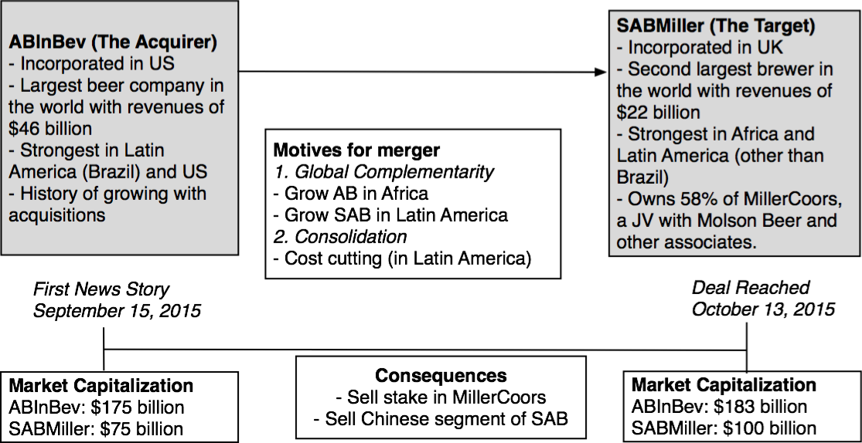
A Really Big Deal! InBev buys SABMiller
Notes:
Taking stock of the two companies: the biggest brewer in the world is taking over the second biggest and talk of synergy (and monopoly) fill the air.

Slide 61
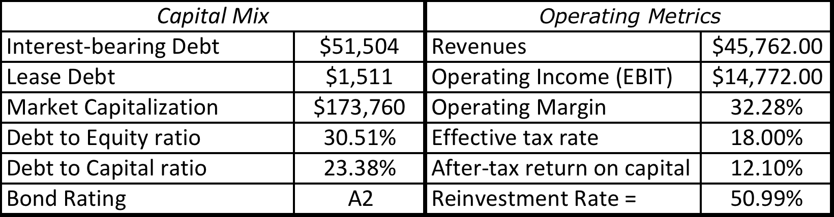
The Acquirer (ABInBev)
Notes:
The company is run by 3G, a Brazilian private equity firm with a reputation for financial deal making and operating efficiencies.

Slide 62
The Target (SABMiller)
Capital Mix |  | Operating Metrics
Interest-bearing Debt | $12,550 | Revenues | $22,130.00
Lease Debt | $368 | Operating Income (EBIT) | $4,420.00
Market Capitalization | $75,116 | Operating Margin | 19.97%
Debt to Equity ratio | 17.20% | Effective tax rate | 26.40%
Debt to Capital ratio | 14.67% | After-tax return on capital | 10.32%
Bond Rating | A3 | Reinvestment Rate = | 16.02%
Notes:
Notice that the margins are lower and there is surprisingly little geographic overlap with InBev.

Slide 63
Step 1: SAB Miller Status Quo Value
 | SAB Miller | + Coors JV | + Share of Associates | SAB Miller Consolidated
Revenues | $22,130.00 | $5,201.00 | $6,099.00
Operating Margin | 19.97% | 15.38% | 10.72%
Operating Income (EBIT) | $4,420.00 | $800.00 | $654.00
Invested Capital | $31,526.00 | $5,428.00 | $4,459.00
Beta | 0.7977 | 0.6872 | 0.6872
ERP | 8.90% | 6.00% | 7.90%
Cost of Equity = | 9.10% | 6.12% | 7.43%
After-tax cost of debt = | 2.24% | 2.08% | 2.24%
Debt to Capital Ratio | 14.67% | 0.00% | 0.00%
Cost of capital = | 8.09% | 6.12% | 7.43%
After-tax return on capital = | 10.33% | 11.05% | 11.00%
Reinvestment Rate = | 16.02% | 40.00% | 40.00%
Expected growth rate= | 1.65% | 4.42% | 4.40%
Number of years of growth | 5 | 5 | 5
Value of firm
PV of FCFF in high growth = | $11,411.72 | $1,715.25 | $1,351.68
Terminal value = | $47,711.04 | $15,094.36 | $9,354.28
Value of operating assets today = | $43,747.24 | $12,929.46 | $7,889.56 | $64,566.26
+ Cash |  |  |  | $1,027.00
- Debt |  |  |  | $12,918.00
- Minority Interests |  |  |  | $1,183.00
Value of equity |  |  |  | $51,492.26
Price on September 15, 2015: $75 billion > $51.5 billion
Notes:
Note that SABMiller has holdings in a Coors JV and other associates that add to its value.

Slide 64
Step 2: SABMiller: Potential for Control
 | SABMiller | ABInBev | Global Alcoholic Beverage Sector
Pre-tax Operating Margin | 19.97% | 32.28% | 19.23%
Effective Tax Rate | 26.36% | 18.00% | 22.00%
Pre-tax ROIC | 14.02% | 14.76% | 17.16%
ROIC | 10.33% | 12.10% | 13.38%
Reinvestment Rate | 16.02% | 50.99% | 33.29%
Debt to Capital | 14.67% | 23.38% | 18.82%
Notes:
If InBev can bring its efficiencies to SABMiller (look at the operating margins), there would be significant value creation.

Slide 65
SABMiller: Value of Control
 | Status Quo Value | Optimal value
Cost of Equity = | 9.10% | 9.37%
After-tax cost of debt = | 2.24% | 2.24%
Cost of capital = | 8.09% | 8.03%
After-tax return on capital = | 10.33% | 12.64%
Reinvestment Rate = | 16.02% | 33.29%
Expected growth rate= | 1.65% | 4.21%
Value of firm
PV of FCFF in high growth = | $11,411.72 | $9,757.08
Terminal value = | $47,711.04 | $56,935.06
Value of operating assets today = | $43,747.24 | $48,449.42
+ Cash | $1,027.00 | $1,027.00
+ Minority Holdings | $20,819.02 | $20,819.02
- Debt | $12,918.00 | $12,918.00
- Minority Interests | $1,183.00 | $1,183.00 | Value of Control
Value of equity | $51,492.26 | $56,194.44 | $4,702.17
Price on September 15, 2015: $75 billion > $51.5 + $4.7 billion
Notes:
If SABMIller were run at least as efficiently as the rest of the sector, its value would be $4.7 billion higher.

Slide 66
Steps 3 &4: Valuing Synergy
 | Inbev | SABMiller | Combined firm (status quo) | Combined firm (synergy)
Levered Beta | 0.85 | 0.8289 | 0.84641 | 0.84641
Pre-tax cost of debt | 3.0000% | 3.2000% | 3.00% | 3.00%
Effective tax rate | 18.00% | 26.36% | 19.92% | 19.92%
Debt to Equity Ratio | 30.51% | 23.18% | 29.71% | 29.71%
Revenues | $45,762.00 | $22,130.00 | $67,892.00 | $67,892.00
Operating Margin | 32.28% | 19.97% | 28.27% | 30.00%
Operating Income (EBIT) | $14,771.97 | $4,419.36 | $19,191.33 | $20.368
After-tax return on capital | 12.10% | 12.64% | 11.68% | 12.00%
Reinvestment Rate = | 50.99% | 33.29% | 43.58% | 50.00%
Expected Growth Rate | 6.17% | 4.21% | 5.09% | 6.00%
Notes:
Change in margin seems to be small (from 28.27% to 30%) but that would require more than $1.2 billion in cost cuts at the combined firm on annual costs on a continuing basis.

Slide 67
The value of synergy
 | Inbev | SABMiller | Combined firm (status quo) | Combined firm (synergy)
Cost of Equity = | 8.93% | 9.37% | 9.12% | 9.12%
After-tax cost of debt = | 2.10% | 2.24% | 2.10% | 2.10%
Cost of capital = | 7.33% | 8.03% | 7.51% | 7.51%
After-tax return on capital = | 12.10% | 12.64% | 11.68% | 12.00%
Reinvestment Rate = | 50.99% | 33.29% | 43.58% | 50.00%
Expected growth rate= | 6.17% | 4.21% | 5.09% | 6.00%
Value of firm
PV of FCFF in high growth = | $28,733 | $9,806 | $38,539 | $39,151
Terminal value = | $260,982 | $58,736 | $319,717 | $340,175
Value of operating assets = | $211,953 | $50,065 | $262,018 | $276,610
Value of synergy = 276,610 – 262,018 = 14,592 million
Notes:
The value of synergy is $14.6 billion.

Slide 68
Passing Judgment
If you add up the restructured firm value of $56.2 billion to the synergy value of $14.6 billion, you get a value of about $70.8 billion.
That is well below the $104 billion that ABInBev is planning to pay for SABMiller.
One of the following has to be true:
  I have massively under estimated the potential for synergy in this merger (either in terms of higher margins or higher growth).
  ABInBev has over paid significantly on this deal. That would go against their history as a good acquirer and against the history of 3G Capital as a good steward of capital.
Notes:
Either InBev over paid or we under valued synergy and control. Only time will tell.

