Slide 1
Acquirers Anonymous: Seven Steps to Business Sobriety…
Aswath Damodaran
Notes:
The original title I had was “Acquirer’s Anonymous: Seven Steps to Sobriety” but I decided that it showed my biases a little too strongly.

Slide 2

Acquisitions are great for target companies but not always for acquiring company stockholders…
Notes:
Easy to tell who the winners in this game are…

Slide 3
And the long-term follow up is not positive either..
Managers often argue that the market is unable to see the long term benefits of mergers that they can see at the time of the deal. If they are right, mergers should create long term benefits to acquiring firms.
The evidence does not support this hypothesis:
  McKinsey and Co. has examined acquisition programs at companies on whether acquirers earn more than the cost of capital and whether they outperform their peers and find most wanting.
  Synergy is elusive. KPMG in a study of global acquisitions concludes that most mergers (>80%) fail - the merged companies do worse than their peer group.
  A large number of acquisitions that are reversed within fairly short time periods. About 20% of the acquisitions made between 1982 and 1986 were divested by 1988. In studies that have tracked acquisitions for longer time periods (ten years or more) the divestiture rate of acquisitions rises to almost 50%.
Notes:
And for those who argue that markets don’t quite understand or see all the good stuff (synergy…) that can come from mergers, there is little evidence that it does show up in these long term follow up studies.

Slide 4

Payoff on Growth Strategies
Notes:
This is from a study by McKinsey, looking at the odds of succeeding with different growth strategies, extracted by looking at their proprietary data base over time. They are ranked in terms of their history in delivering value.
Best strategy in terms of value creation: Develop a new product (Think of Apple during the 2001-2010 time period). The downside is that it is tough to do (Think of Microsoft trying and failing repeatedly over that same period)
Next best: Either find new uses for an existing product (aspirin as heart medicine) or new markets for existing product (Coca Cola going global in the 1980s…)
Maintaining/Growing share of a growing market: If the overall market is growing, maintaining market shares can still be lucrative.
Competing for share in a stable market: Biggest likelihood of losing money, partly because you have to cut prices to get market share..
Acquisitions offer you the least upside and also require much larger investments to deliver the same growth…

Slide 5

The disease is spreading… Indian firms acquiring US targets – 1999 - 2005
Months around takeover
Notes:
Emerging market companies used to be targets. Now that they have become more powerful, they are proud to be the acquirers. But is that a good thing?

Slide 6
Growing through acquisitions seems to be a “loser’s game”
Firms that grow through acquisitions have generally had far more trouble creating value than firms that grow through internal investments.
In general, acquiring firms tend to
  Pay too much for target firms
  Over estimate the value of “synergy” and “control”
  Have a difficult time delivering the promised benefits
Worse still, there seems to be very little learning built into the process. The same mistakes are made over and over again, often by the same firms with the same advisors.
Conclusion: There is something structurally wrong with the process for acquisitions which is feeding into the mistakes.
Notes:
To understand why acquisitions fail, we have to break the process apart to see what part of it is not working…

Slide 7
Acquisition Sins

Slide 8
The seven sins in acquisitions…
Risk Transference: Attributing acquiring company risk characteristics to the target firm.
Debt subsidies: Subsiding target firm stockholders for the strengths of the acquiring firm.
Auto-pilot Control: The “20% control premium” and other myths…
Elusive Synergy: Misidentifying and mis-valuing synergy.
Its all relative: Transaction multiples, exit multiples…
Verdict first, trial afterwards: Deal first, valuation to follow
Not my fault: Holding no one responsible for delivering results.
Notes:
These are seven parts of the acquisition process where errors proliferate. In this presentation, we will focus on each one…

Slide 9
Lets start with a target firm
The target firm has the following income statement:
Assume that this firm will generate this operating income forever (with no growth) and that the cost of equity for this firm is 20%. The firm has no debt outstanding. What is the value of this firm?
 | Next Year
Revenues | $ 100.00
Operating Expenses (includes depreciation of $20 million) | $ 80.00
Pre-tax Operating Income | $ 20.00
Taxes | $ 8.00
After-tax Operating Income | $ 12.00
Notes:
Could not be simpler:
Value of the firm = 12/.20 = 60 million

Slide 10
Test 1: Risk Transference

Slide 11
Risk Transference…
Assume that as an acquiring firm, you are in a much safer business and have a cost of equity of 10%. What is the value of the target firm to you?
$60 million
$90 million
$120 million
Other
Notes:
Does not change. You cannot make the argument (though many do) that since it is your equity that is being used to fund the acquisition, you can use your cost of equity (which would lead you to double the value of the target firm).

Slide 12
Lesson 1: Don’t transfer your risk characteristics to the target firm
Let’s start with a basic capital budgeting principle, which is often ignored: The discount rate used for an investment should reflect the risk of the investment and not the risk characteristics of the investor who raised the funds.
  Risky businesses cannot become safe just because the buyer of these businesses is in a safe business.
  The right cost of equity to use in valuation is the one that reflects the risk in equity in the target firm.
Notes:
The reason lies in a basic principle in capital budgeting - that a project’s discount rate should reflect the risk of the project and not of the entity taking the project. (Of course, this would also imply that you would use project specific costs of equity and capital….)
If you fail on this principle, safe companies will end up overvaluing and overpaying for risky companies (as many did in the late 1990s)

Slide 13
If you fail this test..
Risky firms will look cheap to you: If you use your (acquirer’s) cost of equity and capital in valuing a target firm, you will find that risky firms look under valued.
You will pay too much for these risky firms: It follows then that you will pay a premium over what you should pay (even though it looks like a bargain relative to your assessed value.
You will become a risky (and bad) firm: Over time, you (the acquiring firm) will become not just a much riskier firm, but one that has been built up through over investing in risky projects.

Slide 14
Test 2: The Debt Trick

Slide 15
Cheap debt + Debt Capacity
Assume as an acquirer that you have both excess debt capacity (because you have not chosen to borrow as much as you could have, given your assets) and access to cheap debt.
You plan to borrow money at 4% (in after-tax terms) and that you plan to fund half the acquisition with debt. How much would you be willing to pay for the target firm?
Notes:
This is a tougher one and you may be tempted to argue that the new cost of capital for the target firm will be:
Cost of capital = 20% (.5) + 4% (.5) = 12%
This would lead you to value the target firm at 100.
What is the problem with doing this? Remember that the reason you are able to borrow money is because you as the acquiring firm have excess debt capacity and you are able to borrow at low rates because you have no default risk. If you use this lower cost of capital, you are in effect subsidizing the target firm stockholders with your excess debt capacity.
How about if the target firm could have afforded to have a 50% debt ratio and a 4% cost of debt? That is a different question and can be considered a value for control. If you pay 100, though, you do all the work of bringing them to their optimal debt ratio and the target firm stockholders walk away with all of the benefits.

Slide 16
Lesson 2: Render unto the target firm owners that which is theirs, not a penny more..
As an acquiring firm, it is entirely possible that you can borrow much more than the target firm can on its own and at a much lower rate.
If you build these characteristics into the valuation of the target firm, you are essentially transferring wealth from your firm’s stockholder to the target firm’s stockholders.
When valuing a target firm, use a cost of capital that reflects the debt capacity and the cost of debt that would apply to the firm.
Notes:
The minute you start building into the valuation strengths that flow from you (as the acquiring firm), you start giving target firm stockholders premiums that they do not deserve.

Slide 17
If you fail this test…
You will subsidize target firms: If you use your (acquirer’s) cost of debt and debt capacity to compute a cost of capital to value a target firm, you will be subsidizing the target firm shareholders for something (your debt capacity + low cost of debt) that they had no role in creating. That is investing malpractice.
The subsidy gets worse, if you are not adjusting your cost of debt for the higher debt that you will have, post-acquisition, and the changed riskiness of the combined firm, after the deal.

Slide 18
Test 3: Control Premiums

Slide 19
The 20% Control Premium
Assume that you are now told that it is conventional to pay a 20% premium for control in acquisitions.
That premium is justified by pointing to historical studies that show that this is what acquirers pay for control, i.e., pay roughly a 20% premium over the market price.
  How much would you be willing to pay for the target firm?
  Assuming that you are paying a control premium, how would you justify it?
Notes:
Wrong on both counts. Control can be worth nothing (or 50%) and rules of thumb are useless.

Slide 20
The Shaky Origins of the 20% Control Premium!
Me-tooism is not great rationale: Just because everyone does it does not make it right.
Price premium also covers other motives: Even if this is the right premium, on average, it is a premium for everything in a merger, not just control.
And if it is on a publicly traded firm, it is a pricing premium: The premium is the premium over the market price, not intrinsic value.

Slide 21
The Expected Value of Control
The value of the control premium that will be paid to acquire a block of equity will depend upon two factors -
  Probability that control of firm will change: This refers to the probability that incumbent management will be replaced. This can be either through acquisition or through existing stockholders exercising their muscle.
  Value of Gaining Control of the Company: The value of gaining control of a company arises from two sources - the increase in value that can be wrought by changes in the way the company is managed and run, and the side benefits and perquisites of being in control
  Value of Gaining Control = Present Value (Value of Company with change in control - Value of company without change in control)
Notes:
Contrary to conventional wisdom, the value of control is not 20%… (That is a common rule of thumb used in acquisitions, and really reflects the average premium paid in acquisitions..) Even if bidders do not overpay, the premium on an acquisition can reflect lots of other motivations besides control (synergy, for example).

Slide 22
Value Enhancement 101
Notes:
The key is that there is a trade off between current cashflows and future growth. If you increase current cashflows at the expense of future growth, you may destroy value rather than add to it.

Slide 23
Myth 1: Higher growth = Higher Value

Slide 24
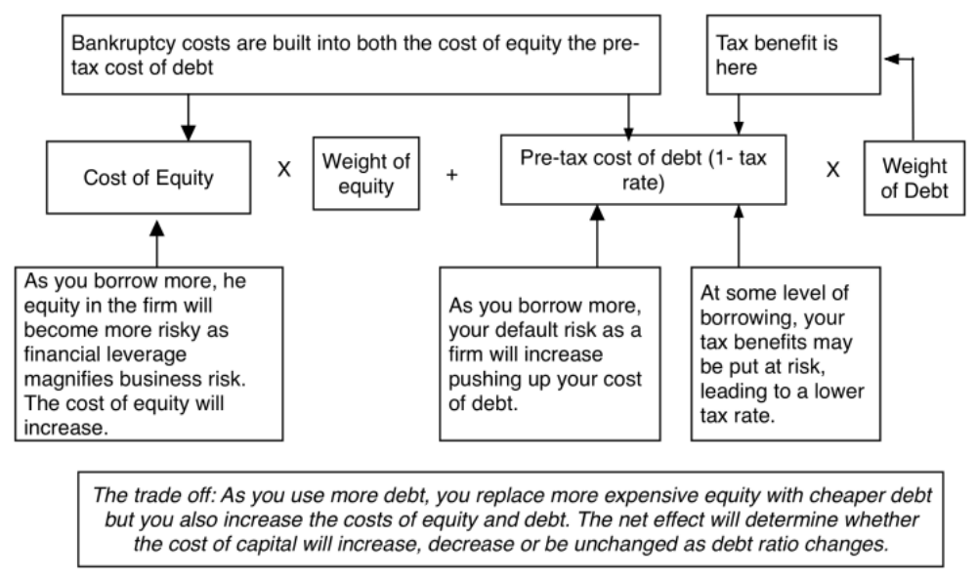
Myth 2: Borrowing money always lowers your cost of capital
Notes:
Reducing the cost of capital, holding cashflows constant, increases firm value. Note that while people tend to focus on changing the mix of debt and equity to reduce cost of capital, you can reduce cost of capital by reducing fixed costs and by making your product/service less discretionary to your customers…

Slide 25
Lesson 3: Control is not worth 20%.. It could be worth nothing or 100%
The value of control is target-specific: The value of control will depend upon how well or badly managed the target firm is, and how easily the mismanagement can be fixed by a new management (presumably you).
Without a plan, that value will not delivered: Control does not happen by accident. To enhance value, you need to know what (in the target firm) needs changing and what should be left alone and.
And if you pay it all as a premium, why bother? If you pay the entire value of control as a premium, you are putting in the hard work and target shareholders are reaping the benefits.
Notes:
Rules of thumb in billion dollar valuations are signs of laziness and indicate an unwillingness to actually estimate the value of control or what a reasonable value to EBITDA multiple is for a firm.

Slide 26
If you fail this test
Pointless Premiums: If control is always worth 20%, you will find a way to pay a premium for any company, even if you have no good reason for doing acquisitions.
Control ≠ Change: If you do not do your homework on what you plan to change after you acquire a firm you will either change nothing or use cookbook solutions (borrow money & buy back stock).
Leave all value on table: If you do not value control explicitly, you will leave it all on the table or even pay more than it is worth to target shareholders.

Slide 27
Test 4: Synergy Magic

Slide 28
Synergy….
Assume that you are told that the combined firm will be less risky than the two individual firms and that it should have a lower cost of capital (and a higher value). Is this likely?
  Yes
  No
Assume now that you are told that there are potential growth and cost savings synergies in the acquisition. Would that constitute value added?
  Yes
  No
Should you pay this as a premium?
  Yes
  No
Notes:
Answer to part a
Not unless I am given specifics. Buzz words are worth nothing.
Answer to part b
By the present value of the cashflows that will be generated by the synergy
Answer to part c
Since synergy requires both the acquiring firm and the target firm’s strengths to be pooled, you (as the acquirer) should demand your fair share of that synergy. If there are literally dozens of firms that have the strength you bring to the merger, odds are that you will end up with very little of the synergy.

Slide 29
The Value of Synergy
Notes:
The value of synergy has to show up in one or more of the inputs into a DCF valuation. In this picture, I look at different types of synergy (operating and financial) and where they will show up in terms of the inputs…

Slide 30
Valuing Synergy
Step 1: The firms involved in the merger are valued independently, by discounting expected cash flows to each firm at the weighted average cost of capital for that firm.
Step 2: The value of the combined firm, with no synergy, is obtained by adding the values obtained for each firm in the first step.
Step 3: The effects of synergy are built into expected growth rates and cash flows, and the combined firm is re-valued with synergy.
  Value of Synergy = Value of the combined firm, with synergy - Value of the combined firm, without synergy
Notes:
You have to do three valuations to value synergy and you have to quantify the impact of synergy into valuation inputs.

Slide 31
Synergy 1.1: Why lower risk is an illusion..
When we estimate the cost of equity for a publicly traded firm, we focus only on the risk that cannot be diversified away in that firm (which is the rationale for using beta or betas to estimate the cost of equity).
When two firms merge, it is true that the combined firm may be less risky than the two firms individually, but the risk that is reduced is ‘firm specified risk’.
By definition, market risk is risk that cannot be diversified away and the beta of the combined firm will always be a weighted average of the betas of the two firms in the merger.
When does it make sense to “merge” to reduce total risk?

Slide 32
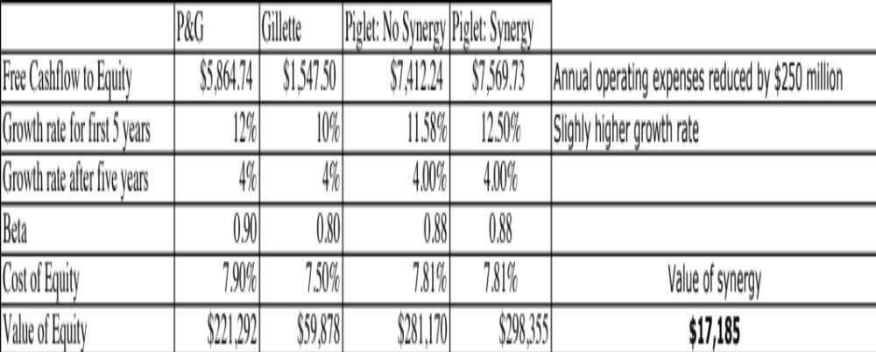
Synergy 1.2: Higher growth and cost savings can create value
Notes:
If you can cut costs and/or increase growth, synergy can be worth a lot.
In this example, P&G has synergy of almost $ 17 billion in the acquisition of Gillette.
This is probably a best case valuation, since it is based on assuming that everything managers claimed would happen actually happened and did so instantaneously.
A Follow up question
What would happen to the value of synergy if the cost savings were over estimated by $ 100 million/year? (Drop by 40%)
What if you have to wait 5 years for synergy to show up? (You would have to discount the value of synergy back 5 years, using the cost of capital of the combined firm)

Slide 33
Synergy 1.3: Paying that synergy as a premium on price is a mistake
Premium on value versus price: If you have valued the acquiring and target companies and derived the value of synergy by valuing the combined firm, that synergy value is over intrinsic value, not price. You have to compute the premium over price, which can be much smaller (usually) or bigger (sometimes).
Fair share? If you pay the entire synergy as a premium, you are effectively delivering the entire value to the target company stockholders and keeping none for yourself.

Slide 34
Lesson 4: Value synergy first and make sure you negotiate for your fair share.
You have to value synergy, before you decide how much to pay (not after): Synergy will be the buzzword that explains away the premium that you are paying.
To value synergy, you need specifics: Before you value synergy, you need to be specific about what synergies you see in a merger and where they will show up in a valuation.
Don’t mistake control for synergy: If the benefits can be generated by just one of the two entities in the merger, it is not synergy.
Negotiate for your fair share: As the acquiring firm, you should negotiate for your share of the synergy, not pay it all off as a premium.
Notes:
To value synergy, you would need to do the following:
Value the two firms independently
Define how synergy will show up in the combined firm. It can take the form of higher growth (with growth synergies), higher margins (with cost saving synergies), longer growth period (with strategic synergies).
Value the combined firm with the synergy built it.
Value of synergy = Value of combined firm (from step c) - Sum of the values of the independent companies from step a.

Slide 35
If you fail this test
Synergy will become a plug variable: Synergy will be your explanation for the difference between what you paid and what you should have.
No plan, no synergy: If you are not explicit about the form synergy will take, you cannot plan for it and check to see whether it is being delivered. That may explain:
  Why synergy does not manifest itself in so many mergers, after the mergers.
  Why no one seems to lose their jobs, even after the worst mergers.

Slide 36
Test 5: The Pricing Game

Slide 37
Exit Multiples and Comparables
Now assume that you are told that an analysis of other acquisitions reveals that acquirers have been willing to pay 5 times EBITDA.. Given that your target firm has EBITDA of $ 40 million, would you be willing to pay $ 200 million for the acquisition?
What if I estimate the terminal value using an exit multiple of 5 times EBITDA?
Notes:
Two basic problems here:
Sampling bias: Looking at transaction multiples (on other acquisitions), you are looking a sample of firms that are likely to have over paid. If you are going to do relative valuation, at least look at how other publicly traded companies in the sector are trading at. Better still, try to control for differences between your firm and these comparable firms.
If the market is, on average, wrong and overpaying for stocks in a sector, you will end up overpaying as well. This problem becomes even worse when you use the industry average to estimate terminal value in acquisition valuations. If the market is wrong, it is likely to correct well before you get to your terminal year.

Slide 38
Pricing ≠ Value

Slide 39
The Problems in Acquisition Pricing
Biased samples: Basing what you pay on what other acquirers have paid is a recipe for disaster. After all, we know that acquirers, on average, pay too much for acquisitions. By matching their prices, we risk replicating their mistakes.
Game Playing with Metrics: Allowing analysts (especially if they have an agenda) to pick the multiple that they will use is a recipe for backing into a bad deal.
Myopic Multipliers: One of the most distracting games in acquisitions is working out EPS accretion and dilution, and arguing that accretive mergers are good (they are not) and dilutive mergers should be avoided (again not true).
And pushing into the terminal value does not make the problem go away: Creating a front end of cash flows, when the terminal value is coming from a multiple, is not a discounted cash flow valuation.

Slide 40
Lesson 5: If you are going to price a target firm, do it right..
Pick your game: If you are acquiring other companies not for the cash flows but because you think that you can sell them to someone else at a higher price, it is perfectly okay to play the pricing game. If you are acquiring a firm for its cash flows, you have to play the value game.
Don’t get distracted: If you are playing the pricing game, dispense with the DCF and do an honest pricing. If you are playing the value game, stop looking at what other people are paying.
To do an honest pricing, you have to be unbiased in your choice of multiple and comparable firms, and control for differences between your firm & the peer group.
Notes:
The fact that everyone else in the sector is doing bad acquisitions and over paying for them is not a good reason to join the group. It is entirely possible that you are operating in a value destroying sector and it may be time for you to consider shrinking while everyone else is expanding or better still become a target of their acquisitions.

Slide 41
If you fail this test..
You will over price the target: By using a biased sample (of acquirers who are more likely to be over paying), you will end up over paying as well.
You will open the door to bias in your choice of multiples: Since you pick the multiple, you will find bias guiding your choices.
You will end up paying twice for synergy and control: Even if other acquirers are paying a “fair” price on their acquisitions, that fair price will already include a control premium and perhaps a synergy premium. Paying these premiums on top of your assessed price will be double paying.

Slide 42
Test 6: The CEO wants this..

Slide 43
The CEO really wants to do this… Or your competitors are all in the game..
Now assume that you know that the CEO of the acquiring firm really, really wants to do this acquisition and that the investment bankers on both sides have produced fairness opinions that indicate that the firm is worth $ 150 million. Would you be willing to go along?
  Yes
  No
Now assume that you are told that your competitors are all doing acquisitions and that if you don’t do them, you will be at a disadvantage? Would you be willing to go along?
  Yes
  No
Notes:
Fairness opinions are not worth the paper they are written on. When the deal makers (investment bankers) also pass judgment on whether the deal makes sense (which is what the fairness opinion provides), you have a huge conflict of interest.

Slide 44
CEO Egos and Overconfidence: The Dirty Secret in Mergers
The Deal Rules: The premiums paid on acquisitions often have nothing to do with synergy, control or strategic considerations (though they may be provided as the reasons). They are just what you have to pay to get the deals done, because management really, really wants it done.
The Ego Problem: They may just reflect the egos of the CEOs of the acquiring firms. There is evidence that “over confident” CEOs are more likely to make acquisitions and that they leave a trail across the firms that they run.

Slide 45
Defensive Mergers: Signs of a Deeper Rot?
Me-tooism: Pre-emptive or defensive acquisitions, where you over pay, either because everyone else is overpaying or because you are afraid that you will be left behind if you don’t acquire are dangerous.
Weak businesses? If the only way you can stay competitive in a business is by making bad investments, it may be best to think about shrinking or even getting out of the business.
There is no glory in survival, for the sake of survival. Corporate sustainability, as a corporate objective, is not just a joke, but an expensive one.

Slide 46
The Deal Process is broken..
Deal makers are deal analysts: If you were going to design a process that maximizes bias, you could not do much better than the current one, especially in a friendly merger.
Spending other People’s Money: Managerial interests don’t align with shareholder interests and they can advance them using shareholder money.
Boards of directors are managerial rubber stamps, mostly incapable or unwilling to check managerial egos.
The legal system is incapable of stopping bad acquisitions. Unwittingly, it has given acquiring firms a template to evade responsibility for bad mergers, with the expensive charade called ”fairness opinions”.

Slide 47
Fairness Opinions: A waste of time and money?

Slide 48
Lesson 6: Egos and Conflicts of Interest are your biggest enemies
Winning is not everything: If you define your objective in a bidding war as winning the auction at any cost, you will win. But beware the winner’s curse!
Bankers do what’s in their best interests, not yours: If your rewards and compensation are contingent on the deal going through, you cannot be an honest advisor.
It is easy to spend other people’s money: In public companies, it is shareholder money that is being spent on acquisitions, often in the pursuit of managerial interests. Boards of directors need to do their jobs.
Notes:
This is not a macho game. CEOs are all too willing to fight out acquisitions with other people’s money. Investment bankers are all too willing to go along. In a typical acquisition, who is watching out for the stockholders of the acquiring firm?

Slide 49
Test 7: Accountability

Slide 50
When deals fall apart..
When deals fall apart, as many do, there seems to be little or no accountability in the system, and the larger the deal, the less accountability there is for mistakes.
Breaking it down:
  The managers who initiate these bad deals seem to face few consequences and often move up the ranks.
  The boards that okay these deals protect themselves by claiming that the did due diligence and listened to experts.
  The bankers keep their fees, arguing that their missed forecasts were just mistakes.

Slide 51

To illustrate: A bad deal is made, and justified by accountants & bankers
Notes:
HP acquired Autonomy, a UK-based business software company, for $11.1 billion in 2011. At the time, almost everyone except for HP’s management thought that they were paying too much. Leo Apotheker, HP’s CEO at the time, claimed that they had done their homework and that the investment bankers had done a DCF and found the deal to be an accretive, good deal. The board of HP went along with the deal… and Meg Whitman was on the board. This is the same board that a year earlier had been caught sleeping on the job as the previous CEO, Mark Hurd, was found to have been involved in personal misconduct… And guess what…. This board met all of the Sarbanes Oxley requirements for independence.

Slide 52
The CEO steps in… and digs a hole…
Leo Apotheker was the CEO of HP at the time of the deal, brought in to replace Mark Hurd, the previous CEO who was forced to resign because of a “sex” scandal.
In the face of almost universal feeling that HP had paid too much for Autonomy, Mr. Apotheker addressing a conference at the time of the deal: “We have a pretty rigorous process inside H.P. that we follow for all our acquisitions, which is a D.C.F.-based model,” he said, in a reference to discounted cash flow, a standard valuation methodology. “And we try to take a very conservative view.”
Apotheker added, “Just to make sure everybody understands, Autonomy will be, on Day 1, accretive to H.P….. “Just take it from us. We did that analysis at great length, in great detail, and we feel that we paid a very fair price for Autonomy. And it will give a great return to our shareholders.

Slide 53

A year later… HP admits a mistake…and explains it…
Notes:
About a year later, HP announced that it was writing off almost $8.9 billion off its original deal value and claimed that Autonomy had cooked the books. This was my attempt to break down the write off, even with the presumption of accounting impropriety. The CEO of HP, Meg Whitman, claimed no responsibility…

Slide 54
A Glimmer of Hope!

Slide 55
Gauging the Odds
The odds seem to be clearly weighted against success in acquisitions. If you were to create a strategy to grow, based upon acquisitions, which of the following offers your best chance of success?
This | Or this
Sole Bidder | Bidding War
Public target | Private target
Pay with cash | Pay with stock
Small target | Large target
Cost synergies | Growth synergies
Notes:
Not necessarily…

Slide 56

1. Better to lose a bidding war than to win one…
Returns in the 40 months before & after bidding war
Source: Malmendier, Moretti & Peters (2011)
Notes:
This graph looks at the stock returns a forty-month period after a bidding war to the “winner” and “loser” of the bidding war… Seems like no contest. The losing firm in the bidding war significantly outperforms the winning firm by almost 50%. The results are invariant to different measures of risk and correcting for sector performance.

Slide 57

2. Better off buying small rather than large targets…
Notes:
Note that the larger the target, the greater the negative returns…
And cash acquisitions tend to do better than stock acquisitions, at least for big acquisitions. For small acquisitions, the reverse is true.. (Perhaps, target company stockholders in big acquisitions are more likely to be suspicious about the use of stock as currency)

Slide 58

3. And focusing on private firms and subsidiaries, rather than public firms…
Notes:
Better to target private businesses and subsidiaries, where you don’t have to pay market price plus…

Slide 59


4. On cost synergies, not growth synergies
Notes:
Cost savings synergies are more likely to be realized than growth synergies. Here are some reasons why:
They are more concrete and more likely to therefore be put down on paper
It is easier to hold some one responsible for delivering cost savings
It is easier to track how close you are to your forecasts

Slide 60
For acquisitions to create value, you have to stay disciplined..
Staying disciplined is the only way to create value in acquisitions. Thus, if you find a way to create value by buying small, private businesses or divisions of other companies, you should stick with that strategy.
This strategy is time limited: Even the most successful acquirers will finds that an acquisition based strategy runs out of steam because:
  The acquiring firm becomes too big.
  Imitators enter the game and push up the price of targets.
Notes:
This is a very tough game to win at. When you decide to grow through acquisitions, especially of publicly traded firms, the odds are against you because you always have to pay the market price plus a premium. It is not who you buy that determines the success of an acquisition, it is how much you pay.
The odds are better when you grow by buying private companies, where you assess the value and you are less likely to get into bidding wars. In addition, there are real constraints on private firms that my be removed when you take them over. This offers potential for increasing value.

