Slide 1
AI: The Personal Threat
The AI Bogeyman is coming: Are you ready

Slide 2
The Damodaran Bot
I was in the eleventh week of teaching my 2024 spring semester classes at Stern, when my good friend, Vasant Dhar, who teaches a range of classes from machine learning to data science at Stern, and has forgotten more about AI than I will ever know, called me.
He mentioned that he had developed a Damodaran Bot, and explained that it was an AI creation, which had read every blog post that I had ever written and every valuation that I had made public. Since almost everything that I have ever written or done is in the public domain, in my blog, YouTube video and webpage, that effectively means that my bot is better informed than I am about my own work, since its memory is perfect and mine is definitely not.
He also went on to tell me that he was ready to take the Bot on a trial run, and when I asked him what he meant, he said that he would like the Bot to value companies and see how those valuations measured up against valuations done by the best students in my class.

Slide 3
Gauging the threat!
In the months since I was made aware of the Damodaran Bot, I have thought in general terms about what AI will be able to do as well or better than I can, and the areas where it might have trouble.
Ultimately, AI is the culmination of two forces that have become more powerful over the last few decades.
  The first is increasing (and cheaper) computing power, often coming into smaller and smaller packages; our phones are now computationally more powerful than the very first personal computers.
  The second is the cumulation of data, both quantitative and qualitative, especially with social media accelerating personal data sharing.
As an AI novice, it is entirely possible that I am not gauging the threat correctly, but there are four dimensions on which I see the AI playing out (well or badly).

Slide 4
1. Mechanical versus Intuitive/Adaptable
Well before ChatGPT broke into the public consciousness, IBM's Deep Blue was making a splash playing chess, and beating some of the world's greatest chess players.
  Deep Blue's strength at chess came from the fact that it had access, in its memory, to every chess game ever played (data) and the computing power to evaluate 200 million chess positions per second, putting even the most brilliant human chess player to shame.
In contrast, AI has struggled more with automated driving, not because driving is mechanically complicated, but because there are human drivers on the surface roads, behaving in unpredictable ways.
While AI is making progress on making intuitive leaps, and being adaptable, it will always struggle more on those tasks than on the purely mechanical ones.

Slide 5
2. Rules-based versus Principles-based
Expanding the mechanical/intuitive divide, AI will be better positioned to work smoothly in rules-based disciplines and will be at a disadvantage in principle-positioned disciplines.
  Using valuation to illustrate my point, accounting and legal valuations are mostly rule-based, with the rules sometimes coming from logic, and sometimes from arbitrary rule writers. AI can not only replicate those valuations but can do so at no cost and with a much closer adherence to the rules.
  In contrast, financial valuations done right, is built around principles, requires judgment calls and analysis on the part of appraisers, on how these principles get applied, and should be more difficult to replace with AI.

Slide 6
3. Subjective versus Objective
When valuing companies, I am often accused by those who disagree with my numbers of being “subjective”, with the subtext being that estimating something (and being wrong) is a sign of weakness.
  The alternative that they are looking for is something objective, by which they usually mean an equation or data.
  The bottom line is that the future is subjective, and using objectivity as a shield against making estimates is delusional.
If your entire process is built around this version of objectivity, a machine can do it better than you can.

Slide 7
4. Biased versus Open minded
If you are biased, your analysis will lead you to the outcome that your biases direct you towards. The more biased you become, the more predictable your outcomes will be as well.
  It is human nature to claim, even in the face of obvious bias, that you are being open minded.
  The bottom line is that if you become biased enough that your outcomes become predictable, a machine will replicate you (at least in terms of outcome) though it may not be able to match your hypocrisy.

Slide 8
Responding to AI
While AI, at least in its current form, may be unable to replace you at your job, the truth is that AI will get better over time, as it learns more from watching what you do.
So, what can we do to make it more difficult to be outsourced by machines or replaced by AI?
  It is a question that I have thought about for three decades, as machines have become more powerful, and data more ubiquitous, and while I don't have all of the answers, here are some thoughts.
  The answers I have are those that work for me, reflecting what I think are my strengths and weaknesses, and what I do.
  You have to come with your own answers.

Slide 9
1. Generalist versus Specialist
In the last century, we have seen a push towards specialization in almost every discipline.
  In medicine, the general practitioner has become the oddity, as specialists abound to treat individual organs and diseases.
  In finance, there are specialists in sub-areas that are so esoteric that no one outside those areas can even comprehend the intricacies.
In the process, there are fewer and fewer people who are comfortable operating outside their domains, and humanity has lost something of value.
In a great book on forecasting, Phil Tetlock argues that foxes (people who know a little bit a lot of things) do better are forecasting than hedgehogs (people who know a great deal about their domain)

Slide 10
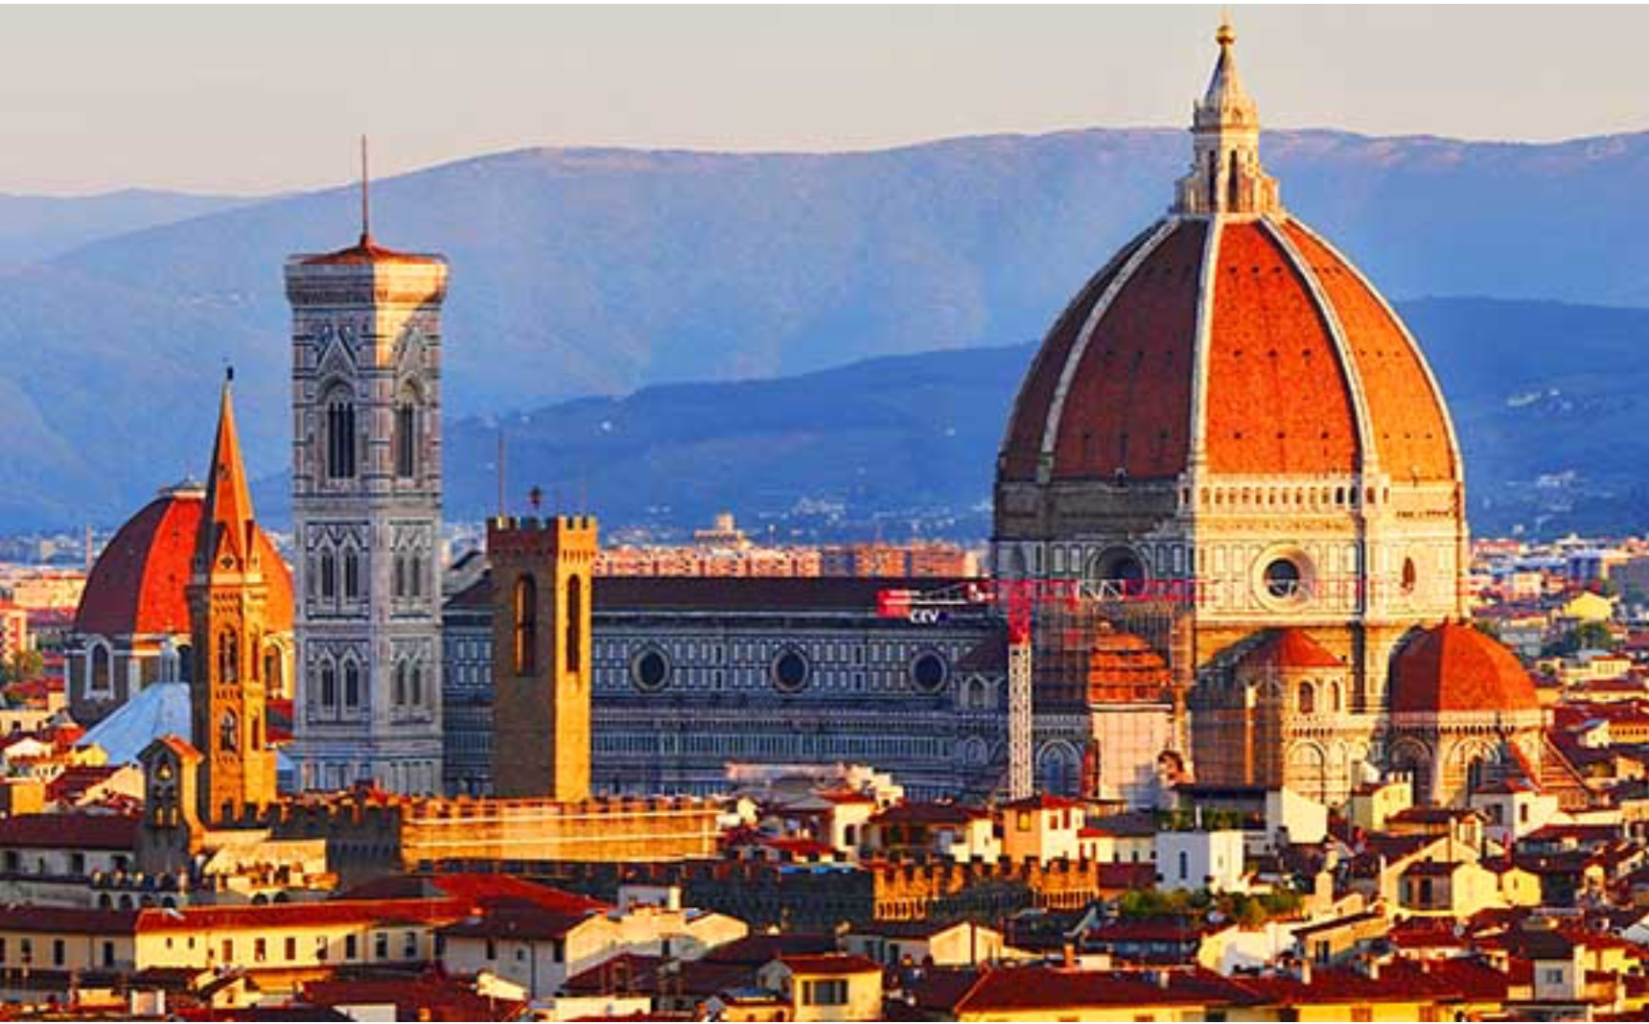
The answer is in the Duomo!

Slide 11
2. Bounded Storytelling
Starting about a decade ago, I drew attention to a contradiction at the heart of valuation practice, where as access to data and more powerful models has increased, in the last few decades, the quality of valuations has actually become worse.
I argued that one reason for that depletion in quality is that valuations have become much too mechanical, exercises in financial modeling, rather than assessments of business quality and value.
If, as legend had it, you have a right brain (controlling your story side) and a left brain (controlling the numbers), most of us as acting as if we are half brained.

Slide 12
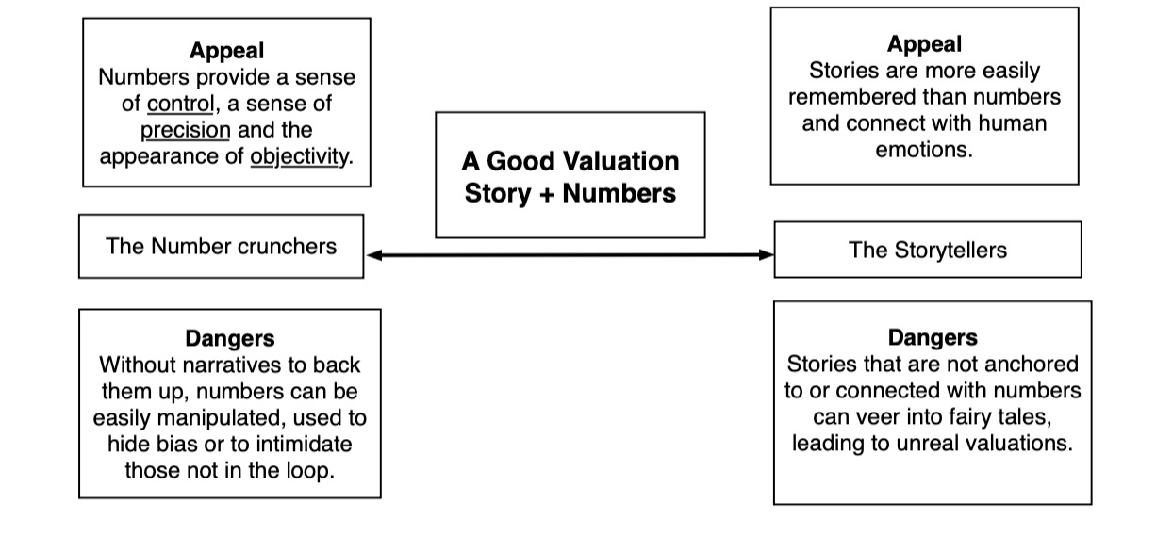
The answer: Stories plus Numbers

Slide 13
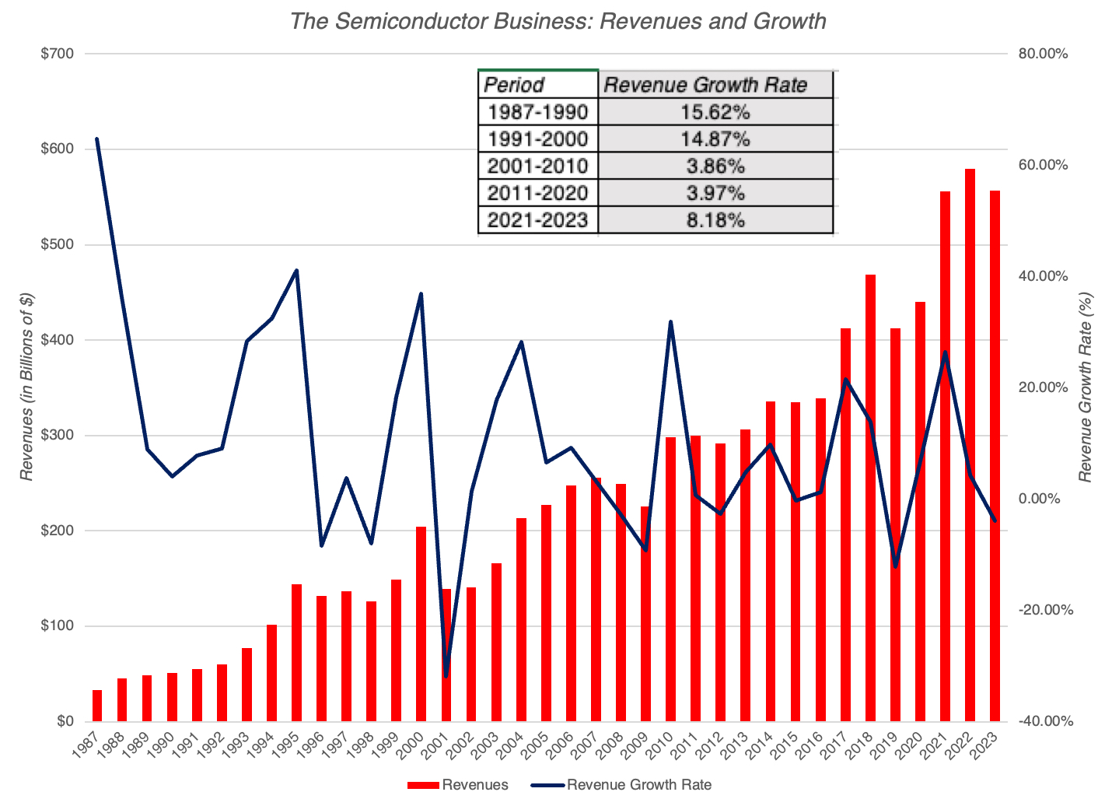
The Semiconductor Business – A Growth Business that is maturing!

Slide 14
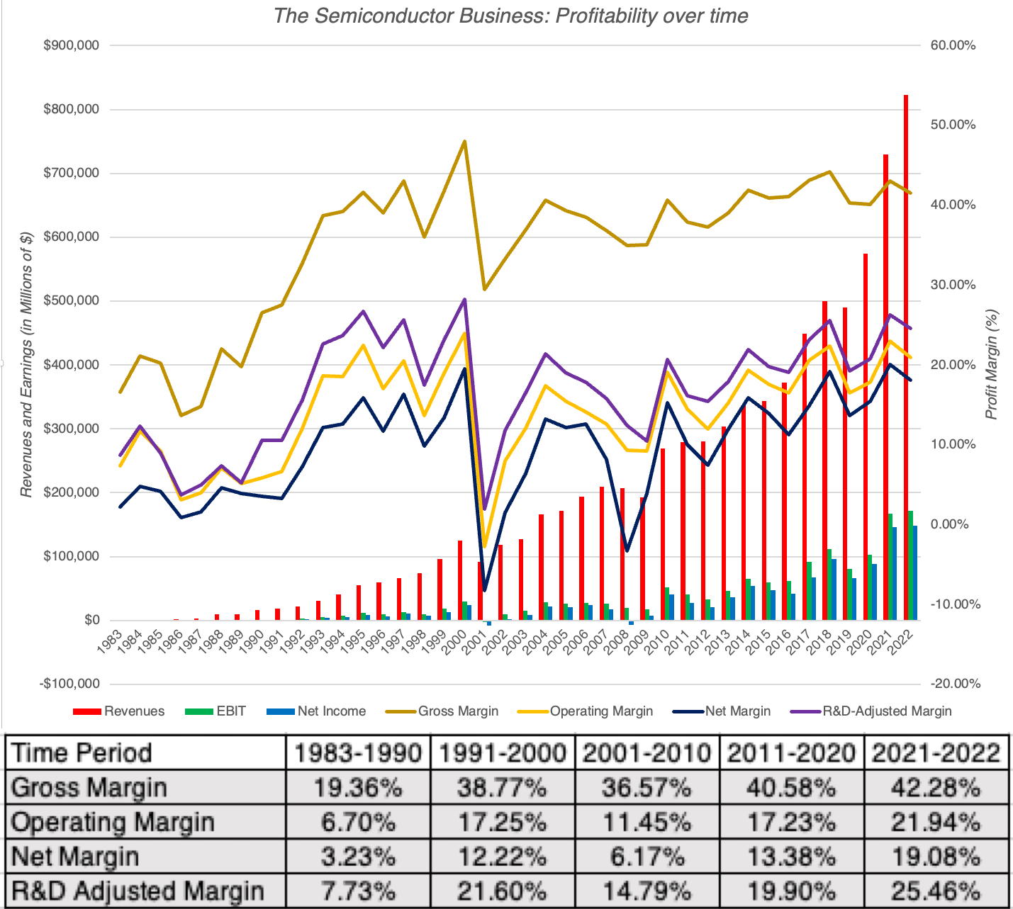
Profitable, with Cycles….

Slide 15
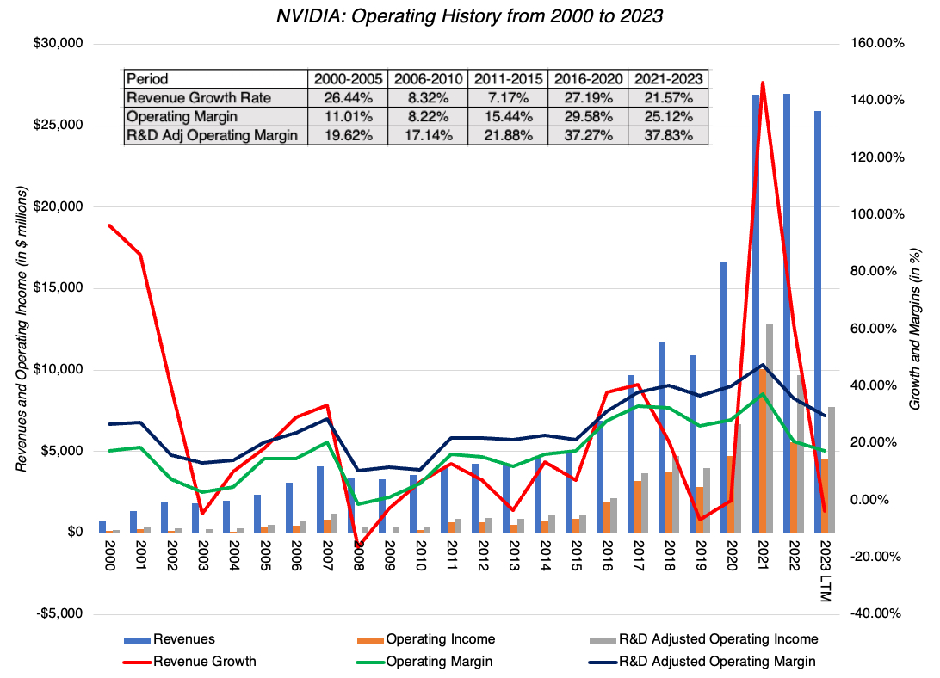
NVIDIA - Opportunistic Growth

Slide 16
NVIDIA: The Payoff to Opportunism
Powered by its lead in the AI chip business, Nvidia will continue on its path of high growth, but even with dominance, that growth will level off. While Nvidia might find other new markets, none of them are likely to provide the market size to allow for continued growth.
As a design company, Nvidia will be able to generate supernormal profit margins. However, it will face push back from powerful players on the other side:
  On the unit economics side, Nvidia will have to share more of its spoils with TSMC, as the two are locked into an embrace that neither can break away from.
  On the customer side, Nvidia’s four biggest customers are giants themselves, and will either look to competition or develop their own chips, putting stress on pricing power.
On the reinvestment side, Nvidia will continue to reinvest in the next generations of chips, but in a market place where others are throwing large amounts of money at doing the same.

Slide 17
Nvidia: The 3P Test
The AI chip market will grow from $80 billion in 2024 to $500 billion in 2034.
  That would require that the AI product/service market be about $2.5 to $3 trillion.
  And that the infrastructure to build this market will be about 20% of total revenues
Nvidia will maintain a dominant market share (60%) of this market, down from its current 80%.
  Competitors will expend significant amounts of money, developing their own chips, but the first mover advantage will keep Nvidia at the top
Nvidia will remain a money-making machine, but its margins will come under pressure, from both its supplier (TSMC) side and consumers (big tech).

Slide 18
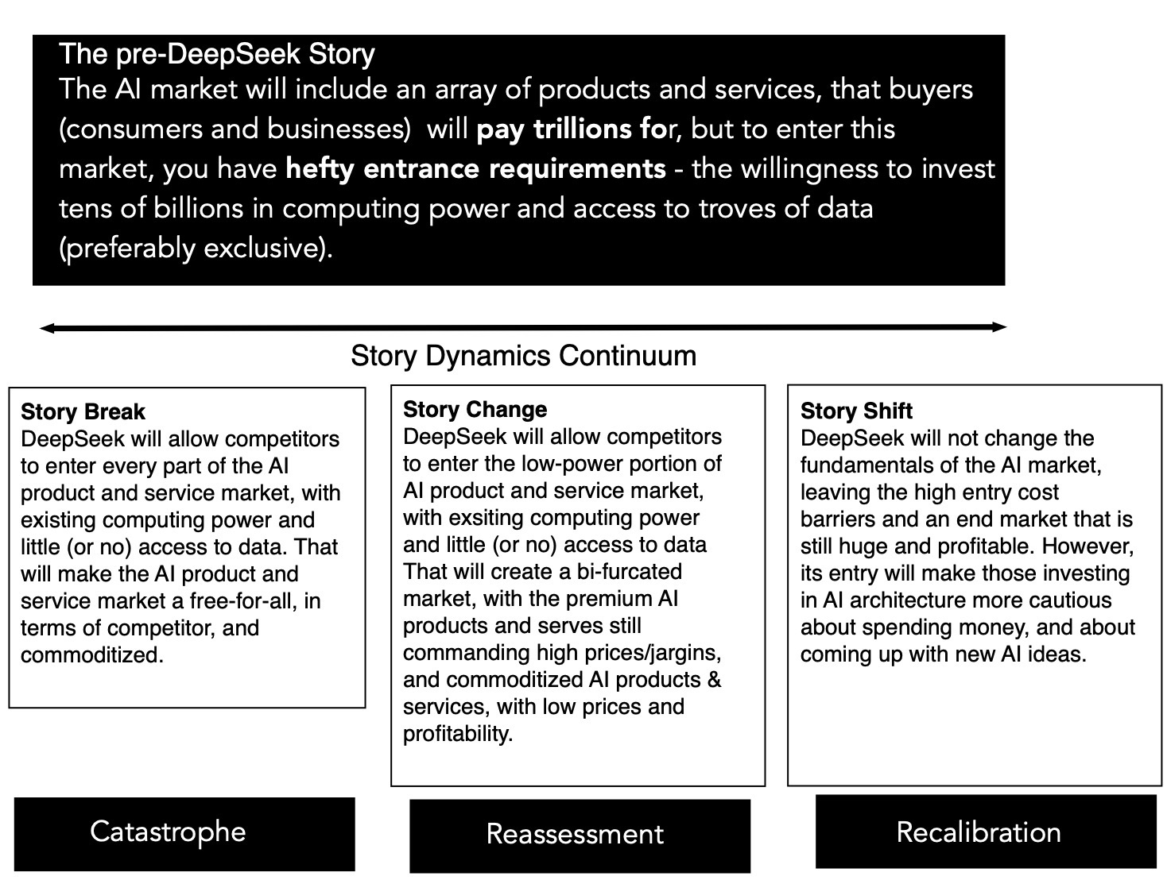
The deepseek effect on the ai story

Slide 19
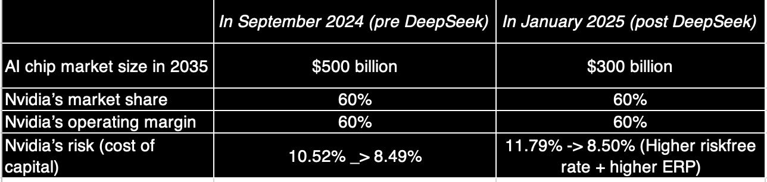
The value effect at Nvidia

Slide 20
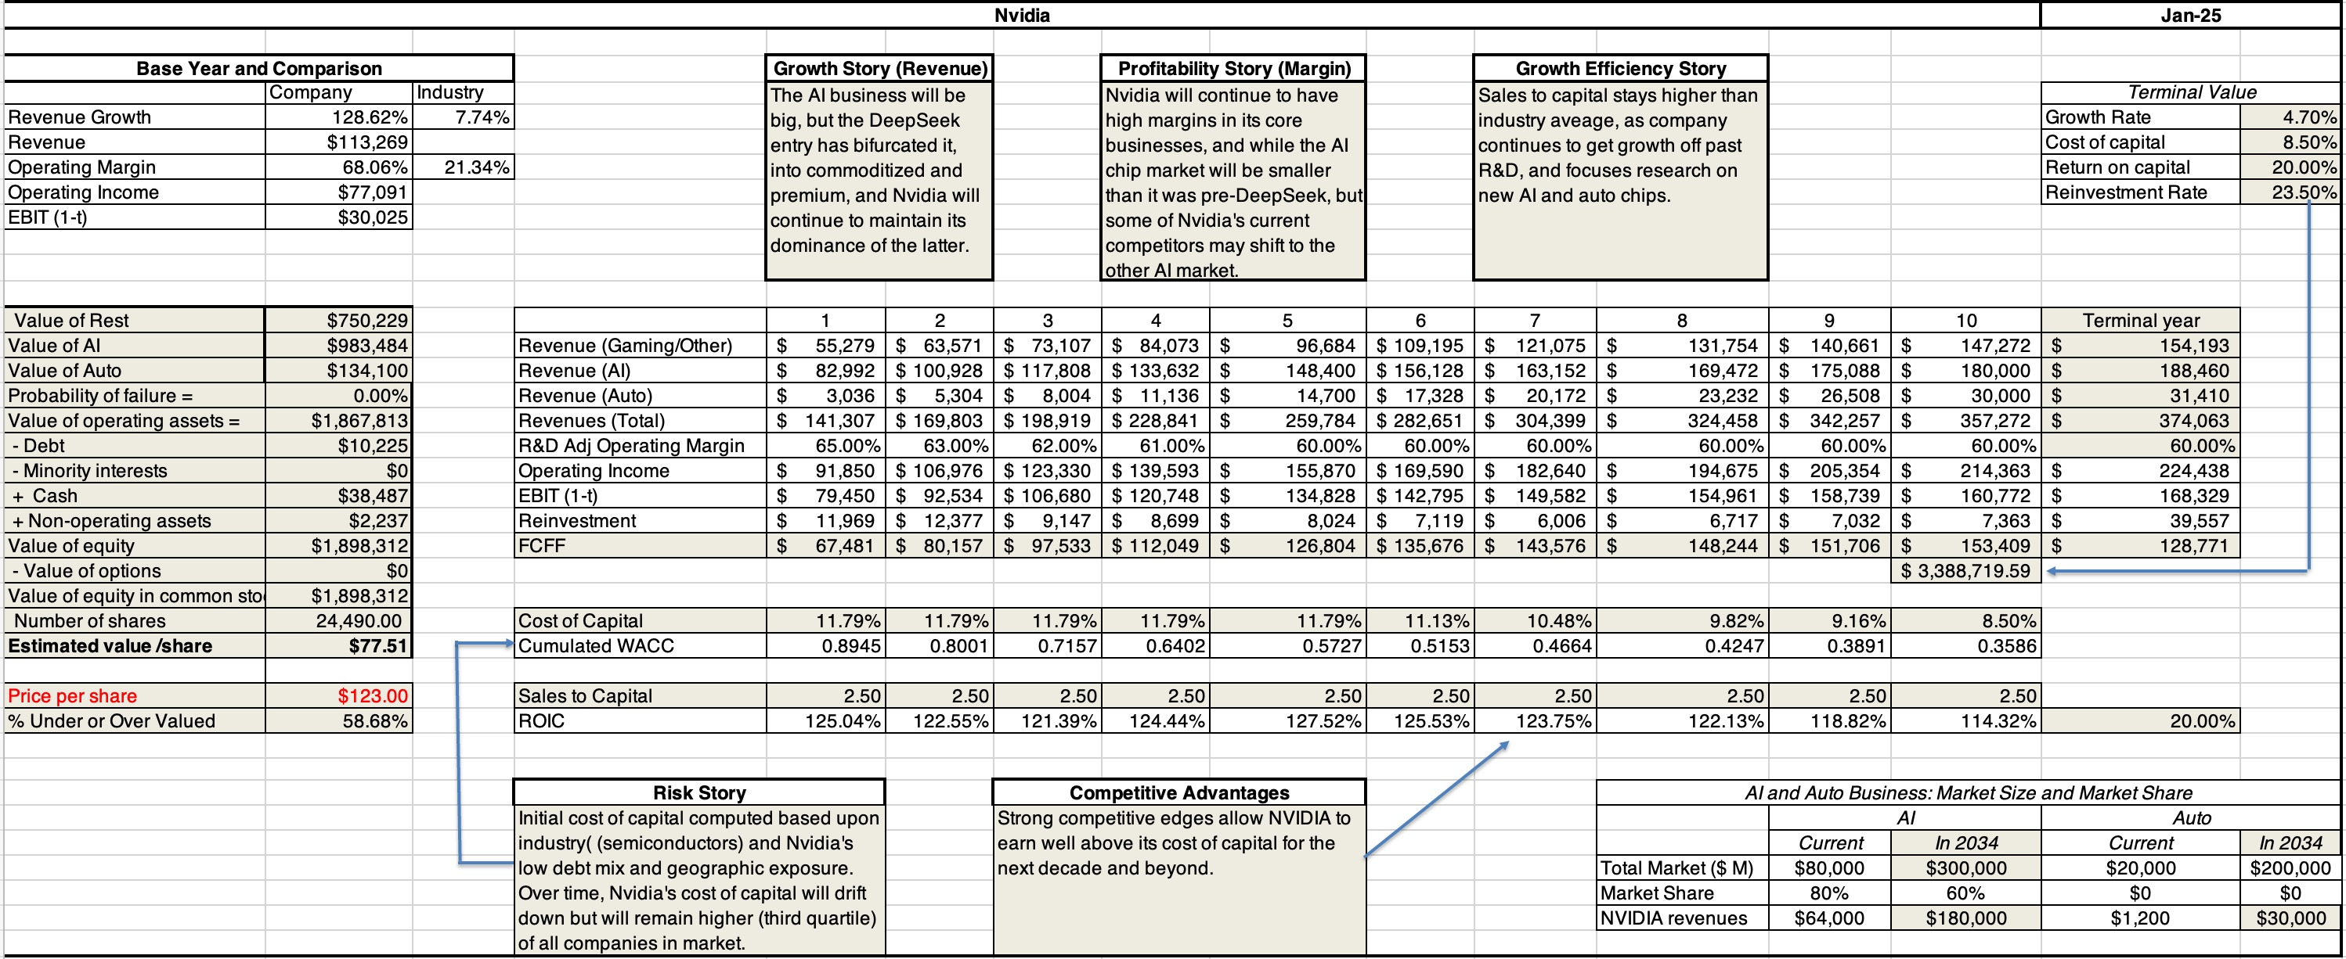
My post-deepseek nvidia valuation

Slide 21
3. Exercise your reasoning muscle…
I have never been good at reading physical maps, and I must confess that I have completely lost even my rudimentary map reading skills, having become dependent on GPS to get to where I need to go.
While that may not make or break me, there are other skills that we have has human beings, where letting machines step in and help us, because of convenience and speed, may have much worse long term consequences.
In an interview I did on teaching a few years, I called this the "Google Search" curse, where when faced with a question, we often are quick to look up the answer online, rather than try to work out the answer.

Slide 22
The answer: Reason it out…
While looking up answers to questions is benign, if you are looking up answers to trivia, it can be malignant, when used to answer questions that we should be reasoning out answers to, on our own.
That reasoning may take longer, and sometimes even lead you to the wrong answer, but it is a learned skill, and one that I am afraid that we risk losing, if we let it languish.
You may think that I am overreacting, but evolution has removed skill sets and organs that we used to use as human beings, when we stopped using or needing them, and reasoning may be next on the list.

Slide 23
4. Let your mind wander…
An empty mind may the devil's workshop, at least according to puritans, but it is also the birthplace for creativity.
I have always marveled at the capacity that we have as human beings to connect unrelated thoughts and occurrences, to come up with marvelous insights.
Like Archimedes in his bath and Newton under the apple tree, we too can make discoveries, albeit not as weighty, from our own ruminations.

Slide 24
Two personal examples…
The first one, Snowmen and Shovels, emerged while I was shoveling snow after a blizzard on the East coast, and as I and my adult neighbors struggled with the heavy snow, our kids were out building snowmen, and I thought of a market analogy, where the same shock (snowstorm) evokes both misery (from some investors) and joy (on the part of others) .
The second, written more recently, was formed while I walked my dog, and pondered how earthquakes in Iceland, a data leak at a genetics company and climate change affected value, and became a more general discourse on how human beings respond (not well) to the possibility of catastrophes.

Slide 25
Are we disarming ahead of the threat?
It is disconcerting that on every one of these four fronts, progress has made it more difficult rather than less so, to practice.
In fact, if you were a conspiracy theorist, you could spin a theory of technologists conspiring to deliver us products, often free and usually convenient, that make us more specialized, more one dimensional, less reasoning and that consume our free time.
This may be delusional on my part, but if I want to keep my bot at bay, and I take these lessons to heart, I should continue to be a dabbler in all that interests me, work on my weak side (which is story telling), try reasoning my way to answers before looking them up online and take my dog for more walks.

Slide 26
Prepping for your Bot Threat
The degree to which AI is a threat to you will vary across disciplines and jobs, but there are some jobs where it will be less of a threat than others.
  White collar jobs are more at threat than blue collar jobs (The ”learn to code” advice meted out rather thoughtlessly to factory workers may become “learn to plumb” being dished out to software engineers and financial analysts.)
  Hard skills are more at threat than soft skills. In my classes, there have always been students who feel that their first priority should be learning Excel. While I have always believed this to be the wrong path, AI makes me even more vehement on this front.
The question each of you has to answer is how big the threat is to you, and what (if anything) you can do to get ahead of it.

Slide 27
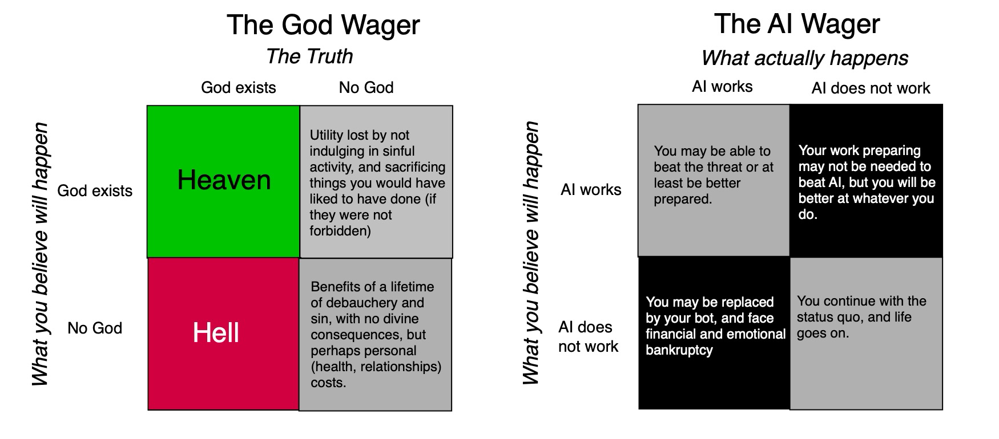
Passcal’s Wager (applied to AI)

Slide 28
Beat your bot!
I am in an unusual position. My life’s work is in the public domain, and I have a bot with my name on it not only tracking all of that work, but also shadowing me on any new work that I do.
  On the minus side, my AI threat is here, and I don’t have the choice of denying its existence or downplaying what it can do.
  On the plus side, I am old enough to not face financial catastrophe, if outsources
Your work may not be public, and you may not have a bot with your name on it, but it behooves you to act like there is one that tracks you at your job.

Slide 29
1. The Secrecy Strategy
My bot has learned how I think and what I do because everything I do is public - on my blog, on YouTube and in my recorded classes.
I know that some of you may argue that I have facilitated my own disruption, and that being more secretive would have kept my bot at bay.
As a teacher, I neither want that secrecy, nor do I think it is feasible, but your work may lend itself better to this strategy. There are two reasons to be wary, though.
  The first is that if others do what you do, an AI entity can still imitate you, making it unlikely that you will escape unscathed.
  The second is that your actions may give away your methods and work process, and AI can thus reverse engineer what you do.

Slide 30
2. The “System Protection” Strategy
I have bought and sold houses multiple times in my lifetime, and it is not only a process that is filled with intermediaries (lawyers, realtors, title deed checkers), all of whom get a slice from the deal, but one where you wonder what they all do in return for their fees. The answer often is not rooted in logic, but in the process, where the system (legal, real estate) requires them to be there for the house ownership to transfer.
This system protection for incumbents is not just restricted to real estate, and cuts across almost every aspect of our lives, and it creates barriers to disruption.
Thus, even if AI can replicate what appraisers do, at close to no cost, I will wager that courts and accounting rule writers will be persuaded by the appraisal ecosystem that the only acceptable appraisals can come from human appraisers.

Slide 31
3. Build your moat!
In business, companies with large, sustainable competitive advantages are viewed as having moats that are difficult to competitors to breach and are thus more valuable.
  That same idea applies at the personal level, especially as you look at the possibility of AI replacing you.
  It is your job, and mine, to think of the moats that we can erect (or already have) that will make it more difficult for our bots to replace us.
As to what those moats might be, I cannot answer for you, but the last section lays out my thinking on what I need to do to stay a step ahead.

Slide 32
The Bottom Line
I am a work in progress, even at this stage of my life, and rather than complain or worry about my bot replacing me, I will work on staying ahead.
It is entirely possible that I am embarking on an impossible mission, but I will keep you posted on my progress (or absence of it).
Of course, my bot can get so much better at what I do than I am, in which case, this blog may very well be written and maintained by it, and you will never know!

