Slide 1
The corporate life cycle: Growing up Is hard to do, growing old is even harder!
Aswath Damodaran

Slide 2
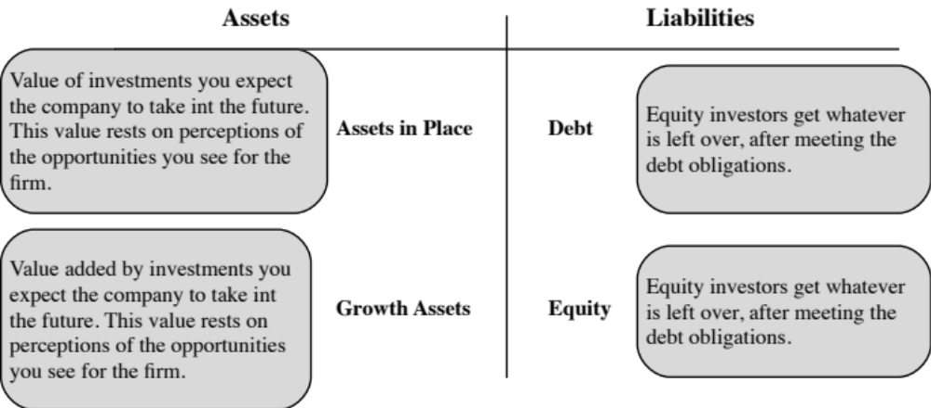
The Financial Balance Sheet

Slide 3
The Corporate Life Cycle

Slide 4
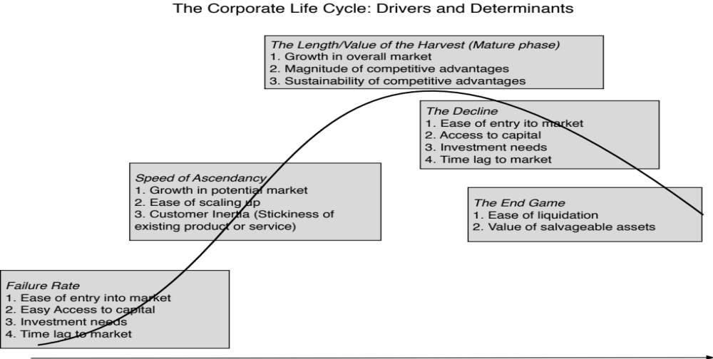
The determinants of the life cycle

Slide 5
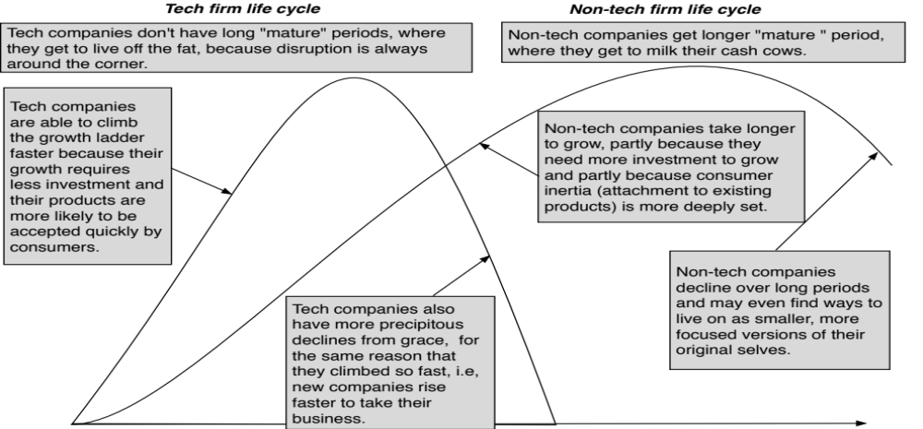
Tech versus Non-tech life cycles

Slide 6
The Dream of Reincarnation
The dream of mature and declining companies is rebirth, i.e., the possibility that they can rediscover their youth, and become young, growth companies again.
In every period, there are a few companies that seem to succeed at this venture, and the companies and their CEOs become legendary, with case studies written about them.
  In some of these companies, it is a combination of great management, luck and timing that allow for this success.
  In others, the change is cosmetic.
There is an ecosystem that is built around these “success stories” that markets them to other aging companies.

Slide 7
CORPORATE FINANCE ACROSS THE LIFE CYCLE
Act your (corporate) age..

Slide 8
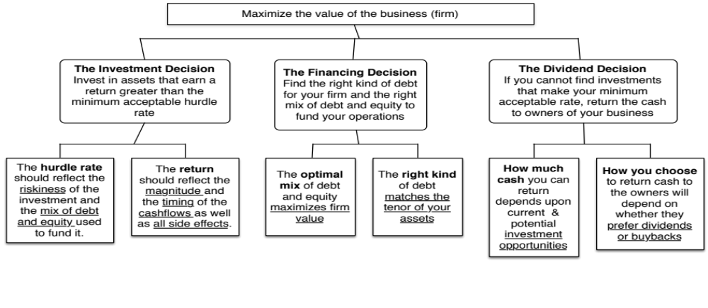
The Big Picture

Slide 9
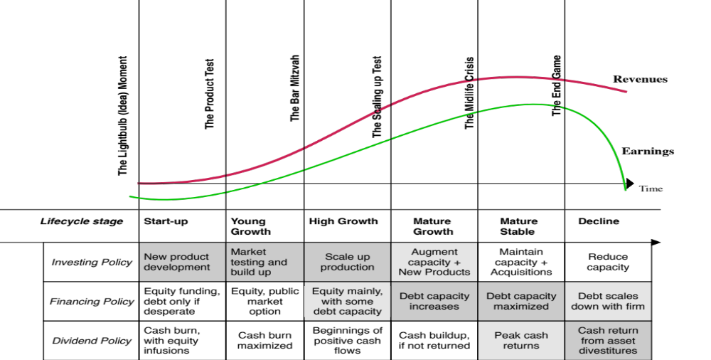
The emphasis in corporate finance shifts..

Slide 10
The Cash Flows over the Life Cycle

Slide 11
With reality checks..
For young companies, cash burn is a feature, not a bug: With young companies, cash flows will be negative in the early years, requiring new equity to be raised and dilution.
As growth starts to ease and companies mature, cash balances will build up during the transition: When growth starts to ease, cash flows will rise faster than revenues/profits, and as companies take time to adjust, cash balances will balloon out.
Once companies adjust to being mature, there will be more cash returned to stockholders: Returning cash to stockholders is not a failure, but a consequence of success.

Slide 12
Companies, act your age!
For many reasons, companies try to speed up or slow down aging
  Young companies that borrow money to grow faster, invest without a purpose or with too much focus on short term profits or pay dividends.
  Mature growth companies that act young and refuse to return cash.
  Stable companies that try to be growth companies through acquisitions.
  Declining companies that think they can reverse decline, with new management and a new business plan.
Companies that don’t “act their age” will destroy value.

Slide 13
narrative to numbers, across the life cycle
All story to mostly numbers..

Slide 14
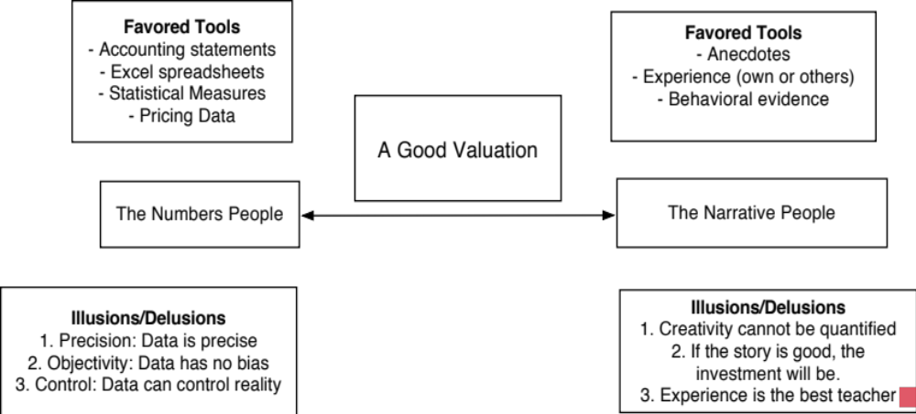
Value = Story + Numbers

Slide 15
Narrative versus Numbers

Slide 16
Narrative to Numbers for companies
With a young company, narrative is central, divergent and volatile.
  It is central because it is the only thing that you are offering investors, since you have no history.
  It is divergent because you can still offer widely different narratives, since it is early in the game.
  It is volatile, because the real world will deliver surprises that will require you to adjust your narrative.
As companies age, their narratives get narrower as their histories, size and culture start to become binding. The numbers often drive the narrative, rather than the other way around.

Slide 17
From story to numbers and beyond..

Slide 18
A Young Company: My Uber Narrative in June 2014
An urban car service business: I saw Uber primarily as a force in urban areas and only in the car service business.
Which would expand the business moderately (about 40% over ten years) by bringing in new users.
With local networking benefits: If Uber becomes large enough in any city, it will quickly become larger, but that will be of little help when it enters a new city.
Maintain its revenue sharing (20%) system due to strong competitive advantages (from being a first mover).
And its existing low-capital business model, with drivers as contractors and very little investment in infrastructure.

Slide 19

Uber in 2014: From Story to Inputs

Slide 20
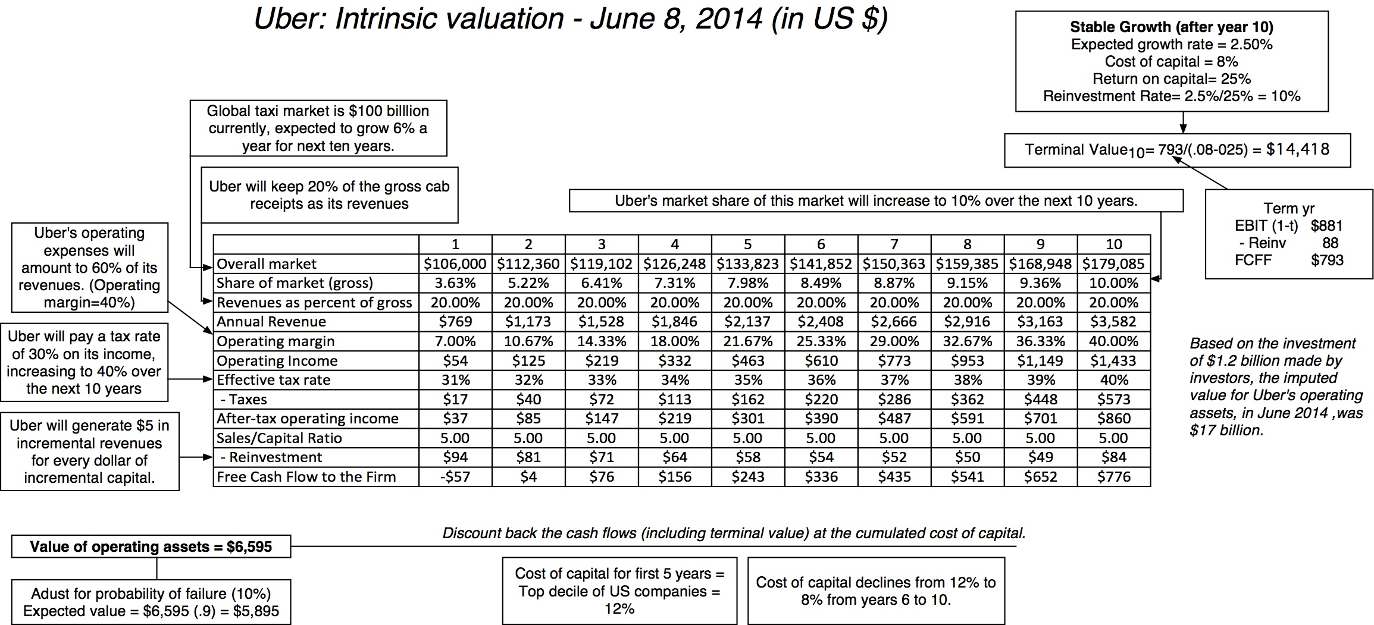
Uber in 2014: From Inputs to Value

Slide 21
Divergent Stories? Tesla Story Choices in 2016

Slide 22
And how they translate to numbers

Slide 23
As companies mature, their stories become bounded..

Slide 24
And in decline, they can be depressing..

Slide 25
The Bottom Line for Investors
To be a successful investor in early-stage businesses, you need to be a good judge of narrative.
  Not only do you need to be able to find good stories to invest in, but you also have to be able to separate impossible stories (fairy tales) from plausible stories, and then providing support (financial or management) to make the plausible into the probable.
  You will also get much bigger disagreements about value and story, across investors.
To be a successful in mature businesses, you need to be able to use the numbers that the business has already produced to decide on a narrative that is right for it, and then invest in companies where (you believe) the market has a mistaken narrative.

Slide 26
Price versus value, Across the life cycle

Slide 27
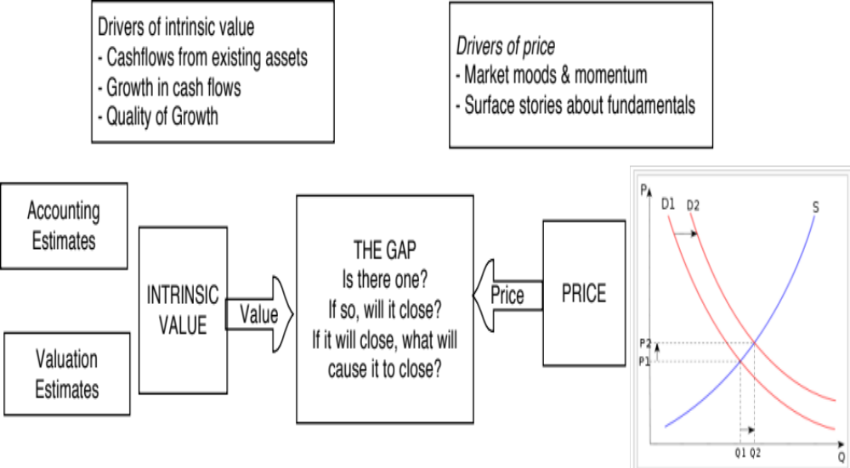
Price versus Value: The Set up

Slide 28
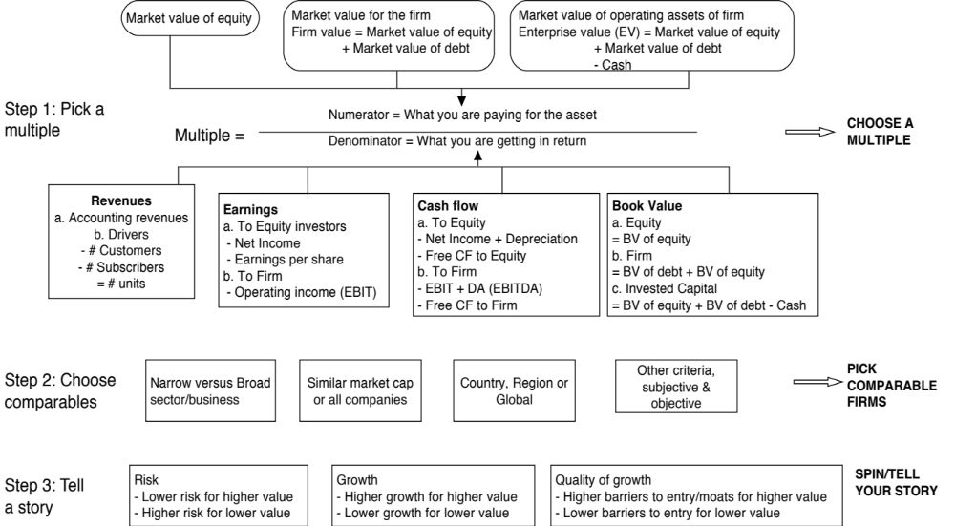
Multiples and Comparable Transactions

Slide 29
Uncertainty and the Pricing Imperative
As investors/analysts face more uncertainty about the future, they become less willing to grapple with it and make estimates for the future, a requirement for valuation.
Instead, they choose to price companies/assets, thus anchoring what they are willing to pay to what others are paying for similar assets.
Note that while this reaction is understandable, the uncertainty still remains.
  You are in denial. Hiding from uncertainty does not make it go away.
  You are letting the crowd, just as uncertain as you are, determine what you should pay.

Slide 30
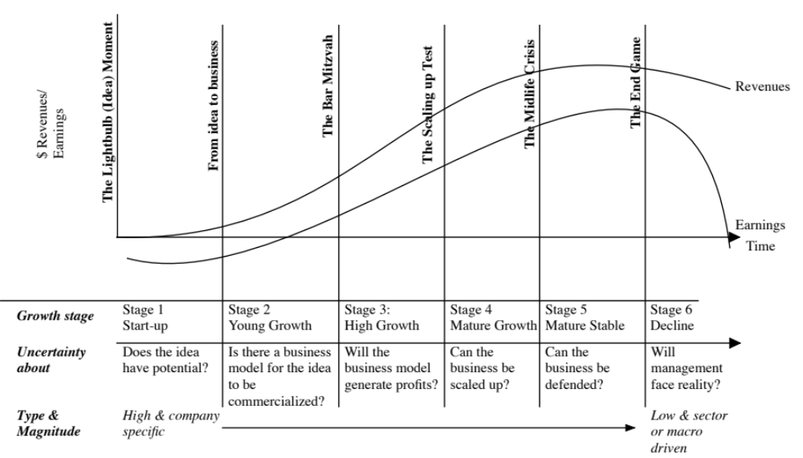
The Evolution of Uncertainty

Slide 31
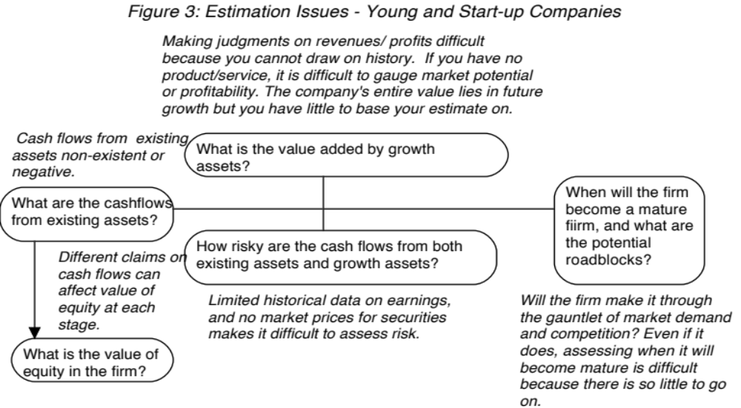
Valuing young companies

Slide 32
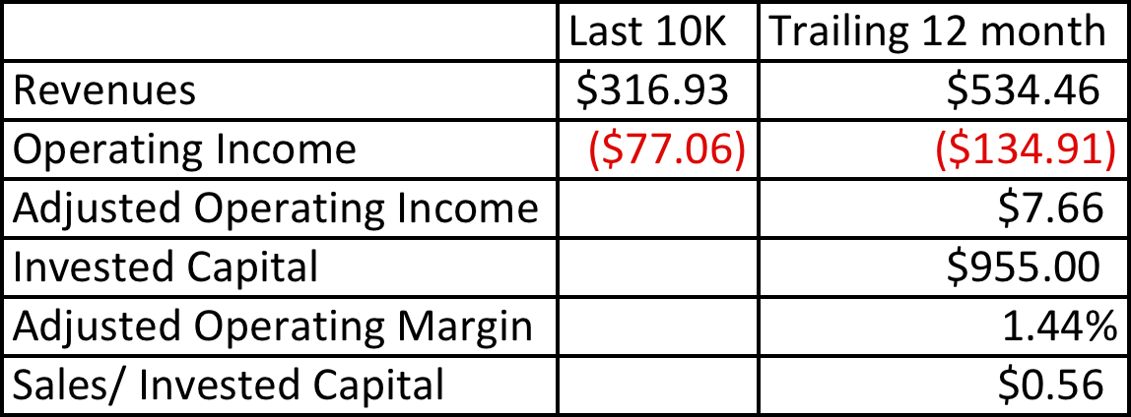
Twitter: Setting the table in October 2013

Slide 33
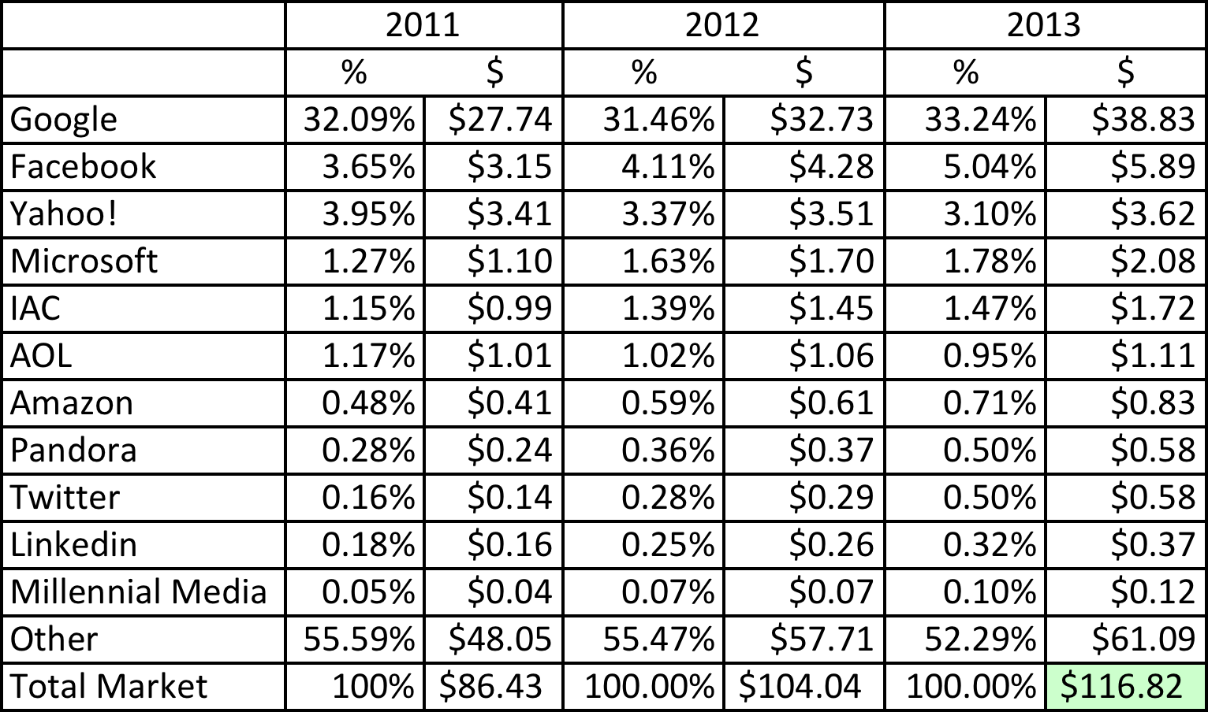
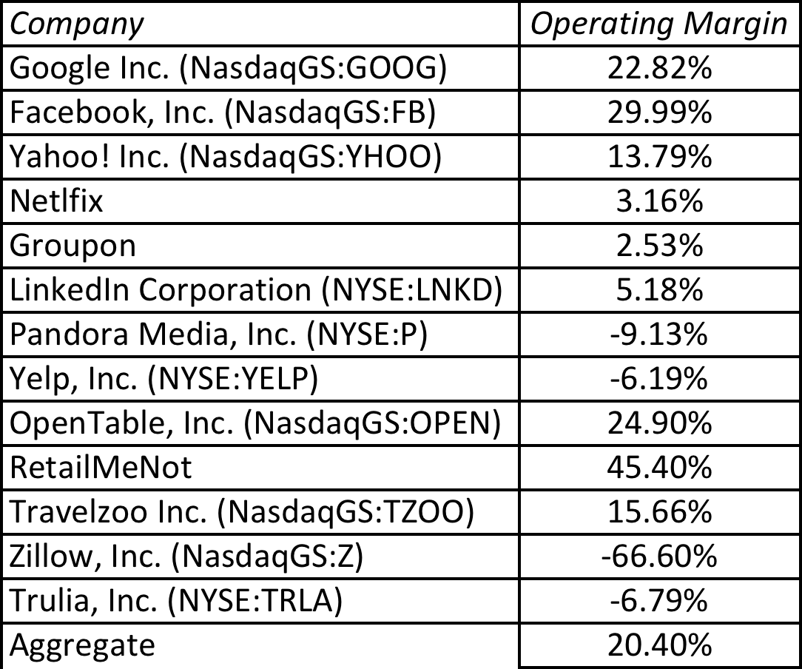
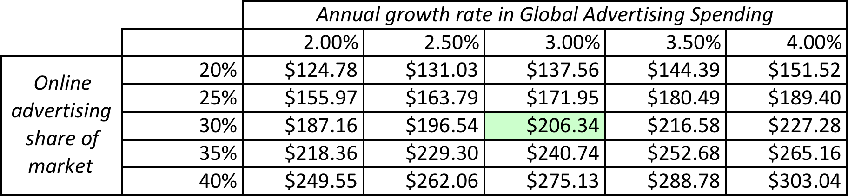
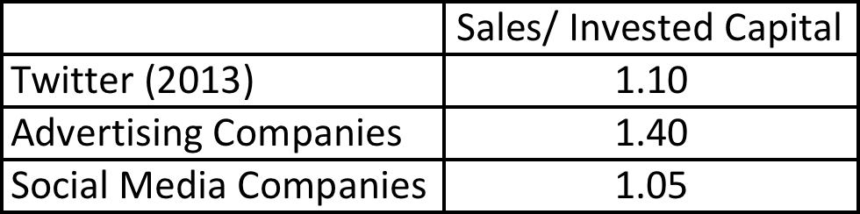
Twitter: Priming the Pump for Valuation
1. Make small revenues into big revenues
2. Make losses into profits
My estimate for Twitter: Operating margin of 25% in year 10
3. Reinvest for growth
My estimate for 2023: Overall online advertising market will be close to $200 billion and Twitter will have about 5.7% ($11.5 billion)
My estimate for Twitter: Sales/Capital will be 1.50 for next 10 years

Slide 34
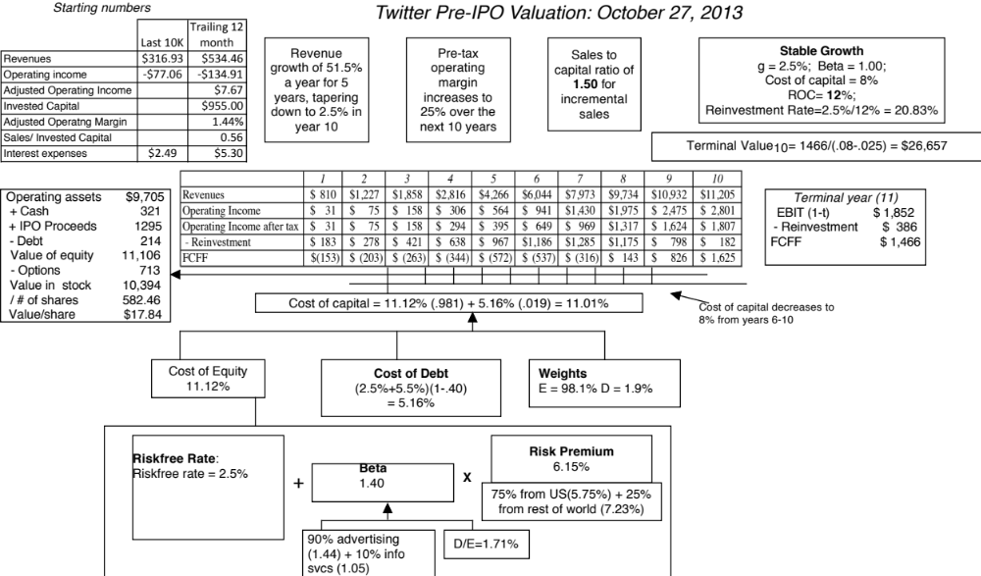

Slide 35
Pricing Twitter: Start with the “comparables”
Company | Market Cap | Enterprise value | Revenues | EBITDA | Net Income | Number of users (millions) | EV/User | EV/Revenue | EV/EBITDA | PE
Facebook | $173,540.00 | $160,090.00 | $7,870.00 | $3,930.00 | $1,490.00 | 1230.00 | $130.15 | 20.34 | 40.74 | 116.47
Linkedin | $23,530.00 | $19,980.00 | $1,530.00 | $182.00 | $27.00 | 277.00 | $72.13 | 13.06 | 109.78 | 871.48
Pandora | $7,320.00 | $7,150.00 | $655.00 | -$18.00 | -$29.00 | 73.40 | $97.41 | 10.92 | NA | NA
Groupon | $6,690.00 | $5,880.00 | $2,440.00 | $125.00 | -$95.00 | 43.00 | $136.74 | 2.41 | 47.04 | NA
Netflix | $25,900.00 | $25,380.00 | $4,370.00 | $277.00 | $112.00 | 44.00 | $576.82 | 5.81 | 91.62 | 231.25
Yelp | $6,200.00 | $5,790.00 | $233.00 | $2.40 | -$10.00 | 120.00 | $48.25 | 24.85 | 2412.50 | NA
Open Table | $1,720.00 | $1,500.00 | $190.00 | $63.00 | $33.00 | 14.00 | $107.14 | 7.89 | 23.81 | 52.12
Zynga | $4,200.00 | $2,930.00 | $873.00 | $74.00 | -$37.00 | 27.00 | $108.52 | 3.36 | 39.59 | NA
Zillow | $3,070.00 | $2,860.00 | $197.00 | -$13.00 | -$12.45 | 34.50 | $82.90 | 14.52 | NA | NA
Trulia | $1,140.00 | $1,120.00 | $144.00 | -$6.00 | -$18.00 | 54.40 | $20.59 | 7.78 | NA | NA
Tripadvisor | $13,510.00 | $12,860.00 | $945.00 | $311.00 | $205.00 | 260.00 | $49.46 | 13.61 | 41.35 | 65.90
 |  |  |  |  |  | Average | $130.01 | 11.32 | 350.80 | 267.44
 |  |  |  |  |  | Median | $97.41 | 10.92 | 44.20 | 116.47

Slide 36
Read the tea leaves: See what the market cares about
 | Market Cap | Enterprise value | Revenues | EBITDA | Net Income | Number of users (millions)
Market Cap | 1.
Enterprise value | 0.9998 | 1.
Revenues | 0.8933 | 0.8966 | 1.
EBITDA | 0.9709 | 0.9701 | 0.8869 | 1.
Net Income | 0.8978 | 0.8971 | 0.8466 | 0.9716 | 1.
Number of users (millions) | 0.9812 | 0.9789 | 0.8053 | 0.9354 | 0.8453 | 1.
Twitter had 240 million users at the time of its IPO. What price would you attach to the company?

Slide 37
Use the “market metric” and “market price”
The most important variable, in late 2013, in determining market value and price in this sector (social media, ill defined as that is) is the number of users that a company has.
Looking at comparable firms, it looks like the market is paying about $100/user in valuing social media companies, with a premium for “predictable” revenues (subscriptions) and user intensity.
Twitter has about 240 million users and can be valued based on the $100/user:
Enterprise value = 240 * 100 = $24 billion

Slide 38
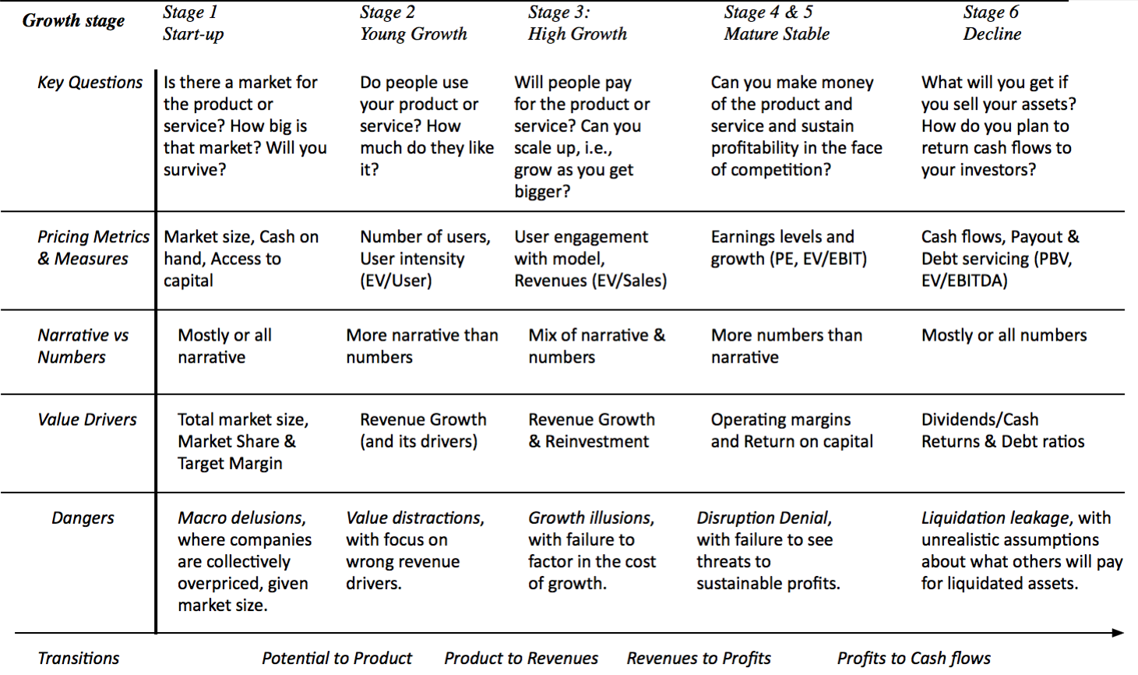
Pricing and Value: Across the Life Cycle

Slide 39
THE MANAGERS’ JOB, ACROSS THE LIFE CYCLE
Story Tellers, Business Builders and Managers

Slide 40
As companies age, the managerial imperative shifts..
With young companies, you need dreamers & visionaries: Early in a company’s life, when all you have are ideas and no clear business plan, it is all about the narrative. Not surprisingly, the most successful managers/investors at this stage are people who are stronger on narrative.
As companies age, you need pragmatists and builders: As companies age, the emphasis shifts to numbers, partly because more of the value is determined by the narrative that has actually unfolded and partly because there are more numbers to focus on. The most successful managers/investors become people who can work with and around those numbers.

Slide 41
And the focus changes.... And so does the right CEO for the company

Slide 42
As emphasis shifts, managers can resist, adapt or move on
As young start-ups succeed and start moving into the growth, the managers who were instrumental in their success have three choices:
  Adapt and adjust their focus to include numbers, without giving up their narrative.
  Stay completely focused on narrative and ignore numbers.
  Hand over control of the operating details of the company to a numbers person while handling the narrative part.
With investors, the transition is made easier by the existence of public markets. As companies go public, these investors can cash out and go back to their preferred habitat.

Slide 43
The challenge of shorter life cycles..
When life cycles were long, stretching over decades, time and aging allowed for smoother transitions, since CEOs aged with their companies, and moved on.
As life cycles shorten, managers are far more likely to find their companies changing under them so quickly that they can no longer adapt.
  To be a long tenured CEO, you will either need to be versatile and/or be able to delegate the work that you cannot do to people you empower and trust.
  If these transitions are not well managed, there will be far more turnover in top management and activist investing will flourish.

Slide 44

“Growing old is mandatory, Growing up is optional”

