Slide 1
The corporate life cycle: Trouble with transitions!
Growing up is hard to do…

Slide 2
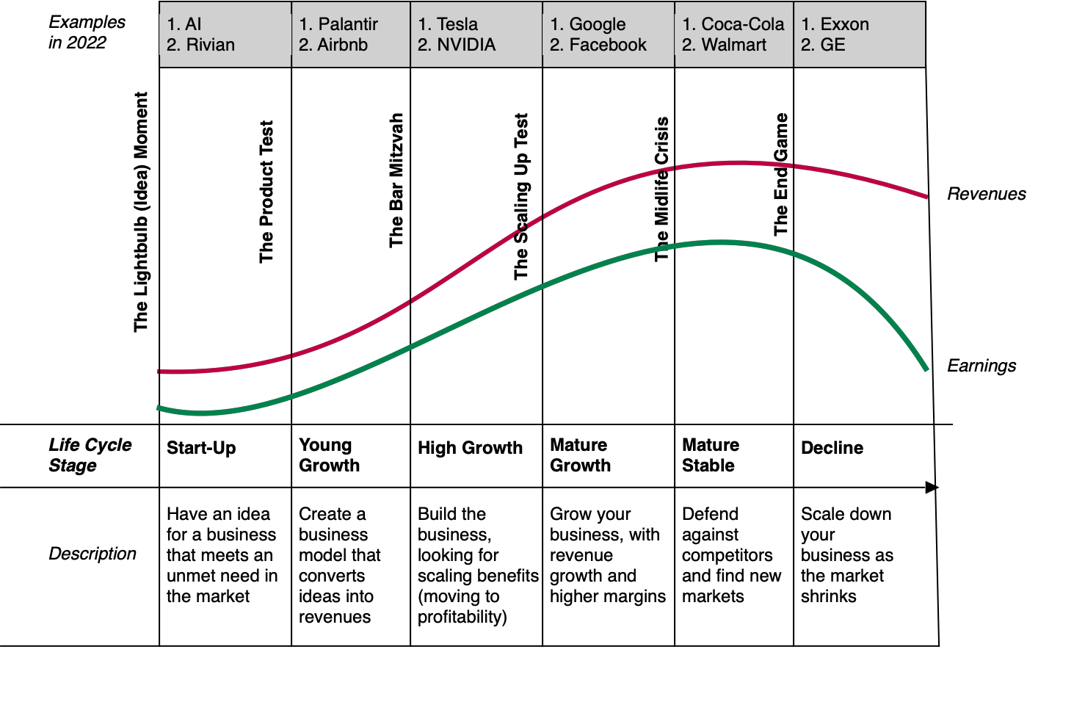
The Corporate Life Cycle

Slide 3
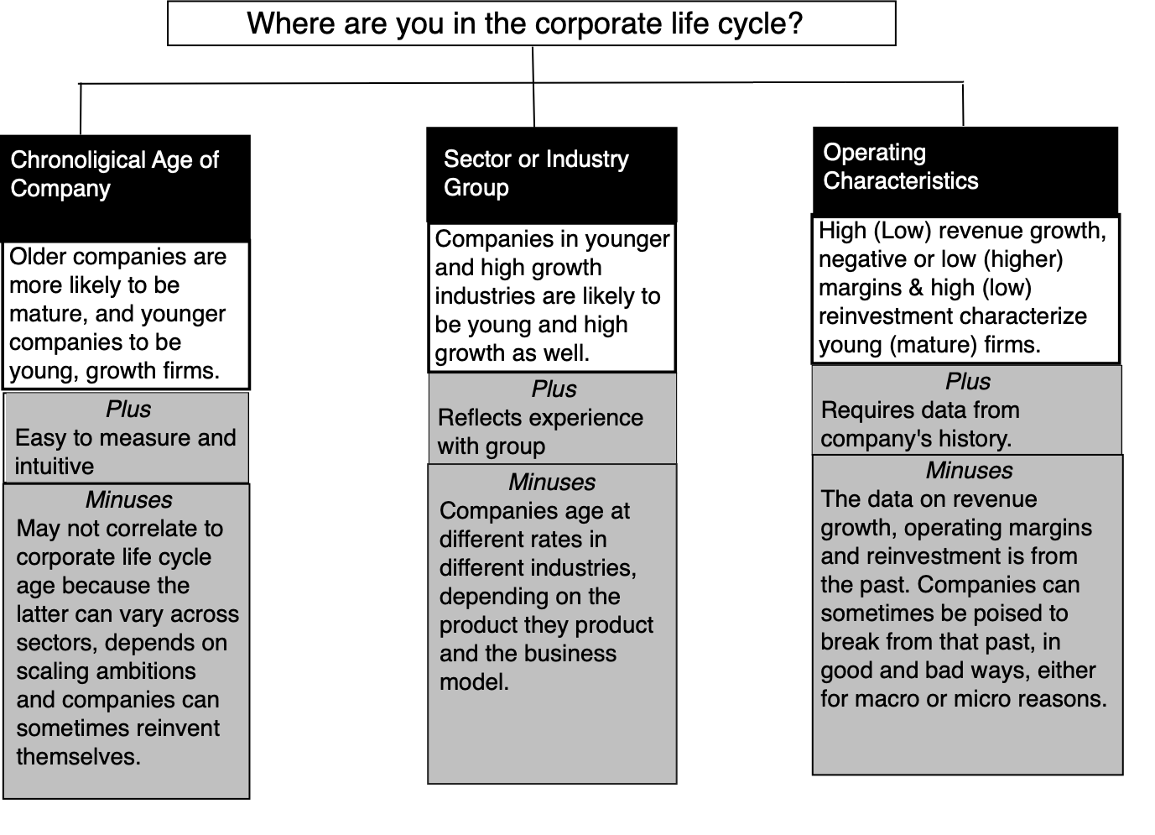
Life Cycle Diagnostics

Slide 4
Corporate Age and Operating Characteristics: The Data
 |  | Revenue Growth Rate (CAGR over last 3 years) |  |  |  | Operating Margin
decile(Age) | # firms | First Quartile | Median | Third Quartile | % with negative growth | First Quartile | Median | Third Quartile | % with negative margins
Bottom decile | 4,026 | -4.86% | 18.16% | 72.42% | 14.80% | -176.76% | -3.29% | 12.22% | 54.91%
2nd decile | 4,164 | -6.00% | 13.58% | 41.46% | 25.55% | -53.00% | 0.00% | 13.77% | 48.17%
3rd decile | 4,930 | -7.18% | 8.88% | 26.08% | 28.86% | -15.02% | 4.28% | 15.61% | 37.39%
4th decile | 4,098 | -4.55% | 8.58% | 21.60% | 29.77% | -5.30% | 4.95% | 14.04% | 31.63%
5th decile | 4,785 | -6.01% | 6.19% | 17.61% | 32.18% | -0.48% | 5.76% | 14.91% | 27.79%
6th decile | 4,029 | -7.11% | 4.15% | 15.51% | 35.84% | 0.00% | 5.79% | 13.98% | 25.83%
7th decile | 4,653 | -7.04% | 3.74% | 14.20% | 35.63% | 0.00% | 5.48% | 13.54% | 25.08%
8th decile | 4,414 | -6.22% | 2.19% | 9.87% | 40.17% | 0.40% | 6.20% | 13.42% | 20.93%
9th decile | 4,582 | -5.24% | 1.32% | 8.38% | 42.12% | 1.21% | 6.03% | 12.57% | 17.03%
Top decile | 4,473 | -3.97% | 1.57% | 7.33% | 40.73% | 0.00% | 5.86% | 12.37% | 12.22%

Slide 5
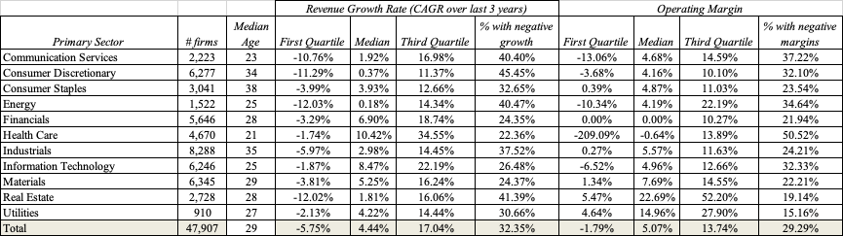
Sector and Operating Characteristics: The Data

Slide 6
The Idea Phase
Idea to Prouct…

Slide 7
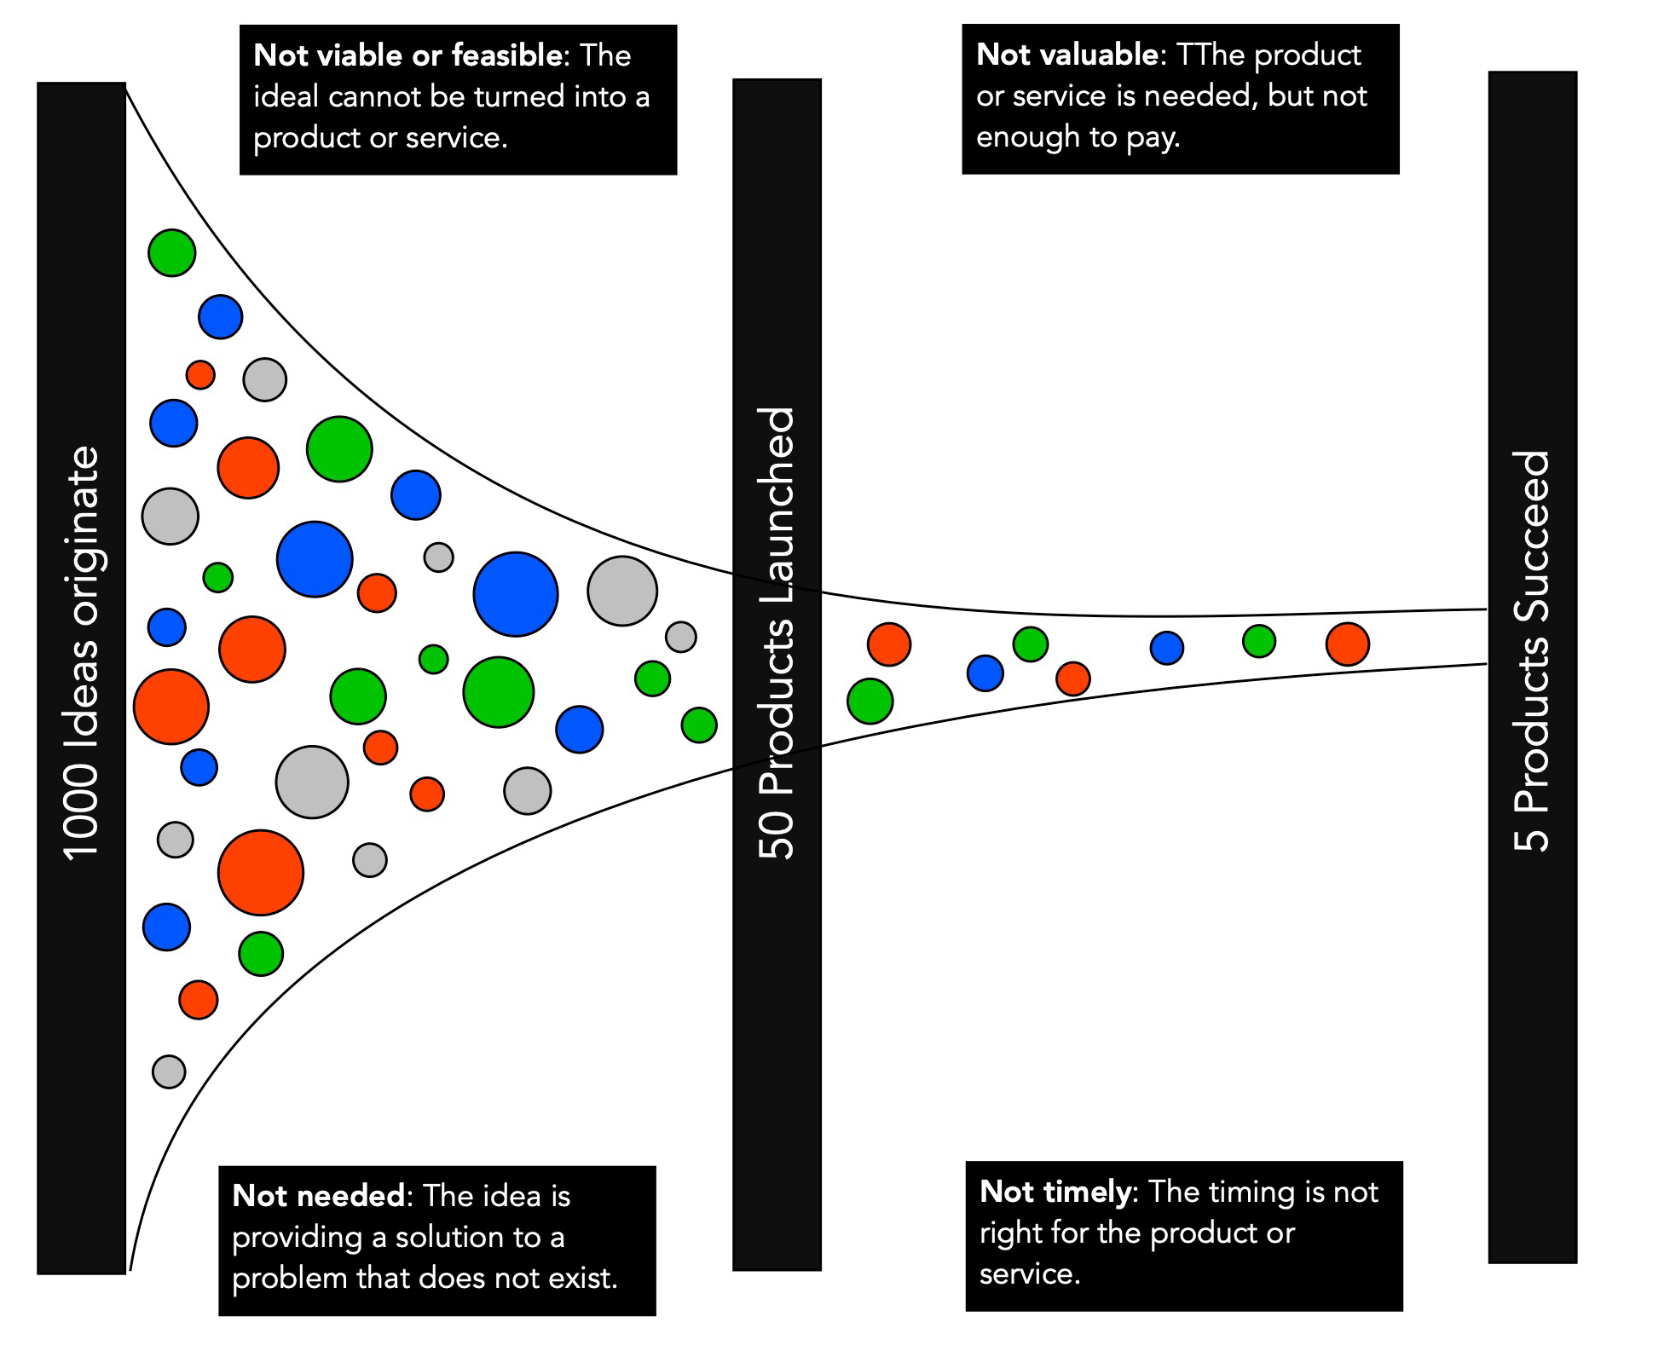
The Idea Funnel

Slide 8
Idea Failure…
Not needed: New ideas for businesses are built on the presumption that there is an unmet or poorly met need. If that presumption is wrong, there is nowhere for the idea to go.
Not (economically) valued: Even if a need exist, to create a business around meeting it, you require customers who are willing to pay for the product.
Not viable/feasible: Assuming that there is a need that is unmet, and that people are willing to pay to meet that need, you still have to come up with a product or service that is a viable solution to that need.
Not timely: There may be a need that is unmet that you can construct a product or service to meet, but the time may not be right.

Slide 9
Founder Failure..
When asked to describe what makes for a successful founder, venture capitalists have a laundry list of characteristics, some of which are in direct contradiction with others on the list.
  We do know that there are characteristics (tunnel vision, arrogance, lack of empathy, savior complex) which lead to founder failure.
  We also know that there are many successful founders who are arrogant, lack empathy and think that they (and they alone) can save the world.
As a generalization, though, founders who are disciplined, have a vision that they can communicate and are adaptable improve their odds of success.

Slide 10
Capital Failure..
The truth remains that no matter how good an idea is, and how well prepared a founder is, converting an idea into a product often requires capital.
Unfair though it might be, access to capital varies across time and people.
  If access to capital is too difficult, good ideas will never make it to product or business stage
  If access to capital it too plentiful, some bad ideas with questionable founders can become businesses as well.
Generally, ideas that require much more capital to convert into products will fail more often than ideas that can be converted into products with less capital intensity. This link between success and capital need can explain why so much “financially successful” innovation is surface-level and why so little of it qualifies as true innovation.

Slide 11
The Product Test
Product to Business…

Slide 12
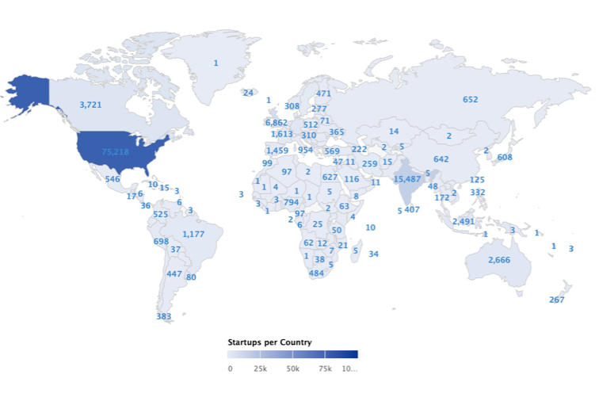
Geography matters…
Barriers to entry
Regulatory & legal barriers to starting new businesses
Access to Capital
Greater access allows for more products to become businesses
Market Size
Larger markets lend themselves to more start-ups

Slide 13
Truncation Risk: Failure is the norm…

Slide 14
Success requires business trade offs…
Purity versus Pragmatism: Founders who insist on purity of vision, and are unwilling to compromise to get to market, are more likely to fail.
Growth versus Business Building: With the limited time and resources that they have, founders must decide whether to prioritize growth or building businesses.
Small story versus Big story: Early on, founders have to determine whether to stay focused on a small & conquerable market or to go after a big market. The odds of succeeding will be greater with the former, but the pricing you get will be higher with the latter.

Slide 15
And giving up control…

Slide 16
The Founder’s Dilemma

Slide 17
The Bar Mitzvah Test
Grown-up yet?

Slide 18
The “Bar-Mitzvah” Test
Young companies often are cut slack by investors (private and public), who are willing to overlook their financial shortcomings (big losses, fresh capital raises), because of their growth potential in large markets.
There will be a time in these companies’ lives when even these investors will start asking questions about profitability and cash flows, and demanding answers about how and when…
That is the Bar Mitzvah test, and many young companies are unprepared for it, since they never expected to be tested.

Slide 19
The ”Build-a-Business” Toolbox
Preserve or improve unit economics: Even though young companies may be money-losers, they should be working on and presenting evidence on unit economics, i.e., their profits on the marginal unit sold.
Show evidence of economies of scale: While young businesses may be money-losing, revenues should be growing faster than costs, so that profitability ensues.
Consider trade-offs on growth: Growth is not an unalloyed good, and companies should not only document and show how much it costs them to deliver growth. For a manufacturing firm, this may be easy to do, but for technology and user-based companies, it will require more work.

Slide 20
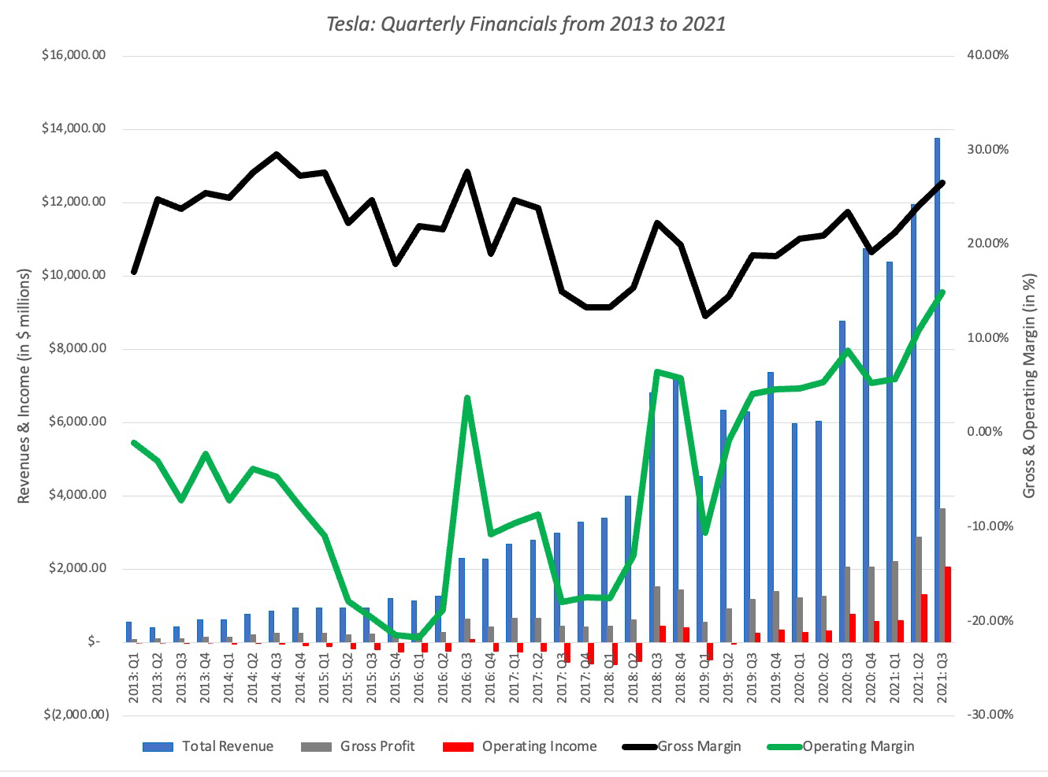
Passing the test? Tesla in 2022

Slide 21
Failing the test? The financials leading into the WeWork IPO

Slide 22
The Scaling-up Test
Why most businesses stay small…

Slide 23
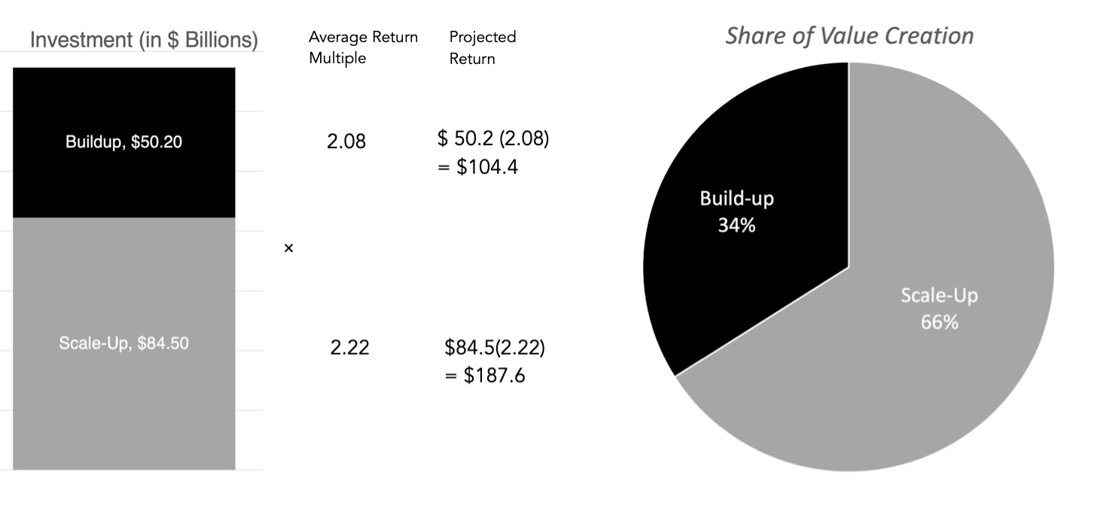
Scaling up is the key to value augmentation…

Slide 24
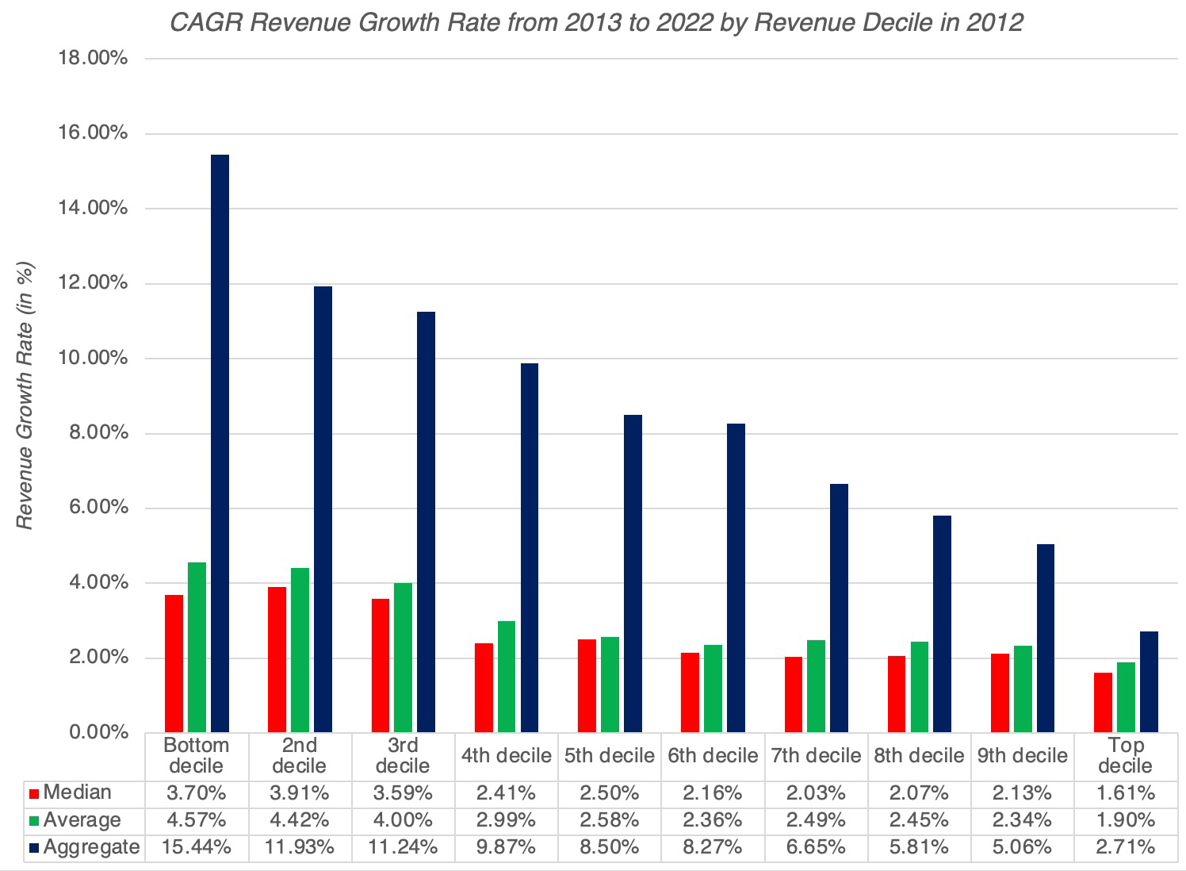
Scaling up is tough to do…

Slide 25
And it comes with costs…
Loss of focus: As companies try to scale up, many will have to move from their core businesses into new ones.
Less efficient growth: As companies become larger, growth is not only more difficult to attain, but is often more expensive to deliver.
And a tradeoff on sustainability? Sustainability and social purpose are the buzzwords for the moment, and every enterprise claims to have these qualities embedded in them. The truth is that scaling up often comes at the expense of both, and you (as the founder or owner) have to decide what you value more.

Slide 26
But if you can pull it off…

Slide 27
The Midlife Crisis
To be young again…

Slide 28
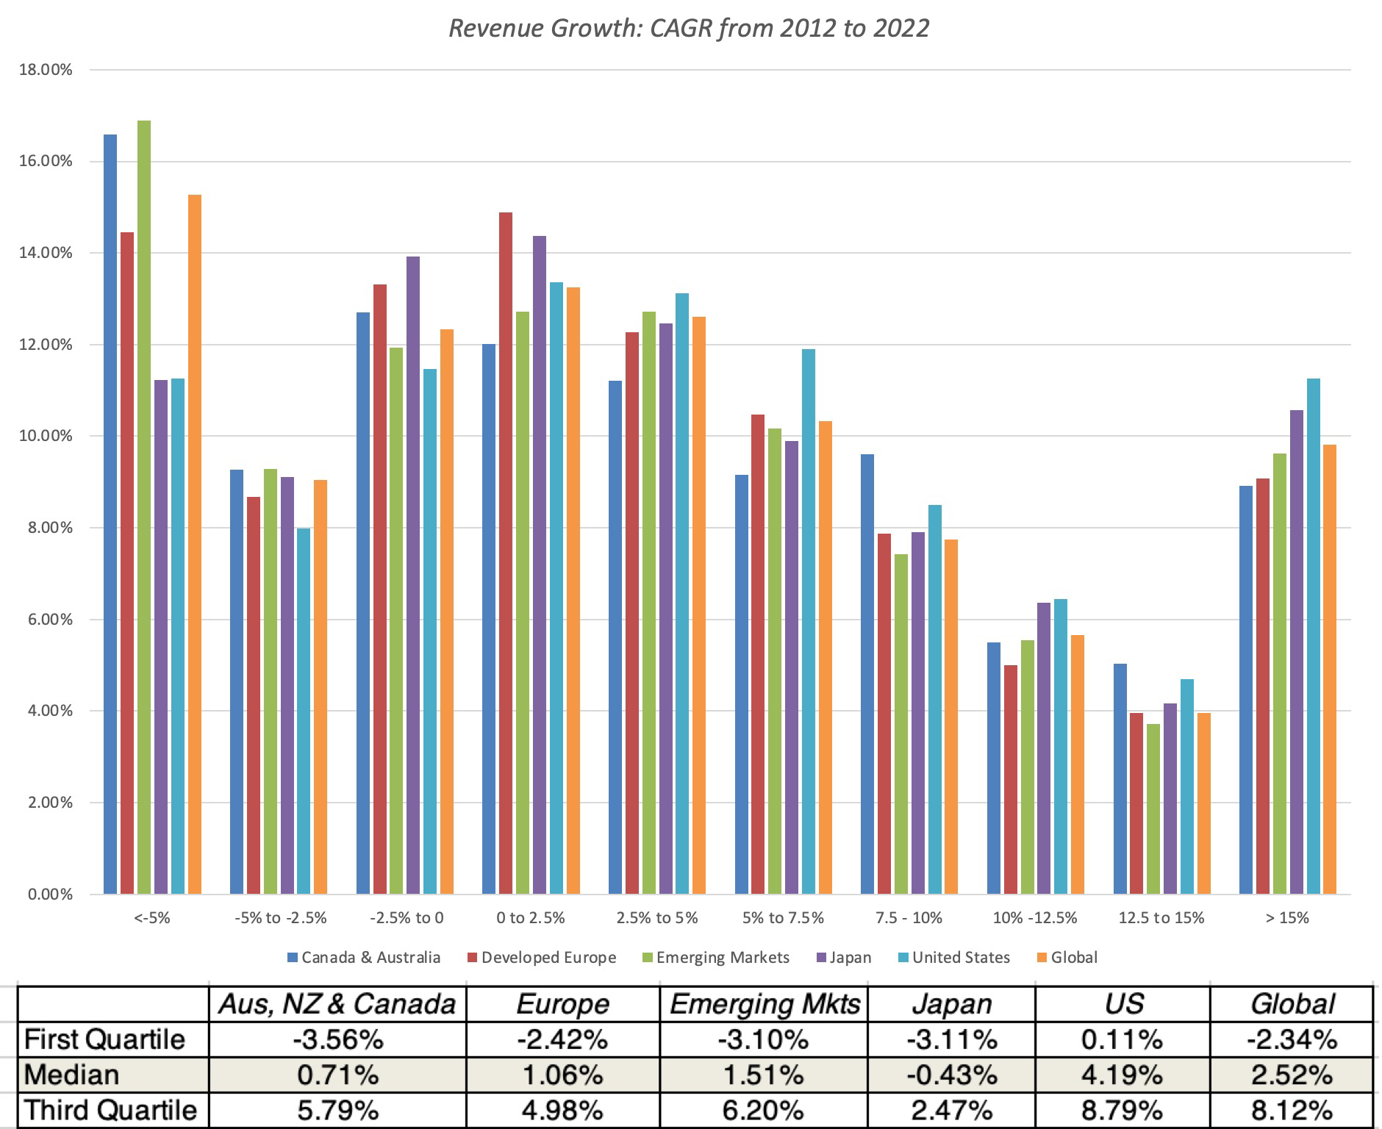
Hitting your limits…

Slide 29
The False Promise of Acquisitions…

Slide 30
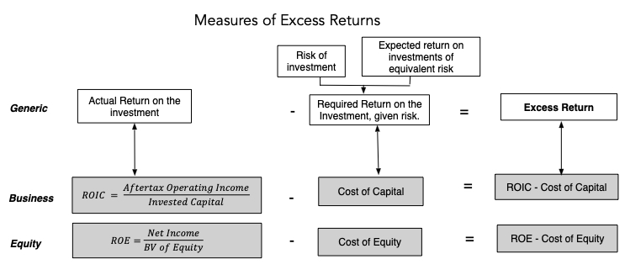
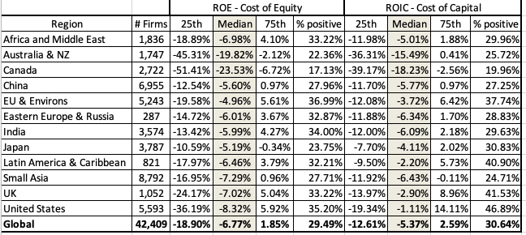
And growth at any cost…

Slide 31
The End Game
Why businesses fight decline…

Slide 32
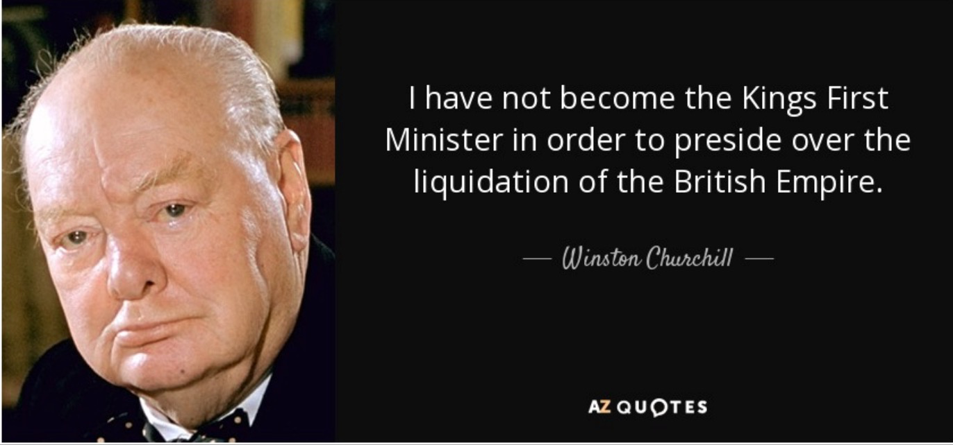
Decline is inevitable… as is fighting it…

Slide 33
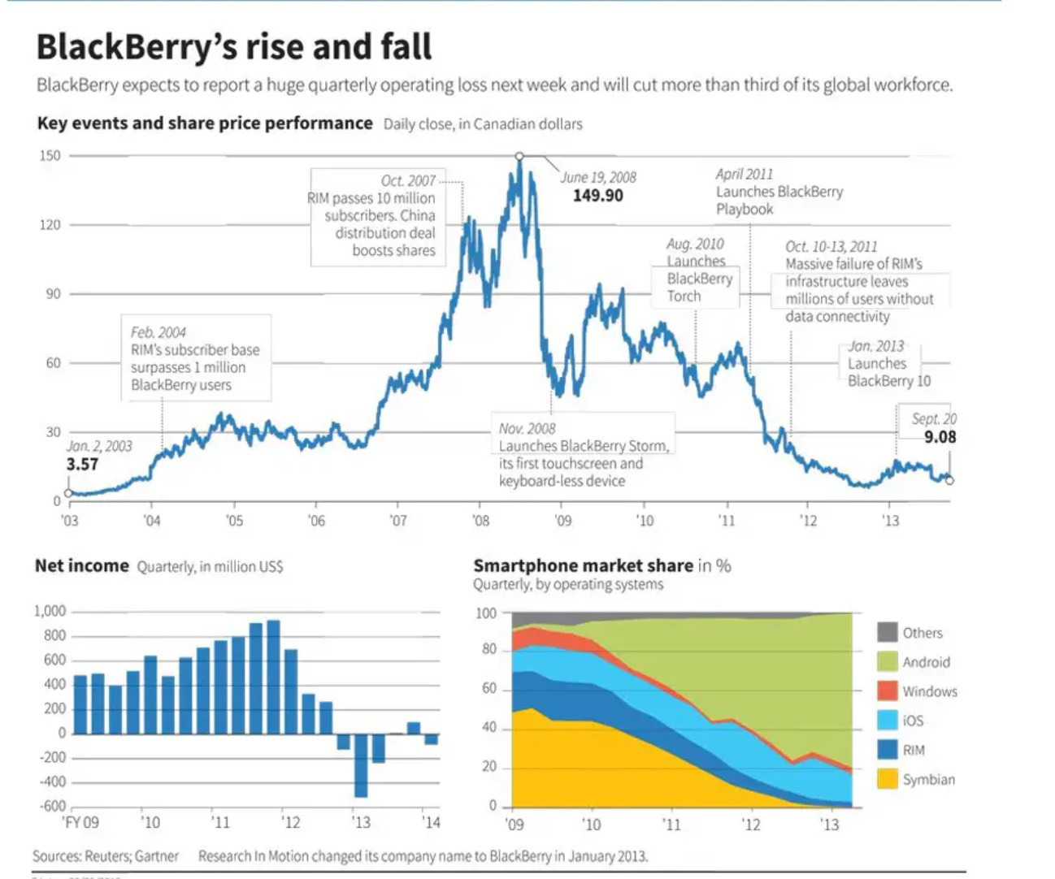
1. Denial

Slide 34
2. Acceptance

Slide 35
3. Reincarnation

Slide 36
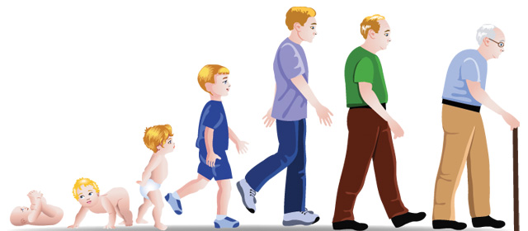
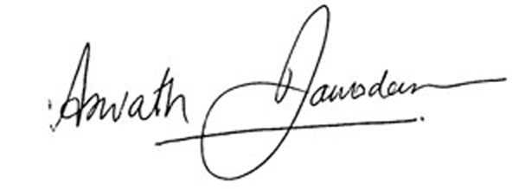
“Growing old is mandatory, Growing up is optional”

