Slide 1
The ESG Movement: The Goodness Gravy train Rolls on!
Charity begins at home

Slide 2
Buzz Words and Magic Bullets!
In my four decades in corporate finance and valuation, I have seen many "new and revolutionary" ideas emerge, marketed as the solution to all of the problems in business decision making.
  Most of the time, these ideas represent either a repackaging of existing concepts, with a healthy dose of marketing and selling, usually by consultants and bankers, and their magic fades quickly once their limitations come to the surface, as they inevitably do.
  Worse, they operate as weapons of mass distraction, used to justify the unjustifiable.
The latest entrant in this game is ESG (Environmental, Social and Governance), and the sales pitch is wider and deeper.
  Companies that improve their social goodness standing will not only become more profitable and valuable over time, we are told, but they will also advance society's best interests, thus resolving one of the fundamental conflicts of private enterprise, while also enriching investors.

Slide 3
The ESG Promises: Cake for all, with no calories!
For companies, the promise is that being "good" will generate higher profits for the company, at least in the long term, with lower risk, and thus make them more valuable.
For investors in these companies, the promise is that investing in "good" companies will generate higher returns than investing in "bad" or middling companies.
For society, the promise is that not only would good companies help fight problems directly related to ESG, like climate change and low wages, but also counter more general problems like income inequality and healthcare crises.

Slide 4
The Five Big Questions
What is ESG and can it be measured?
  Implicit in ESG is the assumption that there is consensus on what comprises good, and that it can be measured.
How (if at all) does ESG affect value?
  ESG is being marketed to companies as being value increasing.
  The marketing pitch is based upon anecdotal evidence (usually from fossil fuel/mining companies) and studies that are more advocacy than serious research.
As an investor, can (will) you make money investing based on ESG?
  The pitch is that investors in “good” companies will earn higher returns
  But that pitch is internally inconsistent and fundamentally incoherent
Is society better off, if companies follow the ESG path?
  The argument is that ESG makes the world a better place, and thus merits acceptance
  But does it?
If you want to make the world a better place (and who does not), what is the alternative to ESG?

Slide 5
1. Goodness is measurable, but it is individualized…
It is fuzzy: The first is that much of social impact is qualitative and developing a numerical value for that impact is difficult to do.
Person specific: The second is even trickier, which is that there is little consensus on what social impacts to measure, and the weights to assign to them. In fact, we know that people measure goodness very differently, depending on age, culture, religion, nationality ETC.
But it is still being measured: If your counter is that there are multiple services now that measure ESG at companies, you are right, but the lack of clarity and consensus results in the companies being ranked very differently by different services.

Slide 6
ESG Services disagree…

Slide 7
Even on high profile companies…

Slide 8
What exactly do ESG scores measure? The Revisionist History of ESG
Goodness: Much as ESG services and advocates like to scrub away the original intent of ESG, ESG was created as a measure that could measure how well companies were contributing to the planet’s well being.
Risk: It was only a few years ago, and just after the first backlash against goodness measures that ESG services changed their tune and argued that ESG scores were a measure of risk.
Disclosure of material impact: In the last year, in particular, as the pushback against ESG’s use by investment managers has mounted, ESG has been reframed as a mechanism of disclosure of “material” impact.

Slide 9
If it is goodness, it certainly generates some odd results…
Manufacturing versus Service: ESG scores through most of the period that ESG has been around have been skewed away from manufacturing and towards service businesses, perhaps because of the focus on carbon footprint.
Tangible versus Intangible: Until recently, technology companies were ESG favorites, reflecting the same focus on carbon footprint and an implicit bias towards price momentum in markets. (Just as analysts rush out with buy (sel) recommendations for companies after their stock prices go up (down), ESG scores drift up after stock prices go up for a company, and drift down after they go down).

Slide 10
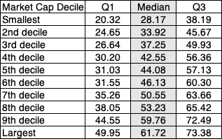
Odd fact 1: ESG Scores are higher for bigger firms

Slide 11
Odd fact 2: ESG scores increase with disclosure bulk, and goodness is increasing..

Slide 12
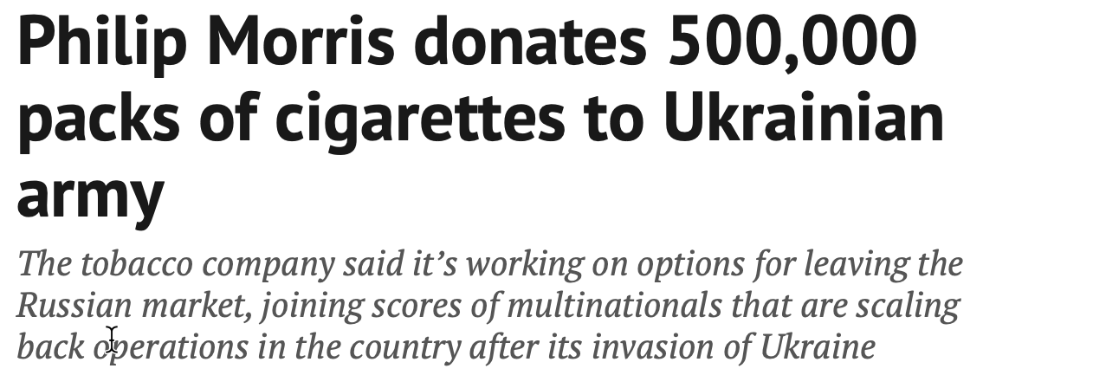
Odd fact 3: Goodness is a shifting definition…

Slide 13
If your answer is risk… look again
In the last three or four years, ESG services seem to have changed their tune about what they are measuring, from “goodness” to “risk”.
At various points, ESG services have claimed that
  Companies with higher ESG scores have lower costs of capital than companies with lower ESG scores
  Companies with higher ESG scores have more stable earnings than companies with lower ESG scores
  Companies with higher ESG scores are less likely to face crises or catastrophic risk
Each of those statements is misleading, at the very least, and untrue, at its core.

Slide 14
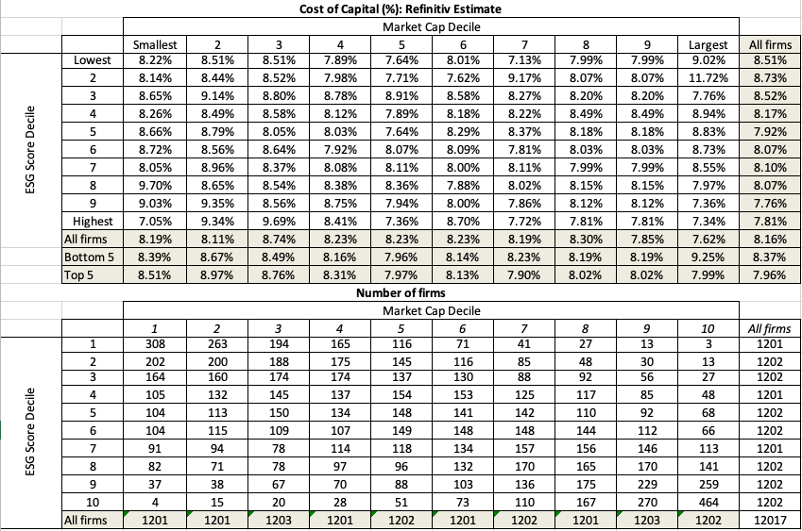
Refinitiv’s ESG and Cost of Capital: Is there an ESG link?
Controlling for the fact that ESG scores tend to be higher for larger firms, there is no correlation between ESG and cost of capital.

Slide 15
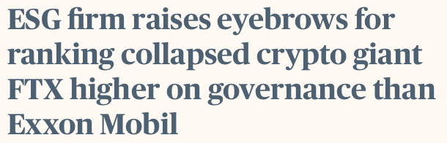
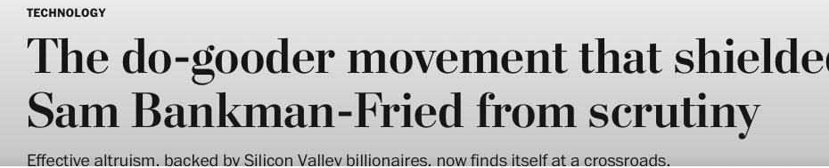
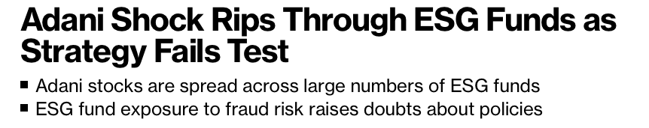
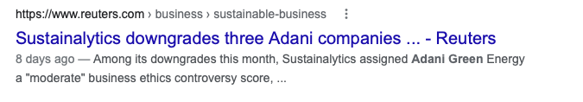
As for catastrophic risks, the evidence, at least on the highest profile firms, is to the contrary
FTX
Adani Group
It is true that this is anecdotal evidence, but as a challenge, is there a single high-profile firm that you can think of where a low ESG score would have warned you ahead of a crisis?
Too little, too late

Slide 16
ESG score differences will persist… and the gaming will get worse…
There are some who believe that as companies provide more disclosure on ESG data and ESG measurement services mature, there will be consensus.
  I don’t believe it, because. if there were consensuswe would not need to convince businesses to reflect that consensus.
  If there is a consensus that emerges, it will be because ESG services will draw on a small subset of people who have been trained in ESG talk, bring the same mindset and indulge in group think.
The nature of any scoring system is that the “scored” will learn (either because it explicitly lays out the components that lead to a high score) or scores can be reverse engineered to figure out what causes high and low scores.
  The bottom line is that gaming is a feature of any scored system than a bug in the system.
  As scoring systems mature, the gaming gets easier (not harder) making the scores even less useful.

Slide 17
2. The ESG Promise: The Good shall be rewarded!

Slide 18
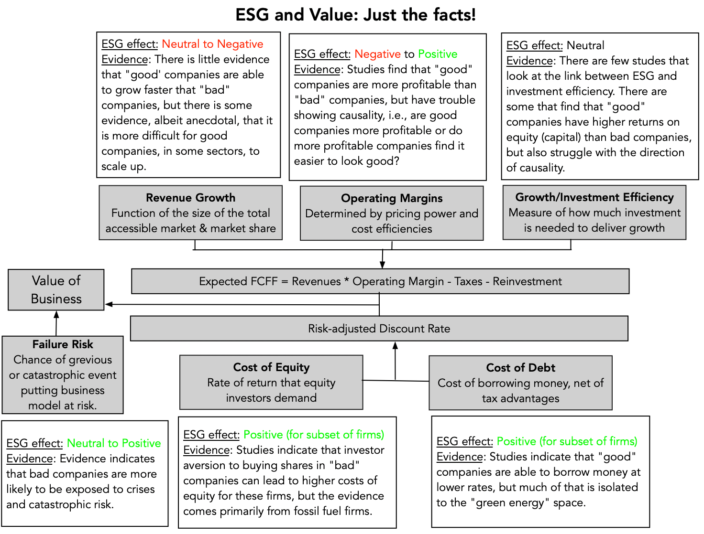
The Evidence: Being good will help some firms, hurt others and do others unaffected!

Slide 19
Is ESG good for companies?
The notion that ESG is good for companies is being sold strongly, with research that is
  Anecdotal, in the form of case studies and stories of success
  From advocates, with strong priors that ESG matters
  Statistically a mess, because it is so difficult to tell the direction of causation
The truth is much grayer and predates the entire ESG movement, and is that
  Companies that are “bad” or perceived to be so, because they have crossed a good corporate citizen line are exposed to punishment. That punishment, right now, is coming from investors and lenders more than from customers and employees.
  There are some companies that benefit from being “good”, but they have trouble scaling up
  For other companies, ESG is just a marketing tactic, which loses (or already has lost) its effectiveness, as everyone uses it.

Slide 20
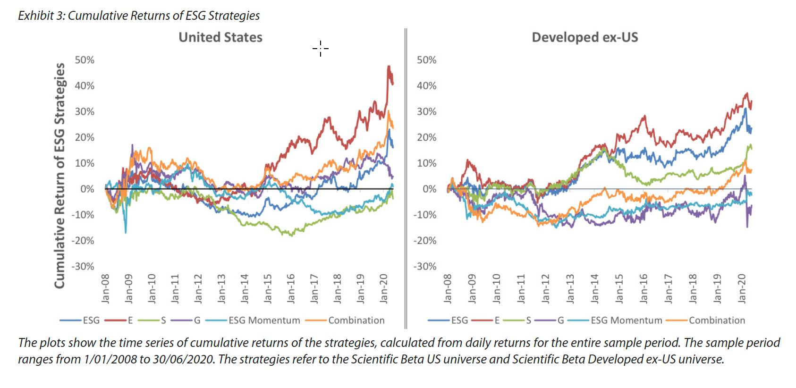
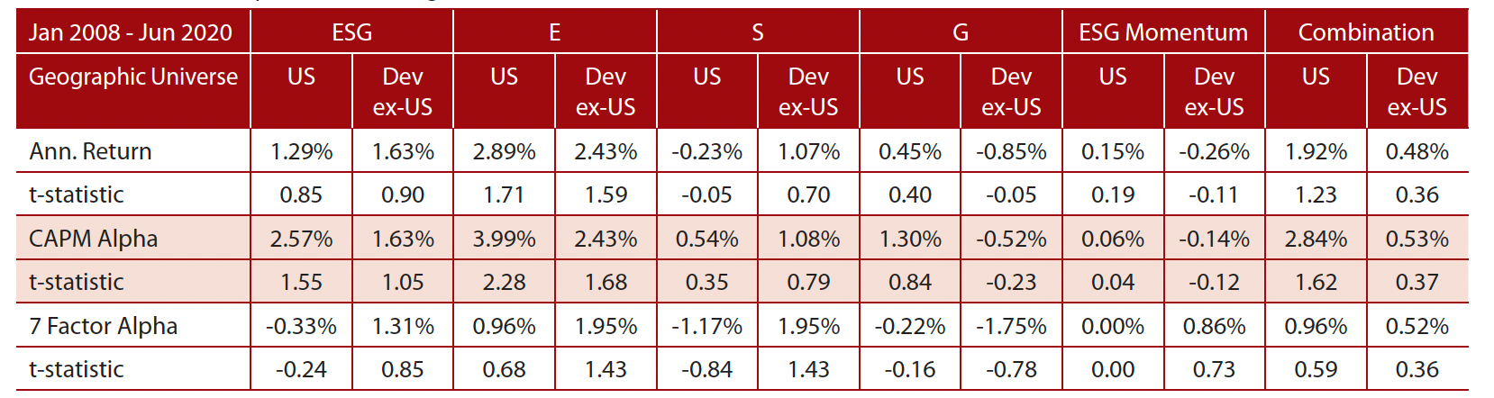
3. The ESG Pitch: Investing in “good” companies generates alpha…
Source: Honey, I shrunk the ESG alpha

Slide 21
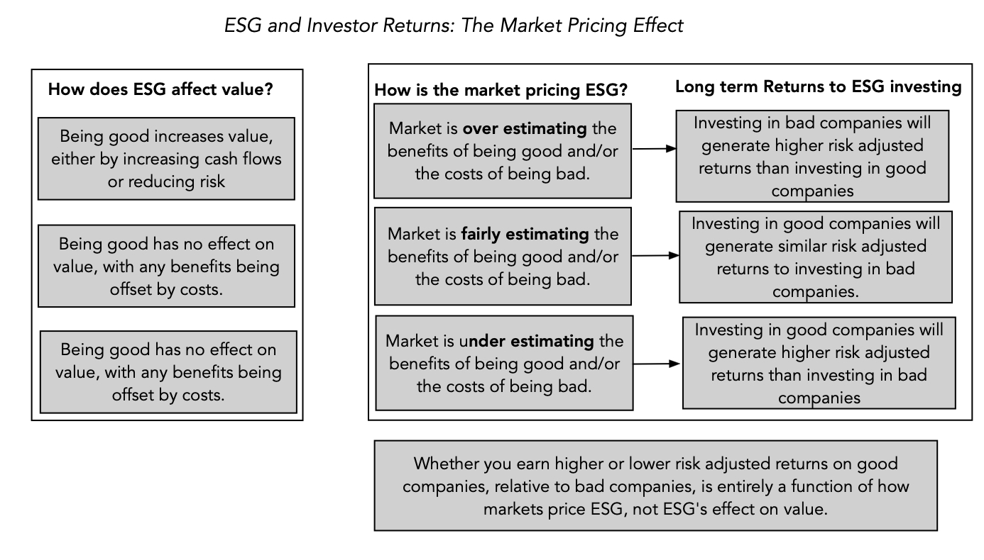
The ESG sales pitch is internally inconsistent and fundamentally incoherent

Slide 22
Why returns to ESG are tough to read…
Value Effect | Market Pricing | Investor Returns to ESG
ESG increases value | Markets overreact, pushing up prices too much | Negative excess returns for investors in good ESG firms.
ESG decreases value | Markets overreact, pushing down prices too much | Positive excess returns for investors in good ESG firms.
ESG increases value | Markets underreact, with prices going up too little. | Positive excess returns for investors in good ESG firms.
ESG decreases value | Markets underreact, with prices going down too little. | Negative excess returns for investors in good ESG firms.
ESG increases value | Markets react correctly, with prices increasing to reflect value. | Zero excess returns for investors in good ESG firms.
ESG decreases value | Markets underreact, with prices going down too little. | Zero excess returns for investors in good ESG firms.

Slide 23
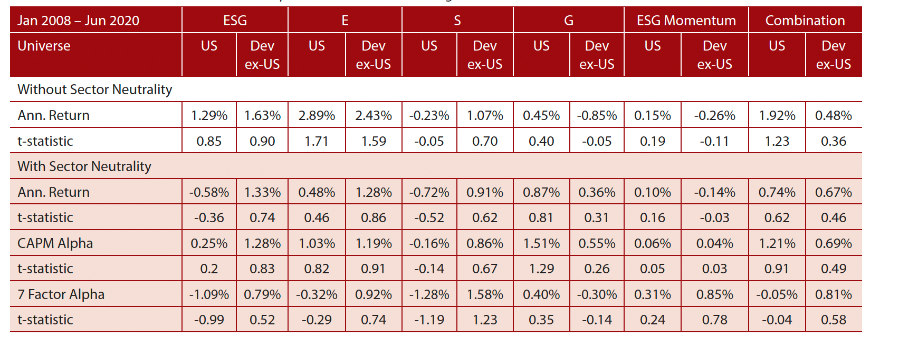
The Returns to ESG: A Closer Look
ESG scores are correlated with many factors that we know already generated excess returns during the 2008-2020 time period. For instance, tech companies have historically had higher ESG scores than non-tech companies. Correcting for these factor skews in ESG rankings, the alphas become much smaller.

Slide 24
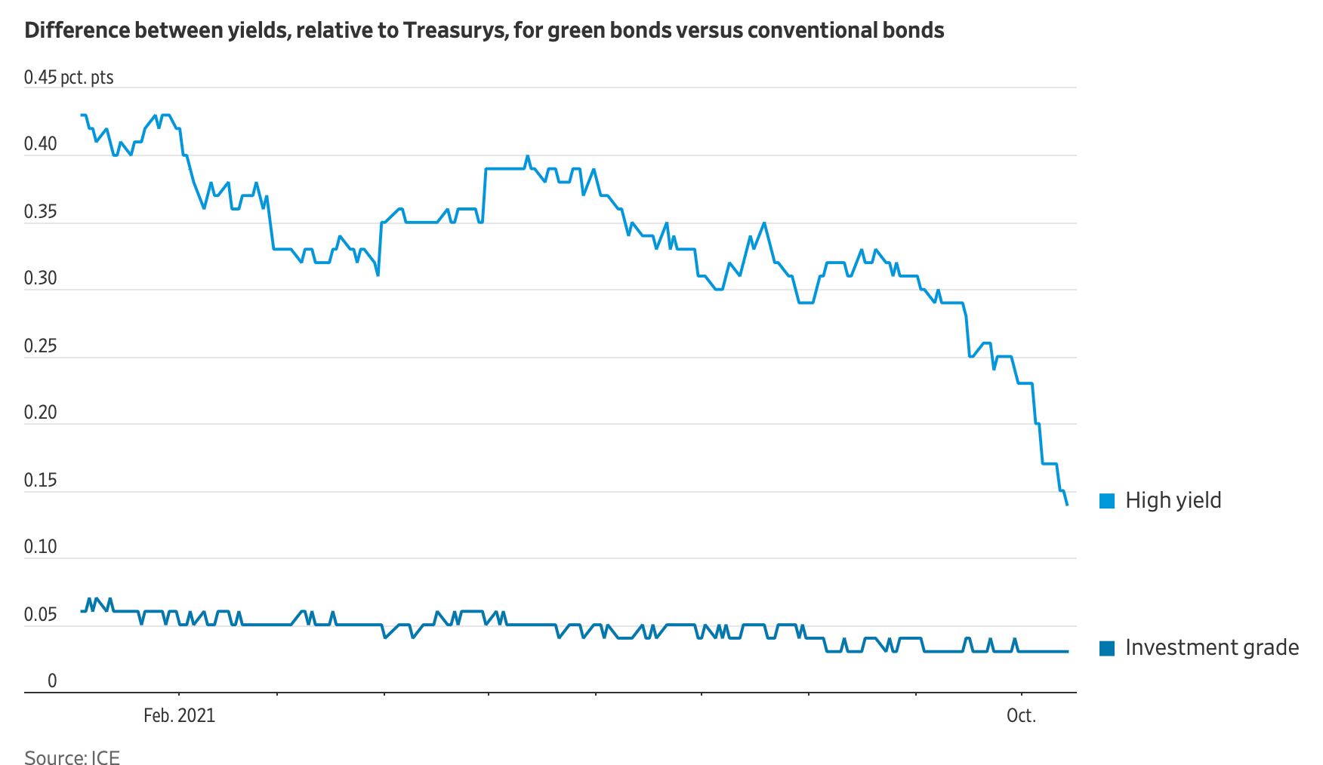
Green Bonds: The Shrinking Premium

Slide 25
Implications for investing
The first is that it suggests that much of the research on the relationship between ESG and returns yields murky findings. Put simply, there is very little that we learn from these studies, whether they find positive or negative relationships between ESG and investor returns, since that relationship is compatible with a number of competing hypotheses about ESG, value and price.
The second is that bringing in market pricing does shed some light on perhaps the only aspect of ESG investing that seems to deliver a payoff for investors, which is investing ahead or during market transitions.
  I pointed to this study that find that activist investors who take stakes in "bad" companies and try to get them to change their ways generate significant excess returns from doing so.
  Another study contends that investing in companies that improve their ESG can generate excess returns of about 3% a year, but skepticism is in order because it is based upon a proprietary ESG improvement score (REIS) and was generated by an asset management firm that invests based upon that score.
If you are interested in making market transitions on ESG work in your favor, you also have to be clear about the strengths you will need to get the payoffs, including skills in divining not only what social values are gaining and losing ground and which changes have staying power.

Slide 26
3a. ESG Disclosure
If ESG does not add to value, at companies, or to returns, for investors, there are some who argue that the primary benefit of the ESG movement has been increased disclosure.
  In short, the new push for ESG seems to be that it just a disclosure movement, that is attempting to let investors know about “material” risks that they might be exposed to.
  Implicit in this argument is the assumption that more disclosure will not only induce better behavior on the parts of the ”disclosing” firms, but also allow consumers and investors to make more informed judgments.
That push has already created results with the EU leading the way on new disclosure requirements, with different interest groups pushing for disclosures on their favorite causes.

Slide 27
The Magic of Materiality
While there seems to be this consensus that we can define materiality, that is far from true. There are three different definitions of materiality:
  Accounting materiality: Reflecting the accounting attention to detail and absence of perspective, accounting materiality is designed to mix the small with the big, and expend resources on details that don’t matter to anyone other than the accountants (Goodwill impairment).
  Value materiality: Value materiality focused on items that change the value of a business by having a significant effect on future cash flows, growth and risk.
  Pricing materiality: Price materiality is built around any item that can cause prices to change substantially, which may or may not overlap with value materiality.
  Legal materiality: Legal materiality is about disclosing any item, no matter how minor, that if things go wrong could be highlighted as material.

Slide 28
Disclosure as information
In theory, disclosures should make us more informed as consumers and investors, but here again, there are caveats.
  Legalese: In an age of litigation and regulation, disclosures seem to be written by lawyers and for lawyers, and there is no reason to believe that ESG disclosures will be any different.
  Information overload: As we have seen with accounting disclosures, there is a danger that if ESG disclosures become too extensive, they will be ignored even by people who claim to care about the disclosed information.
It is almost unavoidable that what starts as value materiality will become legal materiality somewhere along the way, especially when there are laws and regulations that will punish firms, with the benefit of hindsight.

Slide 29
Disclosure and Corporate Behavior
While it is possible that disclosure could lead to better behavior, there are at least two potential problems.
  Greenwashing and Game Playing: Once the disclosure requirements are set, there will be companies that find ways to play the disclosure game to make themselves look better.
  Confess and then sin again: A more dangerous problem is that companies may view disclosure as license for the disclosed bad behavior.
In short, the notion that requiring companies to disclose more will induce better behavior is at odds with the evidence on almost every aspect of disclosure that we have seen so far.
  Did increased risk disclosures make companies more careful about taking risk?
  Have corporate governance disclosures, which have exploded over the last two decades, improved corporate governance at companies?

Slide 30
4. ESG is good for society
There are some who believe that even if ESG makes firms less valuable and investors make lower returns, it is a net positive for society.
  It is premised on the notion that society has developed a consensus on what comprises goodness.
  It is also based upon the presumption that companies that behave well will create less side costs for society and perhaps even contribute to societal good.
If you accept this proposition, the trade off will be positive for society.

Slide 31
The Law of Unintended Consequences…
As publicly traded companies that are exposed to ESG shaming are forced to divest themselves of their “bad” businesses, it is worth remembering that selling or divesting a business does not erase it from the face of the earth, but just transfers it to a different owner, presumably one is less exposed to the ESG shaming.
In the fossil fuel business, for instance, the pressure on the easily pressured (the big US/European oil companies) has led them to cut back on investments in the fossil fuel space.
  That absence of investment is and will continue to push up the price of fossil fuels, making their production more profitable.
  A subset of the investments are now being made by foreign companies (in markets where stockholders has little power) or private equity funds.

Slide 32
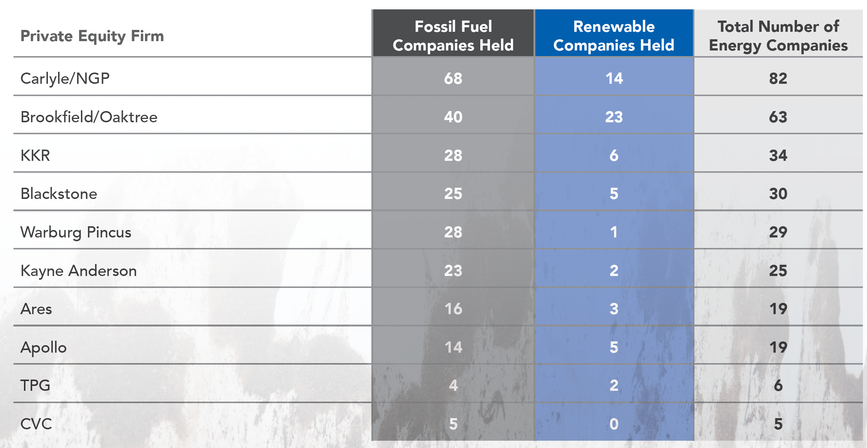
Private Equity in Fossil Fuels
Between 2010 and 2020, private equity funds have invested a trillion dollars in fossil fuel investments…

Slide 33
And how this plays out…
As ESG pressures amp up on publicly traded fossil fuel companies, especially in the US and Europe, to reduce exploration and production of fossil fuels, the laws of demand and supply have created a predictable consequence, which is higher prices for these fossil fuels (gas and oil).
While ESG advocates may view this as a win, it is worth remembering
  that 80% of global energy still comes from fossil fuels, and
  that the people who are most exposed to price increases are not the well off, urban advocates of ESG but the people who are least well off (within countries and across countries).

Slide 34
5. Wanting to do good for society predates ESG…
The notion that until ESG came along, companies (and individuals) are businesses operated without a care for society would be comical, if the people pushing it were not so insistent that it is true.
That is nonsense. People who have wanted to do good have always been able to do so.
  In privately owned businesses, owners have always been free to share their profits or give away their wealth, to meet whatever societal need they felt most strongly about.
  In publicly traded companies, that responsibility fell to the owners of its shares, who again were free to share their winnings with society, in any way they though fit.

Slide 35
Outsourcing your conscience is a salve, not a solution!
The ESG movement has given each of us an easy way out of having to make choices, by outsourcing these choices to corporate CEOs and investment fund managers, asking them to be “good” for us, while not charging us more for their products and services and delivering above-average returns .
Implicit in the ESG push is the presumption that unless companies that are explicitly committed to ESG, they cannot contribute to society, but that is not true. Well before ESG came along, good businesspeople have not only made their shareholders wealthy, and also given back to society.
The difference between this “old” model of business and the proposed “new ESG” version is in who does the giving to society, with corporate CEOs and management taking over that responsibility from shareholders. I am not willing to concede, without challenge, that a corporate CEO knows my value system better than I do, as a shareholder, and is better positioned to make judgments on how much to give back to society, and to whom, than I am.

Slide 36
So why is ESG still being sold? Cui Bono? (Who benefits?)

Slide 37
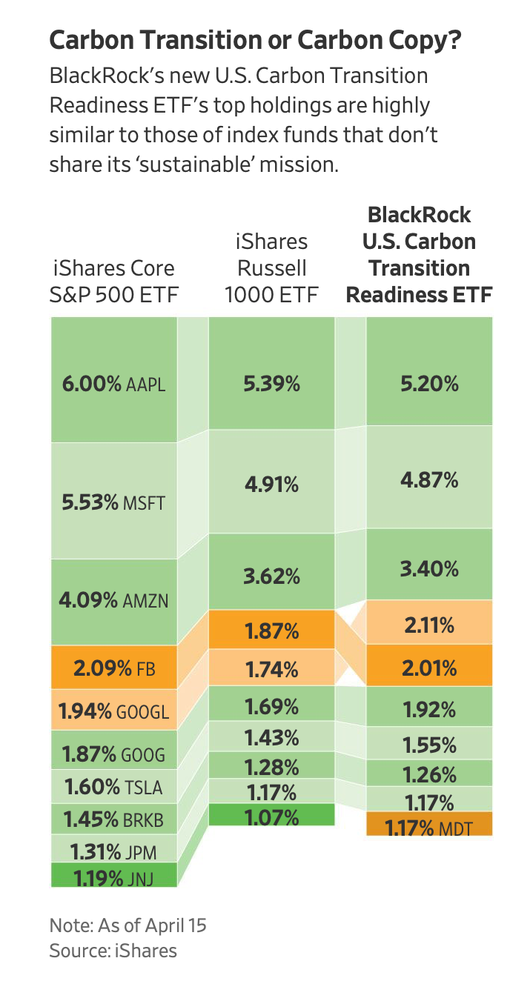
Fake ESG? BlackRock’s Carbon Transition ETF
Expenses: 0.03%
Expenses: 0.15%

Slide 38
And why are corporate managers going along with this charade?
Given that shareholders in companies and investors in funds are paying for this gravy, you may wonder why corporate CEOs not only go along with this charade, but also actively encourage it, and the answer lies in the power it gives them to bypass shareholders and to evade accountability.
After all, these are the same CEOs who, in 2019, put forth the fanciful, but great sounding, argument that it is a company’s responsibility to maximize stakeholder wealth, rather than cater to shareholders, which I argued in a post then that being accountable to everyone effectively meant that CEOs were accountable to no one.
In some cases, flaunting goodness has become a way that founders and CEOs use to cover business model weaknesses and overreach. It is a point that I made in my posts on Theranos, at the time of its implosion in October 2015, and on WeWork, during its IPO debacle in 2019, noting that Elizabeth Holmes and Adam Neumann used their “noble purpose” credentials to cover up fraud and narcissism.

Slide 39
A Roadmap for being and doing good
Start with a personalized measure of goodness, and don’t overreach: The key with moral codes is that they are personal, and for goodness to be incorporated into your investment and business decisions, you have to bring in your value judgments, rather than leave it to ESG measurement services or to portfolio managers.
As a business person, be clear on how being good will affect business models and value: If you own a business, bring your personal views on morality into your business decisions, but if you do so, be at peace with the fact that staying true to your values may, and probably will, cost you money. If you are making decisions at a publicly traded company, as an employee, manager or even CEO, you are investing other people’s money and you have an obligation to be open about what your conscience will cost your shareholders.
As an investor, understand how much goodness has been priced in: If you are an investor, you don’t have to compromise on your values, as long as you realize, at least in the long term, you will have to accept lower returns than you would have earned without that constraint..
As a consumer and citizen, make choices that are consistent with your moral code: Your consumption decisions (on which products and services you buy) and your citizenship decisions (on voting and community participation) have as big, if not greater, an effect.

Slide 40
In conclusion..
On a personal note, I have always found that the people that I've known who do good, spend very little time talking about being good or lecturing other people on goodness. I reserve my skepticism for those companies that spend hundreds of pages of their annual filings telling me how much "good" they do.
The ESG movement’s biggest disservice is the sense that it has given those who are torn between morality and money, that they can have it all.
  Telling companies that being good will always make them more valuable, investors that they can add morality constraints to their investments and earn higher returns at the same time, and young job seekers that they can be paid like bankers, while doing peace corps work, is delusional.
  The truth is that being good will cost you and/or inconvenience you (as businesses, investors or employees), and that you choose to be good, despite that cost.

