Slide 1
Loss of trust: Government Bonds and risk-free investments
The Trust Deficit and Risk-free Rates!

Slide 2
Risk-free Investments and Rates
In almost every basic finance class, you are introduced to the notion of a risk-free investment, and the rate on that investment becomes the basic on which you build to get to expected returns on risky assets and investments.
  In fact, the standard practice that most analysts and investors follow to estimate the risk-free rate is to use the government bond rate, with the only variants being whether you use a short term or a long-term rate.
  In the aftermath of the 2008 crisis, I wrote a series of what I called my nightmare scenario papers, starting with one titled, "What if nothing is risk free?".
A few months ago, Fitch downgraded the US from AAA to AA+, a relatively minor shift, but one with significant psychological consequences for the largest economy in the world, and one whose currency still dominates global transactions.
  After downgrading, my mailbox was inundated with questions of what this downgrade meant for practitioners, in general, and for corporate finance and valuation practice, in particular.

Slide 3
What is a risk-free investment?
An investment that is risk free over a six-month time period will not be risk free, if you have a ten-year time horizon, you have reinvestment risk, i.e., the proceeds from the six-month investment will have to be reinvested back at the prevailing interest rate six months from now, a year from now and so on, until year 10, and those rates are not known at the time you take the first investment.
By the same token, an investment that delivers a guaranteed return over ten years will not be risk free to an investor with a six-month time horizon. With this investment, you face price risk, since even though you know what you will receive as a coupon or cash flow in future periods, since the present value of these cash flows, will change as rates change.
For an investment to be risk free then, it must meet two conditions.
  The first is that there is no risk that the issuer of the security will default on their contractual commitments.
  The second is that the investment generates a cash flow only at your specified duration, and with intermediate cash flows prior to that duration, since those cash flows will then have to be reinvested at future, uncertain rates. For a five-year horizon, then, you would need the rate on a five-year zero default-free zero coupons bond as your risk-free rate.

Slide 4
Why does the risk-free rate matter?
Asset Allocation: Investors vary on risk aversion, with some more willing to be exposed to risk than others, and while there are numerous mechanisms that they use to reflect their differences, the simplest and the most powerful is their choice on how much to invest in risky assets (stocks, corporate bonds, collectibles etc.) and how much to hold in investment with guaranteed returns over their time horizon.
Expected returns for Risky Investments: The risk-free rate becomes the base on which you build expected returns on all other investments. If you read my last post on equity risk premiums, for instance, I described the equity risk premium as the additional return you would demand, over and above the risk-free rate.
Hurdle rate for companies: Using the same reasoning, higher risk-free rates push up the costs of equity and debt for all companies, and by doing so, raise the hurdle rates for new investments.
Derivative pricing: Arbitrage refers to the possibility that you can create what are effectively risk-free positions by combining holdings in different securities, and the benchmark used to judge whether these positions are value-creating becomes the risk-free rate. If you do assume that markets will price away this excess profit, you then have the basis for the models we use to value options and other derivative assets. That is why the risk-free rate becomes an input into option pricing and forward pricing models, and its absence leaves behind a vacuum.

Slide 5
Determinants
Inflation: If you expect inflation to be 3% in the next year, it makes little sense to buy a bond, even if it is default free, that offers only 2%. As expectations of inflation rise, you should expect risk-free rates to rise.
Real Interest Rate: When you buy a note or a bond, you are effectively giving up current consumption for future consumption, and it is fitting that you earn a return for this sacrifice. This is a real risk-free rate, and in the aggregate, it will be determined by the supply of savings in an economy and the demand for those savings from businesses and individuals making real investments. Put simply, economies with a surplus of growth investments, i.e., with more real growth, should see higher real interest rates, in steady state, than stagnant or declining economies.

Slide 6
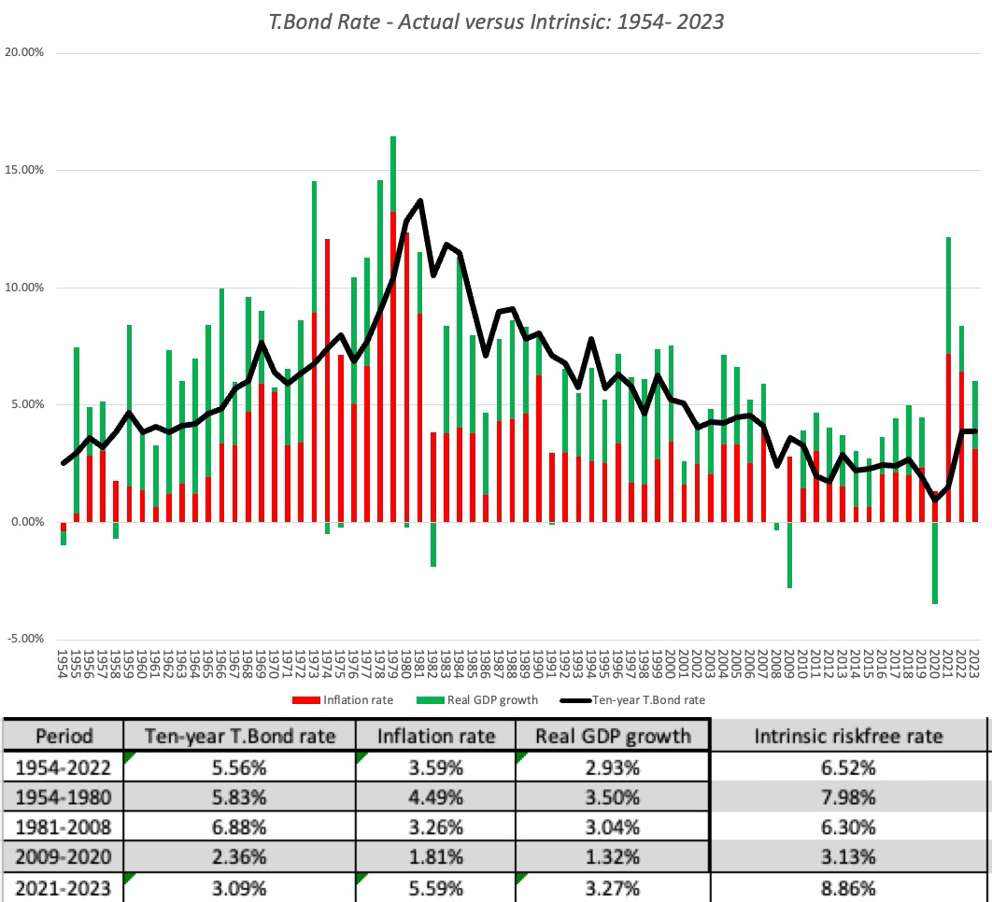
Intrinsic versus Risk-free Rate

Slide 7
Risk-free Rate: Government Bond Rates as Measures
Control of the printing presses: If you have heard the rational for government bond rates as risk-free rates, here is how it usually goes. A government, when it borrows or issues bonds in its local currency, preserves the option to print more money, when that debt comes due, and thus should never default.
Trust in government: Governments that default, especially in their domestic currency, are effectively sending a signal that they cannot be trusted on their obligations, and the implicit assumption is that no government that has a choice would ever send that signal. (Governments send the same signal when they default on their foreign currency debt/bonds, but they can at least point to circumstances out of their control for doing so.)

Slide 8
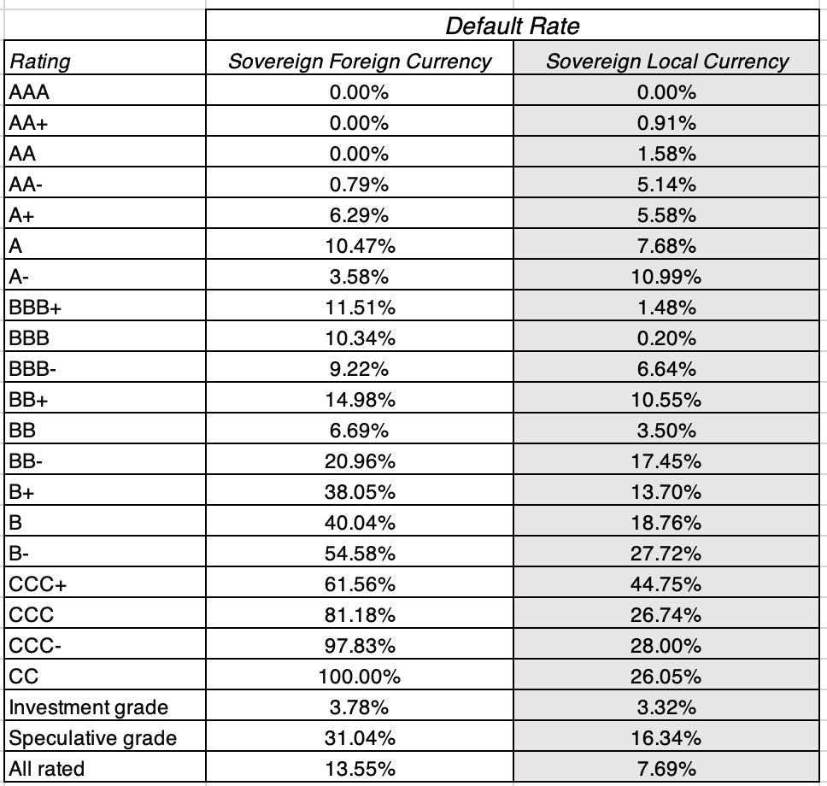
But Governments do default…

Slide 9
And trust in governments has eroded…
It is also worth noting that until 2008, investors had that door firmly shut for some currencies, believing that some governments were so trustworthy that they would not even consider default.
Thus, the notion that the US or UK governments would default on their debt would have been unthinkable, but the 2008 crisis, in addition to the financial damage it created, also opened up a trust deficit.
I have argued that this trust deficit not only gave rise to the crypto boom and to political upheaval, but also has made the unthinkable a reality. In fact, you would be hard pressed to find any government that is trusted the way it was prior to this crisis, and that loss of trust also implies that the clock is ticking towards expiration, for the "government bonds are risk free" argument.

Slide 10
Why governments default…
Economic Reasons: The most obvious reason is economic, where a crisis and collapse in government revenues, from taxes and other sources, causes a government to be unable meet its obligations.
  Concentration of economy: Countries that have more diverse economies are less likely to default than countries with concentrated economies.
  Degree of Indebtedness: The more debt a country takes on, other things remaining equity, the higher its default risk.
  Efficiency of tax system: Countries with more efficient tax systems should have lower default risk.
Political Reasons: When politics becomes dysfunctional, and default is perceived as partisan, with one side of the political divide perceived as losing more from default than the other, governments may default even though they have the resources to cover their obligations.

Slide 11
Measuring Government Default Risk
The first and most widely used measure of default risk is sovereign ratings, where ratings agencies rate countries, just as they do companies, with a rating scale that goes from AAA (Aaa) down to D(default). Fitch, Moody's and S&P all provide sovereign ratings for countries, with separate ratings for foreign currency and local currency debt.
With sovereign ratings, the implicit assumption is that AAA (Aaa) rated countries have negligible or no default risk, and the ratings agencies back this up with the statistic that no AAA rated country has ever defaulted on its debt within 15 years of getting a AAA rating.
That said, the number of AAA (Aaa) rated countries has dropped over time, and there are only nine countries left that have the top rating from all three ratings agencies: Germany, Denmark, Netherlands, Sweden, Norway, Switzerland, Luxembourg, Singapore and Australia. Canada is rated AAA by two of the ratings agencies, and after the Fitch downgrade, the US is rated Aaa only by Moody's, whereas the UK is AAA rated only by S&P.

Slide 12
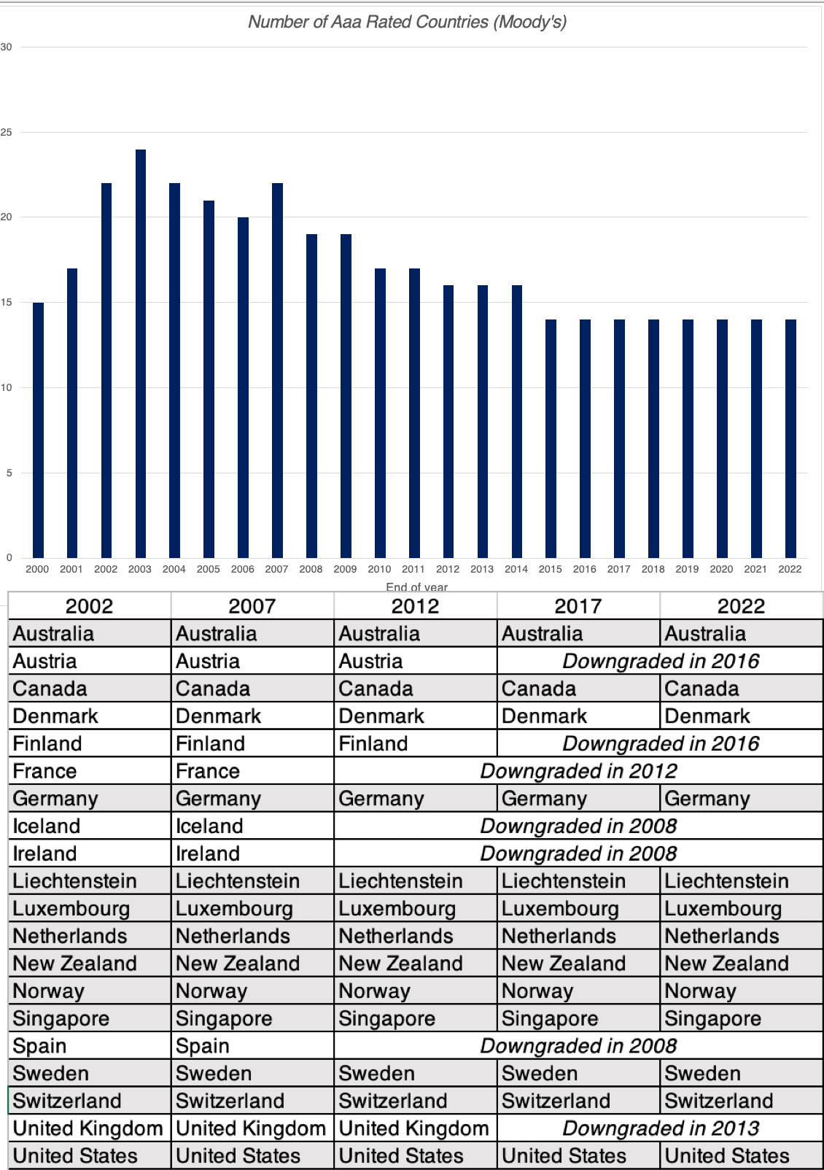
Erosion of Trust?

Slide 13
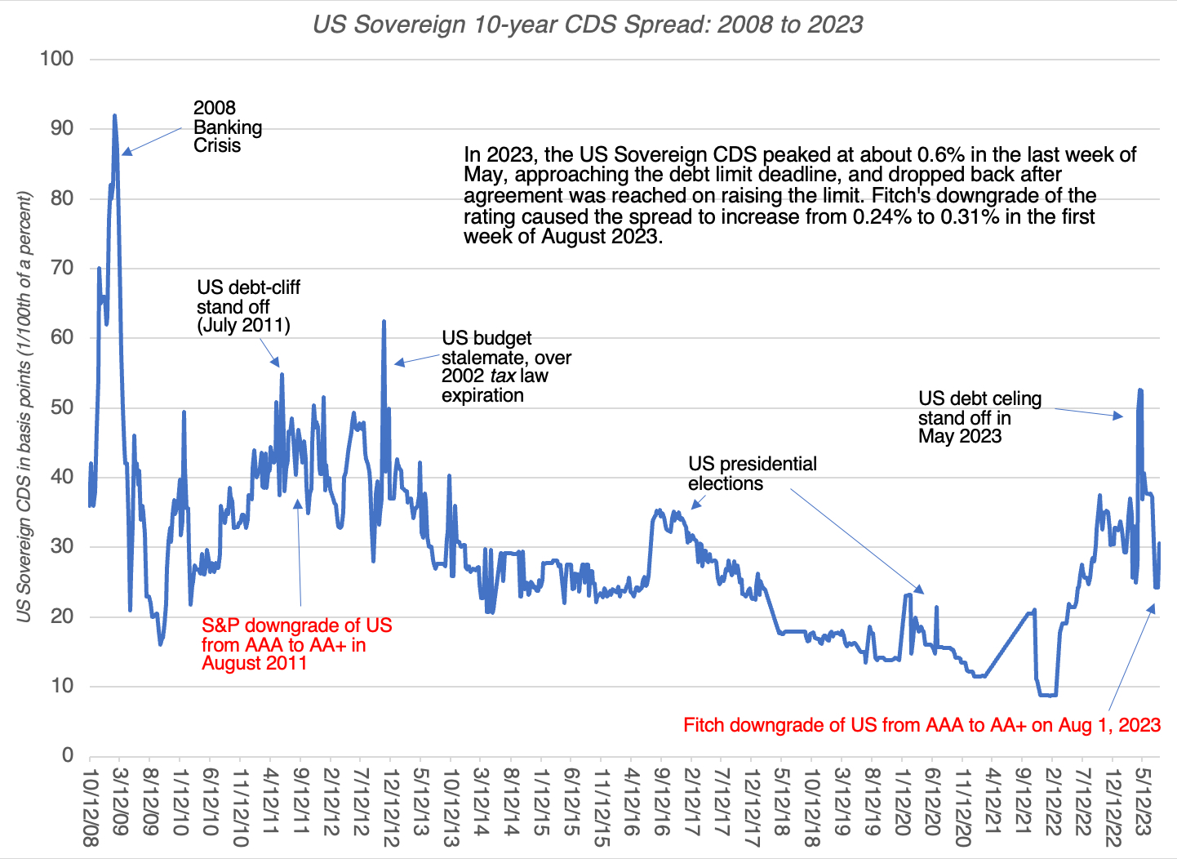
The Sovereign CDS Market: The US CDS

Slide 14
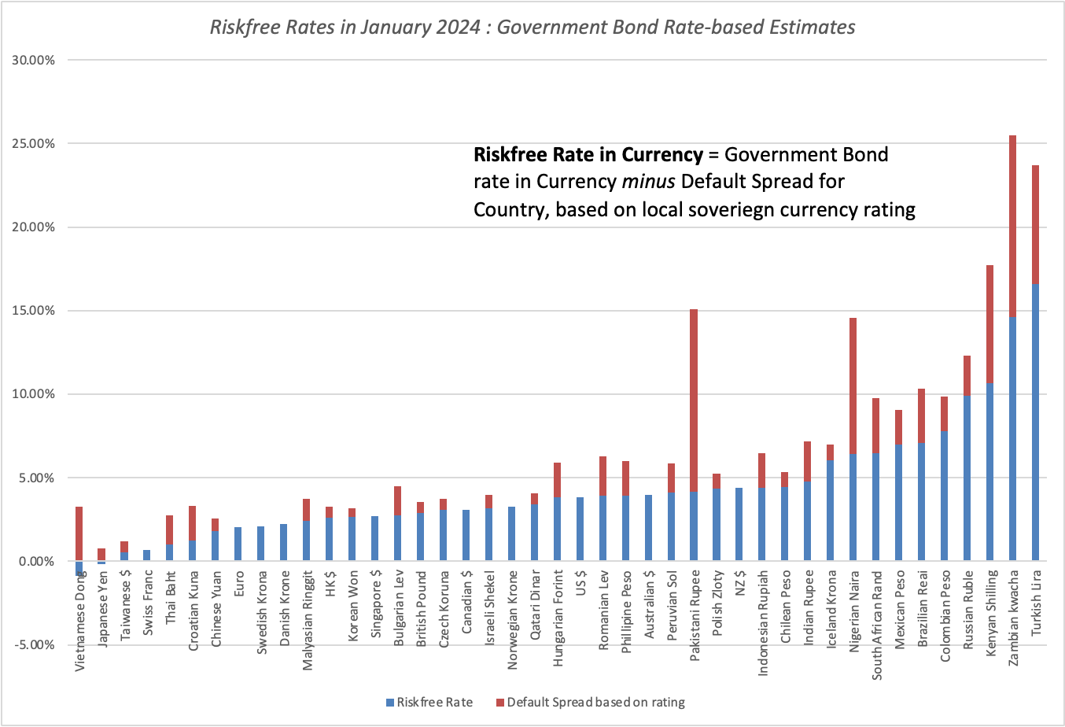
Dealing with Government Default Risk:
Cleaning up Risk-free Rates

Slide 15
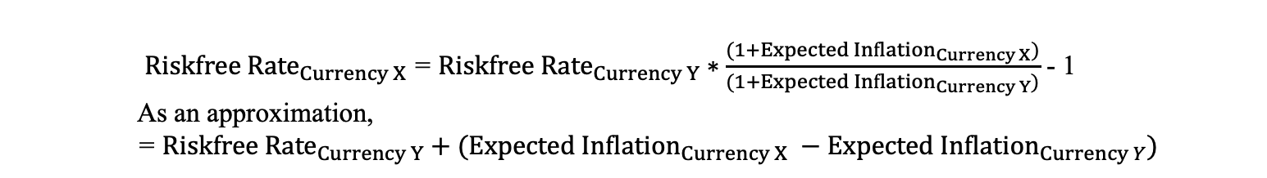
An Inflation-differential Risk-free Rate
To the extent the capital flows globally to from parts with low real returns to geographies with high real returns, the differences in real returns even out, but differences in expected inflation persist.
In my post on country risk, I argued that you can convert a riskfree rate in any currency into a risk-free rate in another currency by adding the differential inflation rate between the currencies to it.
${Riskfree Rate}_{Currency X}$= ${Riskfree Rate}_{Currency Y}∗\frac{(1+{Expected Inflation}_{Currency X})}{(1+{Expected Inflation}_{Currency Y})}$ - 1
    As an approximation,
= ${Riskfree Rate}_{Currency Y}+({Expected Inflation}_{Currency X} −{Expected Inflation}_{Currency Y})$

Slide 16
A What-if with US Treasuries…
If you believe that S&P and Fitch are right on their default risk assessments for the US, and that the US should get a rating lower than Aaa (say Aa1), from Moody's, the path to getting a US risk-free rate has an added step.
You must net out the default spread for the US treasury bond rate to get to a risk-free rate:
  Riskfree Rate in US dollars = US Treasury Bond Rate - Default spread on US T.Bond
Using the sovereign CDS market's estimate of 0.30% in August 2023, for instance, when the US treasury bond rate hit 4.10%, would have yielded a risk-free rate of 3.80% for the US dollar.
  Riskfree Rate in US dollars = 4.10% - -0.30% = 3.80%

Slide 17
The Safe Haven Effect!
During crises, investors seeks out safety, but that pre-supposes that there is a safe place to put your money, where you know what you will make with certainty.
The Fitch downgrade of the US, by itself, is not a market-shaking event, but in conjunction with an 18% return on the ten-year US treasury bond in 2022, these events undercut the notion that there is a safe haven for investors.
When there is no safe haven, market corrections when they happen do not have predictable patterns.
  Historically, when stock prices have plunged, investors have sought out US treasuries, pushing down yields and prices. But what if government securities are viewed as risky?
  Is it any surprise that the loss of trust in governments that has undercut the perception that they are default-free has also given rise to a host of other investment options, each claiming to be the next safe haven. While my skepticism about crypto currencies and NFTs is well documented, a portion of their rise over the last 15 years has been driven by the erosion of trust in institutions.

Slide 18
Concluding Thoughts
Risk-free rates go with currencies, not countries or governments: You estimate a risk-free rate in Euros or dollars, not one for the Euro-zone or the United States. It follows, therefore, that the notion of a global risk-free rate, touted by some, is fantasy, and using the lowest government bond rate, ignoring currencies, as an estimate of this rate, is nonsensical.
Investment returns should be currency-explicit and time-specific: Would you be okay with a 12% return on a stock, in the long term? That question is unanswerable, until you specify the currency in which you are denominating returns, and the time you are making the assessment.
  An investment that earns 12%, in Zambian Kwacha, may be making less than the risk-free rate in Kwachas, but one that earns that same return in Swiss Francs may be a slam-dunk investment.
  In the same vein, an investment that earns 12% in US dollars in 2023 may well pass muster as a good investment, but an investment that earned 12% in US dollars in 1980 would not (since the US treasury bond rate would have yielded more than 10% at the time).
Currencies are measurement calibrators, not value-enhancers or destroyers: A good financial analysis or valuation should be currency-invariant, with whatever conclusion you draw when you do your analysis in one currency carrying over into analyses done in different currencies.
No one (including central banks) cannot fight fundamentals: Central banks and governments that think that they have the power to raise or lower interest rates by edict, and the investors who invest on that basis, are being delusional. While they can nudge rates at the margin, they cannot fight fundamentals (inflation and real growth).

