Slide 1
Session 10: Value Enhancement

Slide 2

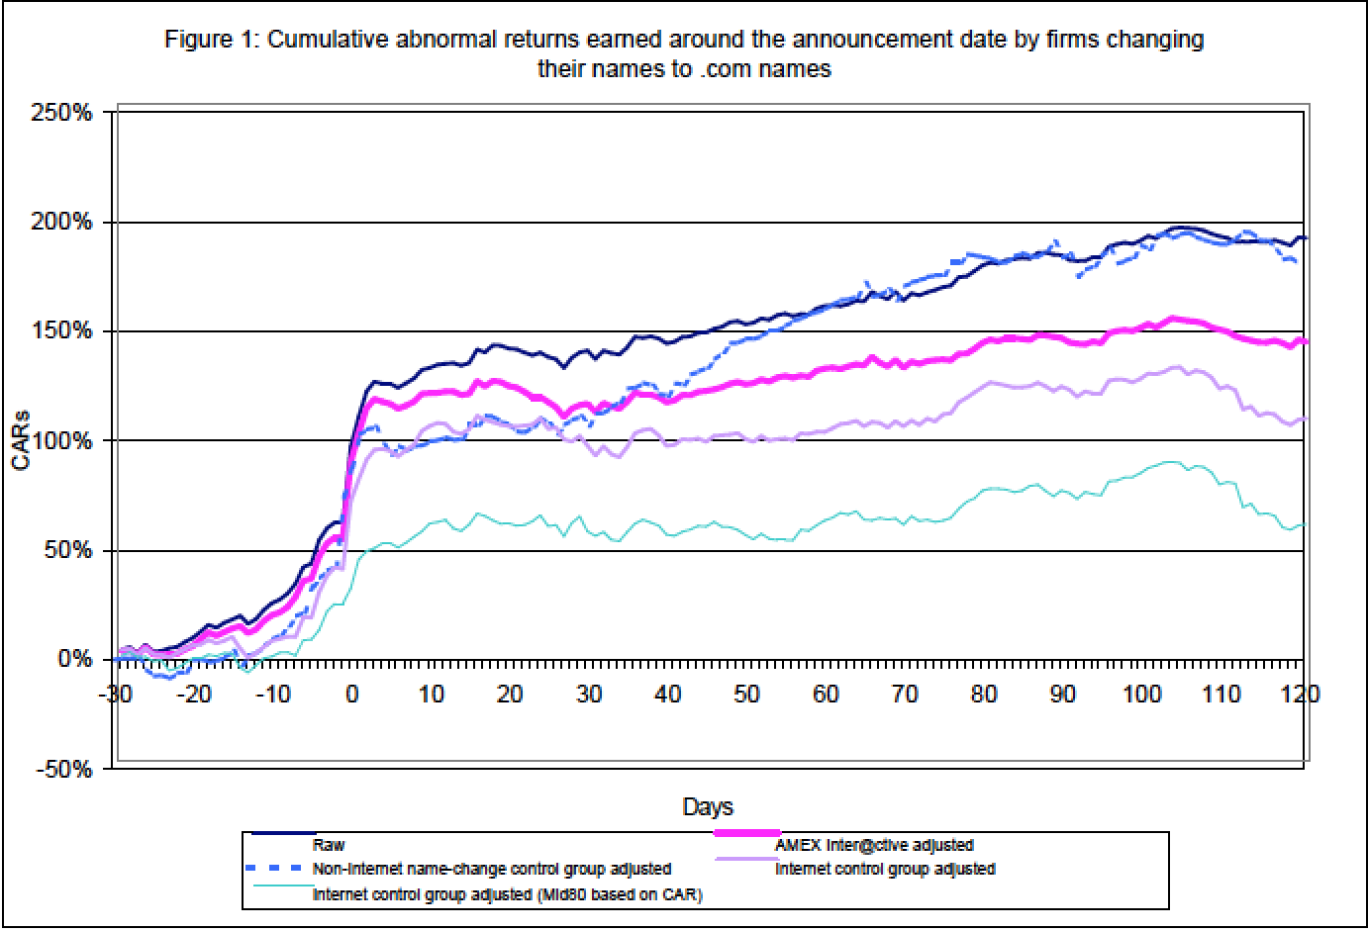
Price Enhancement versus Value Enhancement
Notes:
Value enhancement and price enhancement are equivalent in an efficient market. In a market that does not always reward long-term decision making and behaves irrationally,

Slide 3
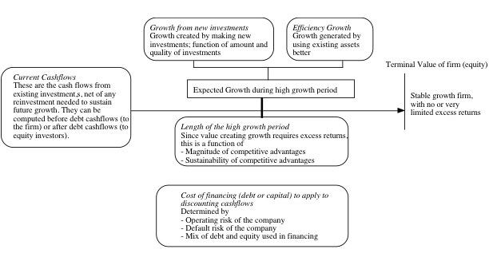
The Paths to Value Creation.. Back to the determinants of value..
Notes:
To create value, you have to change one or more of the above inputs…

Slide 4

Value Creation 1: Increase Cash Flows from Assets in Place
Notes:
The key is that there is a trade off between current cashflows and future growth. If you increase current cashflows at the expense of future growth, you may destroy value rather than add to it.

Slide 5

Value Creation 2: Increase Expected Growth
Price Leader versus Volume Leader Strategies
Return on Capital = Operating Margin * Capital Turnover Ratio
Notes:
Increasing growth will increase value if and only if the return on capital > cost of capital.

Slide 6

Value Creating Growth… Evaluating the Alternatives..

Slide 7

III. Building Competitive Advantages: Increase length of the growth period

Slide 8
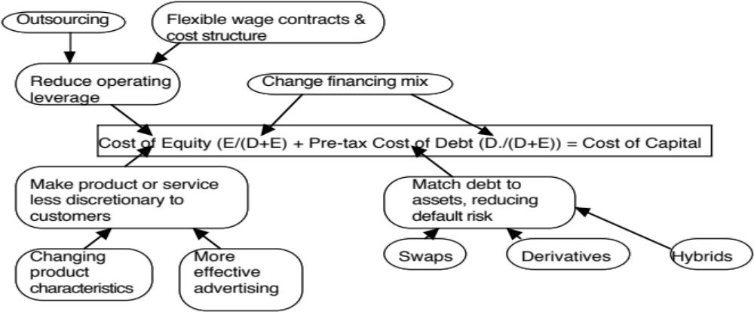
IV. Reduce Cost of Capital
Notes:
Reducing the cost of capital, holding cashflows constant, increases firm value.

Slide 9
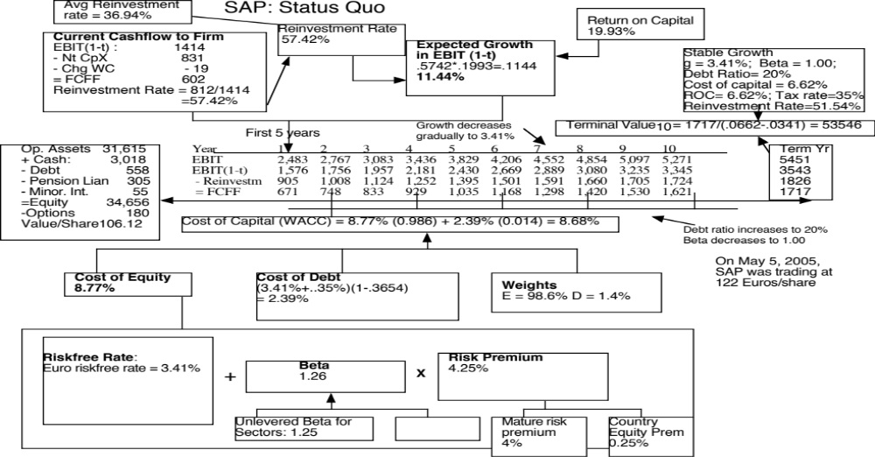
Notes:
A status quo valuation of SAP, the German technology company, yields a value of 106.12 Euros/share.
If you were the new CEO of this company, what would you change about how this company is run?
Is there potential for cost cutting? (Compare the margins to industry averages; SAP earns higher margins than the sector)
Is there potential for higher and more value creating growth? (Reinvestment rate is fairly high and return on capital is excellent)
Is there potential for a longer high growth period? (Are there new competitive advantages that SAP can create.. Does not look like it)
Can it lower its cost of capital? (Only dimension where there seems to be good potential…)

Slide 10
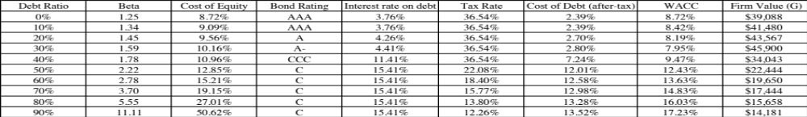
SAP : Optimal Capital Structure
Notes:
Looks like SAP can have a much lower cost of capital, if it moves to a 30% debt ratio…

Slide 11
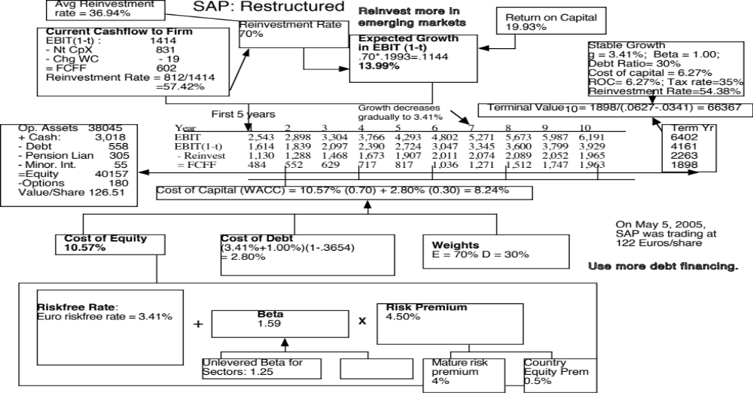
Notes:
With the two changes, the value per share rises to 126.51 Euros/share…. About 20 Euros per share higher than under the status quo..

