Slide 1
Session 12: Loose Ends in Valuation – II
Acquisition Ornaments – Synergy, Control and Complexity
Aswath Damodaran

Slide 2

1. The Value of Synergy

Slide 3
Valuing Synergy
The firms involved in the merger are valued independently, by discounting expected cash flows to each firm at the weighted average cost of capital for that firm.
The value of the combined firm, with no synergy, is obtained by adding the values obtained for each firm in the first step.
The effects of synergy are built into expected growth rates and cashflows, and the combined firm is re-valued with synergy.
Value of Synergy = Value of the combined firm, with synergy - Value of the combined firm, without synergy
Notes:
You have to do three valuations to value synergy and you have to quantify the impact of synergy into valuation inputs.

Slide 4
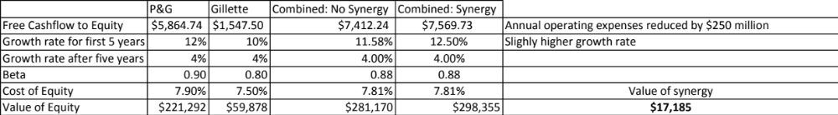
Valuing Synergy: P&G + Gillette

Slide 5
2. The Value of Control
The value of the control premium that will be paid to acquire a block of equity will depend upon two factors -
  Probability that control of firm will change: This refers to the probability that incumbent management will be replaced. this can be either through acquisition or through existing stockholders exercising their muscle.
  Value of Gaining Control of the Company: The value of gaining control of a company arises from two sources - the increase in value that can be wrought by changes in the way the company is managed and run, and the side benefits and perquisites of being in control
  Value of Gaining Control = Present Value (Value of Company with change in control - Value of company without change in control) + Side Benefits of Control

Slide 6
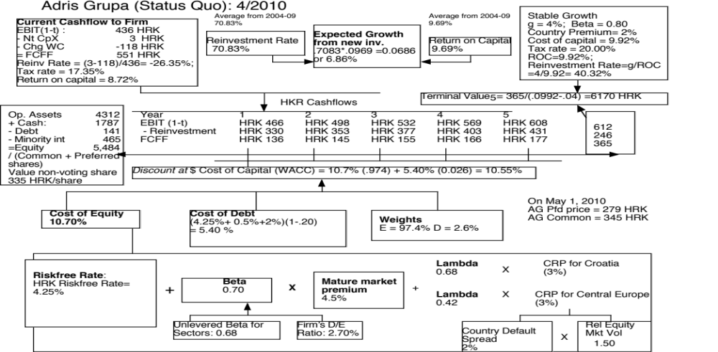

Slide 7
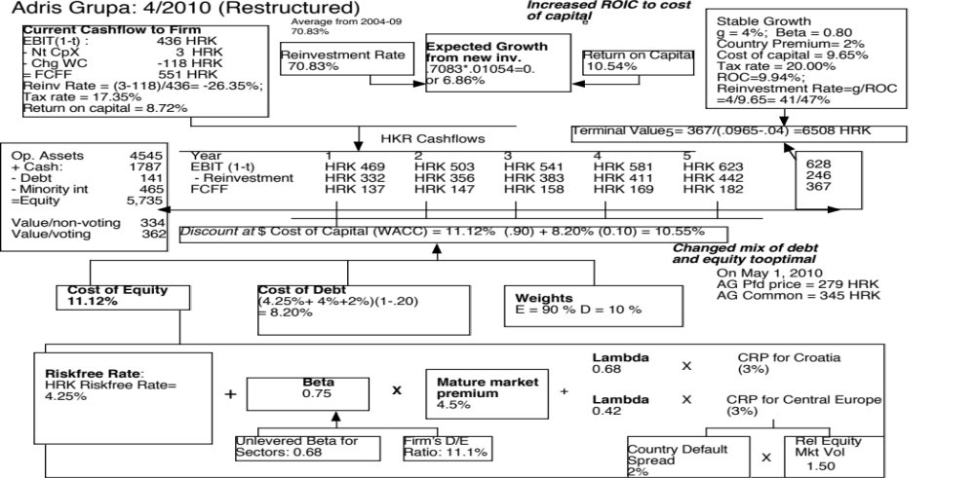

Slide 8
Value of Control and the Value of Voting Rights
The value of control at Adris Grupa can be computed as the difference between the status quo value (5469) and the optimal value (5735).
In this case, we have two values for Adris Grupa’s Equity.
Status Quo Value of Equity = 5,469 million HKR
All shareholders, common and preferred, get an equal share of the status quo value.
Value for a non-voting share = 5469/(9.616+6.748) = 334 HKR/share
The value of the voting shares derives from the capacity to change the way the firm is run
Optimal value of Equity = 5,735 million HKR
Value of control at Adris Grupa = 5,735 – 5469 = 266 million HKR
Only voting shares get a share of this value of control
Value per voting share =334 HKR + 266/9.616 = 362 HKR

Slide 9
3. A Discount for Complexity:
An Experiment
Company A Company B
Operating Income $ 1 billion $ 1 billion
Tax rate 40% 40%
ROIC 10% 10%
Expected Growth 5% 5%
Cost of capital 8% 8%
Business Mix Single Business Multiple Businesses
Holdings Simple Complex
Accounting Transparent Opaque
Which firm would you value more highly?

Slide 10
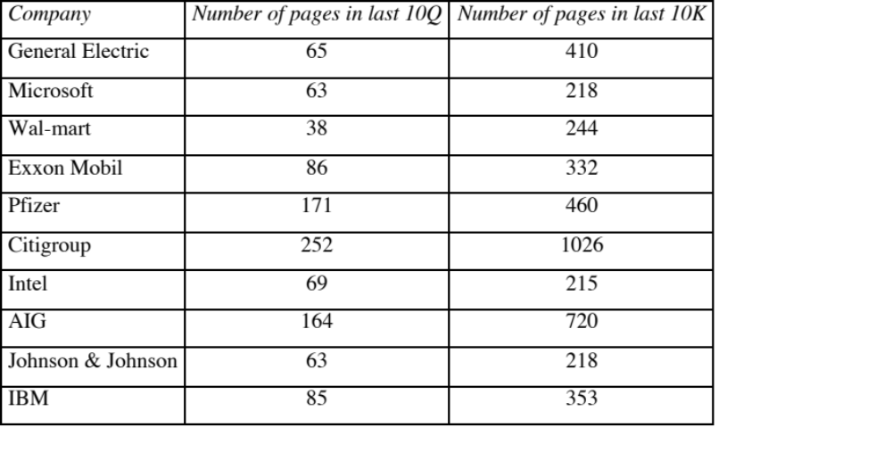
Measuring Complexity: Volume of Data in Financial Statements

Slide 11
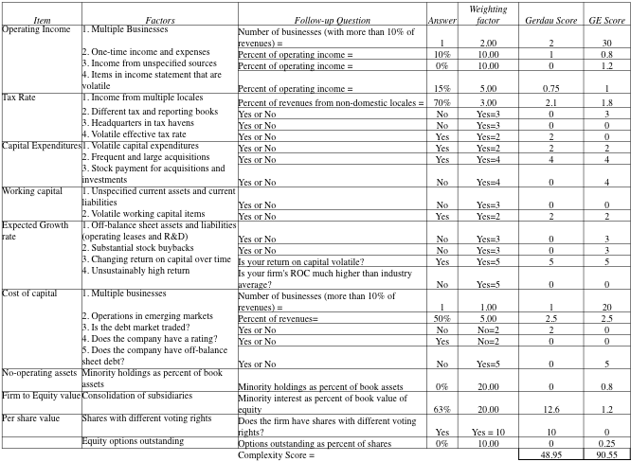
Measuring Complexity: A Complexity Score

Slide 12
Dealing with Complexity
In Discounted Cashflow Valuation
  The Aggressive Analyst: Trust the firm to tell the truth and value the firm based upon the firm’s statements about their value.
  The Conservative Analyst: Don’t value what you cannot see.
  The Compromise: Adjust the value for complexity
    Adjust cash flows for complexity
    Adjust the discount rate for complexity
    Adjust the expected growth rate/ length of growth period
    Value the firm and then discount value for complexity
In relative valuation
  You may be able to assess the price that the market is charging for complexity:
  With the hundred largest market cap firms, for instance:
PBV = 0.65 + 15.31 ROE – 0.55 Beta + 3.04 Expected growth rate – 0.003 # Pages in 10K

