Slide 1
Session 13: Loose Ends in Valuation –III
Distress, Dilution and Illiquidity
Aswath Damodaran

Slide 2
1. Distress and the Going Concern Assumption
Traditional valuation techniques are built on the assumption of a going concern, i.e., a firm that has continuing operations and there is no significant threat to these operations.
  In discounted cashflow valuation, this going concern assumption finds its place most prominently in the terminal value calculation, which usually is based upon an infinite life and ever-growing cashflows.
  In relative valuation, this going concern assumption often shows up implicitly because a firm is valued based upon how other firms - most of which are healthy - are priced by the market today.
When there is a significant likelihood that a firm will not survive the immediate future (next few years), traditional valuation models may yield an over-optimistic estimate of value.
Notes:
The going concern assumption is central in traditional valuation. We often consider firms to have perpetual lives and we value them as such. We either ignore the possibility of distress or consider it, at best, in an ad hoc way.

Slide 3
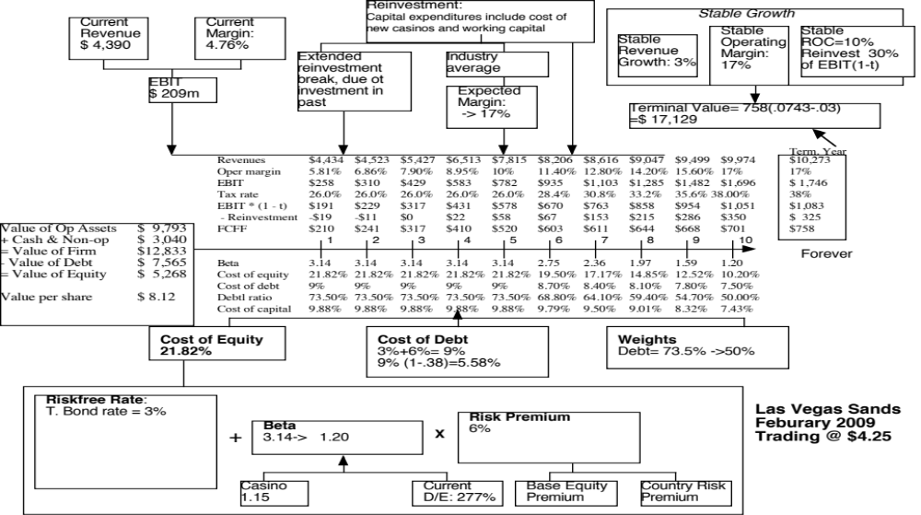

Slide 4
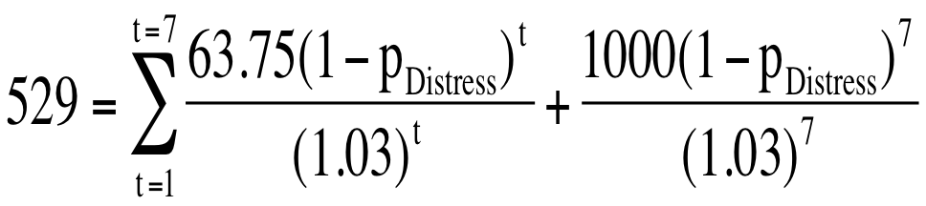
The Distress Factor
In February 2009, LVS was rated B+ by S&P. Historically, 28.25% of B+ rated bonds default within 10 years. LVS has a 6.375% bond, maturing in February 2015 (7 years), trading at $529. If we discount the expected cash flows on the bond at the riskfree rate, we can back out the probability of distress from the bond price:
Solving for the probability of bankruptcy, we get:
π_{Distress} = Annual probability of default = 13.54%
  Cumulative probability of surviving 10 years = (1 - .1354)10 = 23.34%
  Cumulative probability of distress over 10 years = 1 - .2334 = .7666 or 76.66%
If LVS is becomes distressed:
  Expected distress sale proceeds = $2,769 million < Face value of debt
  Expected equity value/share = $0.00
Expected value per share = $8.12 (1 - .7666) + $0.00 (.7666) = $1.92

Slide 5
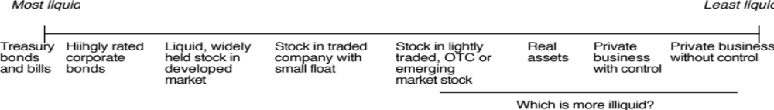
2. Analyzing the Effect of Illiquidity on Value
The simplest way to think about illiquidity is to consider it the cost of buyer’s remorse: it is the cost of reversing an asset trade almost instantaneously after you make the trade.
Defined thus, all assets are illiquid. The difference is really a continuum, with some assets being more liquid than others.
The notion that publicly traded firms are liquid and private businesses are not is too simplistic.

Slide 6
The Theory on Illiquidity Discounts
Illiquidity discount on value: You should reduce the value of an asset by the expected cost of trading that asset over its lifetime.
  The illiquidity discount should be greater for assets with higher trading costs
  The illiquidity discount should be decrease as the time horizon of the investor holding the asset increases
Illiquid assets should be valued using higher discount rates
  Risk-Return model: Some illiquidity risk is systematic. In other words, the illiquidity increases when the market is down. This risk should be built into the discount rate.
  Empirical: Assets that are less liquid have historically earned higher returns. Relating returns to measures of illiquidity (turnover rates, spreads etc.) should allow us to estimate the discount rate for less liquid assets.
Illiqudiity can be valued as an option: When you are not allowed to trade an asset, you lose the option to sell it if the price goes up (and you want to get out).

Slide 7
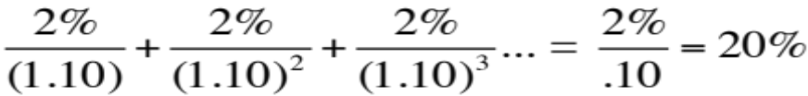
a. Illiquidity Discount in Value
Amihud and Mendelson make the interesting argument that when you pay for an asset today will incorporate the present value of all expected future transactions costs on that asset. For instance, assume that the transactions costts are 2% of the price and that the average holding period is 1 year. The illiquidity discount can be computed as follows:
  Illiquidity discount =
  With a holding period of 3 years, the illiqudity discount will be much smaller (about 6.67%)
It follows then that the illiquidity discount will be
  An increasing function of transactions costs
  A decreasing function of the average holding period

Slide 8
b. Adjusting discount rates for illiquidity
Liquidity as a systematic risk factor
  If liquidity is correlated with overall market conditions, less liquid stocks should have more market risk than more liquid stocks
  To estimate the cost of equity for stocks, we would then need to estimate a “liquidity beta” for every stock and multiply this liquidity beta by a liquidity risk premium.
  The liquidity beta is not a measure of liquidity, per se, but a measure of liquidity that is correlated with market conditions.
Liquidity premiums
  You can always add liquidity premiums to conventional risk and return models to reflect the higher risk of less liquid stocks.
  These premiums are usually based upon historical data and reflect what you would have earned on less liquid investments historically (usually smaller stocks with lower trading volume) relative to more liquid investments. Amihud and Mendelson estimate that the expected return increases about 0.25% for every 1% increase in the bid-ask spread.

Slide 9
3. Equity to Employees: Effect on Value
In recent years, firms have turned to giving employees (and especially top managers) equity option packages as part of compensation. These options are usually
  Long term
  At-the-money when issued
  On volatile stocks
Are they worth money? And if yes, who is paying for them?
Two key issues with employee options:
  How do options granted in the past affect equity value per share today?
  How do expected future option grants affect equity value today?
Notes:
Any options issued by the firm to its employees or investors qualifies. Options issued by third parties (the CBOE) have no effect on value.

Slide 10
Short cuts used to deal with options
Fully diluted value per share
  Once you have estimated the overall value of equity, you can divide by the total number of shares outstanding, including those underlying the options.
  Doing so will understate the value of your equity, since the options, even if exercised, will bring in cash to the firm.
Treasury stock approach
  Value per share = (Estimated Equity value + Proceeds from exercise of options)/ (Number of shares + Number of options)
  This approach will overstate the value of equity since it values options at exercise value and ignores the time premium on options.

Slide 11
Dealing with Employee Options: The Right way
Options outstanding
  Step 1: List all options outstanding, with maturity, exercise price and vesting status.
  Step 2: Value the options, taking into account dilution, vesting and early exercise considerations
  Step 3: Subtract from the value of equity and divide by the actual number of shares outstanding (not diluted or partially diluted).
Expected future option and restricted stock issues
  Step 1: Forecast value of options that will be granted each year as percent of revenues that year. (As firm gets larger, this should decrease)
  Step 2: Treat as operating expense and reduce operating income and cash flows
  Step 3: Take present value of cashflows to value operations or equity.

