Slide 1
Session 14: Relative Valuation
Introduction and Basics
Aswath Damodaran

Slide 2
The Essence of relative valuation?
In relative valuation, the value of an asset is compared to the values assessed by the market for similar or comparable assets.
To do relative valuation then,
  we need to identify comparable assets and obtain market values for these assets
  convert these market values into standardized values, since the absolute prices cannot be compared This process of standardizing creates price multiples.
  compare the standardized value or multiple for the asset being analyzed to the standardized values for comparable asset, controlling for any differences between the firms that might affect the multiple, to judge whether the asset is under or over valued
Notes:
These are the three ingredients you find in almost every equity research report - comparables, a multiple (or standardized price) and a story (which represents the attempt to control for differences).

Slide 3
Relative valuation is pervasive…
Most valuations on Wall Street are relative valuations.
  Almost 85% of equity research reports are based upon a multiple and comparables.
  More than 50% of all acquisition valuations are based upon multiples
  Rules of thumb based on multiples are not only common but are often the basis for final valuation judgments.
While there are more discounted cashflow valuations in consulting and corporate finance, they are often relative valuations masquerading as discounted cash flow valuations.
  The objective in many discounted cashflow valuations is to back into a number that has been obtained by using a multiple.
  The terminal value in a significant number of discounted cashflow valuations is estimated using a multiple.
Notes:
Relative valuations are everywhere and most valuations are relative valuations.

Slide 4
Why relative valuation?
“If you think I’m crazy, you should see the guy who lives across the hall“
      Jerry Seinfeld talking about Kramer in a Seinfeld episode
“ A little inaccuracy sometimes saves tons of explanation”
          H.H. Munro
“ If you are going to screw up, make sure that you have lots of company”
      Ex-portfolio manager
Notes:
Most valuations that you see are relative valuations. There are two reasons why relative valuations are so popular:
If your objective is to buy or sell something, not matter what the price, you can justify your decision using relative valuation. There will always be some other assets out there which are more underpriced or overpriced than the asset you are buying or selling.
In contrast to the detail and time needed for discounted cashflow valuation, relative valuation is quicker and seems to require fewer assumptions about the future. (This, we will argue, is really an illusion.)

Slide 5
So, you believe only in intrinsic value? Here’s why you should still care about relative value
Even if you are a true believer in discounted cashflow valuation, presenting your findings on a relative valuation basis will make it more likely that your findings/recommendations will reach a receptive audience.
In some cases, relative valuation can help find weak spots in discounted cash flow valuations and fix them.
The problem with multiples is not in their use but in their abuse. If we can find ways to frame multiples right, we should be able to use them better.
Notes:
Even if you believe that discounted cashflow valuation is the only way to go, learning the language of relative valuation can be useful.

Slide 6

Multiples are just standardized estimates of price…
Notes:
The distinction between price (representing equity value) and value (representing the combined market value of equity and debt) and enterprise value (representing firm value - cash and marketable securities) should be noted.
The last set of multiples - industry specific multiples - will vary depending upon the sector you look at. With power companies, it can take the form of market value of the firm/ kwh of power produced. With new economy companies in the late 1990s, this was taken to whole new levels of detail - value per subscriber, value per web site visitor….

Slide 7
The Four Steps to Understanding Multiples
Define the multiple
  In use, the same multiple can be defined in different ways by different users. When comparing and using multiples, estimated by someone else, it is critical that we understand how the multiples have been estimated
Describe the multiple
  Too many people who use a multiple have no idea what its cross sectional distribution is. If you do not know what the cross sectional distribution of a multiple is, it is difficult to look at a number and pass judgment on whether it is too high or low.
Analyze the multiple
  It is critical that we understand the fundamentals that drive each multiple, and the nature of the relationship between the multiple and each variable.
Apply the multiple
  Defining the comparable universe and controlling for differences is far more difficult in practice than it is in theory.
Notes:
While we can rail about the fact that a valuation based upon multiples is not as detailed as a discounted cashflow valuation,, the reality is that analysts will continue to use multiples to value companies and that we will often have to use these valuations.
Given this reality, we have to think about how best to use multiples. These four steps represent a way in which we can deconstruct any multiple, understand how to use it well and discover when it is being misused.

Slide 8
Definitional Tests
Is the multiple consistently defined?
  Proposition 1: Both the value (the numerator) and the standardizing variable ( the denominator) should be to the same claimholders in the firm. In other words, the value of equity should be divided by equity earnings or equity book value, and firm value should be divided by firm earnings or book value.
Is the multiple uniformly estimated?
  The variables used in defining the multiple should be estimated uniformly across assets in the “comparable firm” list.
  If earnings-based multiples are used, the accounting rules to measure earnings should be applied consistently across assets. The same rule applies with book-value based multiples.
Notes:
Consistent definition:
Consider two widely used multiples that are consistently defined. In the price-earnings ratio (PE), the numerator is equity value per share and the denominator is equity earnings per share. In the enterprise value/ EBITDA multiple, the numerator is firm value and the denominator is a pre-tax cash flow to all claimholders in the firm. In contrast, the price to EBITDA multiple is inconsistent. Why is this a problem? If you are comparing firms with different debt ratios, the firms will more debt will look cheaper on a price to EBITDA basis.
Uniformally Estimated:
This is actually much more difficult than it looks. Even if accounting standards are the same across firms, you run into two problems:
The degree to which firms bend accounting rules for their own purposes varies across firms. Some firms are inherently more conservative in reporting earnings than others.
The financial year ends at different points for different firms. If the denominator is the earnings in the most recent financial year, the multiple may not be comparable if some firms have December year-ends and some have June year-ends.

Slide 9
Descriptive Tests
What is the average and standard deviation for this multiple, across the universe (market)?
How asymmetric is the distribution and what is the effect of this asymmetry on the moments of the distribution?
How large are the outliers to the distribution, and how do we deal with the outliers?
  Throwing out the outliers may seem like an obvious solution, but if the outliers all lie on one side of the distribution, this can lead to a biased estimate.
  Capping the outliers is another solution, though the point at which you cap is arbitrary and can skew results
Are there cases where the multiple cannot be estimated? Will ignoring these cases lead to a biased estimate of the multiple?
How has this multiple changed over time?
Notes:
Before you use a multiple and develop rules of thumb (8 times EBITDA is cheap), you need to get a sense of the cross-sectional distribution.
Multiples have skewed distributions. Because a multiple cannot be less than zero but can potentially be infinite, the averages for multiples will be much higher than their medians, and the difference will increase as the outliers become larger. Many services cap outliers to prevent them from altering the averages too much, results…
The PE ratio cannot be estimated when the earnings per share are negative. Thus, if you have a sample of 20 firms and 10 have negative earnings, you will be able to compute the PE ratio for only the 10 that have positive earnings and will throw out the remaining firms. This will induce a bias in your sample. One way to avoid this is to take the cumulative values for market capitalization and net income for all 20 firms, and compute a PE ratio based upon the cumulated values. The resulting PE ratio will generally be much higher….

Slide 10
Analytical Tests
What are the fundamentals that determine and drive these multiples?
  Proposition 2: Embedded in every multiple are all of the variables that drive every discounted cash flow valuation - growth, risk and cash flow patterns.
How do changes in these fundamentals change the multiple?
  The relationship between a fundamental (like growth) and a multiple (such as PE) is almost never linear.
  Proposition 3: It is impossible to properly compare firms on a multiple, if we do not know how fundamentals and the multiple move.
Notes:
Behind every multiple (PE of 22, Value to EBITDA of 9) are implicit assumptions about growth, risk and cash flows.. In fact, you make the same assumptions when you use multiples that you make in discounted cashflow valuation.. The difference is that your assumptions are explicit in the latter. The first step in understanding a multiple is determining its fundamental drives…
Not only is it important that you find the drivers for each multiple, but you need to understand how changes in these drivers change the multiple. For example, we all accept the intuition that a company with a 20% growth rate should have a higher PE than an otherwise similar company with a 10% growth rate, but how much higher? Twice as high (which would make the relationship linear), 2.5 times as high, 1.5 times as high…

Slide 11
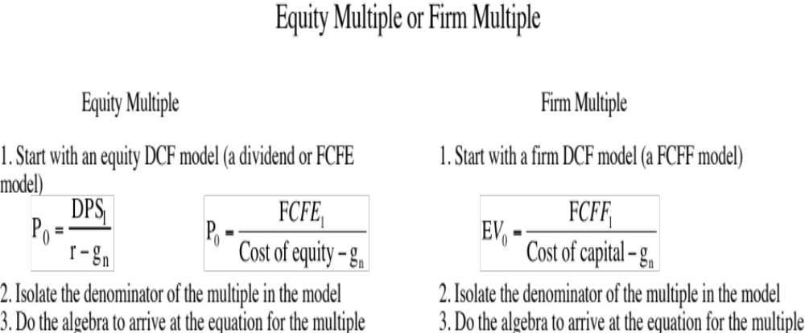
Deconstructing Multiples

Slide 12
Application Tests
Given the firm that we are valuing, what is a “comparable” firm?
  While traditional analysis is built on the premise that firms in the same sector are comparable firms, valuation theory would suggest that a comparable firm is one which is similar to the one being analyzed in terms of fundamentals.
  Proposition 4: There is no reason why a firm cannot be compared with another firm in a very different business, if the two firms have the same risk, growth and cash flow characteristics.
Given the comparable firms, how do we adjust for differences across firms on the fundamentals?
  Proposition 5: It is impossible to find an exactly identical firm to the one you are valuing.
Notes:
In practice, we all too often define comparable as a firm in the same industry or business. This is too narrow a definition. You can have firms in different businesses that have similar cashflow, growth and risk characteristics. These firms can be viewed as comparable firms.
You will never find two identical firms, no matter how hard you search. You therefore have to always control for the residual differences when making comparisons.

