Slide 1
Session 15: PE ratios
Aswath Damodaran

Slide 2
Price Earnings Ratio: Definition
PE = Market Price per Share / Earnings per Share
There are a number of variants on the basic PE ratio in use. They are based upon how the price and the earnings are defined.
Price:
  is usually the current price (though some like to use average price over last 6 months or year)
EPS:
  Time variants: EPS in most recent financial year (current), EPS in most recent four quarters (trailing), EPS expected in next fiscal year or next four quartes (both called forward) or EPS in some future year
  Primary, diluted or partially diluted
  Before or after extraordinary items
  Measured using different accounting rules (options expensed or not, pension fund income counted or not…)
Notes:
This is only the tip of the iceberg. You can have EPS before and after extraordinary items, primary and diluted EPS..
When you are negotiating with someone else and you are both using PE ratios to make your case, the first step is to make sure that you are using the same PE ratio.
There is also the tendency on the part of analysts to pick the definition of pE that best fits their biases. For instance, bullish analysts in the 1990s almost always used forward PE whereas bearish analysts used trailing PE. Since earnings were rising the former were generally much lower than the latter.

Slide 3
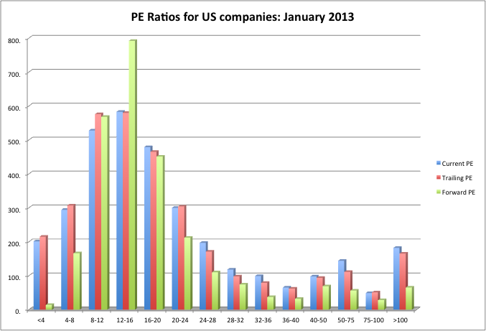
Characteristic 1: Skewed Distributions
PE ratios for US companies in January 2013
Notes:
This graph for all U.S. firms with data available on the Value Line dataset (contains about 7200 firms in the overall sample). Notice that the distributions are skewed to the left and that we have capped the PE ratios at 100….

Slide 4
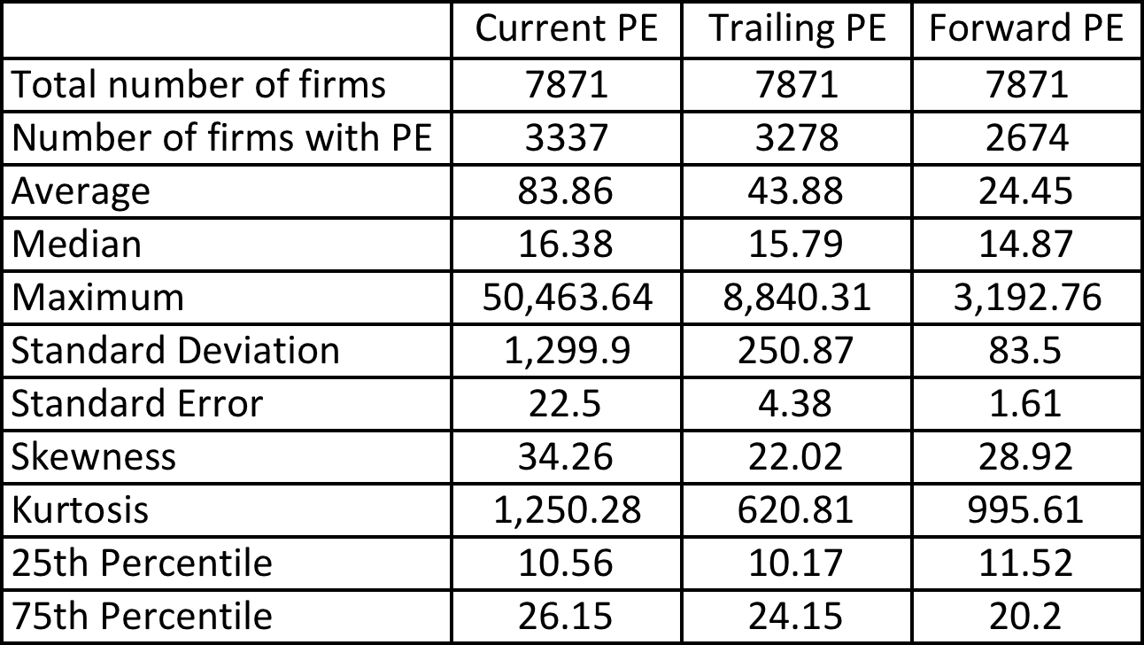
Characteristic 2: Biased Samples
PE ratios in January 2013
Notes:
Four things to note…
Notice the number of firms that we have lost in the sample as we compute PE ratios.
You lose even more firms as you go to forward PE, because you need analyst estimates of expected earnings per share to compute this. Any firms not followed by analysts will not have a forward PE…
The means were computed without capping the PE ratios… the outliers (notice the maximum values for the ratios) push the average to almost twice the median.
The median forward PE is higher than the trailing PE which is higher than the current PE…

Slide 5
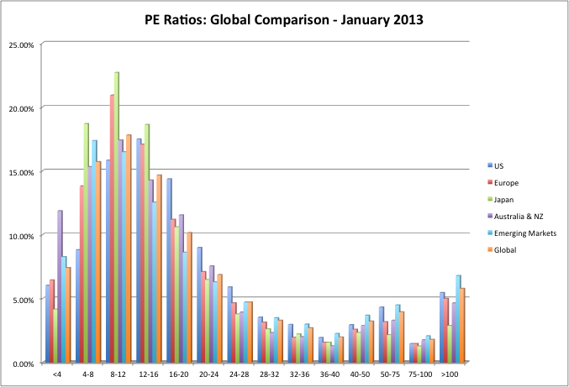
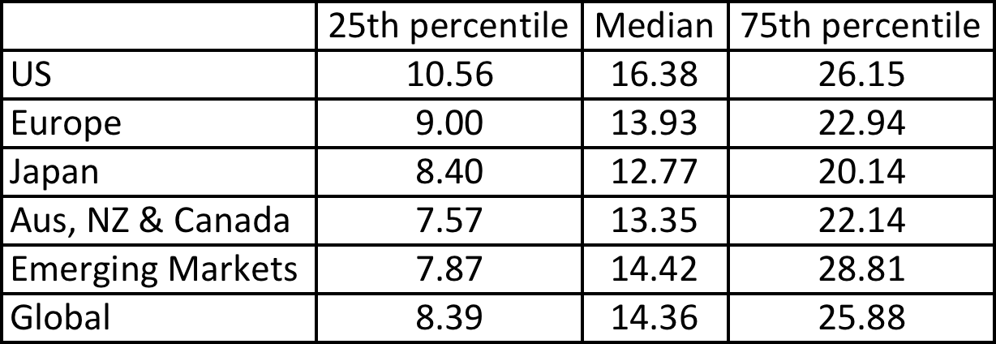
Characteristic 3: Across Markets
PE Ratios: US, Europe, Japan and Emerging Markets – January 2013
Notes:
This compares the percentages of firms in each market that trade in each PE ratio class… Some interesting differences:
More emerging market companies trade at very low PE ratios (less than 8) than European or US companies
More emerging market companies also trade at very high multiples of earnings.
The median PE ratio is lowest in emerging markets, reflecting the effect of country risk on PE.

Slide 6
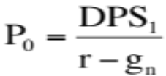
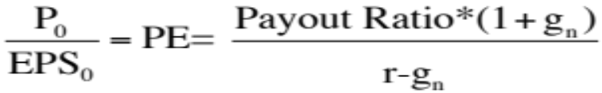
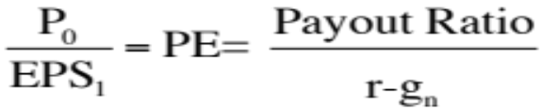
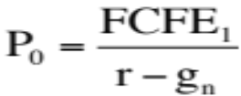
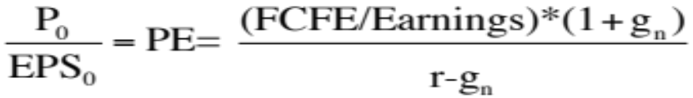
PE Ratio: Understanding the Fundamentals
To understand the fundamentals, start with a basic equity discounted cash flow model. With a stable growth dividend discount model:
Dividing both sides by the current earnings per share or forward EPS:
If this had been a FCFE Model,
Notes:
To get to the heart of equity multiples, we start with an equity DCF model. In this case, we consider the simplest equity valuation model - a stable growth dividend discount model. Restated in terms of the PE ratio, we find that the PE ratio fo a stable growth firm can be written in terms of three variables:
The expected growth rate in earnings per share
The riskiness of the equity, which determines the cost of equity
The efficiency with which the firm generates growth,which is measured by how much the firm can pay out or afford to pay out after reinvested to create the growth.

Slide 7
PE Ratio and Fundamentals
Proposition 1: Other things held equal, higher growth firms will have higher PE ratios than lower growth firms.
Proposition 2: Other things held equal, higher risk firms will have lower PE ratios than lower risk firms
Proposition 3: Other things held equal, firms with lower reinvestment needs will have higher PE ratios than firms with higher reinvestment rates.
Of course, other things are difficult to hold equal since high growth firms, tend to have risk and high reinvestment rats.
Notes:
At first sight, the second proposition may seem counter intuitive. After all, riskiest firms often have the highest PE ratios. The answer lies, of course, in the reality that firms with high risk also tend to have high growth, and growth usually trumps risk….

Slide 8
The perfect under valued company…
If you were looking for the perfect undervalued asset, it would be one
  With a low PE ratio (it is cheap)
  With high expected growth in earnings
  With low risk (and cost of equity)
  And with high ROE
  In other words, it would be cheap with no good reason for being cheap
In the real world, most assets that look cheap on a multiple of earnings basis deserve to be cheap. In other words, one or more of these variables works against the company (It has low growth, high risk or a low ROE).
When presented with a cheap stock (low PE), here are the key questions:
  What is the expected growth in earnings?
  What is the risk in the stock?
  How efficiently does this company generate its growth?

Slide 9
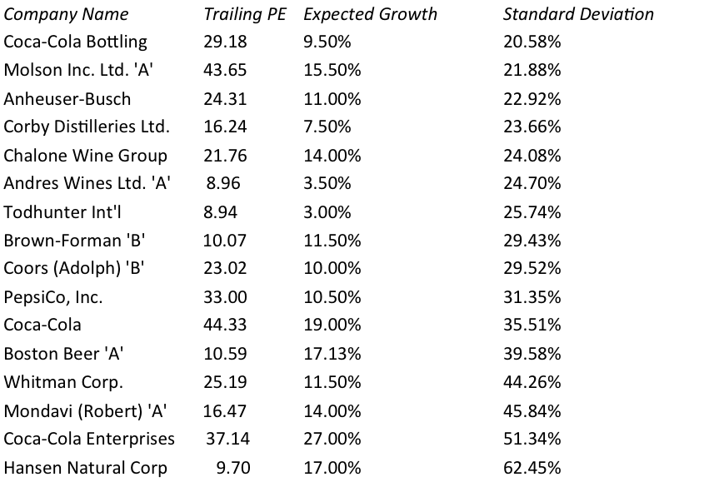
Example 1: Let’s try some story telling
Comparing PE ratios across firms in a sector
Notes:
Notice that while we consider this to be an industry group, these are very different firms in terms of expected growth and size.

Slide 10

Example 2: The limits of story telling
Telecom ADRs in 1999
Notes:
In this sample, note that some of the firms in the sample are emerging market firms any may be exposed to more risk (political risk, economic risk, inflation risk…)

Slide 11
PE, Growth and Risk
Dependent variable is: PE
R squared = 66.2% R squared (adjusted) = 63.1%
Variable Coefficient SE t-ratio Probability
Constant 13.1151 3.471 3.78 0.0010
Growth rate 1.21223 19.27 6.29 ≤ 0.0001
Emerging Market -13.8531 3.606 -3.84 0.0009
Emerging Market is a dummy: 1 if emerging market
0 if not
Predicted PE for Telebras= 13.12 + 1.2122 (7.5) - 13.85 (1) = 8.35
At an actual price to earnings ratio of 8.9, Telebras is slightly overvalued.
Notes:
Higher growth telecomm companies have higher PE ratios..
One way to read this regression: If you have two companies - one with a growth rate of 10% and one with a growth rate of 20%, the latter should have a PE that is 12.1 higher..
If the firm happens to be an emerging market firm, though, you would expect its PE ratio to be 13.85 lower than a firm with similar growth in a developed market.

