Slide 1
Session 17: Book Value Multiples
Aswath Damodaran

Slide 2
Price-Book Value Ratio: Definition
The price/book value ratio is the ratio of the market value of equity to the book value of equity, i.e., the measure of shareholders’ equity in the balance sheet.
  Price/Book Value = Market Value of Equity/ Book Value of Equity
Extending this multiple to cover broader measures of value, we get
  Value/ Book = (Market Value of Equity+ Debt)/ (Book Value of Equity + Debt)
  EV/ Invested Capital= (Market Value of Equity+ Debt – Cash)/ (Book Value of Equity + Debt – Cash))
Notes:
Your definitions of equity in the numerator and denominator should be consistent… this may require the breaking down of book equity if there are multiple classes of shares outstanding.
If you have a class of shares that is non-traded, you have two choices. You can ignore this in computing market equity and take out a proportional shares of the book equity. Alternatively, you can estimate a value for the non-traded shares and add them to the market value of traded shares to arrive at a total market value of equity. It is generally not a good idea to include preferred stock in either the numerator or denominator.

Slide 3
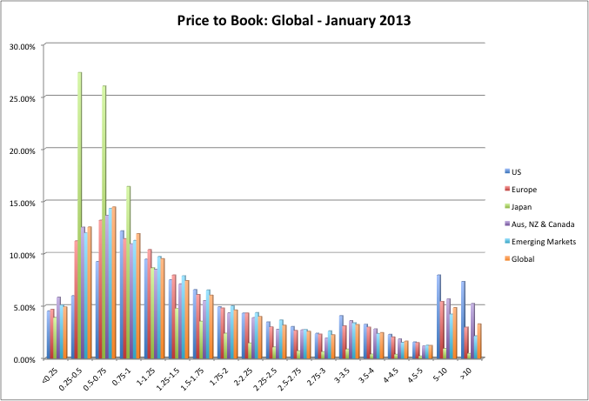
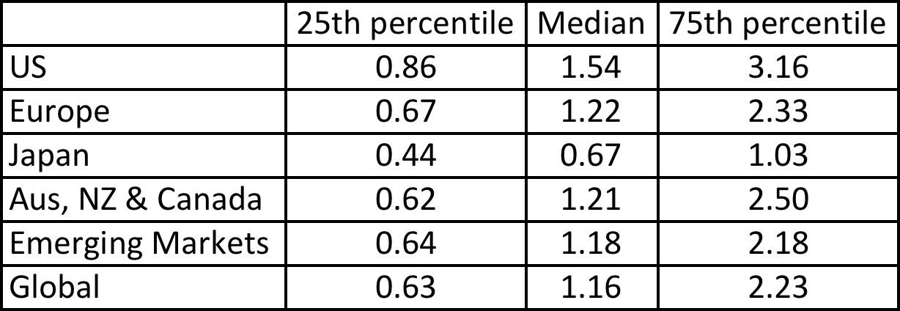
Price to Book: U.S., Europe, Japan and Emerging Markets – January 2013
Notes:
A larger portion of stocks trade at below book value in Europe than do in the United States. An even large proportion trade at below book value in emerging markets, but there are also far more outliers with very high PBV ratios.

Slide 4




Price Book Value Ratio: Stable Growth Firm
Going back to a simple dividend discount model,
Defining the return on equity (ROE) = EPS0 / Book Value of Equity, the value of equity can be written as:
If the return on equity is based upon expected earnings in the next time period, this can be simplified to,
Notes:
Following a familiar route.. The price to book ratio is an equity multiple and you go back to an equity valuation model…
The price to book ratio is determined by the three variables that determine the PE ratio (growth, payout and risk) and one variable that is unique to it (the return on equity)
Every multiple has one variable that can be considered its key determinant - its companion variable, so to speak. For PE, it was growth.. For Value/EBITDA, it was the reinvestment rate. For price to book, it is return on equity.

Slide 5
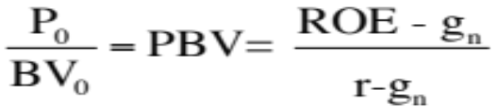
Price Book Value Ratio: Stable Growth Firm
Another Presentation
This formulation can be simplified even further by relating growth to the return on equity:
g = (1 - Payout ratio) * ROE
Substituting back into the P/BV equation,
The price-book value ratio of a stable firm is determined by the differential between the return on equity and the required rate of return on its projects.
Notes:
Restates the price to book in terms of excess returns.. Firms that earn excess returns (on equity) will trade at high price to book ratios… If the return on equity is estimated using the expected earnings next year, the two equations will converge.. Otherwise, the first equation will be higher by a factor (1+g)….

Slide 6
Looking for undervalued securities - PBV Ratios and ROE
Given the relationship between price-book value ratios and returns on equity, it is not surprising to see firms which have high returns on equity selling for well above book value and firms which have low returns on equity selling at or below book value.
The firms which should draw attention from investors are those which provide mismatches of price-book value ratios and returns on equity - low P/BV ratios and high ROE or high P/BV ratios and low ROE.
Notes:
Most companies that trade at high price to book or low price to book deserve to trade at those multiples. The mismatches matter…

Slide 7
An Eyeballing Exercise:
European Banks in 2010
Name | PBV Ratio | Return on Equity | Standard Deviation
BAYERISCHE HYPO-UND VEREINSB | 0.80 | -1.66% | 49.06%
COMMERZBANK AG | 1.09 | -6.72% | 36.21%
DEUTSCHE BANK AG -REG | 1.23 | 1.32% | 35.79%
BANCA INTESA SPA | 1.66 | 1.56% | 34.14%
BNP PARIBAS | 1.72 | 12.46% | 31.03%
BANCO SANTANDER CENTRAL HISP | 1.86 | 11.06% | 28.36%
SANPAOLO IMI SPA | 1.96 | 8.55% | 26.64%
BANCO BILBAO VIZCAYA ARGENTA | 1.98 | 11.17% | 18.62%
SOCIETE GENERALE | 2.04 | 9.71% | 22.55%
ROYAL BANK OF SCOTLAND GROUP | 2.09 | 20.22% | 18.35%
HBOS PLC | 2.15 | 22.45% | 21.95%
BARCLAYS PLC | 2.23 | 21.16% | 20.73%
UNICREDITO ITALIANO SPA | 2.30 | 14.86% | 13.79%
KREDIETBANK SA LUXEMBOURGEOI | 2.46 | 17.74% | 12.38%
ERSTE BANK DER OESTER SPARK | 2.53 | 10.28% | 21.91%
STANDARD CHARTERED PLC | 2.59 | 20.18% | 19.93%
HSBC HOLDINGS PLC | 2.94 | 18.50% | 19.66%
LLOYDS TSB GROUP PLC | 3.33 | 32.84% | 18.66%
Average | 2.05 | 12.54% | 24.99%
Median | 2.07 | 11.82% | 21.93%

Slide 8
The median test…
We are looking for stocks that trade at low price to book ratios, while generating high returns on equity, with low risk. But what is a low price to book ratio? Or a high return on equity? Or a low risk
One simple measure of what is par for the sector are the median values for each of the variables. A simplistic decision rule on under and over valued stocks would therefore be:
  Undervalued stocks: Trade at price to book ratios below the median for the sector,(2.05), generate returns on equity higher than the sector median (11.82%) and have standard deviations lower than the median (21.93%).
  Overvalued stocks: Trade at price to book ratios above the median for the sector and generate returns on equity lower than the sector median.
Notes:
Allows us to compare banks with very different returns on equity and quantify the likely impact on price to book ratios.

Slide 9
How about this mechanism?
We are looking for stocks that trade at low price to book ratios, while generating high returns on equity. But what is a low price to book ratio? Or a high return on equity?
Taking the sample of 18 banks, we ran a regression of PBV against ROE and standard deviation in stock prices (as a proxy for risk).
  PBV = 2.27 + 3.63 ROE - 2.68 Std dev
  (5.56) (3.32) (2.33)
  R squared of regression = 79%

Slide 10
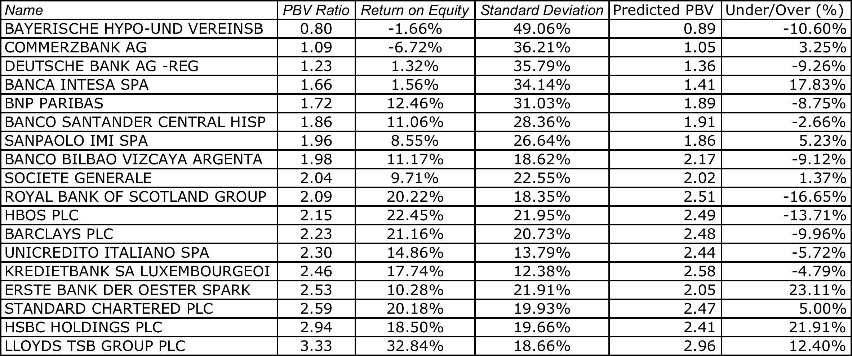
And these predictions?

Slide 11
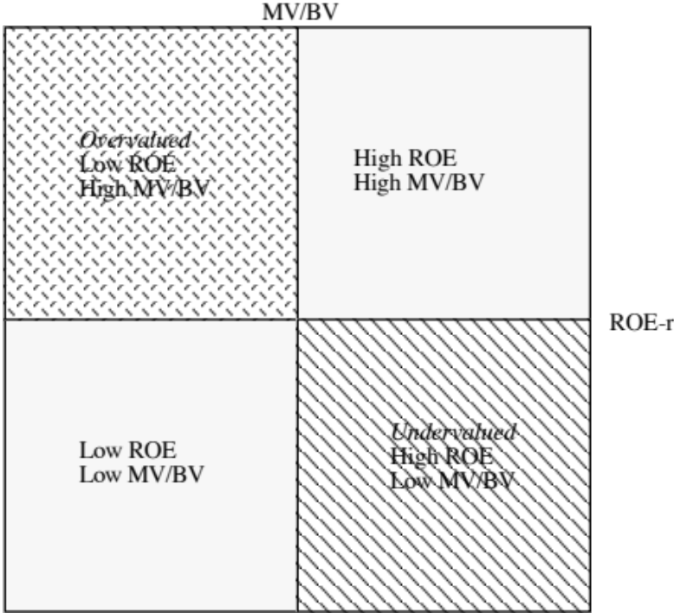
The Valuation Matrix
Notes:
Presents the mismatches in a matrix. You want to buy stocks in lower right quadrant and sell the stocks in the upper left quadrant… A hedge fund?

Slide 12
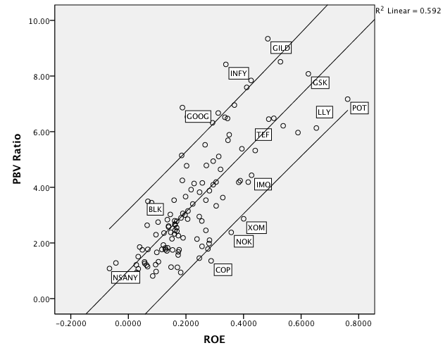
Price to Book vs ROE: Largest Market Cap Firms in the United States: January 2010
Notes:
Looks at the 100 largest market cap firms in the United States… Shows how strong the link is between price to book and return on equity. With a 90% confidence interval, a handful of stocks fall outside the range, but there may be good reasons for each:
The two stocks that fall below the undervalued line are MO (Altria or Philip Morris) and FNMA (because of recent accounting and management scandals.
Above the overvalued line are the high flyers - EBAY, Dell, SAP where presumable investors expect the return on equity to climb over time and high growth to continue…

Slide 13
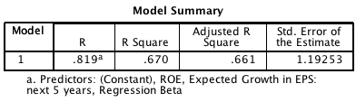
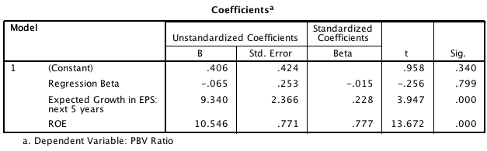
Bringing it all together… Largest US stocks
Notes:
Risk does not seem to matter much, ROE a great deal and growth somewhat in explaining PBV differences across large US companies.

