Slide 1
Session 20: The essence of real options
Aswath Damodaran

Slide 2
Underlying Theme: Searching for an Elusive Premium
Traditional discounted cashflow models under estimate the value of investments, where there are options embedded in the investments to
  Delay or defer making the investment (delay)
  Adjust or alter production schedules as price changes (flexibility)
  Expand into new markets or products at later stages in the process, based upon observing favorable outcomes at the early stages (expansion)
  Stop production or abandon investments if the outcomes are unfavorable at early stages (abandonment)
Put another way, real option advocates believe that you should be paying a premium on discounted cashflow value estimates.
Notes:
The allure of real options is that they allow you to add a premium to traditional value estimates (NPV, discounted cash flow value) and override what are generally considered hard and fast rules in finance. Thus, you can use the real options argument to take a negative NPV investment, bid for a non-viable patent or pay more than fair value (estimated from cashflows) on an acquisition.

Slide 3
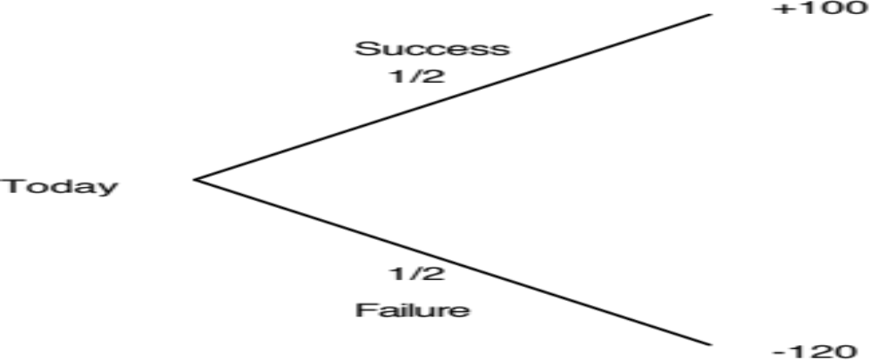
A bad investment…
Notes:
Expected value of this investment = -10

Slide 4
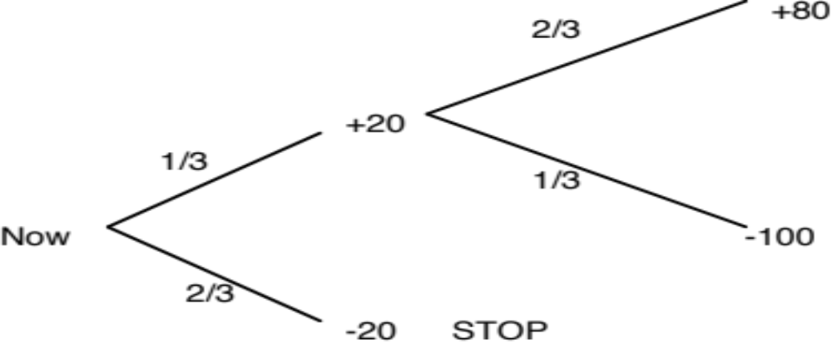
Becomes a good one…
Notes:
If you ignore time value, the cumulative probabilities of success and failure and the cumulative costs of each have not changed in this example but the expected value has become positive…
The gain comes from the fact that what you learn at the first stage allows you to make better decisions in the second. This learning is the essence of the value of real options and is what often gets ignored in conventional discounted cashflow valuation, where we take the expected cashflows from today’s vantage point without considering other pathways that the firm might choose given what happens in the first year, the second year etc.
The keys to real option value then come from learning and adaptive behavior.

Slide 5
Three Basic Questions
When is there a real option embedded in a decision or an asset?
When does that real option have significant economic value?
Can that value be estimated using an option pricing model?
Notes:
To prevent real options arguments from overwhelming common sense, we have to ensure that all three questions get answered in the affirmative before we use the argument in the first place.

Slide 6
When is there an option embedded in an action?
An option provides the holder with the right to buy or sell a specified quantity of an underlying asset at a fixed price (called a strike price or an exercise price) at or before the expiration date of the option.
  There has to be a clearly defined underlying asset whose value changes over time in unpredictable ways.
  The payoffs on this asset (real option) have to be contingent on an specified event occurring within a finite period.
Notes:
You are looking for all three to exist before you attach the option moniker on an asset:
There has to be an underlying asset
The payoff has to be contingent on an event happening
There has to be a finite life.

Slide 7
Payoff Diagram on a Call
Net Payoff
Strike Price
Price of underlying asset
Notes:
Any asset with a cash flow payoff that resembles this has call option characteristics.
The key is that losses are limited and profits are not.

Slide 8
Payoff Diagram on Put Option
Net Payoff
On Put
Strike
Price
Price of underlying asset
Notes:
Any asset with a cash flow payoff that resembles this has put option characteristics.

Slide 9
When does the option have significant economic value?
For an option to have significant economic value, there has to be a restriction on competition in the event of the contingency.
  In a perfectly competitive product market, no contingency, no matter how positive, will generate positive net present value.
At the limit, real options are most valuable when you have exclusivity - you and only you can take advantage of the contingency. They become less valuable as the barriers to competition become less steep.
Notes:
Exclusivity is the defining variable determining whether an option has value. If you and only you can exercise the option, you get 100% of its value. If others also have the opportunity, you start losing value. In effect, opportunities that are available to every one are not options.

Slide 10
Determinants of option value
Variables Relating to Underlying Asset
  Value of Underlying Asset; as this value increases, the right to buy at a fixed price (calls) will become more valuable and the right to sell at a fixed price (puts) will become less valuable.
  Variance in that value; as the variance increases, both calls and puts will become more valuable because all options have limited downside and depend upon price volatility for upside.
  Expected dividends on the asset, which are likely to reduce the price appreciation component of the asset, reducing the value of calls and increasing the value of puts.
Variables Relating to Option
  Strike Price of Options; the right to buy (sell) at a fixed price becomes more (less) valuable at a lower price.
  Life of the Option; both calls and puts benefit from a longer life.
Level of Interest Rates; as rates increase, the right to buy (sell) at a fixed price in the future becomes more (less) valuable.
Notes:
These six variables are constants in all option pricing models. The one variable that is key is risk. Unlike every other asset, options gain value as the underlying asset becomes riskier, because the downside is limited (see limited losses in cash flow diagram).

Slide 11
When can you use option pricing models to value real options?
The notion of a replicating portfolio that drives option pricing models makes them most suited for valuing real options where
  The underlying asset is traded - this yield not only observable prices and volatility as inputs to option pricing models but allows for the possibility of creating replicating portfolios
  An active marketplace exists for the option itself.
  The cost of exercising the option is known with some degree of certainty.
When option pricing models are used to value real assets, we have to accept the fact that
  The value estimates that emerge will be far more imprecise.
  The value can deviate much more dramatically from market price because of the difficulty of arbitrage.

Slide 12
Choices of Models
Black-Scholes Model: Makes restrictive assumptions about volatility (fixed over option life) and early exercise (none) and price process for underlying asset (no jumps), but arrives at a parsimonious model where the option value is a function of only 6 observable inputs:
  The current price of the underlying asset
  The strike price on the option
  The life of the option
  The variance in the price of the underlying assets
  The riskless rate for the option life
  Dividends over the life of the option (not in original Black Scholes)
Binomial Model: This is a more general and less restrictive model but it requires a great deal more data on how the price of the underlying asset will evolve over time.

Slide 13
Choice of Option Pricing Models
Most practitioners who use option pricing models to value real options argue for the binomial model over the Black-Scholes and justify this choice by noting that
  Early exercise is the rule rather than the exception with real options
  Underlying asset values are generally discontinous.
If you can develop a binomial tree with outcomes at each node, it looks a great deal like a decision tree from capital budgeting. The question then becomes when and why the two approaches yield different estimates of value.

Slide 14
Key Tests for Real Options
Is there an option embedded in this asset/ decision?
  Can you identify the underlying asset?
  Can you specify the contigency under which you will get payoff?
Is there exclusivity?
  If yes, there is option value.
  If no, there is none.
  If in between, you have to scale value.
Can you use an option pricing model to value the real option?
  Is the underlying asset traded?
  Can the option be bought and sold?
  Is the cost of exercising the option known and clear?

