Slide 1
Session 21: The Option to Delay
Valuing patents and natural resource reserves
Aswath Damodaran

Slide 2
The Option to Delay
When a firm has exclusive rights to a project or product for a specific period, it can delay taking this project or product until a later date.
A traditional investment analysis just answers the question of whether the project is a “good” one if taken today.
Thus, the fact that a project does not pass muster today (because its NPV is negative, or its IRR is less than its hurdle rate) does not mean that the rights to this project are not valuable.
Notes:
Traditional investment analysis just looks at the question of whether a project is a good one, if taken today. It does not say the rights to this project are worthless.

Slide 3
Valuing the Option to Delay a Project
PV of Cash Flows
from Project
Initial Investment in
Project
Present Value of Expected
Cash Flows on Product
Project's NPV turns
Project has negative
positive in this section
NPV in this section
Notes:
This looks at the option to delay a project, to which you have exclusive rights.
The initial investment in the project is what you would need to invest to convert this project from a right to a real project.
The present value of the cash flows will change over time.
If the perceived present value of the cash flows stays below the investment needed, the project should never be taken.

Slide 4
Example 1: Valuing product patents as options
A product patent provides the firm with the right to develop the product and market it.
It will do so only if the present value of the expected cash flows from the product sales exceed the cost of development.
If this does not occur, the firm can shelve the patent and not incur any further costs.
If I is the present value of the costs of developing the product, and V is the present value of the expected cashflows from development, the payoffs from owning a product patent can be written as:
Payoff from owning a product patent = V - I if V> I
= 0 if V ≤ I

Slide 5
Payoff on Product Option
Net Payoff to
introduction
Cost of product
introduction
Present Value of
cashflows on product

Slide 6
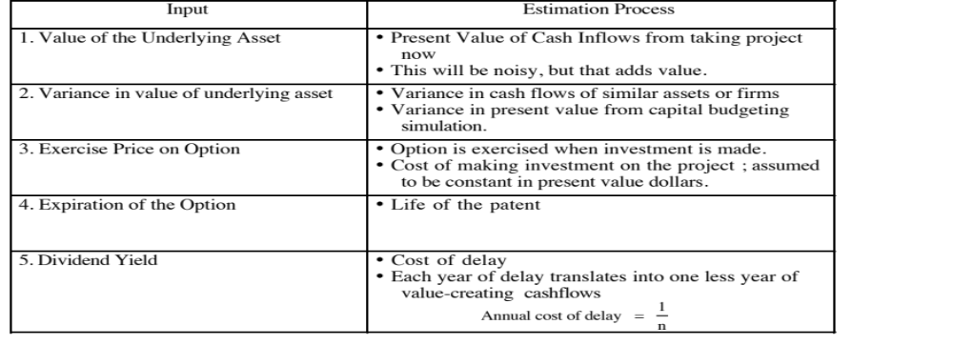
Obtaining Inputs for Patent Valuation

Slide 7
Valuing a Product Patent: Avonex
Biogen, a bio-technology firm, has a patent on Avonex, a drug to treat multiple sclerosis, for the next 17 years, and it plans to produce and sell the drug by itself. The key inputs on the drug are as follows:
  PV of Cash Flows from Introducing the Drug Now = S = $ 3.422 billion
  PV of Cost of Developing Drug for Commercial Use = K = $ 2.875 billion
  Patent Life = t = 17 years Riskless Rate = r = 6.7% (17-year T.Bond rate)
  Variance in Expected Present Values =σ² = 0.224 (Industry average firm variance for bio-tech firms)
  Expected Cost of Delay = y = 1/17 = 5.89%
  d1 = 1.1362 N(d1) = 0.8720
  d2 = -0.8512 N(d2) = 0.2076
Call Value= 3,422 exp^{(-0.0589)(17)} (0.8720) - 2,875 (exp^{(-0.067)(17)} (0.2076)= $ 907 million

Slide 8
Example 2: Valuing Natural Resource Options
In a natural resource investment, the underlying asset is the resource and the value of the asset is based upon two variables - the quantity of the resource that is available in the investment and the price of the resource.
In most such investments, there is a cost associated with developing the resource, and the difference between the value of the asset extracted and the cost of the development is the profit to the owner of the resource.
Defining the cost of development as X, and the estimated value of the resource as V, the potential payoffs on a natural resource option can be written as follows:
  Payoff on natural resource investment = V - X if V > X
  = 0 if V≤ X

Slide 9
Payoff Diagram on Natural Resource Firms
Net Payoff on
Extraction
Cost of Developing
Reserve
Value of estimated reserve of natural resource

Slide 10
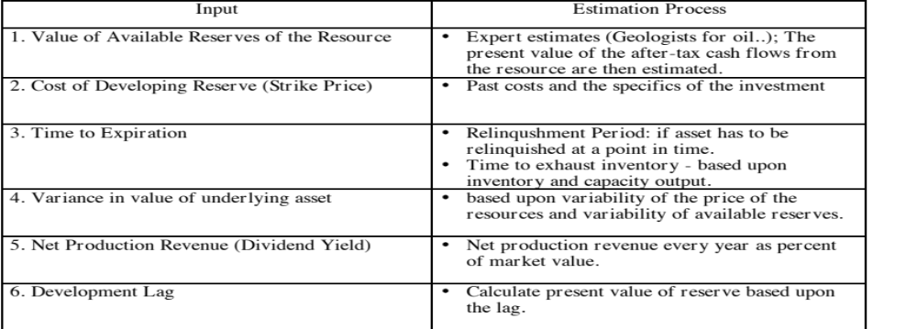
Estimating Inputs for Natural Resource Options

Slide 11
Valuing an Oil Reserve
Consider an offshore oil property with an estimated oil reserve of 50 million barrels of oil, where the present value of the development cost is $12 per barrel and the development lag is two years.
The firm has the rights to exploit this reserve for the next twenty years and the marginal value per barrel of oil is $12 per barrel currently (Price per barrel - marginal cost per barrel).
Once developed, the net production revenue each year will be 5% of the value of the reserves.
The riskless rate is 8% and the variance in ln(oil prices) is 0.03.

Slide 12
Inputs to Option Pricing Model
Current Value of the asset = S = Value of the developed reserve discounted back the length of the development lag at the dividend yield = $12 * 50 /(1.05)² = $ 544.22
  (If development is started today, the oil will not be available for sale until two years from now. The estimated opportunity cost of this delay is the lost production revenue over the delay period. Hence, the discounting of the reserve back at the dividend yield)
Exercise Price = Present Value of development cost = $12 * 50 = $600 million
Time to expiration on the option = 20 years
Variance in the value of the underlying asset = 0.03
Riskless rate =8%
Dividend Yield = Net production revenue / Value of reserve = 5%

Slide 13
Valuing the Option
Based upon these inputs, the Black-Scholes model provides the following value for the call:
  d1 = 1.0359 N(d1) = 0.8498
  d2 = 0.2613 N(d2) = 0.6030
  Call Value= 544 .22 exp^{(-0.05)(20)} (0.8498) -600 (exp^{(-0.08)(20)} (0.6030)= $ 97.08 million
This oil reserve, though not viable at current prices, still is a valuable property because of its potential to create value if oil prices go up.

