Slide 1
Session 23: Valuing Equity in Distressed Firms as an option

Slide 2
Valuing Equity as an option
The equity in a firm is a residual claim, i.e., equity holders lay claim to all cashflows left over after other financial claim-holders (debt, preferred stock etc.) have been satisfied.
If a firm is liquidated, the same principle applies, with equity investors receiving whatever is left over in the firm after all outstanding debts and other financial claims are paid off.
The principle of limited liability, however, protects equity investors in publicly traded firms if the value of the firm is less than the value of the outstanding debt, and they cannot lose more than their investment in the firm.

Slide 3
Equity as a call option
The payoff to equity investors, on liquidation, can therefore be written as:
  Payoff to equity on liquidation = V - D if V > D
  = 0 if V ≤ D
  where,
  V = Value of the firm
  D = Face Value of the outstanding debt and other external claims
A call option, with a strike price of K, on an asset with a current value of S, has the following payoffs:
  Payoff on exercise = S - K if S > K
  = 0 if S ≤ K

Slide 4
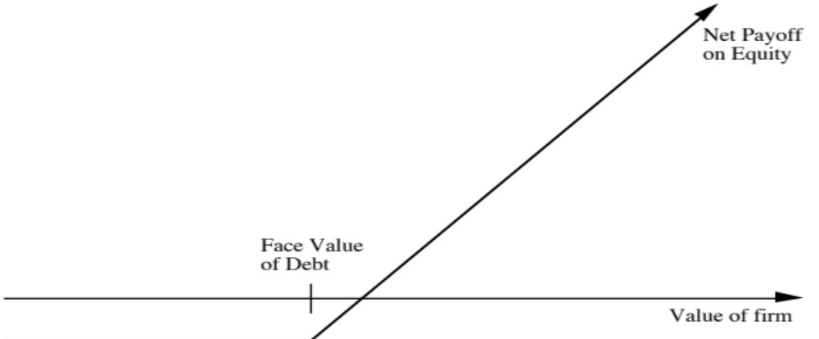
Payoff Diagram for Liquidation Option

Slide 5
Application to valuation: A simple example
Assume that you have a firm whose assets are currently valued at $100 million and that the standard deviation in this asset value is 40%.
Further, assume that the face value of debt is $80 million (It is zero coupon debt with 10 years left to maturity).
If the ten-year treasury bond rate is 10%,
  how much is the equity worth?
  What should the interest rate on debt be?

Slide 6
Model Parameters
Value of the underlying asset = S = Value of the firm = $ 100 million
Exercise price = K = Face Value of outstanding debt = $ 80 million
Life of the option = t = Life of zero-coupon debt = 10 years
Variance in the value of the underlying asset = 2 = Variance in firm value = 0.16
Riskless rate = r = Treasury bond rate corresponding to option life = 10%

Slide 7
Valuing Equity as a Call Option
Inputs to option pricing model
  Value of the underlying asset = S = Value of the firm = $ 100 million
  Exercise price = K = Face Value of outstanding debt = $ 80 million
  Life of the option = t = Life of zero-coupon debt = 10 years
  Variance in the value of the underlying asset = 2 = Variance in firm value = 0.16
  Riskless rate = r = Treasury bond rate corresponding to option life = 10%
Based upon these inputs, the Black-Scholes model provides the following value for the call:
  d1 = 1.5994 N(d1) = 0.9451
  d2 = 0.3345 N(d2) = 0.6310
Value of the call = 100 (0.9451) - 80 exp(-0.10)(10) (0.6310) = $75.94 million
Value of the outstanding debt = $100 - $75.94 = $24.06 million
Interest rate on debt = ($ 80 / $24.06)1/10 -1 = 12.77%

Slide 8
The Effect of Catastrophic Drops in Value
Assume now that a catastrophe wipes out half the value of this firm (the value drops to $ 50 million), while the face value of the debt remains at $ 80 million. What will happen to the equity value of this firm?
It will drop in value to $ 25.94 million [ $ 50 million - market value of debt from previous page]
It will be worth nothing since debt outstanding > Firm Value
It will be worth more than $ 25.94 million

Slide 9
Valuing Equity in the Troubled Firm
Value of the underlying asset = S = Value of the firm = $ 50 million
Exercise price = K = Face Value of outstanding debt = $ 80 million
Life of the option = t = Life of zero-coupon debt = 10 years
Variance in the value of the underlying asset = 2 = Variance in firm value = 0.16
Riskless rate = r = Treasury bond rate corresponding to option life = 10%

Slide 10
The Value of Equity as an Option
Based upon these inputs, the Black-Scholes model provides the following value for the call:
  d1 = 1.0515 N(d1) = 0.8534
  d2 = -0.2135 N(d2) = 0.4155
Value of the call = 50 (0.8534) - 80 exp(-0.10)(10) (0.4155) = $30.44 million
Value of the bond= $50 - $30.44 = $19.56 million
The equity in this firm drops by $45.50 million, but not by $50 million, because of the option characteristics of equity.
This might explain why stock in firms, which are in Chapter 11 and essentially bankrupt, still has value.

Slide 11

Equity value persists ..

Slide 12
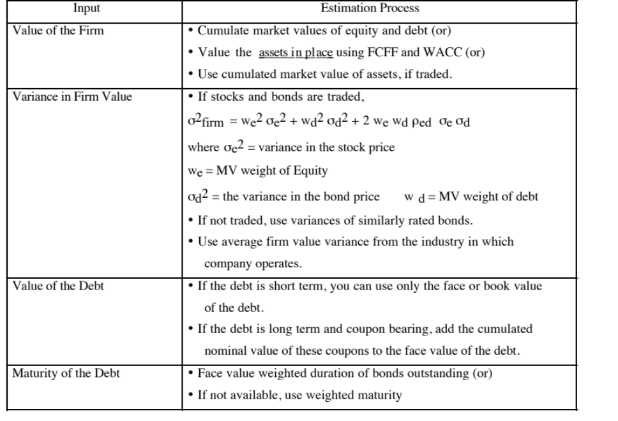
Obtaining option pricing inputs in the real worlds

