Slide 1
Session 3: Discount rate basics the Risk free rate
Aswath Damodaran

Slide 2
Estimating Inputs: Discount Rates
Critical ingredient in discounted cashflow valuation. Errors in estimating the discount rate or mismatching cashflows and discount rates can lead to serious errors in valuation.
At an intuitive level, the discount rate used should be consistent with both the riskiness and the type of cashflow being discounted.
  Equity versus Firm: If the cash flows being discounted are cash flows to equity, the appropriate discount rate is a cost of equity. If the cash flows are cash flows to the firm, the appropriate discount rate is the cost of capital.
  Currency: The currency in which the cash flows are estimated should also be the currency in which the discount rate is estimated.
  Nominal versus Real: If the cash flows being discounted are nominal cash flows (i.e., reflect expected inflation), the discount rate should be nominal
Notes:
While discount rates are a critical ingredient in discounted cashflow valuation, I think we spend far too much time on discount rates and far too little on cashflows. The most significant errors in valuation are often the result of failures to estimate cash flows correctly….
As companies increasingly become global, and multiple listings abound (Royal Dutch has six equity listings in different markets). the consistentcy principle becomes very important. The currency used in estimating cash flows should also be the currency in which you estimate discount rates - Euro discount rates for Euro cashflows and peso discount rates for peso cash flows.
Recently, I came across a valuation of a Mexican company, where the cashflows were in nominal pesos but the discount rate used was the dollar cost of capital of a U.S. acquirer…. As a result, the value was inflated by more than 300%….

Slide 3
Cost of Equity
The cost of equity should be higher for riskier investments and lower for safer investments
While risk is usually defined in terms of the variance of actual returns around an expected return, risk and return models in finance assume that the risk that should be rewarded (and thus built into the discount rate) in valuation should be the risk perceived by the marginal investor in the investment
Most risk and return models in finance also assume that the marginal investor is well diversified, and that the only risk that he or she perceives in an investment is risk that cannot be diversified away (I.e, market or non-diversifiable risk)
Notes:
Re-emphasizes a key assumption that we make in risk and return models in finance. It is not risk that matters, but non-diversifiable risk and the cost of equity will increase as the non-diversifiable risk in an investment increases.
This view of the world may pose a problem for us when valuing private companies or closely held, small publicly traded firms, where the marginal investor (owner, venture capitalist….) may not be diversified.

Slide 4
The Cost of Equity: Competing Models
Model Expected Return Inputs Needed
CAPM E(R) = Rf +  (Rm- Rf) Riskfree Rate
Beta relative to market portfolio
Market Risk Premium
APM E(R) = Rf +  j (Rj- Rf) Riskfree Rate; # of Factors;
Betas relative to each factor
Factor risk premiums
Multi E(R) = Rf +  j (Rj- Rf) Riskfree Rate; Macro factors
factor Betas relative to macro factors
Macro economic risk premiums
Proxy E(R) = a +  bj Yj Proxies
Regression coefficients
Notes:
Lays out the four basic models and how non-diversifiable risk is measured in each model:
The capital asset pricing model makes the most restrictive assumptions (no transactions costs, no private information) and arrives at the simplest model to estimate and use.
The arbitrage pricing model and multi-factor model make less restrictive assumptions but yield more complicated models (with more inputs to estimate)
The proxy model is dependent upon history and the view that firms that have earned higher returns over long periods must be riskier than firms that have lower returns. The characteristics of the firms that earn high returns - small market cap and low price to book value, for example in the Fama-French study - stand in as measures for risk.

Slide 5
The CAPM: Cost of Equity
While the CAPM (and the CAPM beta) has come in for well-justified criticism over the last four decades (for making unrealistic assumptions, for having parameters that are tough to estimate and for not working well), it remains the most-widely used model in practice.
In the CAPM, the cost of equity is a function of three inputs
Cost of Equity = Riskfree Rate + Equity Beta * (Equity Risk Premium)
In practice,
  Government security rates are used as risk free rates
  Historical risk premiums are used for the risk premium
  Betas are estimated by regressing stock returns against market returns
Notes:
While this equation is set up in terms of the capital asset pricing model, the issues raised with the CAPM apply to the more complex models as well -the APM and the multi-factor model

Slide 6
A Riskfree Rate
On a riskfree asset, the actual return is equal to the expected return. Therefore, there is no variance around the expected return.
For an investment to be riskfree, then, it has to have
  No default risk
  No reinvestment risk
Time horizon matters: Thus, the riskfree rates in valuation will depend upon when the cash flow is expected to occur and will vary across time. If your cash flows stretch out over the long term, your risk free rate has to be a long term risk free rate.
Not all government securities are riskfree: Some governments face default risk and the rates on bonds issued by them will not be riskfree.
Notes:
Treasury bills may be default free but there is reinvestment risk when they are used as riskless rates for longer-term cashflows. A 6-month T.Bill is not riskless when looking at a 5-year cashflow.
Would a 5-year treasury be riskfree? Not really. The coupons would still expose you to reinvestment risk. Only a 5-year zero-coupon treasury would be riskfree for a 5-year cash flow.
If you were a purist, you would need different riskfree rates for different cashflows. A pragmatic solution would be to estimate the duration of the cashflows in a valuation and use a treasury of similar duration. (Since the duration is the weighted average of when the cashflows come in, this should be fairly long, especially when you count in the fact that the terminal value is the present value of cashflows forever).

Slide 7
Let’s start easy
A riskfree rate in US dollars!
If you are valuing a company in US dollars, you need a US dollar risk free rate.
In practice, we have tended to use US treasury rates as risk free rates, but that is built on the presumption that the US treasury is default free.
  If you accept the premise that the US treasury is default free, you still have several choices, since the US treasury issues securities with differing maturities (ranging from 3 months to 30 years) as well in real or nominal terms (Inflation protected treasuries (TIPs) or nominal treasuries)
  In valuation, we estimate cash flows forever (or at least for very long time periods) and in nominal terms. The correct risk free rate to use should therefore be a long term, nominal rate. The thirty-year treasury bond rate is the longest term rate that you can find and there is a good case to be made that it should be the risk free rate. However, given how difficult it is to get the other inputs for the discount rate (default spreads & equity risk premium) over thirty year periods, you should consider using the ten-year US treasury bond rate as your risk free rate for US dollar valuations.
Notes:
Since we are valuing cashflows for the long term, we want a long-term riskfree rate (so, rule out the 6-month T.Bill rate). Since the valuation is in US dollars (a nominal rate), we can also rule out the TIPS rate. In theory, the 30-year rate should be the best choice. In practice, I would go with the 20-year bond for the following reasons:
It is the most liquid of the treasuries and there is always a fresh auction rate from the previous Monday,
Getting other inputs such as equity risk premiums and default spreads is easier with a 10-year rate than a 30-year rate
The term structure flattens out by the time you get to the 10-year rate…..

Slide 8
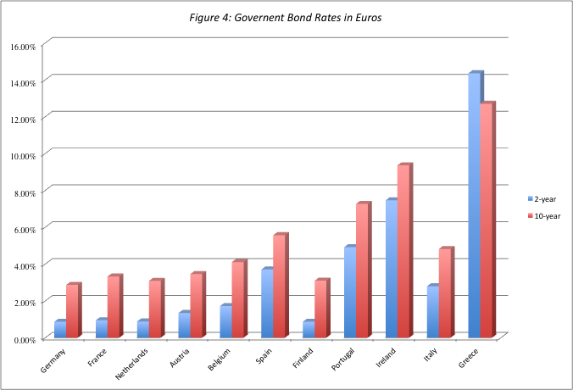
A Riskfree Rate in Euros
Notes:
The only reason for differences in rates across these securities is default risk. Consequently, it makes sense to use the lowest of the rates (Germany) as the rsikfree rete, if you are valuing a company in Euros.

Slide 9
A Riskfree Rate in nominal Reais
The Brazilian government had 10-year BR$ denominated bonds outstanding in January 2013, with an interest rate of 9%.
In January 2013, the Brazilian government had a local currency sovereign rating of Baa2. The typical default spread (over a default free rate) for Baa2 rated country bonds in January 2013 was 1.75%. The risk free rate in nominal reais is therefore:
  Riskfree rate in Reais = Nominal 10-year BR$ rate – Default spread
  = 9% - 1.75% = 7.25%
Notes:
The government bond rate is not riskfree. To get to a riskfree rate, you would subtract out the default spread of 2.55% from the bond rate to get to a riskfree rate of 8%.

Slide 10
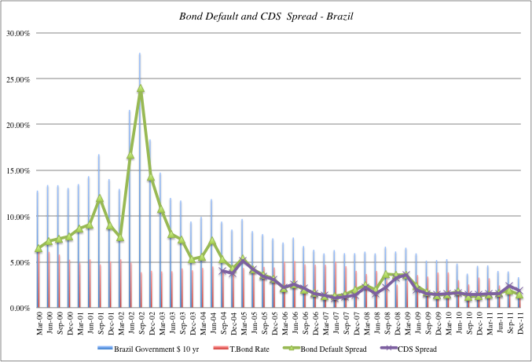
Sovereign Default Spreads: Two paths to the same destination…

Slide 11
And a third – Average Default Spreads: January 2013
Rating | Default spread in basis points
Aaa | 0
Aa1 | 25
Aa2 | 50
Aa3 | 70
A1 | 85
A2 | 100
A3 | 115
Baa1 | 150
Baa2 | 175
Baa3 | 200
Ba1 | 240
Ba2 | 275
Ba3 | 325
B1 | 400
B2 | 500
B3 | 600
Caa1 | 700
Caa2 | 850
Caa3 | 1000

Slide 12
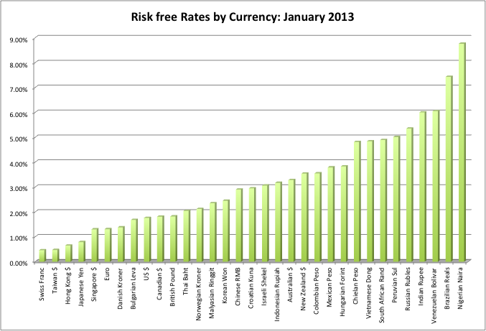
Risk free rates in different currencies: January 2013

