Slide 1
Session 4: Equity Risk Premiums
DCF Valuation

Slide 2
Equity Risk Premiums: Intuition
The equity risk premium is the premium that investors charge for investing in the average equity. For lack of a better description, think of it as the price of bearing a unit of equity risk.
It is a function of
  How risk averse investors are collectively
  How much risk they see in the average equity
The level of the equity risk premium should vary over time as a function of:
  Changing macro economic risk (inflation & GDP growth)
  The fear of catastrophic risk
  The transparency or lack thereof of the companies issuing equity

Slide 3
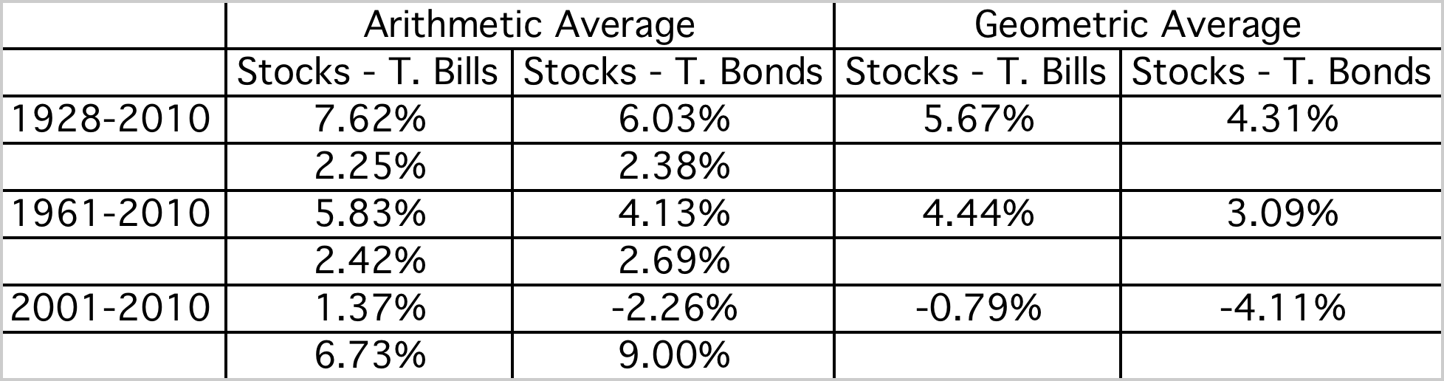
Equity Risk Premiums
The ubiquitous historical risk premium
The historical premium is the premium that stocks have historically earned over riskless securities.
While the users of historical risk premiums act as if it is a fact (rather than an estimate), it is sensitive to
  How far back you go in history…
  Whether you use T.bill rates or T.Bond rates
  Whether you use geometric or arithmetic averages.
Notes:
While everyone uses historical risk premiums, the actual premium in use can vary depending upon
How far back you go in time
Whether you T.Bills or T.Bonds
Whether you use arithmetic or geometric averages
This table was developed using data that is publicly accessible on the S&P 500, treasury bills and 10-year treasury bonds on the Federal Reserve of St. Louis web site.
Dataset: histretSP.xls
An interesting issue that has been raised by some researchers is that there may be a selection bias here. The U.S. stock market was undoubtedly the most successful equity market of the 20th century. Not surprisingly, you find that it earned a healthy premium over riskless rates. A more realistic estimate of the premium would require looking at the ten largest equity markets in the early part of the century and estimating the average premium you would have earned over all ten markets. A study at the London Business School that did this found an average equity risk premium of only 4% across these markets.

Slide 4
The perils of trusting the past…….
Noisy estimates: Even with long time periods of history, the risk premium that you derive will have substantial standard error. For instance, if you go back to 1928 (about 80 years of history) and you assume a standard deviation of 20% in annual stock returns, you arrive at a standard error of greater than 2%:
Standard Error in Premium = 20%/√80 = 2.26%
Survivorship Bias: Using historical data from the U.S. equity markets over the twentieth century does create a sampling bias. After all, the US economy and equity markets were among the most successful of the global economies that you could have invested in early in the century.
Notes:
The noise in stock prices is such that you need 100-150 years of data to arrive at reasonably small standard errors. It is pointless estimating risk premiums with 10-20 years of data.
The survivorship bias will push historical risk premiums up, if you use the US as the base market.

Slide 5
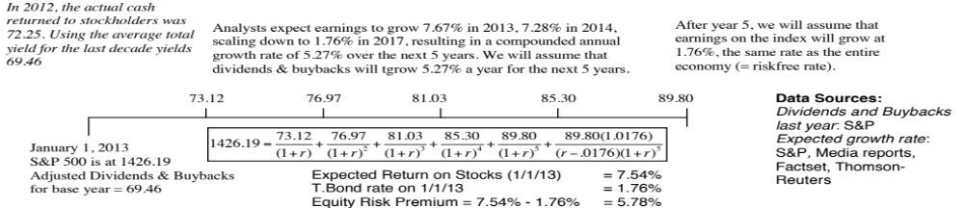
An Updated Equity Risk Premium:
On January 1, 2013, the S&P 500 was at 1426.19, essentially unchanged for the year. And it was a year of macro shocks – political upheaval in the Middle East and sovereign debt problems in Europe. The treasury bond rate dropped below 2% and buybacks/dividends surged.
Notes:
The key lesson I would take away is that equity risk premiums are unstable and that globalization has made them more unstable. The other is that there seems to be mean reversion in the process – implied premiums, when abnormally high or low, move back towards a longer term average.

Slide 6
Implied Premiums in the US: 1960-2012
Notes:
As the index changes (and it is the input most likely to change by large amounts in short periods), the implied premium will change. Note that as premiums rise, stock prices drop. Notice two historical phenomena: (1) Equity risk premiums spiked in the 1970s as inflation increased in the US (2) Equity risk premiums bottomed out at 2% at the end of 1999 at the peak of the dot-com boom.
Would you settle for a 2% premium? If your answer is no, you believe that stocks are overvalued.

Slide 7
Why implied premiums matter?
In many investment banks, it is common practice (especially in corporate finance departments) to use historical risk premiums (and arithmetic averages at that) as risk premiums to compute cost of equity. If all analysts in the department used the geometric average premium for 1928-2012 of 4.2% to value stocks in January 2013, given the implied premium of 5.78%, what were they likely to find?
The values they obtain will be too low (most stocks will look overvalued)
The values they obtain will be too high (most stocks will look under valued)
There should be no systematic bias as long as they use the same premium (4.2%) to value all stocks.
Notes:
Everything will look cheap…
Using any premium higher than the implied premium today will bias values downwards (and most stocks will look overvalued). This is why risk premiums used in equity research departments tend to be different than those used in corporate finance.
So, how do analysts compensate for this bias?
They make unrealistic estimates of growth and reinvestment to arrive at what they feel are reasonable values. They then put pressure on management to deliver these unrealistic numbers. Managers bend the accounting rules to pull this off… and we have the makings of accounting scandals.

Slide 8
Estimating a risk premium for an emerging market
Approach 1: Build off a mature market premium
Assume that the equity risk premium for the US and other mature equity markets was 5.8% in January 2013. You could then add on an additional premium for investing in an emerging markets.
Two ways of estimating the country risk premium:
  Default spread on Country Bond: In this approach, the country equity risk premium is set equal to the default spread of the bond issued by the country. Brazil’s default spread, based on its rating, in September 2011 was 1.75%.
    Equity Risk Premium for Brazil = 5.8% + 1.75% = 7.55%
  Adjusted for equity risk: The country equity risk premium is based upon the volatility of the equity market relative to the government bond rate.
    Standard Deviation in Bovespa = 21%
    Standard Deviation in Brazilian government bond= 14%
    Default spread on Brazilian Bond= 1.75%
    Total equity risk premium for Brazil = 5.8% + 1.75% (21/14) = 8.43%

Slide 9
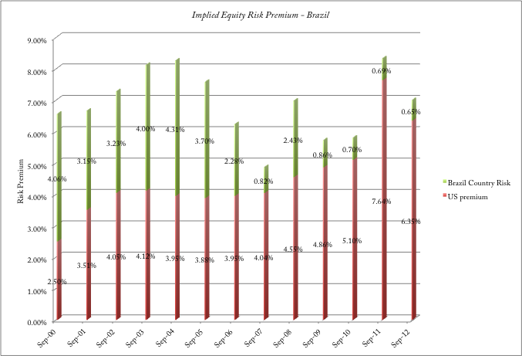
Approach 2: Estimate an implied equity risk premium for Brazil

Slide 10

Belgium | 1.05% | 6.85%
Germany | 0.00% | 5.80%
Portugal | 4.88% | 10.68%
Italy | 2.63% | 8.43%
Luxembourg | 0.00% | 5.80%
Austria | 0.00% | 5.80%
Denmark | 0.00% | 5.80%
France | 0.38% | 6.18%
Finland | 0.00% | 5.80%
Greece | 10.50% | 16.30%
Iceland | 3.00% | 8.80%
Ireland | 3.60% | 9.40%
Netherlands | 0.00% | 5.80%
Norway | 0.00% | 5.80%
Slovenia | 2.63% | 8.43%
Spain | 3.00% | 8.80%
Sweden | 0.00% | 5.80%
Switzerland | 0.00% | 5.80%
Turkey | 3.60% | 9.40%
UK | 0.00% | 5.80%
W.Europe | 1.05% | 6.85%
Albania | 6.00% | 11.80%
Armenia | 4.13% | 9.93%
Azerbaijan | 3.00% | 8.80%
Belarus | 9.00% | 14.80%
Bosnia & Herzegovina | 9.00% | 14.80%
Bulgaria | 2.63% | 8.43%
Croatia | 3.00% | 8.80%
Czech Republic | 1.28% | 7.08%
Estonia | 1.28% | 7.08%
Georgia | 4.88% | 10.68%
Hungary | 3.60% | 9.40%
Kazakhstan | 2.63% | 8.43%
Latvia | 3.00% | 8.80%
Lithuania | 2.25% | 8.05%
Moldova | 9.00% | 14.80%
Montenegro | 4.88% | 10.68%
Poland | 1.50% | 7.30%
Romania | 3.00% | 8.80%
Russia | 2.25% | 8.05%
Slovakia | 1.50% | 7.30%
Ukraine | 9.00% | 14.80%
E. Europe & Russia | 2.68% | 8.48%
Bangladesh | 4.88% | 10.68%
Cambodia | 7.50% | 13.30%
China | 1.05% | 6.85%
Fiji Islands | 6.00% | 11.80%
Hong Kong | 0.38% | 6.18%
India | 3.00% | 8.80%
Indonesia | 3.00% | 8.80%
Japan | 1.05% | 6.85%
Korea | 1.05% | 6.85%
Macao | 1.05% | 6.85%
Malaysia | 1.73% | 7.53%
Mongolia | 6.00% | 11.80%
Pakistan | 10.50% | 16.30%
Papua New Guinea | 6.00% | 11.80%
Philippines | 3.60% | 9.40%
Singapore | 0.00% | 5.80%
Sri Lanka | 6.00% | 11.80%
Taiwan | 1.05% | 6.85%
Thailand | 2.25% | 8.05%
Vietnam | 7.50% | 13.30%
Asia | 1.55% | 7.35%
Country Risk Premiums
January 2013
Canada | 0.00% | 5.80%
USA | 0.00% | 5.80%
N. America | 0.00% | 5.80%
Argentina | 9.00% | 14.80%
Belize | 15.00% | 20.80%
Bolivia | 4.88% | 10.68%
Brazil | 2.63% | 8.43%
Chile | 1.05% | 6.85%
Colombia | 3.00% | 8.80%
Costa Rica | 3.00% | 8.80%
Ecuador | 10.50% | 16.30%
El Salvador | 4.88% | 10.68%
Guatemala | 3.60% | 9.40%
Honduras | 7.50% | 13.30%
Mexico | 2.25% | 8.05%
Nicaragua | 9.00% | 14.80%
Panama | 2.63% | 8.43%
Paraguay | 6.00% | 11.80%
Peru | 2.63% | 8.43%
Uruguay | 3.00% | 8.80%
Venezuela | 6.00% | 11.80%
Latin America | 3.38% | 9.18%
Angola | 4.88% | 10.68%
Botswana | 1.50% | 7.30%
Egypt | 7.50% | 13.30%
Kenya | 6.00% | 11.80%
Mauritius | 2.25% | 8.05%
Morocco | 3.60% | 9.40%
Namibia | 3.00% | 8.80%
Nigeria | 4.88% | 10.68%
Senegal | 6.00% | 11.80%
South Africa | 2.25% | 8.05%
Tunisia | 3.00% | 8.80%
Zambia | 6.00% | 11.80%
Africa | 4.29% | 10.09%
Bahrain | 2.25% | 8.05%
Israel | 1.28% | 7.08%
Jordan | 4.13% | 9.93%
Kuwait | 0.75% | 6.55%
Lebanon | 6.00% | 11.80%
Oman | 1.28% | 7.08%
Qatar | 0.75% | 6.55%
Saudi Arabia | 1.05% | 6.85%
United Arab Emirates | 0.75% | 6.55%
Middle East | 1.16% | 6.96%
Australia | 0.00% | 5.80%
New Zealand | 0.00% | 5.80%
Australia & NZ | 0.00% | 5.80%
Black #: Total ERP
Red #: Country risk premium
AVG: GDP weighted average
Notes:
Updated country risk premiums.

Slide 11
From Country Equity Risk Premiums to Corporate Equity Risk premiums
Approach 1: Assume that every company in the country is equally exposed to country risk. In this case,
  E(Return) = Riskfree Rate + CRP + Beta (Mature ERP)
  Implicitly, this is what you are assuming when you use the local Government’s dollar borrowing rate as your riskfree rate.
Approach 2: Assume that a company’s exposure to country risk is similar to its exposure to other market risk.
  E(Return) = Riskfree Rate + Beta (Mature ERP+ CRP)
Approach 3: Treat country risk as a separate risk factor and allow firms to have different exposures to country risk (perhaps based upon the proportion of their revenues come from non-domestic sales)
  E(Return)=Riskfree Rate+  (Mature ERP) +  (CRP)
Mature ERP = Mature market Equity Risk Premium
CRP = Additional country risk premium
Notes:
The differences between the three approaches lie largely in what you do with the CRP. In the first approach, you just add it to the company’s cost of equity and treat it as different from all other macro economic risk exposure. In the second, you assume that beta measures exposure to country risk exposure as with all other macro economic risk. In the third approach, you estimate a different exposure to country risk, assuming that it is different from all other risk.

Slide 12
Approaches 1 & 2: Estimating country risk premium exposure
Location based CRP: The standard approach in valuation is to attach a country risk premium to a company based upon its country of incorporation. Thus, if you are an Indian company, you are assumed to be exposed to the Indian country risk premium. A developed market company is assumed to be unexposed to emerging market risk.
Operation-based CRP: There is a more reasonable modified version. The country risk premium for a company can be computed as a weighted average of the country risk premiums of the countries that it does business in, with the weights based upon revenues or operating income. If a company is exposed to risk in dozens of countries, you can take a weighted average of the risk premiums by region.

Slide 13
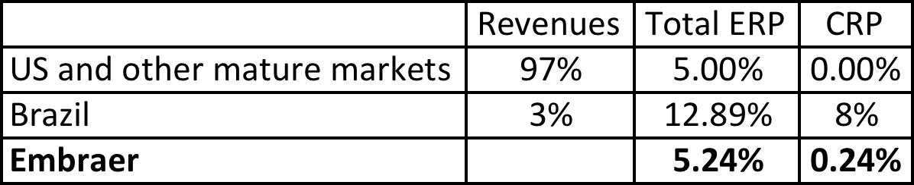
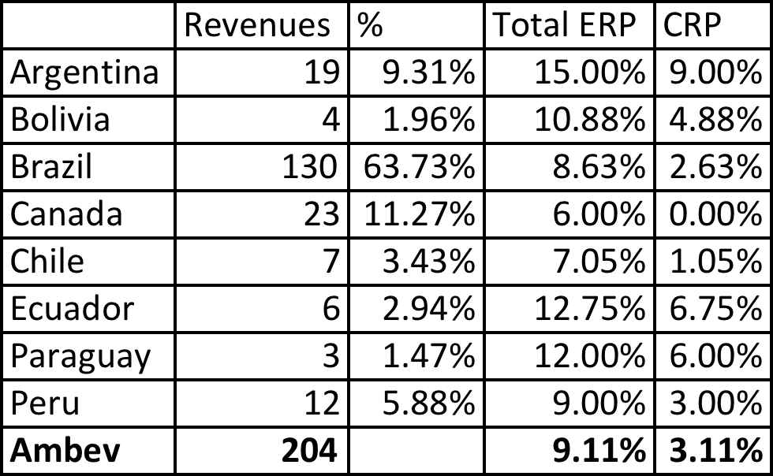
Operation based CRP: Single versus Multiple Emerging Markets
Single emerging market: Embraer, in 2004, reported that it derived 3% of its revenues in Brazil and the balance from mature markets. The mature market ERP in 2004 was 5% and Brazil’s CRP was 7.89%.
Multiple emerging markets: Ambev, the Brazilian-based beverage company, reported revenues from the following countries during 2011.
Notes:
In the case of Embraer, its limited revenues in Brazil give it a low equity risk premium.
In the case of Ambev, the computation is messier because it has revenues in many Latin American markets. We use revenue weights to weight the CRP.

Slide 14
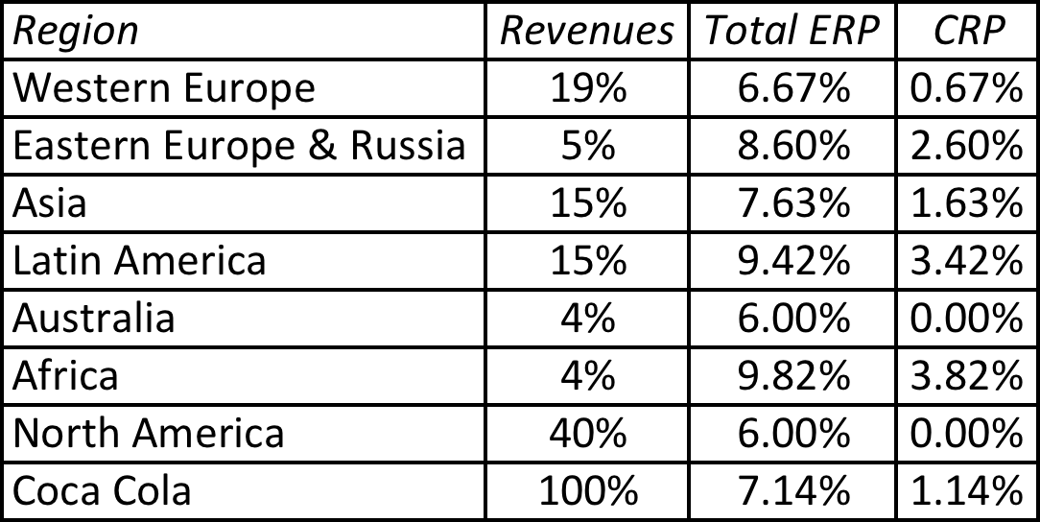
Extending to a multinational: Regional breakdown
Coca Cola’s revenue breakdown and ERP in 2012
Things to watch out for
Aggregation across regions. For instance, the Pacific region often includes Australia & NZ with Asia
Obscure aggregations including Eurasia and Oceania
Notes:
With a multinational, it is often too messy to do individual countries, either because of the logistics of computing dozens of CRP or because the information is not provided. You can use the regional breakdown to get an approximate ERP. I applied the GDP weighted average from the map to arrive at the ERPs and CRPs for each region.

Slide 15
Approach 3: Estimate a lambda for country risk
Source of revenues: Other things remaining equal, a company should be more exposed to risk in a country if it generates more of its revenues from that country.
Manufacturing facilities: Other things remaining equal, a firm that has all of its production facilities in a “risky country” should be more exposed to country risk than one which has production facilities spread over multiple countries. The problem will be accented for companies that cannot move their production facilities (mining and petroleum companies, for instance).
Use of risk management products: Companies can use both options/futures markets and insurance to hedge some or a significant portion of country risk.
Notes:
This is not meant to be an all inclusive list. While there are undoubtedly other factors to consider, you also have to be able to obtain this information not only on your firm but on other firms in the market. In fact, of the three items listed above, revenue sources may be the only publicly available information on companies.

Slide 16
Estimating Lambdas: The Revenue Approach
The easiest and most accessible data is on revenues. Most companies break their revenues down by region.
● = % of revenues domestically_{firm}/ % of revenues domestically _{average firm}
Consider, for instance, Embraer and Embratel, both of which are incorporated and traded in Brazil. Embraer gets 3% of its revenues from Brazil whereas Embratel gets almost all of its revenues in Brazil. The average Brazilian company gets about 77% of its revenues in Brazil:
  Lambda_{Embrae}r = 3%/ 77% = .04
  Lambda_{Embrate}l = 100%/77% = 1.30
Note that if the proportion of revenues of the average company gets in the market is assumed to be 100%, this approach collapses into the first one.,
There are two implications
  A company’s risk exposure is determined by where it does business and not by where it is located
  Firms might be able to actively manage their country risk exposure
Notes:
This is a simplistic approach, but it is the easiest one to use. You can usually get the percent of revenues that your firm gets in the country from its annual report.
Notice that Embraer has a lambda close to zero since it gets so little of its revenues in Brazil. Since its factories and work force are still in Brazil, this estimate seems to be too low.

