Slide 1
Session 7: Estimating Cash flows
Aswath Damodaran

Slide 2
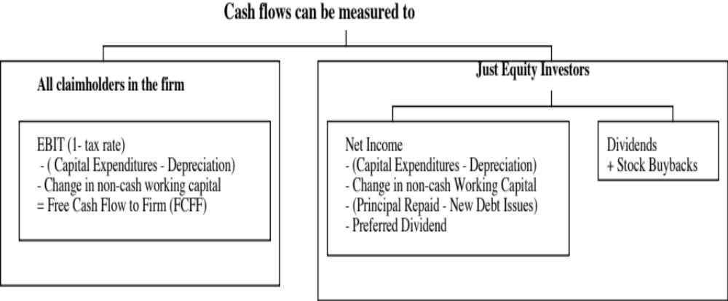
Defining Cashflow
Notes:
Lays out the three definitions of cashflows. The strictest measure is the dividend measure. (In fact, there are some who do not count stock buybacks.) The more expansive equity measure is the free cashflow to equity, which you can think off as potential dividends. The free cashflow to the firm is the cash available for all claimholders in the firm - it is before cashflows to any of the claimholders in the firm - debt or equity.

Slide 3
The basic ingredients for free cash flows..
Estimate the current earnings of the firm
  If looking at cash flows to equity, look at earnings after interest expenses - i.e. net income
  If looking at cash flows to the firm, look at operating earnings after taxes
Consider how much the firm invested to create future growth
  If the investment is not expensed, it will be categorized as capital expenditures. To the extent that depreciation provides a cash flow, it will cover some of these expenditures.
  Increasing working capital needs are also investments for future growth
If looking at cash flows to equity, consider the cash flows from net debt issues (debt issued - debt repaid)

Slide 4
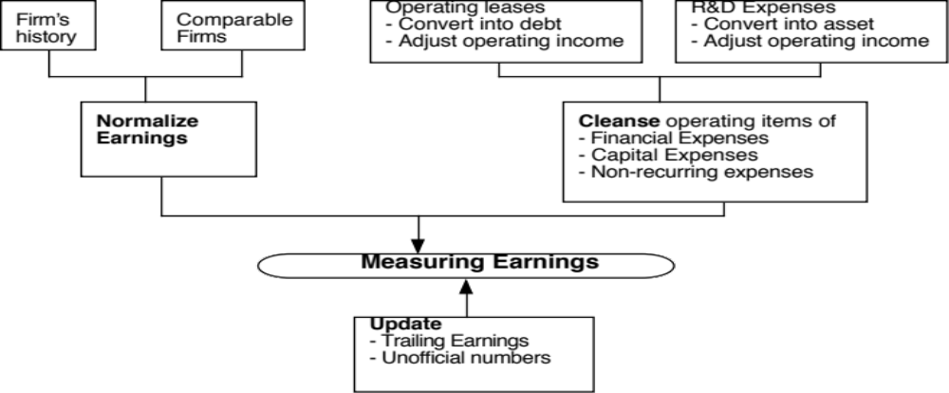
Step 1: Get your earnings “right”
Notes:
Very seldom can you use the reported earnings in the annual report in valuation. This lays out the three adjustments that you usually have to make before you start doing valuation:
You might need to update the accounting information for most recent reports that have come from the firm or other sources.
If you have a cyclical or commodity firm, you have to adjust the earnings for where in the cycle (of the economy, for a cyclical firm, or for the commodity price, for a commodity firm) you are currently.
You have to clean up for obvious shortcomings in accounting rules.

Slide 5
Dealing with Operating Lease Expenses
Operating Lease Expenses are treated as operating expenses in computing operating income. In reality, operating lease expenses should be treated as financing expenses, with the following adjustments to earnings and capital:
  Debt Value of Operating Leases = Present value of Operating Lease Commitments at the pre-tax cost of debt
When you convert operating leases into debt, you also create an asset to counter it of exactly the same value. That asset then has to be depreciated.
Adjusted Operating Earnings
  Adjusted Operating Earnings = Operating Earnings + Operating Lease Expenses - Depreciation on Leased Asset
  As an approximation, this works:
  Adjusted Operating Earnings = Operating Earnings + Pre-tax cost of Debt * PV of Operating Leases.
Notes:
From an intuitive standpoint, there is little difference between a term loan (where you pay off a loan in equal annual installments) and an operating lease. It may be more like unsecured debt than secured debt but it is debt.
It is not just debt that is affected when you convert operating leases to debt. The operating income also will change.

Slide 6
Operating Leases at The Gap in 2003
The Gap has conventional debt of about $ 1.97 billion on its balance sheet and its pre-tax cost of debt is about 6%. Its operating lease payments in the 2003 were $978 million and its commitments for the future are below:
Year Commitment (millions) Present Value (at 6%)
1 $899.00 $848.11
2 $846.00 $752.94
3 $738.00 $619.64
4 $598.00 $473.67
5 $477.00 $356.44
6&7 $982.50 each year $1,346.04
Debt Value of leases = $4,396.85 (Also value of leased asset)
Debt outstanding at The Gap = $1,970 m + $4,397 m = $6,367 m
Adjusted Operating Income = Stated OI + OL exp this year - Deprec’n
  = $1,012 m + 978 m - 4397 m /7 = $1,362 million (7 year life for assets)
Approximate OI = $1,012 m + $ 4397 m (.06) = $1,276 m
Notes:
The Gap reports its lease commitments in its financial statements. The present value of operating lease expenses is computed using the pre-tax cost of debt. (An argument can be made that the unsecured cost of debt should be used.)

Slide 7
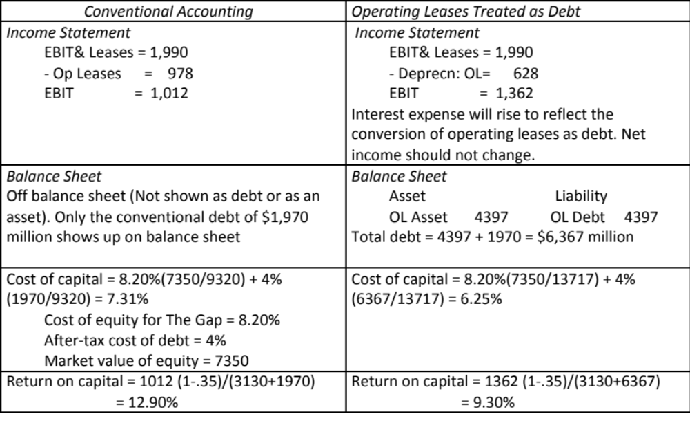
The Collateral Effects of Treating Operating Leases as Debt
Notes:
Traces the effect of converting operating leases to debt. Both operating income and capital invested increase. The net effect on return on capital will depend upon which increases more.
In general, treating leases as debt will affect the return spread you earn (by changing both the cost of capital and return on capital). If the spread decreases (as it does for the Gap), your values will decrease when you capitalize leases. If the spread increases, your value will increase. In either case, the values that you get with the capitalized leases is the more realistic estimate of value.

Slide 8
R&D Expenses: Operating or Capital Expenses
Accounting standards require us to consider R&D as an operating expense even though it is designed to generate future growth. It is more logical to treat it as capital expenditures.
To capitalize R&D,
  Specify an amortizable life for R&D (2 - 10 years)
  Collect past R&D expenses for as long as the amortizable life
  Sum up the unamortized R&D over the period. (Thus, if the amortizable life is 5 years, the research asset can be obtained by adding up 1/5th of the R&D expense from five years ago, 2/5th of the R&D expense from four years ago...:
Notes:
The argument used by accountants - that R&D yields uncertain benefits - is specious. You could make the same argument about other investments - investing in a factory in an emerging market, deciding to build a concept car - and you are forced to treat these as capital expenditures.
To capitalize R&D, you need to specify
On average, how long it takes between the time you do research and a commercial product emerges from the research. (This is the amortizable life)
R&D expenses from the past (for a period equivalent to the amortizable life). If your firm has not been in existence for that long, you would go back for as many years as you can.
Depreciation schedules - stick with the simplest which is straight line depreciation.

Slide 9
Capitalizing R&D Expenses: SAP
R & D was assumed to have a 5-year life.
Year R&D Expense Unamortized Amortization this year
Current 1020.02 1.00 1020.02
-1 993.99 0.80 795.19 € 198.80
-2 909.39 0.60 545.63 € 181.88
-3 898.25 0.40 359.30 € 179.65
-4 969.38 0.20 193.88 € 193.88
-5 744.67 0.00 0.00 € 148.93
Value of research asset = € 2,914 million
Amortization of research asset in 2004 = € 903 million
Increase in Operating Income = 1020 - 903 = € 117 million
Notes:
The amortizable life is an assumption based upon SAP’s business. It would be shorter in other businesses (such as computer chips) and longer in businesses that need regulatory approval (such as pharmaceuticals).
Note that the amortization is 1/5 of the R&D expense each year.
We are also assuming that R&D expenses are spent at the end of each year - not realistic, but simplifies analysis - that is why there is no amortization of the current year’s expense.
The effect of capitalizing R&D will be greatest at firms where R&D is growing over time and be non-existent at firms with flat R&D.

Slide 10
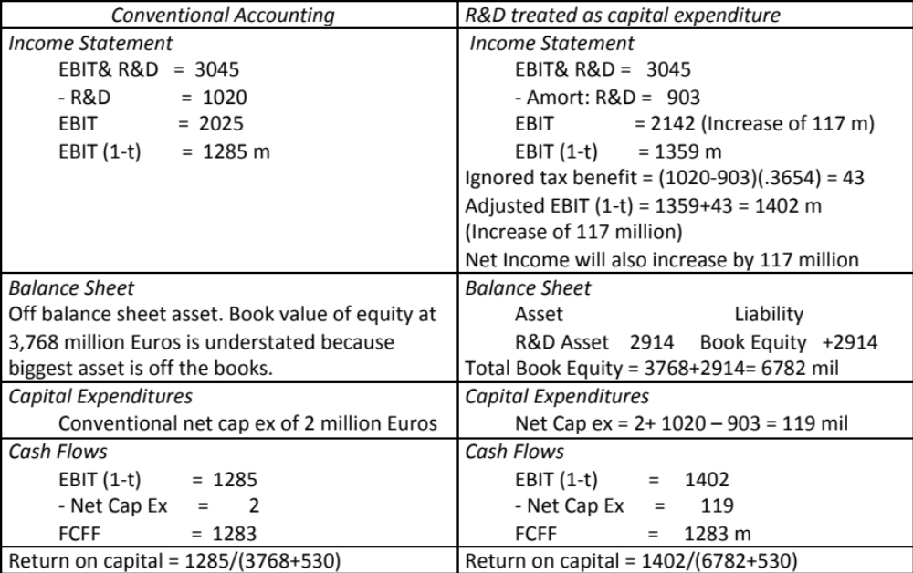
The Effect of Capitalizing R&D at SAP
Notes:
Traces out the effects of capitalizing R&D. The key aspect is that operating income will be increased by exactly the same amount that net capital expenditures will be increased, with the increase being:
Change in operating income and net cap ex = Current year’s R&D expense - R&D amortization
In other words, the free cashflow to the firm will not change as a result of this capitalization. So why do it? It allows us to
Get a better sense of the profitability of the firm (operating income and return on capital)
Better estimate how much the firm is reinvesting for future growth.
Get a measure of whether R&D is value creating or value destroying.

Slide 11
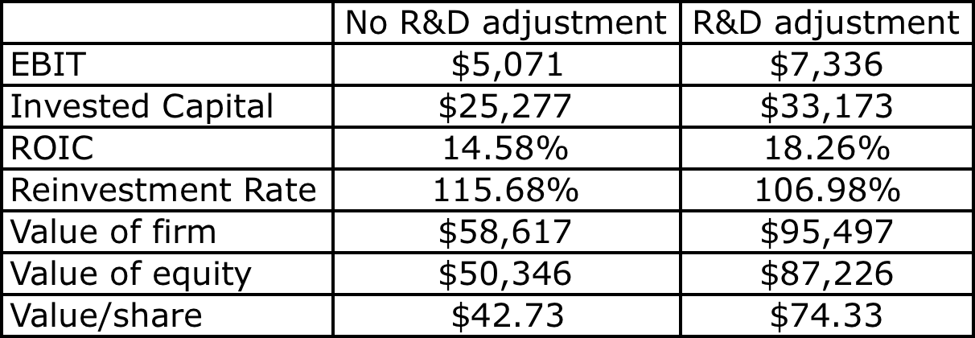
And the consequences…

Slide 12
Step 2: Consider the effect of taxes…
Your earnings and cash flows should be after corporate taxes. With cash flow to equity, you start with net income, which is already after taxes. So, you are set.
When you do free cash flow to the firm, you are computing your cash flows “as if you had no debt”. That is why it is called an unlevered cash flow.
Consequently, you have to compute the tax you would have paid on your operating income, as if it were taxable income.
For the short term, you can use the effective tax rate, since it is the tax rate you paid on average on your taxable income. Over time, though, you would expect this tax rate to climb towards your marginal tax rate.
Notes:
The effective tax rate is defined as taxes paid/ taxable income, as defined in the reporting books. The marginal tax rate is the tax rate on the last dollar of income. The effective tax rate is lower than the marginal tax rate for most firms. Why?
Bracket creep: Can be a reason for small private businesses but not for large publicly traded firms where most of the income is at the highest marginal tax rate anyway.
Cosmetic factors: Two sets of books with different accounting standards for tax and reporting books.
Real factors: Capacity to defer taxes to the future.

Slide 13
Step 3: Define reinvestment broadly
For long term assets…
Research and development expenses, once they have been re-categorized as capital expenses. The adjusted net cap ex will be
  Adjusted Net Capital Expenditures = Net Capital Expenditures + Current year’s R&D expenses - Amortization of Research Asset
Acquisitions of other firms, since these are like capital expenditures. The adjusted net cap ex will be
  Adjusted Net Cap Ex = Net Capital Expenditures + Acquisitions of other firms - Amortization of such acquisitions
  Two caveats:
    Most firms do not do acquisitions every year. Hence, a normalized measure of acquisitions (looking at an average over time) should be used
    The best place to find acquisitions is in the statement of cash flows, usually categorized under other investment activities
Notes:
The accounting definition of cap ex is too narrow. It excludes external cap ex (which is what acquisitions are) and intangible cap ex (which is what R&D is).
We would include all acquisitions, including stock swaps acquisitions. To those who would argue that there is no cashflow associated with stock swaps, we would suggest that all that has occurred is that the firm has just skipped a step - the firm could have issued the stock to the market and used the cash on the acquisitions.
It is true that incorporating acquisitions into valuation can be messy for firms that do relatively few and very diverse acquisitions over time. You have the option of ignoring these acquisitions when you do valuation but make sure that the expected growth rate in earnings does not then include the expected growth from acquisitions. You are implicitly assuming that acquisitions in the future will be done at fair value and hence have no value impact.

Slide 14
And short term assets
In accounting terms, the working capital is the difference between current assets (inventory, cash and accounts receivable) and current liabilities (accounts payables, short term debt and debt due within the next year)
A cleaner definition of working capital from a cash flow perspective is the difference between non-cash current assets (inventory and accounts receivable) and non-debt current liabilities (accounts payable)
Any investment in this measure of working capital ties up cash. Therefore, any increases (decreases) in working capital will reduce (increase) cash flows in that period.
When forecasting future growth, it is important to forecast the effects of such growth on working capital needs, and building these effects into the cash flows.
Notes:
We remove cash from current assets because cash is not a wasting asset for most firms with substantial cash balances. Cash today tends to be invested in treasuries or commercial paper which yields a fair return for the risk taken (which is little or none). There are some analysts who still use operating cash (which they estimate as a percent of revenues) as part of working capital, but we believe that this is no longer appropriate for firms in markets with well developed banking systems and investment alternatives.
The debt in current liabilities is included in the debt used for cost of capital.

Slide 15
Step 4: To get from FCFF to FCFE, consider debt cash flows….
In the strictest sense, the only cash flow that an investor will receive from an equity investment in a publicly traded firm is the dividend that will be paid on the stock.
Actual dividends, however, are set by the managers of the firm and may be much lower than the potential dividends (that could have been paid out)
  managers are conservative and try to smooth out dividends
  managers like to hold on to cash to meet unforeseen future contingencies and investment opportunities
The potential dividends of a firm are the cash flows left over after the firm has made any “investments” it needs to make to create future growth and net debt repayments (debt repayments - new debt issues):
  Net Income
  - (Capital Expenditures - Depreciation)
  - Changes in non-cash Working Capital
  - (Principal Repayments - New Debt Issues)
  = Free Cash flow to Equity

