Slide 1
Session 8: Estimating Growth

Slide 2
Growth in Earnings
Look at the past
  The historical growth in earnings per share is usually a good starting point for growth estimation
Look at what others are estimating
  Analysts estimate growth in earnings per share for many firms. It is useful to know what their estimates are.
Look at fundamentals
  Ultimately, all growth in earnings can be traced to two fundamentals - how much the firm is investing in new projects, and what returns these projects are making for the firm.
Notes:
Three basic approaches for estimating growth. We tend to use all three but the degree to which we weight each in will depend upon the company that we are looking at.

Slide 3
I. Historical Growth in EPS
The historical growth rate in earnings for a company may seem like a fact but it is an estimate. In fact, it is sensitive to
  How it is computed: The growth rates in earnings will be different, depending upon how you compute the average. An simple (arithmetic) average growth rate will tend to be higher than a compounded (geometric) average growth rate.
  Estimation period: The starting point for the computation can make a big difference. Using a bad year as the base year will generate much higher growth rates.
In using historical growth rates, recognize the following:
  Growth rates become meaningless when earnings go from negative values to positive values
  Growth rates will go down as companies get larger
Worst of all, there is evidence that historical growth rates in earnings are not very good predictors of future earnings…
Notes:
Estimating historical growth rates may seem to be trivial, but there are a number of estimation issues that can lead different analysts to estimate different historical growth rates for the same firm.

Slide 4
II. Management/Analyst Forecasts
When valuing companies, we often fall back on management forecasts for the future (after all, they know the company better than we do) or forecasts of other analysts.
Management forecasts may reflect their “superior” knowledge, but they have a fatal flaw. They are biased.
Analyst forecasts may seem like a simple way to avoid the problem, but not only are they also biased but using them represents an abandonment of a basic requirement in valuation: that you make your own best judgment of growth.

Slide 5
III. Fundamental Growth
Growth has to be earned by a company. You and I do not have the power to endow a company with growth.
In terms of basic fundamentals, for a company to grow its earnings, it has to
  Add to its asset or capital base and generate returns on that added capital (new investment growth)
  Manage its existing assets more efficiently, generating higher margins and higher returns on existing assets (efficiency growth)

Slide 6
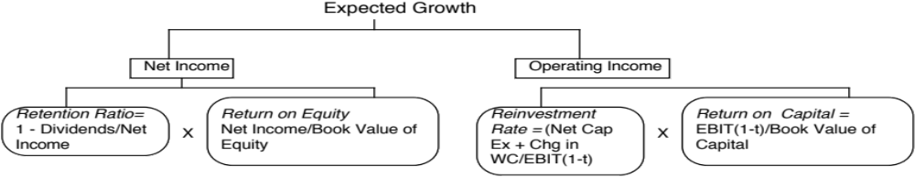
a. New Investment Growth
The growth in earnings for a firm from new investments is a function of two decisions:
  How much to reinvest back into the business for long term growth
    Equity earnings: Portion of net income put back into the business (retention)
    Operating earnings: Portion of after-tax operating income invested in the business.
  How well it reinvests its money, defined again
    With equity earnings, the return on equity
    With operating earnings, the return on invested capital

Slide 7
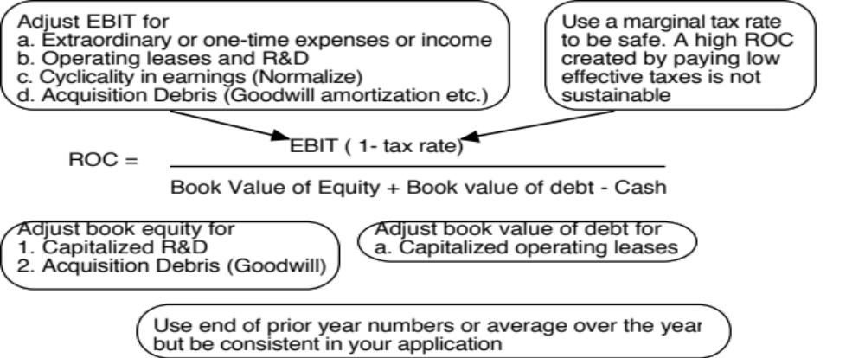
The Key Number: Return on Capital (Equity)

Slide 8
b. Efficiency Growth
When the return on equity or capital is changing, there will be a second component to growth, positive if the return is increasing and negative if the return is decreasing. If ROC _{t} is the return on capital in period t and ROC _{t+1} is the return on capital in period t+1, the growth rate in operating income will be:
  Expected Growth Rate = ROCt+1 * Reinvestment rate +(ROC _{t+1} – ROC_{t}) / ROC_{t}
For example, assume that you have a firm that is generating a return on capital of 8% on its existing assets and expects to increase this return to 10% next year. The efficiency growth for this firm is
  Efficiency growth = (10% -8%)/ 8% = 25%
Thus, if this firm has a reinvestment rate of 50% and makes a 10% return on capital on its new investments as well, its total growth next year will be 30%
  Growth rate = .50 * 10% + 25% = 30%
The key difference is that growth from new investments is sustainable whereas returns from efficiency are short term (or transitory).

Slide 9
Revenue Growth and Operating Margins
All of the fundamental growth equations assume that the firm has a return on equity or return on capital it can sustain in the long term.
When operating income is negative or margins are expected to change over time:
  Estimate growth rates in revenues over time
    Use historical revenue growth to get estimates of revenue growth in the near future
    Decrease the growth rate as the firm becomes larger
    Keep track of absolute revenues to make sure that the growth is feasible
  Estimate expected operating margins each year
    Set a target margin that the firm will move towards
    Adjust the current margin towards the target margin
  Estimate the capital that needs to be invested to generate revenue growth and expected margins
    Estimate a sales to capital ratio that you will use to generate reinvestment needs each year.

Slide 10
Sirius Radio: Revenues and Revenue Growth-
June 2006
Year Revenue Revenue Operating Operating
Growth $ Margin Income
Current $187 -419.92% -$787
1 200.00% $562 -199.96% -$1,125
2 100.00% $1,125 -89.98% -$1,012
3 80.00% $2,025 -34.99% -$708
4 60.00% $3,239 -7.50% -$243
5 40.00% $4,535 6.25% $284
6 25.00% $5,669 13.13% $744
7 20.00% $6,803 16.56% $1,127
8 15.00% $7,823 18.28% $1,430
9 10.00% $8,605 19.14% $1,647
10 5.00% $9,035 19.57% $1,768
Target margin based upon Clear Channel
Notes:
The growth rate in year 1 was set lower to reflect the fact that the economy had slowed down at the time of this forecast. As Sirius gets larger, revenue growth rates become smaller. The initial year’s estimates were based upon looking at the recent past. We estimated the expected revenues in 10 years first (by making assumptions about market share and total market size) and then adjusted the growth rate in the intermediate years to get to these revenues. (Making year-to-year estimates becomes just about impossible with firms like these…)
I used the pre-tax operating margin at Clear Channel, the largest existing company in the space as my year 10 target margin. (Sirius and Clear Channel have different business models. It is possible that the target margin may need to be adjusted for these differences…)

Slide 11
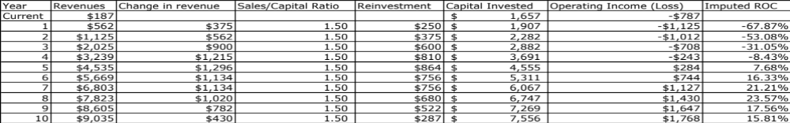
Sirius: Reinvestment Needs
Capital invested in year t+!= Capital invested in year t + Reinvestment in year t+1
Industry average Sales/Cap Ratio
Notes:
To estimate the reinvestment needs, we used the sales to capital ratio… this is the dollars of revenues that I expect each dollar of capital to generate. This number was obtained by looking at
Sirius’s limited history and calculating the change in revenues as a percent of change in capital each year
The industry averages
I am also assuming that reinvestment and growth are contemporaneous - investments in capital and the increase in revenues occur in the same year. If I assumed that there was a lag between investment and growth, I could lag the investment behind revenue growth.

