Slide 1
An Introduction to Valuation
Spring 2025
Aswath Damodaran
Notes:
It always helps to lay a philosophical foundation for what is to come. This presentation, which is usually my first session, attempts to do this. I use it not only as an opportunity to provide an overview of valuation approaches but also to link each to specific views about how markets work and what inefficiencies have to come into play for each approach to yield excess returns.

Slide 2
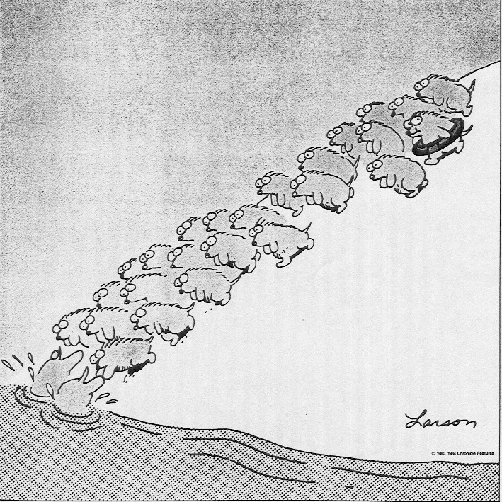
Valuation won’t make you rational. You are a human being with lemmingitis!
" One hundred thousand lemmings cannot be wrong" Graffiti
We thought we were in the top of the eighth inning,
when we were in the bottom of the ninth..
Stanley
Druckenmiller
Notes:
This is one of my favorite cartoons of all time. As humans, we all have a little bit (or a lot) of the lemming in each of us - it is very difficult to go against the crowd, no matter what your rational side tells you. Some investors are lemmings and proud of it - we call them momentum investors. Other investors think they are smarter than the rest - they think they can veer away just as the cliff approaches. Mr. Druckenmiller’s quote cuts to the heart of why that might be difficult to do. All to often, the cliff comes as a surprise to even the most savvy investors. If you are going to be a lemming, be a lemming with a life vest… that is what valuation gives you – you have something (earnings and cash flows) that can sustain you when perceptions shift…

Slide 3
Misconceptions about Valuation
Myth 1: A valuation is an objective search for “true” value
  Truth 1.1: All valuations are biased. The only questions are “how much” and in which direction.
  Truth 1.2: The direction and magnitude of the bias in your valuation is directly proportional to who pays you and how much you are paid.
Myth 2.: A good valuation provides a precise estimate of value
  Truth 2.1: There are no precise valuations.
  Truth 2.2: The payoff to valuation is greatest when valuation is least precise.
Myth 3: . The more quantitative a model, the better the valuation
  Truth 3.1: Your understanding of a valuation model is inversely proportional to the number of inputs required for the model.
  Truth 3.2: Simpler valuation models do much better than complex ones.
Notes:
While we use the cover of numbers and models to obscure the fact, valuation is extraordinarily subjective. Your biases find their way into your valuations.
Every semester, students in my equity valuation class pick companies to value over the semester. A few years ago, I asked students to let me know at the start of the semester what companies they would be valuing and also whether they thought these companies were under or over valued (before they had actually done the valuation). At the end of the semester, I chronicled what they concluded in their quantitative valuations - 88% of those who thought that their companies were under valued at the start of the semester found them to be undervalued, and 82% of those who thought their companies were overvalued found them to be overvalued.
The debate about conflicts of interest faced by analysts who have to bring in investment banking business or own stock in the companies that they analyze is well chronicled.
The more you learn about a company, the more your biases harden, and if you take a position (buy or sell), it adds to the bias.
When money enters the picture, the bias is exaggerated. (I use the example of Lin Cable, a publicly traded company, where AT&T had the option to buy 49% of the company at an appraised value in the early 1990s. Their banker, Morgan Stanley, estimated the value per share at $105, whereas Lehman Brothers, which worked for Lin, estimated the value at $155. Wasserstein Perella, brought in to break the tie, came in at $130).
The key to good valuation is to reduce bias as much as you can, and be honest with yourself about the bias that remains.
Valuation is also inherently imprecise because you are looking at the future. You cannot apply the same tests of precision to valuing a stock that you would to valuing a bond, or within stocks, to valuing a stable utility to valuing a technology company. The imprecise valuation of a risky company, where most people give up, may be more valuable than the precise valuation of a stable company. If your background is quantitative (you are a recovering engineer or mathematician), you will struggle with the reality that there is no right answer, or at least a way of checking to see if it is right.
Finally, adding more inputs may seem costless to those building models, but they are never costless to those using them. In fact, there are two costs to adding more detail. The first is that the models become black boxes, where users are unclear about what happens inside the box. “The model valued the company” becomes the refrain… The second is that these inputs have to be estimated and entered by the user and errors in these inputs can override the benefits of adding detail. So, less is more. Don’t add more detail unless you have special insight or information on estimating that detail.

Slide 4
The Bermuda Triangle of Valuation
Valuation First Principles & Good Sense
Bias & Preconceptions
Denial
Deception
Self delusion
Complexity & Detail
Confusion
Intimidation
Blind faith in models
Uncertainty & the Unknown
Paralysis
Outsourcing
Herding
Mental accounting
Notes:
Bermuda triangle: A triangle of Miami, Bermuda & San Juan, PR
Ships & planes disappear in that triangle
All kinds of theories: From the mildly plausible (crazy weather patterns) to the outlandish (UFOs, lost city of Atlantis)
Here is the analogy: You start with the best of intentions, you read the books, you study the theory, you build the models, you collect the data, you do your valuation but all of the good stuff disappears into the Bermuda triangle of valuation, bounded by bias, uncertainty & complexity.

Slide 5
Approaches to Valuation
Intrinsic valuation, relates the value of an asset to its : its capacity to generate cash flows and the risk in these cash flows. In its most common form, intrinsic value is computed with a discounted cash flow valuation, with the value of an asset being the present value of expected future cash flows on that asset.
Relative valuation or Pricing, estimates how much to pay for an asset by looking at what others are paying for 'comparable' assets, scaled to a common metric that they all share (earnings, revenues, subscribers).
Contingent claim (or real option) valuation, augments the value of assets, whose cash flows are contingent on an event happening.
Notes:
There are some who suggest that there is a fourth way to approach valuation, which is to value the assets of a firm individually. Asset based valuation, however, requires that you either trust accountants completely (use book value) or that you use either discounted cash flow or relative valuation models to value the individual assets. Consequently, we view it as a subset of these approaches. Ultimately, every valuation model falls into one of these buckets, and some try (and mistakenly) to fall into more than one.

Slide 6
Basis for all valuation approaches
The use of valuation models in investment decisions are based upon
  a perception that markets are inefficient and make mistakes in assessing value
  an assumption about how and when these inefficiencies will get corrected
In an efficient market, the market price is the best estimate of value. The purpose of any valuation model is then the justification of this value.
The differences between different investment philosophies, all claiming to beat the market, lie in what types of inefficiencies they see in markets and how those inefficiencies get corrected.
Notes:
Implicit in most valuation is the assumption that markets make mistakes and that we can find those mistakes, using the right valuation models. An often unstated assumption is that markets will correct their mistakes, resulting in excess returns for investors.
If you do believe that markets are efficient, valuation still may be a useful tool in other contexts, such as:
Valuing private businesses (where there is no market to yield a price), for a transaction or for an initial public offering.
Valuing the effect of a restructuring or a merger on the value of a company. This, in effect, is what a private equity investor does when he or she looks at a company.

Slide 7
Discounted Cashflow Valuation (DCF)
What is it: In discounted cash flow valuation, the value of an asset is the present value of the expected cash flows on the asset.
Philosophical Basis: Every asset has an intrinsic value that can be estimated, based upon its characteristics in terms of cash flows, growth and risk.
Information Needed: To use discounted cash flow valuation, you need
  to estimate the life of the asset
  to estimate the cash flows during the life of the asset
  to estimate the discount rate to apply to these cash flows to get present value
Market Inefficiency: Markets are assumed to make mistakes in pricing assets across time, and are assumed to correct themselves over time, as new information comes out about assets.
Notes:
Discounted cash flow valuation is geared for assets that derive their value from the cashflows that they are expected to generate - most businesses and financial assets fall into this category.
The inputs needed for all discounted cash flow models - cash flows, discount rates and asset life - are the same, though the ease with which they can be estimated may vary from asset to asset.
When we use discounted cash flow valuation, we are assuming that we can estimate intrinsic value and that market prices can deviate from intrinsic values. We also assume that prices will revert back to intrinsic value sooner or later - this is why a long time horizon is a pre-requisite.

Slide 8
Advantages of DCF Valuation
Since DCF valuation, done right, is based upon an asset’s fundamentals, it should be less exposed to market moods and perceptions.
  If good investors buy businesses, rather than stocks (the Warren Buffet adage), discounted cash flow valuation is the right way to think about what you are getting when you buy an asset.
  DCF valuation forces you to think about the underlying characteristics of the firm, and understand its business. If nothing else, it brings you face to face with the assumptions you are making when you pay a given price for an asset.
If you buy into the notion of value being driven by a company’s cash flows, you are immunized (to the extent that you have a long time horizon) from what the market thinks about your investment. You have the choice of holding on to your investment and collecting the cash flows each period.
Notes:
No valuation model is ever immune from market moods. Discounted cash flow valuation is less exposed than relative valuation (multiples) to the ebbs and flows of perception. It is therefore much more likely to yield contrarian recommendations when markets get out of hand - sell when markets are booming and buy when markets are down.
The process of valuation is almost as important as the product (the value that you estimate). As you consider the inputs you will use to value a firm, and examine the effect of changes in these inputs on value, you will understand the determinants of firm value.

Slide 9
Disadvantages of DCF valuation
Since it is an attempt to estimate intrinsic value, it requires far more explicit inputs and information than other valuation approaches
These inputs and information are not only noisy (and difficult to estimate), but can be manipulated by the analyst to provide the conclusion he or she wants. The quality of the analyst then becomes a function of how well he or she can hide the manipulation.
In an intrinsic valuation model, there is no guarantee that anything will emerge as under or over valued. Thus, it is possible in a DCF valuation model, to find every stock in a market to be over valued. This can be a problem for
  equity research analysts, whose job it is to follow sectors and make recommendations on the most under and over valued stocks in that sector
  equity portfolio managers, who have to be fully (or close to fully) invested in equities
Notes:
A model’s strengths are also its weaknesses. If your job is to be market neutral (decide on what stocks to buy and sell, given where the market is today), you may find that discounted cash flow valuation yields too few buy recommendations and steers you away from the sectors that are yielding the highest returns at the moment. While you may eventually be proved right, it is small consolation if you lost your job earlier.
One more point. A badly done or internally inconsistent DCF valuation is perhaps the worst way to do valuation. Since it unmoored, you can arrive at outlandish values for businesses, not because they are worth that much but because you have either created the “unsustainable” firm or violated first laws in economics or mathematics. That may explain why so many investors are skeptical about DCF valuation.

Slide 10
When DCF Valuation works best
At the risk of stating the obvious, this approach is designed for use for assets (firms) that derive their value from their capacity to generate cash flows in the future.
It follows that investments that do not generate cash flows (gold, currencies, collectibles) cannot be valued.
It works best for investors who
  have a long time horizon, allowing the market time to correct its valuation mistakes and for price to revert to “true” value or
  are capable of providing the catalyst needed to move price to value, as would be the case if you were an activist investor or a potential acquirer of the whole firm
  are not easily swayed or affected by peer pressure, i.e., market movements that are contrary to their “value” views
Notes:
Assets with clearly defined cash flows are easiest to value with DCF models. Assets that generate a substantial portion of their value from the psychic pleasure they may give their owners - collectibles or even real estate - are much more difficult to value using DCF models.
Investors with long time horizons are much more likely to succeed with DCF models, since they can give markets much more time to correct their mistakes.

Slide 11
Relative Valuation (Pricing)
What is it? The “value” of any asset can be estimated by looking at how the market prices “similar” or ‘comparable” assets.
Philosophical Basis: The intrinsic value of an asset is impossible (or close to impossible) to estimate. The price of an asset is whatever the market is willing to pay for it (based upon its characteristics)
Information Needed: To do a relative valuation, you need
  an identical asset, or a group of comparable or similar assets
  a standardized measure of price (in equity, this is obtained by dividing the price by a common variable, such as earnings or book value)
  and if the assets are not perfectly comparable, variables to control for the differences
Market Inefficiency: Pricing errors made across similar or comparable assets are easier to spot, easier to exploit and are much more quickly corrected.
Notes:
Most valuations are relative valuations, involving three components - a multiple, a set of comparable firms and a story. You see this in equity research, acquisition valuations and portfolio management.
Implicitly, you assume that markets are correct on average. A logical follow-up is that equity research analysts must be much stronger believers in market efficiency than they claim to be, if their primary tools are multiples.
The ‘catalyst’ component may explain why DCF valuation may be a better choice for an activist investor or private equity fund.

Slide 12
Advantages of Pricing
In sync with the market: Pricing is much more likely to reflect market perceptions and moods than discounted cash flow valuation. This can be an advantage when it is important that the price reflect these perceptions as is the case when
  the objective is to sell an asset at that price today (IPO, M&A)
  investing on “momentum” based strategies
With pricing, there will always be a significant proportion of securities that are under valued and over priced. Since portfolio managers are judged based upon how they perform on a relative basis (to the market and other money managers), pricing is more tailored to their needs
Pricing generally requires less explicit information than discounted cash flow valuation.
Notes:
Since relative valuation models more closely mirror the market, they are less likely to leave their adherents on the fringes. There is safety in numbers - a portfolio manages is less likely to lose his or her job if he or she makes the same mistake as other portfolio managers.
Unlike discounted cash flow models, you will always find under or over valued stocks using multiples.
Finally, given how relative valuation is structured, you are more likely to come up with “reasonable” values, if you define reasonable as close to what people will pay right now.

Slide 13
Disadvantages of Pricing
A portfolio that is composed of stocks which are under valued on a relative basis may still be overvalued, even if the analysts’ judgments are right. It is just less overvalued than other securities in the market.
Pricing is built on the assumption that markets are correct in the aggregate, but they make mistakes on individual securities. To the degree that markets can be over or under valued in the aggregate, relative valuation will fail.
Pricing may require less information in the way in which most analysts and portfolio managers use it. However, this is because implicit assumptions are made about other variables (that would have been required in a discounted cash flow valuation). To the extent that these implicit assumptions are wrong the relative valuation will also be wrong.
Notes:
“Lemmings”. Do I need say more?
Assumptions are often left unstated or unspecified and that can be dangerous.

Slide 14
When pricing works best..
Pricing is easiest to use when
  there are a large number of assets comparable to the one being valued
  these assets are priced in a market
  there exists some common variable that can be used to standardize the price
This approach tends to work best for investors
  who have relatively short time horizons
  are judged based upon a relative benchmark (the market, other portfolio managers following the same investment style etc.)
  can take actions that can take advantage of the relative mispricing. For instance, a hedge fund can buy the under valued and sell the over valued assets. A long-only investor cannot.
Notes:
Easier to value real assets, where perfect comparables can be found (Think of buying a ticket to a sporting event online…)
Easier to do relative valuation in the United States (with 10000 stocks) than in Portugal (with less than 100).
Easier to do relative valuation for publicly traded companies than private ones (where transaction data is difficult to obtain).
The best use for relative valuation is if you can take advantage of both sides of the valuation divide and not be exposed to “market” errors. Thus, hedge funds should be in a better position to exploit relative valuation mistakes (since they can long on the under valued and short on the over valued stocks) than mutual funds.
Try this website: seatgeek.com. It shows you relative valuation in play by separating seats based upon how good or bad they as deals.

Slide 15
And there are some investments that can only be priced
 | To value | To price
Assets | Can be valued based upon expected cashflows, with higher cashflows & lower risk = higher value. | Can be priced against similar assets, after controlling for cash flows and risk.
Commodity | Can be valued based upon utilitarian demand and supply, but with long lags in both. | Can be priced against its own history (normalized price over time)
Currency | Cannot be valued | Can be priced against other currencies, with greater acceptance & more stable purchasing power = higher price.
Collectible | Cannot be valued | Can be priced based upon scarcity and desirability.
Notes:
You can value only those investments that generate cash flows, from stocks to bonds to real businesses, but you cannot value investments that don’t generate cash flows. These can only be priced.

Slide 16
Asset Based Valuation: A Detour
In contrast to valuing a business as a going concern (based on cash flows) or by looking at how other businesses that look it are priced (relative valuation), you sometimes may value a business by valuing its assets.
Asset based valuation may be used in the context of
  Liquidation valuation, where you are valuing the assets for sale
  Accounting valuation, where you are valuing individual assets for accounting reasons (fair value or goodwill estimation
  Sum of the parts valuation, to either see if a company is cheap as an investment or a good target for acquisition/ restructuring
To value the individual assets, though, you have to either use expected cash flows (intrinsic valuation) or base it on the pricing of similar assets (relative valuation).
Asset based valuation is easiest to do when assets are separable and have stand alone earnings/cash flows.
Notes:
Note that while many people think of asset based valuation as a separate valuation approach, you have to use either intrinsic or relative valuation to value the individual assets. Thus, it is more an application of approaches rather than a stand-alone approach.

Slide 17
What approach would work for you?
As an investor, given your investment philosophy, time horizon and beliefs about markets (that you will be investing in), which of the the approaches to valuation would you choose?
  Discounted Cash Flow Valuation
  Relative Valuation
  Neither. I believe that markets are efficient.
Notes:
There is no right answer. The answer will depend upon several factors - your time horizon, your job description, what you think about markets…
It is often useful to do this survey at the start of a valuation class and again at the very end of the class to see how the choices change as you learn more about valuation…

Slide 18
Contingent Claim (Option) Valuation
Options have several features
  They derive their value from an underlying asset, which has value
  The payoff on a call (put) option occurs only if the value of the underlying asset is greater (lesser) than an exercise price that is specified at the time the option is created. If this contingency does not occur, the option is worthless.
  They have a fixed life
Any security that shares these features can be valued as an option.
Notes:
There are a lot of assets that have these characteristics that may not be categorized as options…. Option pricing models will do a better job of valuing these assets than traditional discounted cash flow models.

Slide 19
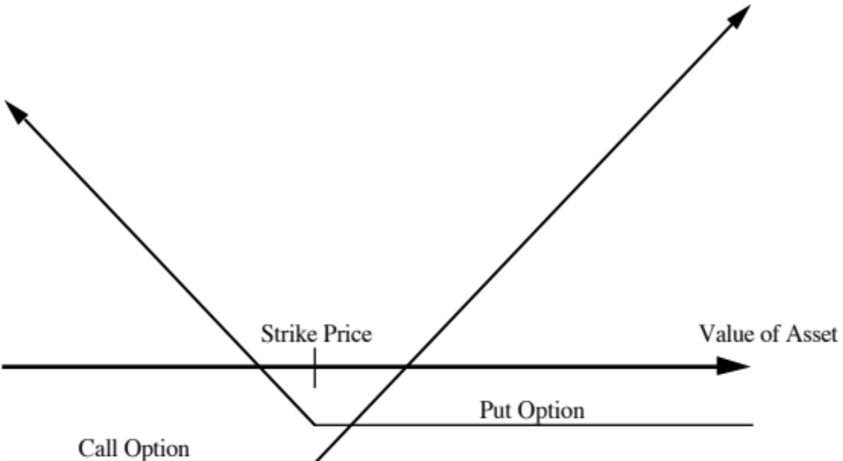
Option Payoff Diagrams
Notes:
Shows the payoff diagram at expiration on call and put options. The essence of the options is that they have limited downside risk and significant upside potential. Any asset that has a payoff diagram that looks like this has option characteristics.

Slide 20
Direct Examples of Options
Listed options, which are options on traded assets, that are issued by, listed on and traded on an option exchange.
Warrants, which are call options on traded stocks, that are issued by the company. The proceeds from the warrant issue go to the company, and the warrants are often traded on the market.
Contingent Value Rights, which are put options on traded stocks, that are also issued by the firm. The proceeds from the CVR issue also go to the company
Scores and LEAPs, are long term call options on traded stocks, which are traded on the exchanges.
Notes:
Option pricing models were really designed to value these options and may have to be modified to value real options …

Slide 21
Indirect Examples of Options
Equity in a deeply troubled firm - a firm with negative earnings and high leverage - can be viewed as an option to liquidate that is held by the stockholders of the firm. Viewed as such, it is a call option on the assets of the firm.
The reserves owned by natural resource firms can be viewed as call options on the underlying resource, since the firm can decide whether and how much of the resource to extract from the reserve,
The patent owned by a firm or an exclusive license issued to a firm can be viewed as an option on the underlying product (project). The firm owns this option for the duration of the patent.
The rights possessed by a firm to expand an existing investment into new markets or new products.
Notes:
These options are often referred to as real options. Most firms have at least some assets that have option characteristics - vacant land owned by a real estate company, undeveloped patents owned by a pharmaceutical firm…

Slide 22
Advantages of Using Option Pricing Models
Option pricing models allow us to value assets that we otherwise would not be able to value. For instance, equity in deeply troubled firms and the stock of a small, bio-technology firm (with no revenues and profits) are difficult to value using discounted cash flow approaches or with multiples. They can be valued using option pricing.
Option pricing models provide us fresh insights into the drivers of value. In cases where an asset is deriving it value from its option characteristics, for instance, more risk or variability can increase value rather than decrease it.
Notes:
Discounted cash flow models value a technology or product based upon today’s expectations. Thus, if the expectation is that the product will not be viable in the future, the discounted cash flow value can be low or non-existent. If there is substantial uncertainty about the future, an option pricing model may yield a very different result.
When an asset derives its value from its option characteristics, it also changes the way we think about value drives. Thus, higher risk may reduce the value of a cashflow generating asset but may make assets with option characteristics (undeveloped oil reserves or a non-viable patent) more valuable.

Slide 23
Disadvantages of Option Pricing Models
When real options (which includes the natural resource options and the product patents) are valued, many of the inputs for the option pricing model are difficult to obtain. For instance, projects do not trade and thus getting a current value for a project or a variance may be a daunting task.
The option pricing models derive their value from an underlying asset. Thus, to do option pricing, you first need to value the assets. It is therefore an approach that is an addendum to another valuation approach.
Finally, there is the danger of double counting assets. Thus, an analyst who uses a higher growth rate in discounted cash flow valuation for a pharmaceutical firm because it has valuable patents would be double counting the patents if he values the patents as options and adds them on to his discounted cash flow value.
Notes:
It is far more difficult obtaining the inputs for real option models than it is to obtain the inputs for valuing financial options.
Also, note that real options are not a substitute for conventional valuation approach but an add on.
Double counting is a real and present danger as is using the presence of real options as a filler variable to explain away differences between the estimated value of a company and its market value.

Slide 24
In summary…
While there are hundreds of valuation models and metrics around, there are only three valuation approaches:
  Intrinsic valuation (usually, but not always a DCF valuation)
  Relative valuation or Pricing
  Contingent claim valuation
The three approaches can yield different estimates of value for the same asset at the same point in time.
To truly grasp valuation, you have to be able to understand and use all three approaches. There is a time and a place for each approach, and knowing when to use each one is a key part of mastering valuation.
Notes:
The table has been set… let the fun begin…

