Slide 1
OPTIMAL FINANCING MIX V: ALTERNATE APPROACHES
If you count the good stuff, you also have to count the bad stuff.
Notes:
Sets the agenda for the class. This is a class that will be focused on the big picture of corporate finance rather than details, theories or models on a piecemeal basis.

Slide 2
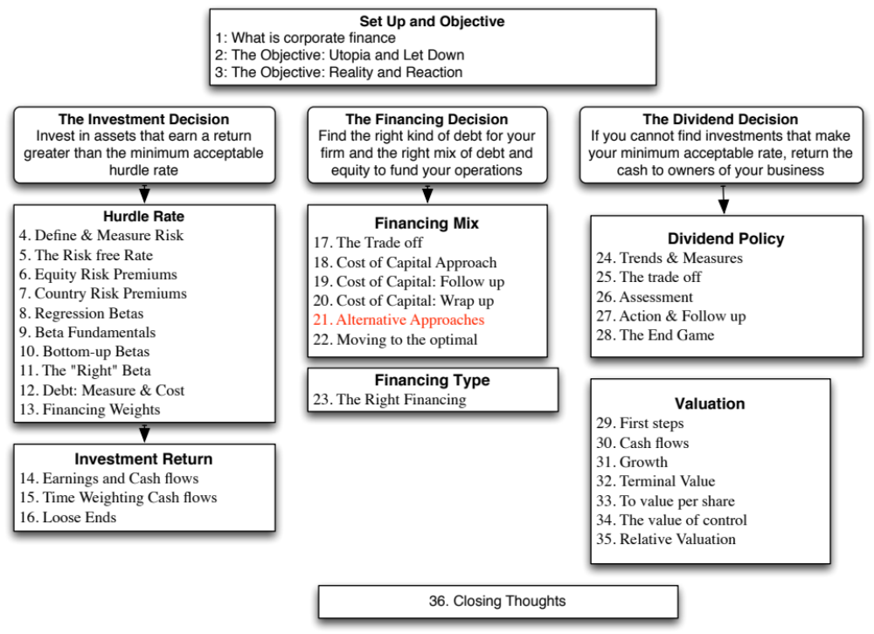

Slide 3
I. The APV Approach to Optimal Capital Structure
In the adjusted present value approach, the value of the firm is written as the sum of the value of the firm without debt (the unlevered firm) and the effect of debt on firm value
  Firm Value = Unlevered Firm Value + (Tax Benefits of Debt - Expected Bankruptcy Cost from the Debt)
The optimal dollar debt level is the one that maximizes firm value
Notes:
This is an alternative approach with the same objective of maximizing firm value. It assesses the costs and benefits of debt in dollar value terms rather than through the cost of capital.

Slide 4
Implementing the APV Approach
Step 1: Estimate the unlevered firm value. This can be done in one of two ways:
  Estimating the unlevered beta, a cost of equity based upon the unlevered beta and valuing the firm using this cost of equity (which will also be the cost of capital, with an unlevered firm)
  Alternatively, Unlevered Firm Value = Current Market Value of Firm - Tax Benefits of Debt (Current) + Expected Bankruptcy cost from Debt
Step 2: Estimate the tax benefits at different levels of debt. The simplest assumption to make is that the savings are perpetual, in which case
  Tax benefits = Dollar Debt * Tax Rate
Step 3: Estimate a probability of bankruptcy at each debt level, and multiply by the cost of bankruptcy (including both direct and indirect costs) to estimate the expected bankruptcy cost.
Notes:
In practice, analysts often do the first two steps but skip the third because the inputs are so difficult to get. The result is that the value of the firm always go up as you borrow money, since you count in the tax benefits but you don’t consider the bankrutpcy costs.

Slide 5
Estimating Expected Bankruptcy Cost
Probability of Bankruptcy
  Estimate the synthetic rating that the firm will have at each level of debt
  Estimate the probability that the firm will go bankrupt over time, at that level of debt (Use studies that have estimated the empirical probabilities of this occurring over time - Altman does an update every year)
Cost of Bankruptcy
  The direct bankruptcy cost is the easier component. It is generally between 5-10% of firm value, based upon empirical studies
  The indirect bankruptcy cost is much tougher. It should be higher for sectors where operating income is affected significantly by default risk (like airlines) and lower for sectors where it is not (like groceries)
Notes:
The two key inputs you need to estimate the expected bankruptcy cost. The first one is easier to get than the second. There have been attempts to measure the magnitude of indirect bankruptcy costs and they conclude that
Indirect bankruptcy costs can be as high as 20-30% of firm value
Indirect bankrtupcy costs as a percent of firm value are different for different firms. In general, they tend to be higher for firms that produce longer life assets than for assets that have shorter lives and for firms where reputation matters more.

Slide 6
Ratings and Default Probabilities: Results from Altman study of bonds
Rating Likelihood of Default
AAA 0.07%
AA 0.51%
A+ 0.60%
A 0.66%
A- 2.50%
BBB 7.54%
BB 16.63%
B+ 25.00%
B 36.80%
B- 45.00%
CCC 59.01%
CC 70.00%
C 85.00%
D 100.00%
Altman estimated these probabilities by looking at bonds in each ratings class ten years prior and then examining the proportion of these bonds that defaulted over the ten years.
Notes:
This table is updated every year by Ed Altman at the Stern School of Business. It is the probability that a bond is each of these ratings classes will default and is based upon actual default rates over 10 years of bonds in each ratings class. This is from the 2009 update.

Slide 7
Disney: Estimating Unlevered Firm Value
Current Value of firm = $121,878+ $15,961 = $ 137,839
- Tax Benefit on Current Debt = $15,961 * 0.361 = $ 5,762
+ Expected Bankruptcy Cost = 0.66% * (0.25 * 137,839) = $ 227
Unlevered Value of Firm = = $ 132,304
  Cost of Bankruptcy for Disney = 25% of firm value
  Probability of Bankruptcy = 0.66%, based on firm’s current rating of A
  Tax Rate = 36.1%
Notes:
To implement APV, you have to first estimate the unlevered firm value.We are using a short-cut to derive the tax benefit from current debt and the indirect bankruptcy cost is an assumption (we went right for the mid-point of the 10-40% range for all companies.

Slide 8
Disney: APV at Debt Ratios
Debt Ratio | $ Debt | Tax Rate | Unlevered Firm Value | Tax Benefits | Bond Rating | Probability of Default | Expected Bankruptcy Cost | Value of Levered Firm
0% | $0 | 36.10% | $132,304 | $0 | AAA | 0.07% | $23 | $132,281
10% | $13,784 | 36.10% | $132,304 | $4,976 | Aaa/AAA | 0.07% | $24 | $137,256
20% | $27,568 | 36.10% | $132,304 | $9,952 | Aaa/AAA | 0.07% | $25 | $142,231
30% | $41,352 | 36.10% | $132,304 | $14,928 | Aa2/AA | 0.51% | $188 | $147,045
40% | $55,136 | 36.10% | $132,304 | $19,904 | A2/A | 0.66% | $251 | $151,957
50% | $68,919 | 36.10% | $132,304 | $24,880 | B3/B- | 45.00% | $17,683 | $139,501
60% | $82,703 | 36.10% | $132,304 | $29,856 | C2/C | 59.01% | $23,923 | $138,238
70% | $96,487 | 32.64% | $132,304 | $31,491 | C2/C | 59.01% | $24,164 | $139,631
80% | $110,271 | 26.81% | $132,304 | $29,563 | Ca2/CC | 70.00% | $28,327 | $133,540
90% | $124,055 | 22.03% | $132,304 | $27,332 | Caa/CCC | 85.00% | $33,923 | $125,713
The optimal debt ratio is 40%, which is the point at which firm value is maximized.
Notes:
Disney’s optimal debt ratio is 40%, which matches the optimal debt ratio from the cost of capital approach.

Slide 9
II. Relative Analysis
The “safest” place for any firm to be is close to the industry average
Subjective adjustments can be made to these averages to arrive at the right debt ratio.
  Higher tax rates -> Higher debt ratios (Tax benefits)
  Lower insider ownership -> Higher debt ratios (Greater discipline)
  More stable income -> Higher debt ratios (Lower bankruptcy costs)
  More intangible assets -> Lower debt ratios (More agency problems)
Notes:
Most firms pick their debt ratios by looking at industry averages. By staying close to the average, managers get cover in case they make mistakes - everyone else has made the same mistake.
Managers also try to stay close to the industry average, because ratings agencies and equity research analysts look at these averages.

Slide 10

Comparing to industry averages
Notes:
Based on this comparison, Disney is operating at a debt ratio lower than those of other firms in the industry in both market and book value terms, whereas Vale and Tata Motors have debt ratios much higher than the averages for their sector.
The underlying assumptions in this comparison are that firms within the same industry are comparable and that, on average, these firms are operating at or close to their optimal. Both assumptions can be questioned, however. Firms within the same industry can have different product mixes, different amounts of operating risk, different tax rates, and different project returns. In fact, most do. For instance, Disney is considered part of the entertainment industry, but its mix of businesses is very different from that of Lion’s Gate, which is primarily a movie company, or Liberty Media, which is primarily a cable broadcasting company. Furthermore, Disney’s size and risk characteristics are very different from that of Westwood One, which is also considered part of the same industry group. The other problem is that, as we noted in Chapter 4, both Disney and Vale are multi-business companies and picking a sector to compare these firms is difficult to do.

Slide 11
Getting past simple averages
Step 1: Run a regression of debt ratios on the variables that you believe determine debt ratios in the sector. For example,
  Debt Ratio = a + b (Tax rate) + c (Earnings Variability) + d (EBITDA/Firm Value)
Check this regression for statistical significance (t statistics) and predictive ability (R squared)
Step 2: Estimate the values of the proxies for the firm under consideration. Plugging into the cross sectional regression, we can obtain an estimate of predicted debt ratio.
Step 3: Compare the actual debt ratio to the predicted debt ratio.
Notes:
This is one way to control for differences across firms. The variables in the regression should be proxies for the factors that drive the debt trade-off
Tax Benefit -> Tax Rate
Bankruptcy Risk -> Earnings Variability
Agency Costs-> EBITDA/Firm Value

Slide 12
Applying the Regression Methodology: Global Auto Firms
Using a sample of 56 global auto firms, we arrived at the following regression:
Debt to capital = 0.09 + 0.63 (Effective Tax Rate) + 1.01 (EBITDA/ Enterprise Value) - 0.93 (Cap Ex/ Enterprise Value)
The R squared of the regression is 21%. This regression can be used to arrive at a predicted value for Tata Motors of:
Predicted Debt Ratio = 0.09 + 0.63 (0.252) +1.01 (0.1167) - 0.93 (0.1949) = .1854 or 18.54%
Based upon the capital structure of other firms in the automobile industry, Tata Motors should have a market value debt ratio of 18.54%. It is over levered at its existing debt ratio of 29.28%.
Notes:
This assumes a linear relationship between the independent variables and the debt ratio. The variables can be transformed if the relationship is non-linear.
I plugged in the values for Tata Motors into the regression. This suggest that TMT is underlevered, relative to comparable firms, after controlling for differences across these firms. Note that the low R-squared will also result in large prediction errors.

Slide 13
Extending to the entire market
Using 2014 data for US listed firms, we looked at the determinants of the market debt to capital ratio. The regression provides the following results –
DFR = 0.27 - 0.24 ETR -0.10 g– 0.065 INST -0.338 CVOI+ 0.59 E/V
(15.79) (9.00) (2.71) (3.55) (3.10) (6.85)
  DFR = Debt / ( Debt + Market Value of Equity)
  ETR = Effective tax rate in most recent twelve months
  INST = % of Shares held by institutions
  CVOI = Std dev in OI in last 10 years/ Average OI in last 10 years
  E/V = EBITDA/ (Market Value of Equity + Debt- Cash)
  The regression has an R-squared of 8%.
Notes:
This looks at the entire market and uses the following variables (from Value Line CD-ROM)
Tax Rate as proxy for tax benefits
Effective tax rate for Tax benefits of debt
INST for Disciplinary power of debt (more institutions – Less need?)
CVOI for Bankruptcy costs
EBITDA/Value for Cash flow generating capacity
Low R-squared is typical of these large cross sectional regressions.

Slide 14
Applying the Regression
Disney had the following values for these inputs in 2008. Estimate the optimal debt ratio using the debt regression.
  ETR = 31.02%
  Expected Revenue Growth = 6.45%
  INST = 70.2%
  CVOI = 0.0296
  E/V = 9.35%
Optimal Debt Ratio
= 0.27 - 0.24 (.3102) -0.10 (.0645)– 0.065 (.702) -0.338 (.0296)+ 0.59 (.0935)
= 0.1886 or 18.86%
What does this optimal debt ratio tell you?
Why might it be different from the optimal calculated using the weighted average cost of capital?
Notes:
Based upon the debt ratios of other firms in the market and Disney’s financial characteristics, we would expect Disney to have a debt ratio of 19%. Since its actual debt ratio is 12%, Disney is under levered.
It may be different from the optimal because it is based upon the assumption that firms, on average, get their debt ratios right. If most firms are under levered, for instance, you will get a lower predicted value from the regression than for a cost of capital approach.

Slide 15

Summarizing the optimal debt ratios…
Notes:
Disney is under levered, no matter how you slice it. Vale is close to fairly levered, if you assume that income will bounce back. Tata Motors is over levered and Baidu is very mildly under levered.

Slide 16

Task
Relative to the sector in which your company operates, examine where it has too much or too little debt.
Read
Chapter 8

