Slide 1
Getting to the optimal Financing mix
The pathway to the optimal mix can be rocky.
Notes:
Sets the agenda for the class. This is a class that will be focused on the big picture of corporate finance rather than details, theories or models on a piecemeal basis.

Slide 2
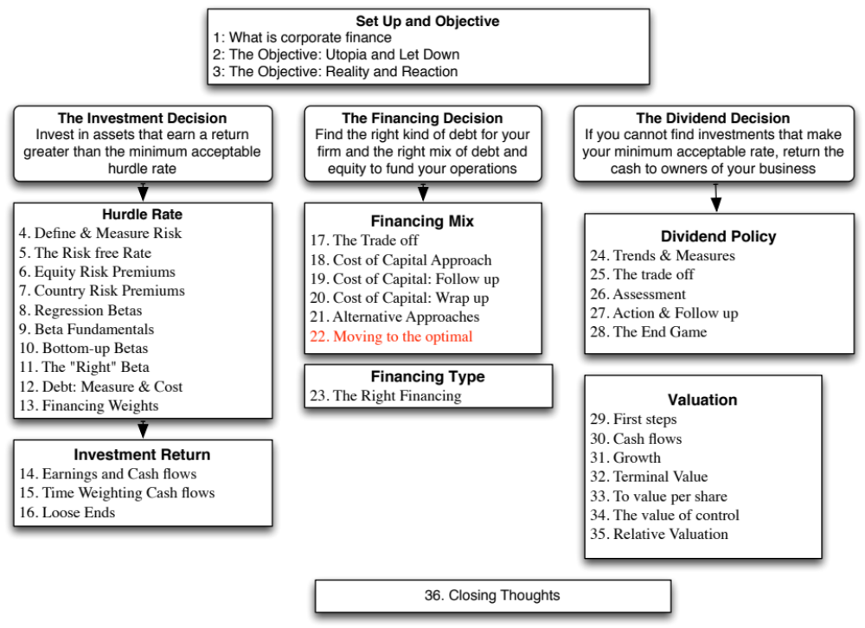

Slide 3
Now that we have an optimal.. And an actual.. What next?
At the end of the analysis of financing mix (using whatever tool or tools you choose to use), you can come to one of three conclusions:
  The firm has the right financing mix
  It has too little debt (it is under levered)
  It has too much debt (it is over levered)
The next step in the process is
  Deciding how much quickly or gradually the firm should move to its optimal
  Assuming that it does, how should it move to its optimal, i.e., a recapitalization or investments.
Notes:
When a firm is under or over levered, the natural reaction of the analyst looking at the numbers is that the firm should fix the problem instantaneously. However, there is a cost to abrupt shifts in capital structures:
You could be wrong in your assessment of the optimal: In other words, you may have misestimated the optimal, in which case the firm may have to back track, if it has followed your recommendations. That is expensive to do (and sometimes fatal).
Macro variables may shift: If there is a shift in the macro environment (interest rates and risk premiums could change), your recommendations can be wrong in hindisight
Adjustment costs: Changes in capital structure can change the way a company is managed and decision makers may not be ready to make the shift. Managers at highly levered firms have to make decisions differently (and perhaps focus on different decision rules) than managers at lightly levered firms. Increasing the debt ratio for a firm overnight can create adjustment problems for these managers.

Slide 4
A Framework for Getting to the Optimal
Is the actual debt ratio greater than or lesser than the optimal debt ratio?
Actual > Optimal
Actual < Optimal
Overlevered
Underlevered
Is the firm under bankruptcy threat?
Is the firm a takeover target?
Yes
No
Yes
No
Reduce Debt quickly
Does the firm have good
Increase leverage
Does the firm have good
1. Equity for Debt swap
projects?
quickly
projects?
2. Sell Assets; use cash
ROE > Cost of Equity
1. Debt/Equity swaps
to pay off debt
ROC > Cost of Capital
2. Borrow money&
ROE > Cost of Equity
3. Renegotiate with lenders
buy shares.
ROC > Cost of Capital
Yes
No
Yes
No
Take good projects with
1. Pay off debt with retained
Take good projects with
new equity or with retained
earnings.
debt.
earnings.
2. Reduce or eliminate dividends.
Do your stockholders like
3. Issue new equity and pay off
dividends?
debt.
Yes
No
Pay Dividends
Buy back stock
Notes:
Studies that have looked at the likelihood of a firm being taken over (in a hostile takeover) have concluded that
Small firms are more likely to be taken over than larger firms
Closely held firms are less likely to be taken over than widely held firms
Firms with anti-takeover restrictions in the corporate charter (or from the state) are less likely to be taken over than firms without these restrictions
Firms which have done well for their stockholders (positive Jensen’s alpha, Positive EVA) are less likely to be taken over than firms which have done badly.
Whether a firm is under bankruptcy threat can be assessed by looking at its rating. If its rating is BB or less, you can argue that the bankruptcy threat is real.
Looking at historical ROE or ROC, relative to the cost of equity and capital, does assume that the future will look like the past.

Slide 5
Disney: Applying the Framework
Is the actual debt ratio greater than or lesser than the optimal debt ratio?
Actual > Optimal
Actual < Optimal
Overlevered
Actual (11.5%) < Optimal (40%)
Is the firm under bankruptcy threat?
Is the firm a takeover target?
Yes
No
Yes
No. Large mkt cap & positive Jensen’s α
Reduce Debt quickly
Does the firm have good
Increase leverage
Does the firm have good
1. Equity for Debt swap
projects?
quickly
projects?
2. Sell Assets; use cash
ROE > Cost of Equity
1. Debt/Equity swaps
to pay off debt
ROC > Cost of Capital
2. Borrow money&
ROE > Cost of Equity
3. Renegotiate with lenders
buy shares.
ROC > Cost of Capital
Yes
No
Yes. ROC > Cost of capital
No
Take good projects with
1. Pay off debt with retained
Take good projects
new equity or with retained
earnings.
With debt.
earnings.
2. Reduce or eliminate dividends.
Do your stockholders like
3. Issue new equity and pay off
dividends?
debt.
Yes
No
Pay Dividends
Buy back stock
Notes:
This is the analysis for Disney in 2009.
I am assuming that future projects will be more successful than current projects..
Over time, our assessments have changed:
In 2003, we would have pushed for higher dividends (since Disney was earning terrible returns on capital and we did not trust management)
In 2000, Disney would have been a takeover target (because its market cap had dropped and its performance was awful on both accounting and stock price returns)
In 1997, Disney would not have been a takeover target (high market cap, good performance) and its excess debt capacity would have been directed to good investments.

Slide 6
6 Application Test: Getting to the Optimal
Based upon your analysis of both the firm’s capital structure and investment record, what path would you map out for the firm?
  Immediate change in leverage
  Gradual change in leverage
  No change in leverage
Would you recommend that the firm change its financing mix by
  Paying off debt/Buying back equity
  Take projects with equity/debt
Notes:
Map out your firm’s path to the optimal debt ratio depending upon
Urgency: If your is a likely target for an acquisition or bankruptcy, go for an immediate change. If not, go for a gradual change.
If your stock price performance has been poor (Jensen’s alpha < 0) and your project choice has yielded negative excess returns (EVA <0) , go for recapitalization (paying off debt or buying back equity). If you have good projects, go for good investments.

Slide 7

Task
If your firm’s actual debt ratio is different from its optimal, evaluate how quickly it has to act & what the best course of action is.
Read
Chapter 9

