Slide 1
The Objective in corporate Finance: Reality strikes
Reality intrudes!
Notes:
Sets the agenda for the class. This is a class that will be focused on the big picture of corporate finance rather than details, theories or models on a piecemeal basis.

Slide 2
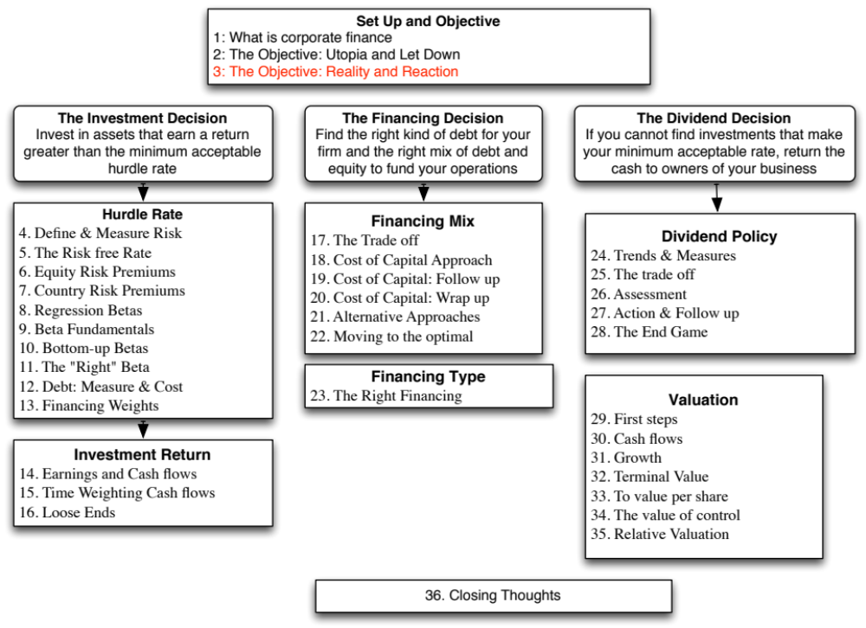

Slide 3
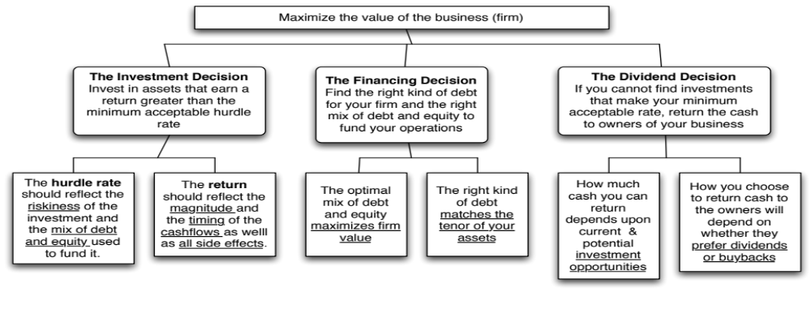
First Principles
Notes:
Our focus will be on the objective: Maximize firm value.
Since so much of corporate finance is built on this objective, it is important that we be clear about what it means and why we choose it. In addition, it is also worth exploring what the alternatives are and why this objective is preferable to the alternatives.

Slide 4
When traditional corporate financial theory breaks down, the solution is:
To choose a different mechanism for corporate governance,.
To choose a different objective for the firm.
To maximize stock price, but reduce the potential for conflict and breakdown:
  Making managers (decision makers) and employees into stockholders
  Protect lenders from expropriation
  By providing information honestly and promptly to financial markets
  Minimize social costs
Notes:
At this point, things look pretty bleak for stock price maximization. These are the three choices that we have, if we abandon pure stock price maximization as an objective function.

Slide 5
I. An Alternative Corporate Governance System
Germany and Japan developed a different mechanism for corporate governance, based upon corporate cross holdings.
At their best, the most efficient firms in the group work at bringing the less efficient firms up to par. They provide a corporate welfare system that makes for a more stable corporate structure
At their worst, the least efficient and poorly run firms in the group pull down the most efficient and best run firms down. The nature of the cross holdings makes its very difficult for outsiders (including investors in these firms) to figure out how well or badly the group is doing.
Notes:
In the 1980s, Michael Porter argued that US companies should move towards the Japanese system. The Japanese and German systems tend to do well in stable environments, where failure tends to be unsystematic ( a firm here and a firm there). They can take care of their “failures” and nurse them back to health, rather than exposing themselves to the costs associated with failure.
These systems break down when problems are wide spread and systematic. Contrast the way US banks dealt with problem loans on their balance sheets (markets forced them to deal with these problems quickly ) and the way Japanese banks have dealt with them (by hiding them and hoping they go away)
In recent years, people have pointed to the Chinese system (centrally planned, quasi market) as the success story. I don’t buy it (yet). The test of a system comes not during periods of success but during periods of failure. Neither the Chinese nor the Indian systems have been tested yet. The next two years will tell us whether either system is a long term sustainable system.

Slide 6
II. Choose a Different Objective Function
Firms can always focus on a different objective function. Examples would include
  maximizing earnings
  maximizing revenues
  maximizing firm size
  maximizing market share
  maximizing EVA
With intermediate objective functions.
  If correlated with the long term value of the company, they work well.
  To the degree that they do not, the firm can end up with a disaster
Notes:
Consider each of these objectives. If you put them through the same tests that we did stock price maximization, you come up with far more problems with each.
Note that firms might pick an intermediate objective (like market share) when it is correlated with firm value but continue to use it, even after it loses this link. Do you want a 100% market share of a losing business?
In the 1980s, American Airlines (under Robert Crandall) set itself the objective of becoming the number one domestic airline in the United States. It succeeded but by 1989, it was losing billions.

Slide 7
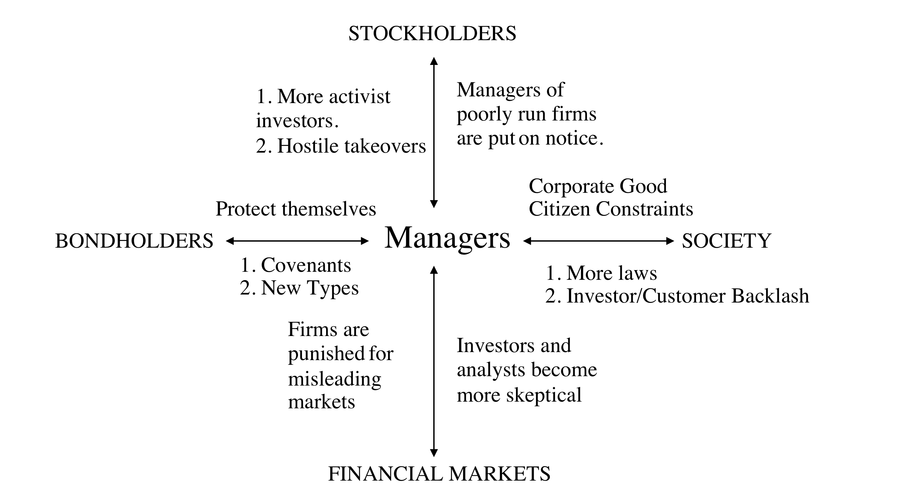
III. A Market Based Solution

Slide 8
Disney: Eisner’s rise & fall from grace
The Early Years: In his early years, Michael Eisner brought about long-delayed changes in the company and his success allowed him to consolidate power.
The ABC Deal & Unraveling: In 1996, Eisner spearheaded the push to buy ABC and the board rubberstamped his decision. In the years following, troubles at its ABC acquisition and other operations and stockholders started to get restive, especially as the stock price halved between 1998 and 2002.
The Blowback
  In 2003, Roy Disney and Stanley Gold resigned from the Disney board, arguing against Eisner’s autocratic style.
  In early 2004, Comcast made a hostile bid for Disney and later in the year, 43% of Disney shareholders withheld their votes for Eisner’s reelection to the board of directors.
  Following that vote, the board of directors at Disney voted unanimously to elect George Mitchell as the Chair of the board, replacing Eisner, who vowed to stay on as CEO. In October 2005, Eisner stepped down as CEO, to be replaced by Bob Iger.
Notes:
Eisner was a good CEO when he came into Disney, partly because it was a company badly in need of change and partly because he had a solid COO in Frank Wells, who acted as a counterweight. Two things changed in the 1990s. The first was that Eisner was successful, and the ego boost that he received was the basis for acquiring more power (a compliant board). The second was that Frank Wells dies in an air accident, leaving Eisner as the imperial CEO. Power corrupts and absolute power does so absolutely.
As long as Disney was doing well, though, shareholders were willing to cut Eisner slack. However a bad acquisition followed by under performance (share prices and earnings) gradually ate away that support, until you get to the tipping point which in this case were the resignations and the hostile acquisition bid.

Slide 9

A Market Solution: Eisner’s exit… and a new age dawns? Disney’s board in 2008
Notes:
The changes made by Eisner were too little.. Too late,,, and he was forced to leave in 2005, His successor, Bob Iger, has made a break from the past. Note the differences between the board in 2008 and the one in 2004:
It is smaller, 12 members instead of 18.
There is little overlap between this board and the 2003 board, reflecting the fact that this is now Iger’s board and not Eisner’s board.
The directors with the most obvious conflicts of interests are gone.
The question, though, is an open one. As Iger becomes entrenched as CEO, will be find directors who are beholden to him?

Slide 10
But as a CEO’s tenure lengthens, does corporate governance suffer?
Little board turnover: While the board size has stayed compact (at twelve members), there has been only one change since 2008, with Sheryl Sandberg, COO of Facebook, replacing the deceased Steve Jobs.
CEO & Chair: The board voted reinstate Iger as chair of the board in 2011, reversing a decision made to separate the positions after the Eisner years.
Step Down & Reversal: In 2011, Iger announced his intent to step down as CEO in 2015 but Disney’s board convinced Iger to stay on as CEO for an extra year, for the “the good of the company”.
Investor unrest? There were signs of restiveness among Disney’s stockholders, especially those interested in corporate governance. Activist investors (CalSTRS) starting making noise and Institutional Shareholder Services (ISS) raised red flags about compensation and board monitoring at Disney.
Notes:
The longer the tenure of a CEO, the more power he or she accumulates. Perhaps, we need term limits for CEOs.

Slide 11

Task
Based on it’s actions, assess your company’s objective
Read
Chapter 2

