Slide 1
Numbers AND NARRATIVE: MODELING, STORY TELLING AND INVESTING
Aswath Damodaran

Slide 2
The Bermuda Triangle of Valuation
Valuation First Principles & Good Sense
Bias & Preconceptions
Complexity & Detail
Uncertainty & the Unknown

Slide 3
Value: The Drivers

Slide 4
What are you?
If you were asked to categorize yourself, would you more naturally think of yourself as a
  Numbers Person
  Story Person
  Not sure
When did you make this decision and how has it affected your educational and career choices?
At your current job or position, do you find yourself hanging out with people who are like you (in inclination and training)?

Slide 5

Bridging the Gap

Slide 6
The Corporate Life Cycle

Slide 7
A Life Cycle View of Uncertainty

Slide 8
In value, the emphasis shifts as well, from narrative to numbers…

Slide 9
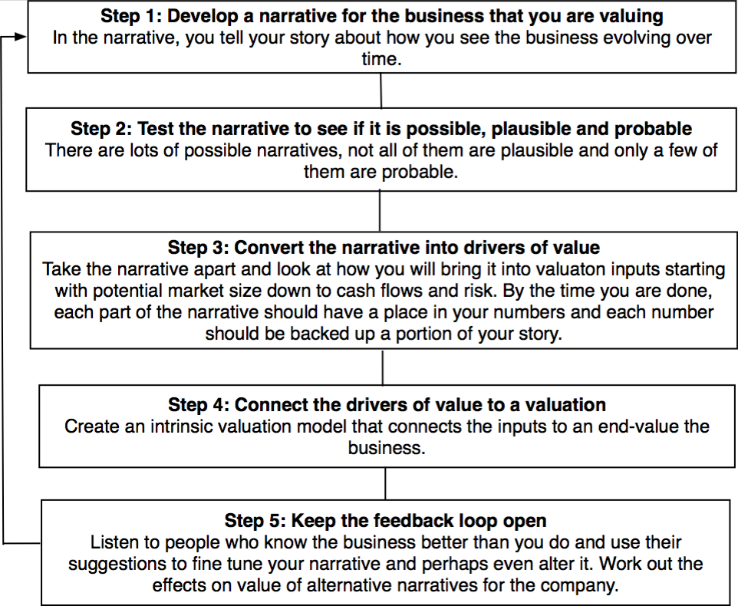
The Steps

Slide 10
Step 1a: Survey the landscape
Every valuation starts with a narrative, a story that you see unfolding for your company in the future.
In developing this narrative, you will be making assessments of
  Your company (its products, its management and its history.
  The market or markets that you see it growing in.
  The competition it faces and will face.
  The macro environment in which it operates.

Slide 11
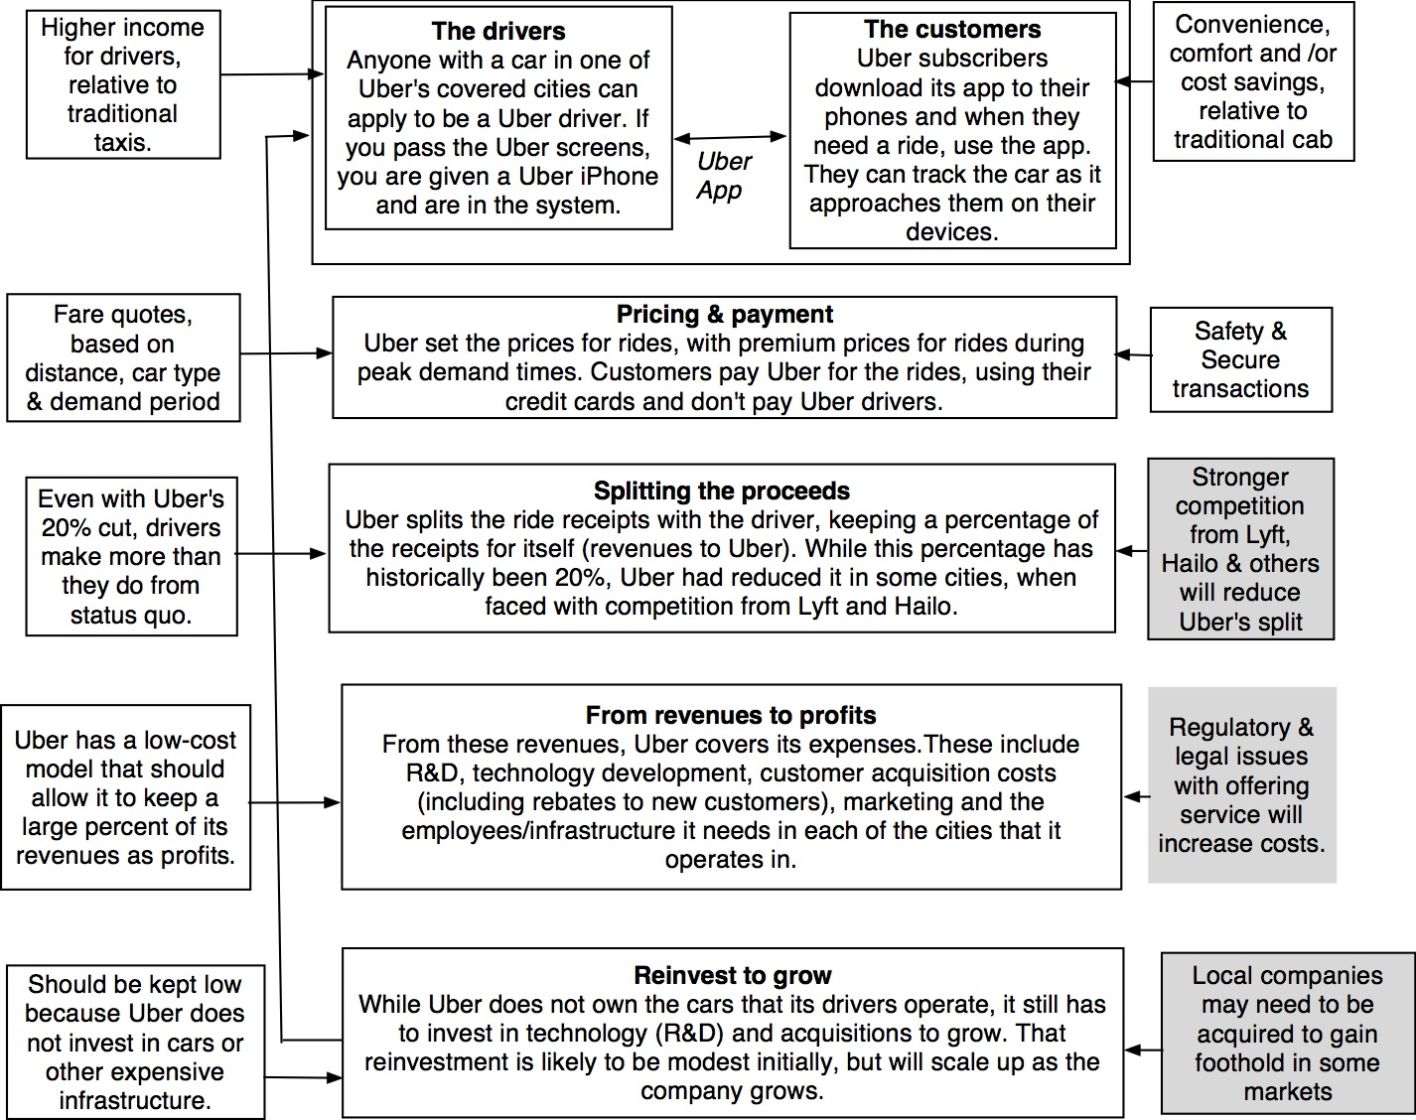
Understanding Uber in 2014

Slide 12
Step 1b: Create a narrative for the future
Every valuation starts with a narrative, a story that you see unfolding for your company in the future.
In developing this narrative, you will be making assessments of your company (its products, its management), the market or markets that you see it growing in, the competition it faces and will face and the macro environment in which it operates.
  Rule 1: Keep it simple.
  Rule 2: Keep it focused.

Slide 13
The Uber Narrative: An Urban, Car Service disruptor
In June 2014, my initial narrative for Uber was that it would be
An urban car service business: I saw Uber primarily as a force in urban areas and only in the car service business.
Which would expand the business moderately (about 40% over ten years) by bringing in new users.
With local networking benefits: If Uber becomes large enough in any city, it will quickly become larger, but that will be of little help when it enters a new city.
Maintain its revenue sharing (20%) system due to strong competitive advantages (from being a first mover).
And its existing low-capital business model, with drivers as contractors and very little investment in infrastructure.

Slide 14
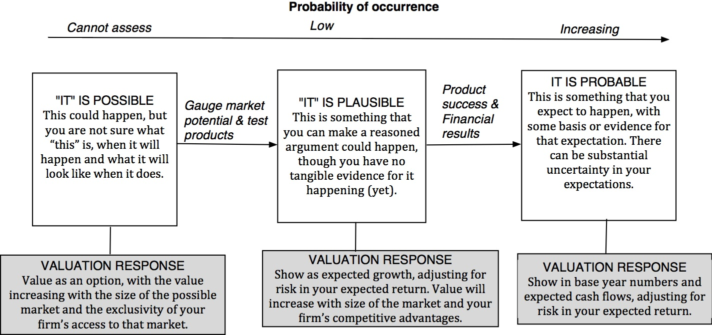
Step 2: Check the narrative against history, economic first principles & common sense

Slide 15
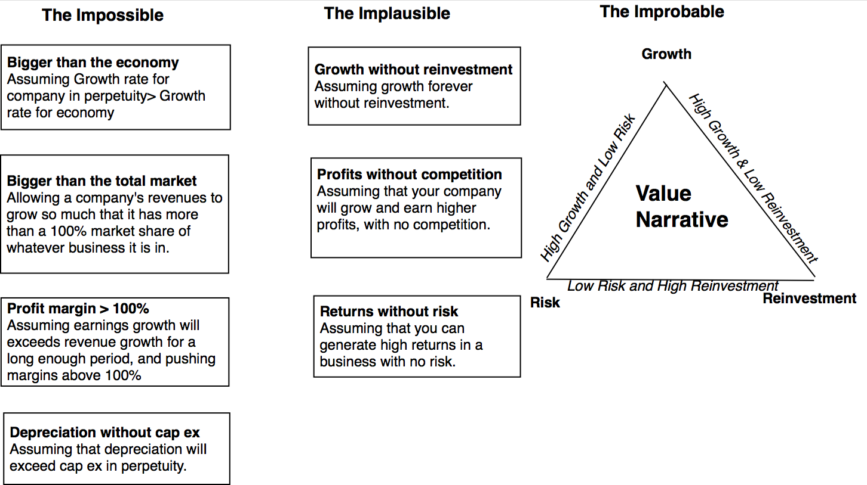
The Impossible, The Implausible and the Improbable

Slide 16
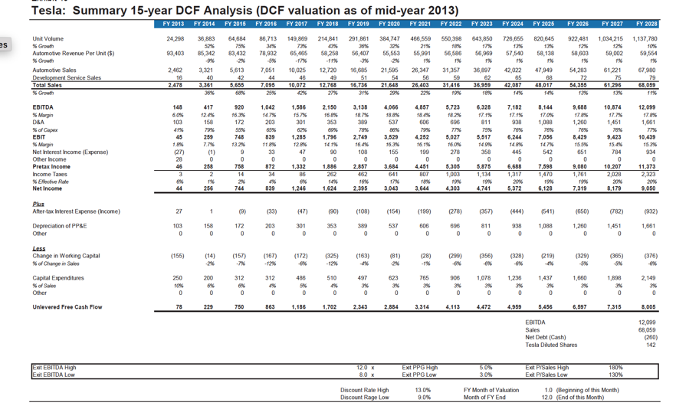
The Improbable: Willy Wonkitis

Slide 17
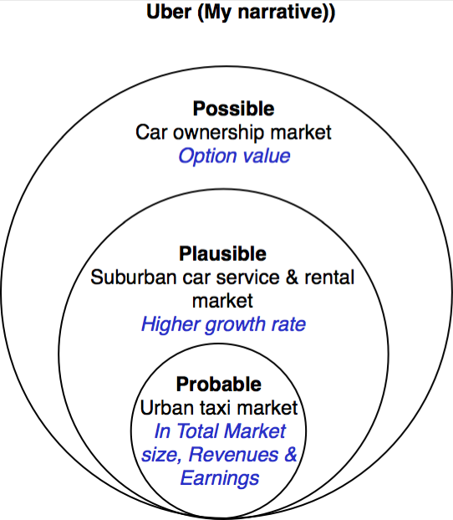
Uber: Possible, Plausible and Probable
The larger & more ambitious your story, the more onus there is on you to show that it is possible, plausible & probable.

Slide 18
The Runaway Story: When you want a story to be true…
With a runaway business story, you usually have three ingredients:
  Charismatic, likeable Narrator: The narrator of the business story is someone that you want to see succeed, either because you like the narrator or because he/she will be a good role model.
  Telling a story about disrupting a much business, where you dislike the status quo: The status quo in the business that the story is disrupting is dissatisfying (to everyone involved)>
  With a societal benefit as bonus: And if the story holds, society and humanity will benefit.
Since you want this story to work out, you stop asking questions, because the answers may put the story at risk.

Slide 19
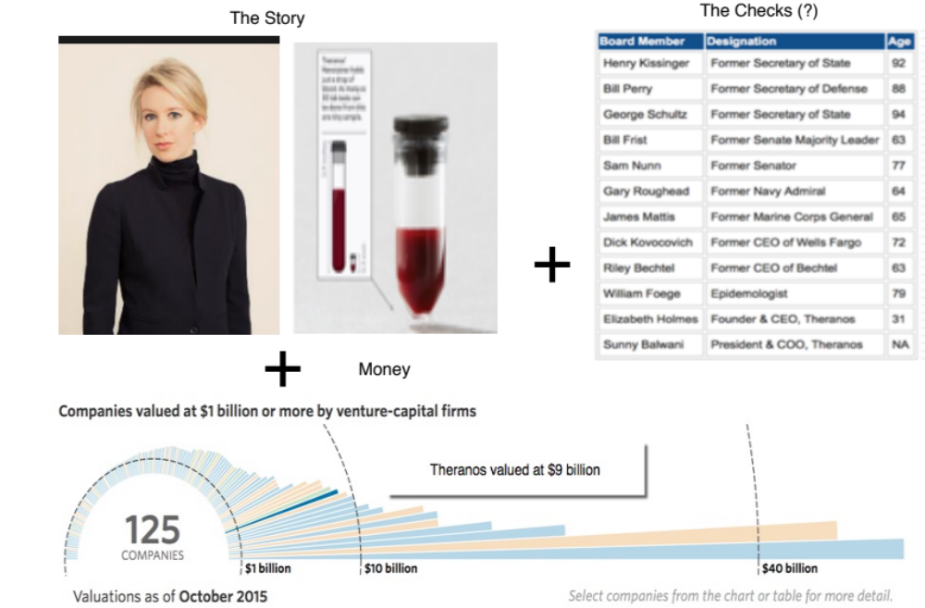
The Impossible: The Runaway Story

Slide 20
Step 4a: Connect your narrative to key drivers of value

Slide 21
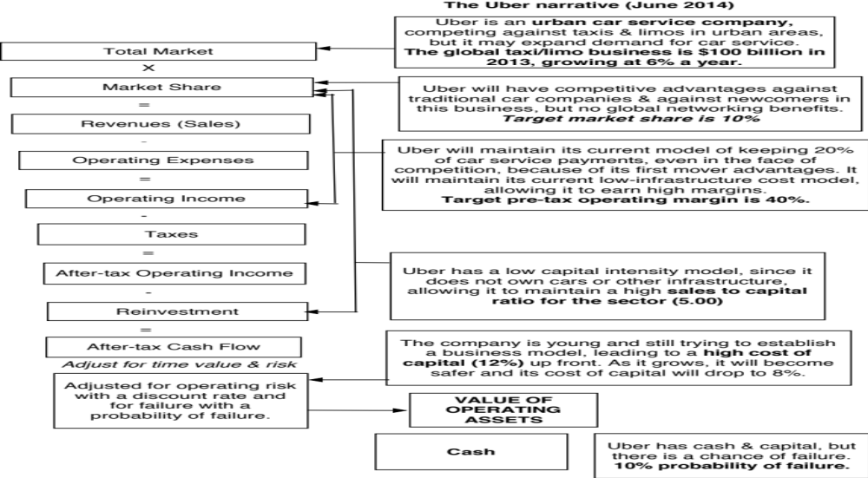
The Uber Link

Slide 22
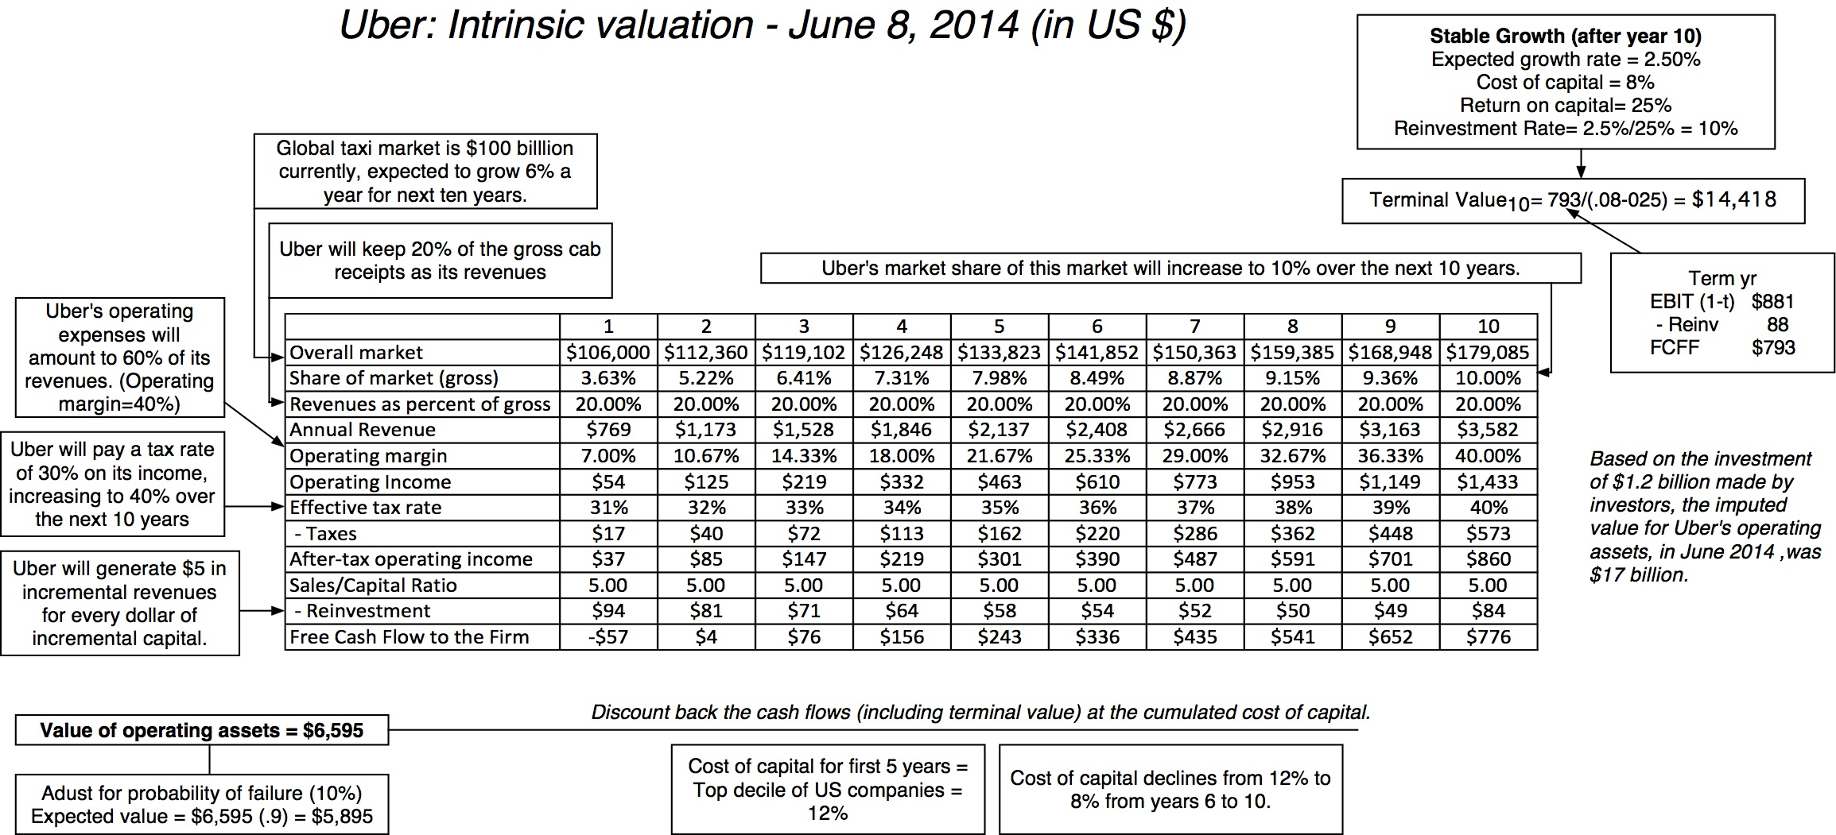
Step 4b: Value the company (Uber)

Slide 23
Step 5: Keep the feedback loop open
When you tell a story about a company (either explicitly or implicitly), it is natural to feel attached to that story and to defend it against all attacks. Nothing can destroy an investor more than hubris.
Being open to other views about a company is not easy, but here are some suggestions that may help:
  Face up to the uncertainty in your own estimates of value.
  Present the valuation to people who don’t think like you do.
  Create a process where people who disagree with you the most have a say.
  Provide a structure where the criticisms can be specific and pointed, rather than general.

Slide 24
The Uber Feedback Loop: Bill Gurley
Not just car service company.: Uber is a car company, not just a car service company, and there may be a day when consumers will subscribe to a Uber service, rather than own their own cars. It could also expand into logistics, i.e., moving and transportation businesses.
Not just urban: Uber can create new demands for car service in parts of the country where taxis are not used (suburbia, small towns).
Global networking benefits: By linking with technology and credit card companies, Uber can have global networking benefits.

Slide 25
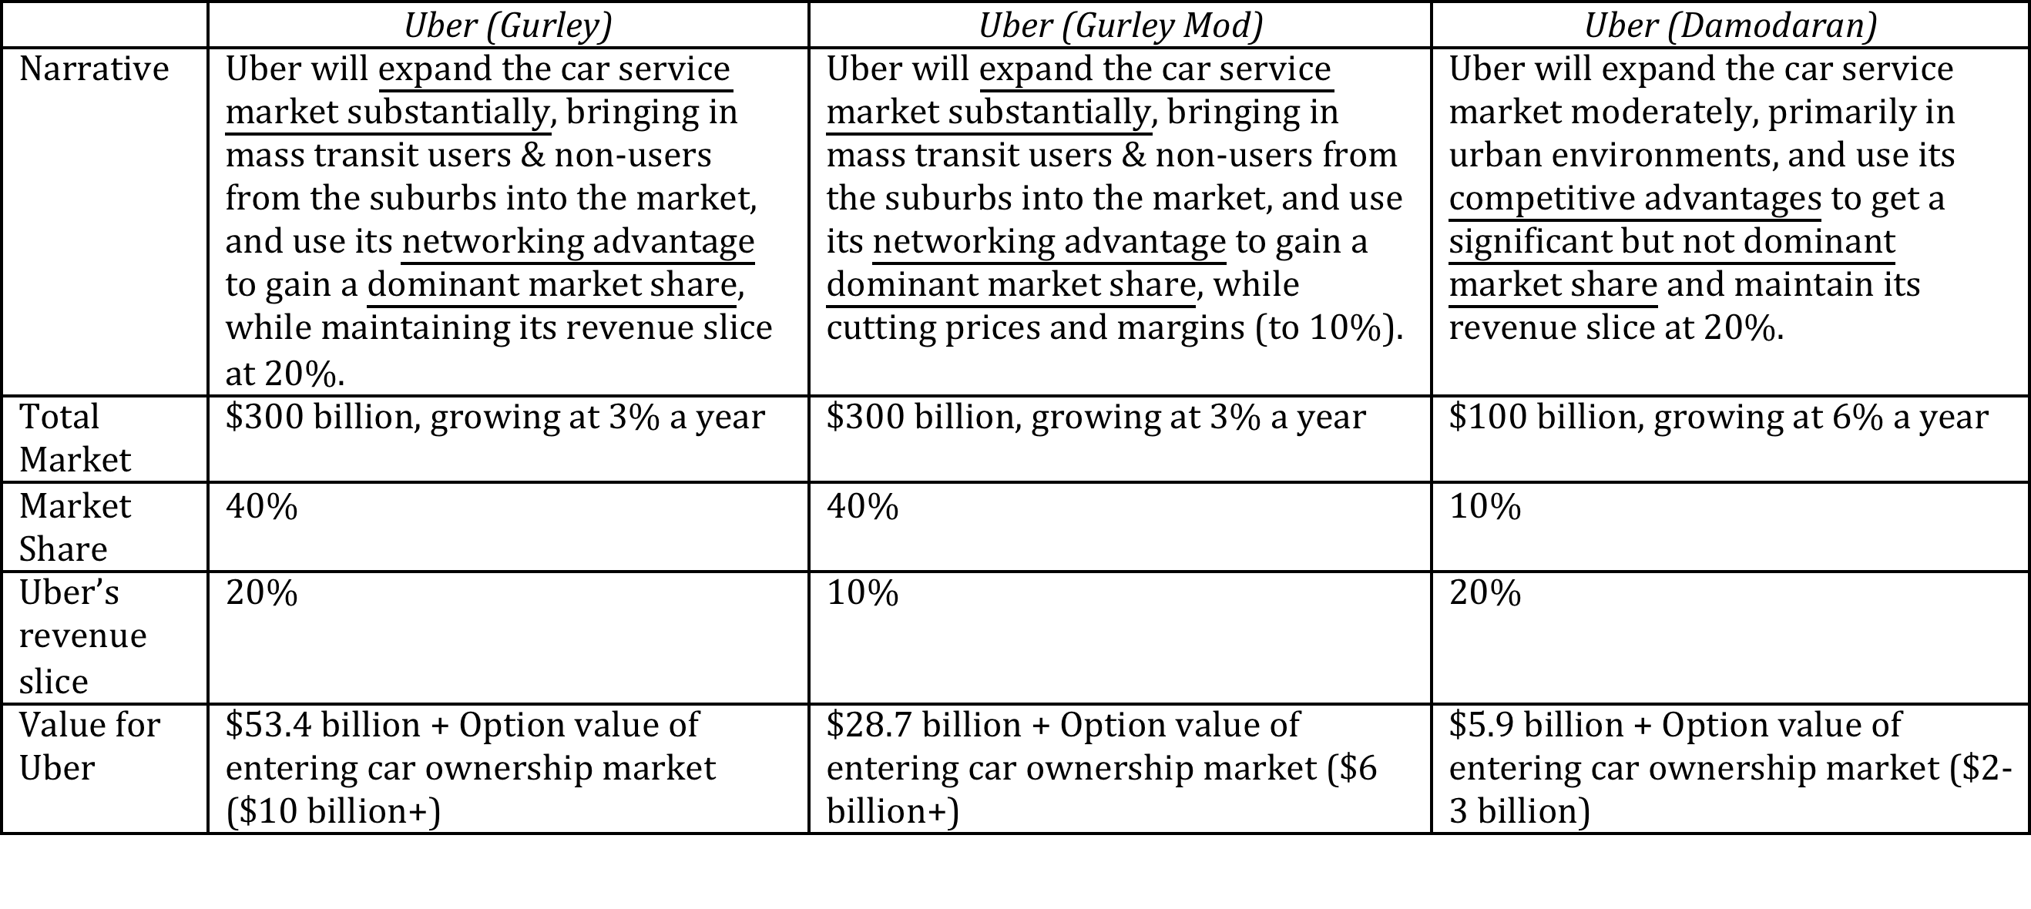
Valuing Bill Gurley’s Uber narrative

Slide 26
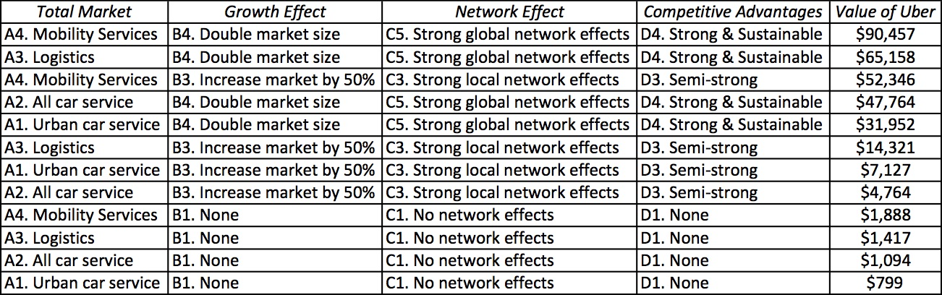
Different narratives, Different Numbers

Slide 27
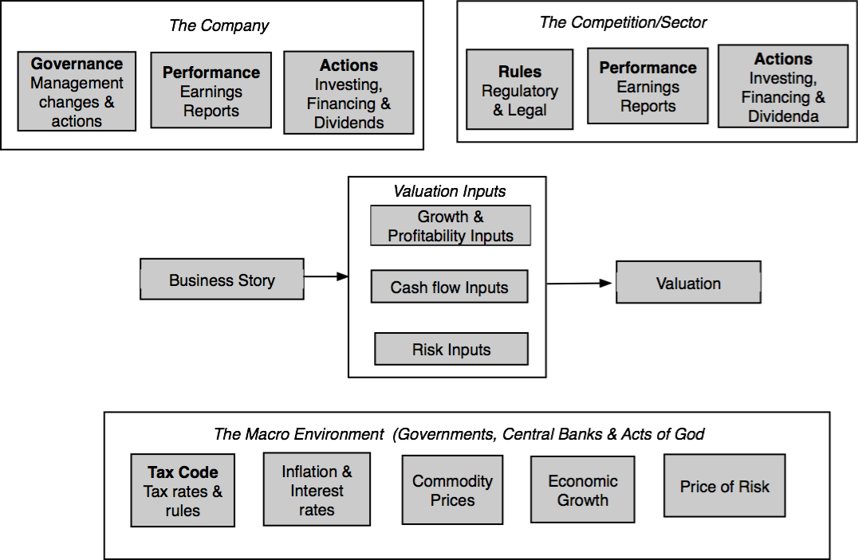
Why narratives change

Slide 28
How narratives change
Narrative Break/End | Narrative Shift | Narrative Change (Expansion or Contraction)
Events, external (legal, political or economic) or internal (management, competitive, default), that can cause the narrative to break or end. | Improvement or deterioration in initial business model, changing market size, market share and/or profitability. | Unexpected entry/success in a new market or unexpected exit/failure in an existing market.
Your valuation estimates (cash flows, risk, growth & value) are no longer operative | Your valuation estimates will have to be modified to reflect the new data about the company. | Valuation estimates have to be redone with new overall market potential and characteristics.
Estimate a probability that it will occur & consequences | Monte Carlo simulations or scenario analysis | Real Options

Slide 29
The End
“There is no real ending. It’s just the place where you stop the story.”

