Slide 1
Numbers AND NARRATIVE: MODELING, STORY TELLING AND INVESTING
Aswath Damodaran

Slide 2
Intrinsic Valuation 101

Slide 3
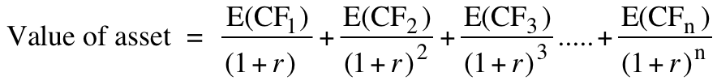
DCF: Unraveling the Mysteries
The value of a risky asset can be estimated by discounting the expected cash flows on the asset over its life at a risk-adjusted discount rate:
The IT Proposition: If “it” does not affect the cash flows or alter risk (thus changing discount rates), “it” cannot affect value.
The DUH Proposition: For an asset to have value, the expected cash flows have to be positive some time over the life of the asset.
The DON’T FREAK OUT Proposition: Assets that generate cash flows early in their life will be worth more than assets that generate cash flows later; the latter may however have greater growth and higher cash flows to compensate.

Slide 4
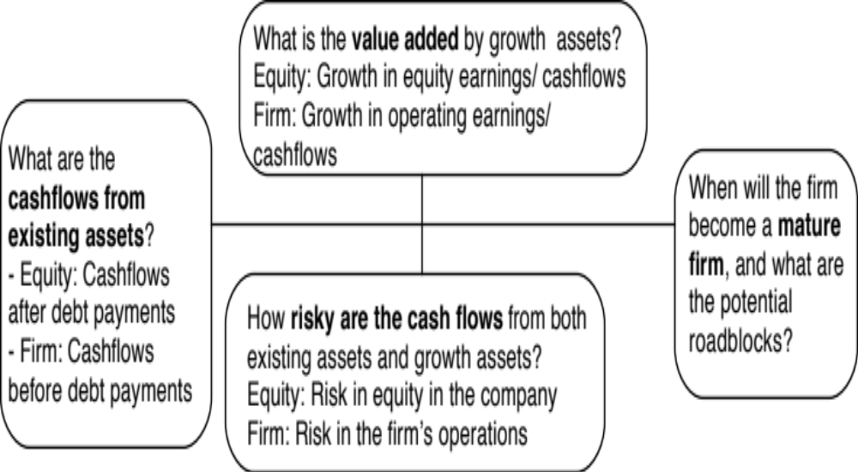
The Key Questions in valuation…
Notes:
The four pillars of value:
Cashflows
Potential for high growth
Length of the high growth period (before the firm starts growing at the same rate as the economy)
Discount rate
Note the variations and the need for consistency:
With equity -> Cashflows to equity - > Growth rate in net income -> Discount at the cost of equity
With firm -> Cashflows to firm - > Growth rate in operating income -> Discount at the cost of capital

Slide 5
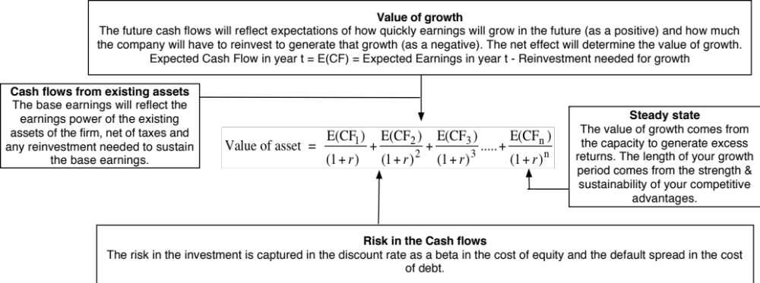
DCF as a tool for intrinsic valuation
Notes:
Cash is king. A firm with negative cash flows today can be a very valuable firm but only if there is reason to believe that cash flows in the future will be large enough to compensate for the negative cash flows today. The riskier a firm and the longer you have to wait for the cash flows, the greater the cashflows eventually have to be….

Slide 6
The Basics of Value

Slide 7
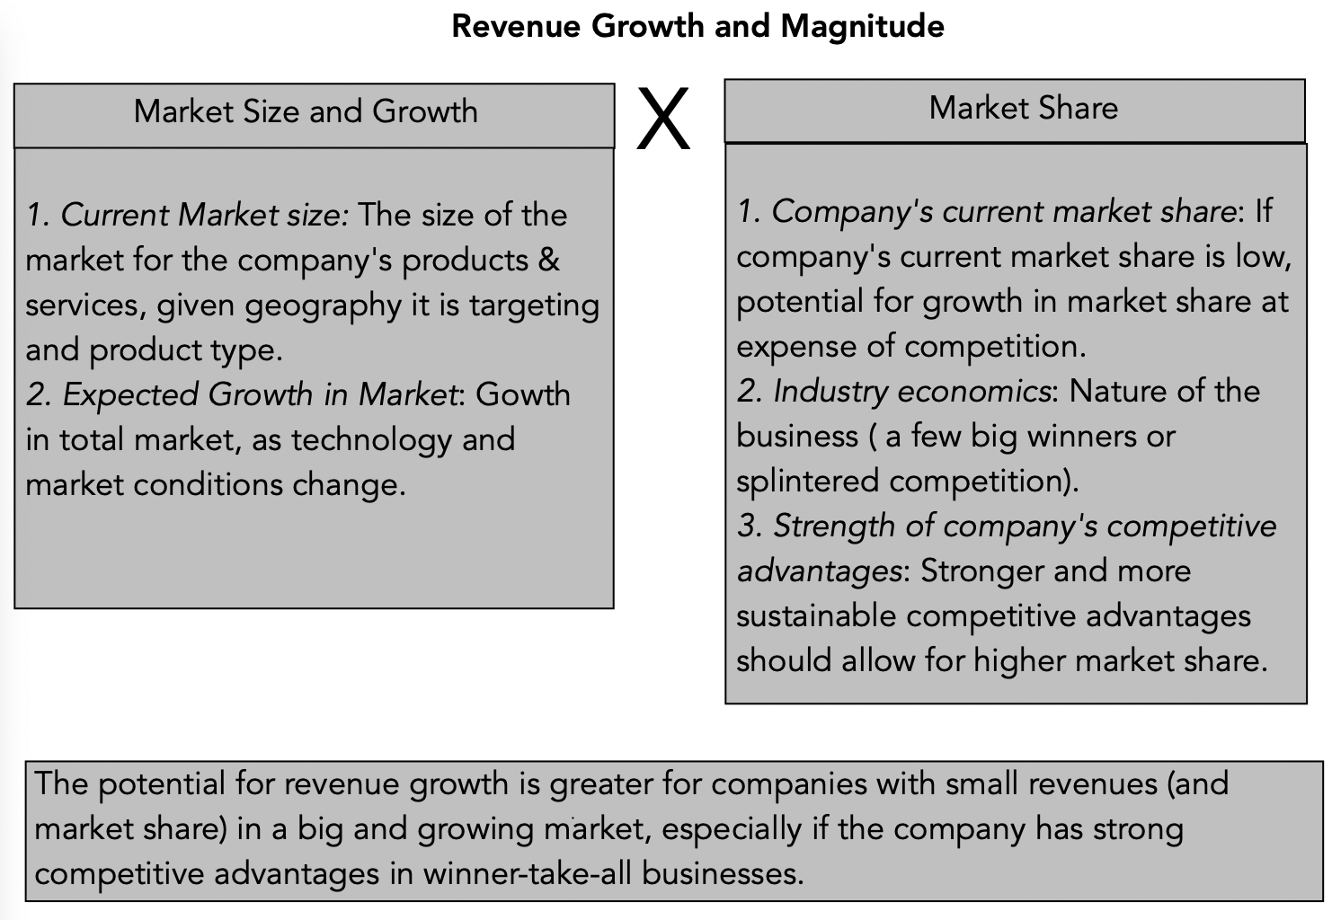
1. Revenue Growth
Notes:
To estimate revenue growth at a company, you need to assess the total market that the company’s products or services are targeted at. That market can be small or large, depending upon:
Niche or mass market product: A product or service designed for a broader swathe of customers will have a larger potential market than one designed for a niche of the market. (A mass market auto company will have a bigger total market than a luxury auto company)
Market dynamics: If the market is itself growing, either because customer tastes are evolving (ridesharing and the car service market) or because technology is altering the market structure (online advertising versus traditional advertising), that growth can help the company grow as well.
Companies with larger total markets, holding all else constant, have higher potential value and this is leading to some game playing on the part of young companies that claim absurdly large total addressable markets (TAM) when they seek out investors. (Uber claimed a total addressable market of $5.2 trillion when they went public, obtained by adding up everything that everyone was spending on transportation and transit).
The other part of the equation is market share, with companies that have smaller market share having the potential for growth from increasing market share. The end market share of a company will be determined not only by its competitive advantages and access to capital/technology but also by the economics of the industry. In online advertising, for instance, the “networking benefits” of being a larger company creates winner-take-all markets, dominated by two or three players, with each holding a bigger market share.

Slide 8
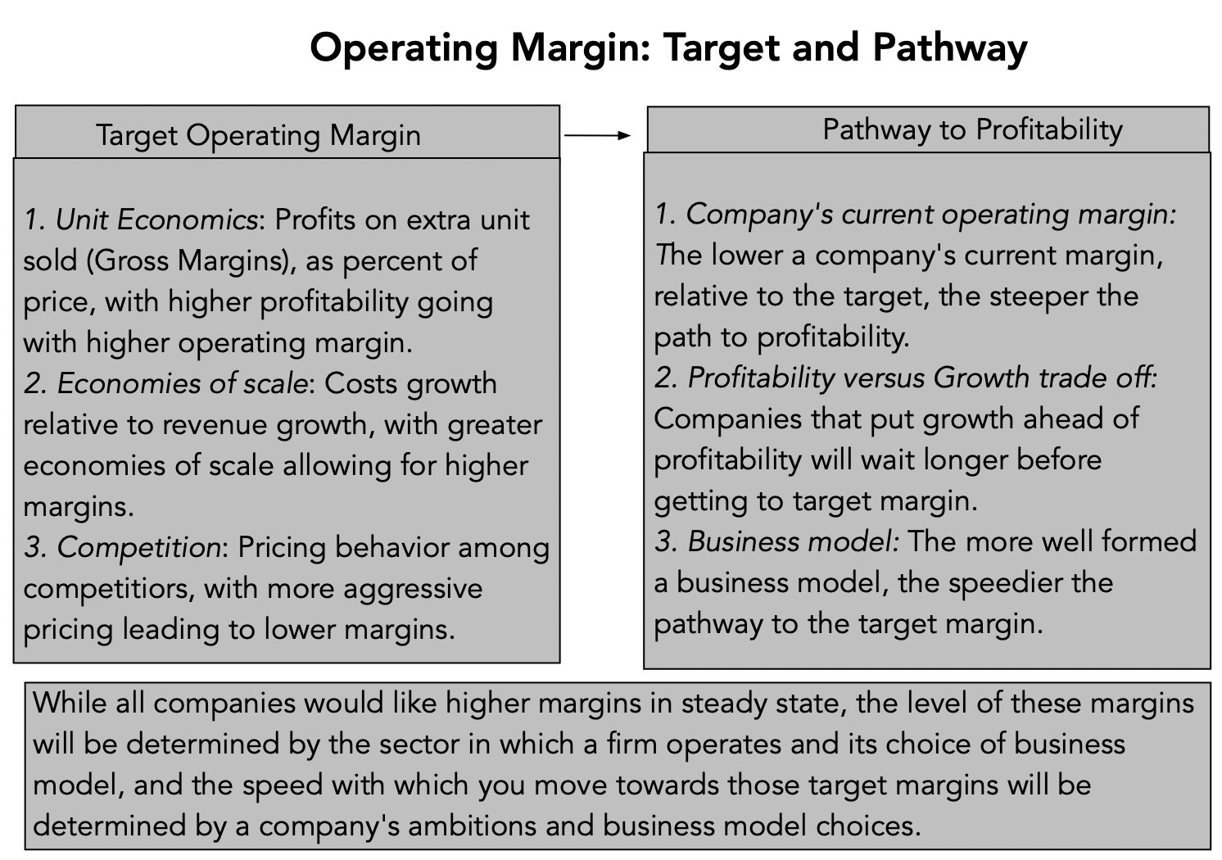
2. Target Margins (and path there)…
Notes:
To measure the factors driving target operating margin, consider these:
1. Unit economics: Look at the costs of producing the extra unit, with higher gross margins going with better unit economics.
2. Economies of scale: Look at how quickly revenues have grown, relative to big cost items (including SG &A) to gauge the strength of economies of scale. If costs are growing at the same rate as revenues, it puts a dent in the economies of scale argument.
3. Pricing pressures: Look at whether prices are rising or falling, and if they are falling, why…
The pathway to profitability is a function of the business a company is in, but it is also determined by whether the company is prioritizing building a business model and making trade offs to at least consider profitability. Growth-minded businesses can often ignore both these actions and end up losing more money for longer periods.

Slide 9
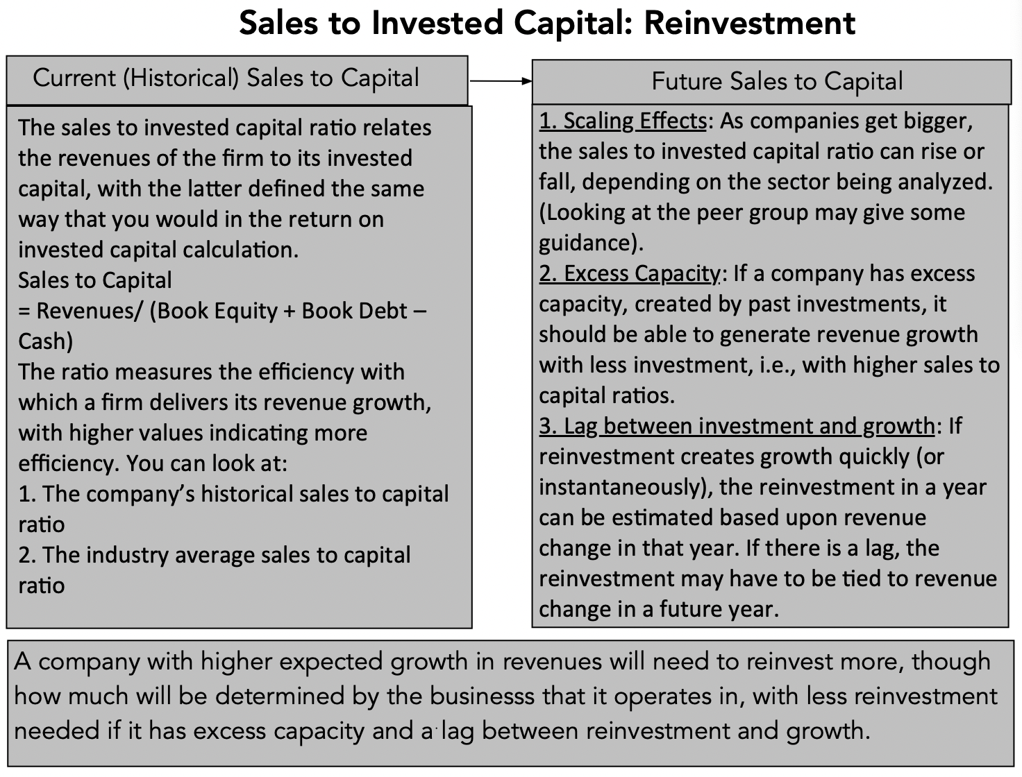
3. Sales to Invested Capital: A Pathway to estimating Reinvestment
Notes:
The sales to invested capital is a proxy for the efficiency with which a company delivers growth, with higher sales to capital ratios indicating more efficiency. It is worth remembering that the sales to capital ratio that you are trying to estimate is in the future (rather than in the past) and is a marginal (rather than an aggregate number). Put simply, the sales to capital ratio that you estimate for next year reflects the investment you will need to make next year for the change in revenue you are estimating in that year. That is why having excess capacity can give you breathing room to estimate much less reinvestment (higher sales to capital) until you catch up.

Slide 10
Left brain or right brain?

Slide 11
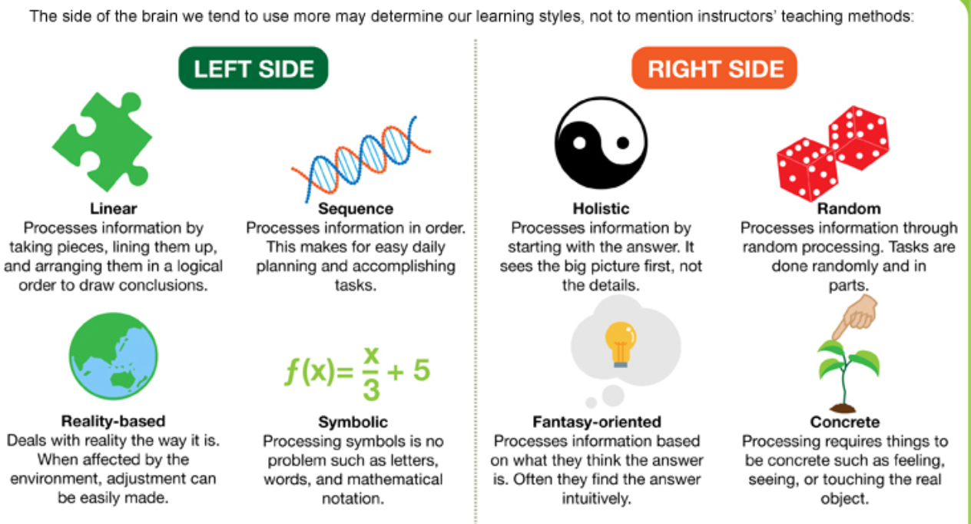
Left Brain or Right Brain?

Slide 12
The delusions of the number crunchers
The illusion of precision: If you use numbers, you are being more precise than when you don’t, and the more numbers you use, the more precise you become.
The illusion of “no bias”: Numbers don’t lie and data does not have an agenda. Thus, analysts who use numbers are more likely to be unbiased.
The illusion of control: If you put a number on something (your cash flows, expected growth rate, risk etc.), you can control it better.

Slide 13
The delusions of the story tellers
Number crunchers don’t dream in technicolour: Creativity and Numbers are mutually exclusive. If you talk about numbers, you cannot be creative, and if you are being creative, talk about numbers only crimps your creative instincts.
Creativity is deserving of reward: If your story is good, your business will success and your investment will pay off.
Experience is the best teacher: If you have pulled this off before (started and succeeded at running a business), your story is more believable.

Slide 14
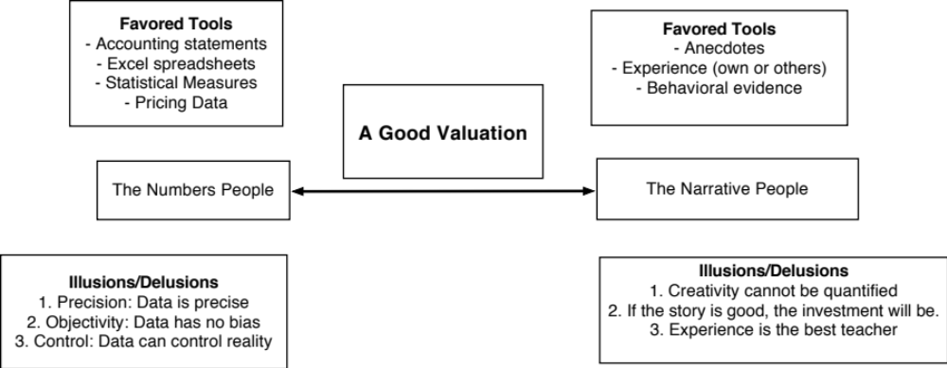
Valuation as a Bridge

Slide 15
The Corporate Life Cycle

Slide 16
In value, the emphasis shifts as well, from narrative to numbers…

Slide 17
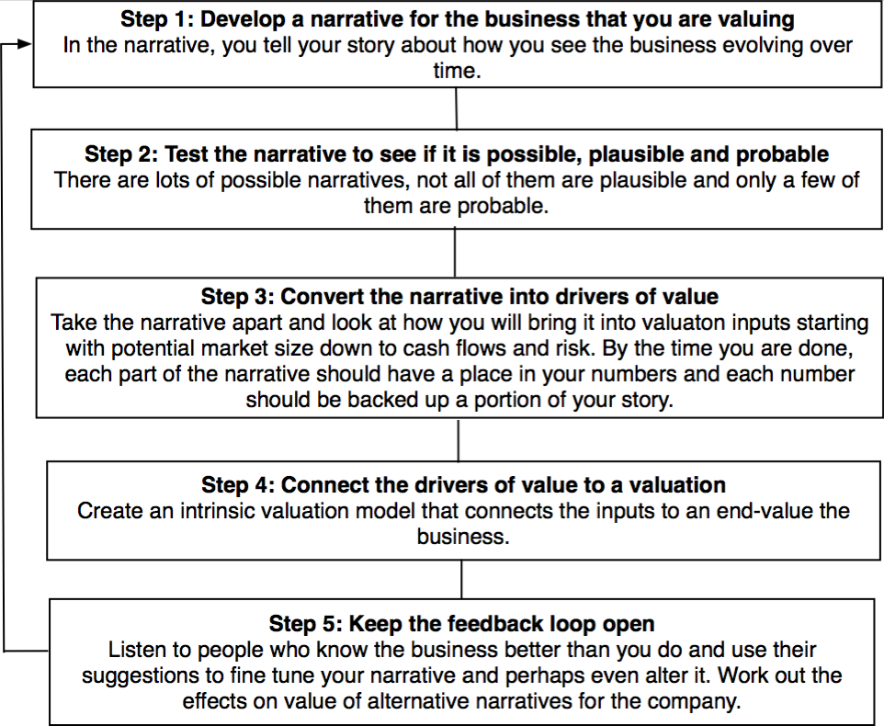
From Stories to Numbers: The Steps

Slide 18
Step 1a: Survey the landscape
Every valuation starts with a narrative, a story that you see unfolding for your company in the future.
In developing this narrative, you will be making assessments of
  Your company (its products, its management and its history.
  The market or markets that you see it growing in.
  The competition it faces and will face.
  The macro environment in which it operates.

Slide 19
The Landscape?
Total Market: The first step in valuing a business is sizing the market, and while acronyms about, this requires understanding what products or services you offer, and what business you are in.
Taking stock: The second step is assessing how this market is growing and how it is structured. In particular,
  Is it a market that is splintered or prone to consolidation?
  Who are your competitors in this market?
Your company’s standing: Where does your company stand in this market?
  If you have historical data, look at growth & profitability trends
  If not, make an assessment anyway…

Slide 20
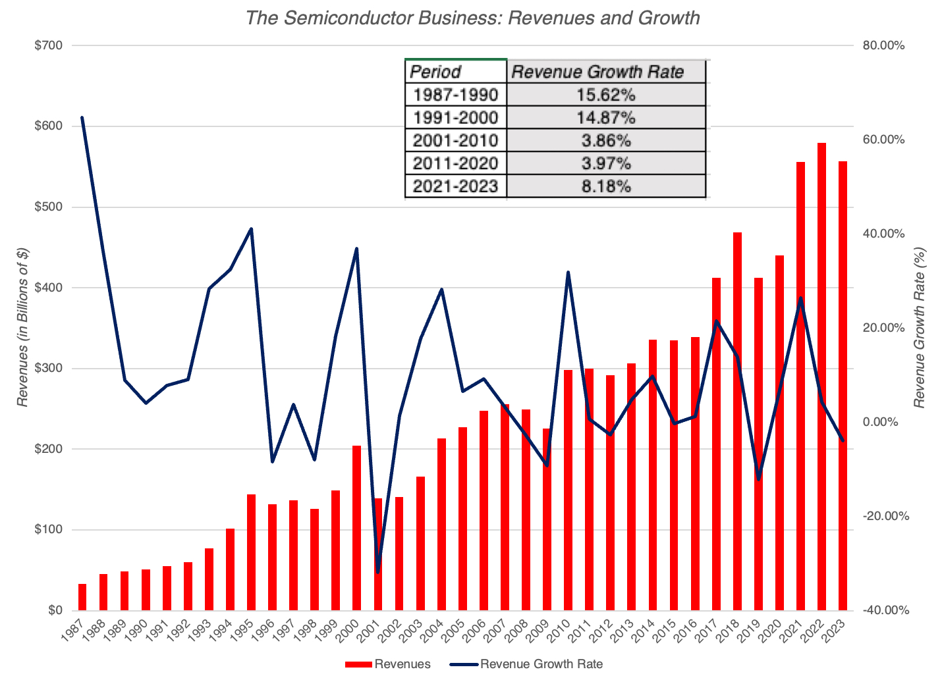
The Semiconductor Business – A Growth Business that is maturing!

Slide 21
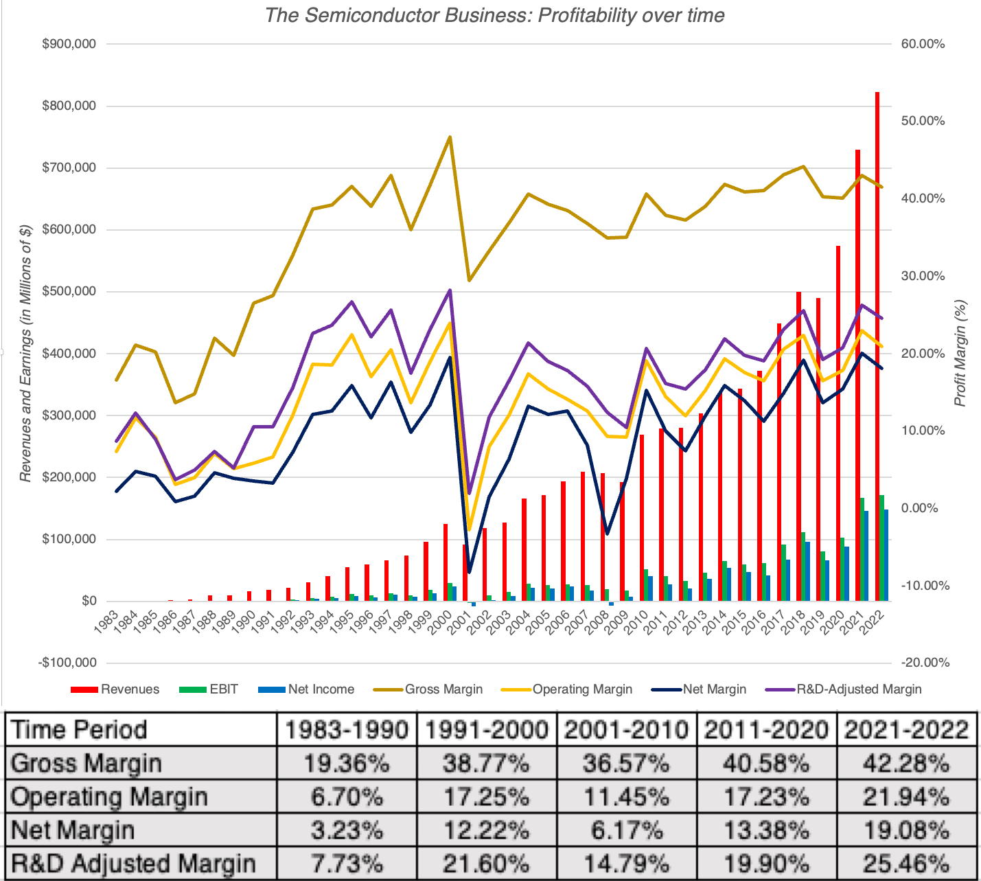
Profitable, with Cycles….

Slide 22
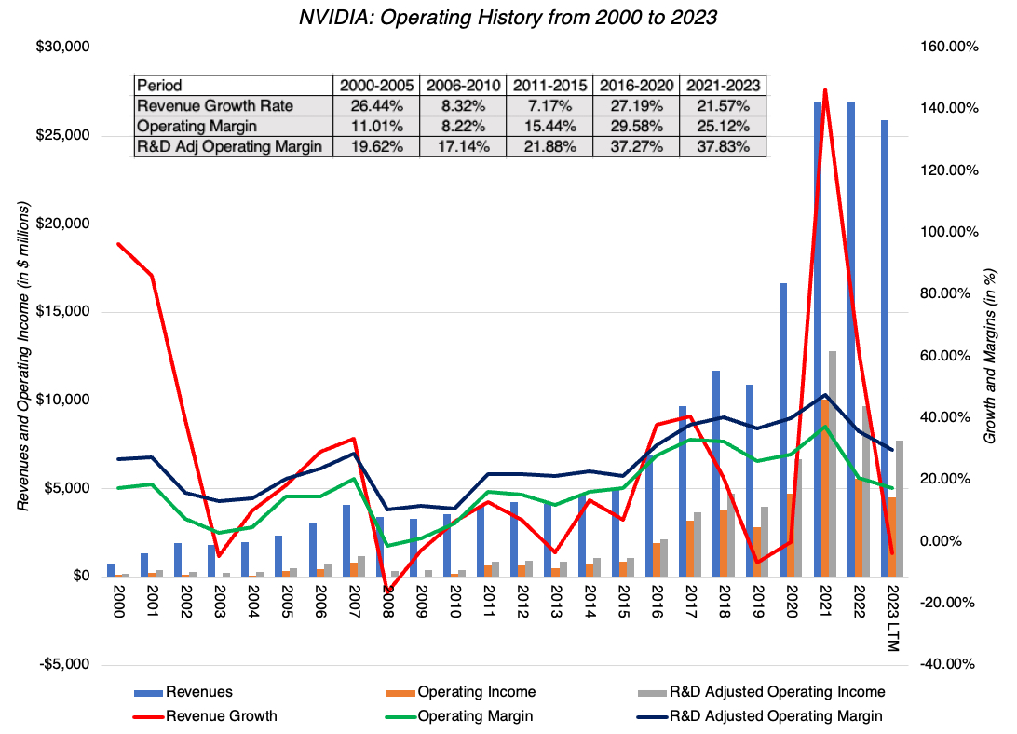
NVIDIA - Opportunistic Growth

Slide 23
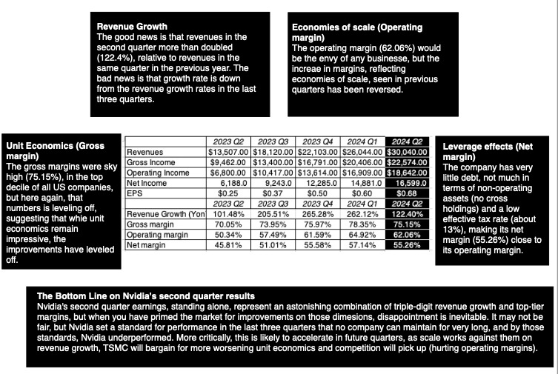
An Earnings Report in 2024: And data updates…

Slide 24
Step 1b: Create a narrative for the future
Every valuation starts with a narrative, a story that you see unfolding for your company in the future.
In developing this narrative, you will be making assessments of your company (its products, its management), the market or markets that you see it growing in, the competition it faces and will face and the macro environment in which it operates.
  Rule 1: Keep it simple.
  Rule 2: Keep it focused.

Slide 25
Business story basics
A good business story is not a list of bullet points, but a narrative of what you do as a business, the (unmet or under-met) need that you are filling and why you can monetize that need.
A good business story is not filled with details and buzzwords that only business insiders understand, but is understandable to someone who is a novice to this business.
A good business story has a hook, something that makes people not only remember you, but understand your actions as a business.
A good business story is bounded – by the realities of natural and economic laws.

Slide 26
NVIDIA: The Payoff to Opportunism
Powered by its lead in the AI chip business, Nvidia will continue on its path of high growth, but even with dominance, that growth will level off. While Nvidia might find other new markets, none of them are likely to provide the market size to allow for continued growth.
As a design company, Nvidia will be able to generate supernormal profit margins. However, it will face push back from powerful players on the other side:
  On the unit economics side, Nvidia will have to share more of its spoils with TSMC, as the two are locked into an embrace that neither can break away from.
  On the customer side, Nvidia’s four biggest customers are giants themselves, and will either look to competition or develop their own chips, putting stress on pricing power.
On the reinvestment side, Nvidia will continue to reinvest in the next generations of chips, but in a market place where others are throwing large amounts of money at doing the same.

Slide 27
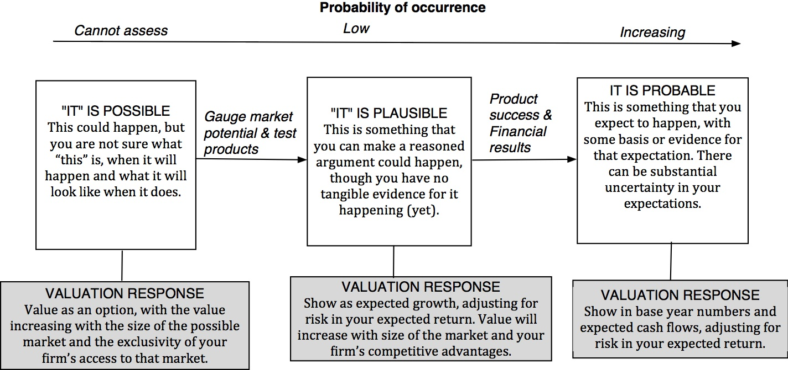
Step 2: Check the narrative against history, economic first principles & common sense

Slide 28
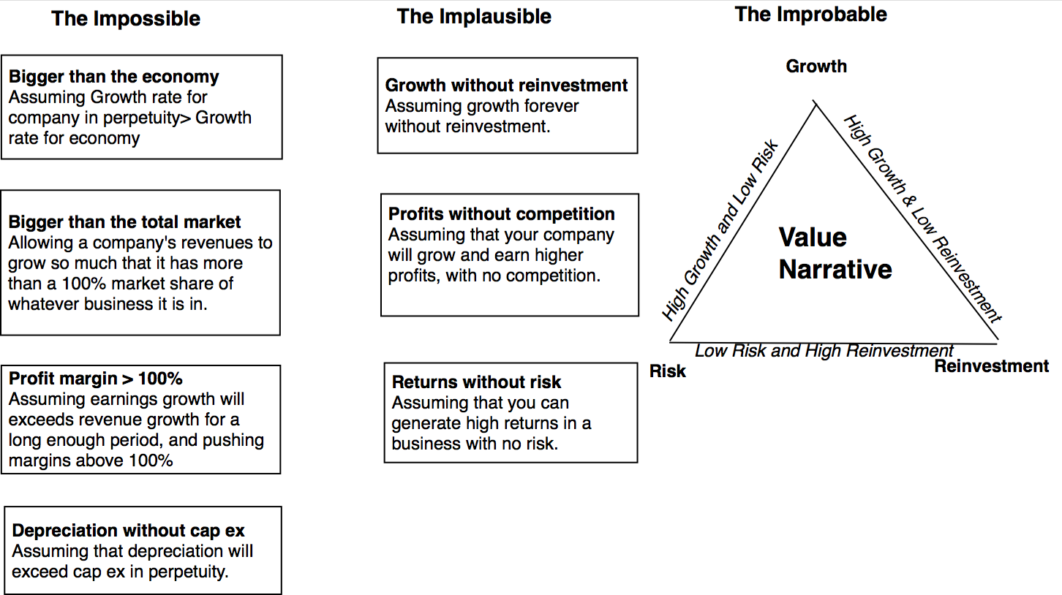
The Impossible, The Implausible and the Improbable

Slide 29
Nvidia: The 3P Test
The AI chip market will grow from $80 billion in 2024 to $500 billion in 2034.
  That would require that the AI product/service market be about $2.5 to $3 trillion.
  And that the infrastructure to build this market will be about 20% of total revenues
Nvidia will maintain a dominant market share (60%) of this market, down from its current 80%.
  Competitors will expend significant amounts of money, developing their own chips, but the first mover advantage will keep Nvidia at the top
Nvidia will remain a money-making machine, but its margins will come under pressure, from both its supplier (TSMC) side and consumers (big tech).

Slide 30
The Runaway Story: When you want a story to be true…
With a runaway business story, you usually have three ingredients:
  Charismatic, likeable Narrator: The narrator of the business story is someone that you want to see succeed, either because you like the narrator or because he/she will be a good role model.
  Telling a story about disrupting a much business, where you dislike the status quo: The status quo in the business that the story is disrupting is dissatisfying (to everyone involved)>
  With a societal benefit as bonus: And if the story holds, society and humanity will benefit.
Since you want this story to work out, you stop asking questions, because the answers may put the story at risk.

Slide 31
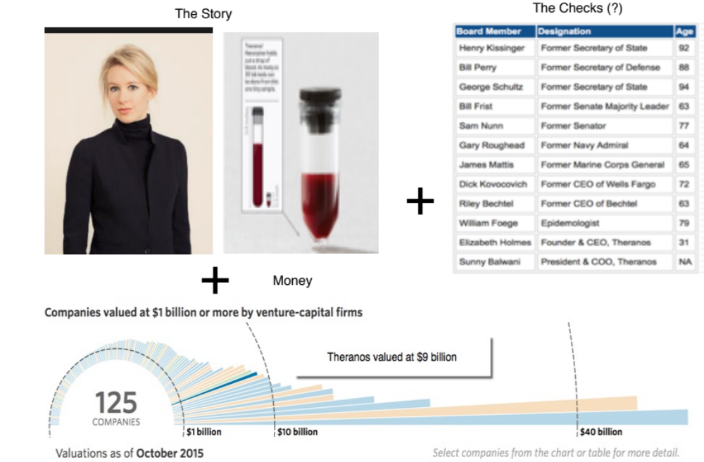
The Impossible: The Runaway Story

Slide 32
Step 3: Connect your story to value drivers
The “It” Proposition: If it does not affect the cash flows or the risk, it cannot affect value.
  If your storyline has heft, it should show up in one of the key value inputs.
  If you struggle with finding an input to change, your story is not complete (or may need revisiting).

Slide 33
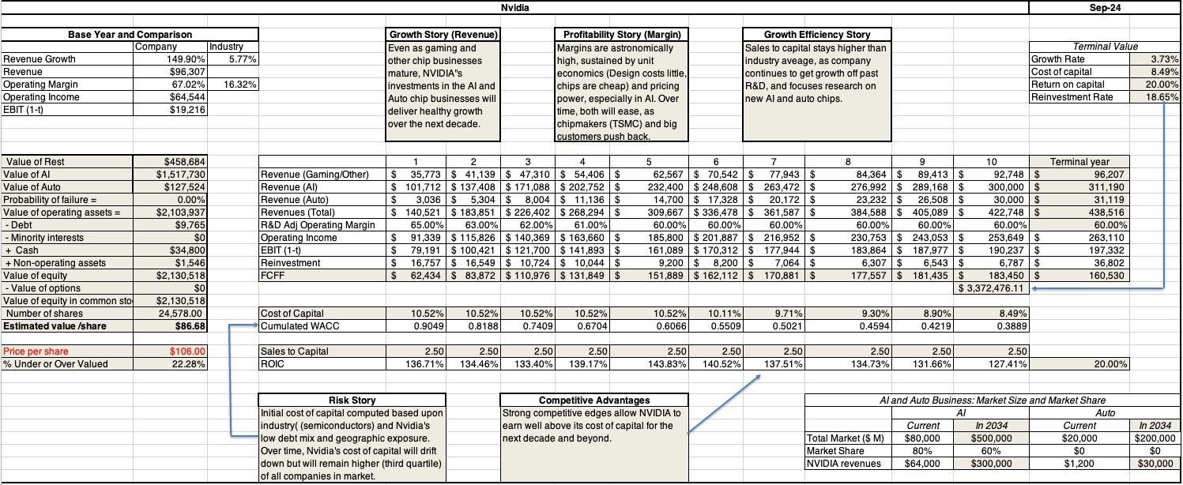
Step 4: Value the company – Nvidia in September 2024

Slide 34
Step 5: Keep the feedback loop open
When you tell a story about a company (either explicitly or implicitly), it is natural to feel attached to that story and to defend it against all attacks. Nothing can destroy an investor more than hubris.
Being open to other views about a company is not easy, but here are some suggestions that may help:
  Face up to the uncertainty in your own estimates of value.
  Present the valuation to people who don’t think like you do.
  Create a process where people who disagree with you the most have a say.
  Provide a structure where the criticisms can be specific and pointed, rather than general.

Slide 35
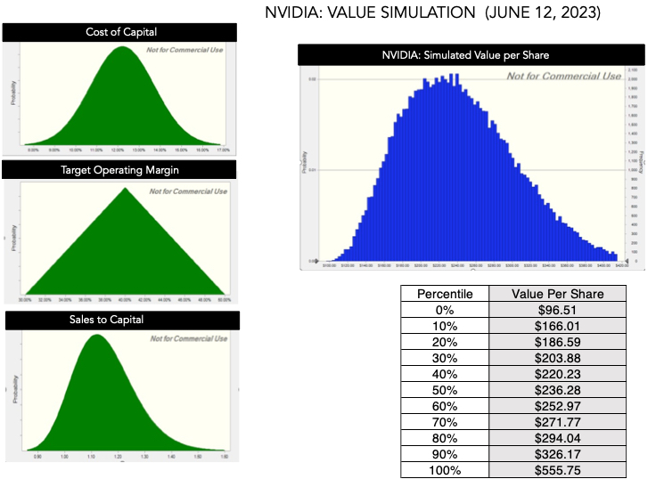
Face up to uncertainty…

Slide 36
Step 6: Recognize that narratives change
Narrative Break/End | Narrative Shift | Narrative Change (Expansion or Contraction)
Events, external (legal, political or economic) or internal (management, competitive, default), that can cause the narrative to break or end. | Improvement or deterioration in initial business model, changing market size, market share and/or profitability. | Unexpected entry/success in a new market or unexpected exit/failure in an existing market.
Your valuation estimates (cash flows, risk, growth & value) are no longer operative | Your valuation estimates will have to be modified to reflect the new data about the company. | Valuation estimates have to be redone with new overall market potential and characteristics.
Estimate a probability that it will occur & consequences | Monte Carlo simulations or scenario analysis | Real Options

Slide 37
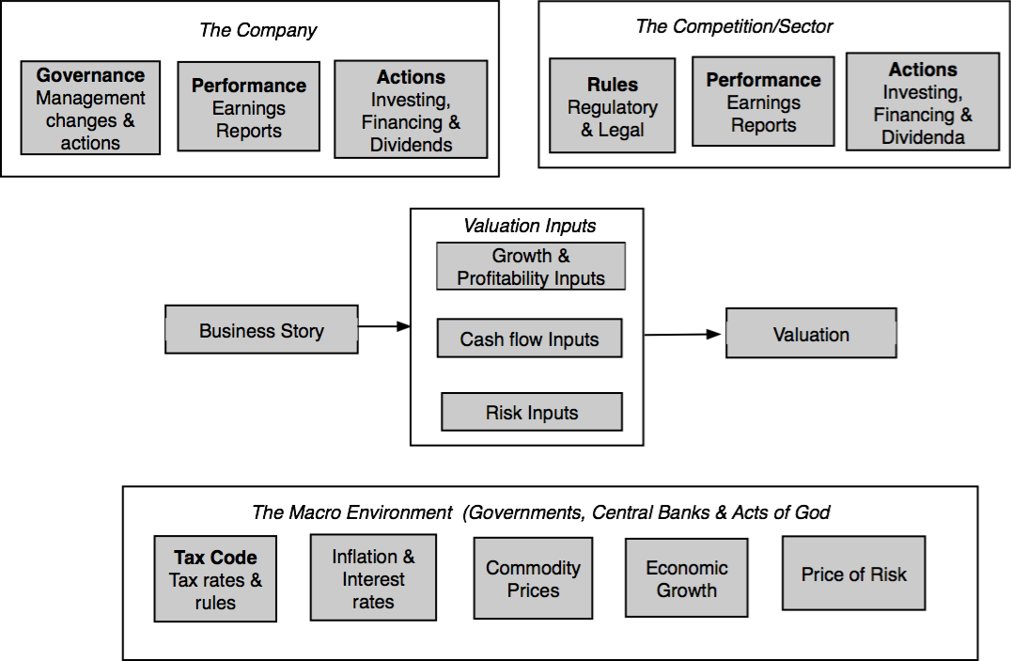
And why they do so…

Slide 38
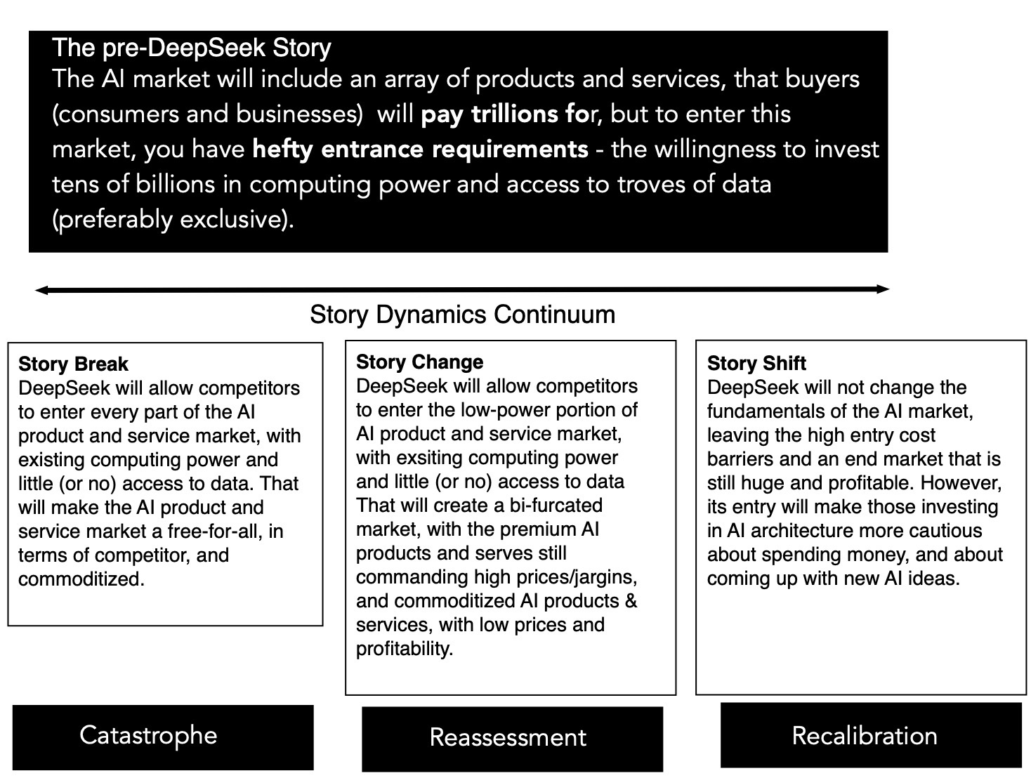
The deepseek effect on the ai story

Slide 39
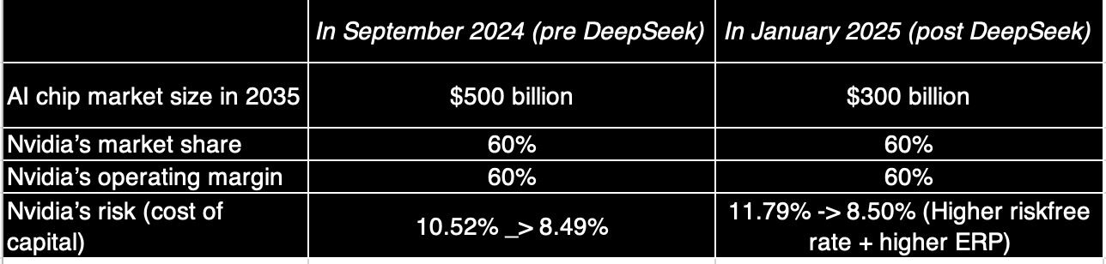
The value effect at Nvidia

Slide 40
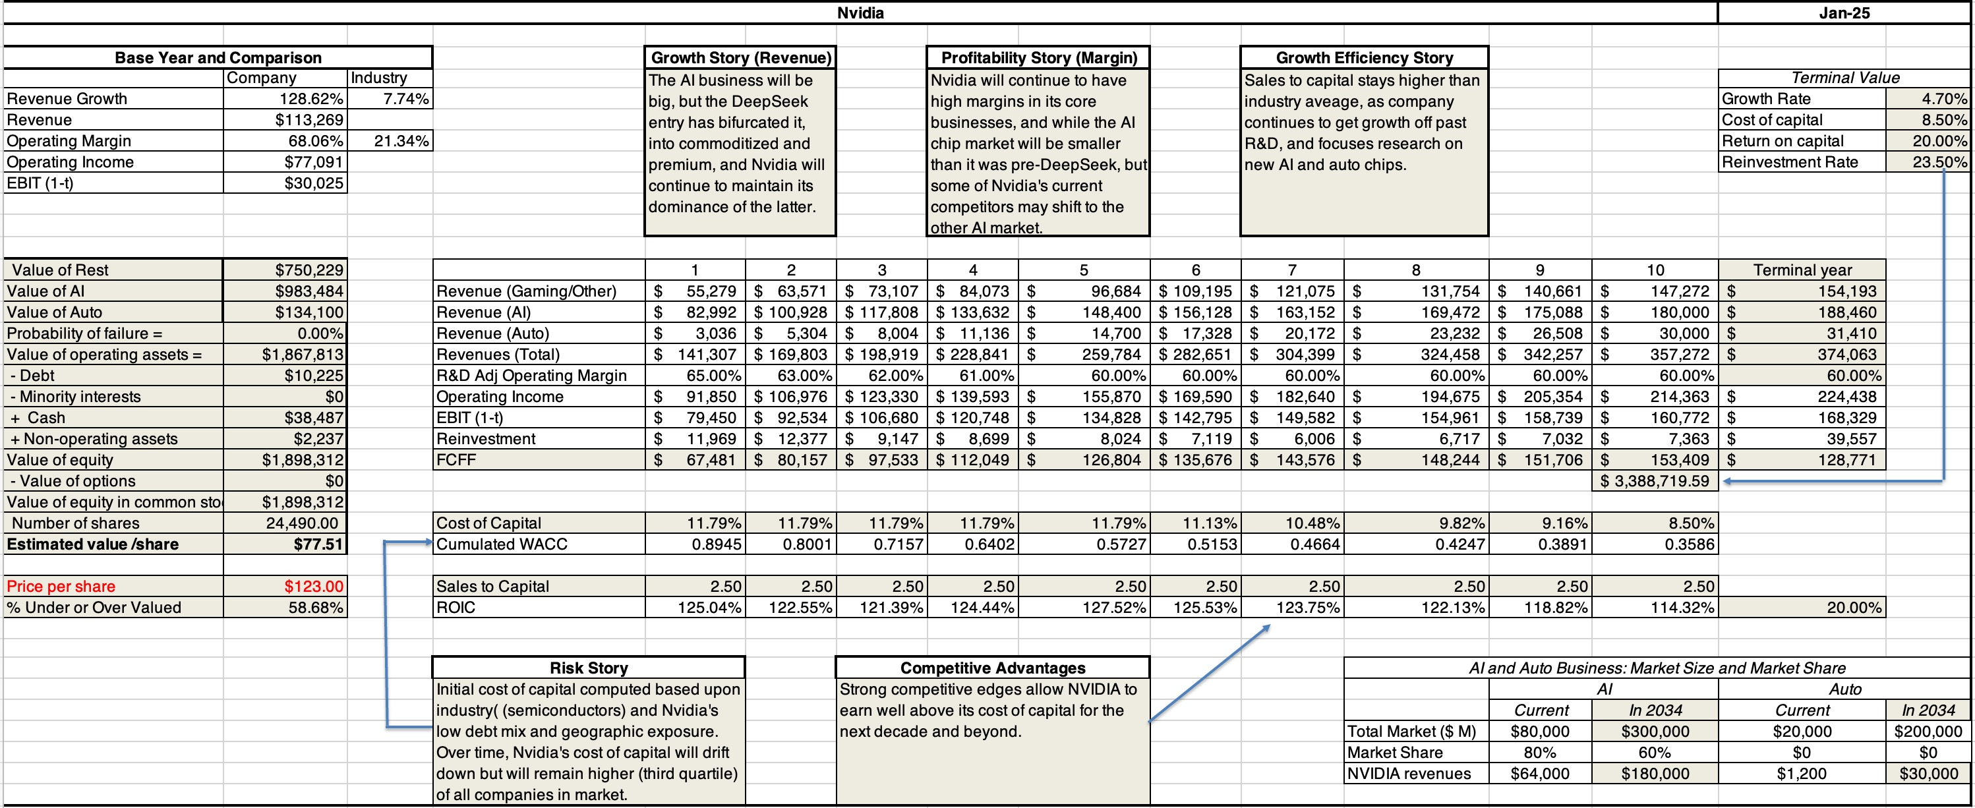
My post-deepseek nvidia valuation

Slide 41
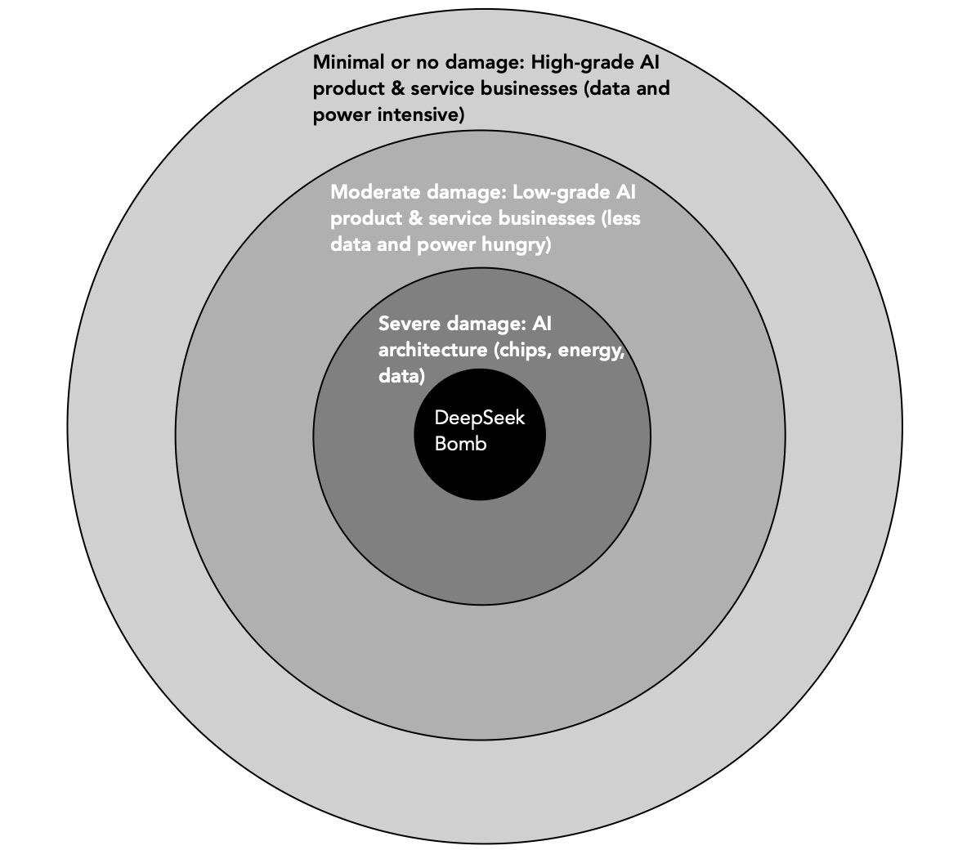
The deepseek effect on ai companies

Slide 42
The End
“There is no real ending. It’s just the place where you stop the story.”

