Slide 1
Numbers AND NARRATIVE: MODELING, STORY TELLING AND INVESTING
Aswath Damodaran

Slide 2
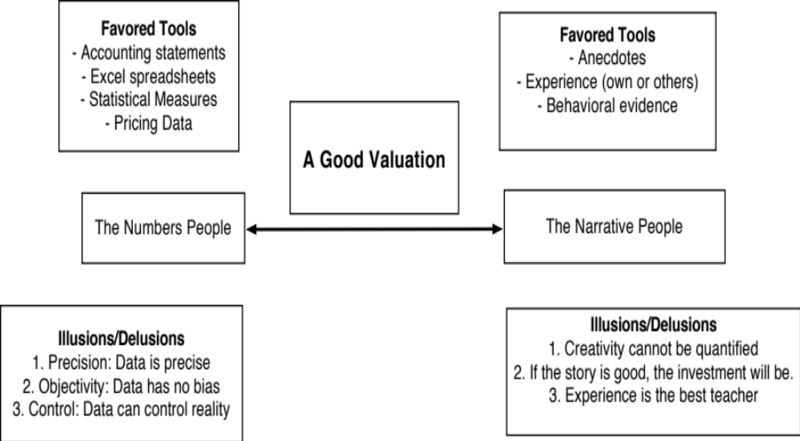
Bridging the Gap

Slide 3
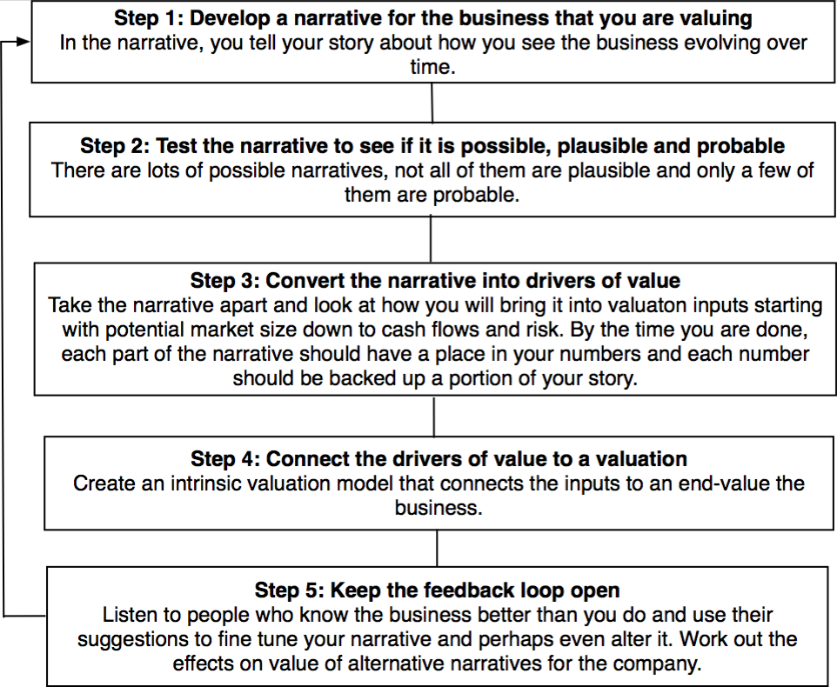
From Story to Numbers: The Steps

Slide 4
Step 1a: Survey the landscape
Every valuation starts with a narrative, a story that you see unfolding for your company in the future.
In developing this narrative, you will be making assessments of
  Your company (its products, its management and its history.
  The market or markets that you see it growing in.
  The competition it faces and will face.
  The macro environment in which it operates.

Slide 5
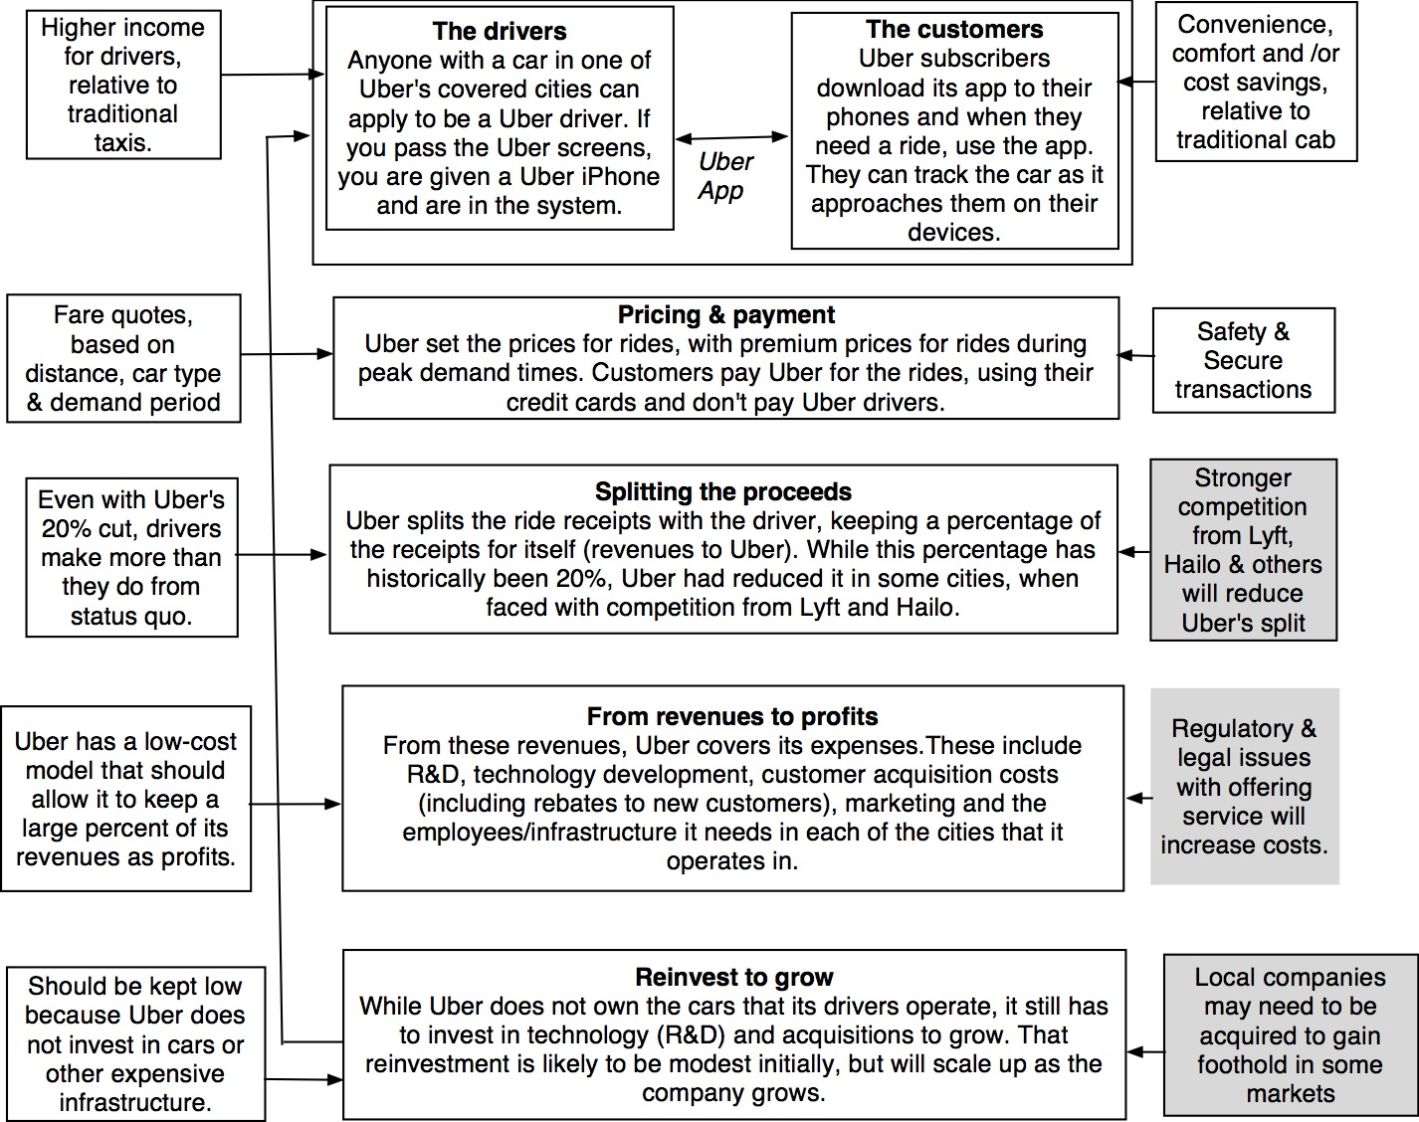

Slide 6
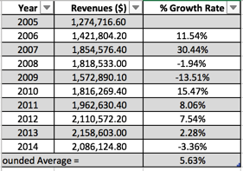
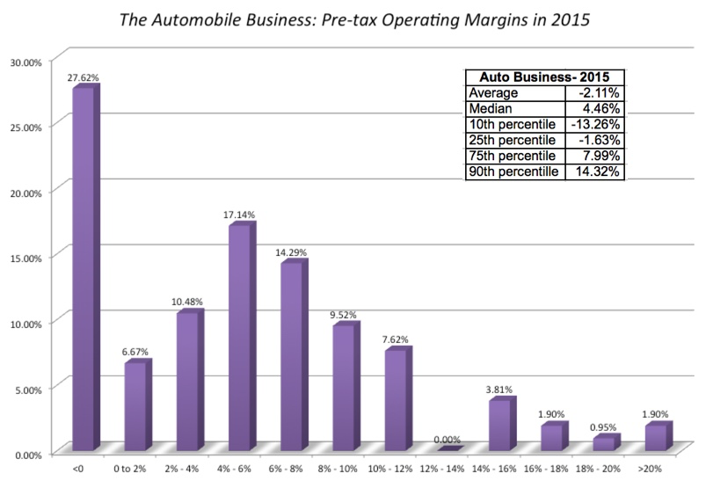
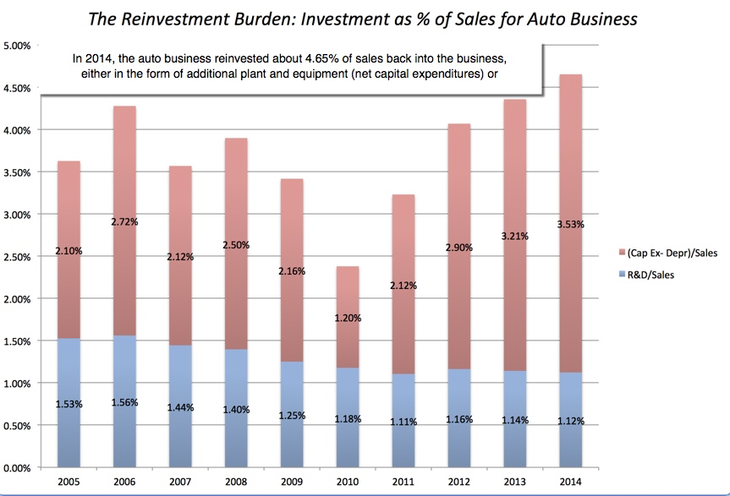
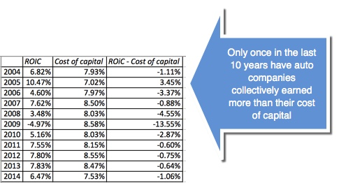
Low Growth
The Auto Business
Low Margins
+
High & Increasing Reinvestment
Bad Business
=

Slide 7
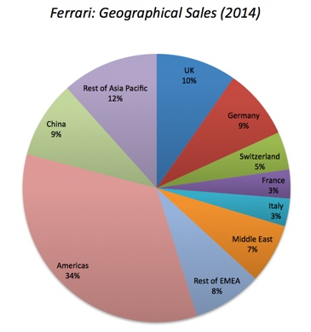
What makes Ferrari different?
Ferrari sold only 7,255 cars in all of 2014
Ferrari sales (in units) have grown very little in the last decade & have been stable
Ferrari had a profit margin of 18.2%, in the 95th percentile, partly because of its high prices and partly because it spends little on advertising.
Ferrari has not invested in new plants.

Slide 8

Severstal: Reading the (historical) tea leaves

Slide 9
Operating income, Reinvestment & Return on Capital -

Slide 10
Fundamentals: Steel Companies in April 2017
Broad Group | Historical growth in Revenues - Last 3 years | Expected growth in revenues - Next 2 years | Return on Capital (ROC or ROIC) | Pre-tax Operating Margin | Effective Tax Rate | Debt to Capital Ratio (Market) | Debt/EBITDA | Dividend Payout
Emerging Markets | -3.34% | 9.51% | 4.70% | 5.35% | 14.58% | 12.50% | 4.38 | 100.30%
Global | -2.96% | 8.03% | 3.65% | 4.56% | 15.17% | 12.05% | 3.89 | 70.32%
Severstal | -14.40% | 5.61% | 47.64% | 25.81% | 5.65% | 3.75% | 1.07 | 56.82%
Shrinking faster & expected to grow slower than peer group
Immensely more profitable than the rest of the sector
Has less debt than other steel companies
While holding back more cash

Slide 11
Step 1b: Create a narrative for the future
Every valuation starts with a narrative, a story that you see unfolding for your company in the future.
In developing this narrative, you will be making assessments of your company (its products, its management), the market or markets that you see it growing in, the competition it faces and will face and the macro environment in which it operates.
  Rule 1: Keep it simple.
  Rule 2: Keep it focused.

Slide 12
The Uber Narrative
In June 2014, my initial narrative for Uber was that it would be
An urban car service business: I saw Uber primarily as a force in urban areas and only in the car service business.
Which would expand the business moderately (about 40% over ten years) by bringing in new users.
With local networking benefits: If Uber becomes large enough in any city, it will quickly become larger, but that will be of little help when it enters a new city.
Maintain its revenue sharing (20%) system due to strong competitive advantages (from being a first mover).
And its existing low-capital business model, with drivers as contractors and very little investment in infrastructure.

Slide 13
The Ferrari Narrative
Ferrari will stay an exclusive auto club, deriving its allure from its scarcity and the fact that only a few own Ferraris.
By staying exclusive, the company gets three benefits:
  It can continue to charge nose bleed prices for its cars and sell them with little or no advertising.
  It does not need to invest in new assembly plants, since it does not plan to ramp up production.
  It sells only to the super rich, who are unaffected by overall economic conditions or market crises.

Slide 14
The Severstal Narrative
Severstal is a company in a bad business (shrinking revenues, margin pressures) that has worked at divesting the portions of its business that have the lowest margins (North America), reducing its debt load and focusing on its high margin domestic business
In my story, the company will continue to emphasize high margins over growth and while country and commodity price risk lurk, it will be able to weather the storms with its domestic profits. Growth with return to low single digits and margins will stabilize at close to its current high levels (because of the company’s competitive advantages in Russia).

Slide 15
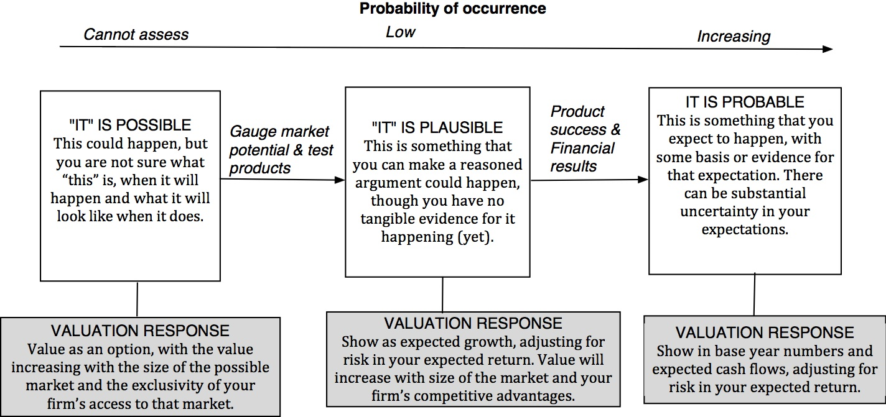
Step 2: Check the narrative against history, economic first principles & common sense

Slide 16
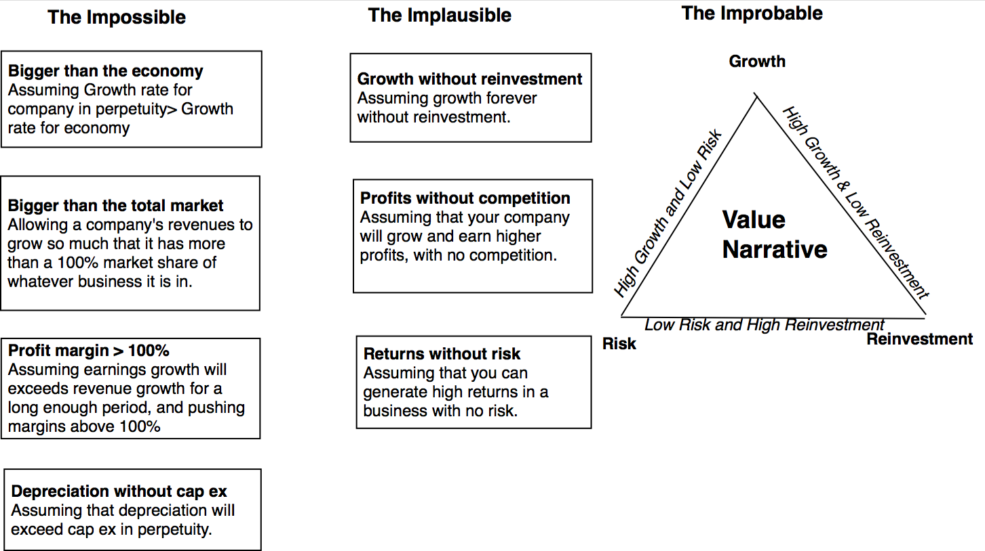
The Impossible, The Implausible and the Improbable

Slide 17
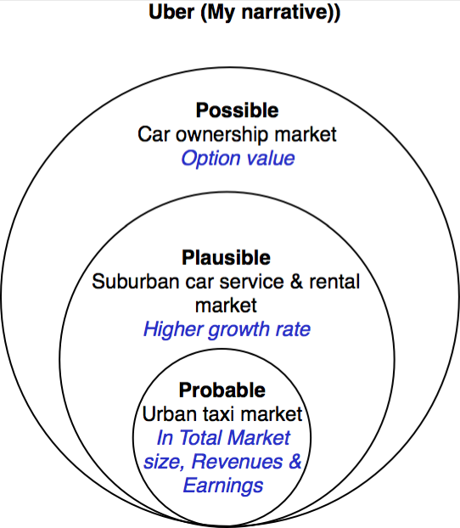
Uber: Possible, Plausible and Probable

Slide 18
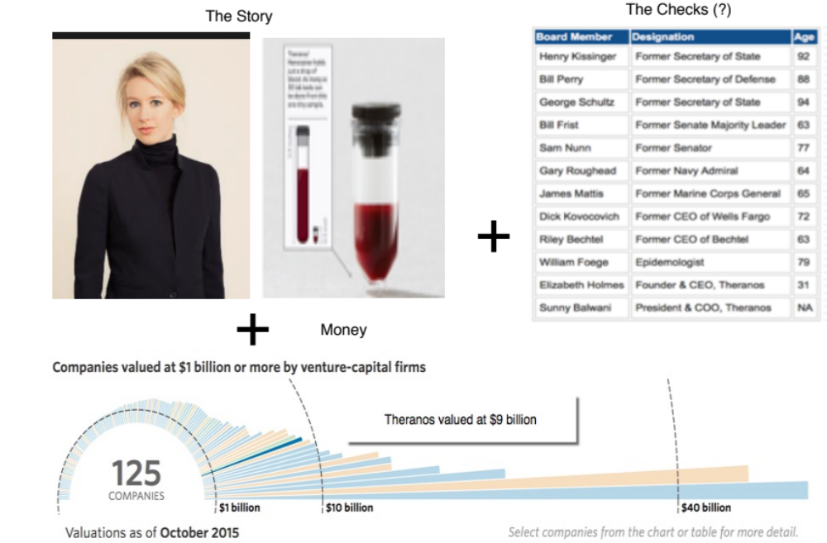
The Impossible: The Runaway Story

Slide 19
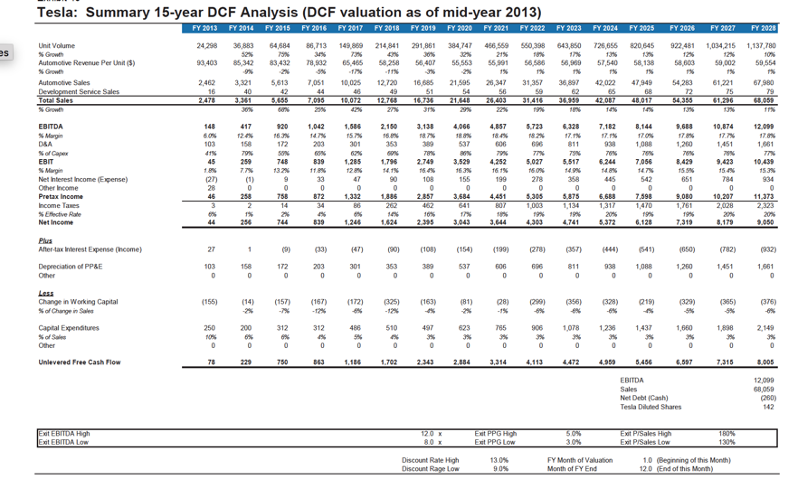
The Improbable: Willy Wonkitis

Slide 20
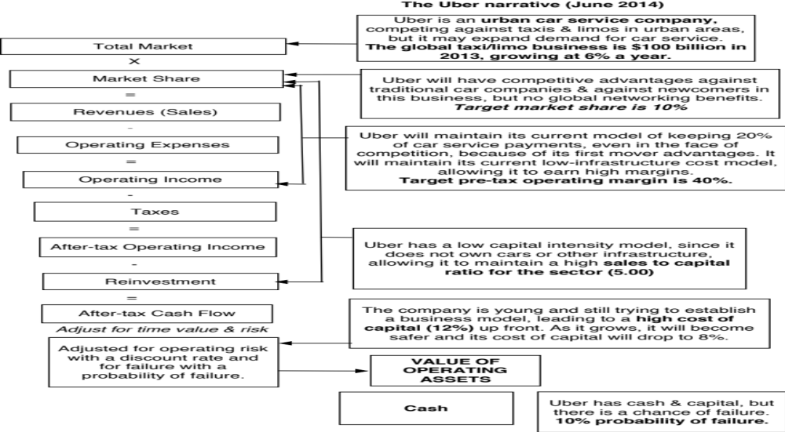
Step 3: Connect your narrative to key drivers of value

Slide 21
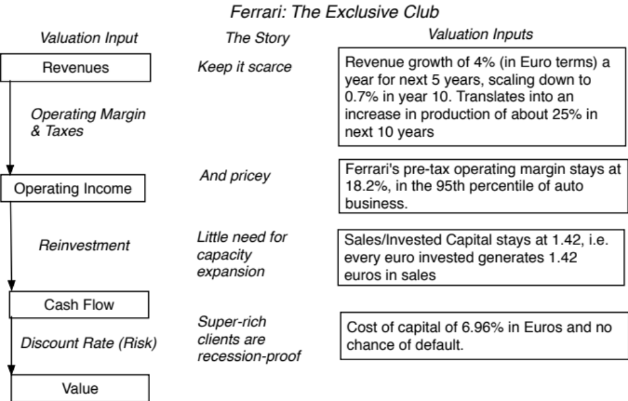
Ferrari: From story to numbers

Slide 22
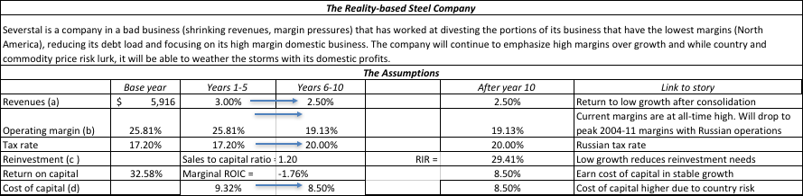
Severstal: Story to Numbers

Slide 23
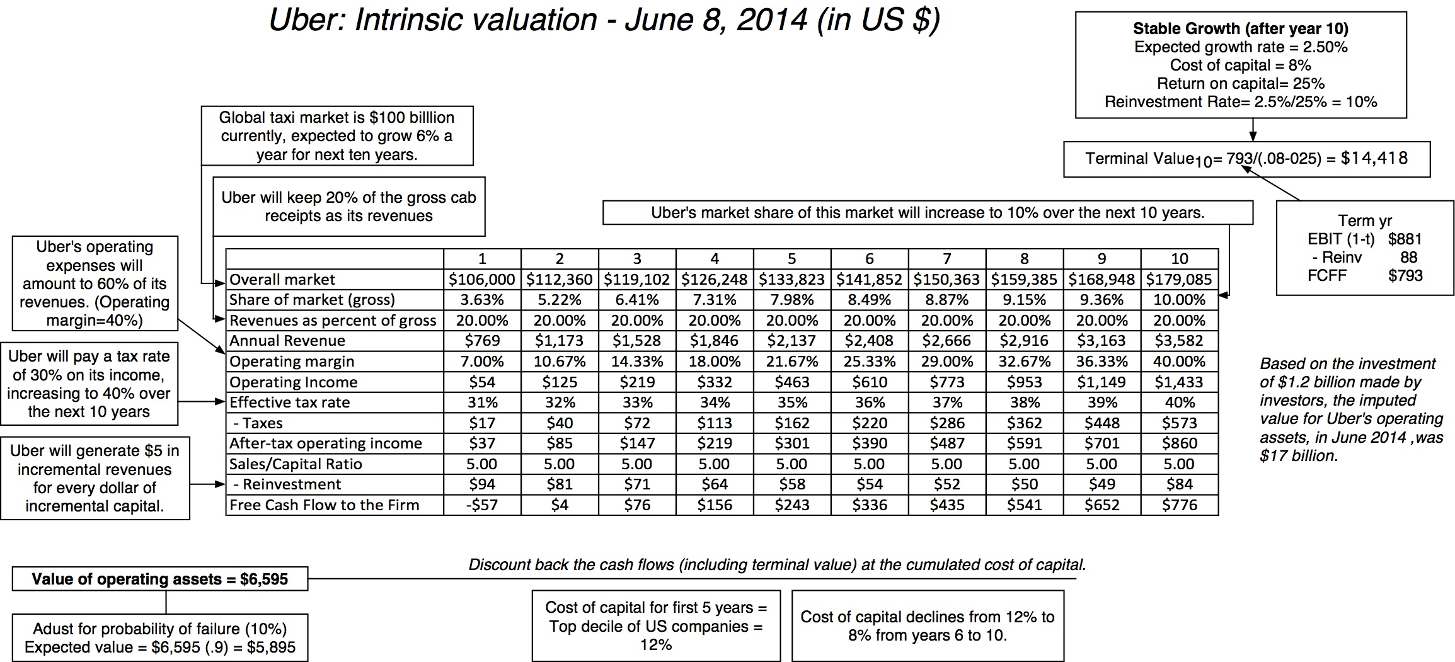
Step 4: Value the company (Uber)

Slide 24
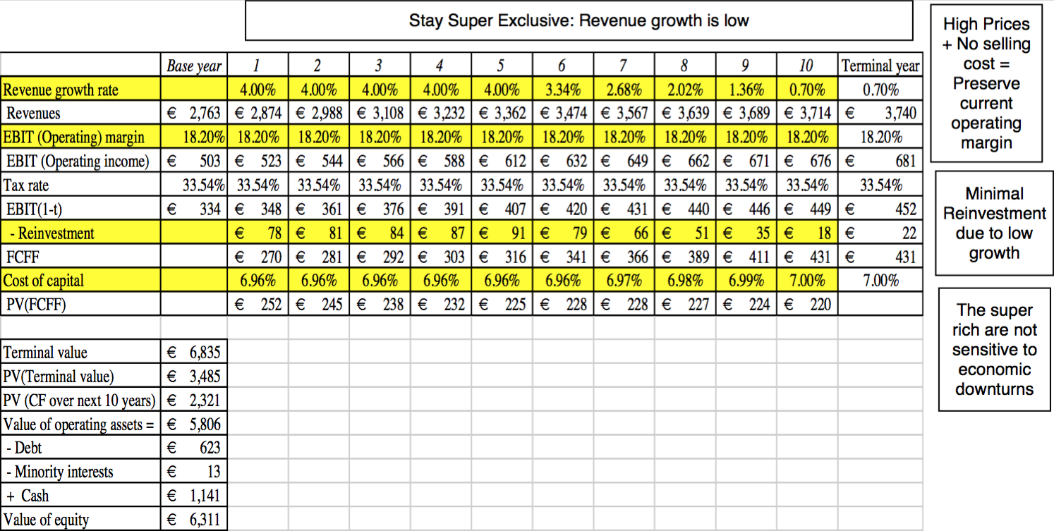
Ferrari: The “Exclusive Club” Value

Slide 26
Step 5: Keep the feedback loop open
When you tell a story about a company (either explicitly or implicitly), it is natural to feel attached to that story and to defend it against all attacks. Nothing can destroy an investor more than hubris.
Being open to other views about a company is not easy, but here are some suggestions that may help:
  Face up to the uncertainty in your own estimates of value.
  Present the valuation to people who don’t think like you do.
  Create a process where people who disagree with you the most have a say.
  Provide a structure where the criticisms can be specific and pointed, rather than general.

Slide 27
The Uber Feedback Loop: Bill Gurley
Not just car service company.: Uber is a car company, not just a car service company, and there may be a day when consumers will subscribe to a Uber service, rather than own their own cars. It could also expand into logistics, i.e., moving and transportation businesses.
Not just urban: Uber can create new demands for car service in parts of the country where taxis are not used (suburbia, small towns).
Global networking benefits: By linking with technology and credit card companies, Uber can have global networking benefits.

Slide 28
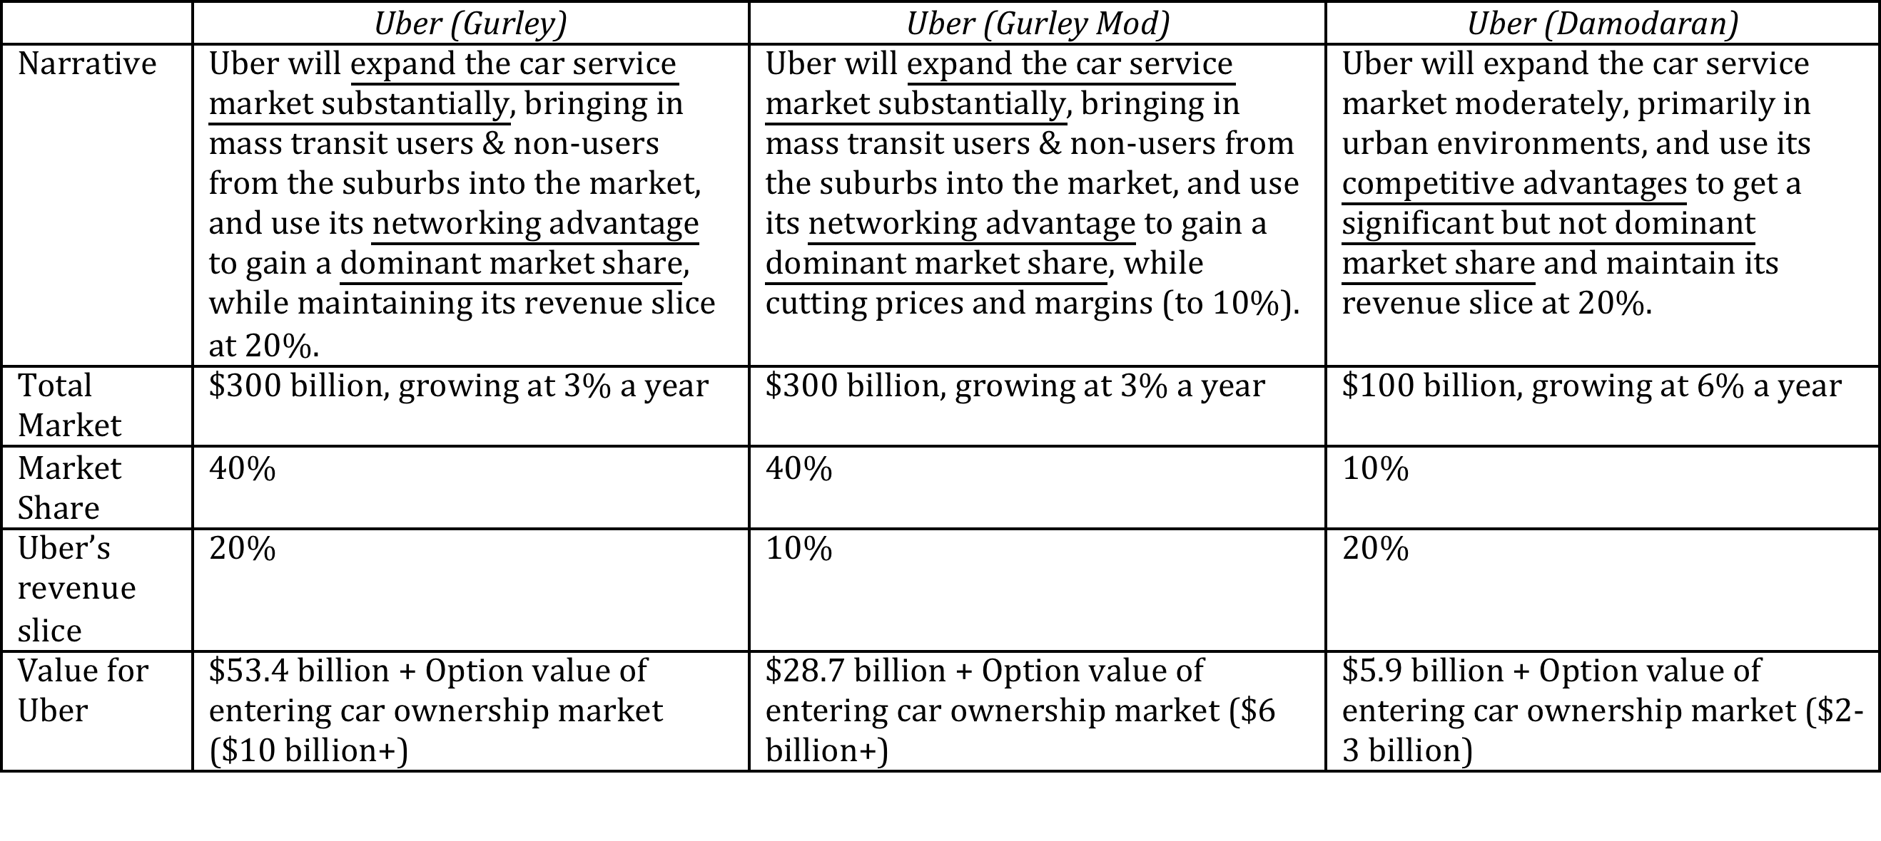
Valuing Bill Gurley’s Uber narrative

Slide 29
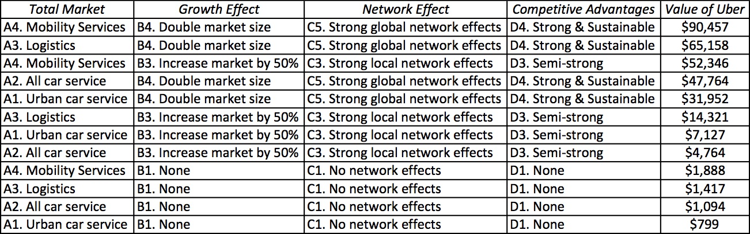
Different narratives, Different Numbers

Slide 30
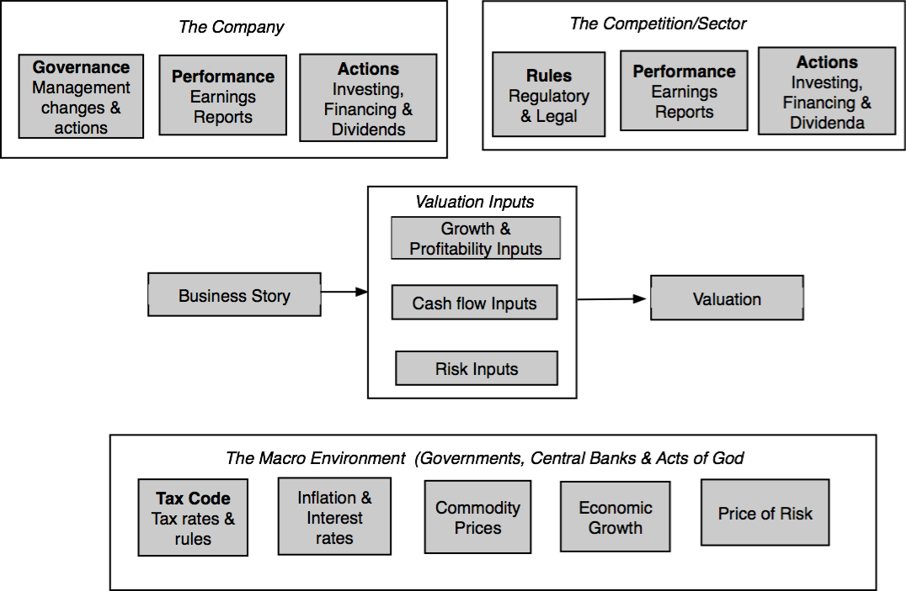
Why narratives change: Because the world changes around you…

Slide 31
How narratives change
Narrative Break/End | Narrative Shift | Narrative Change (Expansion or Contraction)
Events, external (legal, political or economic) or internal (management, competitive, default), that can cause the narrative to break or end. | Improvement or deterioration in initial business model, changing market size, market share and/or profitability. | Unexpected entry/success in a new market or unexpected exit/failure in an existing market.
Your valuation estimates (cash flows, risk, growth & value) are no longer operative | Your valuation estimates will have to be modified to reflect the new data about the company. | Valuation estimates have to be redone with new overall market potential and characteristics.
Estimate a probability that it will occur & consequences | Monte Carlo simulations or scenario analysis | Real Options

Slide 32
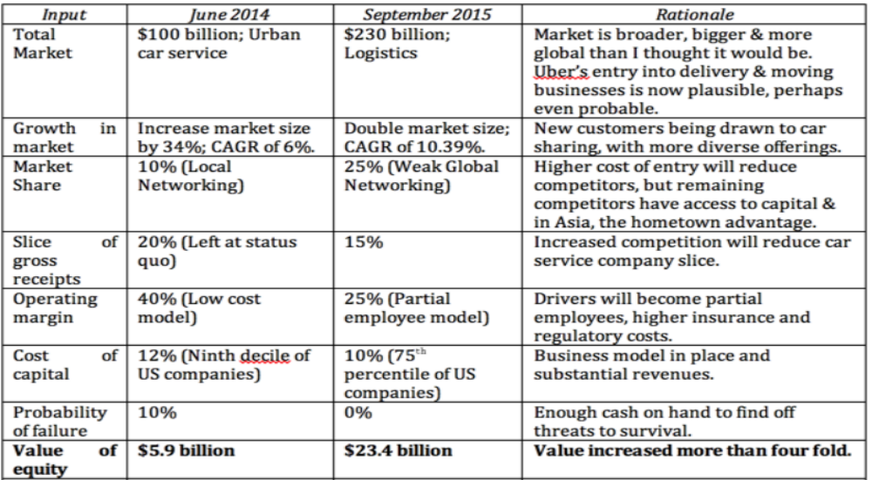
Uber: The September 2015 Update

Slide 33
The End
“There is no real ending. It’s just the place where you stop the story.”

