Slide 1
Numbers AND NARRATIVE: MODELING, STORY TELLING AND INVESTING
Aswath Damodaran

Slide 2
What are you?
If you were asked to categorize yourself, would you more naturally think of yourself as a
  Numbers Person
  Story Person
  Not sure
When did you make this decision and how has it affected your educational and career choices?
As you get older, do you find yourself becoming more of whatever you chose?

Slide 3

Bridging the Gap

Slide 4
From Narrative to Numbers: the Mechanics

Slide 5
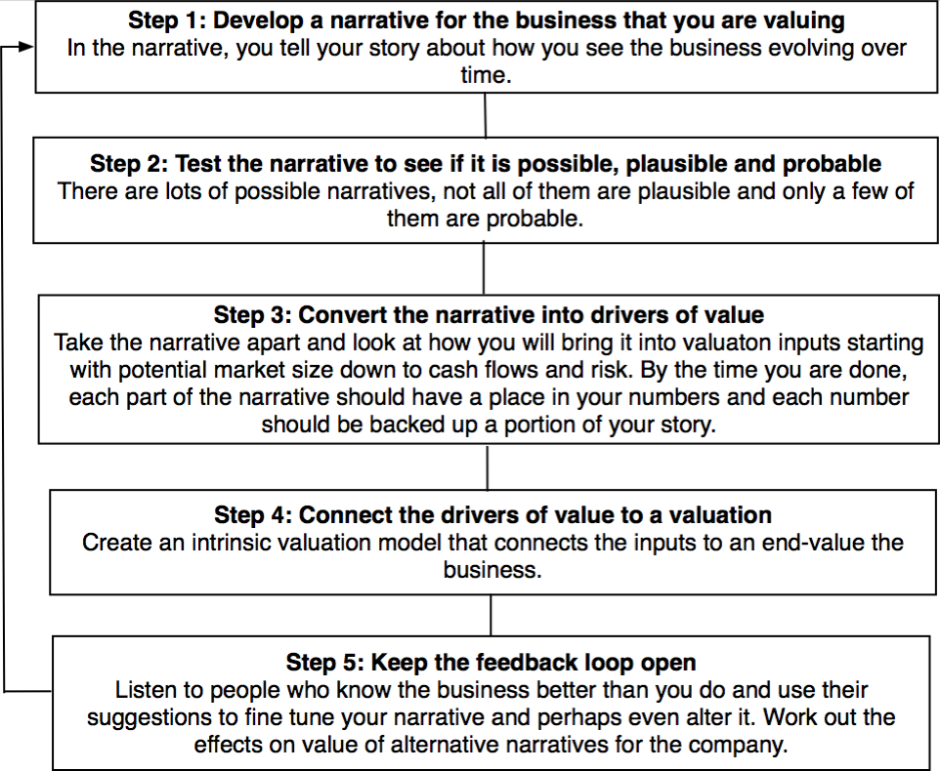
The Steps

Slide 6
Step 1a: Survey the landscape
Every valuation starts with a narrative, a story that you see unfolding for your company in the future.
In developing this narrative, you will be making assessments of
  Your company (its products, its management and its history.
  The market or markets that you see it growing in.
  The competition it faces and will face.
  The macro environment in which it operates.

Slide 7
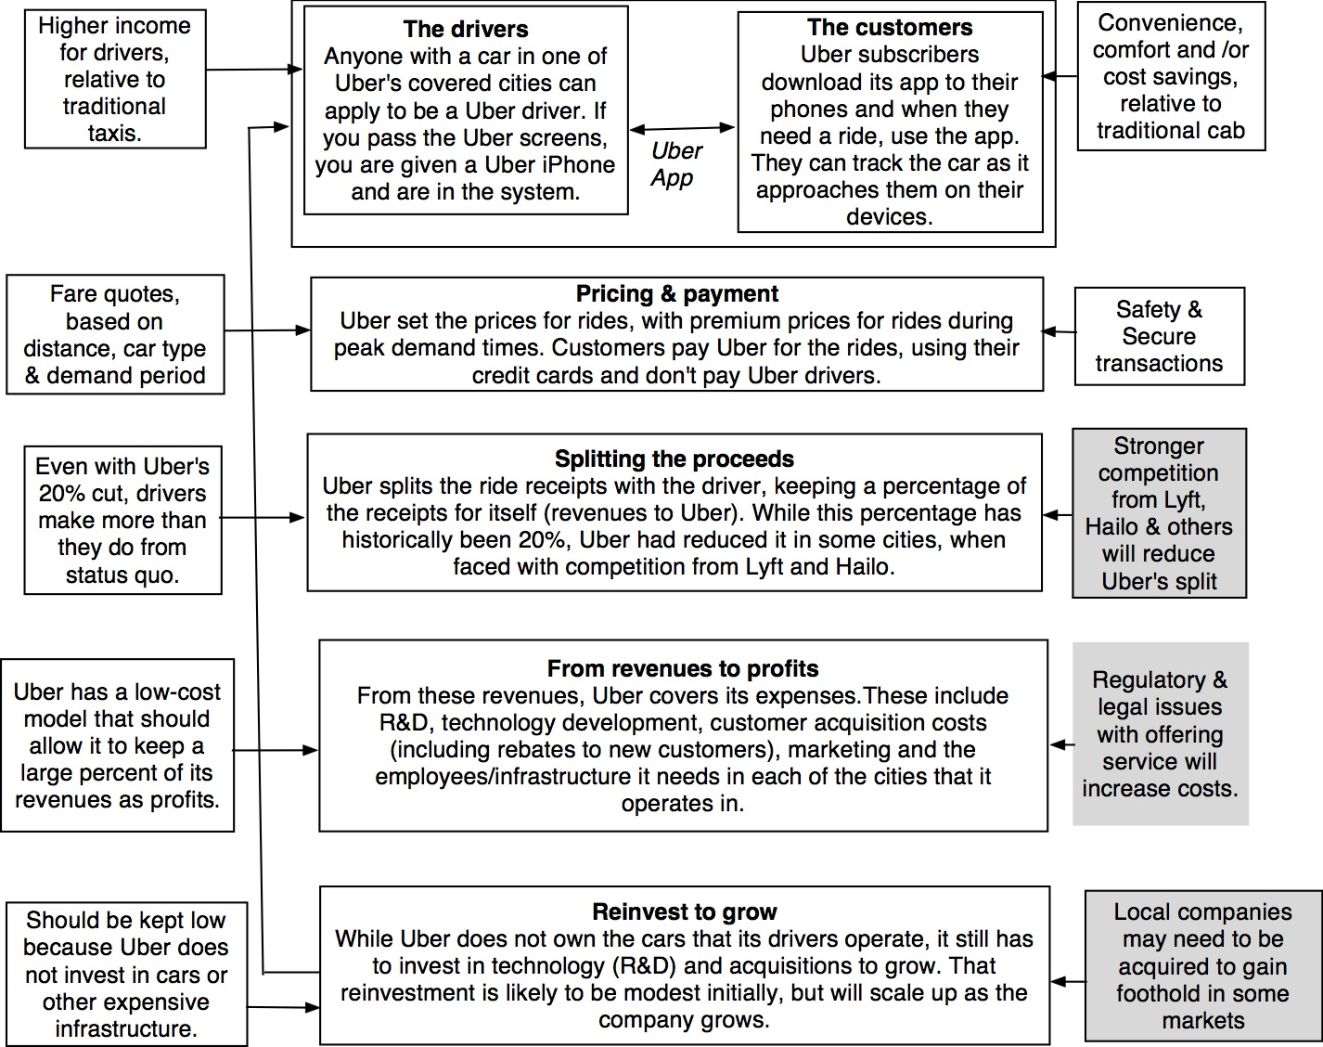
Understanding Uber in 2014

Slide 8
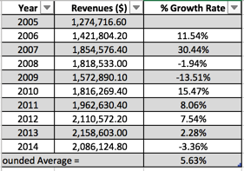
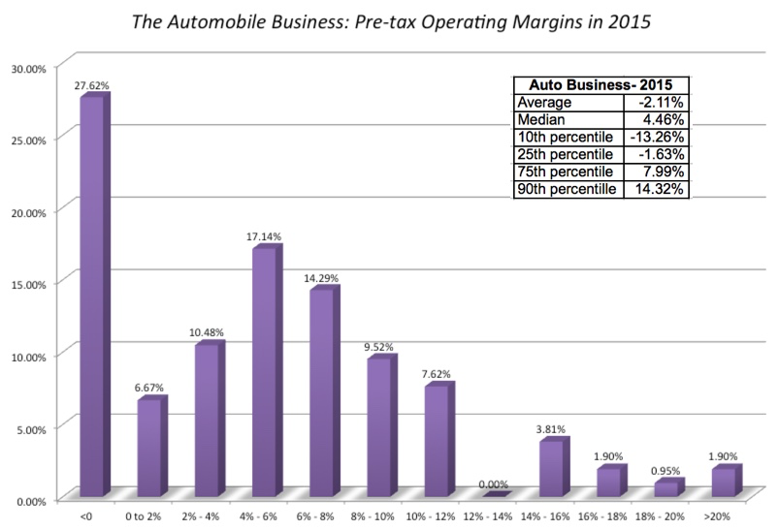
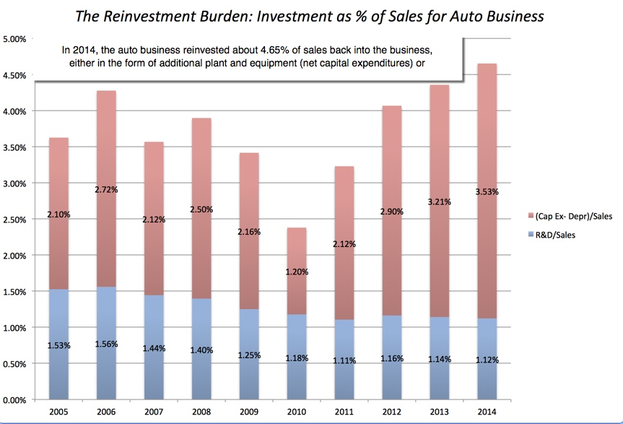
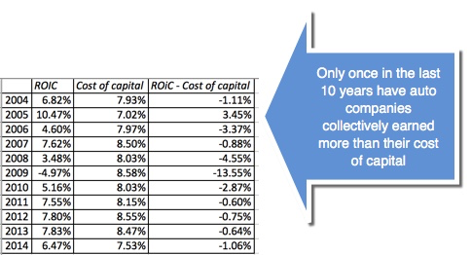
Understanding Ferrari in 2015
Low Growth
It is in the Auto Business
Low Margins
+
High & Increasing Reinvestment
Bad Business
=

Slide 9
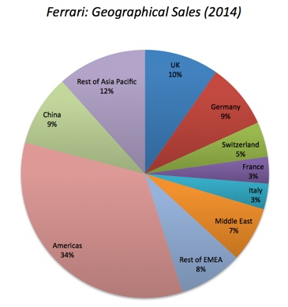
But it is not just another auto company..
Ferrari sold only 7,255 cars in all of 2014
Ferrari sales (in units) have grown very little in the last decade & have been stable
Ferrari had a profit margin of 18.2%, in the 95th percentile, partly because of its high prices and partly because it spends little on advertising.
Ferrari has not invested in new plants.

Slide 10
Step 1b: Create a narrative for the future
Every valuation starts with a narrative, a story that you see unfolding for your company in the future.
In developing this narrative, you will be making assessments of your company (its products, its management), the market or markets that you see it growing in, the competition it faces and will face and the macro environment in which it operates.
  Rule 1: Keep it simple.
  Rule 2: Keep it focused.

Slide 11
The Uber Narrative: An Urban, Car Service disruptor
In June 2014, my initial narrative for Uber was that it would be
An urban car service business: I saw Uber primarily as a force in urban areas and only in the car service business.
Which would expand the business moderately (about 40% over ten years) by bringing in new users.
With local networking benefits: If Uber becomes large enough in any city, it will quickly become larger, but that will be of little help when it enters a new city.
Maintain its revenue sharing (20%) system due to strong competitive advantages (from being a first mover).
And its existing low-capital business model, with drivers as contractors and very little investment in infrastructure.

Slide 12
The Ferrari Narrative: An Exclusive Club
Ferrari will stay an exclusive auto club, deriving its allure from its scarcity and the fact that only a few own Ferraris.
By staying exclusive, the company gets three benefits:
  It can continue to charge nose bleed prices for its cars and sell them with little or no advertising.
  It does not need to invest in new assembly plants, since it does not plan to ramp up production.
  It sells only to the super rich, who are unaffected by overall economic conditions or market crises.

Slide 13
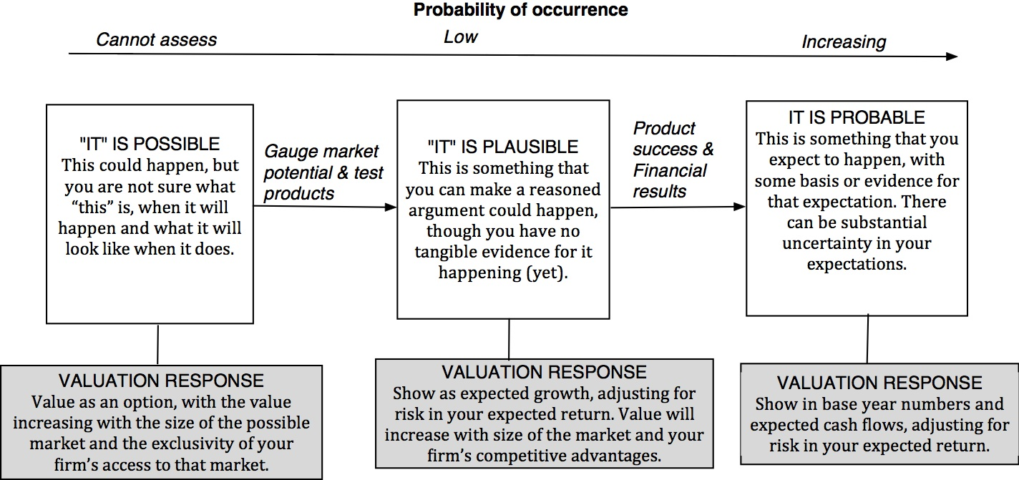
Step 2: Check the narrative against history, economic first principles & common sense

Slide 14
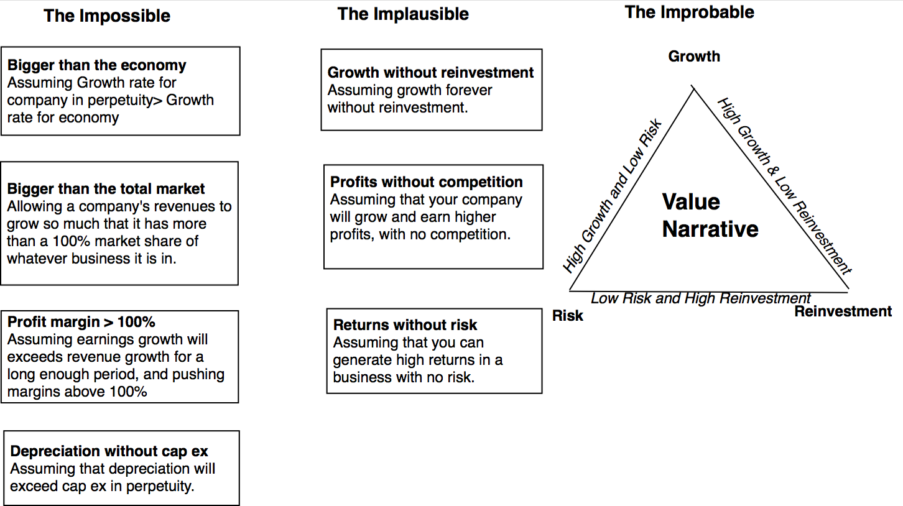
The Impossible, The Implausible and the Improbable

Slide 15
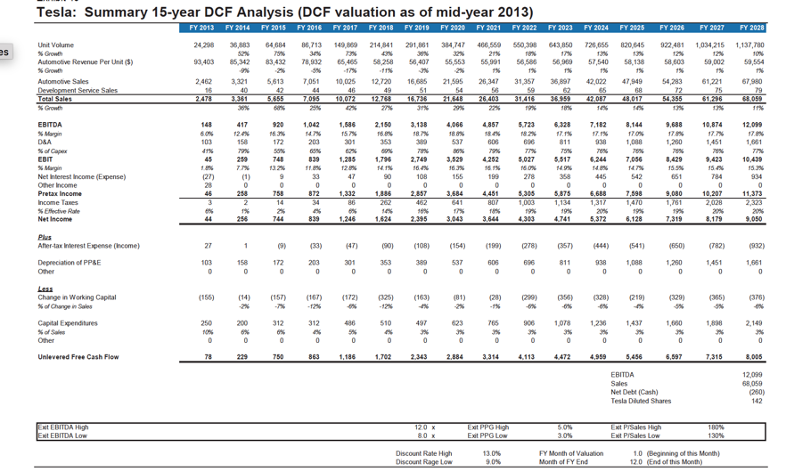
The Improbable: Willy Wonkitis

Slide 16
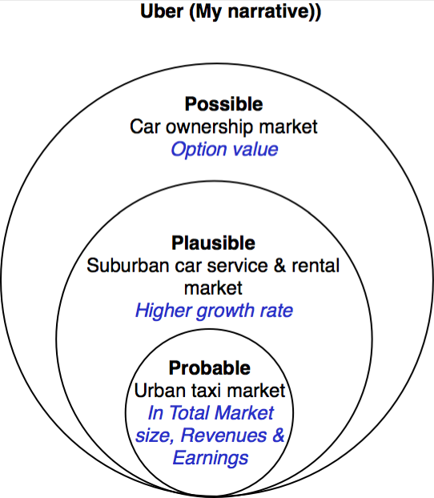
Uber: Possible, Plausible and Probable
The larger & more ambitious your story, the more onus there is on you to show that it is possible, plausible & probable.

Slide 17
The Runaway Story: When you want a story to be true…
With a runaway business story, you usually have three ingredients:
  Charismatic, likeable Narrator: The narrator of the business story is someone that you want to see succeed, either because you like the narrator or because he/she will be a good role model.
  Telling a story about disrupting a much business, where you dislike the status quo: The status quo in the business that the story is disrupting is dissatisfying (to everyone involved)>
  With a societal benefit as bonus: And if the story holds, society and humanity will benefit.
Since you want this story to work out, you stop asking questions, because the answers may put the story at risk.

Slide 18
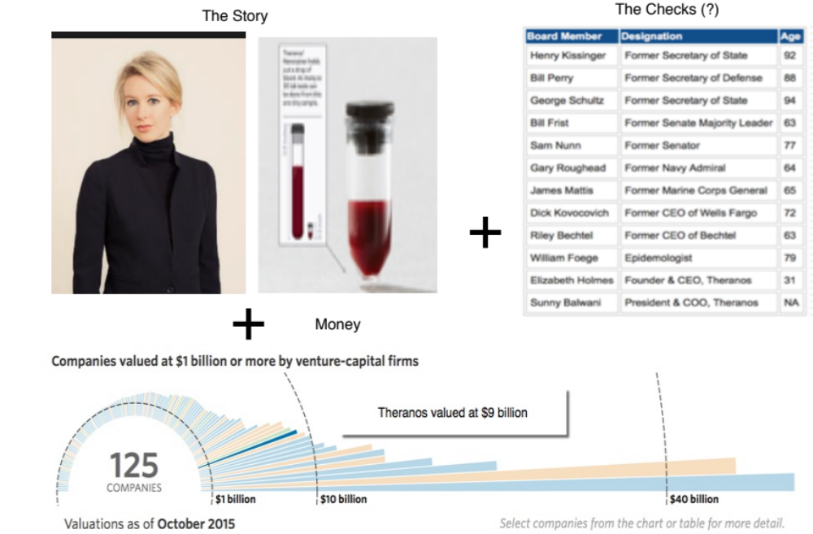
The Impossible: The Runaway Story

Slide 19
Step 4a: Connect your narrative to key drivers of value

Slide 20
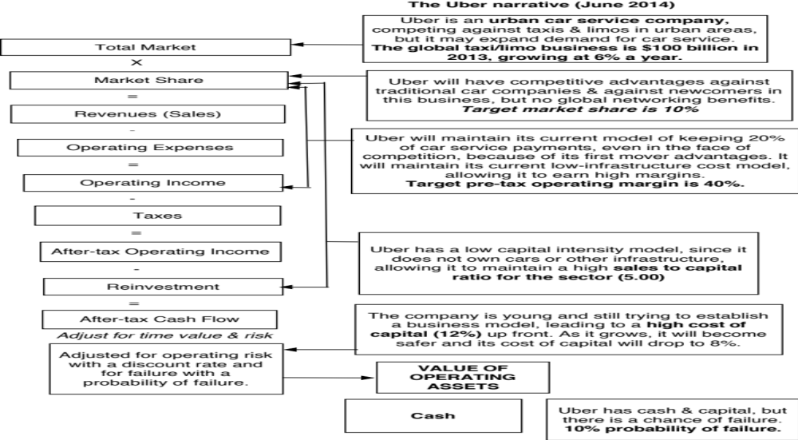
The Uber Link

Slide 21
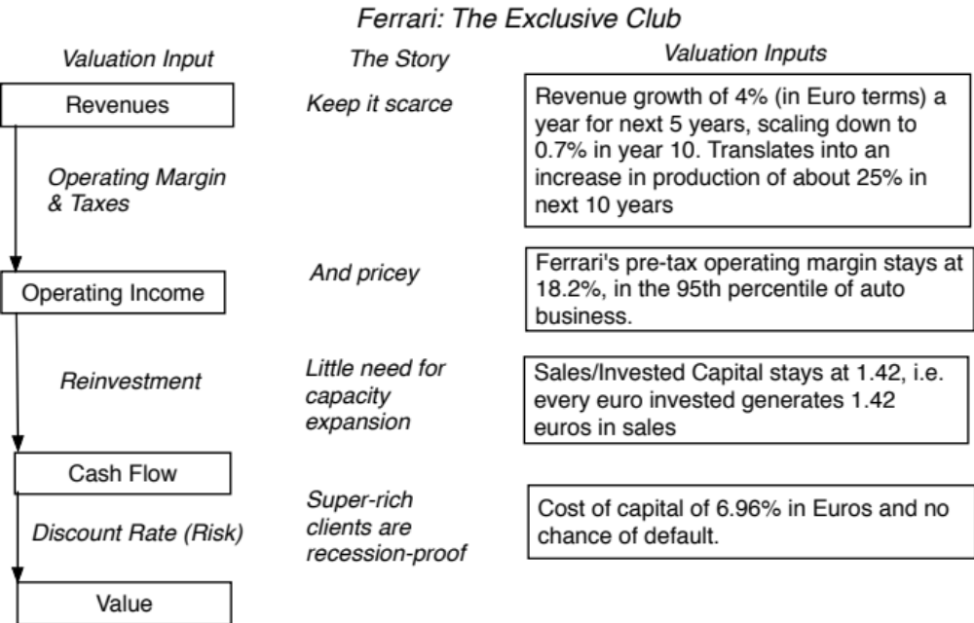
Ferrari: From story to numbers

Slide 22
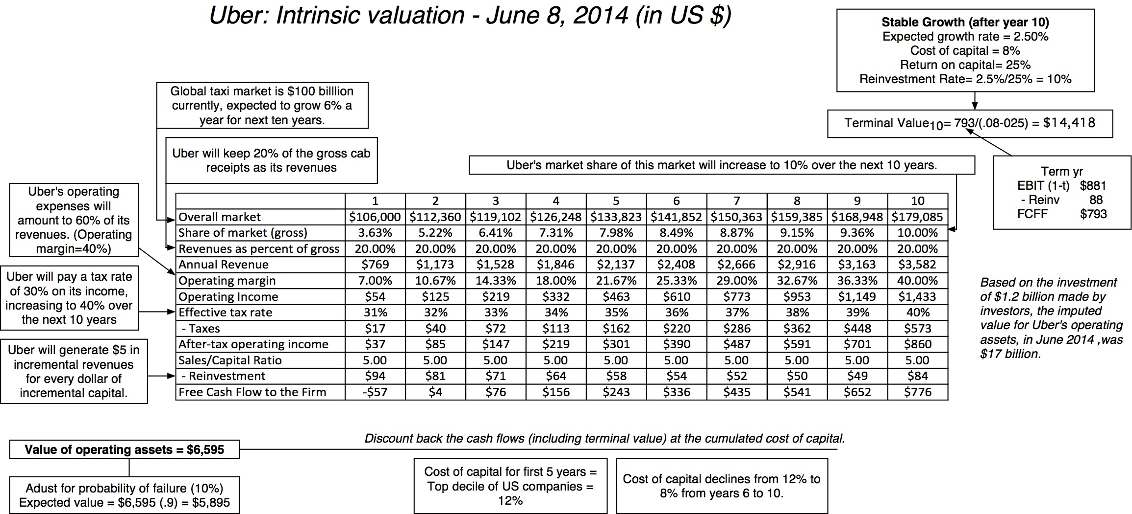
Step 4b: Value the company (Uber)

Slide 23
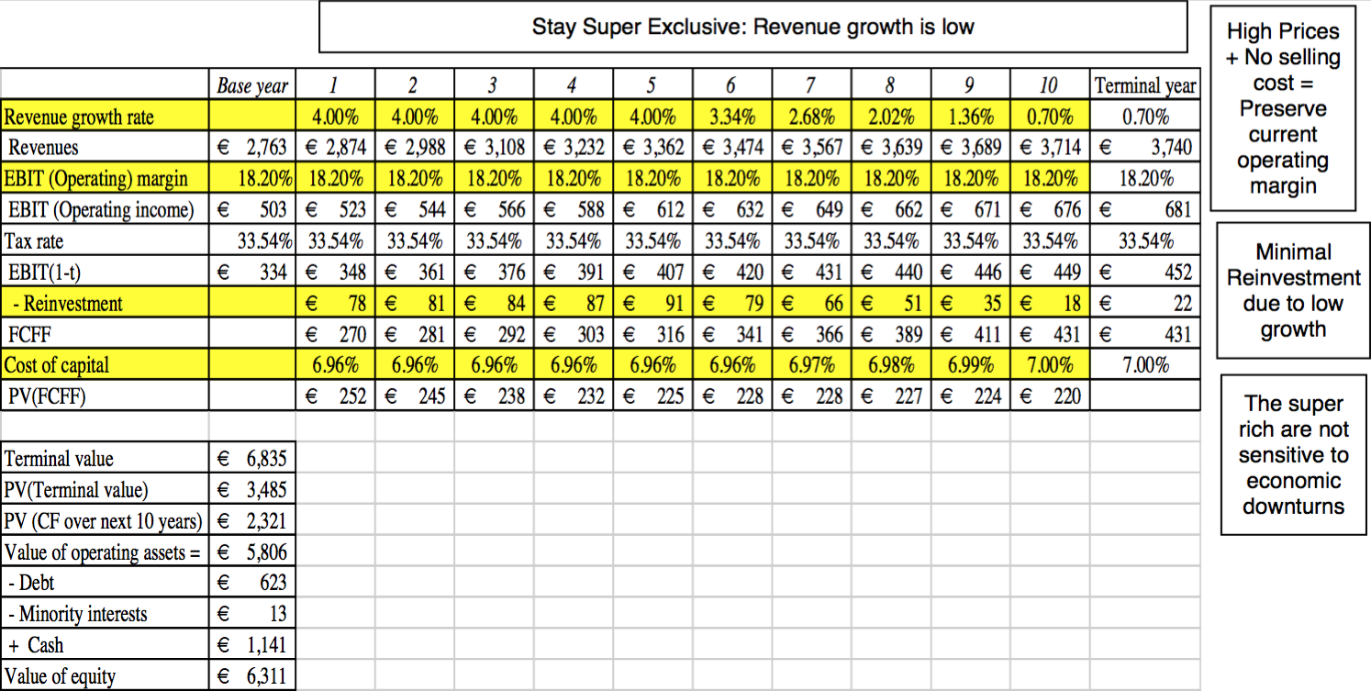
Ferrari: The “Exclusive Club” Value

Slide 24
Step 5: Keep the feedback loop open
When you tell a story about a company (either explicitly or implicitly), it is natural to feel attached to that story and to defend it against all attacks. Nothing can destroy an investor more than hubris.
Being open to other views about a company is not easy, but here are some suggestions that may help:
  Face up to the uncertainty in your own estimates of value.
  Present the valuation to people who don’t think like you do.
  Create a process where people who disagree with you the most have a say.
  Provide a structure where the criticisms can be specific and pointed, rather than general.

Slide 25
The Uber Feedback Loop: Bill Gurley
Not just car service company.: Uber is a car company, not just a car service company, and there may be a day when consumers will subscribe to a Uber service, rather than own their own cars. It could also expand into logistics, i.e., moving and transportation businesses.
Not just urban: Uber can create new demands for car service in parts of the country where taxis are not used (suburbia, small towns).
Global networking benefits: By linking with technology and credit card companies, Uber can have global networking benefits.

Slide 26
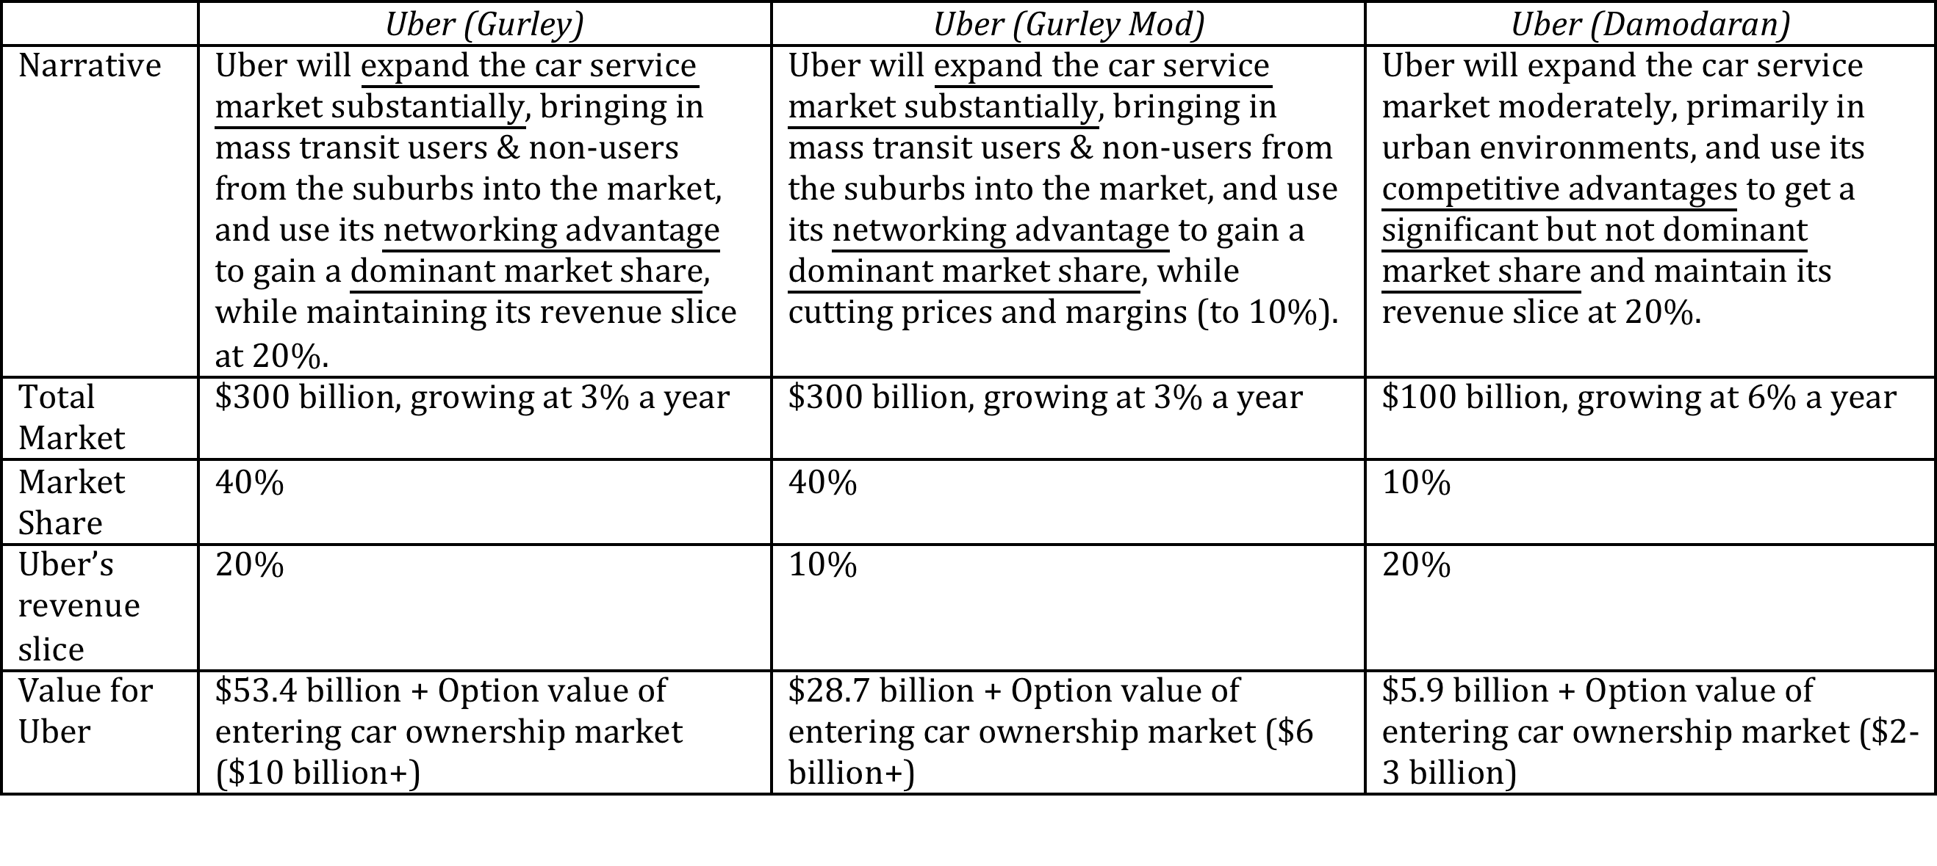
Valuing Bill Gurley’s Uber narrative

Slide 27
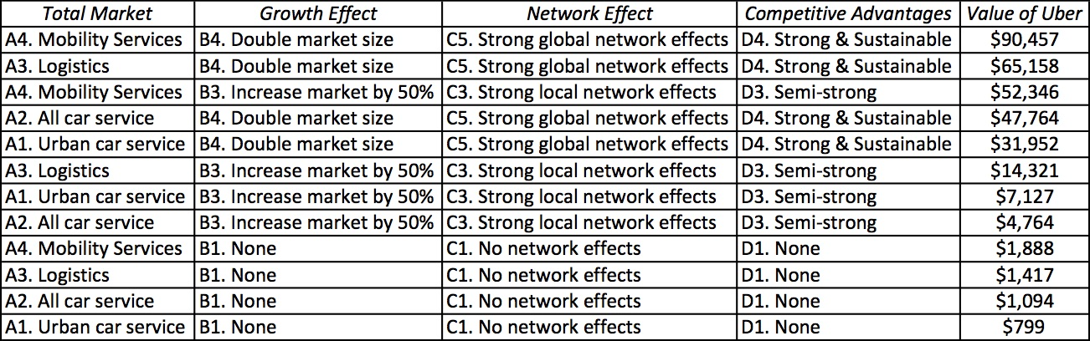
Different narratives, Different Numbers

Slide 28
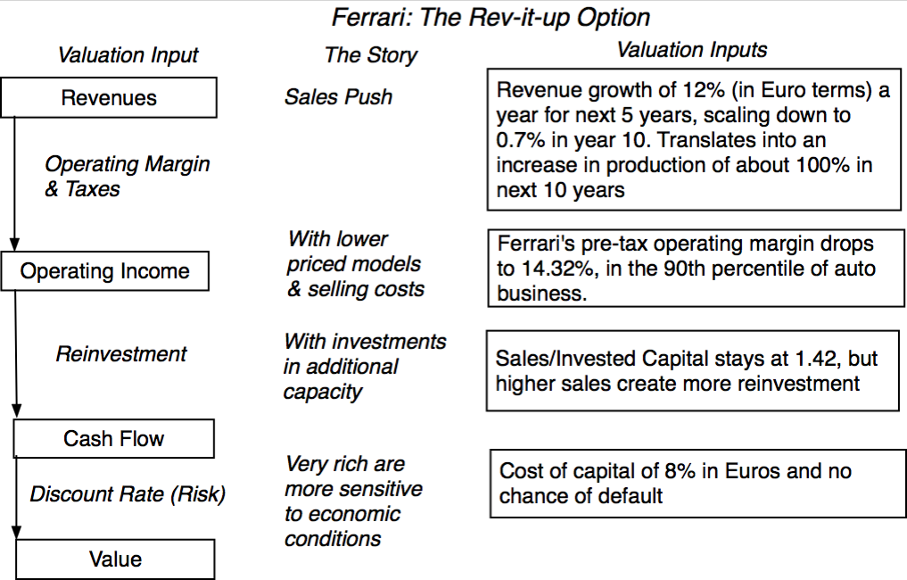
The Ferrari Counter Narrative

Slide 29
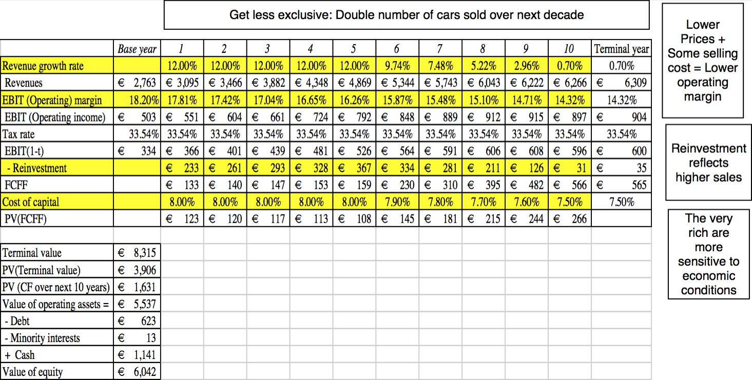
Ferrari: The “Rev-it-up” Alternative

Slide 30

And the world is full of feedback.. My Ferrari afterthought!

Slide 31
Narrative breaks, shifts & changes
“When my information changes, I alter my conclusions. What do you do, sir?”
Lord Keynes

Slide 32
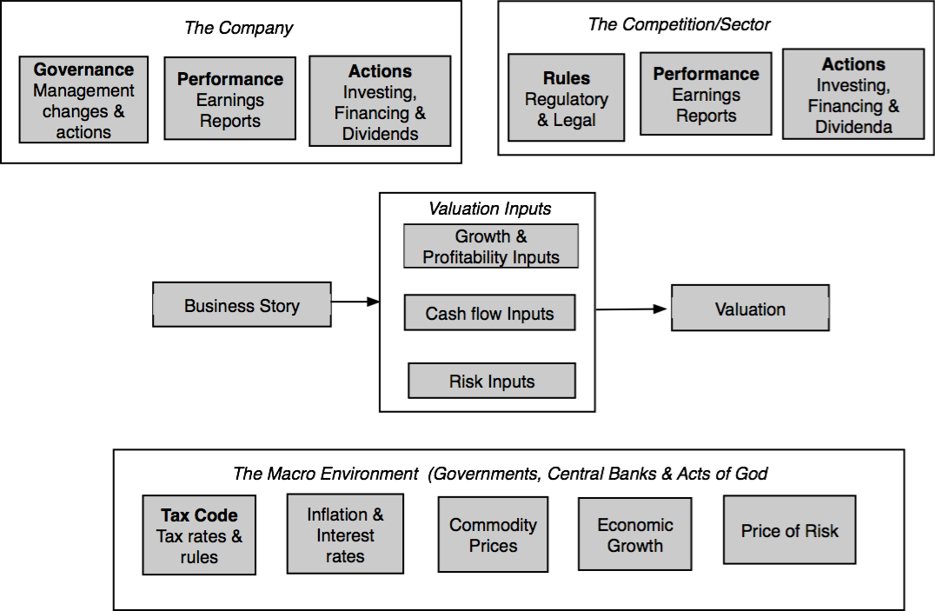
Why narratives change

Slide 33
How narratives change
Narrative Break/End | Narrative Shift | Narrative Change (Expansion or Contraction)
Events, external (legal, political or economic) or internal (management, competitive, default), that can cause the narrative to break or end. | Improvement or deterioration in initial business model, changing market size, market share and/or profitability. | Unexpected entry/success in a new market or unexpected exit/failure in an existing market.
Your valuation estimates (cash flows, risk, growth & value) are no longer operative | Your valuation estimates will have to be modified to reflect the new data about the company. | Valuation estimates have to be redone with new overall market potential and characteristics.
Estimate a probability that it will occur & consequences | Monte Carlo simulations or scenario analysis | Real Options

Slide 34
Sometimes your story does not change..

Slide 35
And sometimes it does.. Facebook’s Evolution
Report Date | Active Users | Mobile Active Users | % of revenue from Mobile | Net Income | Capital | T12m Sales/Capital
7/26/12 | 955 | 543 | NR | ($157) | $3,515 | 1.23
10/23/12 | 1010 | 604 | NR | ($59) | $4,252 | 1.09
1/30/13 | 1060 | 680 | 23.00% | $64 | $4,120 | 1.24
5/1/13 | 1100 | 751 | 30.00% | $219 | $4,272 | 1.28
7/24/13 | 1150 | 819 | 41.00% | ($152) | $3,948 | 1.55
10/30/13 | 1190 | 874 | 49.00% | $425 | $4,007 | 1.71
1/29/14 | 1230 | 945 | 53.00% | $523 | $4,258 | 1.85
4/23/14 | 1280 | 1010 | 59.00% | $642 | $4,299 | 2.07
7/23/14 | 1320 | 1070 | 62.00% | $791 | $4,543 | 2.20

Slide 36
Managers: Narrative or Numbers?
“Management is, above all, a practice where art, science, and craft meet”

Slide 37
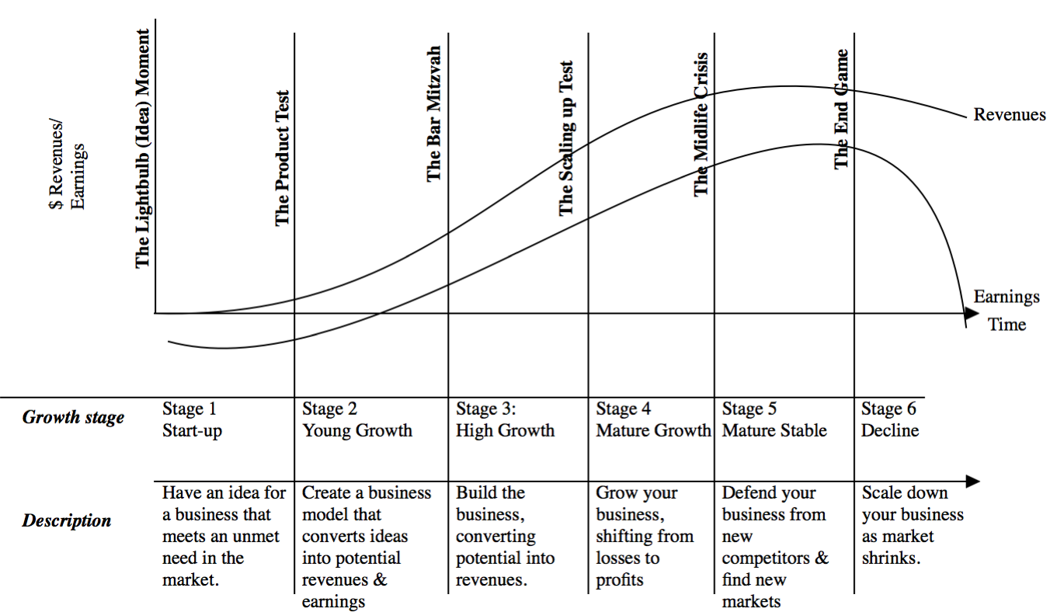
Introducing the corporate life cycle

Slide 38
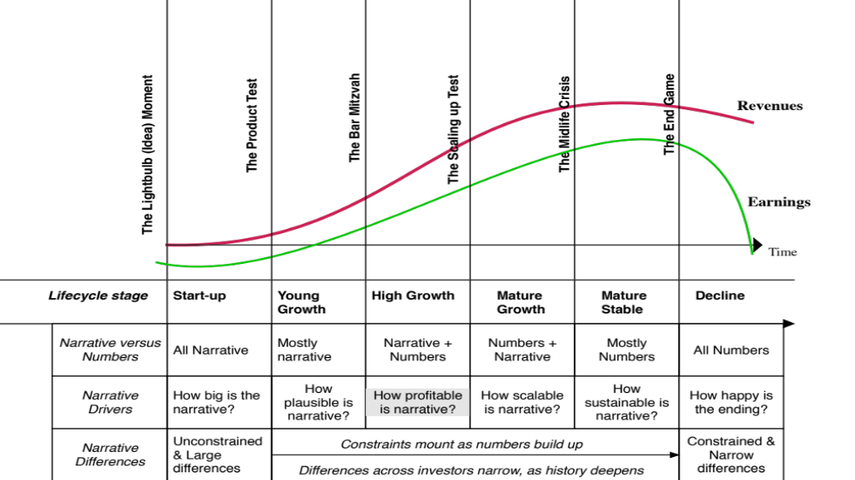
Connecting to narratives..

Slide 39
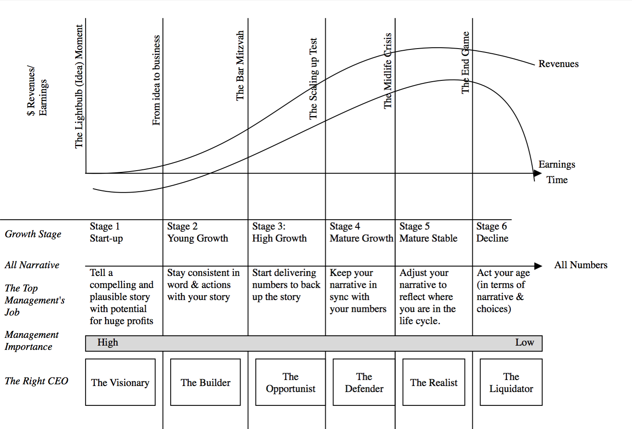
The Managerial Challenge

Slide 40
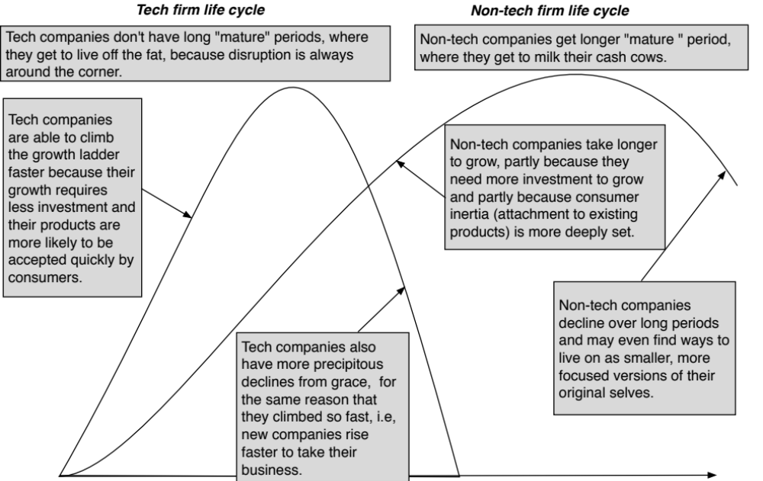
The Compressed Life Cycle?

Slide 41
The Consequences
When life cycles were long, stretching over decades, time and aging allowed for smoother transitions, since CEOs aged with their companies, and moved on.
As life cycles shorten, managers are far more likely to find their companies changing under them so quickly that they can no longer adapt.
  To be a long tenured CEO, you will either need to be versatile and/or be able to delegate the work that you cannot do to people you empower and trust.
  If these transitions are not well managed, there will be far more turnover in top management and activist investing will flourish.

Slide 42
Investors: Narrative or Numbers?
“Show me the money”

Slide 43
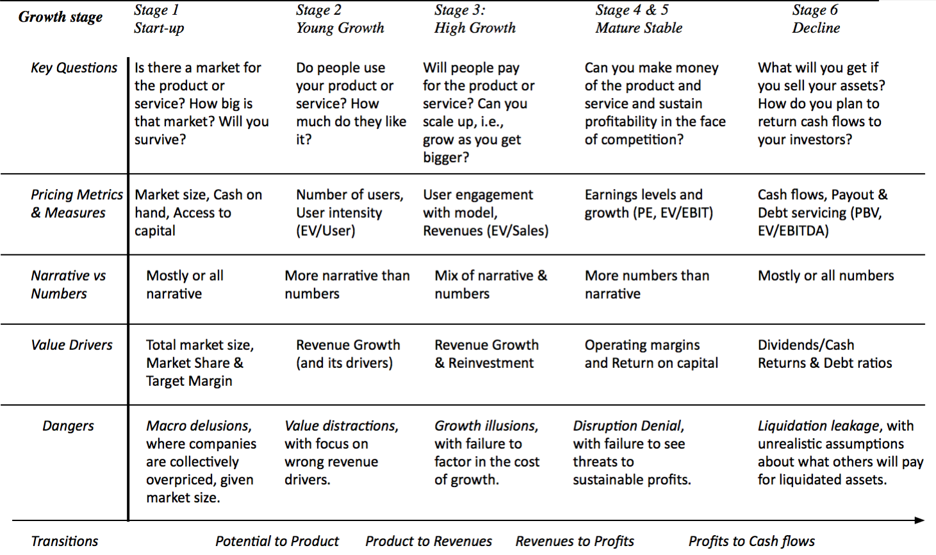
The Investor Challenge

Slide 44
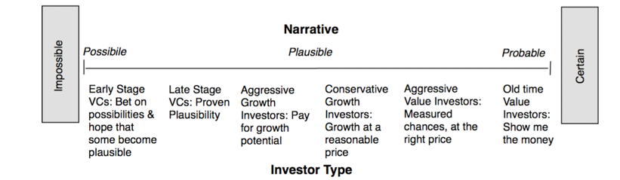
Investment Philosophies & Narratives

Slide 45
There is no one pathway to investing nirvana..
Successful Value investors
  Work primarily with numbers (financial ratios, pricing metrics)
  Will tend to invest in mature companies with stable and clear stories
Successful Growth investors
  Make their investments primarily based upon stories
  Will tend to invest in companies with big and expansive stories that pass the plausibility test.
Both sides will view the other side as deluded, but they will both be better at what they do, if they can work on their weak sides.

Slide 46
The End
“There is no real ending. It’s just the place where you stop the story.”

