Slide 1
Numbers AND NARRATIVE: MODELING, STORY TELLING AND INVESTING
Aswath Damodaran

Slide 2
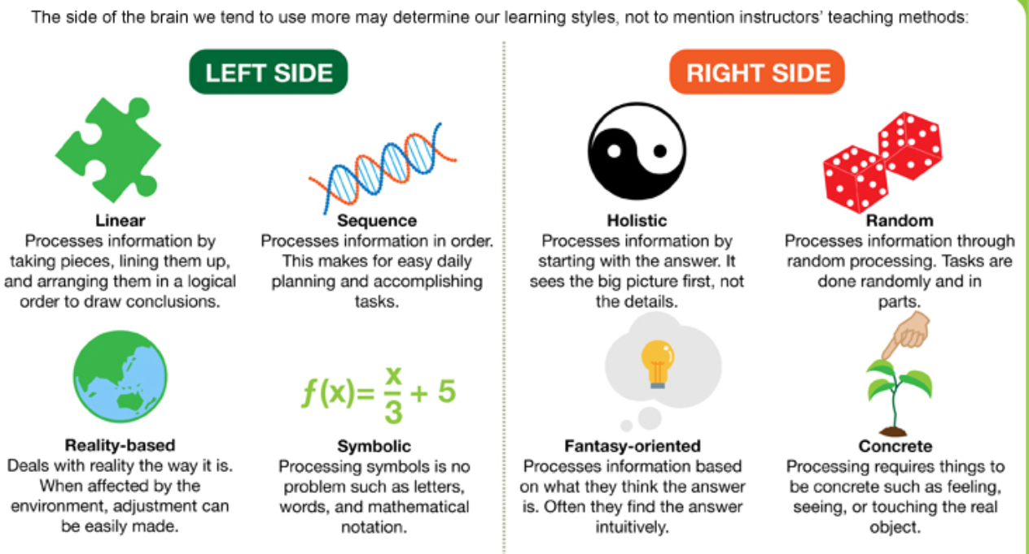
Left Brain or Right Brain?

Slide 3
The delusions of the number crunchers
The illusion of precision: If you use numbers, you are being more precise than when you don’t, and the more numbers you use, the more precise you become.
The illusion of “no bias”: Numbers don’t lie and data does not have an agenda. Thus, analysts who use numbers are more likely to be unbiased.
The illusion of control: If you put a number on something (your cash flows, expected growth rate, risk etc.), you can control it better.

Slide 4
The delusions of the story tellers
Number crunchers don’t dream in technicolour: Creativity and Numbers are mutually exclusive. If you talk about numbers, you cannot be creative, and if you are being creative, talk about numbers only crimps your creative instincts.
Creativity is deserving of reward: If your story is good, your business will success and your investment will pay off.
Experience is the best teacher: If you have pulled this off before (started and succeeded at running a business), your story is more believable.

Slide 5
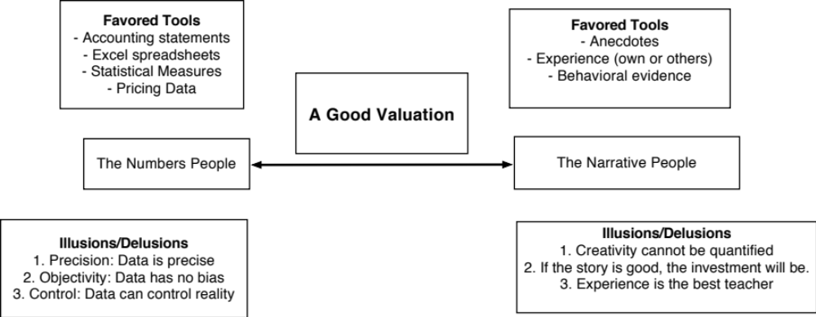
Bridging the Gap

Slide 6
Building a Valuation
Story to Numbers

Slide 7
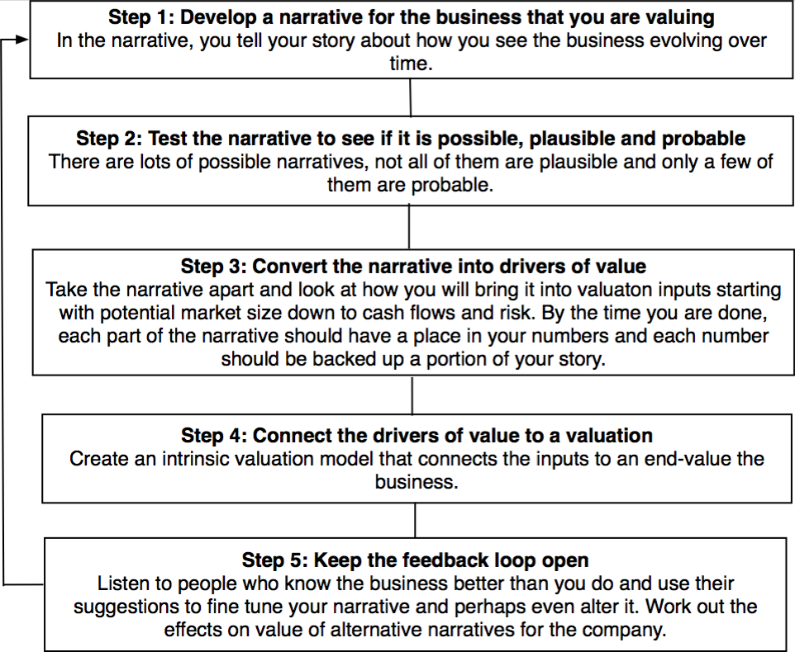
From Story to Numbers: The Steps

Slide 8
Step 1a: Survey the landscape
Every valuation starts with a narrative, a story that you see unfolding for your company in the future.
In developing this narrative, you will be making assessments of
  Your company (its products, its management and its history (financial and other)
  The market or markets that you see it growing in (geography, business)
  The competition it faces and will face, and its competitive advantages and disadvantages
  The macro environment in which it operates, including regulation and restrictions.

Slide 9
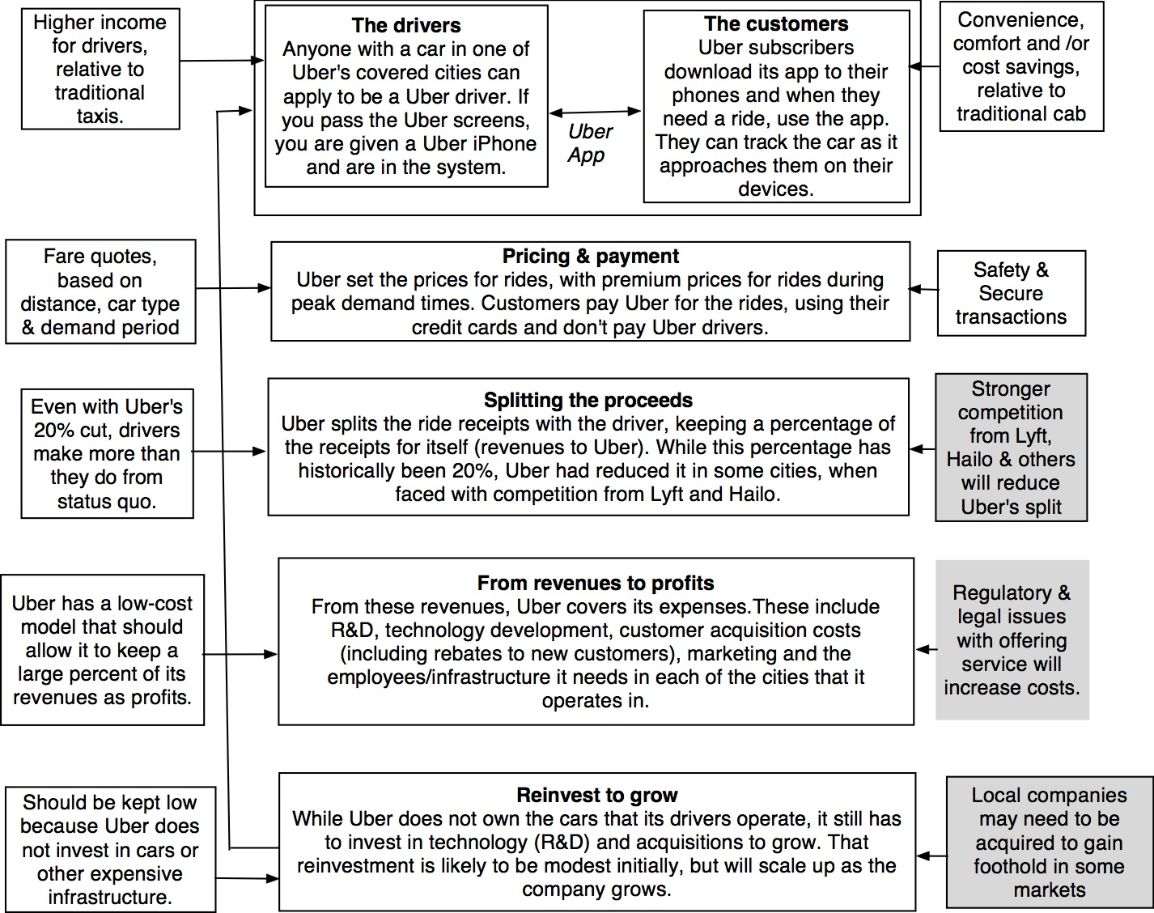

Slide 10
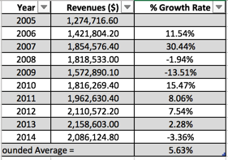
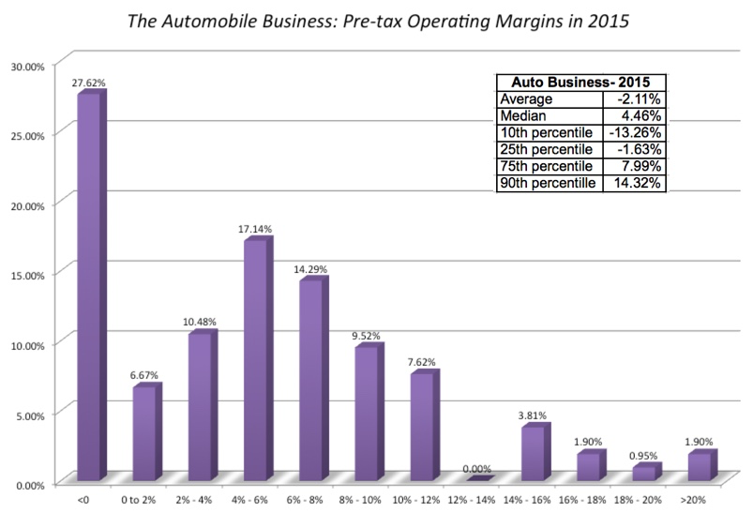
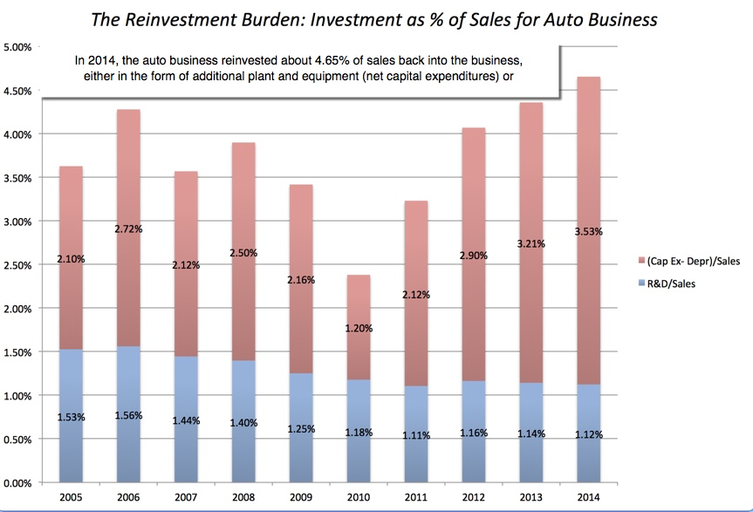
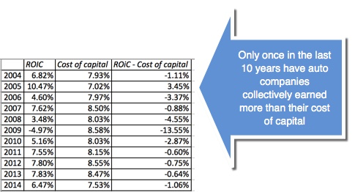
Low Growth
The Auto Business
Low Margins
+
High & Increasing Reinvestment
Bad Business
=

Slide 11
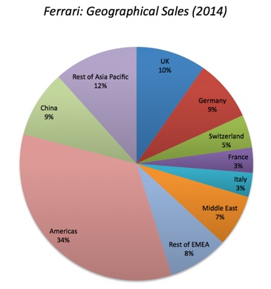
What makes Ferrari different?
Ferrari sold only 7,255 cars in all of 2014
Ferrari sales (in units) have grown very little in the last decade & have been stable
Ferrari had a profit margin of 18.2%, in the 95th percentile, partly because of its high prices and partly because it spends little on advertising.
Ferrari has not invested in new plants.

Slide 12
Latin America Retail
A big market: In 2024, the Latin American retail business generated about $1.5 trillion in revenues, with $180 billion coming from online retail. The three biggest regional mark in Latin America are Brazil, Mexico and Argentina.
Growing online portion: The overall retail market is growing about 5-7% in real terms, but online retail is increasing its share of that market and is expected to grow 10-12% a year over the next decade.
Competition: The brick and mortar retail business in Latin America is still mostly domestic (with big players within each country) firms., but the online retail market is dominated by firms that stretch across markets (Mercado Libre is the largest Latin American player, but Amazon is an a major player).

Slide 13
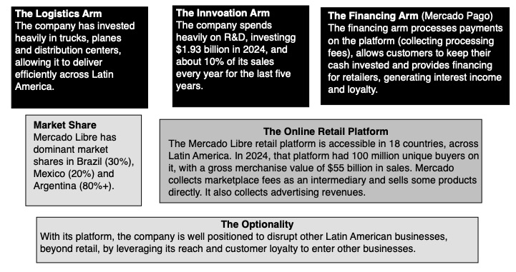
Mercado Libre: The Business Model

Slide 14
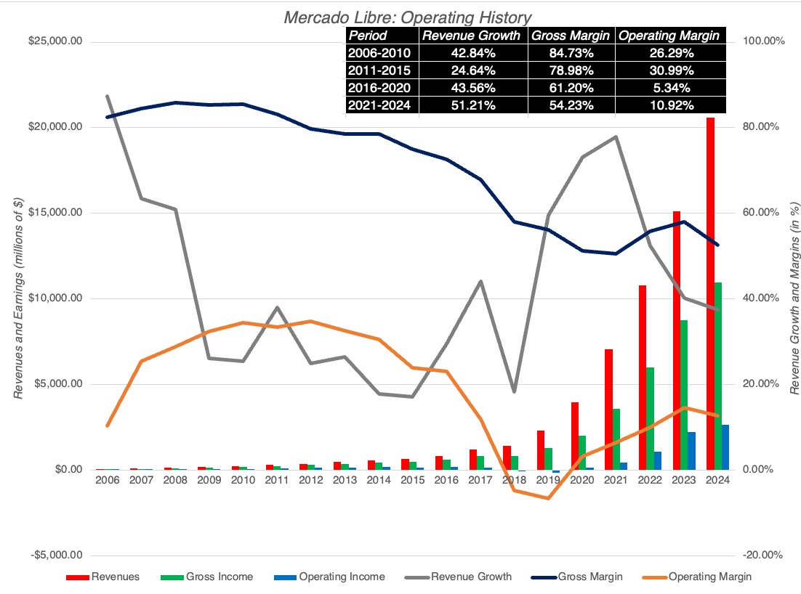
Mercado Libre: financial History

Slide 15
When country and currency risk are front and center..
For most Argentine companies, which report their financials is pesos, the historical data is a mess since high and shifting inflation over time makes it difficult to make sense of the data.
In most countries, a regulated utility, should have a pretty stable storyline, with revenues growing at a stable growth rate and margins reflecting pricing power. That is not the case with Edenor, where inflation and country risk have ravaged the financial data.
  In these cases, you may need to start the story anew drawing on business economics and industry norms for margins and returns on capital.
  In some cases, it may be easier to tell your story in real terms or in a different currency, but the truth is that inflation and currency woes will track you down no matter what you do.

Slide 16
Step 1b: Create a narrative for the future
Every valuation starts with a narrative, a story that you see unfolding for your company in the future.
In developing this narrative, you will be making assessments of your company (its products, its management), the market or markets that you see it growing in, the competition it faces and will face and the macro environment in which it operates.
  Rule 1: Keep it simple.
  Rule 2: Keep it focused.

Slide 17
The Uber Narrative
In June 2014, my initial narrative for Uber was that it would be
An urban car service business: I saw Uber primarily as a force in urban areas and only in the car service business.
Which would expand the business moderately (about 40% over ten years) by bringing in new users.
With local networking benefits: If Uber becomes large enough in any city, it will quickly become larger, but that will be of little help when it enters a new city.
Maintain its revenue sharing (20%) system due to strong competitive advantages (from being a first mover).
And its existing low-capital business model, with drivers as contractors and very little investment in infrastructure.

Slide 18
The Ferrari Narrative
Ferrari will stay an exclusive club, deriving its allure from its scarcity and the fact that only a few own Ferraris.
By staying exclusive, the company gets three benefits:
  It can continue to charge nose bleed prices for its cars and sell them with little or no advertising.
  It does not need to invest in new assembly plants, since it does not plan to ramp up production.
  It sells only to the super rich, who are unaffected by overall economic conditions or market crises.

Slide 19
The Mercado Libre Story
Latin American Retail & Fintech: Notwithstanding ambitions of being a global player, the company’s core market will be Latin American, and centered on retailing. Its financial arm will make much of its money from its retail space, with payment processing for customers and financing for retailers.
Strong competitive advantages: An understanding of the Latin American market, with the combination of scale, financing and logistics making it difficult for a competitor.
Continued growth: The company will continue to focus on and deliver revenue growth, with most of that growth coming at the expense of brick and mortar retail competitors.
Margin pressure: While the need for growth will continue to put pressure on profit margins, we see a flattening out of gross margins and an increase in operating margins, as economies of scale continue to play out.

Slide 20
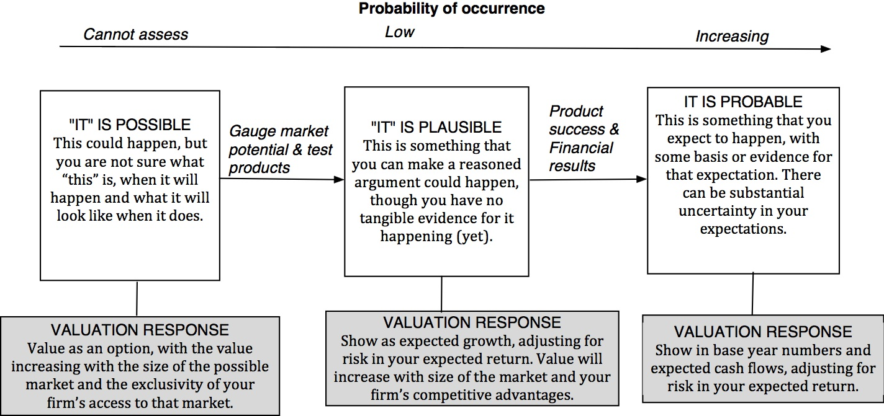
Step 2: Check the narrative against history, economic first principles & common sense

Slide 21
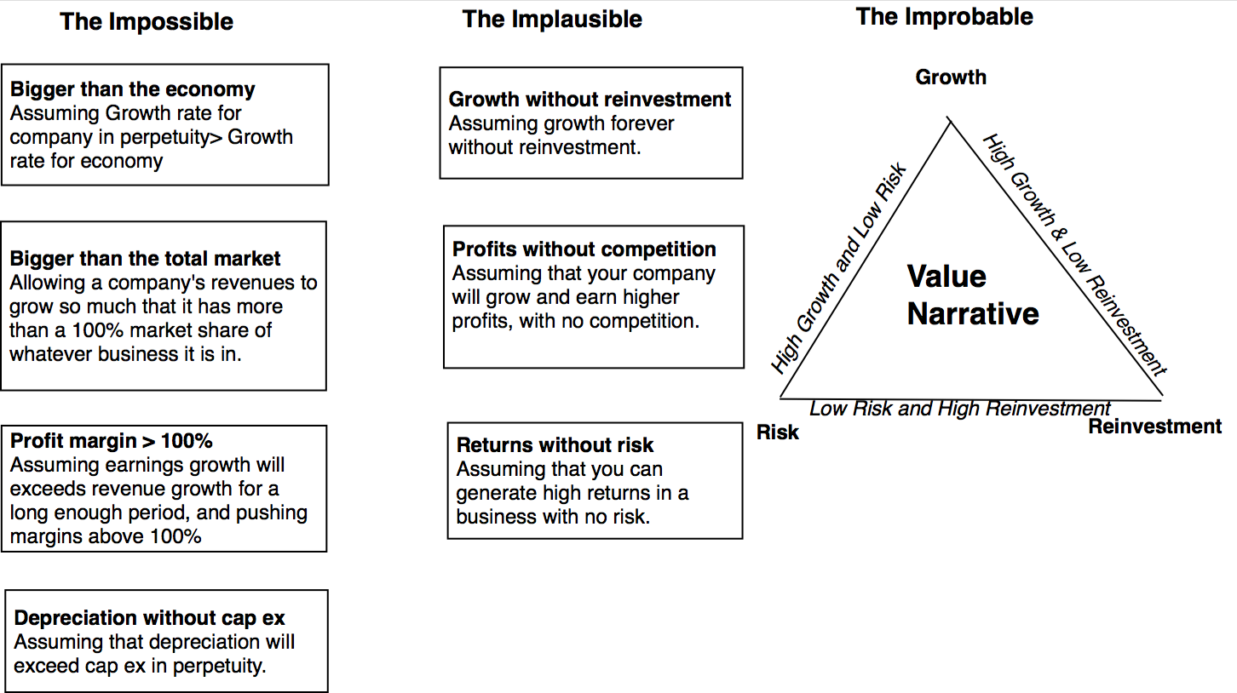
The Impossible, The Implausible and the Improbable

Slide 22
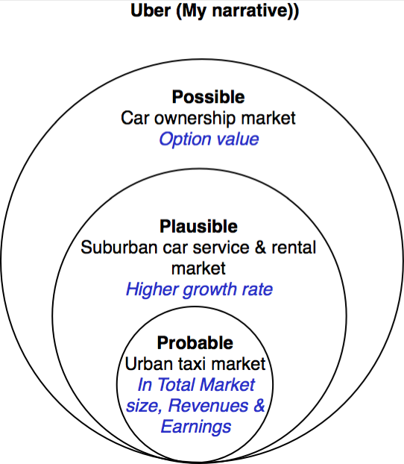
Uber: Possible, Plausible and Probable

Slide 23
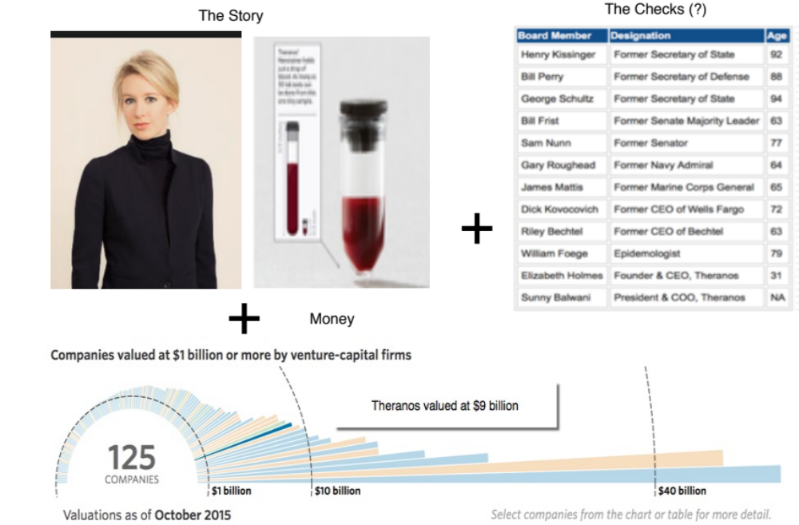
The Impossible: The Runaway Story

Slide 24
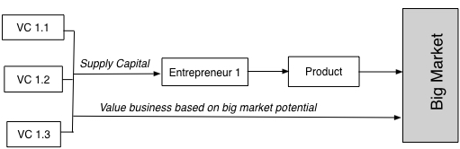
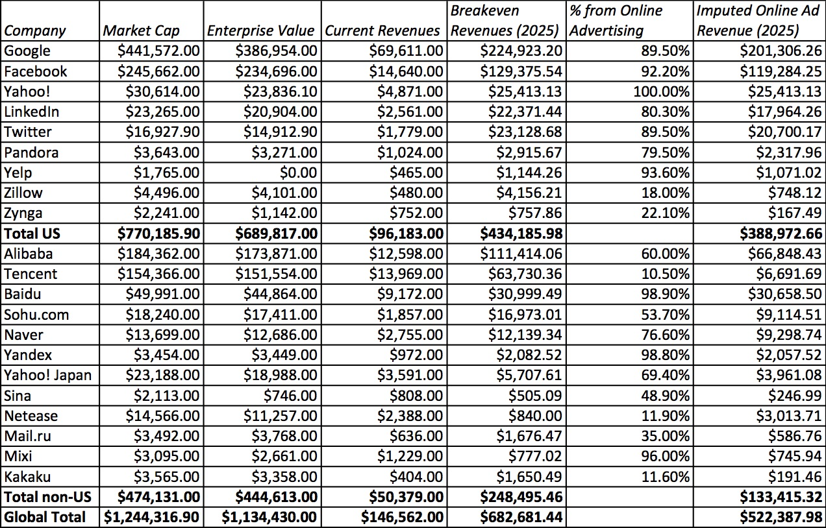
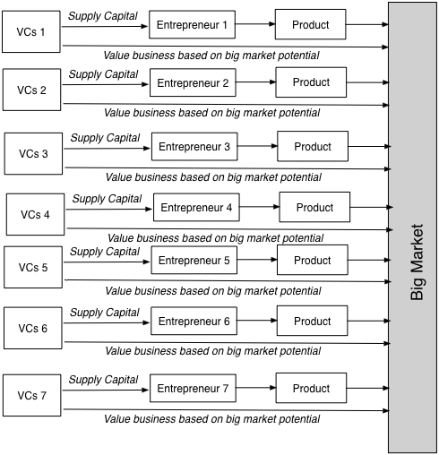
The Implausible: The Big Market Delusion

Slide 25
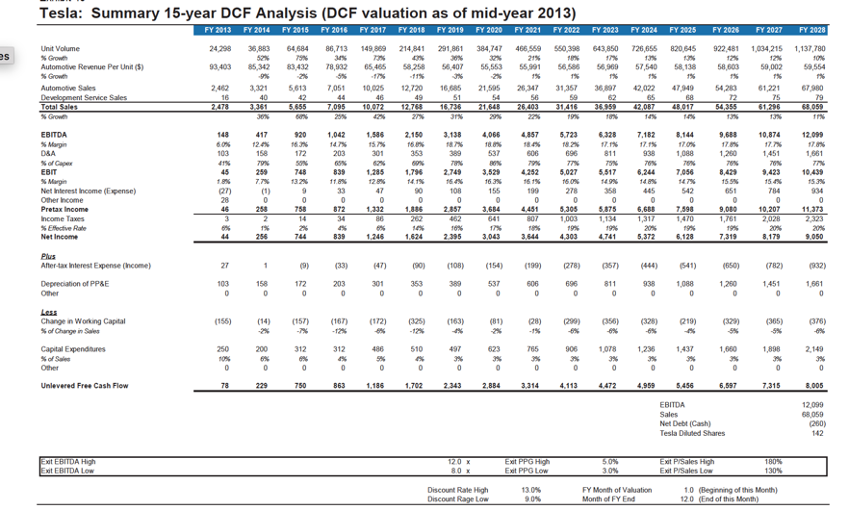
The Improbable: Willy Wonkitis

Slide 26
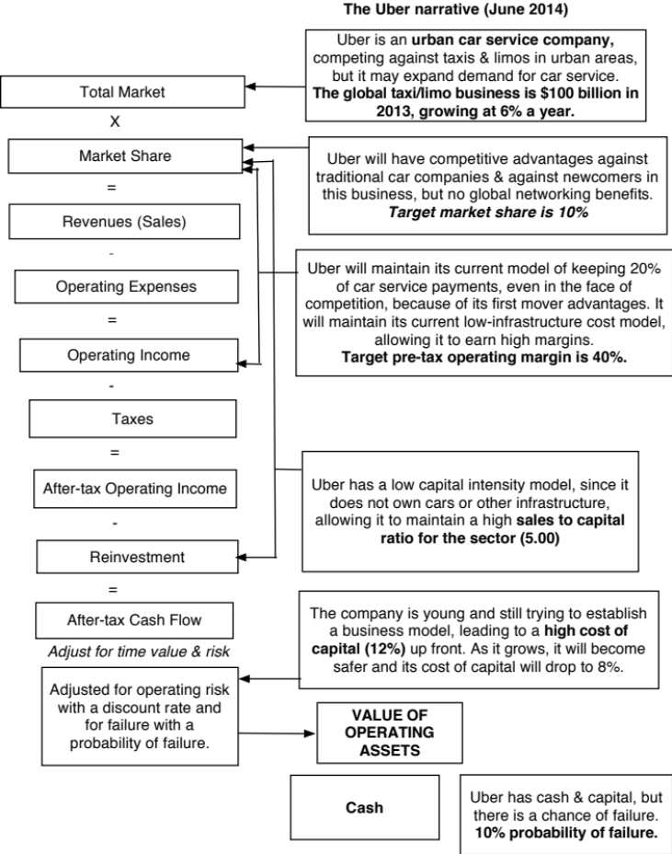
Step 3: Connect your narrative to key drivers of value

Slide 27
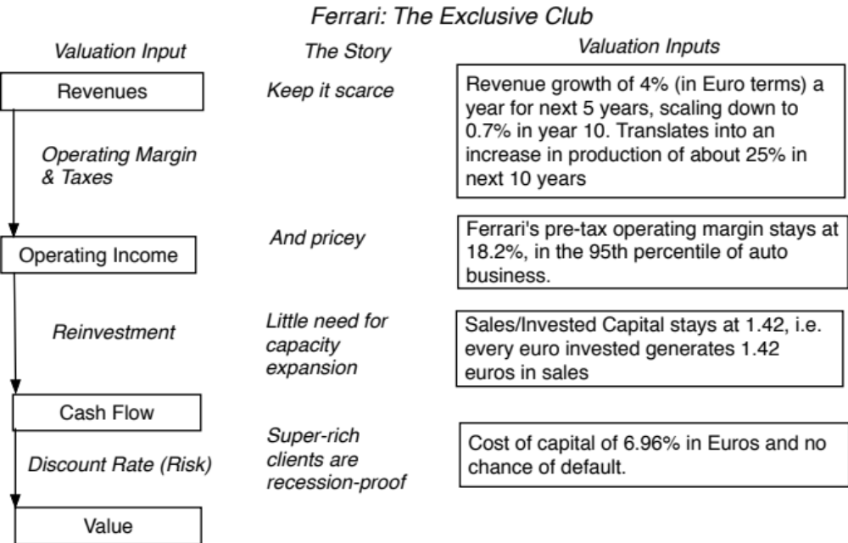
Ferrari: From story to numbers

Slide 28
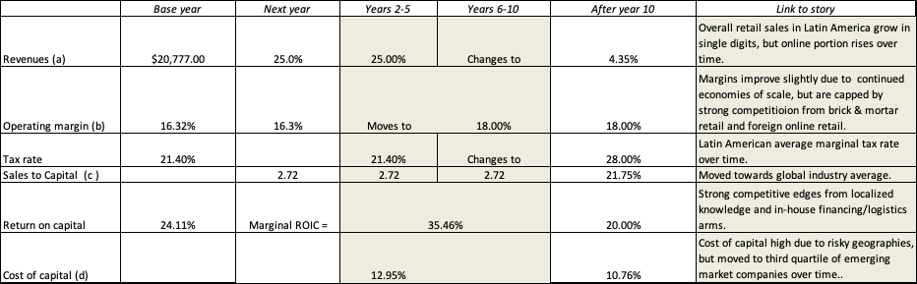
Mercado Libre: From story to numbers

Slide 29
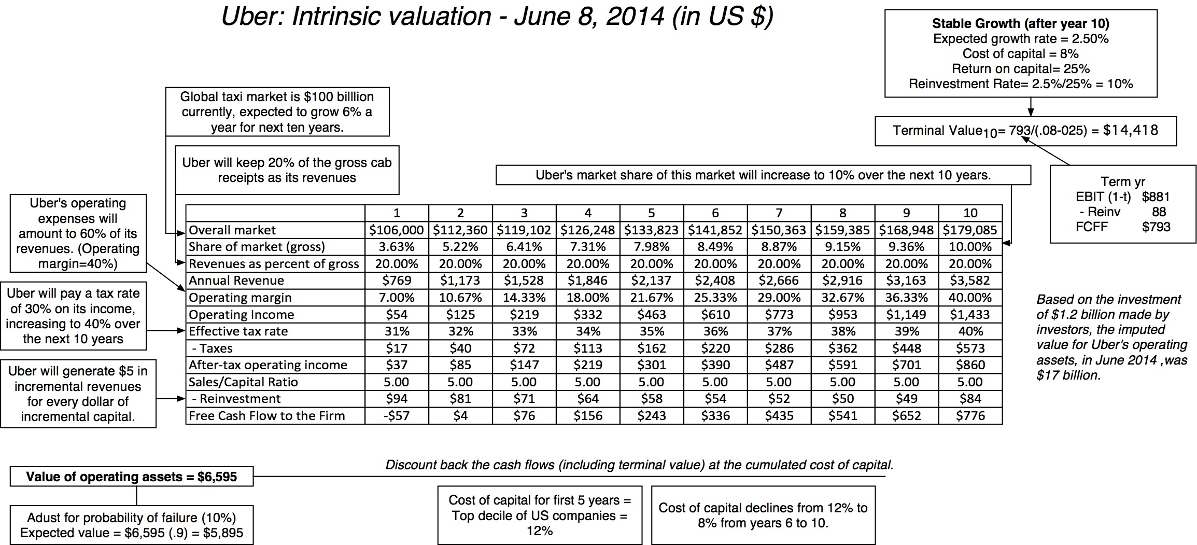
Step 4: Value the company (Uber)

Slide 30
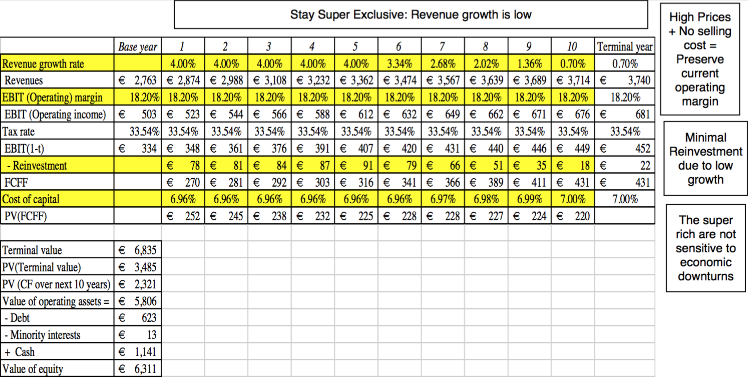
Ferrari: The “Exclusive Club” Value

Slide 31
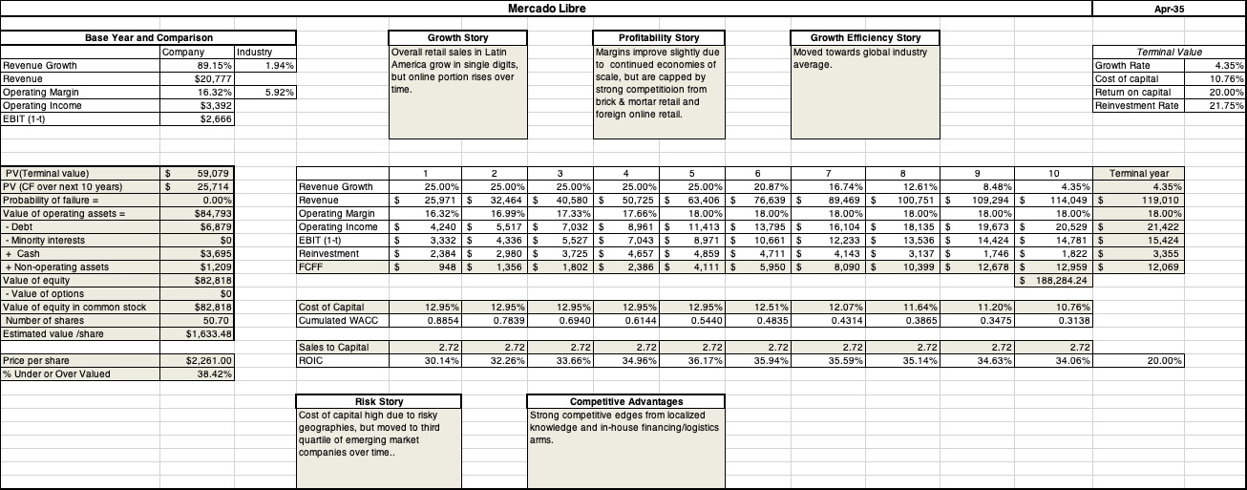

Slide 32
Step 5: Keep the feedback loop open
When you tell a story about a company (either explicitly or implicitly), it is natural to feel attached to that story and to defend it against all attacks. Nothing can destroy an investor more than hubris.
Being open to other views about a company is not easy, but here are some suggestions that may help:
  Face up to the uncertainty in your own estimates of value.
  Present the valuation to people who don’t think like you do.
  Create a process where people who disagree with you the most have a say.
  Provide a structure where the criticisms can be specific and pointed, rather than general.

Slide 33
The Uber Feedback Loop: Bill Gurley
Not just car service company.: Uber is a car company, not just a car service company, and there may be a day when consumers will subscribe to a Uber service, rather than own their own cars. It could also expand into logistics, i.e., moving and transportation businesses.
Not just urban: Uber can create new demands for car service in parts of the country where taxis are not used (suburbia, small towns).
Global networking benefits: By linking with technology and credit card companies, Uber can have global networking benefits.

Slide 34
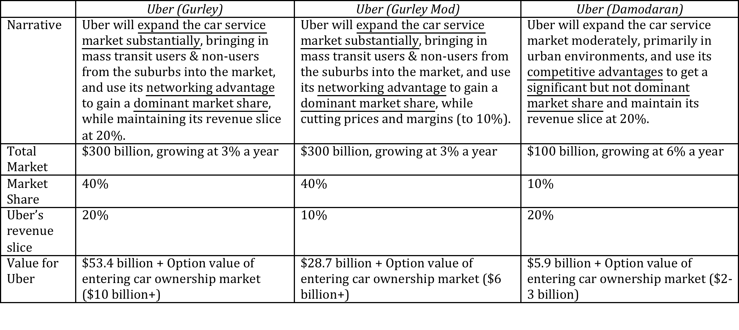
Valuing Bill Gurley’s Uber narrative

Slide 35
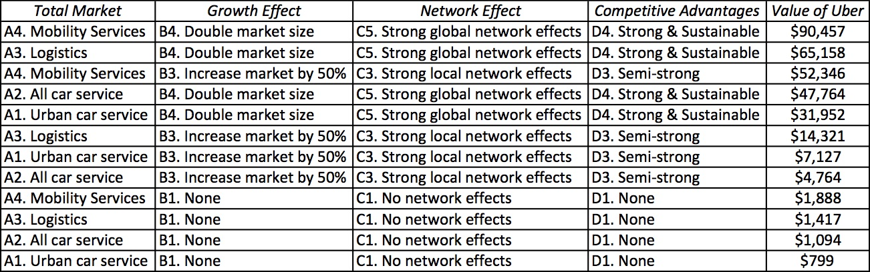
Different narratives, Different Numbers

Slide 36
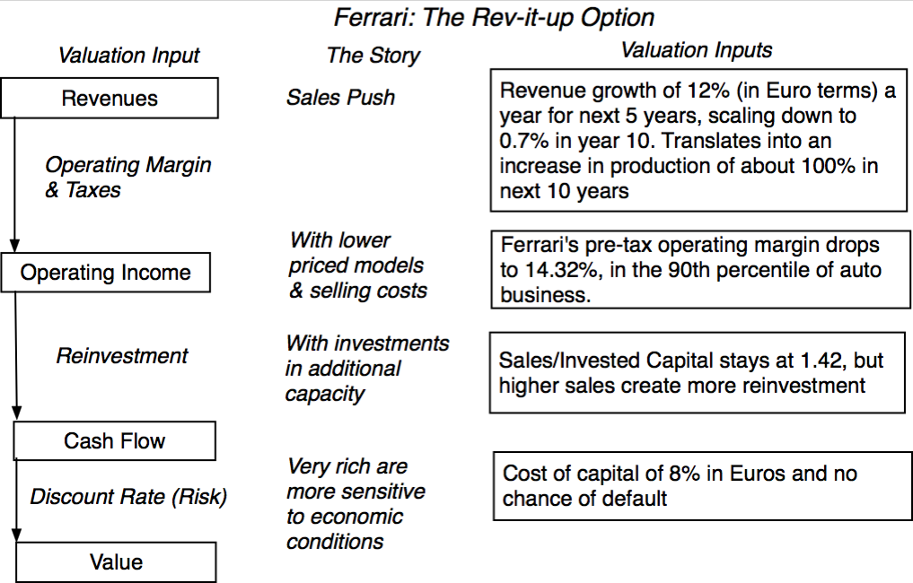
The Ferrari Counter Narrative

Slide 37
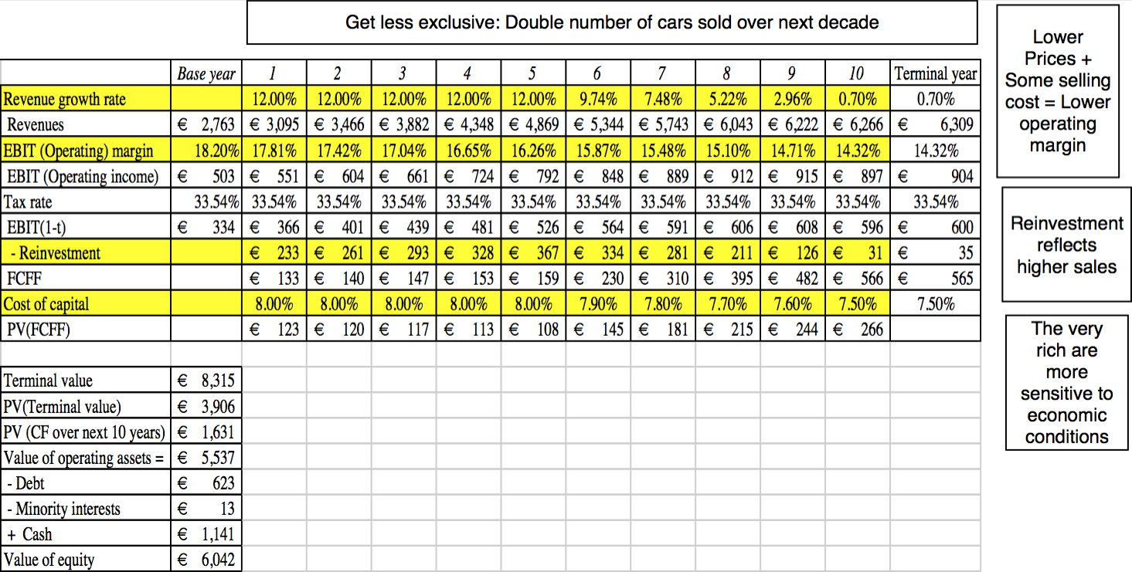
Ferrari: The “Rev-it-up” Alternative

Slide 38
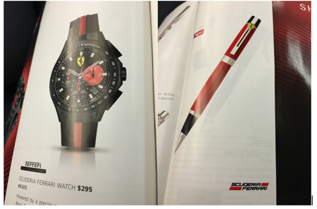
And the world is full of feedback.. My Ferrari afterthought!

Slide 39
Narrative breaks, shifts & changes
“When my information changes, I alter my conclusions. What do you do, sir?”
Lord Keynes

Slide 40
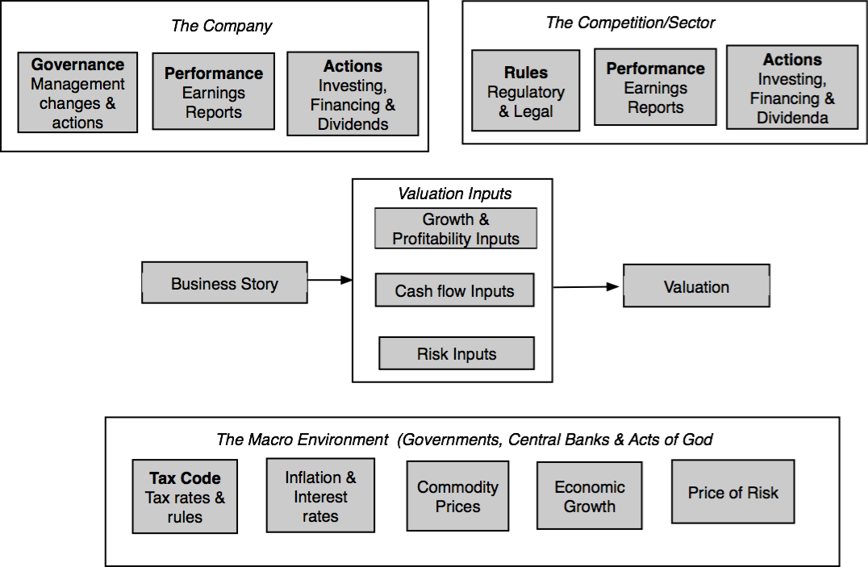
Why narratives change: Because the world changes around you…

Slide 41
How narratives change
Narrative Break/End | Narrative Shift | Narrative Change (Expansion or Contraction)
Events, external (legal, political or economic) or internal (management, competitive, default), that can cause the narrative to break or end. | Improvement or deterioration in initial business model, changing market size, market share and/or profitability. | Unexpected entry/success in a new market or unexpected exit/failure in an existing market.
Your valuation estimates (cash flows, risk, growth & value) are no longer operative | Your valuation estimates will have to be modified to reflect the new data about the company. | Valuation estimates have to be redone with new overall market potential and characteristics.
Estimate a probability that it will occur & consequences | Monte Carlo simulations or scenario analysis | Real Options

Slide 42
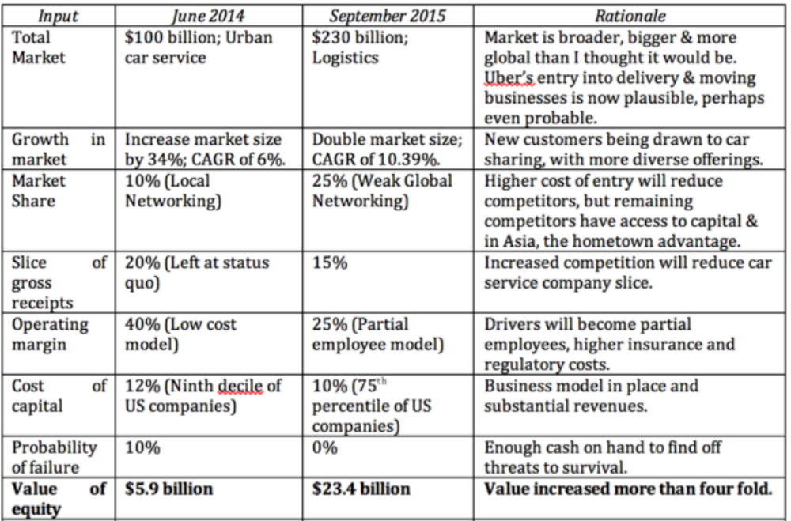
Uber: The September 2015 Update

Slide 43
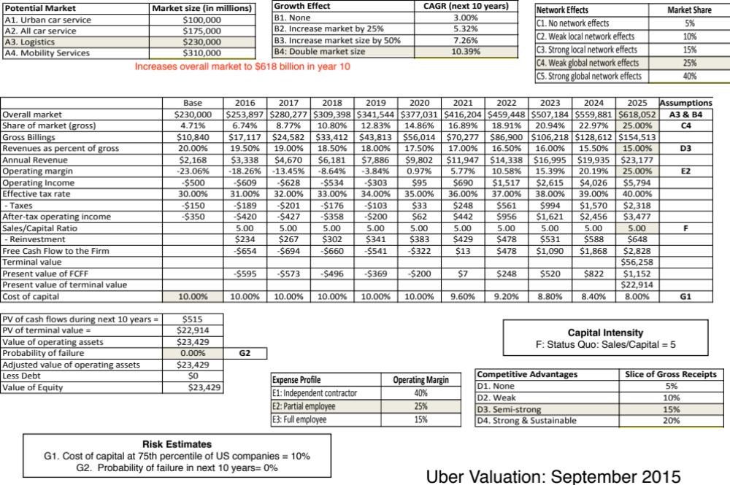

Slide 44
Mercado Libre: A Bet on Latin America and fintech?
Embedded in the Mercado Libre story is a macro story about Latin America, which is mostly positive, but with reservations.
  Real growth will be positive but not overwhelmingly so. The real growth of about 5-7% in retail will track the real growth in Latin America and our story.
  Like the rest of the world, Latin America will become increasingly digital. The growth in online retail comes from increased access to smart phones and better internet service.
  Latin American country risk will decrease over time, but remain towards the top of the risk ladder. The cost of capital decreases, but only to the third quartile for emerging marekt firms.
Any significant change in country risk or economic growth at Mercado’s three biggest markets (Brazil, Argentina and Mexico) will lead to a reassessment of the company.

Slide 45
Investors and Managers: Narrative or Numbers?
“Management is, above all, a practice where art, science, and craft meet”

Slide 46
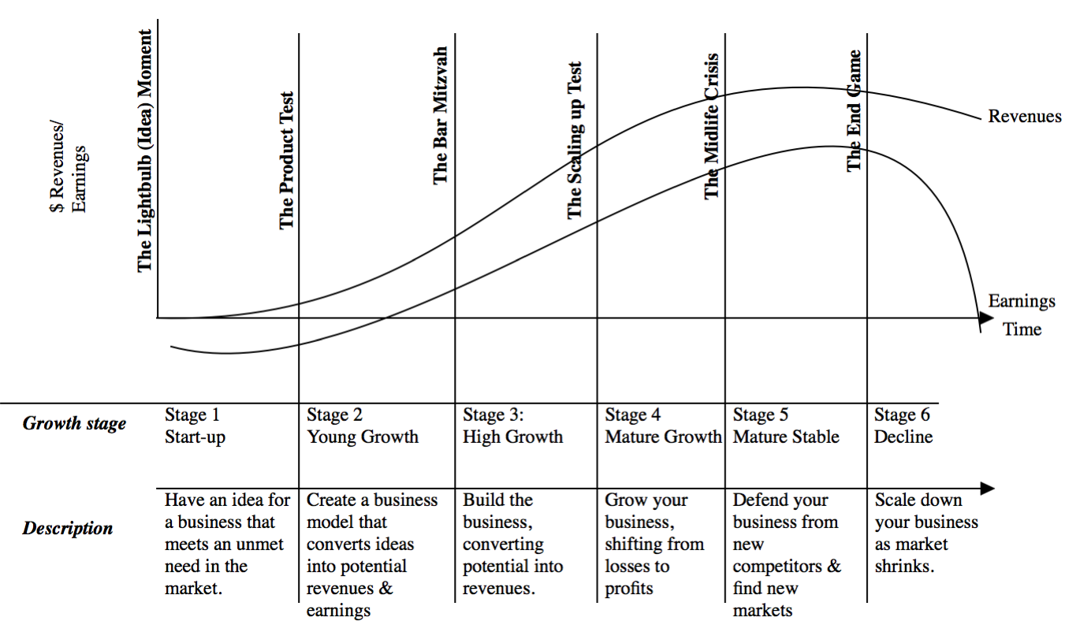
Introducing the corporate life cycle

Slide 47
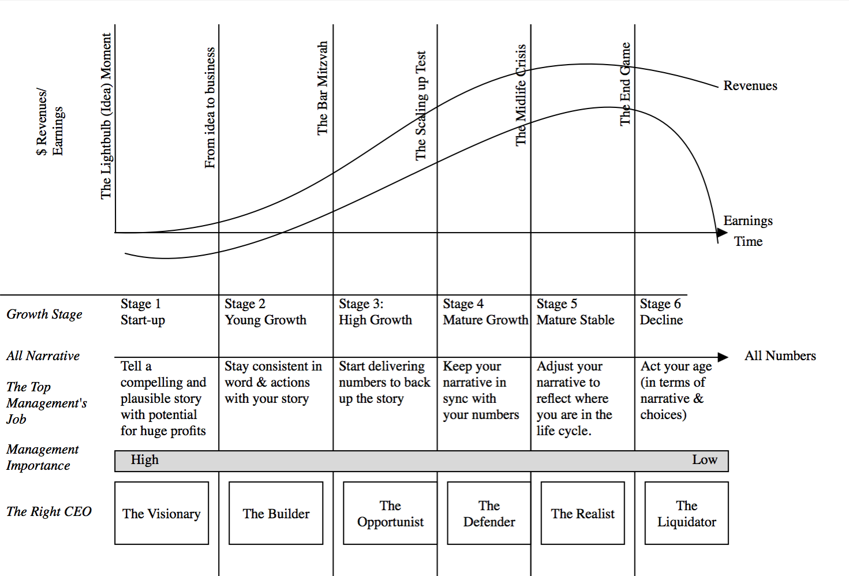
The Managerial Challenge

Slide 48
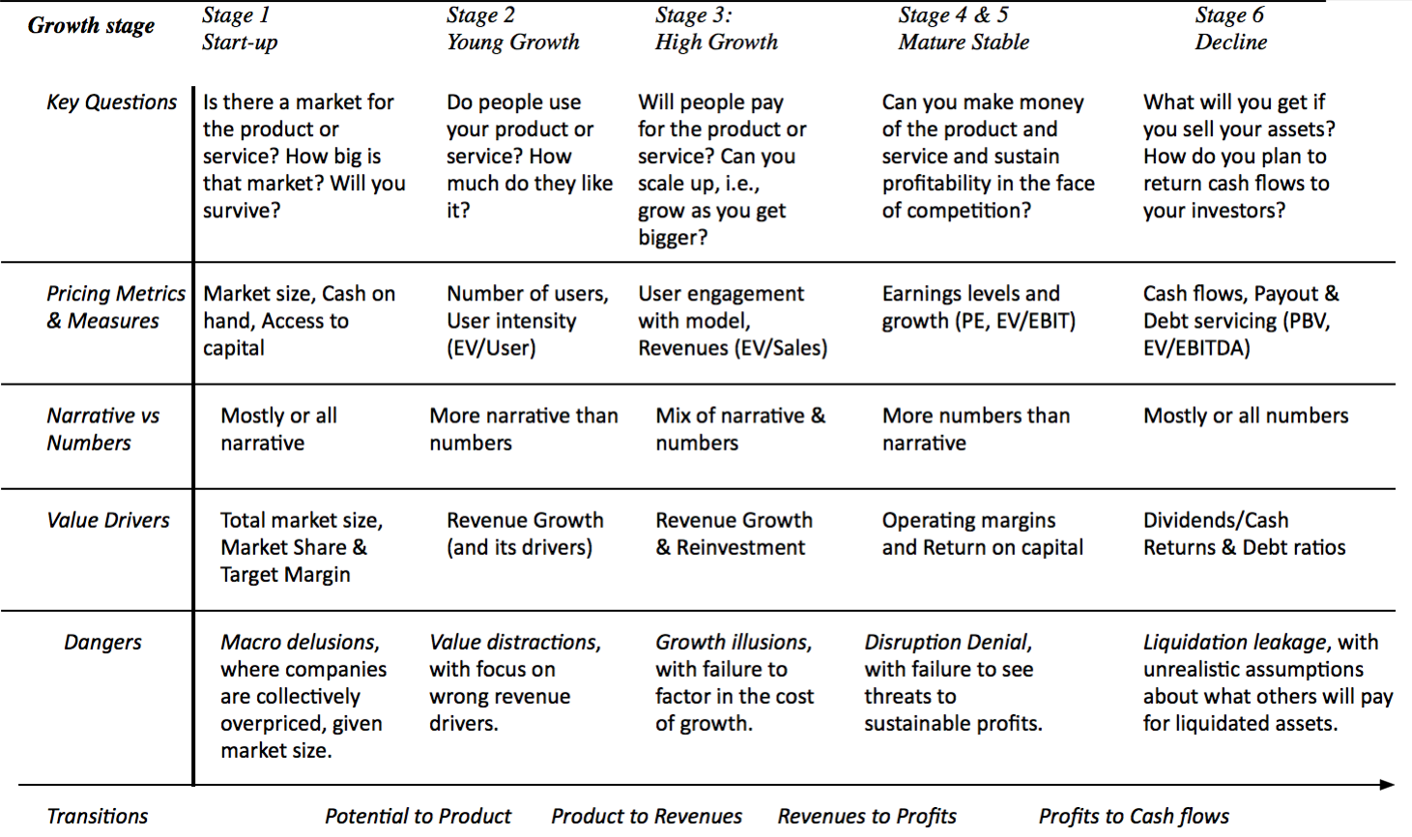
The Investor Challenge

Slide 49
The End
“There is no real ending. It’s just the place where you stop the story.”

