Slide 1
Valuation: Art, SCIENCE, CRAFT or magic?
Aswath Damodaran
www.damodaran.com

Slide 2
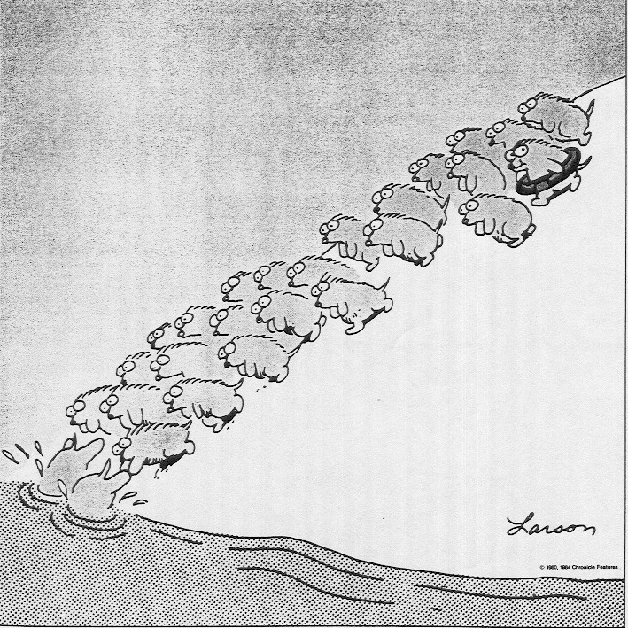
Some Initial Thoughts
" One hundred thousand lemmings cannot be wrong"
Graffiti

Slide 3
Misconceptions about Valuation
Myth 1: A valuation is an objective search for “true” value
  Truth 1.1: All valuations are biased. The only questions are how much and in which direction.
  Truth 1.2: The direction and magnitude of the bias in your valuation is directly proportional to who pays you and how much you are paid.
Myth 2.: A good valuation provides a precise estimate of value
  Truth 2.1: There are no precise valuations
  Truth 2.2: The payoff to valuation is greatest when valuation is least precise.
Myth 3: . The more quantitative a model, the better the valuation
  Truth 3.1: One’s understanding of a valuation model is inversely proportional to the number of inputs required for the model.
  Truth 3.2: Simpler valuation models do much better than complex ones.

Slide 4
Approaches to Valuation
Intrinsic valuation, relates the value of an asset to the present value of expected future cashflows on that asset. In its most common form, this takes the form of a discounted cash flow valuation.
Relative valuation, estimates the value of an asset by looking at the pricing of 'comparable' assets relative to a common variable like earnings, cash flows, book value or sales.
Contingent claim valuation, uses option pricing models to measure the value of assets that share option characteristics.
Notes:
There are some who suggest that there is a fourth way to approach valuation, which is to value the assets of a firm individually. Asset based valuation, however, requires that you use either discounted cash flow or relative valuation models to value the individual assets. Consequently, we view it as a subset of these approaches.

Slide 5
Discounted Cash Flow Valuation
What is it: In discounted cash flow valuation, the value of an asset is the present value of the expected cash flows on the asset.
Philosophical Basis: Every asset has an intrinsic value that can be estimated, based upon its characteristics in terms of cash flows, growth and risk.
Information Needed: To use discounted cash flow valuation, you need
  to estimate the life of the asset
  to estimate the cash flows during the life of the asset
  to estimate the discount rate to apply to these cash flows to get present value
Market Inefficiency: Markets are assumed to make mistakes in pricing assets across time, and are assumed to correct themselves over time, as new information comes out about assets.
Notes:
Discounted cash flow valuation is geared for assets that derive their value from the cashflows that they are expected to generate - most businesses and financial assets fall into this category.
The inputs needed for all discounted cash flow models - cash flows, discount rates and asset life - are the same, though the ease with which they can be estimated may vary from asset to asset.
When we use discounted cash flow valuation, we are assuming that we can estimate intrinsic value and that market prices can deviate from intrinsic values. We also assume that prices will revert back to intrinsic value sooner or later - this is why a long time horizon is a pre-requisit.

Slide 6
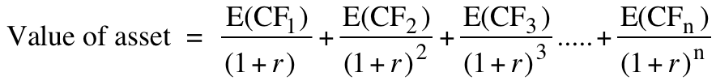
Risk Adjusted Value: Three Basic Propositions
The value of an asset is the present value of the expected cash flows on that asset, over its expected life:
Proposition 1: If “it” does not affect the cash flows or alter risk (thus changing discount rates), “it” cannot affect value.
Proposition 2: For an asset to have value, the expected cash flows have to be positive some time over the life of the asset.
Proposition 3: Assets that generate cash flows early in their life will be worth more than assets that generate cash flows later; the latter may however have greater growth and higher cash flows to compensate.
Notes:
Cash is king. A firm with negative cash flows today can be a very valuable firm but only if there is reason to believe that cash flows in the future will be large enough to compensate for the negative cash flows today. The riskier a firm and the longer you have to wait for the cash flows, the greater the cashflows eventually have to be….

Slide 7
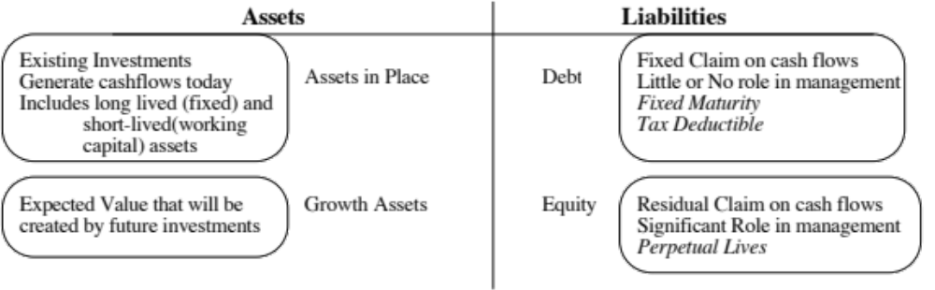
DCF Choices: Equity Valuation versus Firm Valuation
Firm Valuation: Value the entire business
Equity valuation: Value just the equity claim in the business
Notes:
A business and the equity in the business can be very different numbers…
A firm like GE in 2005 had a value of $ 500 billion for its business but its equity is worth only $ 300 billion - the difference is due to the substantial debt that GE has used to fund its expansion.
You can have valuable businesses, where the equity is worth nothing because the firm has borrowed too much….

Slide 8
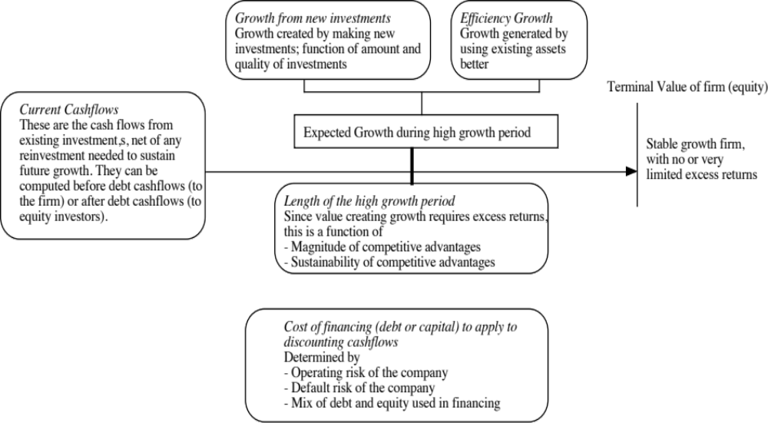
The Drivers of Value…

Slide 9
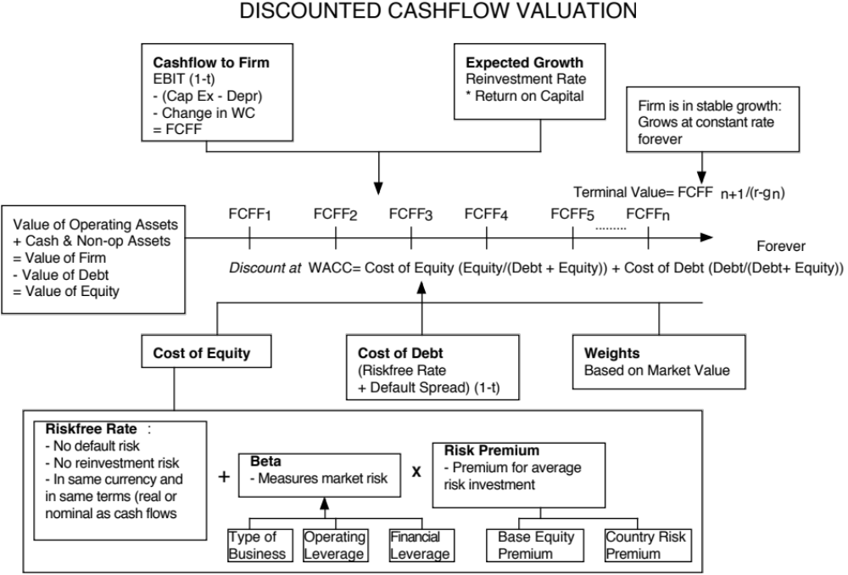

Slide 10
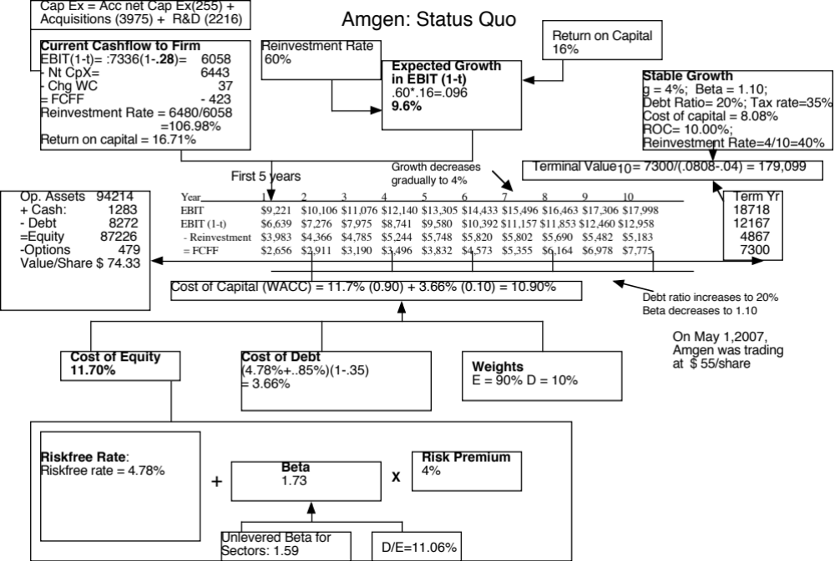

Slide 11
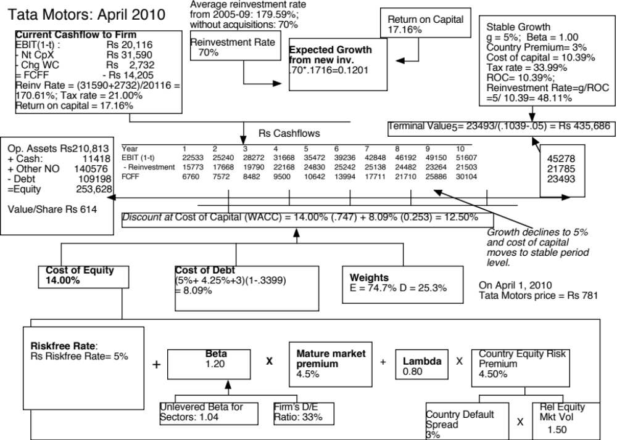

Slide 12
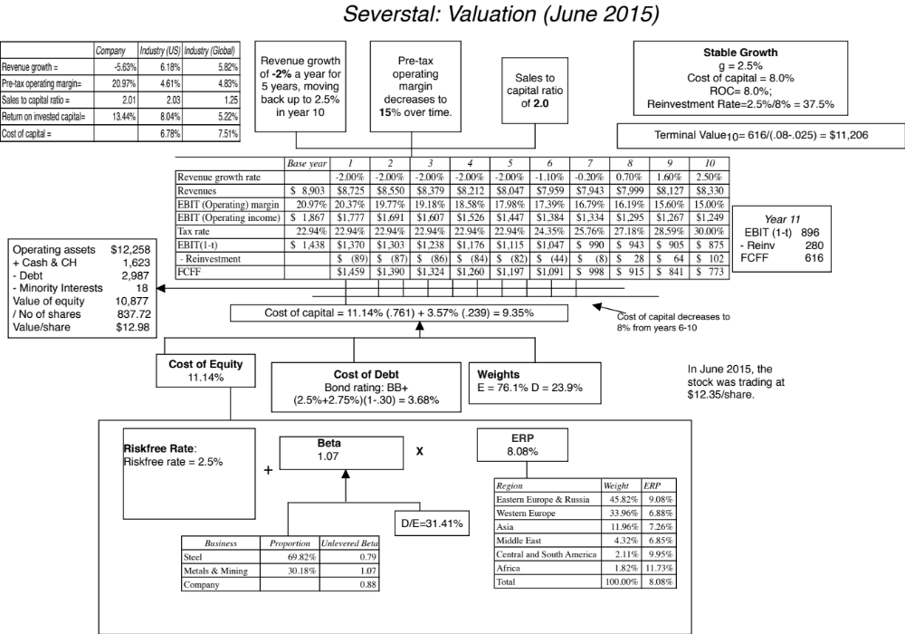

Slide 13
DCF Inputs
“Garbage in, garbage out”

Slide 14
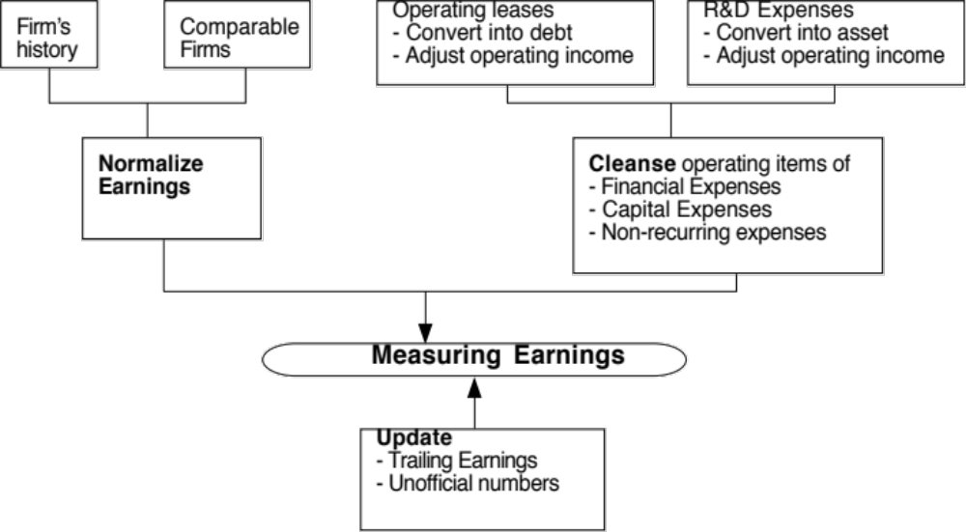
I. Measure earnings right..

Slide 15
Operating Leases at Amgen in 2007
Amgen has lease commitments and its cost of debt (based on it’s A rating) is 5.63%.
Year Commitment Present Value
1 $96.00 $90.88
2 $95.00 $85.14
3 $102.00 $86.54
4 $98.00 $78.72
5 $87.00 $66.16
6-12 $107.43 $462.10 ($752 million prorated)
Debt Value of leases = $869.55
Debt outstanding at Amgen = $7,402 + $ 870 = $8,272 million
Adjusted Operating Income = Stated OI + Lease expense this year – Depreciation
= 5,071 m + 69 m - 870/12 = $5,068 million (12 year life for assets)
Approximate Operating income= stated OI + PV of Lease commitment * Pre-tax cost of debt
= $5,071 m + 870 m (.0563) = $ 5,120 million
Notes:
The Home Depot reports its lease commitments in its financial statements. The present value of operating lease expenses is computed using the pre-tax cost of debt. (An argument can be made that the unsecured cost of debt should be used.)

Slide 16
Capitalizing R&D Expenses: Amgen
R & D was assumed to have a 10-year life.
Year R&D Expense Unamortized portion Amortization this year
Current 3366.00 1.00 3366.00
-1 2314.00 0.90 2082.60 $231.40
-2 2028.00 0.80 1622.40 $202.80
-3 1655.00 0.70 1158.50 $165.50
-4 1117.00 0.60 670.20 $111.70
-5 865.00 0.50 432.50 $86.50
-6 845.00 0.40 338.00 $84.50
-7 823.00 0.30 246.90 $82.30
-8 663.00 0.20 132.60 $66.30
-9 631.00 0.10 63.10 $63.10
-10 558.00 0.00 $55.80
Value of Research Asset = $10,112.80 $1,149.90
Adjusted Operating Income = $5,120 + 3,366 - 1,150 = $7,336 million
Notes:
The amortizable life is an assumption based upon Cisco’s business (telecom equipment and software). It would be shorter in other businesses (such as computer chips) and longer in businesses that need regulatory approval (such as pharmaceuticals).
Note that the amortization is 1/5 of the R&D expense each year.
We are also assuming that R&D expenses are spent at the end of each year - not realistic, but simplifies analysis - that is why there is no amortization of the current year’s expense.
The effect of capitalizing R&D will be greatest at firms where R&D is growing over time and be non-existent at firms with flat R&D.

Slide 17
II. Get the big picture (not the accounting one) when it comes to cap ex and working capital
Capital expenditures should include
  Research and development expenses, once they have been re-categorized as capital expenses.
  Acquisitions of other firms, whether paid for with cash or stock.
Working capital should be defined not as the difference between current assets and current liabilities but as the difference between non-cash current assets and non-debt current liabilities.
On both items, start with what the company did in the most recent year but do look at the company’s history and at industry averages.

Slide 18
Amgen’s Net Capital Expenditures
The accounting net cap ex at Amgen is small:
  Accounting Capital Expenditures = $1,218 million
  - Accounting Depreciation = $ 963 million
  Accounting Net Cap Ex = $ 255 million
We define capital expenditures broadly to include R&D and acquisitions:
  Accounting Net Cap Ex = $ 255 million
  Net R&D Cap Ex = (3366-1150) = $2,216 million
  Acquisitions in 2006 = $3,975 million
  Total Net Capital Expenditures = $ 6,443 million
Acquisitions have been a volatile item. Amgen was quiet on the acquisition front in 2004 and 2005 and had a significant acquisition in 2003.

Slide 19
III. The government bond rate is not always the risk free rate
When valuing Amgen in US dollars, the US$ ten-year bond rate of 4.78% was used as the risk free rate. We assumed that the US treasury was default free.
When valuing Tata Motors in Indian rupees in 2010, the Indian government bond rate of 8% was not default free. Using the Indian government’s local currency rating of Ba2 yielded a default spread of 3% for India and a riskfree rate of 5% in Indian rupees.
Risk free rate in Indian Rupees = 8% - 3% = 5%
To estimate a risk free rate in Russian Rubles in January 2015, you would have to start with the Russian government bond rate in rubles and back out the default spread for Russia.
  Government bond rate in rubles = 14.09%
  Default spread in rubles = 1.90%
  Risk free rate in rubles = 12.19%

Slide 20
Risk free rates will vary across currencies!

Slide 21
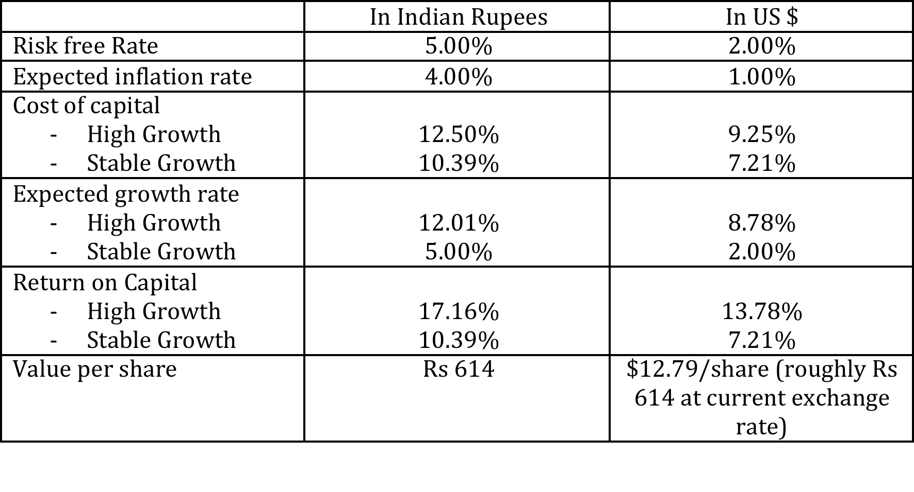
But valuations should not!

Slide 22
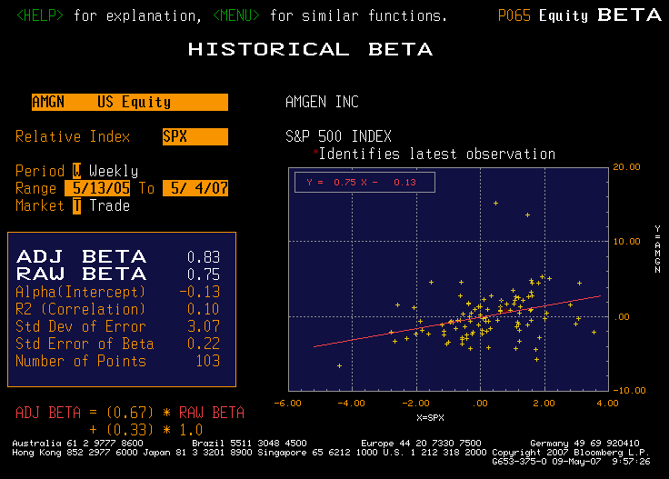
IV. Betas do not come from regressions… and are noisy…

Slide 23
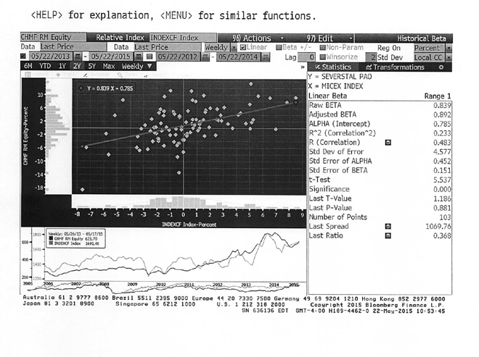
Look better for some companies, but not if run against narrow indices

Slide 24
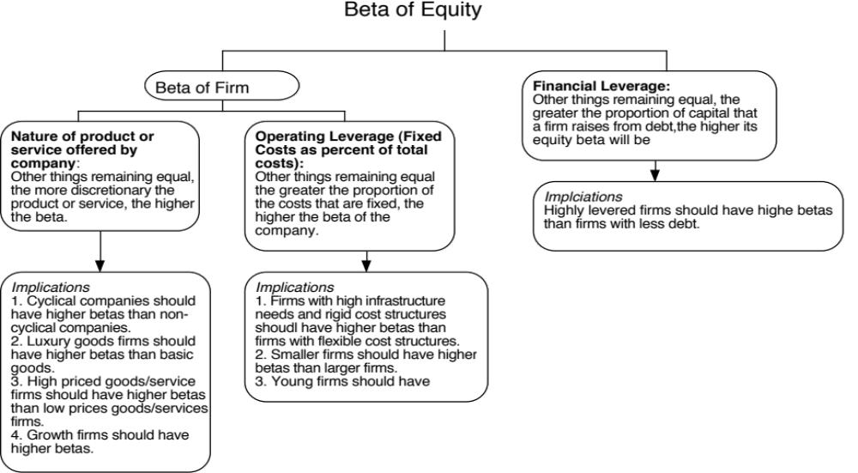
Determinants of Betas
Notes:
These are the three fundamentals that drive betas.
Firms that produce luxury goods (such as Gucci and Tiffanys) should have higher betas than firms that cater to more basic needs (Walmart). These firms tend to have revenues that are much more sensitive to changes in economic conditions.
Firms in businesses with high fixed cost structures (like airlines) should have higher betas than firms with more flexible cost structures.
Firms that borrow more money will have higher equity betas than otherwise similar firms that do not borrow money.

Slide 25
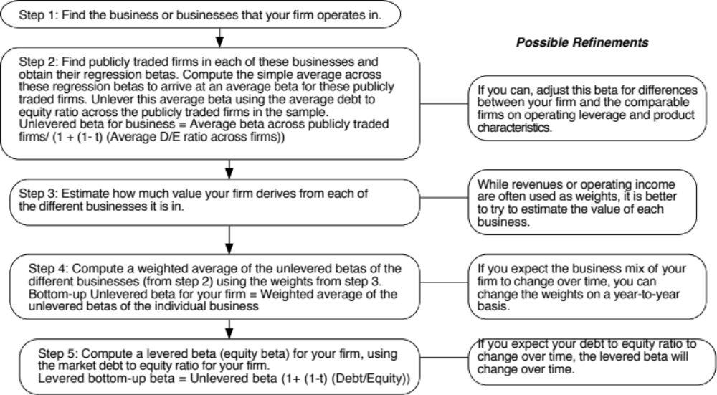
Bottom-up Betas
Notes:
Three measurement issues come up:
How broadly or narrowly do we define comparable firms?
We would argue for a broader rather than a narrow definition, because the savings in standard error increase with the number of firms.
How do we deal with differences in operating leverage and business mix that may persist across these firms?
Assume that there are no differences in operating leverage and business mix or that the differences average out.
Adjust for the differences quantitatively. For instance, you could decompose the unlevered beta further into a business beta and the operating leverage effect:
Unlevered beta = Business beta (1 + (Fixed Cost/Variable costs))
How do we compute an average - simple or weighted?
I prefer simple averages. Otherwise, your betas reflect those of the largest and most stable firms in the business.

Slide 26
Three examples…
Amgen
  The unlevered beta for pharmaceutical firms is 1.59. Using Amgen’s debt to equity ratio of 11%, the bottom up beta for Amgen is
  Bottom-up Beta = 1.59 (1+ (1-.35)(.11)) = 1.73
Tata Motors
  The unlevered beta for automobile firms is 0.98. Using Tata Motor’s debt to equity ratio of 33.87%, the bottom up beta for Tata Motors is
  Bottom-up Beta = 0.98 (1+ (1-.3399)(.3387)) = 1.20
Severstal
Business | Proportion | Unlevered Beta
Steel | 69.82% | 0.79
Metals & Mining | 30.18% | 1.07
Company |  | 0.88

Slide 27
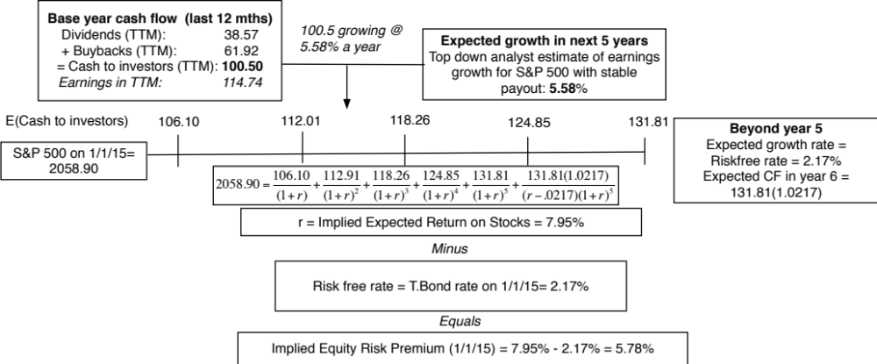
V. And the past is not always a good indicator of the future
 | Arithmetic Average |  | Geometric Average
 | Stocks - T. Bills | Stocks - T. Bonds | Stocks - T. Bills | Stocks - T. Bonds
1928-2014 | 8.00% | 6.25% | 6.11% | 4.60%
 | 2.17% | 2.32%
1965-2014 | 6.19% | 4.12% | 4.84% | 3.14%
 | 2.42% | 2.74%
2005-2014 | 7.94% | 4.06% | 6.18% | 2.73%
 | 6.05% | 8.65%

Slide 28
Implied Premiums in the US: 1960-2014
Notes:
As the index changes (and it is the input most likely to change by large amounts in short periods), the implied premium will change. Note that as premiums rise, stock prices drop. Notice two historical phenomena: (1) Equity risk premiums spiked in the 1970s as inflation increased in the US (2) Equity risk premiums bottomed out at 2% at the end of 1999 at the peak of the dot-com boom.
Would you settle for a 2% premium? If your answer is no, you believe that stocks are overvalued.

Slide 29
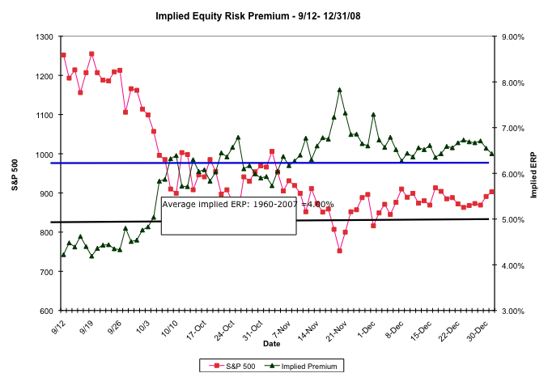
The Anatomy of a Crisis: Implied ERP from September 12, 2008 to January 1, 2009
Notes:
Equity risk premiums changed more in three months than they had in the previous 20 years put together. A wake-up call for those who stick with fixed premiums? That depends on whether we assume that this is an aberration or a break with the past.

Slide 30
Implied Premium for India using the Sensex: April 2010
Level of the Index = 17559
FCFE on the Index = 3.5% (Estimated FCFE for companies in index as % of market value of equity)
Other parameters
  Riskfree Rate = 5% (Rupee)
  Expected Growth (in Rupee)
    Next 5 years = 20% (Used expected growth rate in Earnings)
    After year 5 = 5%
Solving for the expected return:
  Expected return on Equity = 11.72%
  Implied Equity premium for India =11.72% - 5% = 6.72%

Slide 31
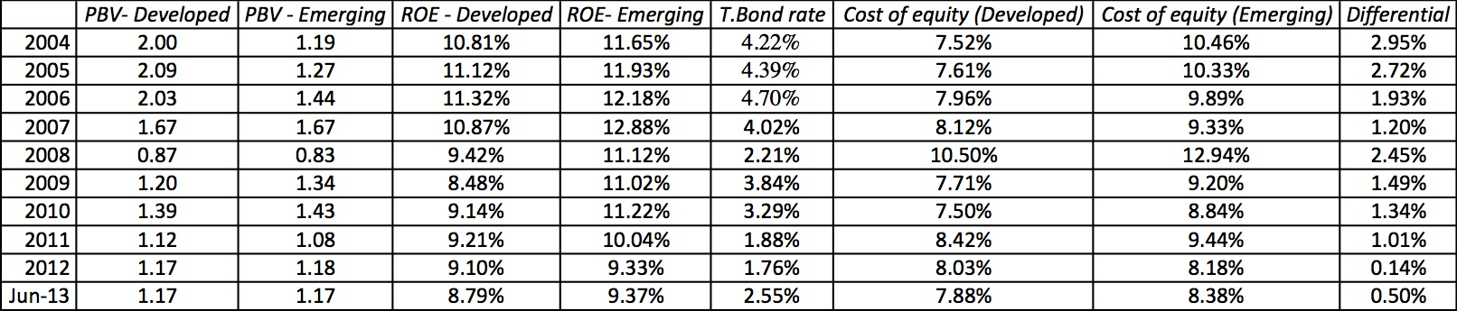
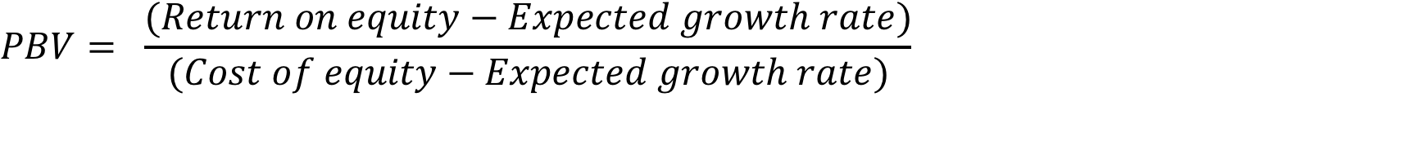
Emerging versus Developed Markets: Implied Equity Risk Premiums

Slide 32
VI. There is a downside to globalization…
Emerging markets offer growth opportunities but they are also riskier. If we want to count the growth, we have to also consider the risk.
Two ways of estimating the country risk premium:
  Sovereign Default Spread: In this approach, the country equity risk premium is set equal to the default spread of the bond issued by the country.
    Equity Risk Premium for mature market = 4.50%
    Default Spread for India = 3.00% (based on rating)
    Equity Risk Premium for India = 4.50% + 3.00%
  Adjusted for equity risk: The country equity risk premium is based upon the volatility of the equity market relative to the government bond rate.
    Country risk premium= Default Spread* Std Deviation_{Country Equity} / Std Deviation_{Country Bond}
    Standard Deviation in Sensex = 21%
    Standard Deviation in Indian government bond= 14%
    Default spread on Indian Bond= 2%
    Additional country risk premium for India = 2% (21/14) = 3%
    Total equity risk premium = US equity risk premium + CRP for India = 6% + 3% = 9%

Slide 33
Russia’s Country Risk Premium
Default Spread for Indonesia in June 2015
  CDS Spread for Russia in June 2015 =2.17%
  Spread based upon Russia’s Ba1 rating = 2.50%
Relative Volatility
  Standard deviation in Russian equities = 18.00%
  Standard deviation in Russian Government Bond = 11.00%
  Relative standard deviation = 18%/11% = 1.64 (approximately)
  Country risk premium for Indonesia = 2.5% (1.64) = 4.10%
  If you use the average relative volatility measure across all emerging markets (about 1.50), country risk premium = 2.50% (1.50) = 3.75%
Estimating equity risk premium for Russia
  Mature market premium on June 1, 2015= 5.75% (US S&P 500)
  Country risk premium for Russia= 3.75%
  Total Equity risk premium for Indonesia = 5.75% + 3.75% = 9.50%

Slide 34

ERP : Jan 2015
Andorra | 8.15% | 2.40% | Italy | 8.60% | 2.85%
Austria | 5.75% | 0.00% | Jersey | 6.35% | 0.60%
Belgium | 6.65% | 0.90% | Liechtenstein | 5.75% | 0.00%
Cyprus | 15.50% | 9.75% | Luxembourg | 5.75% | 0.00%
Denmark | 5.75% | 0.00% | Malta | 7.55% | 1.80%
Finland | 5.75% | 0.00% | Netherlands | 5.75% | 0.00%
France | 6.35% | 0.60% | Norway | 5.75% | 0.00%
Germany | 5.75% | 0.00% | Portugal | 9.50% | 3.75%
Greece | 17.00% | 11.25% | Spain | 8.60% | 2.85%
Guernsey | 6.35% | 0.60% | Sweden | 5.75% | 0.00%
Iceland | 9.05% | 3.30% | Switzerland | 5.75% | 0.00%
Ireland | 8.15% | 2.40% | Turkey | 9.05% | 3.30%
Isle of Man | 6.35% | 0.60% | UK | 6.35% | 0.60%
 |  |  | W. Europe | 6.88% | 1.13%
Albania | 12.50% | 6.75% | Montenegro | 11.15% | 5.40%
Armenia | 10.25% | 4.50% | Poland | 7.03% | 1.28%
Azerbaijan | 9.05% | 3.30% | Romania | 9.05% | 3.30%
Belarus | 15.50% | 9.75% | Russia | 8.60% | 2.85%
Bosnia | 15.50% | .75% | Serbia | 12.50% | 6.75%
Bulgaria | 8.60% | 2.85% | Slovakia | 7.03% | 1.28%
Croatia | 9.50% | 3.75% | Slovenia | 9.50% | 3.75%
Czech Repub | 6.80% | 1.05% | Ukraine | 20.75% | 15.00%
Estonia | 6.80% | 1.05% | E. Europe | 9.08% | 3.33%
Georgia | 11.15% | 5.40%
Hungary | 9.50% | 3.75%
Kazakhstan | 8.60% | 2.85%
Latvia | 8.15% | 2.40%
Lithuania | 8.15% | 2.40%
Macedonia | 11.15% | 5.40%
Moldova | 15.50% | 9.75%
Bangladesh | 11.15% | 5.40%
Cambodia | 14.00% | 8.25%
China | 6.65% | 0.90%
Fiji | 12.50% | 6.75%
Hong Kong | 6.35% | 0.60%
India | 9.05% | 3.30%
Indonesia | 9.05% | 3.30%
Japan | 6.80% | 1.05%
Korea | 6.65% | 0.90%
Macao | 6.50% | 0.75%
Malaysia | 7.55% | 1.80%
Mauritius | 8.15% | 2.40%
Mongolia | 14.00% | 8.25%
Pakistan | 17.00% | 11.25%
Papua New Guinea | 12.50% | 6.75%
Philippines | 8.60% | 2.85%
Singapore | 5.75% | 0.00%
Sri Lanka | 12.50% | 6.75%
Taiwan | 6.65% | 0.90%
Thailand | 8.15% | 2.40%
Vietnam | 12.50% | 6.75%
Asia | 7.26% | 1.51%
Canada | 5.75% | 0.00%
US | 5.75% | 0.00%
North America | 5.75% | 0.00%
Angola | 10.25% | 4.50%
Botswana | 7.03% | 1.28%
Burkina Faso | 15.50% | 9.75%
Cameroon | 14.00% | 8.25%
Cape Verde | 14.00% | 8.25%
Congo (DR) | 15.50% | 9.75%
Congo (Republic) | 11.15% | 5.40%
Côte d'Ivoire | 12.50% | 6.75%
Egypt | 17.00% | 11.25%
Ethiopia | 12.50% | 6.75%
Gabon | 11.15% | 5.40%
Ghana | 14.00% | 8.25%
Kenya | 12.50% | 6.75%
Morocco | 9.50% | 3.75%
Mozambique | 12.50% | 6.75%
Namibia | 9.05% | 3.30%
Nigeria | 11.15% | 5.40%
Rwanda | 14.00% | 8.25%
Senegal | 12.50% | 6.75%
South Africa | 8.60% | 2.85%
Tunisia | 11.15% | 5.40%
Uganda | 12.50% | 6.75%
Zambia | 12.50% | 6.75%
Africa | 11.73% | 5.98%
Argentina | 17.00% | 11.25%
Belize | 19.25% | 13.50%
Bolivia | 11.15% | 5.40%
Brazil | 8.60% | 2.85%
Chile | 6.65% | 0.90%
Colombia | 8.60% | 2.85%
Costa Rica | 9.50% | 3.75%
Ecuador | 15.50% | 9.75%
El Salvador | 11.15% | 5.40%
Guatemala | 9.50% | 3.75%
Honduras | 15.50% | 9.75%
Mexico | 7.55% | 1.80%
Nicaragua | 15.50% | 9.75%
Panama | 8.60% | 2.85%
Paraguay | 10.25% | 4.50%
Peru | 7.55% | 1.80%
Suriname | 11.15% | 5.40%
Uruguay | 8.60% | 2.85%
Venezuela | 17.00% | 11.25%
Latin America | 9.95% | 4.20%
Abu Dhabi | 6.50% | 0.75%
Bahrain | 8.60% | 2.85%
Israel | 6.80% | 1.05%
Jordan | 12.50% | 6.75%
Kuwait | 6.50% | 0.75%
Lebanon | 14.00% | 8.25%
Oman | 6.80% | 1.05%
Qatar | 6.50% | 0.75%
Ras Al Khaimah | 7.03% | 1.28%
Saudi Arabia | 6.65% | 0.90%
Sharjah | 7.55% | 1.80%
UAE | 6.50% | 0.75%
Middle East | 6.85% | 1.10%
Black #: Total ERP
Red #: Country risk premium
AVG: GDP weighted average
Australia | 5.75% | 0.00%
Cook Islands | 12.50% | 6.75%
New Zealand | 5.75% | 0.00%
Australia & NZ | 5.75% | 0.00%
Notes:
Updated country risk premiums.

Slide 35
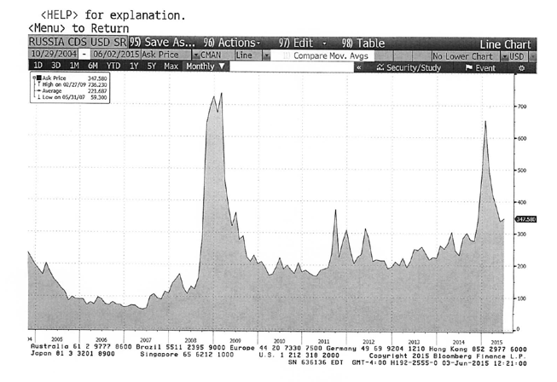
Russia country risk over time

Slide 36
VII. And it is not just emerging market companies that are exposed to this risk..
The “default” approach in valuation has been to assign country risk based upon your country of incorporation. Thus, if you are incorporated in a developed market, the assumption has been that you are not exposed to emerging market risks. If you are incorporated in an emerging market, you are saddled with the entire country risk.
As companies globalize and look for revenues in foreign markets, this practice will under estimate the costs of equity of developed market companies with significant emerging market risk exposure and over estimate the costs of equity of emerging market companies with significant developed market risk exposure.

Slide 37
One way of dealing with this: Operation-based ERP for Severstal
Region | Revenues | Weight | ERP
Eastern Europe & Russia | $3,744.00 | 45.82% | 9.08%
Western Europe | $2,775.00 | 33.96% | 6.88%
Asia | $977.00 | 11.96% | 7.26%
Middle East | $353.00 | 4.32% | 6.85%
Central and South America | $172.69 | 2.11% | 9.95%
Africa | $148.57 | 1.82% | 11.73%
North America | $0.00 | 0.00% | 5.75%
Total | $8,170.26 | 100.00% | 8.08%
Notes:
In the case of Embraer, its limited revenues in Brazil give it a low equity risk premium.
In the case of Ambev, the computation is messier because it has revenues in many Latin American markets. We use revenue weights to weight the CRP.

Slide 38
An alternate way: Estimating a company’s exposure to country risk (Lambda)
Just as beta measures exposure to macro economic risk, lambda measures exposure just to country risk. Like beta, it is scaled around one.
The easiest and most accessible data is on revenues. Most companies break their revenues down by region. One simplistic solution would be to do the following:
  Lambda = % of revenues domestically _{firm}/ % of revenues domestically _{average firm}
In 2008-09, Tata Motors got about 91.37% of its revenues in India and TCS got 7.62%. The average Indian firm gets about 80% of its revenues in India:
  Lambda _{Tata Motors} = 91%/80% = 1.14
  The danger of focusing just on revenues is that it misses other exposures to risk (production and operations).
 | Tata Motors | TCS
% of production/operations in India | High | High
% of revenues in India | 91.37% (in 2009) Estimated 70% (in 2010) | 7.62%
Lambda | 0.80 | 0.20
Flexibility in moving operations | Low. Significant physical assets. | High. Human capital is mobile.

Slide 39
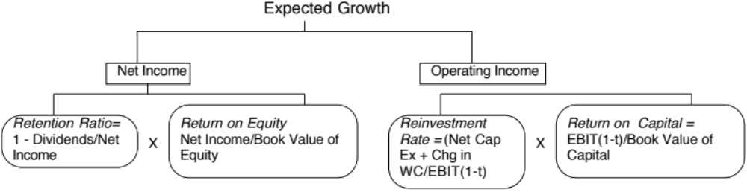
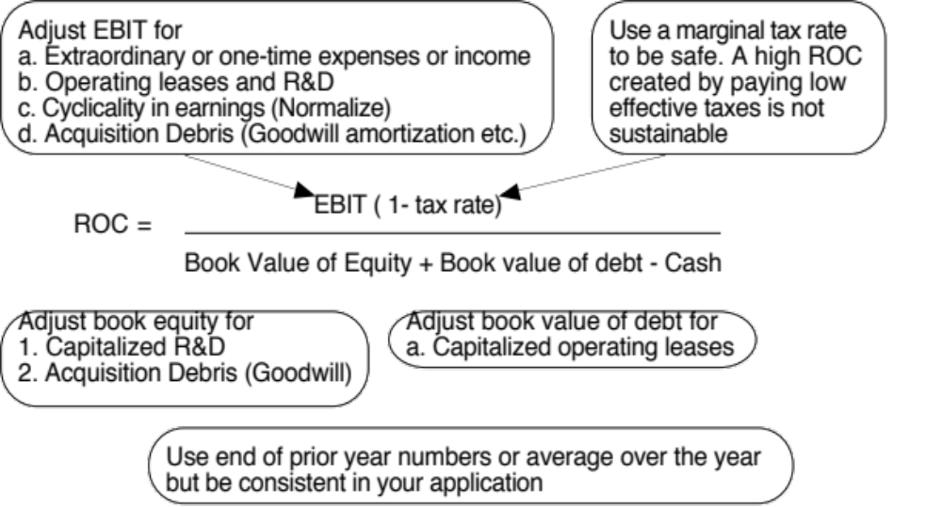
VIII. Growth has to be earned (not endowed or estimated)

Slide 40
Sounds simple, right? But companies seem to have trouble in practice

Slide 41
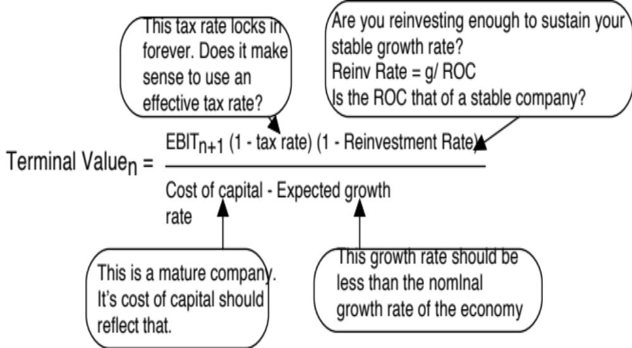
IX. All good things come to an end..And the terminal value is not an ATM…

Slide 42
Terminal Value and Growth
Stable Growth Rate | Amgen | Tata Motors | Severstal
0% | $150,652 | 435,686₹ | $11,206
1% | $154,479 | 435,686₹ | $11,206
2% | $160,194 | 435,686₹ | $11,206
3% | $167,784 | 435,686₹
4% | $179,099 | 435,686₹
5% |  | 435,686₹
Risk free rate | 4.78% | 5.00% | 2.50%
ROIC | 10% | 10.39% | 8.00%
Cost of capital | 8.08% | 10.39% | 8.00%

Slide 43
The loose ends in valuation…
Aswath Damodaran

Slide 44
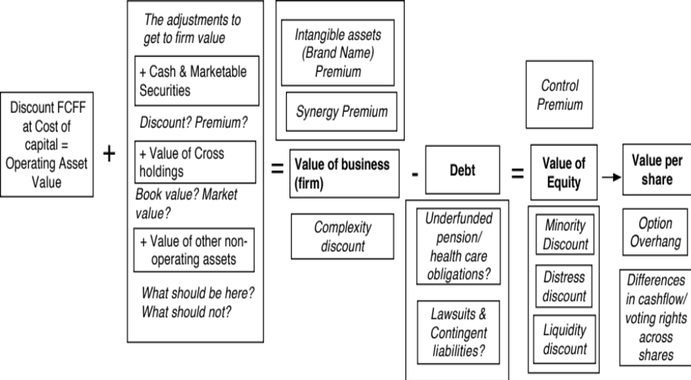
Getting from DCF to value per share: The Loose Ends

Slide 45
1. The Value of Cash
An Exercise in Cash Valuation
Company A Company B Company C
Enterprise Value $ 1 billion $ 1 billion $ 1 billion
Cash $ 100 mil $ 100 mil $ 100 mil
Return on Capital 10% 5% 22%
Cost of Capital 10% 10% 12%
Trades in US US Argentina
In which of these companies is cash most likely to trade at face value, at a discount and at a premium?

Slide 46
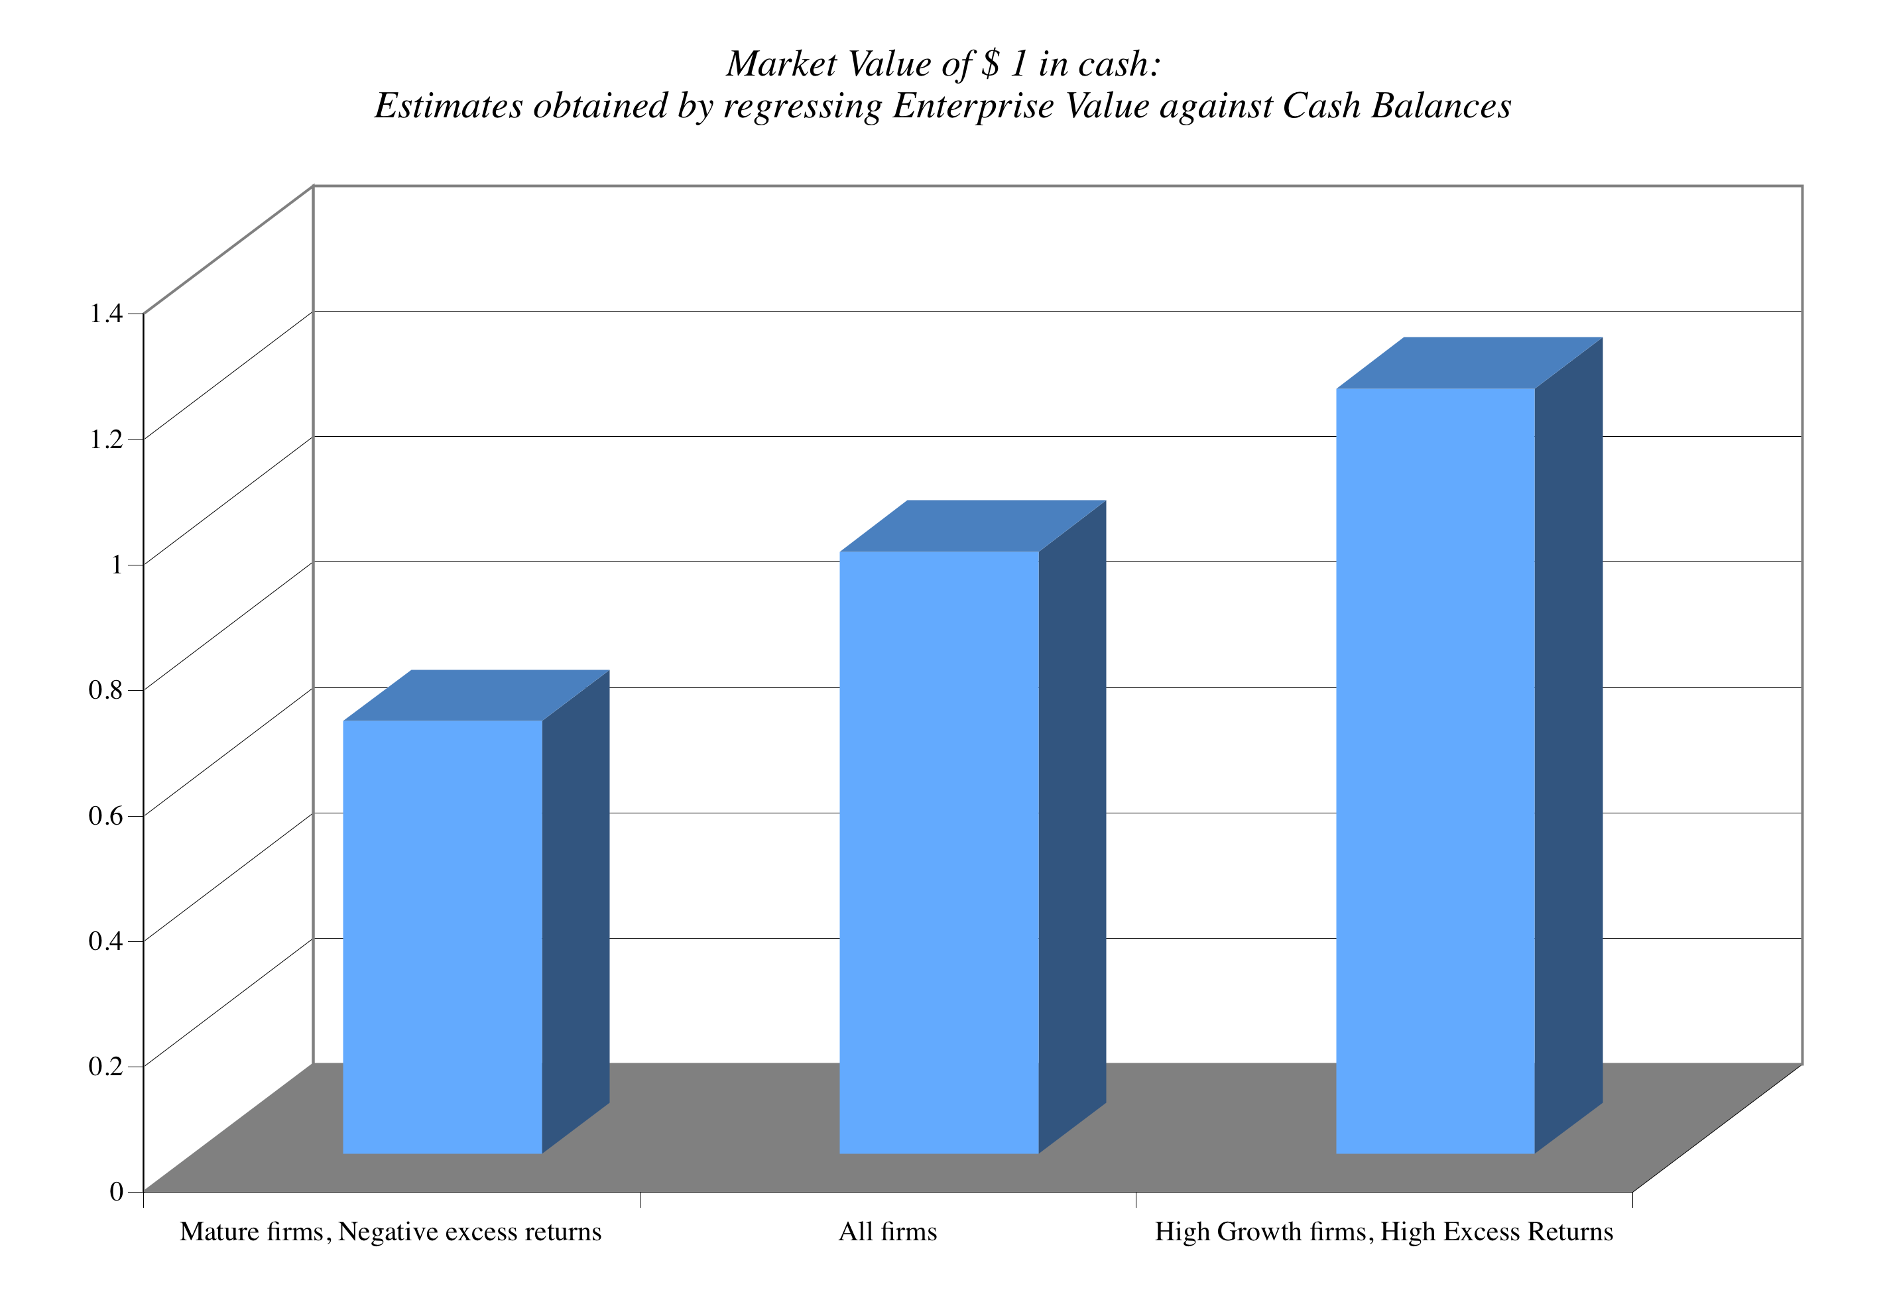
Cash: Discount or Premium?

Slide 47
2. Dealing with Holdings in Other firms
Holdings in other firms can be categorized into
  Minority passive holdings, in which case only the dividend from the holdings is shown in the balance sheet
  Minority active holdings, in which case the share of equity income is shown in the income statements
  Majority active holdings, in which case the financial statements are consolidated.
We tend to be sloppy in practice in dealing with cross holdings. After valuing the operating assets of a firm, using consolidated statements, it is common to add on the balance sheet value of minority holdings (which are in book value terms) and subtract out the minority interests (again in book value terms), representing the portion of the consolidated company that does not belong to the parent company.
Notes:
How you deal with cross holdings depends upon which scenario you face.

Slide 48
How to value holdings in other firms.. In a perfect world..
In a perfect world, we would strip the parent company from its subsidiaries and value each one separately. The value of the combined firm will be
  Value of parent company + Proportion of value of each subsidiary
To do this right, you will need to be provided detailed information on each subsidiary to estimate cash flows and discount rates.
Notes:
If a holding is not consolidated, you have to work to bring the holding into your valuation explicitly since the income from the holding will not be shown as part of operating income. If you are doing equity valuation, you have to be careful to strip out the portion of the net income that is attributable to the holdings - dividends, for instance.
If a holding is consolidated, you are valuing a combined firm - the parent and the subsidiary. You have to ensure that you subtract out the portion of the subsidiary that does not belong to you.

Slide 49
Two compromise solutions…
The market value solution: When the subsidiaries are publicly traded, you could use their traded market capitalizations to estimate the values of the cross holdings. You do risk carrying into your valuation any mistakes that the market may be making in valuation.
The relative value solution: When there are too many cross holdings to value separately or when there is insufficient information provided on cross holdings, you can convert the book values of holdings that you have on the balance sheet (for both minority holdings and minority interests in majority holdings) by using the average price to book value ratio of the sector in which the subsidiaries operate.

Slide 50
Tata Motor’s Cross Holdings

Slide 51
Severstal: From operating assets to equity value
PV of cash flows during high growth = | $7,501 | 61.19%
PV of terminal value | $4,757 | 38.81%
Value of operating assets | $12,258 | $12,258
+ Cash |  | $1,542
+ Minority holdings |  | $81
Value of firm |  | $13,881 | $13,881
- Debt |  |  | $2,987
Value of equity in consolidated companies |  |  | $10,895 | $10,895
- Value of minority interests |  |  |  | $18
Value of equity in company |  |  |  | $10,877

Slide 52
3. Other Assets that have not been counted yet..
Unutilized assets: If you have assets or property that are not being utilized (vacant land, for example), you have not valued it yet. You can assess a market value for these assets and add them on to the value of the firm.
Overfunded pension plans: If you have a defined benefit plan and your assets exceed your expected liabilities, you could consider the over funding with two caveats:
  Collective bargaining agreements may prevent you from laying claim to these excess assets.
  There are tax consequences. Often, withdrawals from pension plans get taxed at much higher rates.
Do not double count an asset. If you count the income from an asset in your cash flows, you cannot count the market value of the asset in your value.

Slide 53
The “real estate” play
Assume that Severstal owns valuable real estate worth $500 million, underlying its plants, mines and office buildings. Can you add this value on to your DCF value?
Yes.
No.
Depends
What would you do if the value of the land under the plant exceeds the present value that you have estimated for them as manufacturing facilities?
  Nothing
  Use the higher of the two values
  Use the lower of the two values
  Use a weighted average of the two values

Slide 54
4. A Discount for Complexity:
An Experiment
Company A Company B
Operating Income $ 1 billion $ 1 billion
Tax rate 40% 40%
ROIC 10% 10%
Expected Growth 5% 5%
Cost of capital 8% 8%
Business Mix Single Multiple Businesses
Holdings Simple Complex
Accounting Transparent Opaque
Which firm would you value more highly?

Slide 55
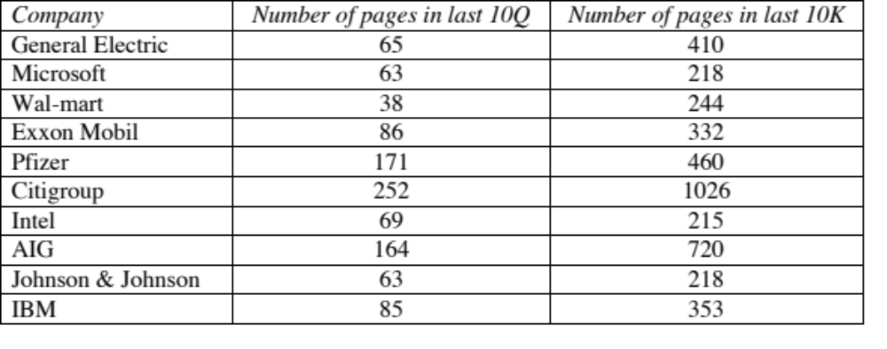
Measuring Complexity: Volume of Data in Financial Statements

Slide 56
Measuring Complexity: A Complexity Score
Item | Factors | Follow-up Question | Answer | Weighting factor | Gerdau Score | GE Score
Operating Income | 1. Multiple Businesses | Number of businesses (with more than 10% of revenues) = | 1 | 2.00 | 2 | 30
 | 2. One-time income and expenses | Percent of operating income = | 10% | 10.00 | 1 | 0.8
 | 3. Income from unspecified sources | Percent of operating income = | 0% | 10.00 | 0 | 1.2
 | 4. Items in income statement that are volatile | Percent of operating income = | 15% | 5.00 | 0.75 | 1
Tax Rate | 1. Income from multiple locales | Percent of revenues from non-domestic locales = | 70% | 3.00 | 2.1 | 1.8
 | 2. Different tax and reporting books | Yes or No | No | Yes=3 | 0 | 3
 | 3. Headquarters in tax havens | Yes or No | No | Yes=3 | 0 | 0
 | 4. Volatile effective tax rate | Yes or No | Yes | Yes=2 | 2 | 0
Capital Expenditures | 1. Volatile capital expenditures | Yes or No | Yes | Yes=2 | 2 | 2
 | 2. Frequent and large acquisitions | Yes or No | Yes | Yes=4 | 4 | 4
 | 3. Stock payment for acquisitions and investments | Yes or No | No | Yes=4 | 0 | 4
Working capital | 1. Unspecified current assets and current liabilities | Yes or No | No | Yes=3 | 0 | 0
 | 2. Volatile working capital items | Yes or No | Yes | Yes=2 | 2 | 2
Expected Growth rate | 1. Off-balance sheet assets and liabilities (operating leases and R&D) | Yes or No | No | Yes=3 | 0 | 3
 | 2. Substantial stock buybacks | Yes or No | No | Yes=3 | 0 | 3
 | 3. Changing return on capital over time | Is your return on capital volatile? | Yes | Yes=5 | 5 | 5
 | 4. Unsustainably high return | Is your firm's ROC much higher than industry average? | No | Yes=5 | 0 | 0
Cost of capital | 1. Multiple businesses | Number of businesses (more than 10% of revenues) = | 1 | 1.00 | 1 | 20
 | 2. Operations in emerging markets | Percent of revenues= | 50% | 5.00 | 2.5 | 2.5
 | 3. Is the debt market traded? | Yes or No | No | No=2 | 2 | 0
 | 4. Does the company have a rating? | Yes or No | Yes | No=2 | 0 | 0
 | 5. Does the company have off-balance sheet debt? | Yes or No | No | Yes=5 | 0 | 5
No-operating assets | Minority holdings as percent of book assets | Minority holdings as percent of book assets | 0% | 20.00 | 0 | 0.8
Firm to Equity value | Consolidation of subsidiaries | Minority interest as percent of book value of equity | 63% | 20.00 | 12.6 | 1.2
Per share value | Shares with different voting rights | Does the firm have shares with different voting rights? | Yes | Yes = 10 | 10 | 0
 | Equity options outstanding | Options outstanding as percent of shares | 0% | 10.00 | 0 | 0.25
 |  | Complexity Score = |  |  | 48.95 | 90.55

Slide 57
Dealing with Complexity
In Discounted Cashflow Valuation
  The Aggressive Analyst: Trust the firm to tell the truth and value the firm based upon the firm’s statements about their value.
  The Conservative Analyst: Don’t value what you cannot see.
  The Compromise: Adjust the value for complexity
    Adjust cash flows for complexity
    Adjust the discount rate for complexity
    Adjust the expected growth rate/ length of growth period
    Value the firm and then discount value for complexity
In relative valuation
  In a relative valuation, you may be able to assess the price that the market is charging for complexity:
  With the hundred largest market cap firms, for instance:
  PBV = 0.65 + 15.31 ROE – 0.55 Beta + 3.04 Expected growth rate – 0.003 # Pages in 10K

Slide 58

5. The Value of Synergy

Slide 59
Valuing Synergy
(1) the firms involved in the merger are valued independently, by discounting expected cash flows to each firm at the weighted average cost of capital for that firm.
(2) the value of the combined firm, with no synergy, is obtained by adding the values obtained for each firm in the first step.
(3) The effects of synergy are built into expected growth rates and cashflows, and the combined firm is re-valued with synergy.
Value of Synergy = Value of the combined firm, with synergy - Value of the combined firm, without synergy
Notes:
You have to do three valuations to value synergy and you have to quantify the impact of synergy into valuation inputs.

Slide 60
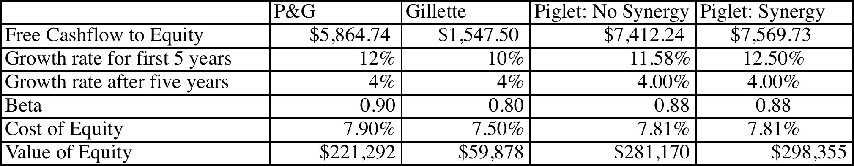
Valuing Synergy: P&G + Gillette
Assume that $250 million in operating expenses will be cut immediately. Translates into an after-tax increase in operating income of approximately $158 million.
Assume that the combined company will grow at a faster rate (for the next decade) starting immediately.

Slide 61
6. Brand name, great management, superb product …Are we short changing intangibles?
There is often a temptation to add on premiums for intangibles. Here are a few examples.
  Brand name
  Great management
  Loyal workforce
  Technological prowess
There are two potential dangers:
  For some assets, the value may already be in your value and adding a premium will be double counting.
  For other assets, the value may be ignored but incorporating it will not be easy.

Slide 62
Valuing Brand Name
Coca Cola With Cott Margins
Current Revenues = $21,962.00 $21,962.00
Length of high-growth period 10 10
Reinvestment Rate = 50% 50%
Operating Margin (after-tax) 15.57% 5.28%
Sales/Capital (Turnover ratio) 1.34 1.34
Return on capital (after-tax) 20.84% 7.06%
Growth rate during period (g) = 10.42% 3.53%
Cost of Capital during period = 7.65% 7.65%
Stable Growth Period
Growth rate in steady state = 4.00% 4.00%
Return on capital = 7.65% 7.65%
Reinvestment Rate = 52.28% 52.28%
Cost of Capital = 7.65% 7.65%
Value of Firm = $79,611.25 $15,371.24

Slide 63
7. Be circumspect about defining debt for cost of capital purposes…
General Rule: Debt generally has the following characteristics:
  Commitment to make fixed payments in the future
  The fixed payments are tax deductible
  Failure to make the payments can lead to either default or loss of control of the firm to the party to whom payments are due.
Defined as such, debt should include
  All interest bearing liabilities, short term as well as long term
  All leases, operating as well as capital
Debt should not include
  Accounts payable or supplier credit

Slide 64
But should consider other potential liabilities when getting to equity value…
If you have under funded pension fund or health care plans, you should consider the under funding at this stage in getting to the value of equity.
  If you do so, you should not double count by also including a cash flow line item reflecting cash you would need to set aside to meet the unfunded obligation.
  You should not be counting these items as debt in your cost of capital calculations….
If you have contingent liabilities - for example, a potential liability from a lawsuit that has not been decided - you should consider the expected value of these contingent liabilities
  Value of contingent liability = Probability that the liability will occur * Expected value of liability

Slide 65
8. The Value of Control
The value of the control premium that will be paid to acquire a block of equity will depend upon two factors -
  Probability that control of firm will change: This refers to the probability that incumbent management will be replaced. this can be either through acquisition or through existing stockholders exercising their muscle.
  Value of Gaining Control of the Company: The value of gaining control of a company arises from two sources - the increase in value that can be wrought by changes in the way the company is managed and run, and the side benefits and perquisites of being in control
  Value of Gaining Control = Present Value (Value of Company with change in control - Value of company without change in control) + Side Benefits of Control

Slide 66
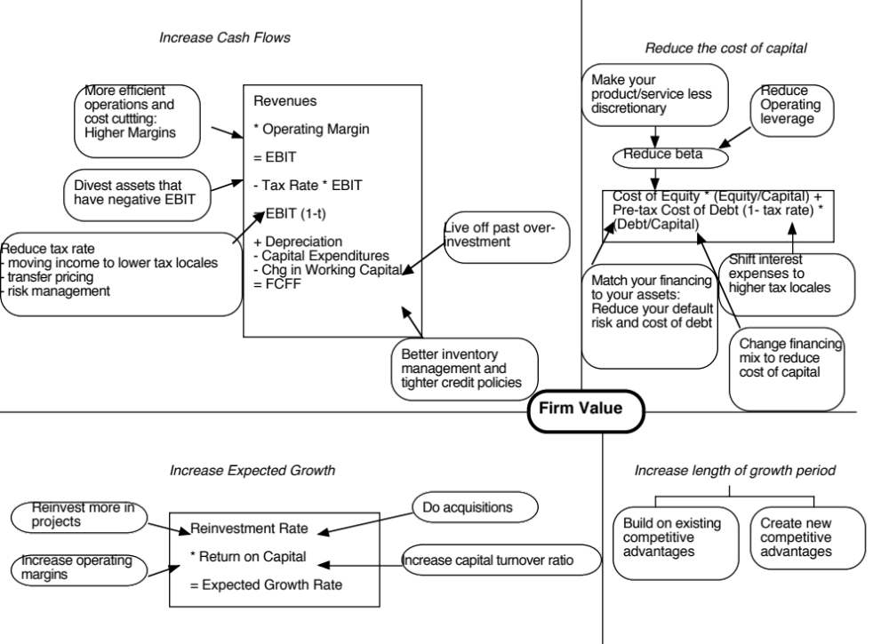

Slide 67
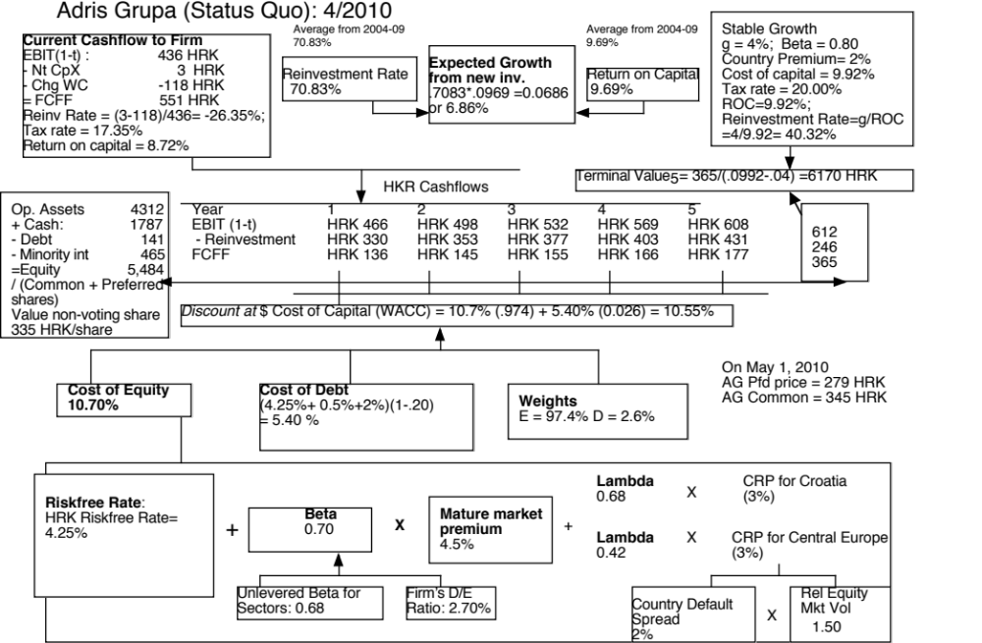

Slide 68
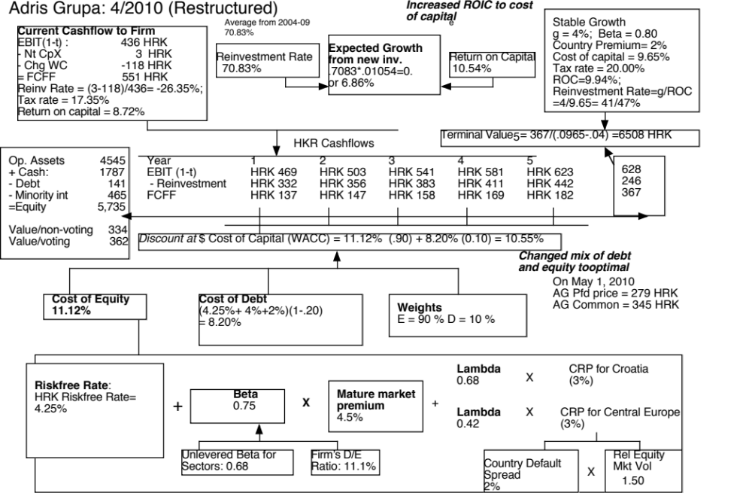

Slide 69
Value of Control and the Value of Voting Rights
Adris Grupa has two classes of shares outstanding: 9.616 million voting shares and 6.748 million non-voting shares.
  To value a non-voting share, we assume that all non-voting shares essentially have to settle for status quo value. All shareholders, common and preferred, get an equal share of the status quo value.
  Status Quo Value of Equity = 5,484 million HKR
  Value for a non-voting share = 5484/(9.616+6.748) = 334 HKR/share
To value a voting share, we first value control in Adris Grup as the difference between the optimal and the status quo value:
  Value of control at Adris Grupa = 5,735 – 5484 = 249 million HKR
  Value per voting share =334 HKR + 249/9.616 = 362 HKR

Slide 70
The Dark Side of Valuation:
Valuing difficult-to-value companies

Slide 71
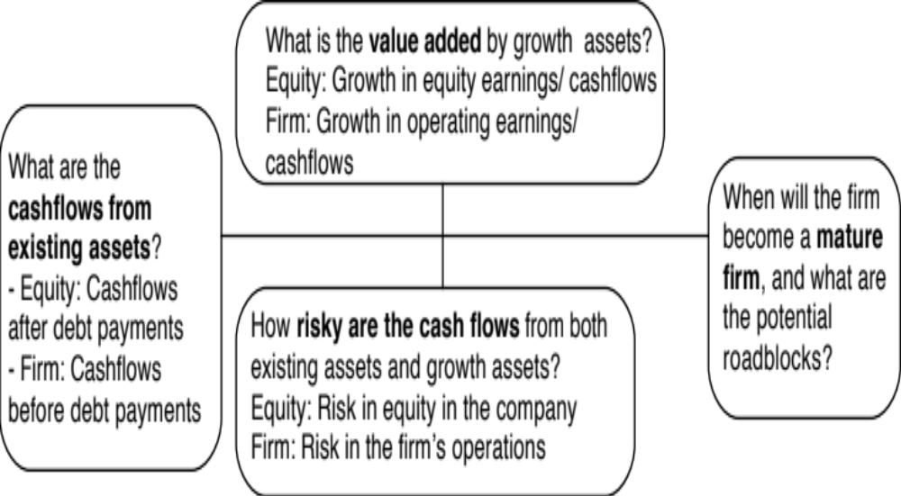
The fundamental determinants of value…
Notes:
The four pillars of value:
Cashflows
Potential for high growth
Length of the high growth period (before the firm starts growing at the same rate as the economy)
Discount rate
Note the variations and the need for consistency:
With equity -> Cashflows to equity - > Growth rate in net income -> Discount at the cost of equity
With firm -> Cashflows to firm - > Growth rate in operating income -> Discount at the cost of capital

Slide 72
The Dark Side of Valuation…
Valuing stable, money making companies with consistent and clear accounting statements, a long and stable history and lots of comparable firms is easy to do.
The true test of your valuation skills is when you have to value “difficult” companies. In particular, the challenges are greatest when valuing:
  Young companies, early in the life cycle, in young businesses
  Companies that don’t fit the accounting mold
  Companies that face substantial truncation risk (default or nationalization risk)

Slide 73
Difficult to value companies…
Across the life cycle:
  Young, growth firms: Limited history, small revenues in conjunction with big operating losses and a propensity for failure make these companies tough to value.
  Mature companies in transition: When mature companies change or are forced to change, history may have to be abandoned and parameters have to be reestimated.
  Declining and Distressed firms: A long but irrelevant history, declining markets, high debt loads and the likelihood of distress make them troublesome.
Across sectors
  Financial service firms: Opacity of financial statements and difficulties in estimating basic inputs leave us trusting managers to tell us what’s going on.
  Commodity and cyclical firms: Dependence of the underlying commodity prices or overall economic growth make these valuations susceptible to macro factors.
  Firms with intangible assets: Accounting principles are left to the wayside on these firms.
Across the ownership cycle
  Privately owned businesses: Exposure to firm specific risk and illiquidity bedevil valuations.
  Venture Capital (VC) and private equity: Different equity investors, with different perceptions of risk.
  Closely held public firms: Part private and part public, sharing the troubles of both.

Slide 74
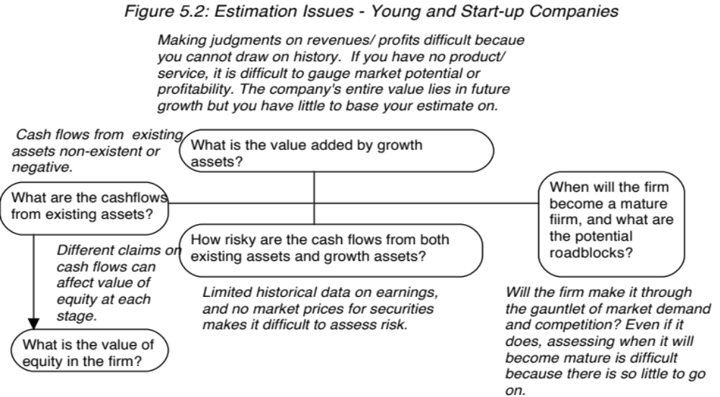
I. The challenge with young companies…
Notes:
Consider a young, start-up firm in a new business or industry…The financial statements provide scanty information because the firm’s operations are small, there is no historical data because the firm has not been around for very long and there are either no comparable firms or they all look like the firm being valued.

Slide 75
Upping the ante.. Young companies in young businesses…
When valuing a business, we generally draw on three sources of information
  The firm’s current financial statement
    How much did the firm sell?
    How much did it earn?
  The firm’s financial history, usually summarized in its financial statements.
    How fast have the firm’s revenues and earnings grown over time?
    What can we learn about cost structure and profitability from these trends?
    Susceptibility to macro-economic factors (recessions and cyclical firms)
  The industry and comparable firm data
    What happens to firms as they mature? (Margins.. Revenue growth… Reinvestment needs… Risk)
It is when valuing these companies that you find yourself tempted by the dark side, where
  “Paradigm shifts” happen…
  New metrics are invented …
  The story dominates and the numbers lag…
Notes:
We look for information in three places - a firm’s financial statements, its history and comparable firms.

Slide 76
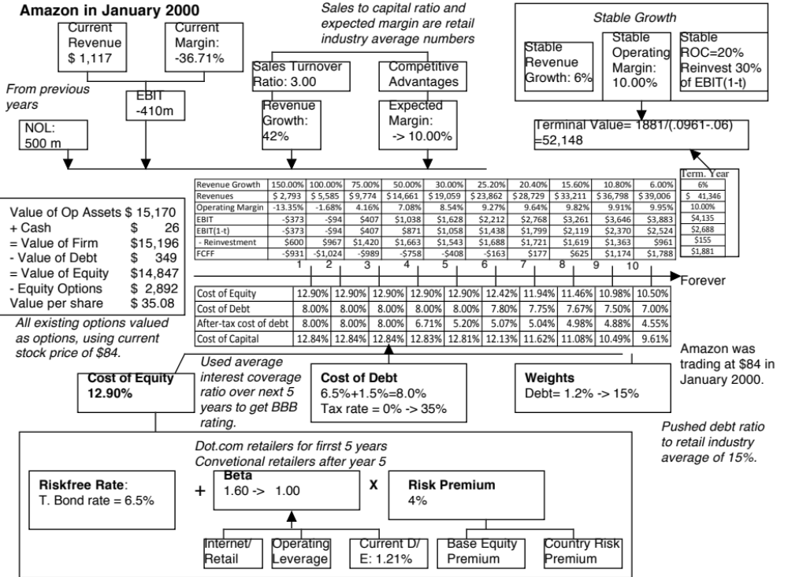
Notes:
To estimate a bottom-up beta for Amazon in January 2000, we used the average beta of internet retailers for the first five years as the bottom-up beta but assume that the beta will move towards the average beta for specialty retailers over time. The high operating leverage that is typical of an internet retailer (high infrastructure and technology costs) provides an intuitive explanation for why they should have higher betas than their brick-and-mortar counterparts.
When a firm has operating losses, the interest coverage ratio is negative. Using the interest coverage ratio table on the next page would yield a D rating for the firm. In January 2000, this seemed a little harsh. For better or worse, bondholders and lenders to the firm seemed to be lending based upon expected operating income in the future rather than past operating income. The interest coverage ratio was therefore defined as follows:
Interest coverage ratio = Average EBIT next 5 years/ Current interest expense
The interest coverage ratio yielded a synthetic rating of BBB and a default spread of 1.50% in January 2000.
3. The pre-tax cost of debt is equal to the after-tax cost for the next 2 years because the firm is expected to keep losing money. In year 3, Amazon is expected to make an operating profit, but it wil have net operating losses that shelter the income leading to no taxes. In year 4, Amazon is able to partially cover the operating income with carried-forward net operating losses… Starting in year 6, we lower the cost of debt since the firm is expected to become a profitable firm with substantial increases in operating income in the subsequent years.
Year 1 2 3 4 5
EBIT -$373 -$94 $407 $1,038 $1,628
Taxes $0 $0 $0 $167 $570
EBIT(1-t) -$373 -$94 $407 $871 $1,058
Tax rate 0% 0% 0% 16.13% 35%
NOL $500 $873 $967 $560 $0
The value per share in January 2000 is $ 34. This valuation was done with all of the inputs at the high end of my expectations and can be considered optimistic. Notwithstanding this, the stock is still overvalued. In fact, the optimism shows when you see that the free cashflows to the firm are negative for the first 6 years… I am assuming that Amazon will have no trouble raising the capital to fund these cashflows…

Slide 77
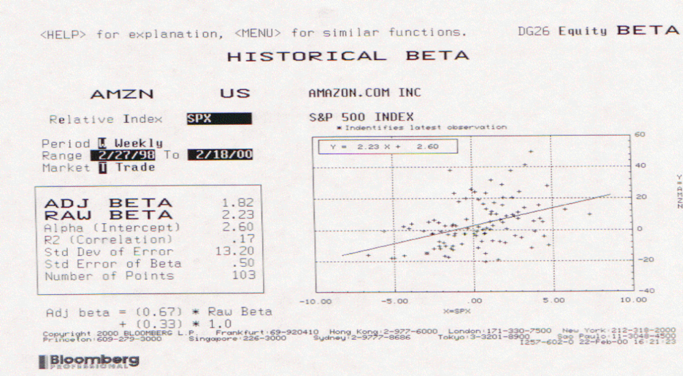
Lesson 1: Don’t trust regression betas….

Slide 78
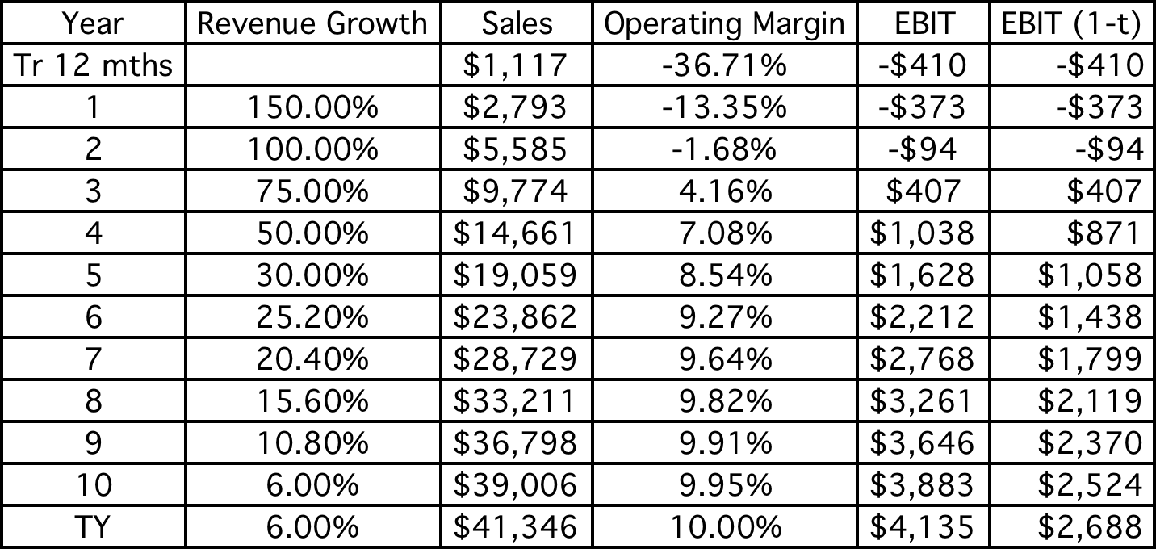
Lesson 2: Work backwards and keep it simple…

Slide 79
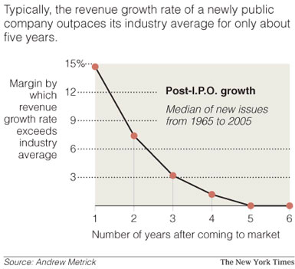
Lesson 3: Scaling up is hard to do…

Slide 80
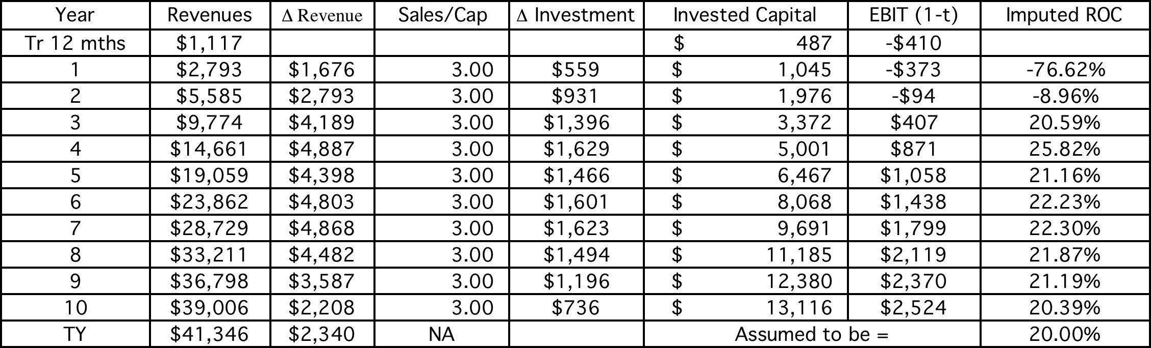
Lesson 4: Don’t forget to pay for growth…

Slide 81
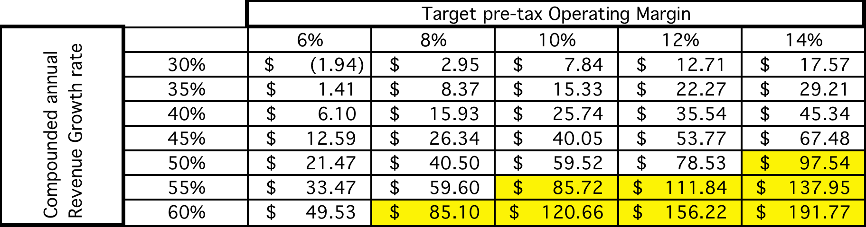
Lesson 5: There are always scenarios where the market price can be justified…
Notes:
Is $ 84 feasible? The answer is yes - a combination of compounded 10-year revenue growth of 60% and margins of 8%, revenue growth of 55% and margins of 10%, revenue growth of 50% and margins of 14% all yield values greater than $ 84…. The problem is that to generate higher revenue growth, Amazon will have to settle for lower margins…
Is $84 likely? The answer is no…

Slide 82
Lesson 6: Don’t forget to mop up…
Watch out for “other” equity claims: If you buy equity in a young, growth company, watch out for other (often hidden) claims on the equity that don’t take the form of common shares. In particular, watch for options granted to managers, employees, venture capitalists and others (you will be surprised…).
  Value these options as options (not at exercise value)
  Take into consideration expectations of future option grants when computing expected future earnings/cash flows.
Not all shares are equal: If there are differences in cash flow claims (dividends or liquidation) or voting rights across shares, value these differences.
  Voting rights matter even at well run companies

Slide 83
Lesson 7: You will be wrong 100% of the time… and it really is not (always) your fault…
No matter how careful you are in getting your inputs and how well structured your model is, your estimate of value will change both as new information comes out about the company, the business and the economy.
As information comes out, you will have to adjust and adapt your model to reflect the information. Rather than be defensive about the resulting changes in value, recognize that this is the essence of risk.
A test: If your valuations are unbiased, you should find yourself increasing estimated values as often as you are decreasing values. In other words, there should be equal doses of good and bad news affecting valuations (at least over time).

Slide 84
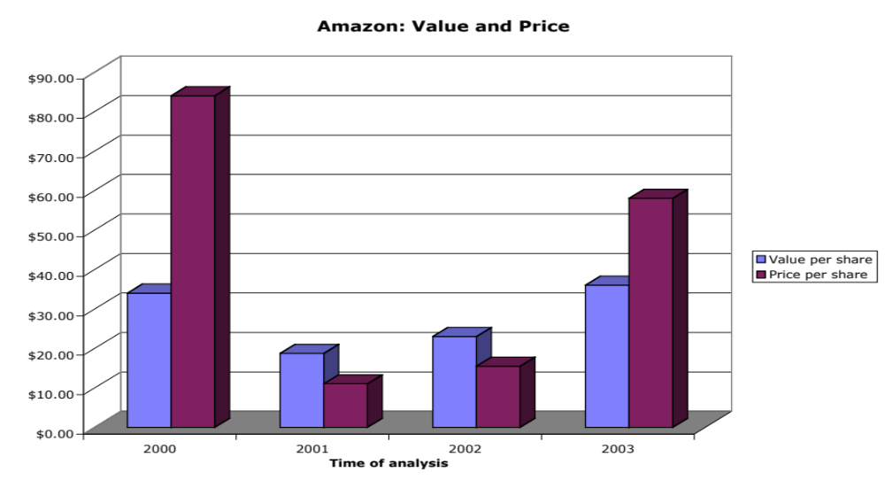
And the market is often “more wrong”….
Notes:
A valuation in September 2003 yielded an estimate of value per share of $36 but the stock had shot up to $ 58… Time to sell and start the cycle all over again… The more things change, the more they stay the same…

Slide 85
Valuing an IPO
Valuation issues:
  Use of the proceeds from the offering: The proceeds from the offering can be held as cash by the firm to cover future investment needs, paid to existing equity investors who want to cash out or used to pay down debt.
  Warrants/ Special deals with prior equity investors: If venture capitalists and other equity investors from earlier iterations of fund raising have rights to buy or sell their equity at pre-specified prices, it can affect the value per share offered to the public.
Pricing issues:
  Institutional set-up: Most IPOs are backed by investment banking guarantees on the price, which can affect how they are priced.
  Follow-up offerings: The proportion of equity being offered at initial offering and subsequent offering plans can affect pricing.

Slide 86
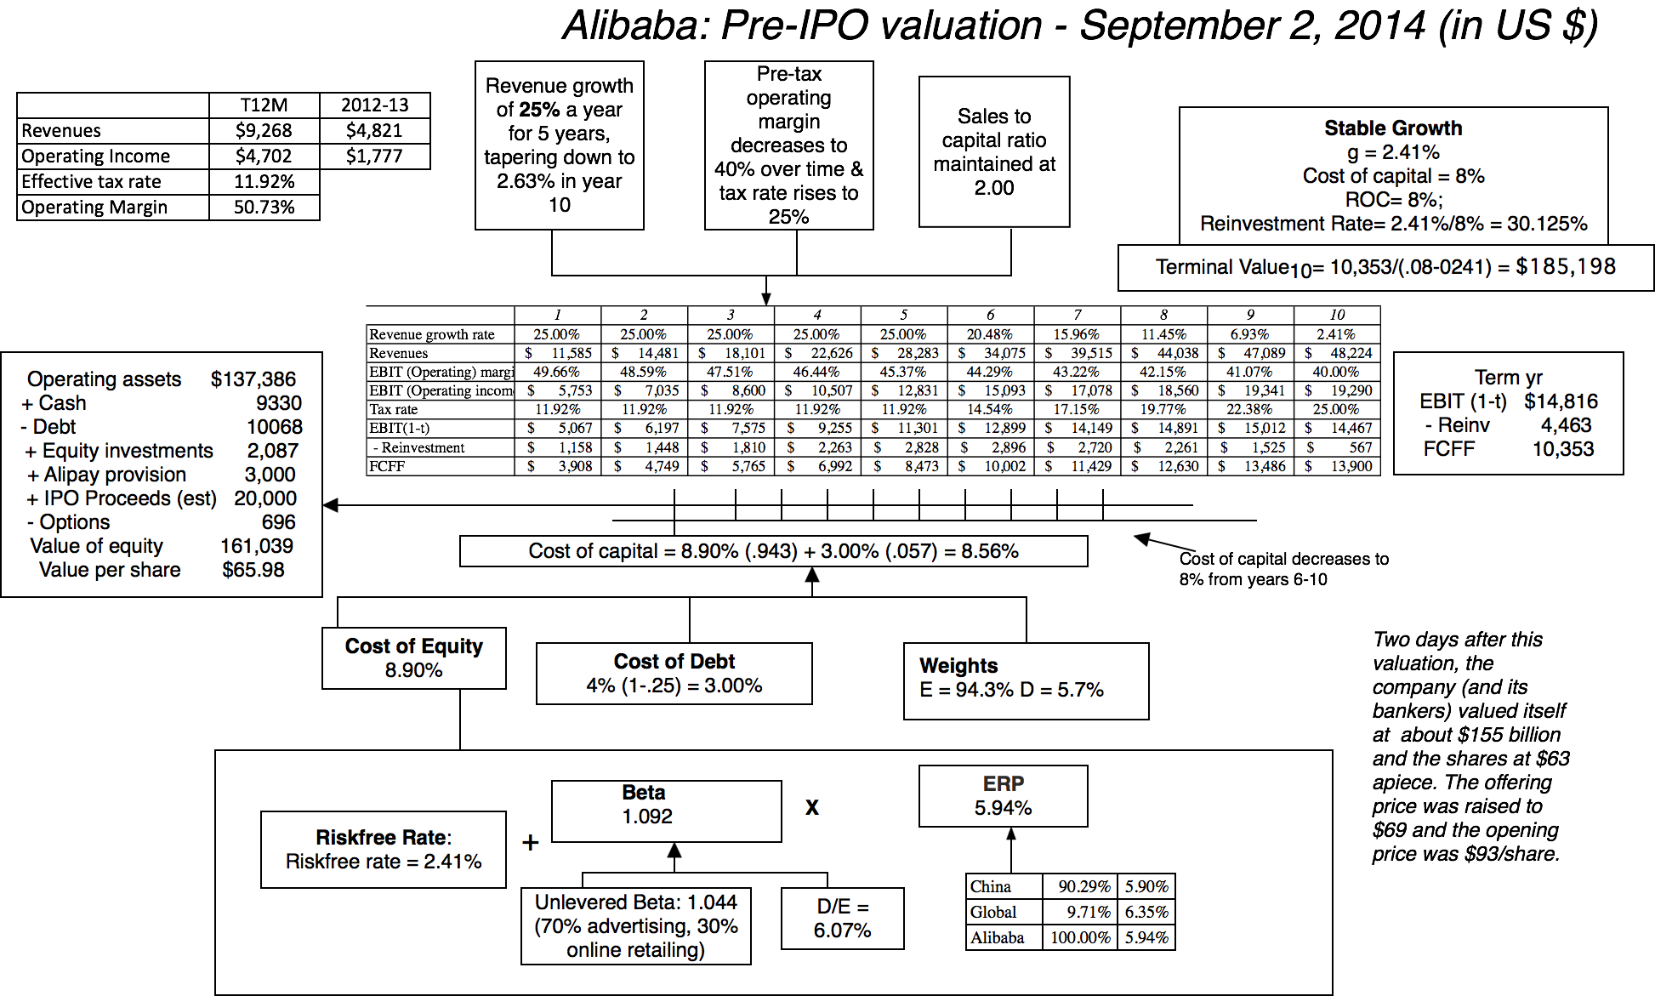

Slide 87
II. Mature Companies in transition..
Mature companies are generally the easiest group to value. They have long, established histories that can be mined for inputs. They have investment policies that are set and capital structures that are stable, thus making valuation more grounded in past data.
However, this stability in the numbers can mask real problems at the company. The company may be set in a process, where it invests more or less than it should and does not have the right financing mix. In effect, the policies are consistent, stable and bad.
If you expect these companies to change or as is more often the case to have change thrust upon them,

Slide 88
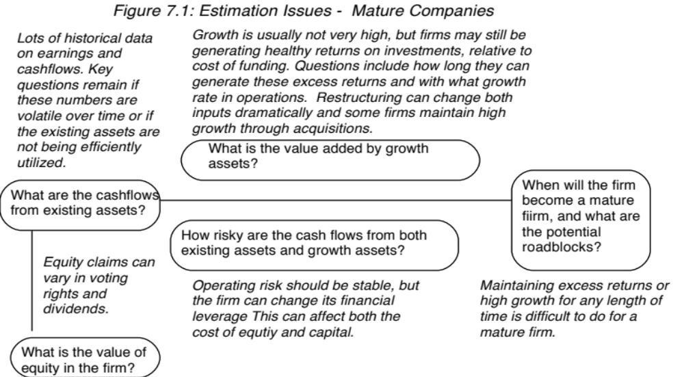
The perils of valuing mature companies…

Slide 89
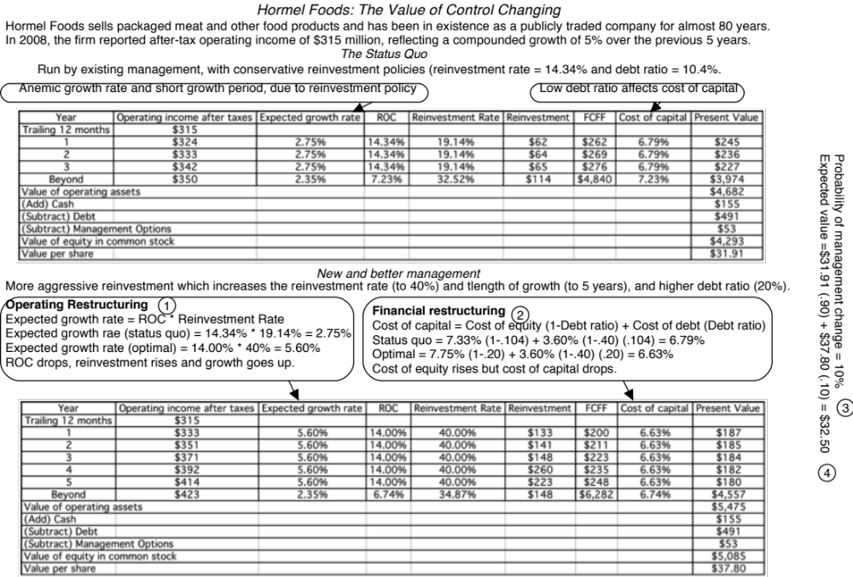

Slide 90

Lesson 1: Cost cutting and increased efficiency are easier accomplished on paper than in practice…

Slide 91

Lesson 2: Increasing growth is not always an option (or at least not a good option)

Slide 92
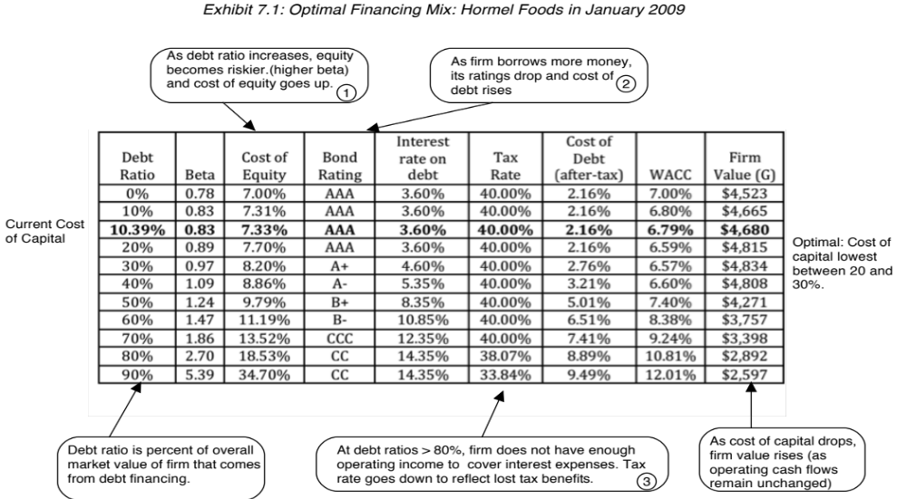
Lesson 3: Financial leverage is a double-edged sword..

Slide 93
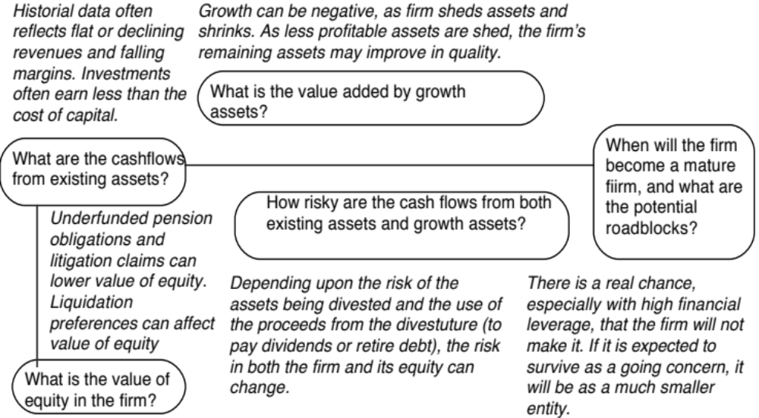
III. Dealing with decline and distress…

Slide 94
Dealing with the “downside” of Distress
A DCF valuation values a firm as a going concern. If there is a significant likelihood of the firm failing before it reaches stable growth and if the assets will then be sold for a value less than the present value of the expected cashflows (a distress sale value), DCF valuations will understate the value of the firm.
Value of Equity= DCF value of equity (1 - Probability of distress) + Distress sale value of equity (Probability of distress)
There are three ways in which we can estimate the probability of distress:
  Use the bond rating to estimate the cumulative probability of distress over 10 years
  Estimate the probability of distress with a probit
  Estimate the probability of distress by looking at market value of bonds..
The distress sale value of equity is usually best estimated as a percent of book value (and this value will be lower if the economy is doing badly and there are other firms in the same business also in distress).
Notes:
DCF valuation tends to view distress rather cavalierly. We either assume that a firm will last forever, or that if even if runs into trouble, it will be able to sell its assets (both in-place and growth) for fair market value. In addition, we assume that our expected cashflows incorporate the possibility that a firm may not survive… In general, DCF valuation will give us an over-optimistic estimate of value for firms in significant financial trouble.
You can estimate the probability of default from a bond by using the price of the bond and solving for the probability of bankruptcy. You can use the distress.xls to make this estimate.

Slide 95
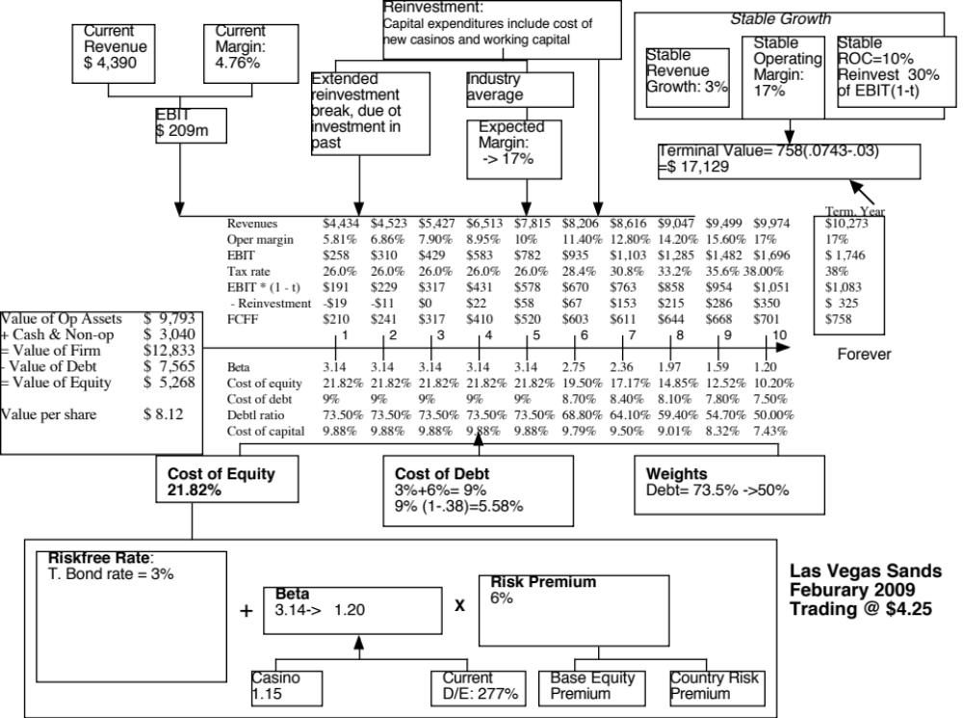

Slide 96
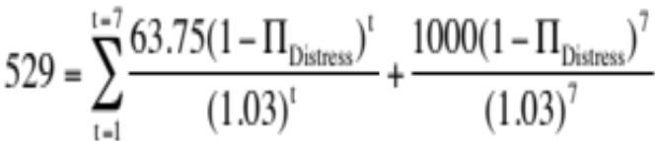
Adjusting the value of LVS for distress..
In February 2009, LVS was rated B+ by S&P. Historically, 28.25% of B+ rated bonds default within 10 years. LVS has a 6.375% bond, maturing in February 2015 (7 years), trading at $529. If we discount the expected cash flows on the bond at the riskfree rate, we can back out the probability of distress from the bond price:
Solving for the probability of bankruptcy, we get:
π_{Distress} = Annual probability of default = 13.54%
  Cumulative probability of surviving 10 years = (1 - .1354)10 = 23.34%
  Cumulative probability of distress over 10 years = 1 - .2334 = .7666 or 76.66%
If LVS is becomes distressed:
  Expected distress sale proceeds = $2,769 million < Face value of debt
  Expected equity value/share = $0.00
Expected value per share = $8.12 (1 - .7666) + $0.00 (.7666) = $1.92

Slide 97

The “sunny” side of distress: Equity as a call option to liquidate the firm

Slide 98
Application to valuation: A simple example
Assume that you have a firm whose assets are currently valued at $100 million and that the standard deviation in this asset value is 40%.
Further, assume that the face value of debt is $80 million (It is zero coupon debt with 10 years left to maturity).
If the ten-year treasury bond rate is 10%,
  how much is the equity worth?
  What should the interest rate on debt be?

Slide 99
Model Parameters & Valuation
The inputs
  Value of the underlying asset = S = Value of the firm = $ 100 million
  Exercise price = K = Face Value of outstanding debt = $ 80 million
  Life of the option = t = Life of zero-coupon debt = 10 years
  Variance in the value of the underlying asset = ² = Variance in firm value = 0.16
  Riskless rate = r = Treasury bond rate corresponding to option life = 10%
The output
  The Black-Scholes model provides the following value for the call:
    d1 = 1.5994 N(d1) = 0.9451
    d2 = 0.3345 N(d2) = 0.6310
  Value of the call = 100 (0.9451) - 80 exp^{(-0.10)(10}) (0.6310) = $75.94 million
  Value of the outstanding debt = $100 - $75.94 = $24.06 million
  Interest rate on debt = ($ 80 / $24.06)1/10 -1 = 12.77%

Slide 100
Firm value drops..
Assume now that a catastrophe wipes out half the value of this firm (the value drops to $ 50 million), while the face value of the debt remains at $ 80 million.
The inputs
  Value of the underlying asset = S = Value of the firm = $ 50 million
  All the other inputs remain unchanged
The output
  Based upon these inputs, the Black-Scholes model provides the following value for the call:
    d1 = 1.0515 N(d1) = 0.8534
    d2 = -0.2135 N(d2) = 0.4155
  Value of the call = 50 (0.8534) - 80 exp^{(-0.10)(10)} (0.4155) = $30.44 million
  Value of the bond= $50 - $30.44 = $19.56 million

Slide 101

Equity value persists .. As firm value declines..

Slide 102
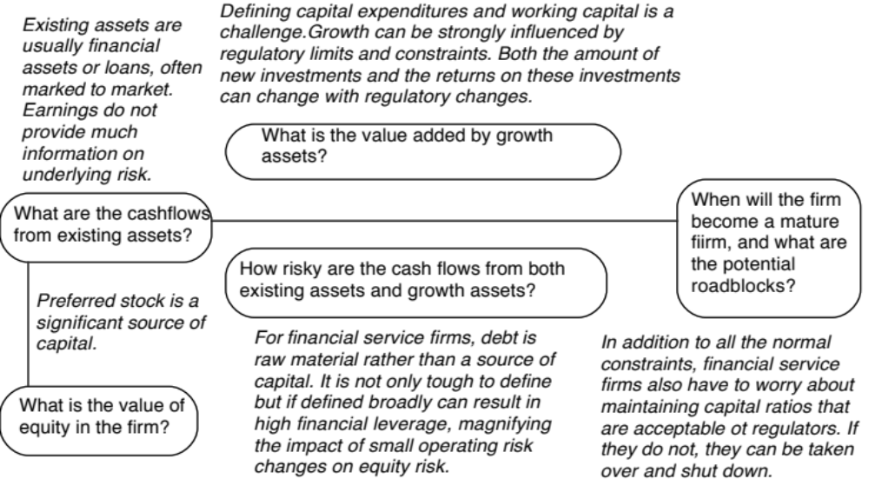
IV. Valuing Financial Service Companies

Slide 103
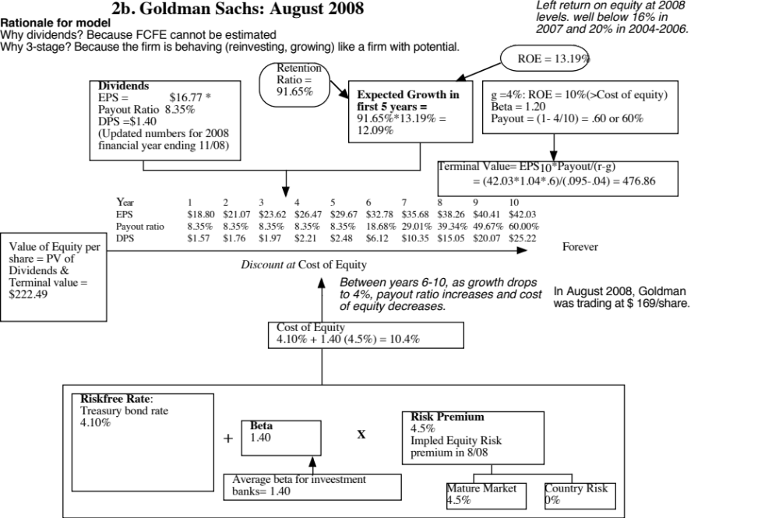
Notes:
A good measure of how the world can shift under you. Four weeks after this valuation, Lehman collapsed and the rest as they say is history. Here are some questions:
With the benefit of hindsight, which inputs for the company were over optimistic? (Base year earnings and expected ROE..)
What macro inputs should be changed, in hindsight again? (I think the ERP of 4.5% turned out to be too low..)

Slide 104
Lesson 1: Financial service companies are opaque…
With financial service firms, we enter into a Faustian bargain. They tell us very little about the quality of their assets (loans, for a bank, for instance are not broken down by default risk status) but we accept that in return for assets being marked to market (by accountants who presumably have access to the information that we don’t have).
In addition, estimating cash flows for a financial service firm is difficult to do. So, we trust financial service firms to pay out their cash flows as dividends. Hence, the use of the dividend discount model.

Slide 105
Lesson 2: For financial service companies, book value matters…
The book value of assets and equity is mostly irrelevant when valuing non-financial service companies. After all, the book value of equity is a historical figure and can be nonsensical. (The book value of equity can be negative and is so for more than a 1000 publicly traded US companies)
With financial service firms, book value of equity is relevant for two reasons:
  Since financial service firms mark to market, the book value is more likely to reflect what the firms own right now (rather than a historical value)
  The regulatory capital ratios are based on book equity. Thus, a bank with negative or even low book equity will be shut down by the regulators.
From a valuation perspective, it therefore makes sense to pay heed to book value. In fact, you can argue that reinvestment for a bank is the amount that it needs to add to book equity to sustain its growth ambitions and safety requirements:
  FCFE = Net Income – Reinvestment in regulatory capital (book equity)

Slide 106
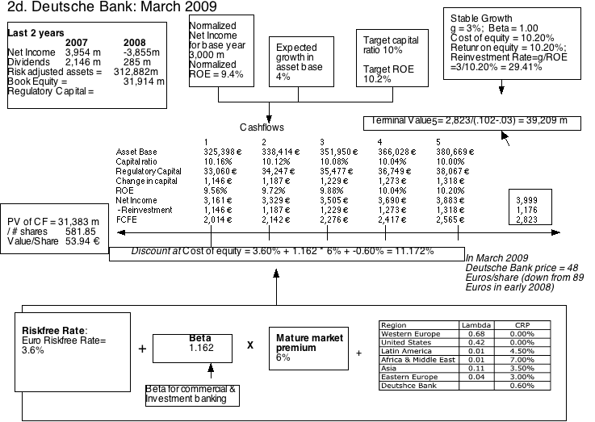

Slide 107
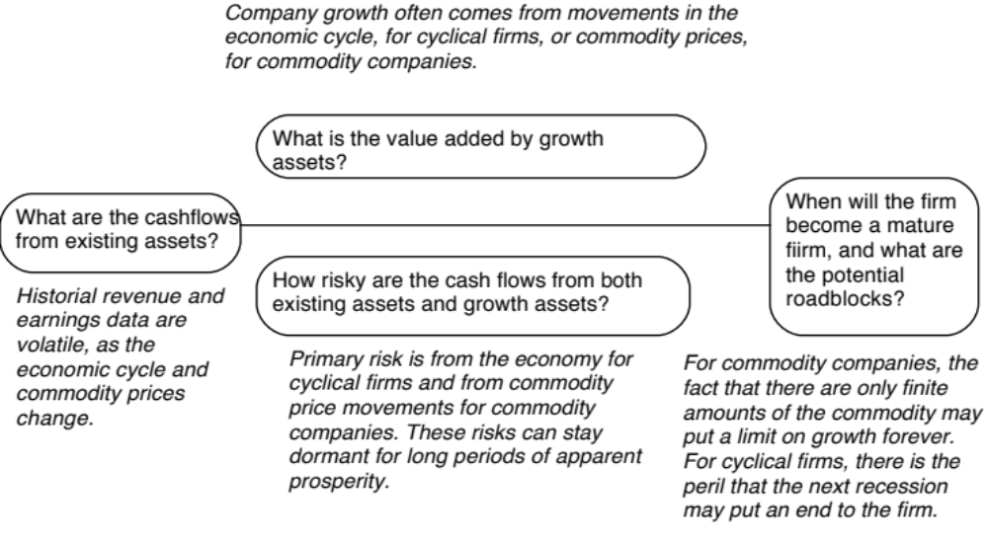
V. Valuing cyclical and commodity companies

Slide 108
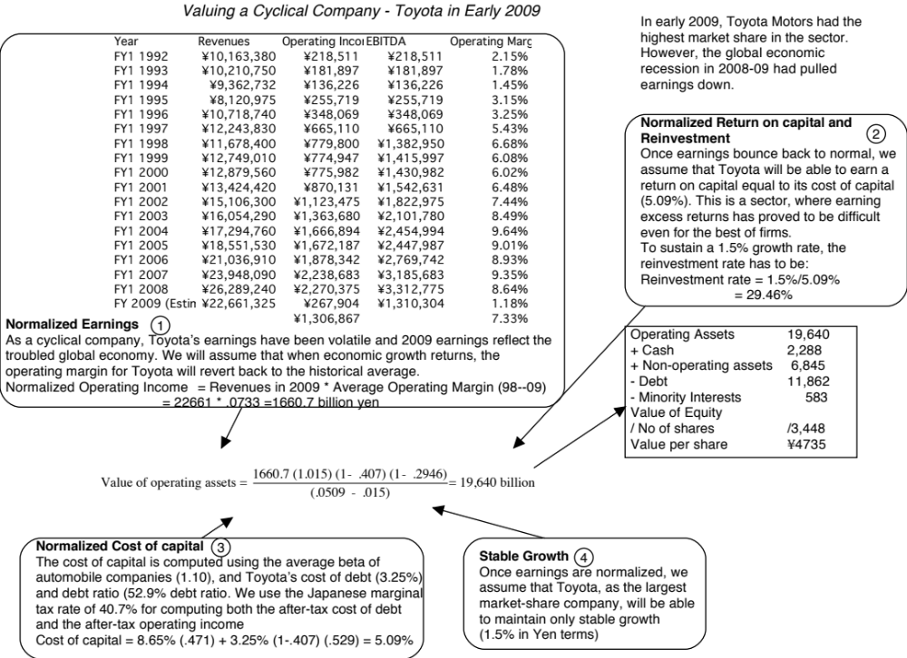
Notes:
With commodity companies, you ride the price of the commodity. As commodity prices rise, current earnings will rise, but what goes up will come down. The key is normalizing the commodity price, easier said than done, but necessary. Here are some strategies:
Look at the average price over a long period (10 years or more)
Estimate what a fair price would be, given demand and supply, for the commodity.

Slide 109


Slide 110
Lesson 1: With “macro” companies, it is easy to get lost in “macro” assumptions…
With cyclical and commodity companies, it is undeniable that the value you arrive at will be affected by your views on the economy or the price of the commodity.
Consequently, you will feel the urge to take a stand on these macro variables and build them into your valuation. Doing so, though, will create valuations that are jointly impacted by your views on macro variables and your views on the company, and it is difficult to separate the two.
The best (though not easiest) thing to do is to separate your macro views from your micro views. Use current market based numbers for your valuation, but then provide a separate assessment of what you think about those market numbers.

Slide 111
Lesson 2: Use probabilistic tools to assess value as a function of macro variables…
If there is a key macro variable affecting the value of your company that you are uncertain about (and who is not), why not quantify the uncertainty in a distribution (rather than a single price) and use that distribution in your valuation.
That is exactly what you do in a Monte Carlo simulation, where you allow one or more variables to be distributions and compute a distribution of values for the company.
With a simulation, you get not only everything you would get in a standard valuation (an estimated value for your company) but you will get additional output (on the variation in that value and the likelihood that your firm is under or over valued)

Slide 112

Lukoil Valuation: Oil Price Simulation

Slide 113
The optionality in commodities: Undeveloped reserves as an option
Net Payoff on
Extraction
Cost of Developing
Reserve
Value of estimated reserve of natural resource

Slide 114
Valuing Gulf Oil
Gulf Oil was the target of a takeover in early 1984 at $70 per share (It had 165.30 million shares outstanding, and total debt of $9.9 billion).
  It had estimated reserves of 3038 million barrels of oil and the average cost of developing these reserves was estimated to be $10 a barrel in present value dollars (The development lag is approximately two years).
  The average relinquishment life of the reserves is 12 years.
  The price of oil was $22.38 per barrel, and the production cost, taxes and royalties were estimated at $7 per barrel.
  The bond rate at the time of the analysis was 9.00%.
  Gulf was expected to have net production revenues each year of approximately 5% of the value of the developed reserves. The variance in oil prices is 0.03.

Slide 115
Valuing Undeveloped Reserves
Inputs for valuing undeveloped reserves
  Value of underlying asset = Value of estimated reserves discounted back for period of development lag= 3038 * ($ 22.38 - $7) / 1.05² = $42,380.44
  Exercise price = Estimated development cost of reserves = 3038 * $10 = $30,380 million
  Time to expiration = Average length of relinquishment option = 12 years
  Variance in value of asset = Variance in oil prices = 0.03
  Riskless interest rate = 9%
  Dividend yield = Net production revenue/ Value of developed reserves = 5%
Based upon these inputs, the Black-Scholes model provides the following value for the call:
  d1 = 1.6548 N(d1) = 0.9510
  d2 = 1.0548 N(d2) = 0.8542
Call Value= 42,380.44 exp^{(-0.05)(12)} (0.9510) -30,380 (exp^{(-0.09)(12)} (0.8542) = $ 13,306 million

Slide 116
The composite value…
In addition, Gulf Oil had free cashflows to the firm from its oil and gas production of $915 million from already developed reserves and these cashflows are likely to continue for ten years (the remaining lifetime of developed reserves).
The present value of these developed reserves, discounted at the weighted average cost of capital of 12.5%, yields:
  Value of already developed reserves = 915 (1 - 1.125⁻¹⁰)/.125 = $5065.83
Adding the value of the developed and undeveloped reserves
  Value of undeveloped reserves = $ 13,306 million
  Value of production in place = $ 5,066 million
  Total value of firm = $ 18,372 million
  Less Outstanding Debt = $ 9,900 million
  Value of Equity = $ 8,472 million
  Value per share = $ 8,472/165.3 = $51.25

Slide 117

VII. Valuing Companies across the ownership cycle

Slide 118


Slide 119

Lesson 1: In private businesses, risk in the eyes of the “beholder” (buyer)

Slide 120


Slide 121
Total Risk versus Market Risk
Adjust the beta to reflect total risk rather than market risk. This adjustment is a relatively simple one, since the R squared of the regression measures the proportion of the risk that is market risk.
  Total Beta = Market Beta / Correlation of the sector with the market
To estimate the beta for Kristin Kandy, we begin with the bottom-up unlevered beta of food processing companies:
  Unlevered beta for publicly traded food processing companies = 0.78
  Average correlation of food processing companies with market = 0.333
  Unlevered total beta for Kristin Kandy = 0.78/0.333 = 2.34
  Debt to equity ratio for Kristin Kandy = 0.3/0.7 (assumed industry average)
  Total Beta = 2.34 ( 1- (1-.40)(30/70)) = 2.94
  Total Cost of Equity = 4.50% + 2.94 (4%) = 16.26%
Notes:
This assumes that
The owner of the private business has all of his or her wealth invested in the business
The reality is that most individuals will fall somewhere between the two extremes.
If you were a private business looking at potential acquirers - one is a publicly traded firm and the other is an individual . Which one is likely to pay the higher price and why?
If both acquirers have the same cash flow expectations, the publicly traded firm will win out (Blockbuster Video, Browning-Ferris are good examples of publicly traded firms which bought small private businesses to grow to their current stature.)

Slide 122
Lesson 2: With financials, trust but verify..
Different Accounting Standards: The accounting statements for private firms are often based upon different accounting standards than public firms, which operate under much tighter constraints on what to report and when to report.
Intermingling of personal and business expenses: In the case of private firms, some personal expenses may be reported as business expenses.
Separating “Salaries” from “Dividends”: It is difficult to tell where salaries end and dividends begin in a private firm, since they both end up with the owner.
The Key person issue: In some private businesses, with a personal component, the cashflows may be intertwined with the owner being part of the business.

Slide 123
Lesson 3: Illiquidity is a clear and present danger..
In private company valuation, illiquidity is a constant theme. All the talk, though, seems to lead to a rule of thumb. The illiquidity discount for a private firm is between 20-30% and does not vary across private firms.
But illiquidity should vary across:
  Companies: Healthier and larger companies, with more liquid assets, should have smaller discounts than money-losing smaller businesses with more illiquid assets.
  Time: Liquidity is worth more when the economy is doing badly and credit is tough to come by than when markets are booming.
  Buyers: Liquidity is worth more to buyers who have shorter time horizons and greater cash needs than for longer term investors who don’t need the cash and are willing to hold the investment.

Slide 124
Narrative and Numbers: valuation as a bridge

Slide 125

Bridging the Gap

Slide 126
Step 1: Create a narrative
Every valuation starts with a narrative, a story that you see unfolding for your company in the future.
In developing this narrative, you will be making assessments of your company (its products, its management), the market or markets that you see it growing in, the competition it faces and will face and the macro environment in which it operates

Slide 127


Slide 128

Potential Markets for Uber

Slide 129
Your narrative and counters
My narrative for Uber: Uber will expand the car service market moderately, primarily in urban environments, and use its competitive advantages to get a significant but not dominant market share and maintain its profit margins.
Bill Gurley’s counter narrative
  Not just car service company.: Uber is a car company, not just a car service company, and there may be a day when consumers will subscribe to a Uber service, rather than own their own cars. It could also expand into logistics, i.e., moving and transportation businesses.
  Not just urban: Uber can create new demands for car service in parts of the country where taxis are not used (suburbia, small towns).
  Global networking benefits: By linking with technology and credit card companies, Uber can have global networking benefits.

Slide 130

Step 2: Check the narrative against history, economic first principles & common sense

Slide 131

Uber: Possible, Plausible and Probable

Slide 132

Step 3: Connect your narrative to key drivers of value

Slide 133

The narrative to numbers

Slide 134

Step 4: Value the company

Slide 135

Step 5: Keep the feedback loop

Slide 136

Narratives drive value

Slide 137
Step 6: Be ready to modify narrative as events unfold
Narrative Break/End | Narrative Shift | Narrative Change (Expansion or Contraction)
Events, external (legal, political or economic) or internal (management, competitive, default), that can cause the narrative to break or end. | Improvement or deterioration in initial business model, changing market size, market share and/or profitability. | Unexpected entry/success in a new market or unexpected exit/failure in an existing market.
Your valuation estimates (cash flows, risk, growth & value) are no longer operative | Your valuation estimates will have to be modified to reflect the new data about the company. | Valuation estimates have to be redone with new overall market potential and characteristics.
Estimate a probability that it will occur & consequences | Monte Carlo simulations or scenario analysis | Real Options

Slide 138
Relative Valuation (Pricing)
Aswath Damodaran

Slide 139
Relative valuation is pervasive…
Most asset valuations are relative.
Most equity valuations on Wall Street are relative valuations.
  Almost 85% of equity research reports are based upon a multiple and comparables.
  More than 50% of all acquisition valuations are based upon multiples
  Rules of thumb based on multiples are not only common but are often the basis for final valuation judgments.
While there are more discounted cashflow valuations in consulting and corporate finance, they are often relative valuations masquerading as discounted cash flow valuations.
  The objective in many discounted cashflow valuations is to back into a number that has been obtained by using a multiple.
  The terminal value in a significant number of discounted cashflow valuations is estimated using a multiple.

Slide 140
The Reasons for the allure…
“If you think I’m crazy, you should see the guy who lives across the hall”
  Jerry Seinfeld talking about Kramer in a Seinfeld episode
“ A little inaccuracy sometimes saves tons of explanation”
  H.H. Munro
“ If you are going to screw up, make sure that you have lots of company”
  Ex-portfolio manager
Notes:
Most valuations that you see are relative valuations. There are two reasons why relative valuations are so popular:
If your objective is to buy or sell something, not matter what the price, you can justify your decision using relative valuation. There will always be some other assets out there which are more underpriced or overpriced than the asset you are buying or selling.
In contrast to the detail and time needed for discounted cashflow valuation, relative valuation is quicker and seems to require fewer assumptions about the future. (This, we will argue, is really an illusion.)

Slide 141

Pricing versus Valuation

Slide 142

Test 1: Are you pricing or valuing?

Slide 143

Test 2: Are you pricing or valuing?

Slide 144
Test 3: Are you pricing or valuing?
 | 1 | 2 | 3 | 4 | 5
EBITDA | $100.00 | $120.00 | $144.00 | $172.80 | $207.36
- Depreciation | $20.00 | $24.00 | $28.80 | $34.56 | $41.47
EBIT | $80.00 | $96.00 | $115.20 | $138.24 | $165.89
- Taxes | $24.00 | $28.80 | $34.56 | $41.47 | $49.77
EBIT (1-t) | $56.00 | $67.20 | $80.64 | $96.77 | $116.12
+ Depreciation | $20.00 | $24.00 | $28.80 | $34.56 | $41.47
- Cap Ex | $50.00 | $60.00 | $72.00 | $86.40 | $103.68
- Chg in WC | $10.00 | $12.00 | $14.40 | $17.28 | $20.74
FCFF | $16.00 | $19.20 | $23.04 | $27.65 | $33.18
Terminal Value |  |  |  |  | $1,658.88
Cost of capital | 8.25% | 8.25% | 8.25% | 8.25% | 8.25%
Present Value | $14.78 | $16.38 | $18.16 | $20.14 | $1,138.35
Value of operating assets today | $1,207.81
+ Cash | $125.00
- Debt | $200.00
Value of equity | $1,132.81

Slide 145

The tool for pricing: A multiple
Notes:
The distinction between price (representing equity value) and value (representing the combined market value of equity and debt) and enterprise value (representing firm value - cash and marketable securities) should be noted.
Note that the denominator can be a number from the income statement (revenues, earnings) or one from the balance sheet (book value). It can even be a non-financial input (number of employees or units of the product produced).

Slide 146
The Four Steps to Deconstructing Multiples
Define the multiple
  In use, the same multiple can be defined in different ways by different users. When comparing and using multiples, estimated by someone else, it is critical that we understand how the multiples have been estimated
Describe the multiple
  Too many people who use a multiple have no idea what its cross sectional distribution is. If you do not know what the cross sectional distribution of a multiple is, it is difficult to look at a number and pass judgment on whether it is too high or low.
Analyze the multiple
  It is critical that we understand the fundamentals that drive each multiple, and the nature of the relationship between the multiple and each variable.
Apply the multiple
  Defining the comparable universe and controlling for differences is far more difficult in practice than it is in theory.
Notes:
While we can rail about the fact that a valuation based upon multiples is not as detailed as a discounted cashflow valuation,, the reality is that analysts will continue to use multiples to value companies and that we will often have to use these valuations.
Given this reality, we have to think about how best to use multiples. These four steps represent a way in which we can deconstruct any multiple, understand how to use it well and discover when it is being misused.

Slide 147
Definitional Tests
Is the multiple consistently defined?
  Proposition 1: Both the value (the numerator) and the standardizing variable ( the denominator) should be to the same claimholders in the firm. In other words, the value of equity should be divided by equity earnings or equity book value, and firm value should be divided by firm earnings or book value.
Is the multiple uniformly estimated?
  The variables used in defining the multiple should be estimated uniformly across assets in the “comparable firm” list.
  If earnings-based multiples are used, the accounting rules to measure earnings should be applied consistently across assets. The same rule applies with book-value based multiples.
Notes:
Consistent definition:
Consider two widely used multiples that are consistently defined. In the price-earnings ratio (PE), the numerator is equity value per share and the denominator is equity earnings per share. In the enterprise value/ EBITDA multiple, the numerator is firm value and the denominator is a pre-tax cash flow to all claimholders in the firm. In contrast, the price to EBITDA multiple is inconsistent. Why is this a problem? If you are comparing firms with different debt ratios, the firms will more debt will look cheaper on a price to EBITDA basis.
Uniformally Estimated:
This is actually much more difficult than it looks. Even if accounting standards are the same across firms, you run into two problems:
The degree to which firms bend accounting rules for their own purposes varies across firms. Some firms are inherently more conservative in reporting earnings than others.
The financial year ends at different points for different firms. If the denominator is the earnings in the most recent financial year, the multiple may not be comparable if some firms have December year-ends and some have June year-ends.

Slide 148
Example 1: Price Earnings Ratio: Definition
PE = Market Price per Share / Earnings per Share
There are a number of variants on the basic PE ratio in use. They are based upon how the price and the earnings are defined.
Price: is usually the current price
is sometimes the average price for the year
EPS: EPS in most recent financial year
EPS in trailing 12 months (Trailing PE)
Forecasted EPSnnext year (Forward PE)
Forecasted EPS in future year
Notes:
This is only the tip of the iceberg. You can have EPS before and after extraordinary items, primary and diluted EPS..
When you are negotiating with someone else and you are both using PE ratios to make your case, the first step is to make sure that you are using the same PE ratio.
There is also the tendency on the part of analysts to pick the definition of pE that best fits their biases. For instance, bullish analysts in the 1990s almost always used forward PE whereas bearish analysts used trailing PE. Since earnings were rising the former were generally much lower than the latter.

Slide 149
Example 2: Enterprise Value /EBITDA Multiple
The enterprise value to EBITDA multiple is obtained by netting cash out against debt to arrive at enterprise value and dividing by EBITDA.
Why do we net out cash from firm value?
What happens if a firm has cross holdings which are categorized as:
  Minority interests?
  Majority active interests?
Notes:
The problem with using firm value is that cash is included in the numerator but not in the denominator. That is why the enterprise value version makes more sense…
A broad problem is posed when firms have holdings in other firms. If such holdings are passive, Value to EBITDA multiples will be overstated, since the numerator will include the value of your holdings, while the EBITDA will not include any of the income from these holdings. If such holdings are majority active and consolidated, the value to EBITDA will be understated because the numerator will include only the portion of the equity you own in the subsidiary but the EBITDA will include all of the EBITDA in the subsidiary.
The safest thing to do (assuming you can do this) is to net out the market value of your holdings from the numerator (for both active and passive holdings) and the EBITDA of your holdings from the denominator ( for majority active holdings)

Slide 150
Descriptive Tests
What is the average and standard deviation for this multiple, across the universe (market)?
What is the median for this multiple?
  The median for this multiple is often a more reliable comparison point.
How large are the outliers to the distribution, and how do we deal with the outliers?
  Throwing out the outliers may seem like an obvious solution, but if the outliers all lie on one side of the distribution (they usually are large positive numbers), this can lead to a biased estimate.
Are there cases where the multiple cannot be estimated? Will ignoring these cases lead to a biased estimate of the multiple?
How has this multiple changed over time?
Notes:
Before you use a multiple and develop rules of thumb (8 times EBITDA is cheap), you need to get a sense of the cross-sectional distribution.
Multiples have skewed distributions. Because a multiple cannot be less than zero but can potentially be infinite, the averages for multiples will be much higher than their medians, and the difference will increase as the outliers become larger. Many services cap outliers to prevent them from altering the averages too much, results…
The PE ratio cannot be estimated when the earnings per share are negative. Thus, if you have a sample of 20 firms and 10 have negative earnings, you will be able to compute the PE ratio for only the 10 that have positive earnings and will throw out the remaining firms. This will induce a bias in your sample. One way to avoid this is to take the cumulative values for market capitalization and net income for all 20 firms, and compute a PE ratio based upon the cumulated values. The resulting PE ratio will generally be much higher….

Slide 151
1. Multiples have skewed distributions…
Notes:
This graph for all U.S. firms with data available on the Value Line CD ROM (contains about 7200 firms in the overall sample). Notice that the distributions are skewed to the left and that we have capped the PE ratios at 100….

Slide 152
2. Making statistics “dicey”
 | Current PE | Trailing PE | Forward PE
Number of firms | 7887 | 7887 | 7887
Number with PE | 3403 | 3398 | 2820
Average | 72.13 | 60.49 | 35.25
Median | 20.88 | 19.74 | 18.32
Minimum | 0.25 | 0.4 | 1.15
Maximum | 23,100. | 23,100. | 5,230.91
Standard deviation | 509.6 | 510.41 | 139.75
Standard error | 8.74 | 8.76 | 2.63
Skewness | 31. | 32.77 | 25.04
25th percentile | 13.578 | 13.2 | 14.32
75th percentile | 33.86 | 31.16 | 25.66
Notes:
Four things to note…
Notice the number of firms that we have lost in the sample as we compute PE ratios.
You lose even more firms as you go to forward PE, because you need analyst estimates of expected earnings per share to compute this. Any firms not followed by analysts will not have a forward PE…
The means were computed without capping the PE ratios… the outliers (notice the maximum values for the ratios) push the average to almost twice the median.
The median forward PE is higher than the trailing PE which is higher than the current PE…

Slide 153
3. Markets have a lot in common : Comparing Global PEs
Notes:
This compares the percentages of firms in each market that trade in each PE ratio class… In 2012, it is difficult to tell them apart. That is a change from a few years ago, when US and European stocks traded at much higher PE ratios than emerging market stocks. The convergence of PE ratios globally may reflect the blurring of the line between developed and emerging markets.

Slide 154

4. Simplistic rules almost always break down…6 times EBITDA may not be cheap…
Notes:
As with the other multiples, a heavily skewed distribution. Suggests that the rule of thumb that is often used by Wall Street (EBITDA multiple less than 8 is cheap) should be used with caution.

Slide 155
But it may be in 2015, unless you are in Japan, Australia or Canada

Slide 156
Analytical Tests
What are the fundamentals that determine and drive these multiples?
  Proposition 2: Embedded in every multiple are all of the variables that drive every discounted cash flow valuation - growth, risk and cash flow patterns.
  In fact, using a simple discounted cash flow model and basic algebra should yield the fundamentals that drive a multiple
How do changes in these fundamentals change the multiple?
  The relationship between a fundamental (like growth) and a multiple (such as PE) is seldom linear. For example, if firm A has twice the growth rate of firm B, it will generally not trade at twice its PE ratio
  Proposition 3: It is impossible to properly compare firms on a multiple, if we do not know the nature of the relationship between fundamentals and the multiple.

Slide 157




PE Ratio: Understanding the Fundamentals
To understand the fundamentals, start with a basic equity discounted cash flow model.
With the dividend discount model,
Dividing both sides by the current earnings per share,
If this had been a FCFE Model,
Notes:
To get to the heart of equity multiples, we start with an equity DCF model. In this case, we consider the simplest equity valuation model - a stable growth dividend discount model. Restated in terms of the PE ratio, we find that the PE ratio fo a stable growth firm can be written in terms of three variables:
The expected growth rate in earnings per share
The riskiness of the equity, which determines the cost of equity
The efficiency with which the firm generates growth,which is measured by how much the firm can pay out or afford to pay out after reinvested to create the growth.

Slide 158

The Determinants of Multiples…

Slide 159
Application Tests
Given the firm that we are valuing, what is a “comparable” firm?
  While traditional analysis is built on the premise that firms in the same sector are comparable firms, valuation theory would suggest that a comparable firm is one which is similar to the one being analyzed in terms of fundamentals.
  Proposition 4: There is no reason why a firm cannot be compared with another firm in a very different business, if the two firms have the same risk, growth and cash flow characteristics.
Given the comparable firms, how do we adjust for differences across firms on the fundamentals?
  Proposition 5: It is impossible to find an exactly identical firm to the one you are valuing.
Notes:
In practice, we all too often define comparable as a firm in the same industry or business. This is too narrow a definition. You can have firms in different businesses that have similar cashflow, growth and risk characteristics. These firms can be viewed as comparable firms.
You will never find two identical firms, no matter how hard you search. You therefore have to always control for the residual differences when making comparisons.

Slide 160

An Example: Comparing PE Ratios across a Sector: PE
Notes:
In this sample, note that some of the firms in the sample are emerging market firms any may be exposed to more risk (political risk, economic risk, inflation risk…)

Slide 161
PE, Growth and Risk
Dependent variable is: PE
R squared = 66.2% R squared (adjusted) = 63.1%
Variable Coefficient SE t-ratio Probability
Constant 13.1151 3.471 3.78 0.0010
Growth rate 121.223 19.27 6.29 ≤ 0.0001
Emerging Market -13.853 1 3.606 -3.84 0.0009
Emerging Market is a dummy: 1 if emerging market
0 if not
Is Indosat cheap?
PE = 13.13 + 121.22 (.06) -13.85 (1) = 6.55
At 7.8 times earnings, Indosat is over valued.
Notes:
Higher growth telecomm companies have higher PE ratios..
One way to read this regression: If you have two companies - one with a growth rate of 10% and one with a growth rate of 20%, the latter should have a PE that is 12.1 higher..
If the firm happens to be an emerging market firm, though, you would expect its PE ratio to be 13.85 lower than a firm with similar growth in a developed market.

Slide 162

Lukoil: A Relative Valuation

Slide 163
Comparing Multiples
 | Lukoil | Russian Oil | Emerging Oil | Global Oil
Sample Size |  | 4 | 21 | 40
PE | 7.89 | 5.30 | 11.09 | 15.75
Price to Book | 0.46 | 0.47 | 1.23 | 1.23
EV to Sales | 0.33 | 0.57 | 0.95 | 1.01
EV/EBITDA | 2.71 | 2.53 | 4.56 | 4.89
EV/EBIT | 5.44 | 3.88 | 9.21 | 9.46
EV/Invested Capital | 0.52 | 0.47 | 1.15 | 1.19
EV/Barrel of Proven Reserves | 3.53 | 5.20 | 16.77 | 25.09

Slide 164
Controlling for differences
 | Lukoil | Russian Oil | Emerging Oil | Global Oil
ROE | 5.85% | 9.14% | 8.56% | 6.75%
Pre-tax ROIC | 9.59% | 12.57% | 11.35% | 11.61%
Debt/Capital (Market) | 26.55% | 28.16% | 28.13% | 29.59%
Debt/EBITDA | 0.26 | 0.57 | 0.85 | 0.86
Interest coverage ratio | 13.76 | 26.40 | 6.83 | 10.11

Slide 165
Looking for Price Drivers
 | EV/Invested Capital | Pre-tax ROIC | Debt/Capital (Market) | Debt/EBITDA | Interest coverage ratio | Emerging Dummy
EV/Invested Capital | 1.0000 | 0.0510 | -0.3780 | 0.5760 | 0.1260 | 0.0980
Pre-tax ROIC |  | 1.0000 | -0.2750 | -0.1330 | 0.1260 | 0.1630
Debt/Capital (Market) |  |  | 1.0000 | -0.2150 | -0.2160 | 0.0330
Debt/EBITDA |  |  |  | 1.0000 | 0.0920 | 0.0870
Interest coverage ratio |  |  |  |  | 1.0000 | -0.2060
Emerging Dummy |  |  |  |  |  | 1.0000

Slide 166
Lukoil: The Bottom line
If you regress EV/Invested Capital against Debt to Capital ratios, you get:
  EV/ IC = 1.833 - 2.092 Debt/Capital R²=50.8%
Plugging in Lukoil’s debt to capital ratio of 26.55% into the regression:
  EV/ IC = 1.833 - 2.092 (.2655) = 1.2776
At its actual EV/Invested Capital ratio of 0.52, Lukoil looks like a bargain.

Slide 167
Comparisons to the entire market: Why not?
In contrast to the 'comparable firm' approach, the information in the entire cross-section of firms can be used to predict PE ratios.
The simplest way of summarizing this information is with a multiple regression, with the PE ratio as the dependent variable, and proxies for risk, growth and payout forming the independent variables.
Notes:
There is information in how the market prices all firms that can be used to value any firm in that market.

Slide 168

PE Ratio: Standard Regression for US stocks - January 2015
The regression is run with growth and payout entered as decimals, i.e., 25% is entered as 0.25)
Notes:
This regression has about 1600 firms. While the low R-squared may be troubling, it should not be unexpected, given the scatter plot on the previous page.
The signs of the coefficients are consistent with our priors for growth and higher growth have higher PE ratios. With risk and payout, though, the signs on the coefficient are wrong. Higher risk and lower payout firms firms seems to have higher (instead of lower) PE ratios.

Slide 169
PE ratio regressions across markets
Region | Regression – January 2015 | R²
US | PE = 6.48 + 98.58 g_{EPS} + 16.77 Payout - 3.25 Beta | 35.5%
Europe | PE = 19.32 + 43.89 g_{EPS} + 5.14 Payout - 4.45 Beta | 17.4%
Japan | PE = 7.85+ 32.48 g_{EPS} + 31.32 Payout - 1.165 Beta | 25.2%
Emerging Markets | PE = 10.90 + 57.47 g_{EPS} + 7.62 Payout - 2.36 Beta | 27.0%
Global | PE = 12.49 + 56.89 g_{EPS} + 10.40 Payout - 3.10 Beta | 23.3%
g_{EPS}=Expected Growth: Expected growth in EPS or Net Income: Next 5 years
Beta: Regression or Bottom up Beta
Payout ratio: Dividends/ Net income from most recent year. Set to zero, if net income < 0
Notes:
Note how much in common these regressions have… though the effects of growth, risk and quality of growth may vary across markets, the direction of the effect is the same.

Slide 170
Choosing Between the Multiples
As presented in this section, there are dozens of multiples that can be potentially used to value an individual firm.
In addition, relative valuation can be relative to a sector (or comparable firms) or to the entire market (using the regressions, for instance)
Since there can be only one final estimate of value, there are three choices at this stage:
  Use a simple average of the valuations obtained using a number of different multiples
  Use a weighted average of the valuations obtained using a nmber of different multiples
  Choose one of the multiples and base your valuation on that multiple
Notes:
When doing relative valuation, you can choose between potentially a dozen or more multiples. With each multiple, you will estimate a different value for your firm, leaving you with the unenviable task of reconciling these values.

Slide 171
Picking one Multiple
This is usually the best way to approach this issue. While a range of values can be obtained from a number of multiples, the “best estimate” value is obtained using one multiple.
The multiple that is used can be chosen in one of two ways:
  Use the multiple that best fits your objective. Thus, if you want the company to be undervalued, you pick the multiple that yields the highest value.
  Use the multiple that has the highest R-squared in the sector when regressed against fundamentals. Thus, if you have tried PE, PBV, PS, etc. and run regressions of these multiples against fundamentals, use the multiple that works best at explaining differences across firms in that sector.
  Use the multiple that seems to make the most sense for that sector, given how value is measured and created.
Notes:
This is my preferred approach. Pick one multiple, but which one will depend upon what you view your objective to be.

Slide 172
Conventional usage…
Sector | Multiple Used | Rationale
Cyclical Manufacturing | PE, Relative PE | Often with normalized earnings
Growth firms | PEG ratio | Big differences in growth rates
Young growth firms w/ losses | Revenue Multiples | What choice do you have?
Infrastructure | EV/EBITDA | Early losses, big DA
REIT | P/CFE (where CFE = Net income + Depreciation) | Big depreciation charges on real estate
Financial Services | Price/ Book equity | Marked to market?
Retailing | Revenue multiples | Margins equalize sooner or later

Slide 173
Risk Management & Value
You cannot live life in a defensive crouch!

Slide 174

Risk: The definition
Risk, in traditional terms, is viewed as a ‘negative’. Webster’s dictionary, for instance, defines risk as “exposing to danger or hazard”. The Chinese symbols for crisis, reproduced below, give a much better description of risk.
The first symbol is the symbol for “danger”, while the second is the symbol for “opportunity”, making risk a mix of danger and opportunity.
Notes:
Note that risk is neither good nor bad. It is a combination of danger and opportunity - you cannot have one without the other. Consequently, risk is neither something to be avoided nor sought out but carefully balanced. Good business avoid some risks, let others pass through to their investors and actively seek out still others.
When businesses want opportunity (higher returns), they have to live with the higher risk.
Any sales pitch that offers returns without risk is a pipe dream.

Slide 175
We are all risk averse, but to different degrees
Individuals are risk averse, though the studies differ on what they find about relative risk aversion as wealth increases.
Surveys find that women are more risk averse than men, even after controlling for differences in age, income and education.
The lifecycle risk aversion hypothesis posits that risk aversion should increase with age, but surveys cannot directly test this proposition, since it would require testing the same person at different ages. In weak support of this hypothesis, surveys find that older people are, in fact, more risk averse than younger people because they tend to invest less of their wealth in riskier assets.

Slide 176
But we are not always rational
Framing: Would you rather save 200 out of 600 people or accept a one-third probability that everyone will be saved? While the two statements may be mathematically equivalent, most people choose the first.
Loss Aversion: Would you rather take $ 750 or a 75% chance of winning $1000? Would you rather lose $750 guaranteed or a 75% chance of losing $ 1000?
Myopic loss aversion: Getting more frequent feedback on where they stand makes individuals more risk averse.
House Money Effect: Individuals are more willing to takes risk with found money (i.e. money obtained easily) than with earned money.
The Breakeven Effect: Subjects in experiments who have lost money seem willing to gamble on lotteries (that standing alone would be viewed as unattractive) that offer them a chance to break even.

Slide 177
Task 1: How risk averse are you?
How risk averse are you?
More risk averse than my colleagues
About as risk averse as my colleagues
Less risk averse than my colleagues
If you are more or less risk averse than your colleagues, how does this difference affect your decisions and discussions?

Slide 178
Ways of dealing with risk in analysis
Risk Adjusted Value
  Estimate expected cash flows and adjust the discount rate for risk
  Use certainty equivalent cash flows and use the riskfree rate as the discount rate
  Hybrid approaches
Probabilistic Approaches
  Sensitivity Analysis
  Decision Trees
  Simulations
Value at Risk (VAR) and variants

Slide 179
Task 2: Risk Assessment at your organization
What risk assessment approaches do you use in your organization? (You can pick more than one)
Risk adjusted Value
Sensitivity Analysis
Decision Trees
Simulation
All of the above
None of the above
If you picked none of the above, what do you do about risk in decision making?

Slide 180
How risk can affect value..
For an action to affect value, it has to affect one or more of the following inputs into value:
  Cash flows from existing assets
  Growth rate during excess return phase
  Length of period of excess returns
  Discount rate
Proposition 1: Risk hedging/management can increase value only if they affect cash flows, growth rates, discount rates and/or length of the growth period.
Proposition 2: When risk hedging/management has no effect on cash flows, growth rates, discount rates and/or length of the growth period, it can have no effect on value.

Slide 181

Risk Hedging/ Management and Value

Slide 182


Slide 183
Step 1: Developing a risk profile
List the risks you are exposed to as a business, from the risk of a supplier failing to deliver supplies to environmental/social risk.
Categorize the risk into groups: Not all risks are made equal and it makes sense to break risks down into:
    Economic versus non-Economic risks
    Market versus Firm-specific risks
    Operating versus Financial risk
    Continuous versus Discrete risk
    Catastrophic versus smaller risks
Measure exposure to each risk (if possible): Use historical data and subjective judgments to make your best estimates.

Slide 184
Task 1: Risk in your organization
List the five biggest risks that you see your firm (organization) facing, and then categorize them.
Risk | Micro or Macro | Discrete or Continuous | Catastrophic or Small
1.
2.
3.
4.
5.

Slide 185
Step 2: Decide on what risks to take, which to avoid and which to pass through
Every business (individual) is faced with a laundry list of risks. The key to success is to not avoid every risk, or take every one but to classify these risks into
  Risks to pass through to the investors in the business.
  Risks to avoid or hedge.
  Risks to seek out
In practice, firms often hedge risk that they should be passing through, seek out some risks that they should not be seeking out and avoid risks that they should be taking.

Slide 186
a. Risk Hedging:
Potential Benefits
Tax Benefits: Hedging may reduce taxes paid by either smoothing out earnings or from the tax treatment of hedging expenses.
Better investment decisions: Hedging against macroeconomic risk factors may create better investment decisions because
  Managers are risk averse and protecting against some “uncontrollable” risks may allow them to focus better on business decisions.
  Capital markets are imperfect
Distress costs: Hedging may reduce the chance that a firm will face distress (and cease to exist) and thus reduce indirect bankruptcy costs.
Capital Structure: Hedging risk may allow a firm to borrow more money and take advantage of the tax code’s bias to debt.
Informational benefits: Hedging against macroeconomic risks makes earnings more informative, by eliminating the noise create by shifts in macroeconomic variables.

Slide 187
And costs…
Explicit costs: When companies hedge risk against risk by either buying insurance or put options, the cost of hedging is the cost of buying the protection against risk. It increases costs and reduces income.
Implicit costs: When you buy/sell futures or forward contracts, you have no upfront explicit cost but you have an implicit cost. You give up upside to get downside protection.
  A related and subjective implicit cost is that buying protection may give managers too much insulation against that risk and provide them with a false sense of security.

Slide 188
Evidence on hedging..
Hedging is common: In 1999, Mian studied the annual reports of 3,022 companies in 1992 and found that 771 of these firms did some risk hedging during the course of the year.
Large firms hedge more: Looking across companies, he concluded that larger firms were more likely to hedge than smaller firms, indicating that economies of scale allow larger firms to hedge at lower costs.
Some risks are hedged more frequently: Exchange rate risk is the most commonly hedged risk because it is easy and relatively cheap to hedge and also because it affects accounting earnings (through translation exposure). Commodity risk is the next most hedged risk by both suppliers of the commodity and users.

Slide 189

At commodity companies..
Hedging at gold mining companies.
Less hedging at firms where managers own options than at firms where managers own stock.
Hedging decreases as CEO tenure increases.

Slide 190
Does hedging affect value?
Studies that examine whether hedging increase value range from finding marginal gains to mild losses.
  Smithson presents evidence that he argues is consistent with the notion that risk management increases value, but the increase in value at firms that hedge is small and not statistically significant.
  Mian finds only weak or mixed evidence of the potential hedging benefits– lower taxes and distress costs or better investment decisions. In fact, the evidence in inconsistent with a distress cost model, since the companies with the greatest distress costs hedge the least.
  Tufano’s study of gold mining companies finds little support for the proposition that hedging is driven by the value enhancement
In summary, the benefits of hedging are hazy at best and non-existent at worst, when we look at publicly traded firms. A reasonable case can be made that most hedging can be attributed to managerial interests being served rather than increasing stockholder value.

Slide 191

A framework for risk hedging..

Slide 192
Hedging Alternatives..
Investment Choices: By investing in many projects, across geographical regions or businesses, a firm may be able to get at least partial hedging against some types of risk.
Financing Choices: Matching the cash flows on financing to the cash flows on assets can also mitigate exposure to risk. Thus, using peso debt to fund peso assets can reduce peso risk exposure.
Insurance: Buying insurance can provide protection against some types of risk. In effect, the firm shifts the risk to the insurance company in return for a payment.
Derivatives: In the last few decades, options, futures, forward contracts and swaps have all been used to good effect to reduce risk exposure.

Slide 193
The right tool for hedging…
If you want complete, customized risk exposure, forward contracts can be designed to a firm’s specific needs, but only if the firm knows these needs. The costs are likely to be higher and you can be exposed to credit risk (in the other party to the contract).
Futures contracts provide a cheaper alternative to forward contracts, since they are traded on the exchanges and not customized and there is no credit risk. However, they may not provide complete protection against risk.
Option contracts provide protection against only downside risk while preserving upside potential. This benefit has to be weighed against the cost of buying the options, which will vary with the amount of protection desired.
In combating event risk, a firm can either self-insure or use a third party insurance product. Self insurance makes sense if the firm can achieve the benefits of risk pooling on its own, does not need the services or support offered by insurance companies and can provide the insurance more economically than the third party.

Slide 194

b. Risk Taking & Effect on Value

Slide 195
Evidence on risk taking and value..
The most successful companies in any economy got there by seeking out and exploiting risks and uncertainties and not by avoiding these risks.
Across time, on average, risk taking has paid off for investors and companies.
At the same time, there is evidence that some firms and investors have been destroyed by either taking intemperate risks or worse, from the downside of taking prudent risks.
In conclusion, then, there is a positive payoff to risk taking but not if it is reckless. Firms that are selective about the risks they take can exploit those risks to advantage, but firms that take risks without sufficiently preparing for their consequences can be hurt badly.

Slide 196
How do you exploit risk?
To exploit risk better than your competitors, you need to bring something to the table. In particular, there are five possible advantages that successful risk taking firms exploit:
Information Advantage: In a crisis, getting better information (and getting it early) can allow be a huge benefit.
Speed Advantage: Being able to act quickly (and appropriately) can allow a firm to exploit opportunities that open up in the midst of risk.
Experience/Knowledge Advantage: Firms (and managers) who have been through similar crises in the past can use what they have learned.
Resource Advantage: Having superior resources can allow a firm to withstand a crisis that devastates its competition.
Flexibility: Building in the capacity to change course quickly can be an advantage when faced with risk.

Slide 197

a. The Information Advantage
Invest in information networks. Businesses can use their own employees and the entities that they deal with – suppliers, creditors and joint venture partners – as sources of information.
Test the reliability of the intelligence network well before the crisis hits with the intent of removing weak links and augmenting strengths.
Protect the network from the prying eyes of competitors who may be tempted to raid it rather than design their own.

Slide 198
b. The Speed Advantage
Improve the quality of the information that you receive about the nature of the threat and its consequences. Knowing what is happening is often a key part of reacting quickly.
Recognize both the potential short term and long-term consequences of the threat. All too often, entities under threat respond to the near term effects by going into a defensive posture and either downplaying the costs or denying the risks when they would be better served by being open about the dangers and what they are doing to protect against them.
Understand the audience and constituencies that you are providing the response for. A response tailored to the wrong audience will fail.

Slide 199
c. The Experience/Knowledge Advantage
Expose the firm to new risks and learn from mistakes. The process can be painful and take decades but experience gained internally is often not only cost effective but more engrained in the organization.
Acquire firms in unfamiliar markets and use their personnel and expertise, albeit at a premium.. The perils of this strategy, though, are numerous, beginning with the fact that you have to pay a premium in acquisitions and continuing with the post-merger struggle of trying to integrate firms with two very different cultures. Studies of cross border acquisitions find that the record of failure is high.
Try to hire away managers of firms or share (joint ventures) in the experience of firms that have lived through specific risks.
Find a way to build on and share the existing knowledge/experience within the firm.

Slide 200
d. The Resource Advantage
Capital Access: Being able to access capital markets allows firms to raise funds in the midst of a crisis. Thus, firms that operate in more accessible capital markets should have an advantage over firms that operate in less accessible capital markets.
Debt capacity: One advantage of preserving debt capacity is that you can use it to meet a crisis. Firms that operate in risky businesses should therefore hold less debt than they can afford. In some cases, this debt capacity can be made explicit by arranging lines of credit in advance of a crisis.

Slide 201

e. The Flexibility Advantage
Being able to modify production, operating and marketing processes quickly in the face of uncertainty and changing markets is key to being able to take advantage of risk. Consequently, this may require having more adaptable operating models (with less fixed costs), even if that requires you to settle for lower revenues.
In the 1990s, corporate strategists argued that as firms become more successful, it becomes more difficult for them to adapt and change.

Slide 202
Task 2: Risk actions
Take the five risks that you listed in task 1 and consider for each one, whether you will pass the risk through to your investors, hedge the risk or seek out and exploit the risk.
Risk | Action (Hedge, Pass through or exploit) | Why?

Slide 203
Step 3: Build a successful risk taking organization..
While firms sometimes get lucky, consistently successful risk taking cannot happen by accident.
In particular, firms have to start preparing when times are good (and stable) for bad and risky times.

Slide 204

3.1: Align interests…

Slide 205
3.2: Pick the right people
Good risk takers
  Are realists who still manage to be upbeat.
  Allow for the possibility of losses but are not overwhelmed or scared by its prospects.
  Keep their perspective and see the big picture.
  Make decisions with limited and often incomplete information
To hire and retain good risk takers
  Have a hiring process that looks past technical skills at crisis skills
  Accept that good risk takers will not be model employees in stable environments.
  Keep them challenged, interested and involved. Boredom will drive them away.
  Surround them with kindred spirits.

Slide 206

3.3: Make sure that the incentives for risk taking are set correctly…
You should reward good risk taking behavior, not good outcomes and punish bad risk taking behavior, even if it makes money.

Slide 207
3.4: Make sure the organizational size and culture are in tune..
Organizations can encourage or discourage risk based upon how big they are and how they are structured. Large, layered organizations tend to be better at avoiding risk whereas smaller, flatter organizations tend to be better at risk taking. Each has to be kept from its own excesses.
The culture of a firm can also act as an engine for or as a brake on sensible risk taking. Some firms are clearly much more open to risk taking and its consequences, positive as well as negative. One key factor in risk taking is how the firm deals with failure rather than success; after all, risk takers are seldom punished for succeeding.

Slide 208
3.5. Preserve your options..
Even if you are a sensible risk taker and measure risks well, you will be wrong a substantial portion of the time. Sometimes, you will be wrong on the upside (you under estimate the potential for profit) and sometimes, you will be wrong on the downside.
Successful firms preserve their options to take advantage of both scenarios:
  The option to expand an investment, if faced with the potential for more upside than expected.
  The option to abandon an investment, if faced with more downside than expected.

Slide 209
Task 3: Assess the “risk taking” capacity of your organization
Dimension | Your organization’s standing
1. Are the interests of managers aligned with the interests of capital providers? | Aligned with stockholders Aligned with bondholders Aligned with their own interests
2. Do you have the right people in place to deal with risk? | Too many risk takers Too many risk avoiders Right balance
3. Is the incentive process designed to encourage good risk taking? | Discourages all risk taking Encourages too much risk taking Right balance
4. What is the risk culture in your organization? | Risk seeking Risk avoiding No risk culture
5. Have much flexibility is there in terms of exploiting upside risk and protecting against downside risk? | Good on exploiting upside risk Good in protecting against downside Good on both

Slide 210
And here is the most important ingredient in risk management: Be lucky…
There is so much noise in this process that the dominant variable explaining success in any given period is luck and not skill.
  Proposition 1: Today’s hero will be tomorrow’s goat (and vice verse) There are no experts. Let your common sense guide you.
  Proposition 2: Don’t mistake luck for skill: Do not over react either to success or to failure. Chill.
  Proposition 3: Life is not fair: You can do everything right and go bankrupt. You can do everything wrong and make millions.

Slide 211
Propositions about risk
Risk is everywhere
Risk is threat and opportunity
We (as human beings) are ambivalent about risk and not always rational in the way we deal with it.
Not all risk is created equal: Small versus Large, symmetric versus asymmetric, continuous vs discrete, macro vs micro.
Risk can be measured
Risk measurement/assessment should lead to better decisions
The key to risk management is deciding what risks to hedge, what risks to pass through and what risks to take.

Slide 212

A closing thought…

