Slide 1
The grand finale

Slide 2
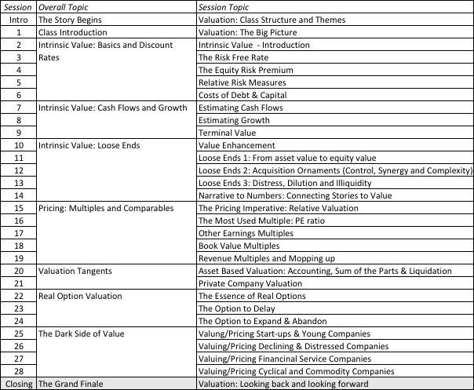
The Closing Argument

Slide 3
Back to the very beginning:
Approaches to Valuation
Discounted Cashflow Valuation, where we try (sometimes desperately) to estimate the intrinsic value of an asset by using a mix of theory, guesswork and prayer.
Relative valuation, where we pick a group of assets, attach the name “comparable” to them and tell a story.
Contingent claim valuation, where we take the valuation that we did in the DCF valuation and divvy it up between the potential thieves (equity) and the victims of this crime (lenders)

Slide 4
Acting on valuation: It is not just an academic exercise
I am not sure yet: Certainty will never come.
All believers now? Markets have to correct their mistakes for your valuations to pay off.
The law of large numbers: More likely to be right across many companies than on any individual one.

Slide 5
Picking your approach: Depends on the asset that you are “valuing”
Marketability: Assets that are marketable are more easily priced than assets that are not.
Cash flow generating capacity: Assets that do not generate cash flows (collectibles, fine art and even gold) can only be priced, not valued.
Uniqueness: Assets that are unique (and don’t have comparables) are more difficult to price tha assets that are not.

Slide 6
Depends on you
  Time horizon: Long or Short?
  Reasons for doing the valuation: For a transaction to get done, to sell to someone else at a higher price or to hold for the cash flows.
  Beliefs about markets: If markets are generally right, on average, but wrong on individual assets, you can price assets. If markets can make systemic mistakes (across entire groups of stocks), intrinsic valuation works better.

Slide 7
Story Tellers? Number Crunchers?
If you are a story teller, I hope that you have
  More confidence in your number crunching
  More discipline in your stories
  Less intimidation, when confronted with number crunchers
If you are a number cruncher, I hope that you have
  More willingness to put stories behind your numbers
  More imagination in your number crunching
  More understanding, when confronted with story telling

Slide 8
Some Not Very Profound Advice
Its all in the fundamentals.
Focus on the big picture. Don’t sweat the small stuff and don’t get distracted.
Anecdotes mean little and experience does not equal knowledge.
Keep your perspective. It is only a valuation.
In investing, luck dominates skill and knowledge.

