Slide 1
Valuation: Setting the table
Aswath Damodaran
Notes:
This is really a valuation class. It is not about instruments or markets or even about equity directly. So, be forewarned. There will be little that is discussed that has no relevance to valuation. However, pretty much everything has something to do with value.

Slide 2
Theme 1: Characterizing Valuation as a discipline
In a science, if you get the inputs right, you should get the output right. The laws of physics and mathematics are universal and there are no exceptions. Valuation is not a science.
In an art, there are elements that can be taught but there is also a magic that you either have or you do not. The essence of an art is that you are either a great artist or you are not. Valuation is not an art.
A craft is a skill that you learn by doing. The more you do it, the better you get at it. Valuation is a craft.

Slide 3
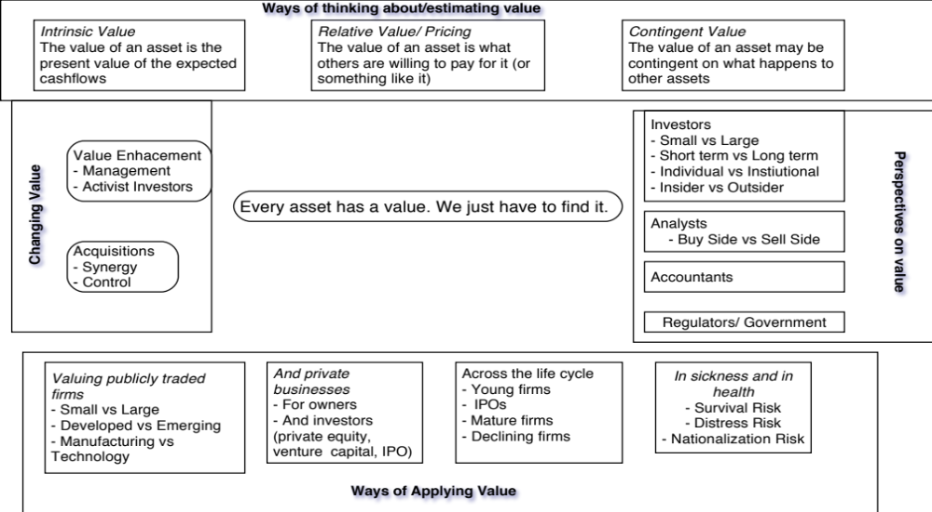
Theme 2: Valuation is simple & universal

Slide 4
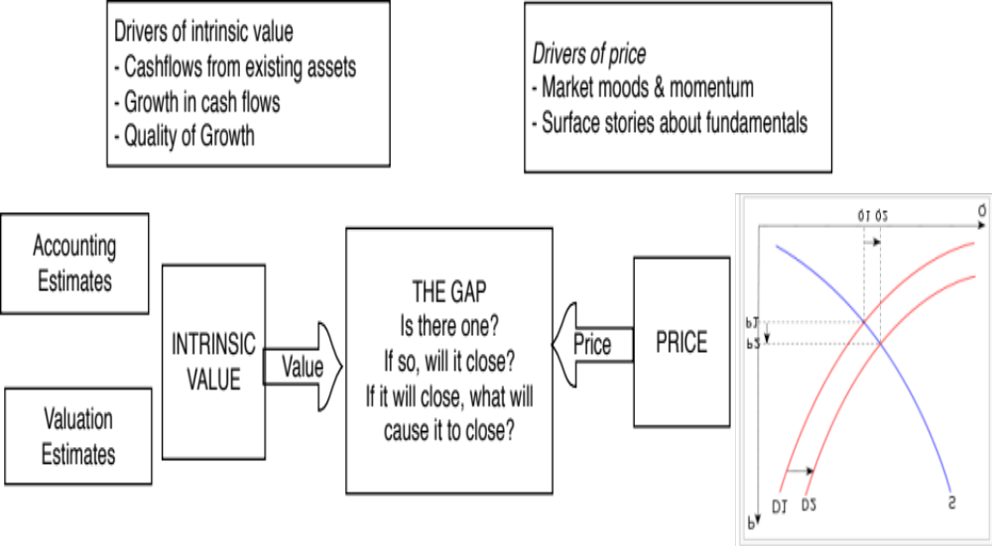
Theme 3: Valuing an asset is not the same as pricing that asset
Notes:
There are three levels at which this class will approach valuation.
At the most elevated level, it will talk about different approaches to valuation, there financial underpinnings and why they may give different answers to valuation. Rather than taking the dogmatic view that DCF valuation is the only approach that a rational person will choose, we will consider why we may prefer relative valuation in some scenarios at least.
At its second level, the class will emphasize how you are and what your task is can affect the value that you attach to an asset. The same firm can have different values to different people, depending upon the information and biases they bring to the process. Some people (managers, acquirers) may have more degrees of freedom when it comes to how a firm is managed and run.
At its most detailed level, all of the philosophical understanding of valuation in the world and deep thinking is of little use unless you can actually value a business (with number). This is where the rubber meets the road. There are many who have trouble at this stage because they are unwilling to make mistakes. Valutation is about using the information you have (not the information you wish you had) to make reasonable estimates of the future.

Slide 5
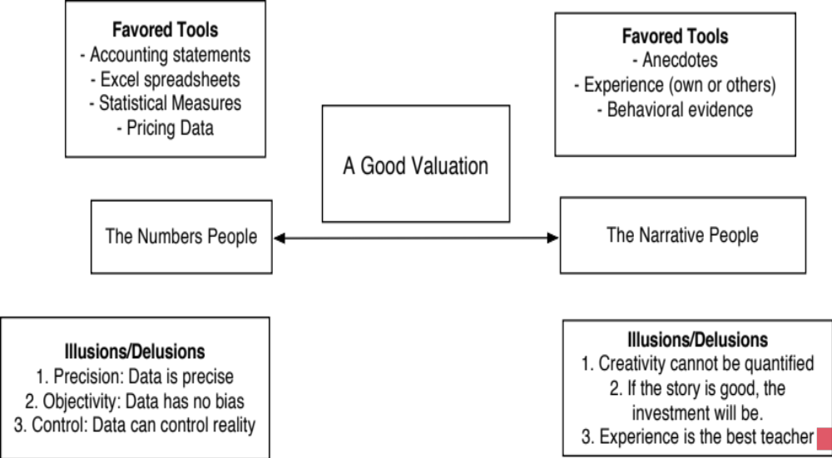
Theme 4: Good valuation = Story + Numbers

Slide 6
Theme 5: If you value something, you should be willing to act on it..
There is very little theory in valuation and I am not sure what an academic valuation would like like and am not sure that I want to find out.
Pragmatism, not purity: The end game is to estimate a value for an asset. I plan to get there, even if it means taking short cuts and making assumptions that would make purists blanch.
To act on your valuations, you have to have faith in
  In your own valuation judgments.
  In markets: that prices will move towards your value estimates.
  That faith will have to be earned.

Slide 7
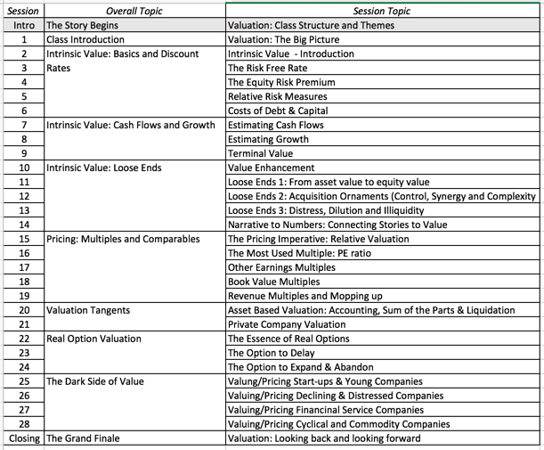
Course Outline
Notes:
A session-by-session breakdown of the class. Starts with DCF valuation, with an emphasis on estimation questions - cashflows, discount rates and growth rates - and uses these tools to analyze multiples and how value can change or be changed in a company. A little segue into option pricing applications in valuation illustrates both their usefulness in some contexts and their limitations in others.

