Slide 1
Valuation: Setting the table
Aswath Damodaran
Notes:
This is really a valuation class. It is not about instruments or markets or even about equity directly. So, be forewarned. There will be little that is discussed that has no relevance to valuation. However, pretty much everything has something to do with value.

Slide 2
Theme 1: Characterizing Valuation as a discipline
Valuation is not a science.
Valuation is not an art.
Valuation is a craft.

Slide 3
Theme 2: Valuation is simple & universal
Across approaches
  Intrinsic Value
  Relative Value or Pricing
  Contingent Value or Real Option
Across companies
  Over the life cycle (From young to declining)
  In different sectors
  Private and Public
  In different geographies
Across users
  Investors in all their forms (passive, active, activist)
  Managers
  Accountants and Regulators

Slide 4
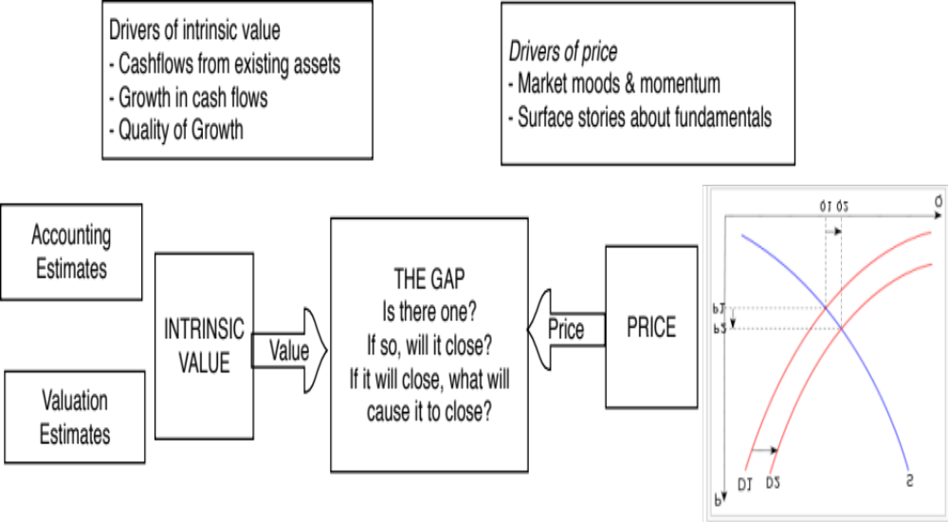
Theme 3: Valuing an asset is not the same as pricing that asset
Notes:
There are three levels at which this class will approach valuation.
At the most elevated level, it will talk about different approaches to valuation, there financial underpinnings and why they may give different answers to valuation. Rather than taking the dogmatic view that DCF valuation is the only approach that a rational person will choose, we will consider why we may prefer relative valuation in some scenarios at least.
At its second level, the class will emphasize how you are and what your task is can affect the value that you attach to an asset. The same firm can have different values to different people, depending upon the information and biases they bring to the process. Some people (managers, acquirers) may have more degrees of freedom when it comes to how a firm is managed and run.
At its most detailed level, all of the philosophical understanding of valuation in the world and deep thinking is of little use unless you can actually value a business (with number). This is where the rubber meets the road. There are many who have trouble at this stage because they are unwilling to make mistakes. Valutation is about using the information you have (not the information you wish you had) to make reasonable estimates of the future.

Slide 5
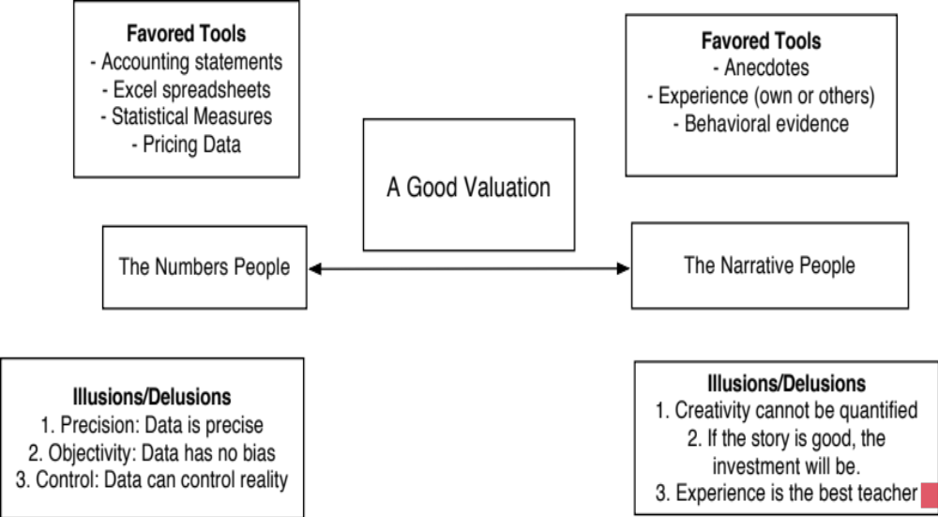
Theme 4: Good valuation = Story + Numbers

Slide 6
Theme 5: If you value something, you should be willing to act on it..
What valuation theory?
Pragmatism, not purity
To act on your valuations, you have to have faith in
  In your valuations
  In markets

Slide 7
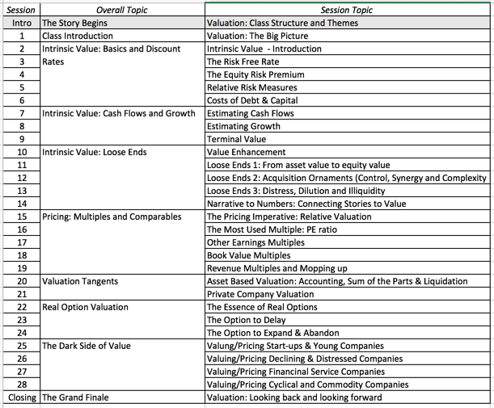
Course Outline
Notes:
A session-by-session breakdown of the class. Starts with DCF valuation, with an emphasis on estimation questions - cashflows, discount rates and growth rates - and uses these tools to analyze multiples and how value can change or be changed in a company. A little segue into option pricing applications in valuation illustrates both their usefulness in some contexts and their limitations in others.

