Slide 1
Session 10: Value Enhancement

Slide 2
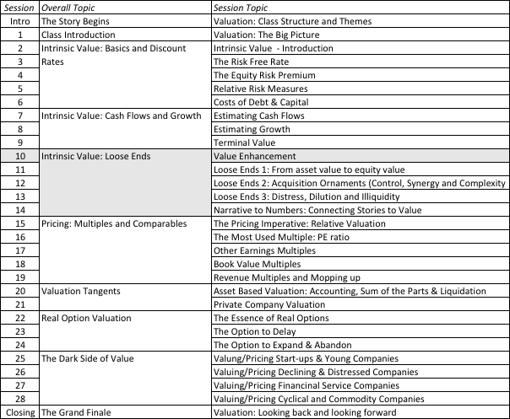
Value Enhancement

Slide 3


Price Enhancement versus Value Enhancement
The market gives…
And takes away….
Notes:
Value enhancement and price enhancement are equivalent in an efficient market. In a market that does not always reward long-term decision making and behaves irrationally,

Slide 4
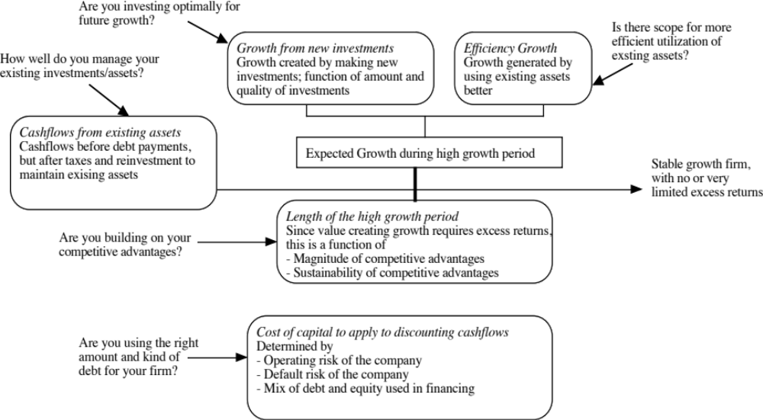
The Paths to Value Creation.. Back to the determinants of value..
Notes:
To create value, you have to change one or more of the above inputs…

Slide 5

1. Increase Cash Flows from Assets in Place
Notes:
The key is that there is a trade off between current cashflows and future growth. If you increase current cashflows at the expense of future growth, you may destroy value rather than add to it.

Slide 6
2. Increase Value from Growth
The value of growth reflects a trade off between the good side of growth (higher earnings in the future) against the bad side (what it costs in reinvestment to generate that growth). That trade off is captured most simply by comparing the return on capital made on new investments to the cost of capital.
To increase value from growth, you have to start with a simple diagnostic. Is growth at your firm currently creating or destroying value?
  If it is creating value, you should explore ways to grow faster, either with more investment (higher reinvestment) or better quality investments (higher return on capital).
  If it is destroying value, your task is to reduce reinvestment or at least that part of reinvestment that is creating value-destroying growth. You will grow at a lower rate but you will be worth more.

Slide 7
2.1. The Value of Growth

Slide 8

2.2. Growth… Evaluating the Alternatives..

Slide 9

3. Building Competitive Advantages: Increase length of the growth period

Slide 10
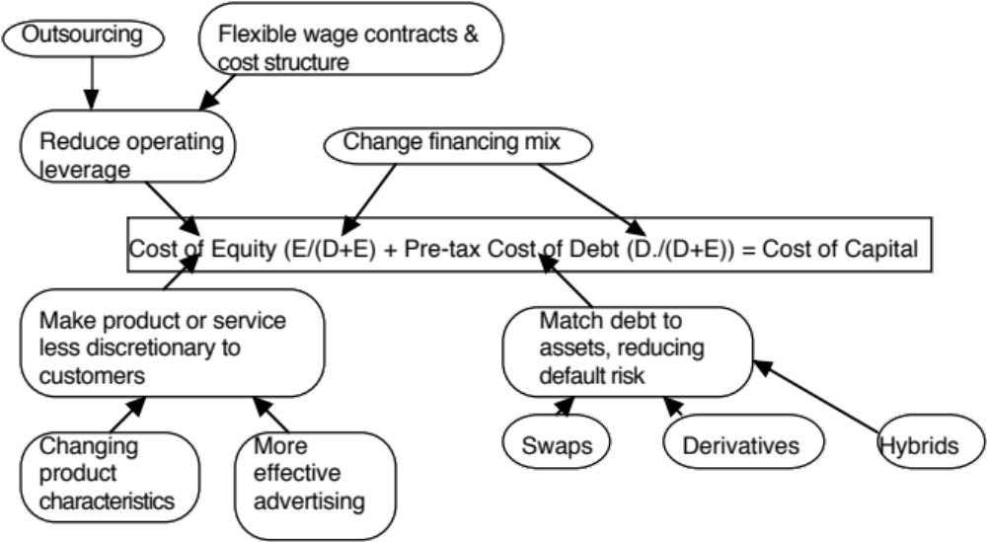
4. Reduce Cost of Capital
Notes:
Reducing the cost of capital, holding cashflows constant, increases firm value.

Slide 11
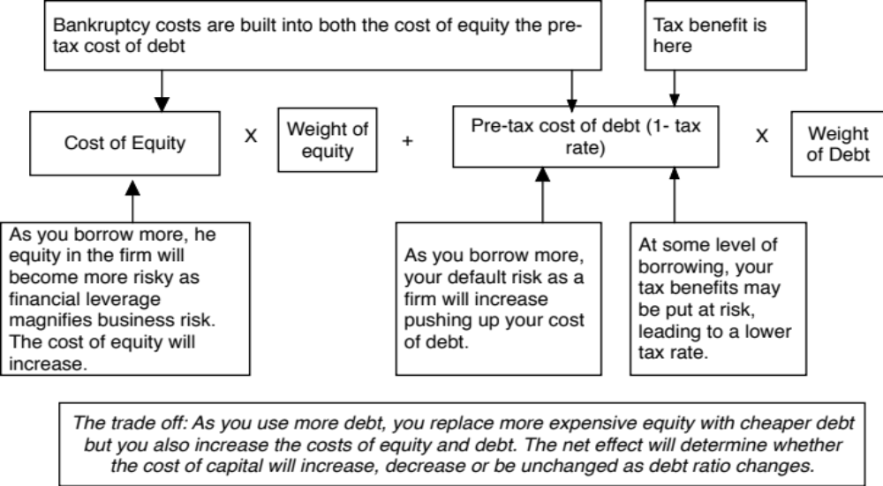
Finding an optimal debt ratio: The Cost of Capital Approach
Notes:
The basic inputs for computing cost of capital are cost of equity and cost of debt. This summarizes the basic approach we will use to estimate each.

Slide 12
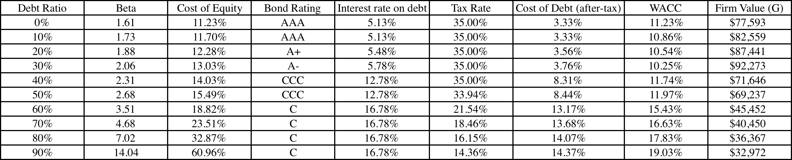
Amgen’s Optimal Financing Mix
Amgen’s current debt ratio = 10%
Amgen’s optimal debt ratio = 30%

