Slide 1
Session 11: From ASSET to equity value

Slide 2
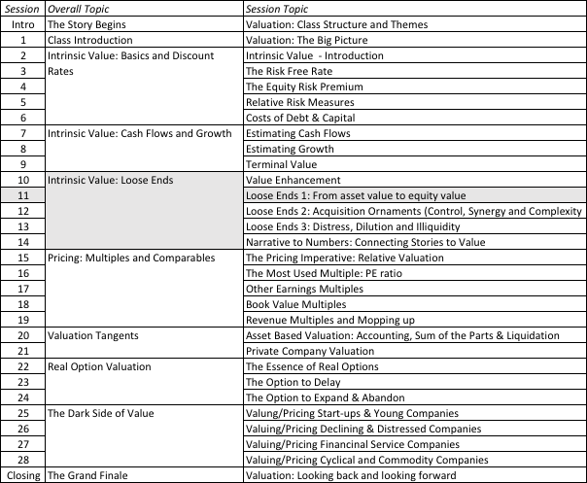
From Asset to Equity Value

Slide 3
1. The Value of Cash
An Exercise in Cash Valuation
Company A Company B Company C
Enterprise Value $ 1 billion $ 1 billion $ 1 billion
Cash $ 100 mil $ 100 mil $ 100 mil
Return on Capital 10% 5% 22%
Cost of Capital 10% 10% 12%
Trades in US US Argentina
In which of these companies is cash most likely to trade at face value, at a discount and at a premium?

Slide 4
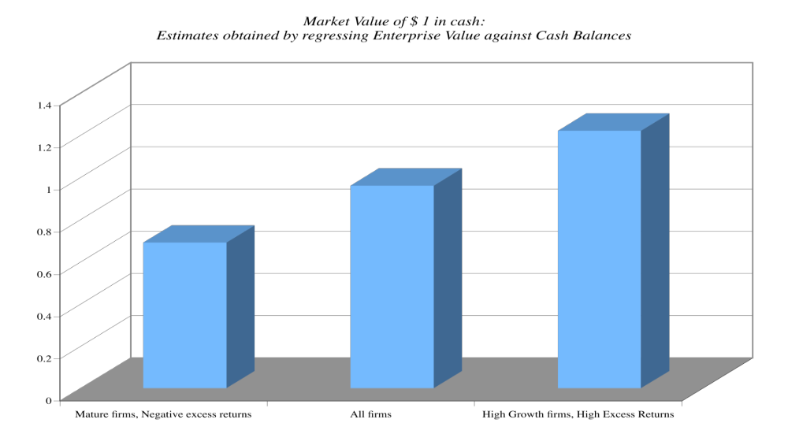
Cash: Discount or Premium?

Slide 5
2. Dealing with Holdings in Other firms
Holdings in other firms can be categorized into
  Minority passive holdings, in which case only the dividend from the holdings is shown in the balance sheet
  Minority active holdings, in which case the share of equity income is shown in the income statements
  Majority active holdings, in which case the financial statements are consolidated.
Notes:
How you deal with cross holdings depends upon which scenario you face.

Slide 6
How to value holdings in other firms.. In a perfect world..
In a perfect world, we would strip the parent company from its subsidiaries and value each one separately. The value of the combined firm will be
  Value of parent company + Proportion of value of each subsidiary
To do this right, you will need to be provided detailed information on each subsidiary to estimated cash flows and discount rates.
Notes:
If a holding is not consolidated, you have to work to bring the holding into your valuation explicitly since the income from the holding will not be shown as part of operating income. If you are doing equity valuation, you have to be careful to strip out the portion of the net income that is attributable to the holdings - dividends, for instance.
If a holding is consolidated, you are valuing a combined firm - the parent and the subsidiary. You have to ensure that you subtract out the portion of the subsidiary that does not belong to you.

Slide 7
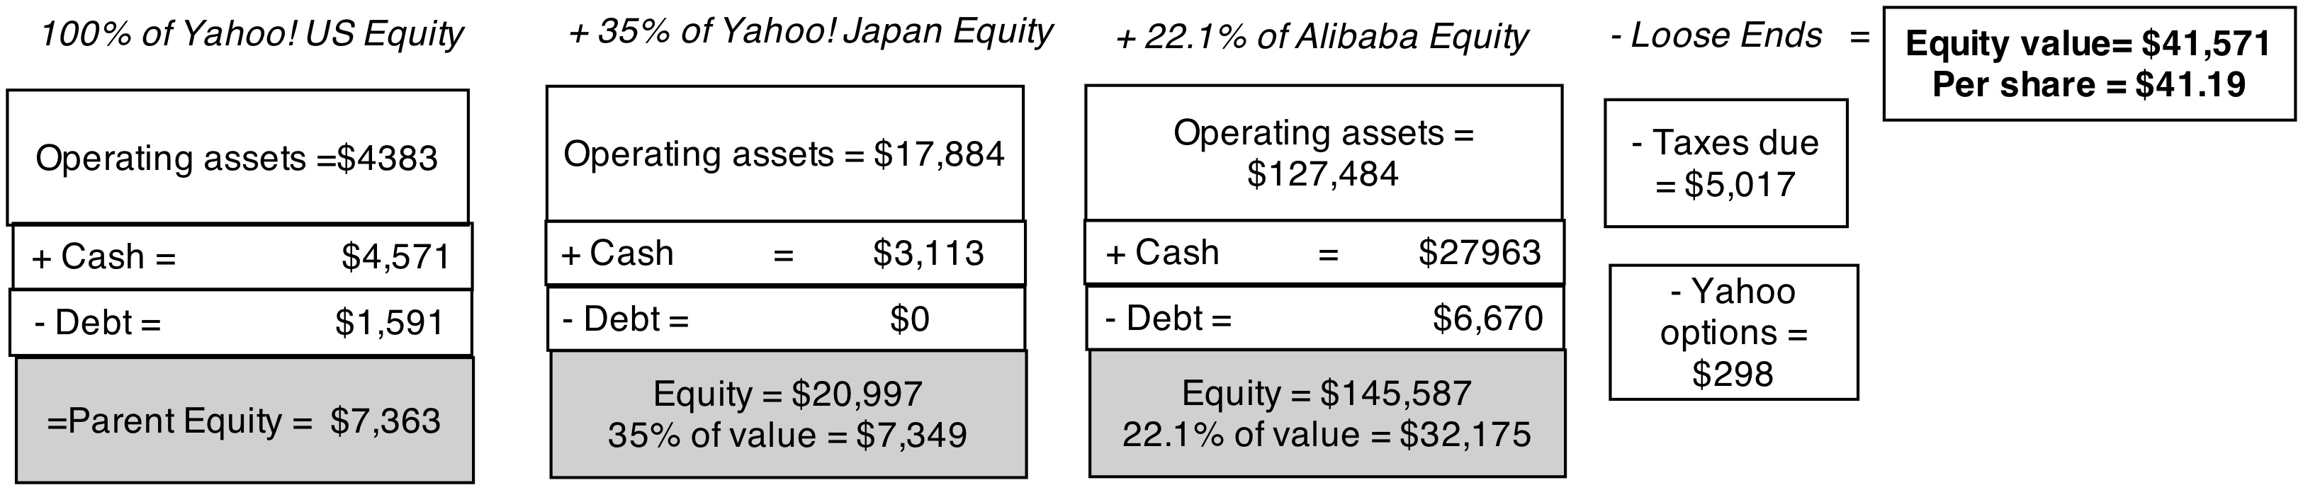
Yahoo! An intrinsic valuation of cross holdings
In May 2014, Yahoo’s core business in the US was struggling (with stagnant revenues & declining margins) but it had valuable minority holdings in Yahoo! Japan (35%) and Alibaba (22%).
Yahoo! was trading at $33.76 in May 2014, just a few weeks prior to the IPO of Alibaba. The intrinsic valuations of Yahoo! Japan and Alibaba are based on their full financial statements.

Slide 8
With insufficient information, two compromise solutions…
The market value solution: When the subsidiaries are publicly traded, you could use their traded market capitalizations.
The relative value solution: You can convert the book values of holdings that you have on the balance sheet by using the average price to book value ratio of the sector in which the subsidiaries operate.

Slide 9
3. Other Assets that have not been counted yet..
Unutilized assets: You can assess a market value for unutilized and uncounted assets and add them on to the value of the firm.
No double counting: If you count the income from an asset in your cashflows, you cannot count the market value of the asset in your value.

Slide 10

An Uncounted Asset?
Price tag: $200 million

Slide 11
4. Be circumspect about defining debt for cost of capital purposes…
General Rule: Debt generally has the following characteristics:
  Commitment to make fixed payments in the future
  The fixed payments are tax deductible
  Failure to make the payments can lead to either default or loss of control of the firm to the party to whom payments are due.
Definitely Debt
  All interest bearing liabilities, short term as well as long term
  All leases, operating as well as capital
Definitely not debt
  Accounts payable or supplier credit
May be debt, but only if legal obligations follow
  Unfunded pensions or health care obligations

Slide 12
But you should consider other potential liabilities when getting to equity value
If you have under funded pension fund or health care plans, you should consider the under funding at this stage in getting to the value of equity.
  If you do so, you should not double count by also including a cash flow line item reflecting cash you would need to set aside to meet the unfunded obligation.
  You should not be counting these items as debt in your cost of capital calculations….
If you have contingent liabilities - for example, a potential liability from a lawsuit that has not been decided - you should consider the expected value of these contingent liabilities
  Value of contingent liability = Probability that the liability will occur * Expected value of liability

