Slide 1
Session 12: Acquisition Ornaments (Control, Synergy and Complexity)

Slide 2
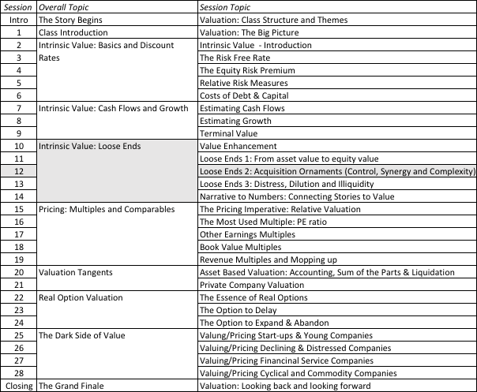
Acquisitions as a Value Changer

Slide 3
1. The Value of Control
The value of the control premium that will be paid to acquire a block of equity will depend upon two factors -
  Probability that control of firm will change: This refers to the probability that incumbent management will be replaced. this can be either through acquisition or through existing stockholders exercising their muscle.
  Value of Gaining Control of the Company: The value of gaining control of a company arises from two sources - the increase in value that can be wrought by changes in the way the company is managed and run, and the side benefits and perquisites of being in control
  Value of Gaining Control = Present Value (Value of Company with change in control - Value of company without change in control) + Side Benefits of Control

Slide 4
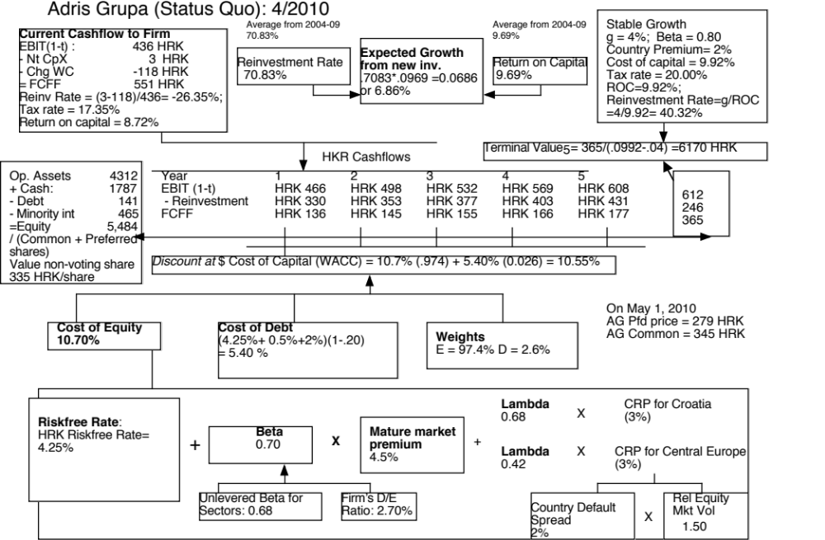

Slide 5
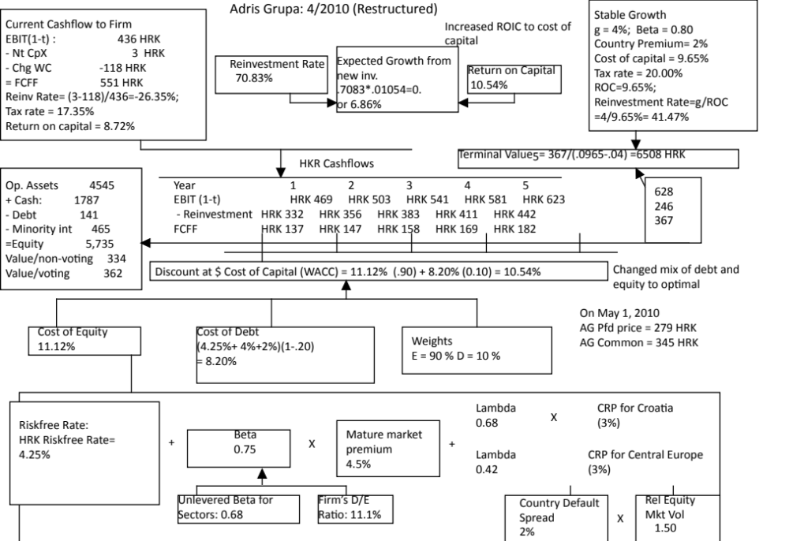

Slide 6

2. The Value of Synergy

Slide 7
Valuing Synergy
(1) the firms involved in the merger are valued independently, by discounting expected cash flows to each firm at the weighted average cost of capital for that firm.
(2) the value of the combined firm, with no synergy, is obtained by adding the values obtained for each firm in the first step.
(3) The effects of synergy are built into expected growth rates and cashflows, and the combined firm is re-valued with synergy.
Value of Synergy = Value of the combined firm, with synergy - Value of the combined firm, without synergy
Notes:
You have to do three valuations to value synergy and you have to quantify the impact of synergy into valuation inputs.

Slide 8
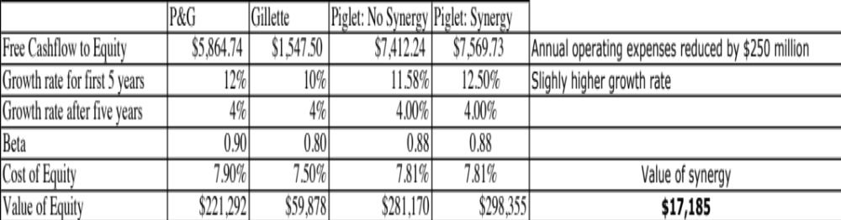
Synergy – Example
Higher growth and cost savings

Slide 9
3. A Discount for Complexity:
An Experiment
Company A Company B
Operating Income $ 1 billion $ 1 billion
Tax rate 40% 40%
ROIC 10% 10%
Expected Growth 5% 5%
Cost of capital 8% 8%
Business Mix Single Multiple Businesses
Holdings Simple Complex
Accounting Transparent Opaque
Which firm would you value more highly?

Slide 10
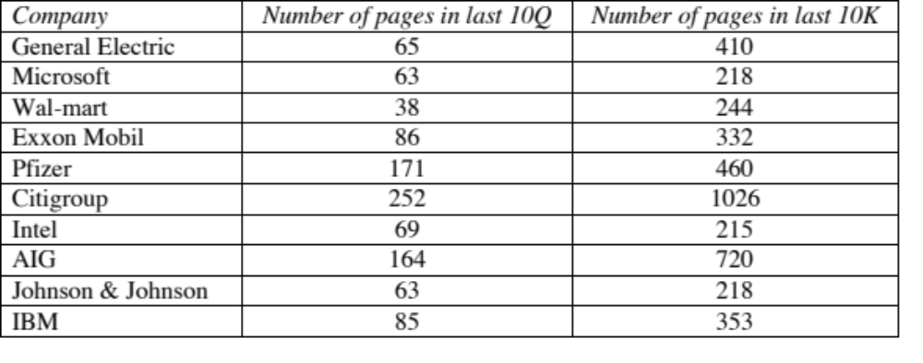
Measuring Complexity: Volume of Data in Financial Statements

Slide 11
Measuring Complexity: A Complexity Score
Item | Factors | Follow-up Question | Answer | Weighting factor | Gerdau Score | GE Score
Operating Income | 1. Multiple Businesses | Number of businesses (with more than 10% of revenues) = | 1 | 2.00 | 2 | 30
 | 2. One-time income and expenses | Percent of operating income = | 10% | 10.00 | 1 | 0.8
 | 3. Income from unspecified sources | Percent of operating income = | 0% | 10.00 | 0 | 1.2
 | 4. Items in income statement that are volatile | Percent of operating income = | 15% | 5.00 | 0.75 | 1
Tax Rate | 1. Income from multiple locales | Percent of revenues from non-domestic locales = | 70% | 3.00 | 2.1 | 1.8
 | 2. Different tax and reporting books | Yes or No | No | Yes=3 | 0 | 3
 | 3. Headquarters in tax havens | Yes or No | No | Yes=3 | 0 | 0
 | 4. Volatile effective tax rate | Yes or No | Yes | Yes=2 | 2 | 0
Capital Expenditures | 1. Volatile capital expenditures | Yes or No | Yes | Yes=2 | 2 | 2
 | 2. Frequent and large acquisitions | Yes or No | Yes | Yes=4 | 4 | 4
 | 3. Stock payment for acquisitions and investments | Yes or No | No | Yes=4 | 0 | 4
Working capital | 1. Unspecified current assets and current liabilities | Yes or No | No | Yes=3 | 0 | 0
 | 2. Volatile working capital items | Yes or No | Yes | Yes=2 | 2 | 2
Expected Growth rate | 1. Off-balance sheet assets and liabilities (operating leases and R&D) | Yes or No | No | Yes=3 | 0 | 3
 | 2. Substantial stock buybacks | Yes or No | No | Yes=3 | 0 | 3
 | 3. Changing return on capital over time | Is your return on capital volatile? | Yes | Yes=5 | 5 | 5
 | 4. Unsustainably high return | Is your firm's ROC much higher than industry average? | No | Yes=5 | 0 | 0
Cost of capital | 1. Multiple businesses | Number of businesses (more than 10% of revenues) = | 1 | 1.00 | 1 | 20
 | 2. Operations in emerging markets | Percent of revenues= | 50% | 5.00 | 2.5 | 2.5
 | 3. Is the debt market traded? | Yes or No | No | No=2 | 2 | 0
 | 4. Does the company have a rating? | Yes or No | Yes | No=2 | 0 | 0
 | 5. Does the company have off-balance sheet debt? | Yes or No | No | Yes=5 | 0 | 5
No-operating assets | Minority holdings as percent of book assets | Minority holdings as percent of book assets | 0% | 20.00 | 0 | 0.8
Firm to Equity value | Consolidation of subsidiaries | Minority interest as percent of book value of equity | 63% | 20.00 | 12.6 | 1.2
Per share value | Shares with different voting rights | Does the firm have shares with different voting rights? | Yes | Yes = 10 | 10 | 0
 | Equity options outstanding | Options outstanding as percent of shares | 0% | 10.00 | 0 | 0.25
 |  | Complexity Score = |  |  | 48.95 | 90.55

Slide 12
Dealing with Complexity
In Discounted Cashflow Valuation
  The Aggressive Analyst: Trust the firm to tell the truth and value the firm based upon the firm’s statements about their value.
  The Conservative Analyst: Don’t value what you cannot see.
  The Compromise: Adjust the value for complexity
    Adjust cash flows for complexity
    Adjust the discount rate for complexity
    Adjust the expected growth rate/ length of growth period
    Value the firm and then discount value for complexity
In relative valuation
  In a relative valuation, you may be able to assess the price that the market is charging for complexity:
  With the hundred largest market cap firms, for instance:
  PBV = 0.65 + 15.31 ROE – 0.55 Beta + 3.04 Expected growth rate – 0.003 # Pages in 10K

