Slide 1
Session 13: dilution and liquidity

Slide 2
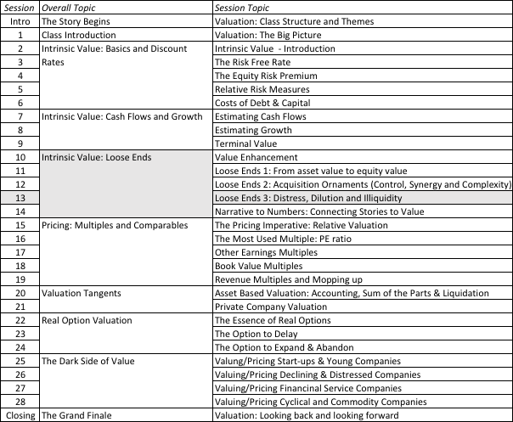
Distress, Dilution and Illiquidity

Slide 3
1. Equity to Employees: Effect on Value
Employee options and restricted stock are now part of compensation packages.
Two key issues with employee options:
  Past option/stock grants
  Expected grants in the future
Notes:
Any options issued by the firm to its employees or investors qualifies. Options issued by third parties (the CBOE) have no effect on value.

Slide 4
The Easier Problem: Restricted Stock Grants
For past grants: Count the restricted stock that have already been granted in shares outstanding today. That will reduce your value per share.
For future grants: Estimate the value of these grants as a percent of revenue and forecast that as expense as part of compensation expenses. That will reduce future income and cash flows.

Slide 5
The tougher problem: Employee Options
Options can increase the number of shares outstanding but dilution per se is not the problem.
Options affect equity value at exercise because
  Shares are issued at below the prevailing market price.
  Alternatively, the company can use cashflows that would have been available to equity investors to buy back shares which are then used to meet option exercise.
Options affect equity value before exercise because we have to build in the expectation that there is a probability and a cost to exercise.
Notes:
It is not the dilution per se that causes the loss of value but the dilution at below market prices. When shares are issued at below market prices, the remaining equity investors in the firm will lose some value.
The arguments that options do not affect value per share are absurd:
Options are not cash expenses (If we use this rationale, companies can use stock or options to pay for everything and claim revenues as earnings)
We do not know whether the options will be exercised and become shares. (That is true but we also do not know whether there will be revenues or earnings next year, whether the managers will commit felonies and whether the universe will still be standing. That does not stop us from forecasting out expected revenues and earnings next year)
Options cannot be really valued. The option pricing models are only model. (True, but I would wager that option pricing models do a better job valuing options than accountants do in estimating earnings for the most recent financial year)
If options are treated as expenses, firms will have to stop issuing them. (Good… Boards will finally recognize how much they are giving away…and for some firms, it will still make sense to issue options)

Slide 6
A simple example…
XYZ company has $ 100 million in free cashflows to the firm, growing 3% a year in perpetuity and a cost of capital of 8%. It has 100 million shares outstanding and $ 1 billion in debt. Its value can be written as follows:
  Value of firm = 100 / (.08-.03) = 2000
  Debt = 1000
  = Equity = 1000
  Value per share = 1000/100 = $10
XYZ decides to give 10 million options at the money (with a strike price of $10) to its CEO. What effect will this have on the value of equity per share?
Notes:
A conventional valuation…

Slide 7
1. Dealing with Employee Options: The Bludgeon Approach
  Value of firm = 100 / (.08-.03) = 2000
  Debt = 1000
  = Equity = 1000
  Number of diluted shares = 110
  Value per share = 1000/110 = $9.09
The diluted approach fails to consider that exercising options will bring in cash into the firm. Consequently, it will overestimate the impact of options and understate the value of equity per share.
Notes:
Simplest approach to use but also the least accurate. Changing the number of shares outstanding is unlikely to yield a good approximation.

Slide 8
2. The Treasury Stock Approach
The treasury stock approach adds the proceeds from the exercise of options to the value of the equity before dividing by the diluted number of shares outstanding.
In the example cited, this would imply the following:
  Value of firm = 100 / (.08-.03) = 2000
  Debt = 1000
  = Equity = 1000
  Number of diluted shares = 110
  Proceeds from option exercise = 10 * 10 = 100
  Value per share = (1000+ 100)/110 = $ 10
Fails to consider the time premium on the options. & will overstate the value per share.
Notes:
Considers the options at exercise value in the valuation. Ignores the time premium on the options.

Slide 9
3. The Option Value Approach
The following are the inputs for the option pricing:
  Stock Price = $ 10, Adjusted for dilution =- $9.58
  Strike Price = $ 10; Maturity = 10 years; Standard deviation in stock price = 40%
  Riskless Rate = 4%
Using a dilution-adjusted Black Scholes model, we arrive at the following inputs:
  Value per call = $ 9.58 (0.8199) - $10 exp ^{-(0.04) (10)(}0.3624) = $5.42
Using the value per call of $5.42, we can now estimate the value of equity per share after the option grant:
  Equity = 1000
  Value of options granted = $ 54.2
  = Value of Equity in stock = $945.8
  / Number of shares outstanding / 100
  = Value per share = $ 9.46
Notes:
Note that the options have zero exercise value but are still worth a lot. In fact, you can think of the option value as a probability adjusted value of the options being exercised in the future.

Slide 10
Option grants in the future…
Expected future option grants will also affect value.
The simplest mechanism for bringing in future option grants into the analysis is to do the following:
  Value of options each year as a percent of revenues.
  Treat this like any other operating erxpense
  Reduce the operating margin and cashflow each year.
Notes:
Firms continue to use options as part of compensation packages. Hence, we have to build into the cashflow forecasts our estimates of the costs associated with expected future option issues.

Slide 11
2. Illiquidity: A Discount?
Less liquid assets should be priced/valued lower than otherwise similar (in terms of cash flows, growth and risk) liquid assets.
That said, though, the discount that will be applied for illiquidity will vary across
  Time
  Investors
  Companies/Assets

Slide 12
Incorporating Illiquidity into Valuation: The Standard Approaches
Adjust the discount rate: :
  By estimating the portion of the illiquidity that is systematic and estimating a risk premium for that illiquidity
  By looking at the premiums earned by less liquid asset classes over more liquid assets in the past.
Discount the value: Value the illiquid asset/business with an unadjusted discounted rate and then discount the value for illiquidity.

Slide 13
The “alternative” approaches
Bid-ask spreads: All traded assets are illiquid. The bid ask spread, measuring the difference between the price at which you can buy and sell the asset at the same point in time is the illiquidity measure.
    Spread = 0.145 – 0.0022 ln (Annual Revenues) -0.015 (DERN) – 0.016 (Cash/Firm Value) – 0.11 ($ Monthly trading volume/ Firm Value)
Option pricing: Liquidity can be viewed as a put option, where you get the right to sell at the prevailing market price. Illiquidity can therefore be viewed as the loss of this put option.

